Slide 1
How to send a customized letter to all users that have an item on loan
Yoel Kortick
Senior Librarian

Slide 2
Introduction
Step 1 Define the specific user notification
Step 2 Define messages for letter
Step 3 Edit the xsl of the letter
Step 4 Define a set of users to receive letter
Step 5 Run the job "Update/Notify Users"

Slide 3
Introduction

Slide 4
Introduction
In the example here we will send a letter to all users that have an item on loan.
We will send a letter which states that due to extenuating circumstances the library has been closed until further notice and that all loan due dates have been indefinitely extended.

Slide 5
Introduction
We will send the users the specific letter using the job “Update/Notify Users for user set”.
We will assume that you already know how to create a set of users that have loans, and if this is not the case please see separate presentation How to create a set of all users that have an item on loan .

Slide 6
Step 1 Define the specific user notification

Slide 7
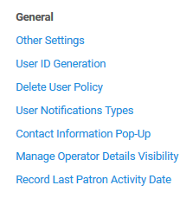
Step 1 Define the specific user notification
Define the specific user notification at "Administration > User Management Configuration > Configuration Menu > General > User Notification Types.
The notification will later appear in the job "Update/Notify Users"

Slide 8
Step 1 Define the specific user notification
We have created a notification with code LIBRARY_CLOSED and text “The library has been closed until further notice and all loan due dates have been indefinitely extended.”

Slide 9
Step 2 Define messages for letter

Slide 10
Step 2 Define messages for letter
In Alma Navigate to "General Configuration > Letters > Letters Configuration > User Notifications Letter > edit" (and then switch to "labels" tab)

Slide 11
Step 2 Define messages for letter
This is the "Labels" tab.
Line_1 = The library has been closed until further notice.
Line_2 = All loan due dates have been indefinitely extended.
Line_3 = Thank you for your understanding.
Subject = Library notice

Slide 12
Step 3 Edit the xsl of the letter

Slide 13
Step 3 Edit the xsl of the letter
Edit the xsl of the letter so that it will print the lines from the User Notifications Letter edited in step 2
You must add the user notification type code added in step 1 to the xsl the letter (instead of the condition already there, or add a new condition).
You must also comment out the default password appearance in the xsl of the letter. The password is by default in the letter in case it will be used to notify patrons of their password.
By default only line 1 and 2 will appear in the letter. If you also want line 3 or more you must add it.
For information about editing the xsl of a letter see Letter Configuration in Alma.

Slide 14
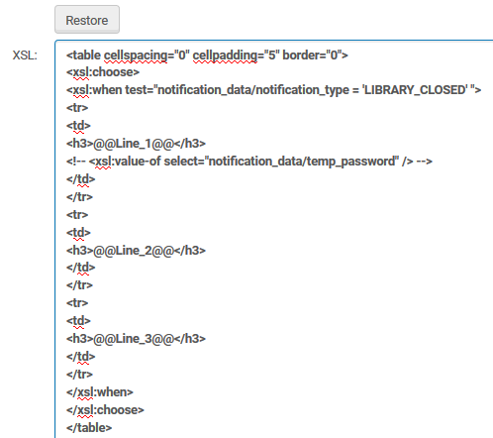
Step 3 Edit the xsl of the letter
Template tab
The notification type code defined in step 1
Add whatever additional lines you want
Comment out the appearance of the password

Slide 15
Step 3 Edit the xsl of the letter
The user notification type code added in step 1 as it appears in the xsl of the letter.

Slide 16
Step 4 Define a set of users to receive letter

Slide 17
Step 4 Define a set of users to receive letter
Please see separate presentation How to create a set of all users that have an item on loan .

Slide 18
Step 5 Run the job "Update/Notify Users"

Slide 19
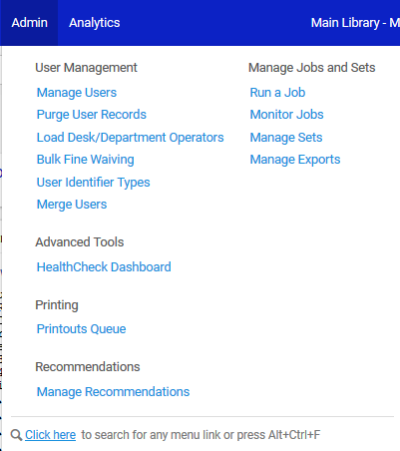
Step 5 Run the job "Update/Notify Users"
Access “Run a job”

Slide 20
Step 5 Run the job "Update/Notify Users"
Filter by type “Users” and choose “Update/Notify Users for user set”

Slide 21
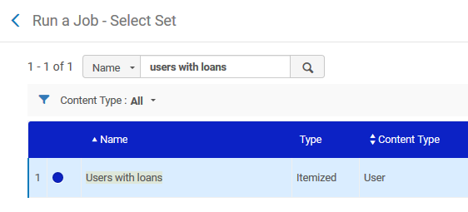
Step 5 Run the job "Update/Notify Users"
Select the set

Slide 22
Step 5 Run the job "Update/Notify Users"
Check the box "Send notification to user" and Choose the message which we defined in step 1

Slide 23
Step 5 Run the job "Update/Notify Users"
Wait for job to complete

Slide 24
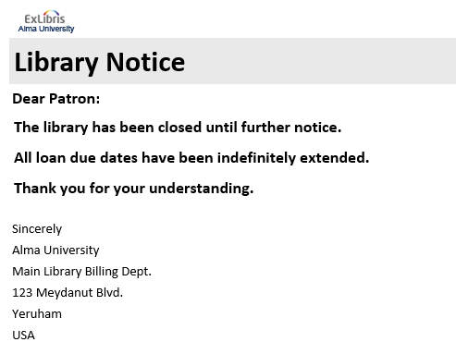
Step 5 Run the job "Update/Notify Users"
See that letter is sent to the users

Slide 25
Thank you!
xxx@exlibrisgroup.com

