Slide 1
Holdings record management on the library level
Yoel Kortick – Senior Librarian

Slide 2
Introduction
The relevant roles
Our sample staff user and roles
Two existing sample holdings records
Trying to edit existing holdings records
Trying to create new holdings records
A cataloger who can only edit bibliographic and authority records

Slide 3
Introduction

Slide 4
Introduction
The development described here allows the institution to control which users can edit holdings records of which libraries.
For example, the institution may define that users A and B can only edit holdings records for the Law and Humanities Libraries, while users C and D only edit holdings records for the Medicine Library. Users E and F, however, can edit holdings records for any library.
In these cases the library is that entity specified in the 852 subfield b of the holding record.

Slide 5
Introduction
Additionally, it is possible to have a user who can create and edit bibliographic and authority records but cannot create or edit holdings records.
Thus, in this sense, there is a separation of holdings editing from bibliographic and authority editing

Slide 6
The relevant roles

Slide 7
The relevant roles
The privilege PHYSICAL_INVENTORY_MANAGE is part of the following roles :
Physical Inventory Operator
Repository Manager
Physical Inventory Operator – Limited
Purchasing Operator
Purchasing Manager

Slide 8
The relevant roles
This can be seen from “Configuration > User Management > Roles and Registration > Privileges Report > Filter by Privilege”:

Slide 9
Our sample staff user and roles

Slide 10
Our sample staff user and roles
Here we have given staff user Alicia Chen the role “Physical Inventory Operator” only for the “Engineering Library”
The code for the Engineering Library is UELEC

Slide 11
Our sample staff user and roles
Here we have given staff user Alicia Chen the role “Repository Manager” only for the “Engineering Library”

Slide 12
Our sample staff user and roles
Here we have given staff user Alicia Chen the role “Purchasing Operator” only for the “Engineering Library”

Slide 13
Our sample staff user and roles
Here we have given staff user Alicia Chen the role “Purchasing Manager” only for the “Engineering Library”

Slide 14
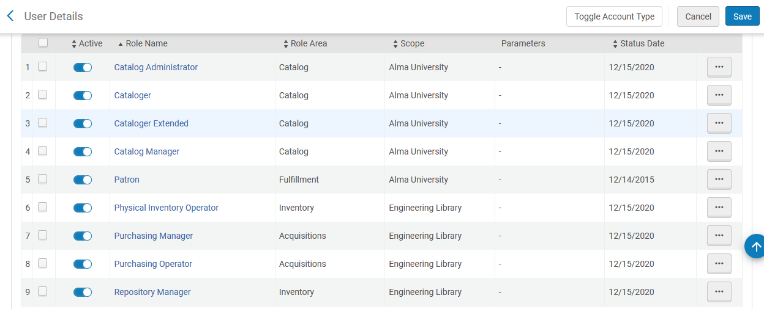
Our sample staff user and roles
Here are all of Alicia’s roles.

Slide 15
Two existing sample holdings records

Slide 16
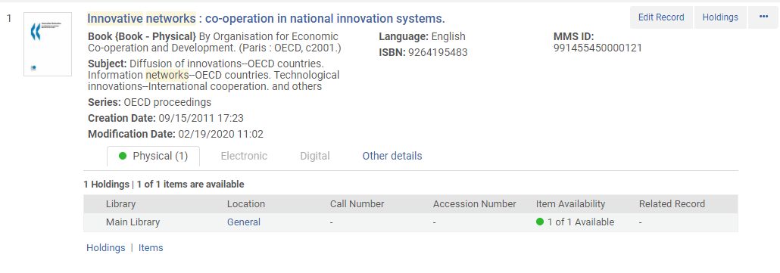
Two existing sample holdings records
Title “Innovative networks : co-operation in national innovation systems” has one holdings record in the Main Library.

Slide 17
Two existing sample holdings records
Title “Directory of Taiwan scholars” has one holdings record in the Engineering Library.

Slide 18
Trying to edit existing holdings records

Slide 19
Trying to edit existing holdings records
Alicia logs in and accesses the holdings record for the Main Library

Slide 20
Trying to edit existing holdings records
Alicia has no option to edit the holdings record in the Main Library (this is because her scope is for a different library)

Slide 21
Trying to edit existing holdings records
If Alicia tries to do “push to Metadata editor” from the link on top she will get this message:

Slide 22
Trying to edit existing holdings records
Alicia logs in and accesses the holdings record for the Engineering Library

Slide 23
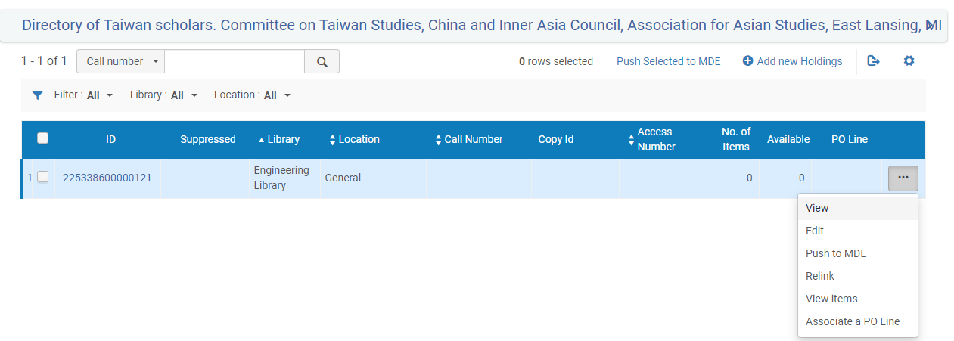
Trying to edit existing holdings records
Alicia Chen can edit and push to Metadata Editor for the holdings record in the Engineering Library (because this is the library of her scope)
When Alicia viewed the actions for the holdings record in the Main library she did not have “Edit”, “Push to MDE”, or “Relink”

Slide 24
Trying to create new holdings records

Slide 25
Trying to create new holdings records
Now Alicia will add a new holdings record

Slide 26
Trying to create new holdings records
Note (for the purposes of our test here) that the code for the Engineering Library is UELEC

Slide 27
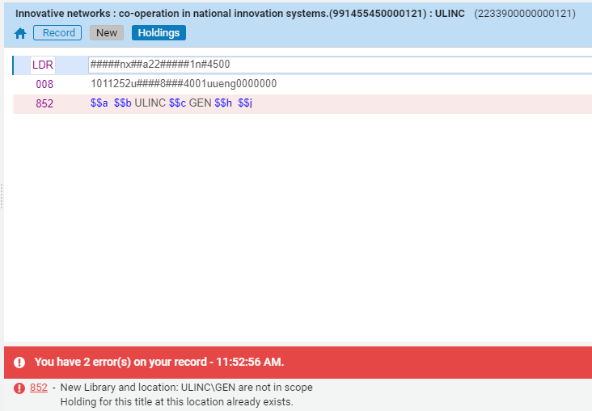
Trying to create new holdings records
If Alicia tries to enter a code for a library which is not the Engineering Library (not UELUC) then she will not be allowed to save.

Slide 28
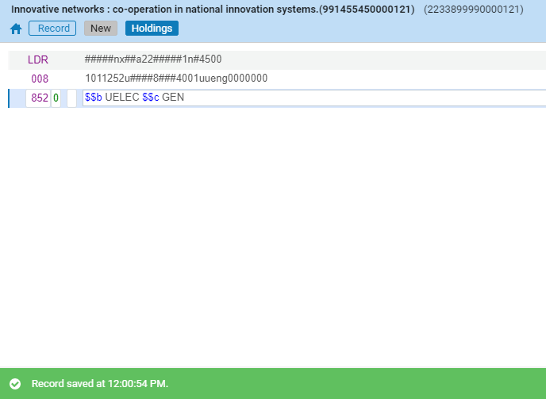
Trying to create new holdings records
If Alicia tries to enter a code for a library which is the Engineering Library (UELEC) then she will be allowed to save.

Slide 29
A cataloger who can only edit bibliographic and authority records

Slide 30
A cataloger who can only edit bibliographic and authority records
We will now look at staff user Elia. She has roles has only roles 'Catalog Administrator', 'Cataloger', 'Cataloger Extended' and 'Catalog Manager’.
Unlike Alicia, she does not have the ‘Physical Inventory Operator’ role.
As a result, Elia can edit bibliographic and authority records but she cannot edit holdings records.

Slide 31
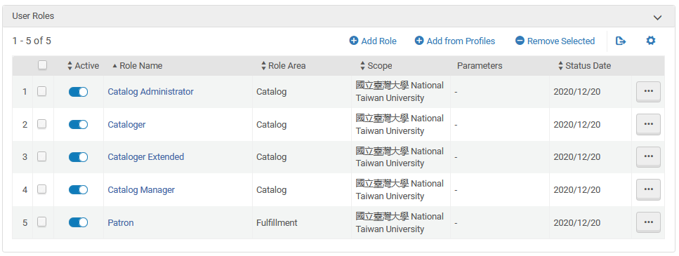
A cataloger who can only edit bibliographic and authority records
Elia’s roles.

Slide 32
A cataloger who can only edit bibliographic and authority records
From the repository search she has no way to edit a holdings record.
From the metadata editor she can do ‘view inventory’ and then the only permission for the holdings record will be ‘view’.
There will be no option to edit the holdings record.

Slide 33
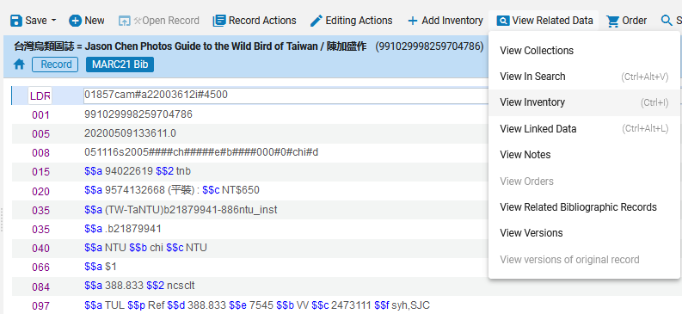
A cataloger who can only edit bibliographic and authority records
From the metadata editor Elia does ‘view inventory’

Slide 34
A cataloger who can only edit bibliographic and authority records
Now Elia can only ‘view’ inventory. ‘Edit’ is disabled.

Slide 35
A cataloger who can only edit bibliographic and authority records
If Elia also gets role ‘Physical Inventory Operator’ then she could also edit the holdings records

Slide 36
xxx@exlibrisgroup.com

