Slide 1
Centrally managing configurations and entities in a network zone consortia
Yoel Kortick
Senior Librarian

Slide 2
Agenda
Introduction
Distribute network acquisitions changes to members
Distribute network fulfillment changes to members
Distribute network zone configuration table changes to member institutions
Distribute network letter templates changes to members
Distribute central resource sharing configuration
Distribute network resource management changes to members
Distribute network user management configuration changes
Distribute network administration changes to members
Centrally Managing Configuration Tables at the Row Level
Centrally Managing Configuration Tables at the Table Level

Slide 3
Introduction

Slide 4
Demo Environment Network Zone Consortia
Manage configurations and entities here
Network Zone institution
Use configurations and entities here
Member institution
‘Alma University’
Member institution
‘Open University’
Member institution
‘University of Knowledge’

Slide 5
Introduction
In addition to this presentation, it is recommended to also see Centrally Managing Configurations in a Network Zone.

Slide 6
Introduction
It is possible to manage configurations in the Network Zone and distribute the configurations to member institutions.
This is especially useful for cases where a specific configuration is identical for all or even most of the member institutions.
In these cases it is more efficient to distribute those configurations from the network to the members than to have staff of each member institution deal with his or her own configurations.

Slide 7
Introduction
There are two cases in which configuration is distributed:
Entire tables that are configured in the network zone can be distributed to the members.
See Centrally Managing Configuration Tables at the Table Level
Specific rows within a table can be configured in the network zone can be distributed to the members.
See Centrally Managing Configuration Tables at the Row Level

Slide 8
Introduction
In other cases entities (in addition to the configuration tables) are distributed.
This includes, for example:
Vendors
Fulfillment units
Terms of Use
Letter templates
Resource sharing partners
Resource sharing Rota templates
Resource sharing Rota assignment rules
Resource sharing Locate profiles
Resource sharing Workflow profiles
Resource sharing Sending borrowing request rules
Description Templates
Representation Label Template Rules
Role profiles
Role assignment rules
Integration profiles

Slide 9
Introduction
As part of the workflow, staff working in the network zone distribute configurations to member institutions.
The distribution of the configuration is done via dedicated jobs created specifically for this purpose.
Regarding this, see Jobs for Centrally Managing Configurations and Profiles in the Network Zone .

Slide 10
Introduction
By default, member institution 'local changes' are not overwritten by the Network Zone.
This means that if a member institution configures an entire table, or a row of a table, and that table is centrally managed by the Network Zone, the centrally managed copy is not distributed to that member institution.
Further, the member institution can select Restore (to the original out-of-the-box value) for the locally configured table or row. When this is done then the next time the configuration distribution job runs in the Network Zone (see Jobs for Centrally Managing Configurations and Profiles in the Network Zone), the centrally managed configuration from the Network Zone is distributed to the member institution.

Slide 11
Distribute network acquisition changes to members

Slide 12
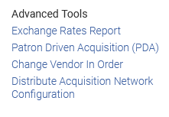
Distribute network acquisition changes to members
This job distributes the following to member institutions:
new vendor information
centrally managed licenses

Slide 13
Distribute network acquisition changes to members
The information is distributed to the members if it was added to the network after the date in the acq_distribute_changes_last_run parameter.
For more information, see Configuring Other Settings, Shared Vendor Information, and Adding a Negotiation License or a Centrally Negotiated License.

Slide 14
Distribute network acquisition changes to members
Here is the parameter acq_distribute_changes_last_run.
The date in this parameter gets updated every time the job runs. It can be viewed at 'configuration > acquisitions > general > other settings'

Slide 15
Distribute network acquisition changes to members
Here is a newly added vendor in the network zone, called 'A. Chen Publishers Intl.'.

Slide 16
Distribute network acquisition changes to members
The job runs and completes successfully

Slide 17
Distribute network acquisition changes to members
Here is the vendor viewed in the member institution. The vendor was distributed from the network:
Indication that the vendor is shared

Slide 18
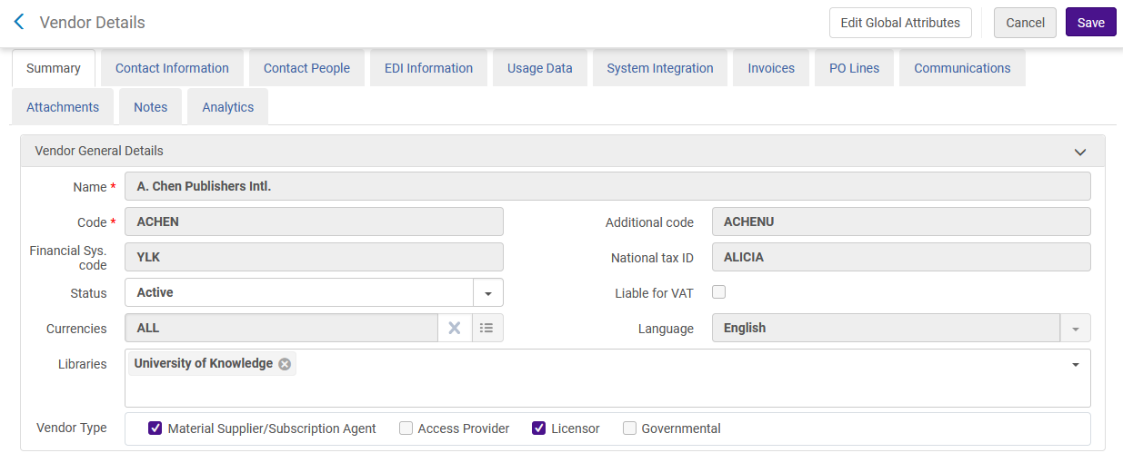
Distribute network acquisition changes to members
There are parts of the vendor which are shared are greyed out because they cannot be changed.

Slide 19
Distribute network fulfillment changes to members

Slide 20
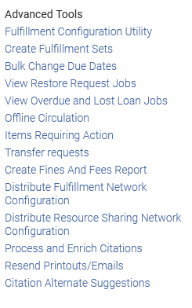
Distribute network fulfillment changes to members
This job distributes the following to member institutions:
Terms of Use and fulfillment units. The policies and Terms of Use defined at the Network Zone can be viewed at the member institutions. These policies appear on the Policy Management page with a Policy Owner value of Network.
The fulfillment units defined at the Network Zone can be viewed at the member institutions. They appear on the Fulfillment Units List

Slide 21
Distribute network fulfillment changes to members
The information is distributed to the members if it was added to the network after the date in the distribute_fulfills_changes_last_run parameter.
The date in this parameter gets updated every time the job runs. It can be viewed at 'configuration > fulfillment > general > other settings'

Slide 22
Distribute network fulfillment changes to members
'Loanable with no recall' is a Terms of use in the Network Zone

Slide 23
Distribute network fulfillment changes to members
The job 'Distribute network fulfillment changes to members' completes

Slide 24
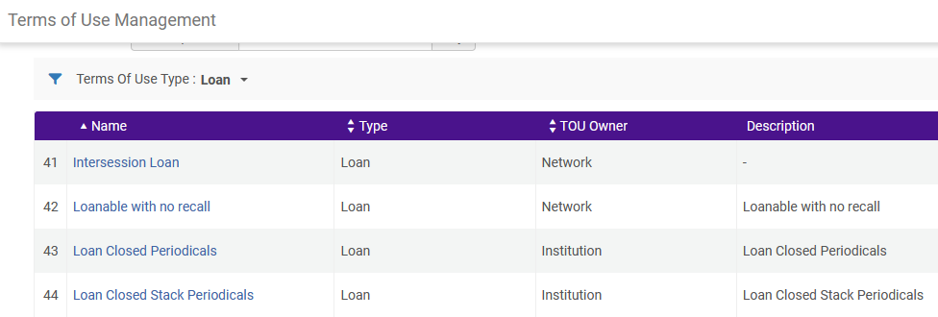
Distribute network fulfillment changes to members
The terms of use now appears in the member institutions with owner 'Network'

Slide 25
Distribute network zone configuration table changes to member institutions

Slide 26
Distribute network zone configuration table changes to member institutions
This job distributes changes made to the Network Zone to the member institutions.
The job runs when 'Manage Table in Network' is selected for a table and then 'Save and Distribute' is preformed.
We will show an example here using the 'Job Categories' table at 'Configuration > User Management > User Details > Job Categories'.
The values from the table in the network will be distributed to the member institutions.

Slide 27
Distribute network zone configuration table changes to member institutions
After doing 'Configuration > User Management > User Details > Job Categories' the user clicks 'Manage Table in Network'. This needs to be done only once, not each time the table is accessed

Slide 28
Distribute network zone configuration table changes to member institutions
Now we can make desired changes and then 'Save and Distribute'
Note that after we click once 'Manage Table in Network', we no longer have the 'Manage table in network' button. Instead, we have 'Stop Network Management'

Slide 29
Distribute network zone configuration table changes to member institutions
After clicking 'Save and Distribute' we can choose to override or not override the customizations of the member institution.

Slide 30
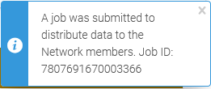
Distribute network zone configuration table changes to member institutions
By clicking 'Confirm' we send the job 'Distribute network zone configuration table changes to member institutions' to run.

Slide 31
Distribute network zone configuration table changes to member institutions
The job has run and completed successfully.

Slide 32
Distribute network zone configuration table changes to member institutions
Here in one of the member institutions we can see that the values were updated from the network.

Slide 33
Distribute network letter templates changes to members

Slide 34
Distribute network letter templates changes to members
It is also possible to configure letters in the network zone and then distribute them to the member institutions.
In this way there will be uniformity among all members of the consortia, and each member will not have to deal with doing the configuration.

Slide 35
Distribute network letter templates changes to members
In the Network Zone institution, find the desired letter (Configuration Menu > General > Letters > Letters Configuration) and select 'Manage Activation in Network'

Slide 36
Distribute network letter templates changes to members
After selecting 'Manage Activation in Network' the term 'Activation' will appear in the 'Managed in Network' column

Slide 37
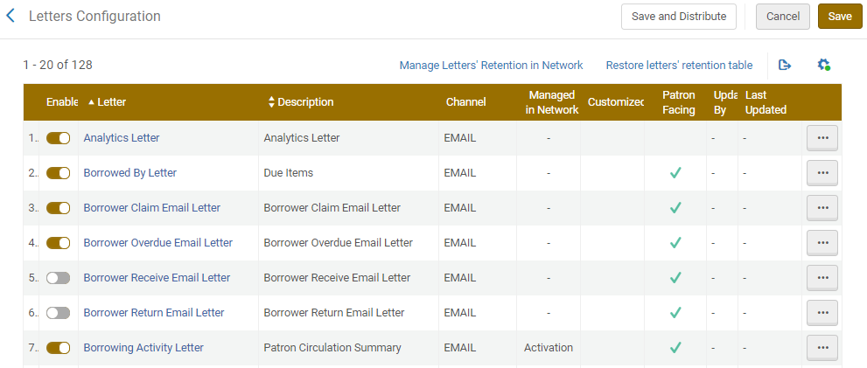
Distribute network letter templates changes to members
After customizing the letter as desired select Save and Distribute.

Slide 38
Distribute network letter templates changes to members
After clicking 'Save and Distribute' we can choose to override or not override the customizations of the member institution.

Slide 39
Distribute network letter templates changes to members
By clicking 'Confirm' we send the job 'Distribute Network Zone letter activity and letter retention tables changes to member institutions' to run.

Slide 40
Distribute network letter templates changes to members
The job has run and completed successfully.

Slide 41
Distribute network letter templates changes to members
Here in one of the member institutions we can see that the letter template was updated from the network.

Slide 42
Distribute network letter templates changes to members
To stop the centralized management of the letter template choose 'Stop Activation Network Management' and then select Save and Distribute.

Slide 43
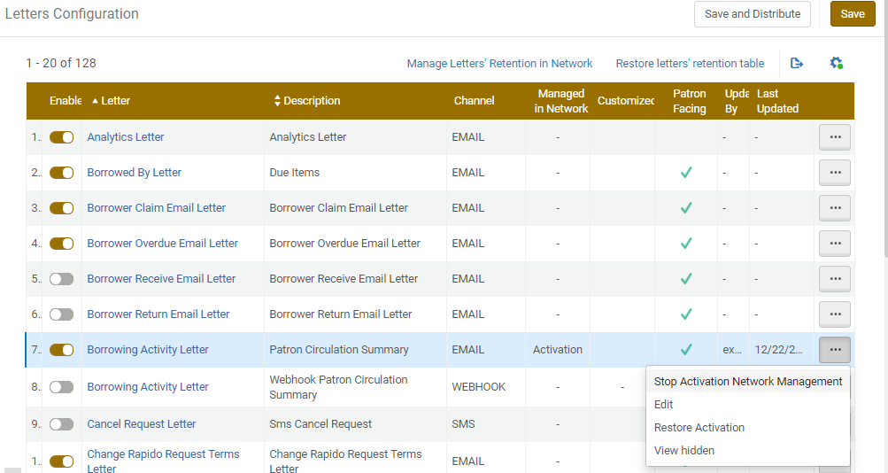
Distribute network letter templates changes to members

Slide 44
Distribute central resource sharing configuration

Slide 45
Distribute central resource sharing configuration
This job distributes the following to member institutions:
Resource sharing partners
Rota templates
Rota assignment rules
Locate profiles
Workflow profiles
Sending borrowing request rules.

Slide 46
Distribute central resource sharing configuration
Here is an example of a new resource sharing partner added to the network institution. The partner is 'A. Chen University (Taipei, Taiwan)'

Slide 47
Distribute central resource sharing configuration
The job has run and completed

Slide 48
Distribute central resource sharing configuration
Now we view resource sharing partners in one of the member institutions.
The partner has been added to the member institution
Indication that the vendor is shared

Slide 49
Distribute central resource sharing configuration
Note that because this is a shared partner some fields are grayed out and cannot be edited.

Slide 50
Distribute network resource management changes to members

Slide 51
Distribute network resource management changes to members
This job distributes resource management changes made to the Network Zone to the member institutions.
Examples of data that is shared from the network to the member institutions are 'Description Templates' and 'Representation Label Template Rules'

Slide 52
Distribute network resource management changes to members
In the network we have this description template 'Vol. before enum a':
Configuration > Resources > General > Description Templates

Slide 53
Distribute network resource management changes to members
In the network we have this Representation Label Template Rule 'Title to display for article':

Slide 54
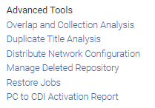
Distribute network resource management changes to members
We run the 'Distribute Network Configuration' job at Resources > Advanced Tools > Distribute Network Configuration

Slide 55
Distribute network resource management changes to members
The job runs and completes successfully

Slide 56
Distribute network resource management changes to members
Now in the member institution we see the description template from the network

Slide 57
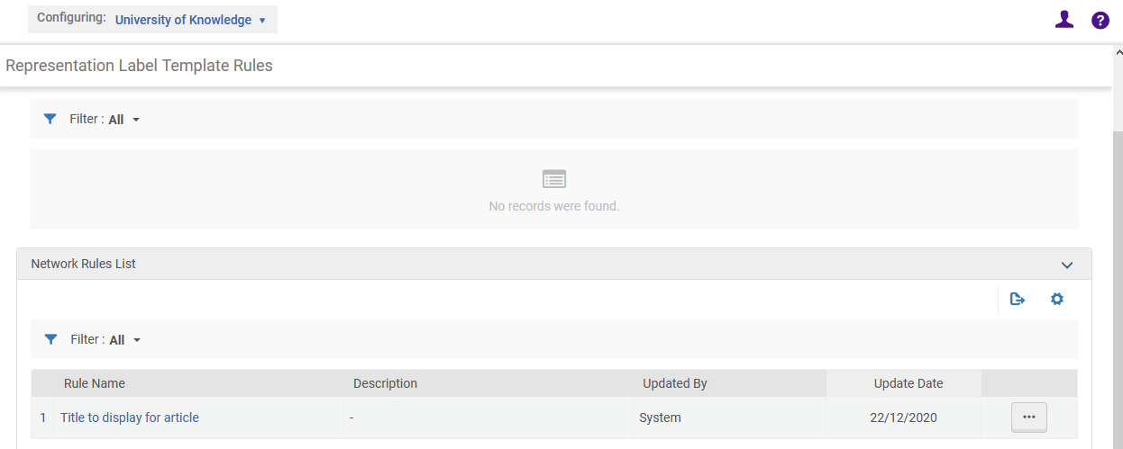
Distribute network resource management changes to members
And in the member institution we see the representation label template

Slide 58
Distribute network resource management changes to members
It is possible to determine whether to use the description templates from the network or from the member. This of course is relevant only when both exist in the member institution.
This is determined in the member institution at 'Resources > General > Other Settings' via the parameter network_description_templates_rules_precedence
true = use the Network's item description rules run first.
false = use the local member's item description rules run first.

Slide 59
Distribute network resource management changes to members
It is possible to determine whether to use the label template rules from the network or from the member. This of course is relevant only when both exist in the member institution.
This is determined in the member institution at 'Resources > General > Other Settings' via the parameter network_label_template_rules_precedence
true = use the Network Zone's label generation rules instead of the locally defined rules
false = use the local member's item description rules run first.

Slide 60
Distribute network user management configuration changes

Slide 61
Distribute network user management configuration changes
The job 'Distribute network user management configuration change' distributes changes made in the Network Zone to the member institutions for the following areas:
Role profiles
Role assignment rules

Slide 62
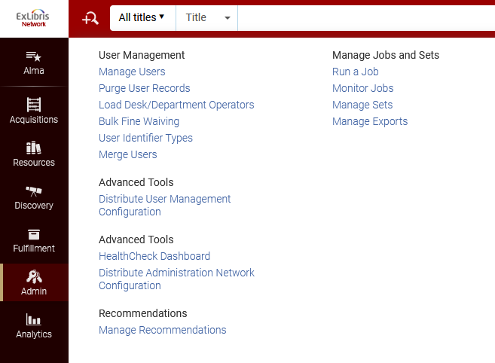
Distribute network user management configuration changes
The job is accessed from 'Admin > Advanced Tools Distribute User Management Configuration'.

Slide 63
Distribute network user management configuration changes
For example, 'Special Task Force' is a profile which was recently added to the network zone

Slide 64
Distribute network user management configuration changes
The job 'Distribute network user management changes to members' completes successfully

Slide 65
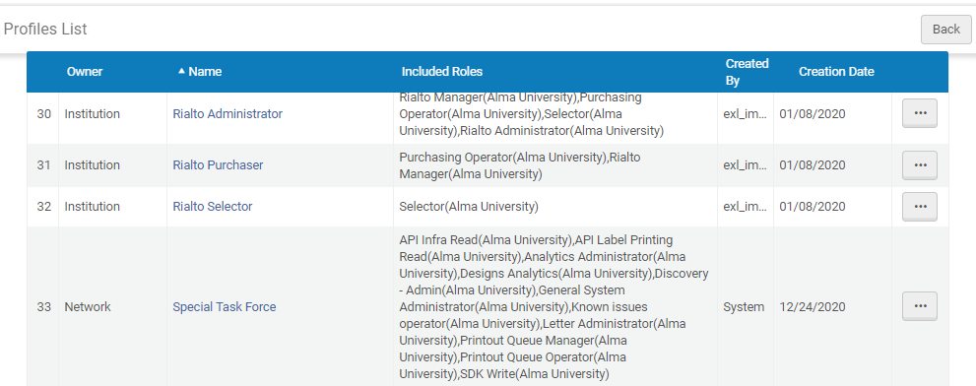
Distribute network user management configuration changes
The profile has been distributed from the network to the member and has owner 'Network'

Slide 66
Distribute network user management configuration changes
When the job completes successfully, the run date updates the distribute_user_management_changes_last_run parameter with the date for use the next time the job runs. This is accessed at 'Configuration > User Management > general > Other Settings'

Slide 67
Distribute network user management configuration changes
The network_user_profiles_and_assignment_rules_distribution_members_behavior parameter controls how the members' user profiles and assignment rules are handled when the Network Zone's records are distributed.
Valid values are: Remove and None.
Remove = will remove all the local records.
None = (the default) leaves all previously existing records exactly as they were before the distribution.

Slide 68
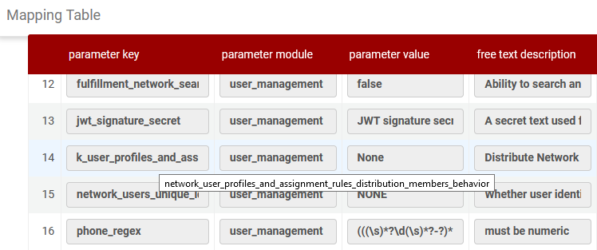
Distribute network user management configuration changes
Here is the parameter at 'Configuration > User Management > General > Other Settings'

Slide 69
Distribute network administration changes to members

Slide 70
Distribute network administration changes to members
This job distributes changes made in the Network Zone to member institutions for the following profiles, unless the member institution already has a profile of this type configured.
SAML
If the SAML profile is marked as Manage in Network in the Network Zone, the copy distributed to the member is set to view-only access.
S/FTP (see Configuring S/FTP Connections for more information)
SRU (see SRU/SRW Search for more information)
Z39.50

Slide 71
Distribute network administration changes to members
The member institution does not have an SRU profile.

Slide 72
Distribute network administration changes to members
The network institution does have an SRU profile.

Slide 73
Distribute network administration changes to members
We will now run the job, which is accessed from Admin > Advanced Tools > Distribute Administration Network Configuration.
Note that via the 'actions' we made this 'Managed in Network'

Slide 74
Distribute network administration changes to members
We will define this profile to be 'Managed in network'
This profile is now 'Managed in Network'

Slide 75
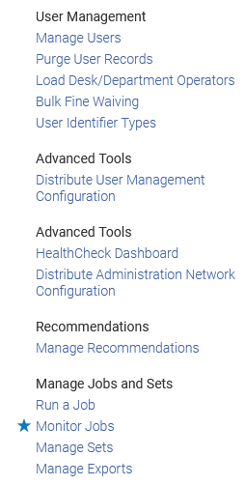
Distribute network administration changes to members
We will now run the job, which is accessed from 'Admin > Advanced Tools > Distribute Administration Network Configuration'.

Slide 76
Distribute network administration changes to members
The job completes

Slide 77
Distribute network administration changes to members
Now the SRU profile also exists in the member institution.

Slide 78
Centrally Managing Configuration Tables at the Row Level

Slide 79
Centrally Managing Configuration Tables at the Row Level
To centrally manage configuration tables configured at the row level:
In the Network Zone, select a configuration table that is configured at the row level.
Select 'Customize' from the row actions list for the row that you want to manage in the Network Zone and select 'Manage in Network'.

Slide 80
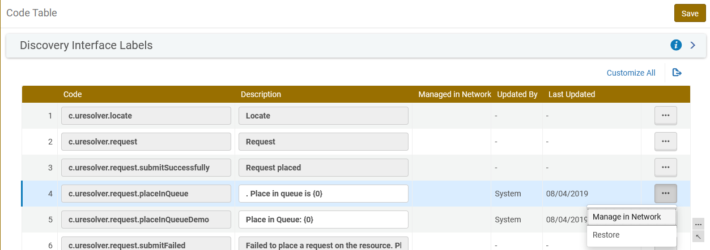
Centrally Managing Configuration Tables at the Row Level
Here we will define that PlaceInQueue in code table 'Discovery Interface Labels' is managed in network.

Slide 81
Centrally Managing Configuration Tables at the Row Level
Now we see that PlaceInQueue in code table 'Discovery Interface Labels' is managed in the network.

Slide 82
Centrally Managing Configuration Tables at the Row Level
'Save and Distribute' the table.

Slide 83
Centrally Managing Configuration Tables at the Row Level
Choose desired option. We will choose 'Override member institution customization'

Slide 84
Centrally Managing Configuration Tables at the Row Level
Clicking the 'Save and Distribute' button causes the job 'Distribute Network Zone configuration table changes to member institutions' to run

Slide 85
Centrally Managing Configuration Tables at the Row Level
Now in the member we see that PlaceInQueue is managed by the network

Slide 86
Centrally Managing Configuration Tables at the Table Level

Slide 87
Centrally Managing Configuration Tables at the Table Level
To centrally manage configuration tables configured at the table level:
From the Network Zone, select a configuration table that is configured at the table level.
On the top click 'Manage in Network'

Slide 88
Centrally Managing Configuration Tables at the Table Level

Slide 89
Centrally Managing Configuration Tables at the Table Level
After clicking 'Manage Table in Network' the 'Stop Network Management' link and 'Save and Distribute' button appear.

Slide 90
Centrally Managing Configuration Tables at the Table Level
Choose desired option. We will choose 'Override member institution customization'

Slide 91
Centrally Managing Configuration Tables at the Table Level
The job 'Distribute Network Zone configuration table changes to member institutions' runs.

Slide 92
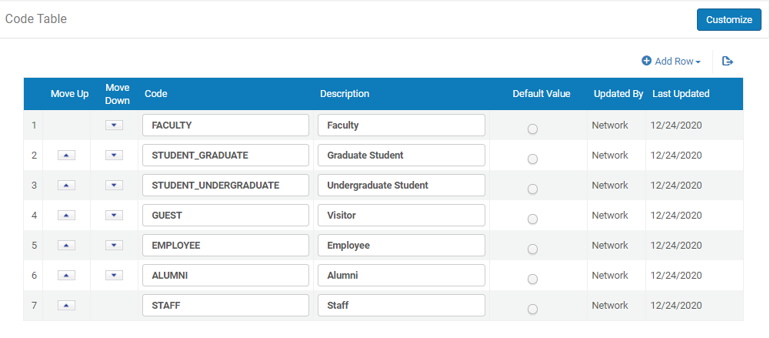
Centrally Managing Configuration Tables at the Table Level
Now in the member institution we see that the table was updated by the network

