Slide 1
How to concatenate multiple rows of the same field to one row
Yoel Kortick – Senior Librarian

Slide 2
Introduction
How is it done?
Let's do it

Slide 3
Introduction

Slide 4
Introduction
There may be cases whereby one specific field in an analytics report make several rows appear for one “entity” such as a title.
Depending on the purpose of the report, it may be useful to concatenate these fields to one row and delimit them with a specific character such as a pipe (|).
On the next slide for example we see a report where for many of the titles there are several barcodes, and a new row is created for each barcode.
Instead of having a new row we may want to have all barcodes together.

Slide 5
Introduction
Here we have 4 rows because there are 4 barcodes for one title
Here we have 5 rows because there are 5 barcodes for one title
Here we have 2 rows because there are 2 barcodes for one title

Slide 6
How is it done?

Slide 7
How is it done?
We will use a formula as follows instead of "folder name"."field name":
cast(EVALUATE_AGGR('LISTAGG(%1, %2 on overflow truncate) WITHIN GROUP (ORDER BY %1) ', "folder name"."field name", ' | ') as varchar(4000))
This will be the delimiter
So, for example instead of this
"Institution"."Institution Code"
We will have this:
cast(EVALUATE_AGGR('LISTAGG(%1, %2 on overflow truncate) WITHIN GROUP (ORDER BY %1) ',"Institution"."Institution Code", ' | ') as varchar(4000))

Slide 8
How is it done?
So, for example instead of this
"Physical Item Details"."Barcode"
We will have this:
cast(EVALUATE_AGGR('LISTAGG(%1, %2 on overflow truncate) WITHIN GROUP (ORDER BY %1) ', "Physical Item Details"."Barcode", ' | ') as varchar(4000))

Slide 9
How is it done?
So, for example instead of this
"Holding Details"."Holding Id"
We will have this:
cast(EVALUATE_AGGR('LISTAGG(%1, %2 on overflow truncate) WITHIN GROUP (ORDER BY %1) ', "Holding Details"."Holding Id", ' | ') as varchar(4000))

Slide 10
Let's do it

Slide 11
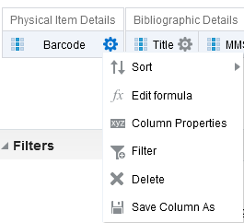
Let's do it
In the criteria tab of the report do “edit formula” on the desired field.
We will do it for barcode.

Slide 12
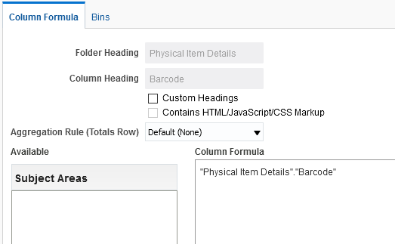
Let's do it
We see this

Slide 13
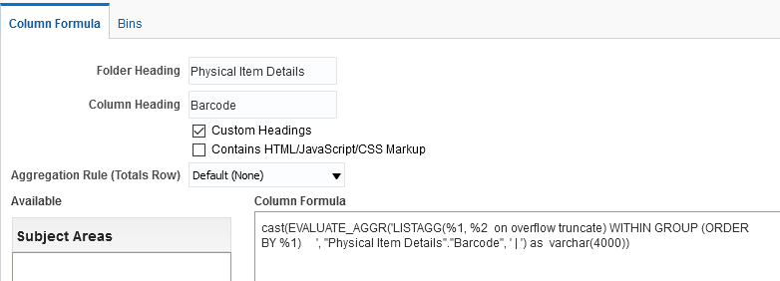
Let's do it
We change it to this

Slide 14
Let's do it
Now the report looks like this

Slide 15
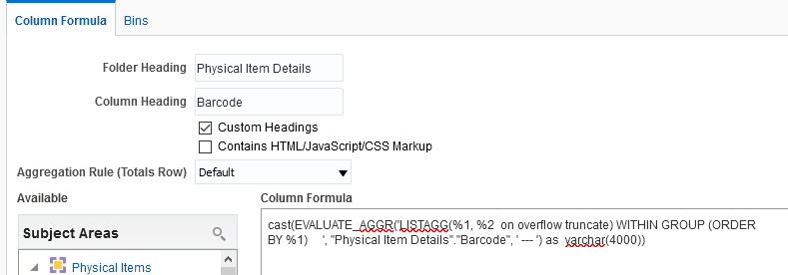
Let's do it
Instead of a pipe lets make the delimiter be three dashes

Slide 16
Let's do it
Now we have this:

Slide 17
xxx@exlibrisgroup.com

