Slide 1
Customizing the New Alma Viewer
May 2021
Daniel Greenberg | Alma Digital product manager

Slide 2
Introduction
The New Alma Viewer, released in March 2020, supports full customization via Primo Studio.
In this presentation we will show several examples of how to customize UX elements for Primo VE users.

Slide 3
Customization Flow
Open the viewer in Primo Studio​
Make desired changes​
Download the changed version to PC​
Upload the changed version to Alma

Slide 4
Steps
In the following slides we will review the following steps:
Select a sample representation for customizing the viewer
Populate the representation ID in the Alma viewer customization configuration
Open Primo Studio via the customization configuration
Design the viewer
Download the new Primo Studio package
Upload the Primo Studio Package to Alma

Slide 5
Step 1 - Select a sample representation
Copy Representation ID

Slide 6
Step 2 - Set representation ID in Alma viewer configuration
Go to Alma Configuration -> Fulfillment -> Discovery Interface Display Logic -> Viewer Services -> Alma Viewer
Select Edit
Select customization tab
Select desired Primo view from drop-down
Paste in sample representation ID
Select “Generate Link”
Select “Open Primo Studio”

Slide 7
Step 2 - Set representation ID in Alma viewer configuration
1. Select Primo view
2. Paste Representation ID
3. Generate Link
4. Open Primo Studio

Slide 8
Step 3 - Open Primo Studio via customization configuration
We will change the header color and remove contents icon

Slide 9
Step 4 - Design the viewer: Change header color
Select desired color for header

Slide 10
Step 4 - Design the viewer: Remove content icon and sign-in
1. Remove UI elements via css editor
2. Apply all changes
3. Review Changes – green header color and removed icon

Slide 11
Step 5 - Download the new Primo Studio package
Download a package.zip file to your pc

Slide 12
Step 6 - Upload Primo Studio Package to Alma
Upload package via Alma Configuration -> Discovery -> Configure Views -> Edit desired view -> Manage Customization Package

Slide 13
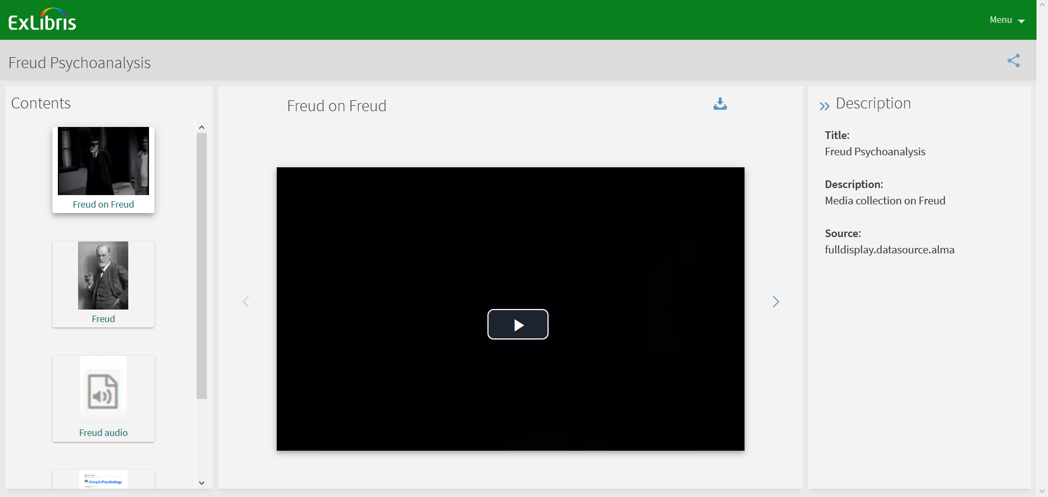
Review Results
Open Alma Viewer via selected Primo view:

Slide 14
Additional Resources
Primo Studio for Primo VE users
Primo Studio for Standard Primo users
Customizing the viewer for Standard Primo users

Slide 15
Thank you!
Daniel.Greenberg@exlibrisgroup.com

