Slide 1
How to create and test a COUNTER Release 5 SUSHI Account
Managing
Electronic
Resources
Yoel Kortick
Senior Librarian

Slide 2
Table of Contents
Introduction
Step 1: Retrieve the Alma Vendor and navigate to the "Usage Data" tab
Step 2: Click "Add SUSHI Account" and choose "Release 5"
Step 3: Search the Community Zone (CZ) for the vendor and link to it
Step 4: If you want to use a different URL then you can fill in the "Override URL"
Step 5: Fill in other fields as required
Step 6: Test connection for the SUSHI account
Step 7: Test connection for the specific report types.

Slide 3
Introduction
3

Slide 4
Introduction
When adding a SUSHI account, the staff user specifies if the account will be for COUNTER Release 4 or COUNTER Release 5.
In this way institutions can simultaneously work with both COUNTER Release 4 and COUNTER Release 5.
This of course will be until COUNTER Release 4 support will be phased out at some unspecified future time, by both "the industry" as well as by Alma.
We will now create a COUNTER Release 5 SUSHI Account for ProQuest. We will use URL https://sushi.pre.proquest.com/counter/r5

Slide 5
Step One - Retrieve the vendor and navigate to the “Usage Data” tab
5

Slide 6
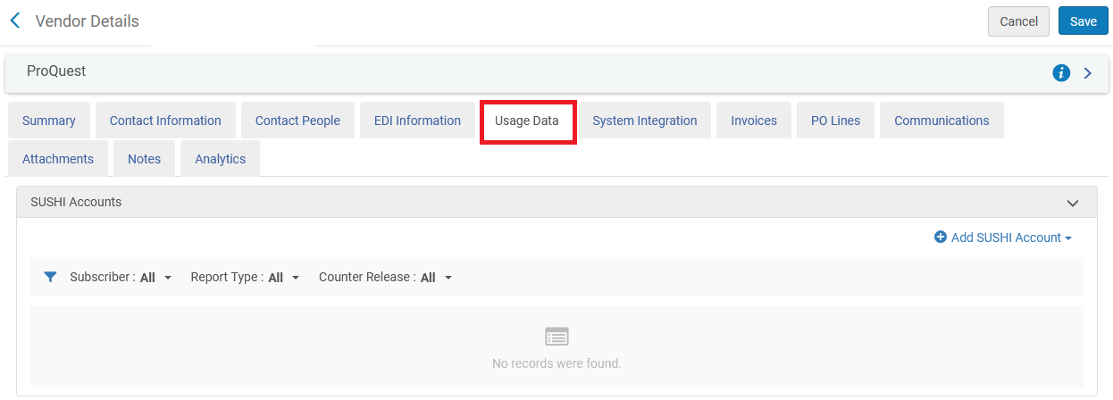
Step One
Every SUSHI Account is part of an Alma Vendor. Retrieve the Alma Vendor and navigate to the "Usage Data" tab

Slide 7
Step Two – Add a release 5 SUSHI account
7

Slide 8
Step Two
Click "Add SUSHI Account" and choose "Release 5".

Slide 9
Step Three – Link SUSHI account to the CZ
9

Slide 10
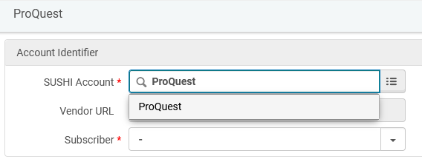
Step Three
Search the Community Zone (CZ) for the vendor and link to it. You can search the CZ by beginning to type the vendor name or by clicking the three lines to the right of the field and then searching. Here we have started typing "ProQuest" and then we will choose "ProQuest“
If the vendor is not in the CZ it can still be added by entering the SUSHI Account code without the “pickup” from the CZ. It can then be “contributed” to the CZ.

Slide 11
Step Four – Use “override URL” if needed
11

Slide 12
Step Four (slide one of two)
After linking the SUSHI Account to the CZ account the URL gets automatically filled in. If you want to use a different URL then you can fill in the "Override URL". Either the Override URL or the Vendor URL must be populated. If the Vendor URL for a SUSHI account changes in the list of SUSHI-certified vendors, the Vendor URL is updated. The Override URL is not changed by the update. When both the "Vendor URL" and "URL Override" fields are filled in Alma will first attempt to connect via the "URL Override".
In the example here have entered an "Override URL" of "https://sushi.pre.proquest.com/counter/r5". The URL which came from the CZ is "https://sushi.proquest.com/counter/r5".

Slide 13
Step Four (slide two of two)

Slide 14
Step Five – Fill in remaining SUSHI account fields as needed
14

Slide 15
Step Five (slide one of two)
Fill in other fields as required. The "Subscriber" is filled in from the pull down box. See Configuring COUNTER Subscribers. for more information about the subscribers.
For a description of the other fields see Managing SUSHI Accounts. Here we have filled in the fields according to the details of our SUSHI account in the "Introduction" above.
Note that different vendors require different fields to be filled in. See SUSHI-Certified Vendors Release 5 for more information.
In our example the fields are visually "blocked out" for security reasons.

Slide 16
Step Five (slide two of two)

Slide 17
Step Six – Test connection for the SUSHI account
17

Slide 18
Step Six (slide one of four)
After saving the SUSHI account you can then test connection. This will ensure that the account has been set up correctly.

Slide 19
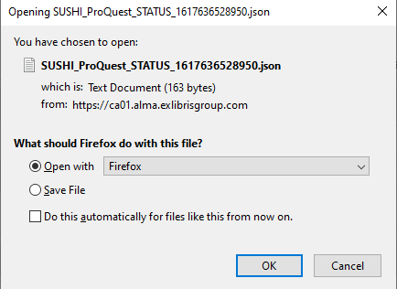
Step Six (slide two of four)
A "json" format file will be downloaded chowing the connection status

Slide 20
Step Six (slide three of four)
Here we see that the connection is successful

Slide 21
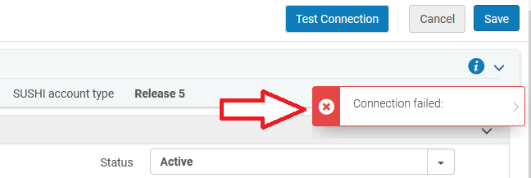
Step Six (slide four of four)
If the connection was not successful then the following would have appeared after clicking "Test Connection".

Slide 22
Step Seven – Add report types and test connection for the report types
22

Slide 23
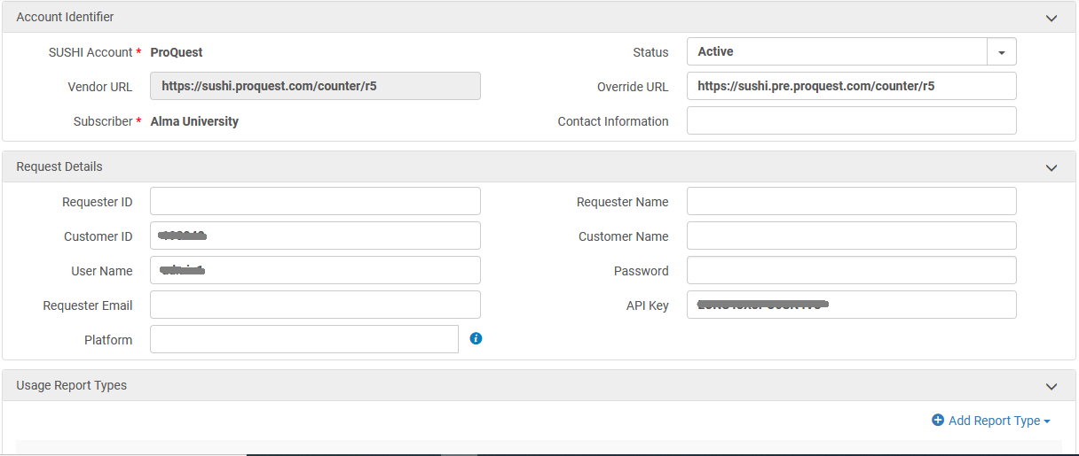
Step Seven (slide one of five)
In COUNTER Release 5 one account can have multiple report types.

Slide 24
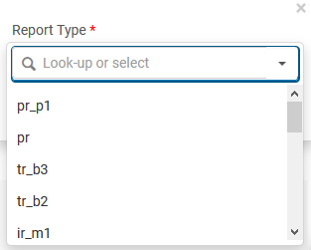
Step Seven (slide two of five)
The various COUNTER Release 5 report type can be chosen.

Slide 25
Step Seven (slide three of five)
See that the various report types of the SUSHI account appear, and the "test connection with response" is done per report type.

Slide 26
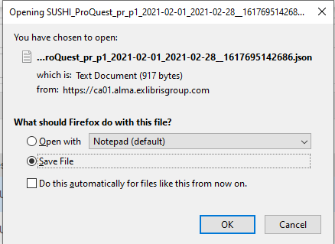
Step Seven (slide four of five)
The "test connection with response" also downloads a json file.

Slide 27
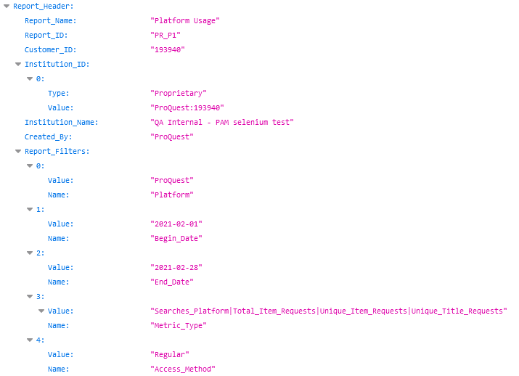
Step Seven (slide five of five)
See the json file with information per report type
The connection works.

