Slide 1
How to schedule and monitor COUNTER SUSHI harvesting
Managing
Electronic
Resources
Yoel Kortick
Senior Librarian

Slide 2
Table of Contents
Introduction
Step 1: Define the frequency in which you want the SUSHI Harvesting job to run
Step 2: Monitor the SUSHI harvesting job reports
Step 3: Monitor the harvested (uploaded from the vendor) files
Step 4: Monitor the harvesting for a specific vendor

Slide 3
Introduction

Slide 4
Introduction
The harvesting of COUNTER reports via SUSHI (Standardized Usage Statistics Harvesting Initiative) can be scheduled by the institution.
In addition, the institution can monitor the harvesting (loading to Alma from the vendor) within Alma.
We will explain here how this can be done.

Slide 5
Step One – Define the frequency of the SUSHI harvesting

Slide 6
Step One
At “Configuration menu -> Acquisitions -> General -> Acquisition Jobs Configuration” define the frequency in which you want the SUSHI Harvesting job to run.
Here the job is defined to run every Saturday morning at 08:00

Slide 7
Step One
Several other scheduling options could also have been chosen

Slide 8
Step Two – Monitor the SUSHI harvesting

Slide 9
Step Two
Monitor the SUSHI harvesting job reports. You can get an email sent to you and other users via the “row action” at “Alma Menu > Admin > Manage Jobs and Sets > Monitor Jobs > Go to ‘Scheduled’ Tab > Filter by ‘Acquisitions’ > Go to SUSHI harvesting job’

Slide 10
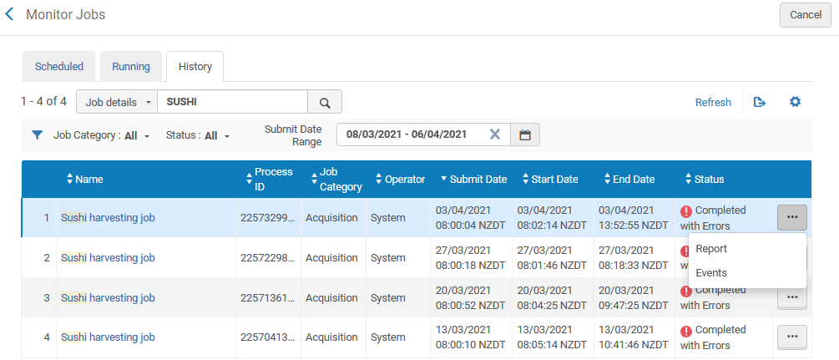
Step Two
The ‘SUSHI harvesting job’ report can be viewed from the “Monitor Jobs” “History” tab

Slide 11
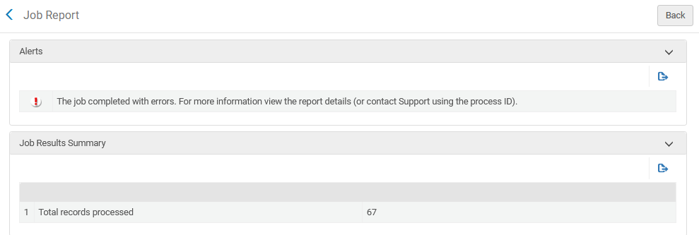
Step Two
Here is the beginning of the report

Slide 12
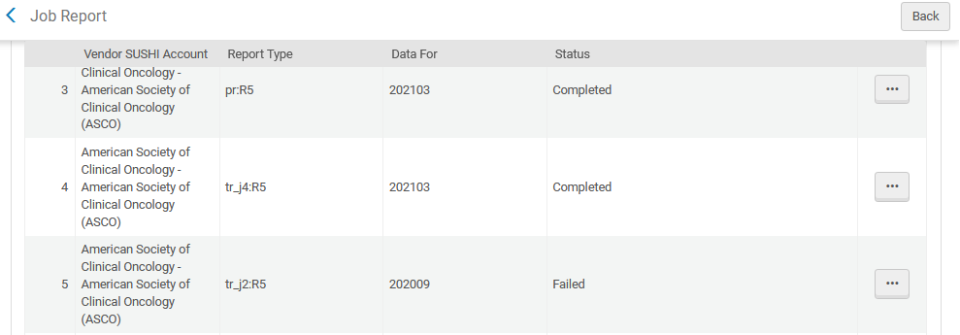
Step Two
Here is the continuation of the report
Here is why the job has status ‘Completed with errors’

Slide 13
Step Two
Each row can be further investigated

Slide 14
Step Two
After clicking “Preview records’ for a specific row it is possible to downloaded the loaded COUNTER report.

Slide 15
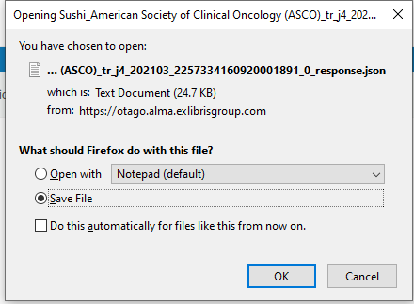
Step Two
Downloading the COUNTER report.

Slide 16
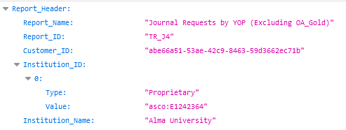
Step Two
Here is the beginning of the downloaded COUNTER report.

Slide 17
Step Three - Monitor the harvested (uploaded from the vendor) files

Slide 18
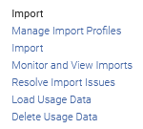
Step Three
It is possible to monitor the files which have been uploaded via the “Usage Data Loader” page.
The “Usage Data Loader” page can be accessed at “Alma Menu > Acquisitions > Import > Load Usage Data”

Slide 19
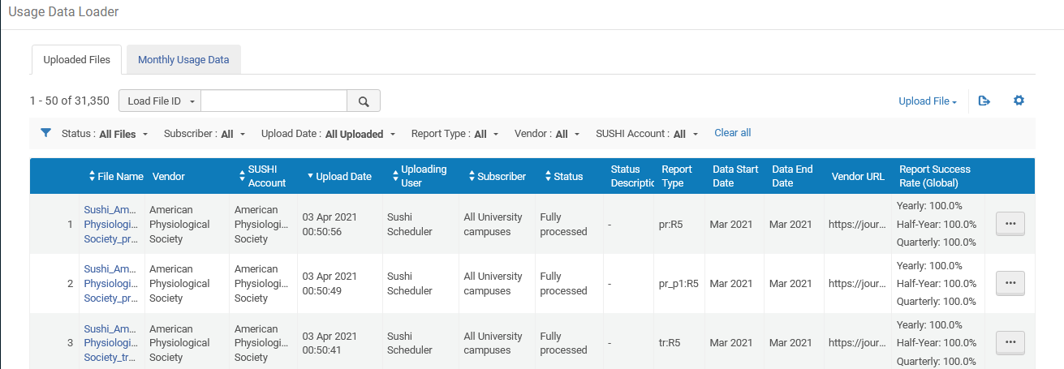
Step Three
The ‘Uploaded files’ tab allows us to view the files which were uploaded and their status along with additional information
Multiple filtering options

Slide 20
Step Three
The ‘Monthly usage data’ tab allows us to view the harvest success of reports by their platform

Slide 21
Step Three
The green check mark means that the usage report was successfully retrieved and loaded.

Slide 22
Step Three
The yellow exclamation mark means that the usage report was not successfully retrieved and loaded because no usage was available.

Slide 23
Step Four - Monitor the harvesting for a specific vendor

Slide 24
Step Four
In the “Usage Data” tab of a specific vendor, when viewing the specific SUSHI accounts, it is possible to see all files which have been harvested for that specific SUSHI account
On the next slide we will see that the lower section will include harvesting details for this active SUSHI account

Slide 25
Step Four
This is identical to the “Usage data Loader” page seen in step three, but it is already filtered by one particular vendor.
When there are multiple active SUSHI accounts it is possible to filter by a specific one.

