Slide 1
Designing and Using Normalization Rules

Slide 2
Designing and Using Normalization Rules

Slide 3
Introduction

Slide 4
Introduction
Normalization rules are designed to change or update bibliographic metadata records. Action can be taken when a metadata record is
Saved in the MD Editor
Open in the MD Editor and the operator selects Editing Actions > Enhance the Record
Imported via an import profile
Updated using a set and a job (global update)
Imported from external search resource (Z39.50 search)
Published (exported) via a general publishing profile

Slide 5
Introduction
Normalization rules are written in a specific syntax allowing the user to create rules to
Add fields
Delete fields
Change text
Change field tags
Change indicators
These operations may be performed
Unconditionally
Conditionally

Slide 6
Introduction
This presentation will not discuss the specific syntax of the normalization rules.
The focus here will be specifically on how the normalization rules are created as well as how and where the rules may be used.
See also:
Presentations and Documents about Normalization Rules
Alma Normalization Rule Examples
Online Help for working with normalization rules

Slide 7
Introduction
Roles that work with Normalization Rules
Catalog Administrator
Catalog Manager
Cataloger
Roles that work with configuring processes
Catalog Administrator
General System Administrator

Slide 8
Creating Normalization Rules and Processes

Slide 9
Creating Normalization Rules and Processes
Create a Normalization Rule three different ways
In the MD editor under New > Normalization
Click Rule Actions > Duplicate from an existing normalization rule in any folder
Right click and choose Duplicate from an existing normalization rule in any folder
Search EXL in the Community folder for Normalization Rules that have been contributed by Ex Libris

Slide 10
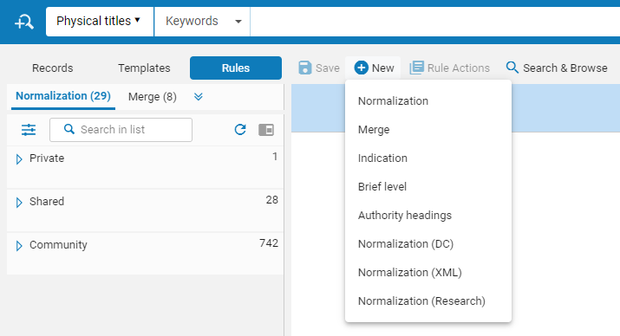
Creating Normalization Rules and Processes
In the metadata editor under New > Normalization

Slide 11
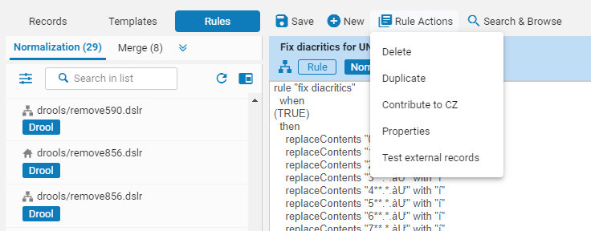
Creating Normalization Rules and Processes
Click Rule Actions > Duplicate from an existing normalization rule in any folder
Notes:
Shared folder
-Rules delivered with your environment can’t be edited—choose duplicate to see and edit these rules
-Rules that have been added to your environment by your team will display the Edit option in the drop-down menu

Slide 12
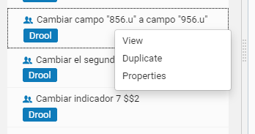
Creating Normalization Rules and Processes
Right click and choose Duplicate from an existing normalization rule in any folder
Notes:
Contributed by Ex Libris and customers.
Rules that start with EXL and contributed by Alma University are the rules we have placed in the CZ

Slide 13
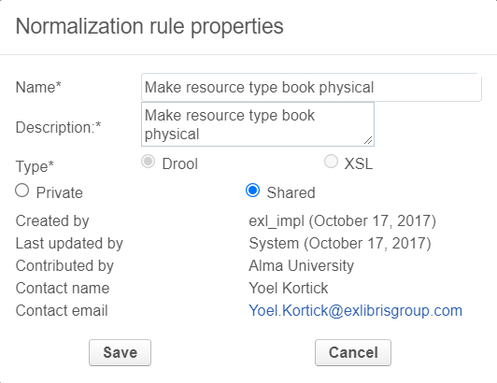
Creating Normalization Rules and Processes
Normalization Rule Properties
A logical name and description to know what this rule does
Choose Shared if you want other uses in your environment to be able to access this rule
Click Save when done editing properties

Slide 14
Creating Normalization Rules and Processes
Testing a Normalization Rule
Open a bibliographic record in the MD editor
Switch to split screen editor mode (F6)
Click in the right pane of the window to focus on that side
Click the Rules tab and click on the normalization rule to test
Click the Preview button in the bottom right corner of the MD editor
Changes to the record will appear with yellow highlighting

Slide 15
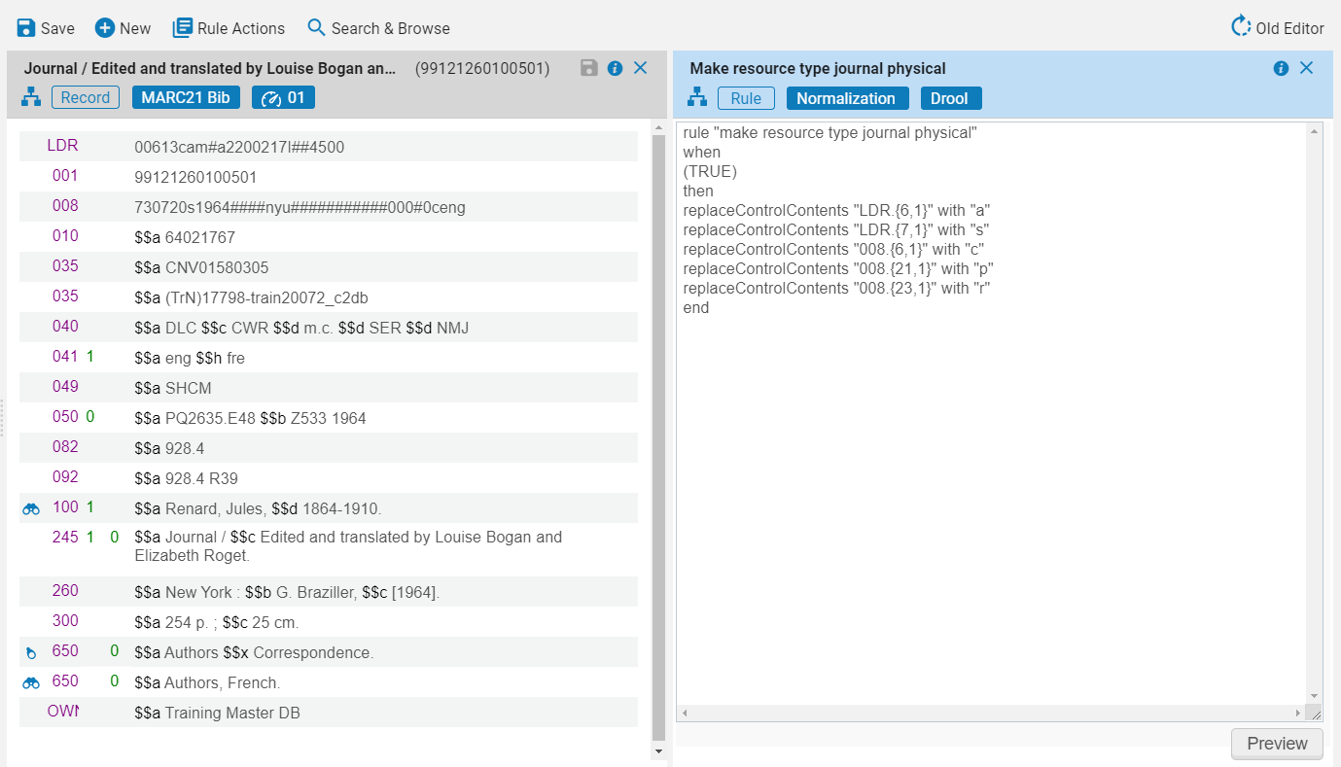
Creating Normalization Rules and Processes

Slide 16
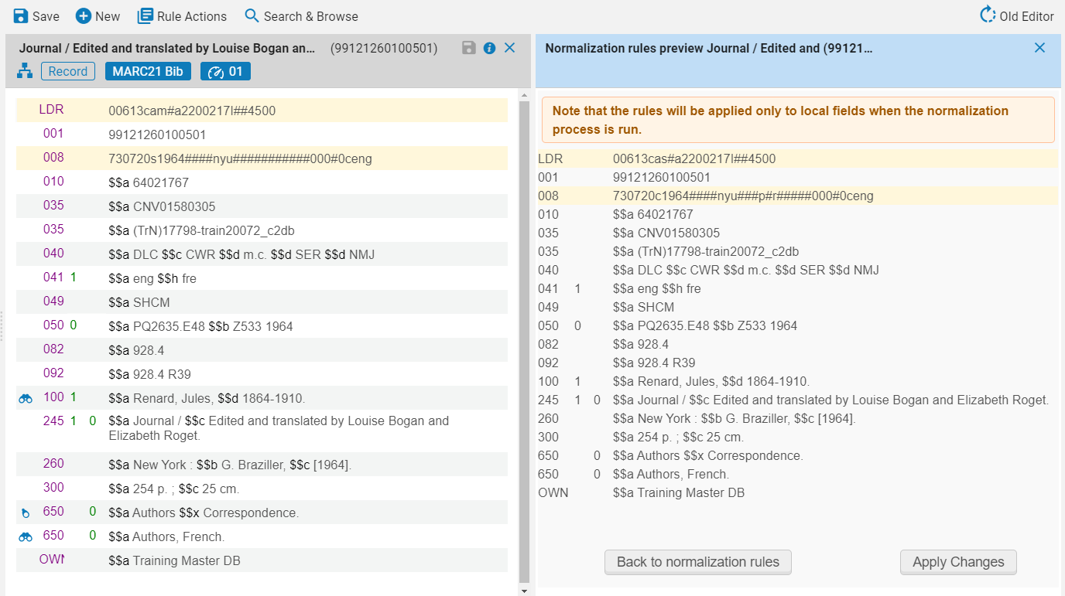
Creating Normalization Rules and Processes
The record on right has updated information in the LDR and 008 tags
Compare the records and see results
Clicking Back to normalization rules will return the user to the rule for additional editing
Clicking Apply Changes will update the record

Slide 17
Creating Normalization Rules and Processes
In order to be able to use the normalization rule in Alma it needs to be added as a process
Each process may include one or more normalization rules
In this example we will add one normalization rule to a process
The normalization rule we will add to a process is Delete 029 fields

Slide 18
Creating Normalization Rules and Processes
This normalization rule deletes any 029 field that is present in a bibliographic record

Slide 19
Creating Normalization Rules and Processes
Access the list of normalization processes from the Configuration menu > Resources > Cataloging > Metadata Configuration > click MARC21 Bibliographic > Normalization Processes tab
Click Add Process

Slide 20
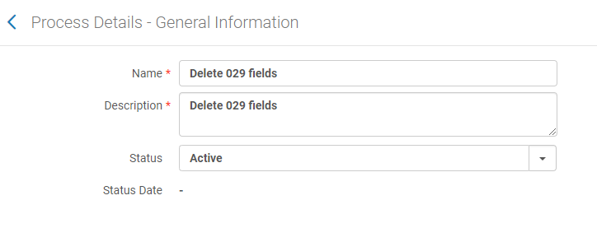
Creating Normalization Rules and Processes
Fill in the name and description fields
Click Next
In this example the name of the process will be the same as the normalization rule. This is not mandatory.

Slide 21
Creating Normalization Rules and Processes
3. Click Add Tasks
4. Scroll down and choose MarcDroolNormalization
5. Click Add and Close
6. Click Next
Notes:
Can add more than one MARCDroolNormalization lines.
Consider order of normalization rules when building the process.

Slide 22
Creating Normalization Rules and Processes
7. Choose a normalization rule from the menu and click Save to close the wizard

Slide 23
Creating Normalization Rules and Processes
The new normalization process has been added to your environment
Notes:
This was a simple process with a single normalization rule. It is possible to layer or stack multiple normalization rules into a single process by adding multiple tasks to the process.
Additional Drools tasks can be added to an existing rule and then showing how multiple lines appear in task parameters. Available normalization rules show in the drop-down menus.

Slide 24
Using a Normalization Process in the MD Editor

Slide 25
Normalize on Save
Every time you save a record in Alma a set of normalization processes run on that record
The 035 fields are derived from the 001 and 003 fields (if the 003 field exists)
For new records, the 001 value is saved as the originating system ID (MMS ID)
For existing records, the 001 field is updated with the MMS ID
The 008 field is updated if it exists
The 005 field is updated
Part of the LDR (leader) field is updated (mostly the length of the record)
Any additional, custom normalize on save processes/tasks that have been configured in MARC 21 Bib normalize on save or MARC 21 Holding normalize on save
https://knowledge.exlibrisgroup.com/Alma/Product_Documentation/010Alma_Online_Help_(English)/040Resource_Management/040Metadata_Management/020Navigating_the_MD_Editor_Page#Normalizing_on_Save
Notes:
A normalization process is run against a record every time you click Save in Alma. Some of the parameters are hard-coded.

Slide 26
Normalize on Save
Configuration > Resources > Cataloging > Metadata Configuration > MARC21 Bibliographic > Normalization Processes tab > MARC21 Bib normalize on Save
Notes:
On the task list we see that the following tasks are applied,
MARC tags are resequenced according the LC cataloguing rules
Empty MARC tags are cleared from the record
A MARC Drool Normalization task is run
Looking at the Task Parameters we can see that the normalization rule titled Import cleanup will be run.
If needed you can add additional tasks to the process.

Slide 27
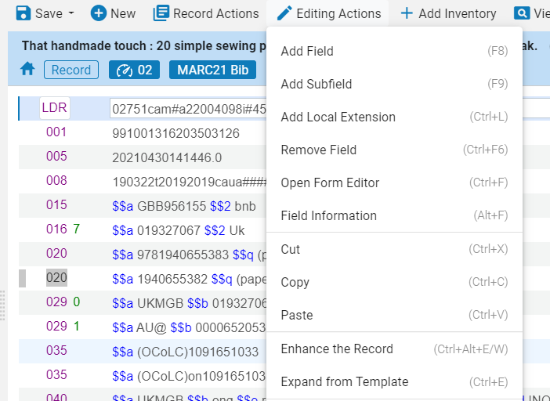
Enhance the Record
Open a bibliographic record in the MD Editor
Click Editing Actions > Enhance the Record or Ctrl + Alt + E/W
Choose the Normalization Type from the dropdown menu and click OK
Save your changes to the record
Notes:
I’m going to use the Delete 029 Fields Process that was just created.
Demonstrate this in Alma.
Note the 029 tags have been removed from the bib record.

Slide 28
Using a Normalization Processes in an Import Profile

Slide 29
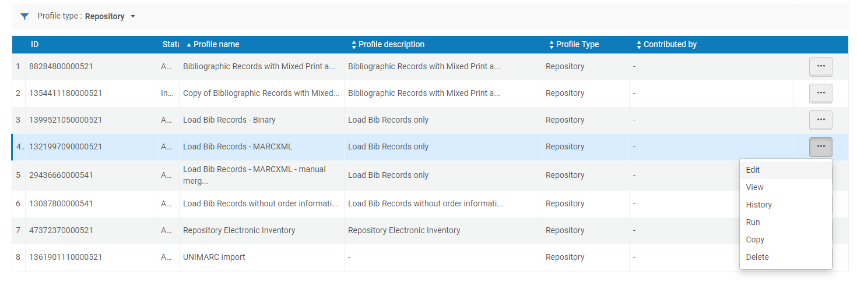
Using a Normalization Processes in an Import Profile
Resources > Import > Manage Import Profiles > Select an import profile > and choose Edit
Notes:
Normalization rules can be applied when running a bulk import.
They are defined in an import profile.

Slide 30
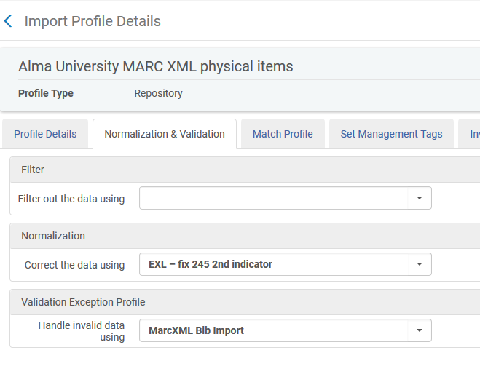
Using a Normalization Processes For an Import Profile
On the Normalization & Validation tab choose a defined normalization process from the drop-down menu.

Slide 31
Using a normalization processes for batch update

Slide 32
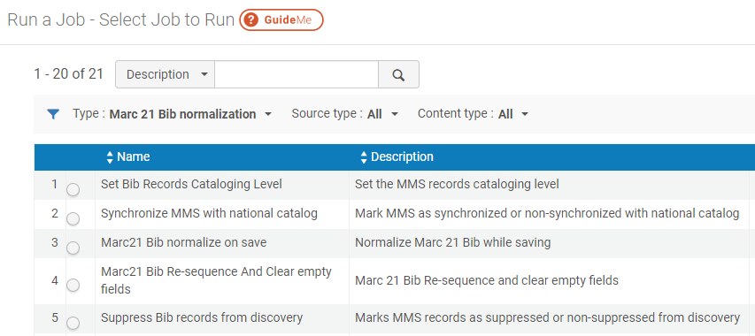
Using a normalization processes for batch update
Define your set of records
Admin > Manage Jobs and Sets > Run a Job
Filter by Type Marc 21 Bib Normalization
Notes:
Normalization rules can be applied to a set of records in batch.

Slide 33
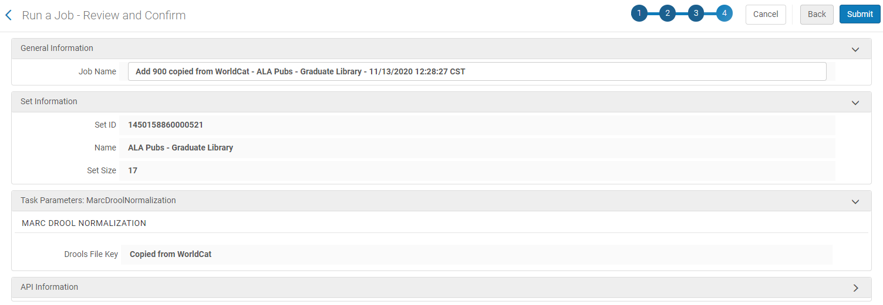
Using a normalization processes for batch update
4. Search for and/or select the appropriate defined normalization process and click Next
5. Select the set of records and click Next
6. View the normalization rule and click Next
7. Review the settings for the job and click Submit

Slide 34
Using a Normalization Process When Publishing Records

Slide 35
Using a Normalization Process When Publishing Records
1. Navigate to Resources > Publishing > Publishing Profiles
2. Click Add Profile and choose General Profile
3. Fill in Publishing Profile information and click Next
4. Select the desired normalization rule from the drop-down menu along with other parameters and click Save
Notes:
Normalization rules can be applied when publishing records.

Slide 36
Review
Creating Normalization Rules
Duplicate an existing rule
Test the rule
Add the rule to a process
Using Normalization Rules
In the MD editor
While importing records
On a set of records
When publishing records

Slide 37
Discussion
https://www.chronicle.com/article/The-Holy-Grail-of-Class/245009

