Slide 1
How to create and test a COUNTER Release 5 SUSHI Account
Yoel Kortick – Senior Librarian

Slide 2
One bibliographic record with multiple 773 host item entry fields
Yoel Kortick – Senior Librarian

Slide 3
Table of Contents
Introduction
Step 1: Retrieve the Alma Vendor and navigate to the "Usage Data" tab
Step 2: Click "Add SUSHI Account" and choose "Release 5"
Step 3: Search the Community Zone (CZ) for the vendor and link to it
Step 4: If you want to use a different URL then you can fill in the "Override URL"
Step 5: Fill in other fields as required
Step 6: Test connection for the SUSHI account
Step 7: Test connection for the specific report types.

Slide 4
Introduction

Slide 5
Introduction
When adding a SUSHI account, the staff user specifies if the account will be for COUNTER Release 4 or COUNTER Release 5.
In this way institutions can simultaneously work with both COUNTER Release 4 and COUNTER Release 5.
This of course will be until COUNTER Release 4 support will be phased out at some unspecified future time, by both "the industry" as well as by Alma.
We will now create a COUNTER Release 5 SUSHI Account for ProQuest. We will use URL https://sushi.pre.proquest.com/counter/r5

Slide 6
Step One - Retrieve the vendor and navigate to the “Usage Data” tab

Slide 7
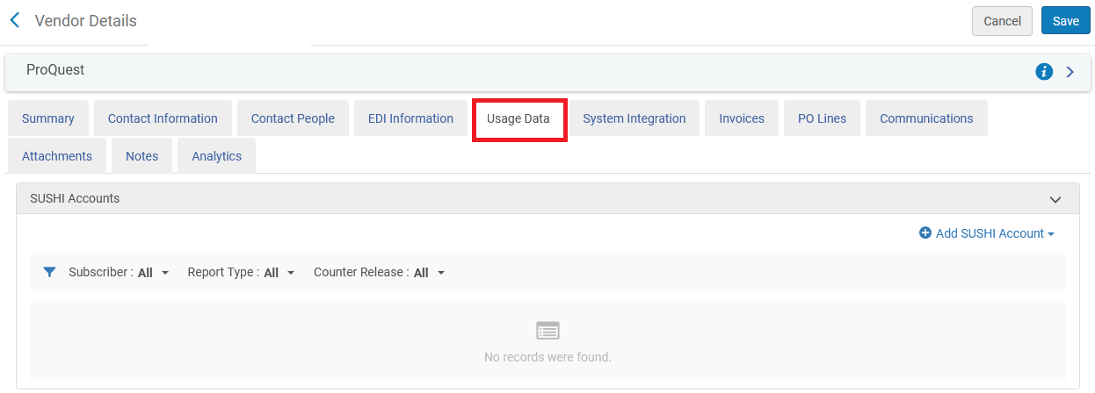
Step One
Every SUSHI Account is part of an Alma Vendor. Retrieve the Alma Vendor and navigate to the "Usage Data" tab

Slide 8
Step Two – Add a release 5 SUSHI account

Slide 9
Step Two
Click "Add SUSHI Account" and choose "Release 5".

Slide 10
Step Three – Link SUSHI account to the CZ

Slide 11
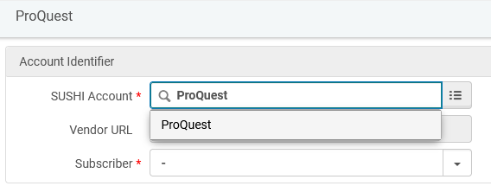
Step Three
Search the Community Zone (CZ) for the vendor and link to it. You can search the CZ by beginning to type the vendor name or by clicking the three lines to the right of the field and then searching. Here we have started typing "ProQuest" and then we will choose "ProQuest“
If the vendor is not in the CZ it can still be added by entering the SUSHI Account code without the “pickup” from the CZ. It can then be “contributed” to the CZ.

Slide 12
Step Four – Use “override URL” if needed

Slide 13
Step Four (slide one of two)
After linking the SUSHI Account to the CZ account the URL gets automatically filled in. If you want to use a different URL then you can fill in the "Override URL". Either the Override URL or the Vendor URL must be populated. If the Vendor URL for a SUSHI account changes in the list of SUSHI-certified vendors, the Vendor URL is updated. The Override URL is not changed by the update. When both the "Vendor URL" and "URL Override" fields are filled in Alma will first attempt to connect via the "URL Override".
In the example here have entered an "Override URL" of "https://sushi.pre.proquest.com/counter/r5". The URL which came from the CZ is "https://sushi.proquest.com/counter/r5".

Slide 14
Step Four (slide two of two)

Slide 15
Step Five – Fill in remaining SUSHI account fields as needed

Slide 16
Step Five (slide one of two)
Fill in other fields as required. The "Subscriber" is filled in from the pull down box. See Configuring COUNTER Subscribers. for more information about the subscribers.
For a description of the other fields see Managing SUSHI Accounts. Here we have filled in the fields according to the details of our SUSHI account in the "Introduction" above.
Note that different vendors require different fields to be filled in. See SUSHI-Certified Vendors Release 5 for more information.
In our example the fields are visually "blocked out" for security reasons.

Slide 17
Step Five (slide two of two)

Slide 18
Step Six – Test connection for the SUSHI account

Slide 19
Step Six (slide one of five)
After saving the SUSHI account you can then test connection. This will ensure that the account has been set up correctly.

Slide 20
Step Six (slide two of five)
After saving the SUSHI account you can then test connection. This will ensure that the account has been set up correctly.

Slide 21
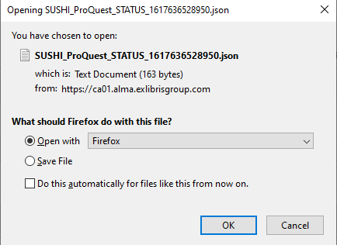
Step Six (slide three of five)
A "json" format file will be downloaded chowing the connection status

Slide 22
Step Six (slide four of five)
Here we see that the connection is successful

Slide 23
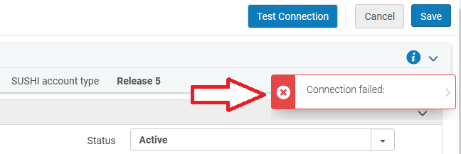
Step Six (slide five of five)
If the connection was not successful then the following would have appeared after clicking "Test Connection".

Slide 24
Step Seven – Add report types and test connection for the report types

Slide 25
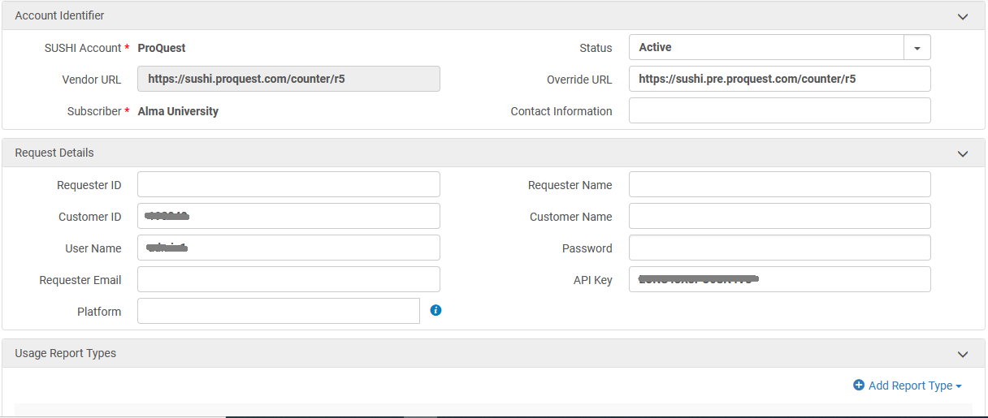
Step Seven (slide one of five)
In COUNTER Release 5 one account can have multiple report types.

Slide 26
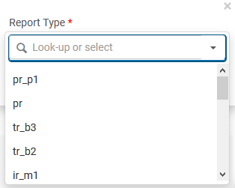
Step Seven (slide two of five)
The various COUNTER Release 5 report type can be chosen.

Slide 27
Step Seven (slide three of five)
See that the various report types of the SUSHI account appear, and the "test connection with response" is done per report type.

Slide 28
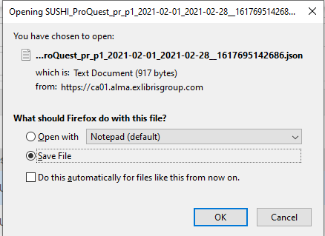
Step Seven (slide four of five)
The "test connection with response" also downloads a json file.

Slide 29
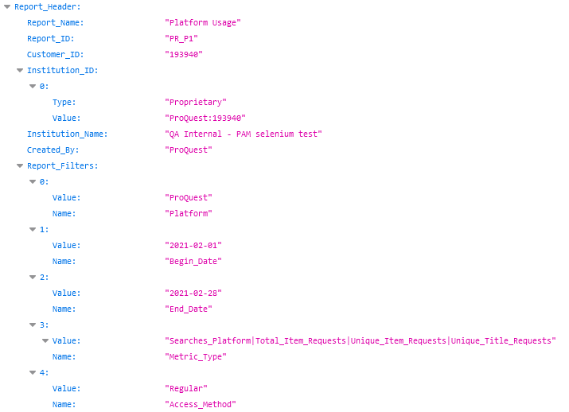
Step Seven (slide five of five)
See the json file with information per report type
The connection works.

Slide 30
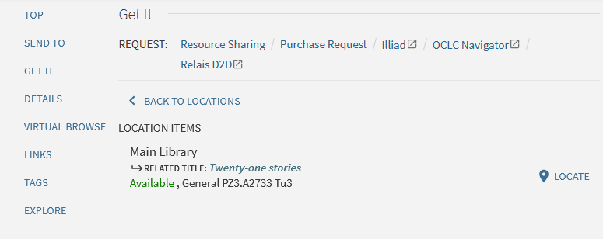
What happens in Primo
After clicking one of the specific items the user sees the item details

Slide 31
xxx@exlibrisgroup.com

