Slide 1
Best of Knowledge Days 2021
Date | Session
June 1 | Handling Related Records
June 3 | Alma Analytics for Beginners
June 8 | Managing E-Resources: The Basics
June 10 | Central Discovery Index
June 15 | Managing COUNTER-Compliant Usage Data
June 17 | Optimize and Streamline Alma Workflows
June 22 | Overlap Analysis and Deselection Tools with Alma Analytics
June 24 | Designing and Using Normalization Rules
June 29 | Managing E-Resources: Advanced
July 1 | Fundamentals of Sets and Jobs
https://page.exlibrisgroup.com/knowledge-days-2021

Slide 2
Fundamentals of Sets and Jobs
Managing Sets and Running Jobs
Yaala Ariel-Joel, Technical Support Analyst
Amanda Schriver, Premium Services Consultant

Slide 3
Agenda:
An Introduction to Sets
Creating and Editing Sets
Set Manipulation
Running jobs on sets of data
Restore a job
Documentation, blogs, knowledge articles.
Agenda

Slide 4
What are search queries and sets?
A set is a group of entities with a common value– such as items, users, PO Lines.
Sets may be used to:
Manage data directly (view or edit the records one by one).
Manage the data by running a job (e.g., publish records, edit in bulk, notify users).

Slide 5
Types of Sets, Logical
Logical – A saved search query, which runs every time the set is referenced.
Set content is dynamic - results reflect information currently in the repository.

Slide 6
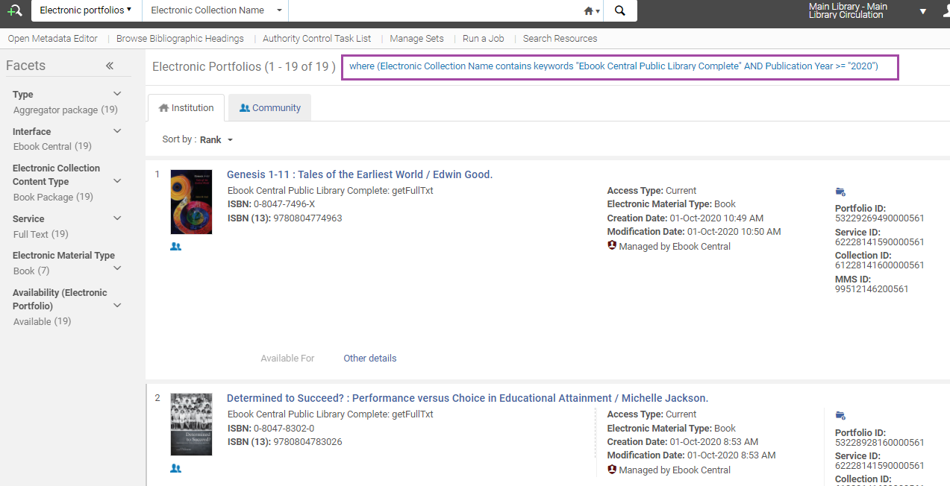
Logical Set – based on a dynamic search
For example: find all Portfolios for a specific Electronic Collection
Add publication year; or – all items from specific Location…

Slide 7
Types of Sets, Itemized
Itemized – Individual items, selected or uploaded by the user.
Set content is static – members can be added or removed manually.
Use an Input file, or an Analytics report.

Slide 8
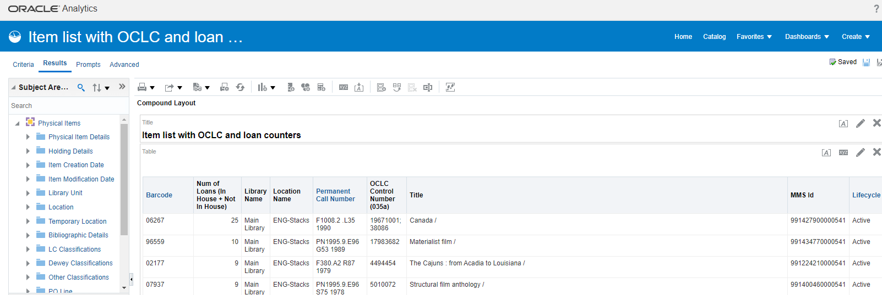
Itemized Set- based on a predetermined list
For example: create an itemized physical items set based on an Analytics report (most loaned items)
Notes:
​

Slide 9
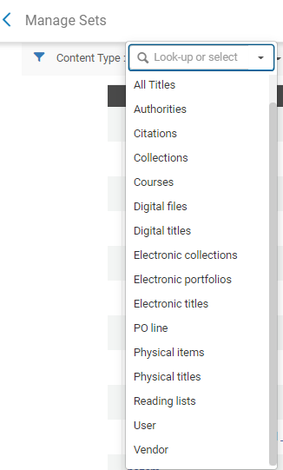
Set Content Types
Resource Management sets
Titles, Authorities, Collections,
Inventory: Digital/Electronic/Physical
Acquisition sets
PO Lines, or Vendors
User sets
Reading List Sets

Slide 10
Manage Sets
Set Tabs:
My Sets – Your saved search queries, both private and public
Public Sets – All users' saved queries that are not marked private
All Sets – All queries
Notes:
​

Slide 11
Give me an idea…
When do we create set and analyze, or run jobs on them?

Slide 12
Use Case – Post migration
For example, migrated eBooks need to be reviewed
Solution:
Create a Set for P2E standalone portfolios
Move the Set to a Local Electronic Collection
Link to Community
Read: Post Migration clean-up of eResources in Alma

Slide 13
Use Cases – Ongoing Tasks
Ongoing tasks, such as:
Change “Missing” items to “In Place”, Knowledge Article here, or Bulk Scan in with an App.
Create Authorities set in the Community Zone, check Youtube.
Define Users set in Analytics, change expiry date, or email them.
Define a set of PO Lines – change Reporting Code or Fund (Online Help here) or switch PO Line Types from P to E using a CloudApp.

Slide 14
New in 2021! Check the new Cloud Apps
How to install and use the Bulk Scan In Cloud App?
Create a set and Return items in bulk
And so much more at: https://developers.exlibrisgroup.com/cloudapps/docs/

Slide 15
Agenda:
An Introduction to Sets
Creating and Editing Sets
Set Manipulation
Running jobs on sets of data
Restore a job
Documentation, blogs, knowledge articles.
Agenda

Slide 16
How to create a set? Add Set via a Wizard
“Add Set” from: Manage Sets
Choose if Logical, or Itemized

Slide 17
Add Set – Logical or Itemized?
Follow the menu. Decide first on Set Content Type:
The set name cannot contain special characters (for example: &, #, $, %).

Slide 18
Add Set – Logical > From Search
The next step – define the search, and save

Slide 19
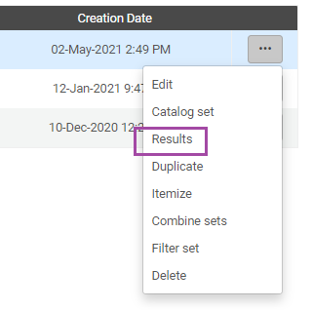
Logical Set – view Results (modify search terms & save)
Find the set > actions > view Results and modify as needed

Slide 20
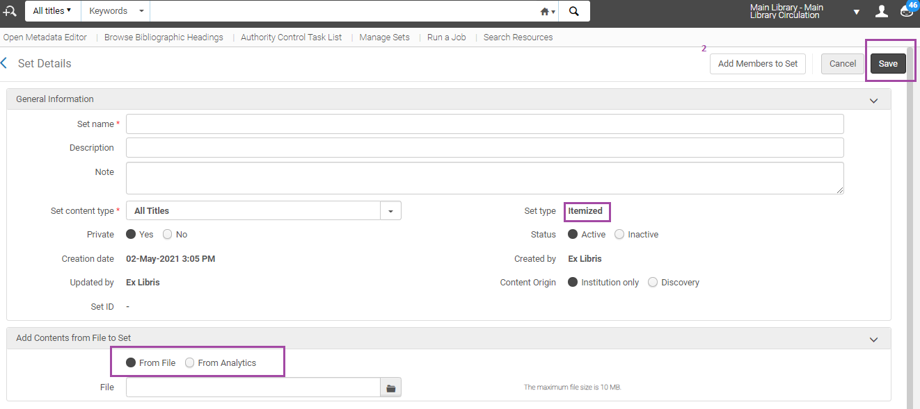
Add Set - Itemized
From xls, xlsx, txt, csv or Analytics
Or - save the Set Name, and then “Add Members to Set”

Slide 21
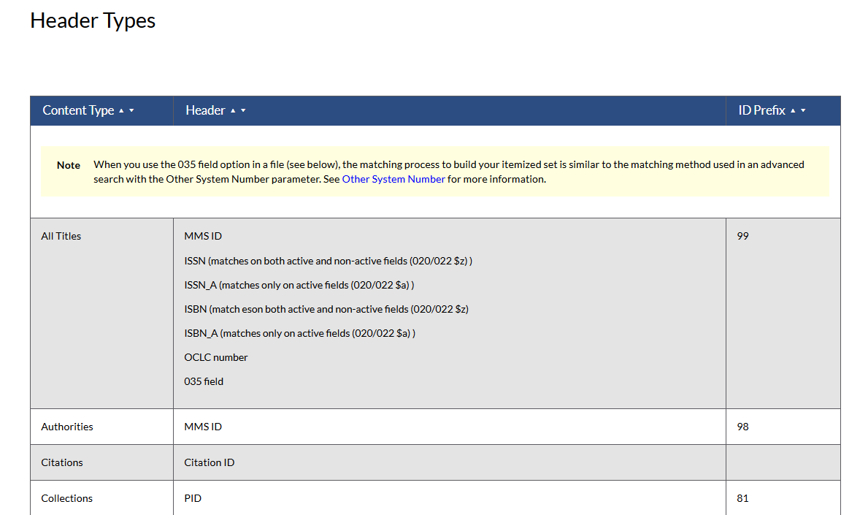
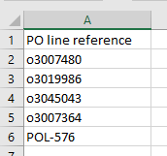
Add Set – Itemized, input file
Use a text file (.txt or .csv) or Excel file (.xls or .xlsx)
Have correct header. Consult the Online Help
The first column which has valid header – is read.

Slide 22
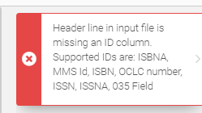
Add Set – Itemized: error is received with information regarding supported IDs

Slide 23
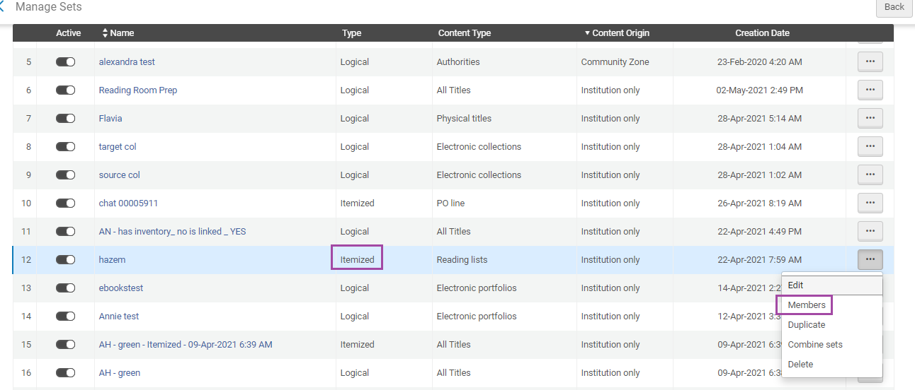
Itemized Set – View Members

Slide 24
Itemized Set – Removed Selected

Slide 25
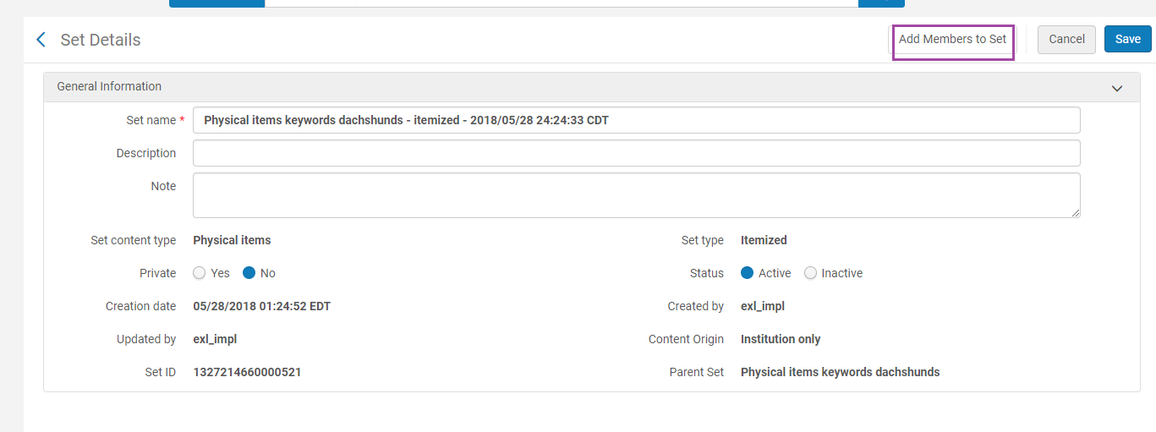
Itemized Set – Edit and Add Members to Set

Slide 26
Agenda:
An Introduction to Sets
Creating and Editing Sets
Set Manipulation
Running jobs on sets of data
Restore a job
Documentation, blogs, knowledge articles.
Agenda

Slide 27
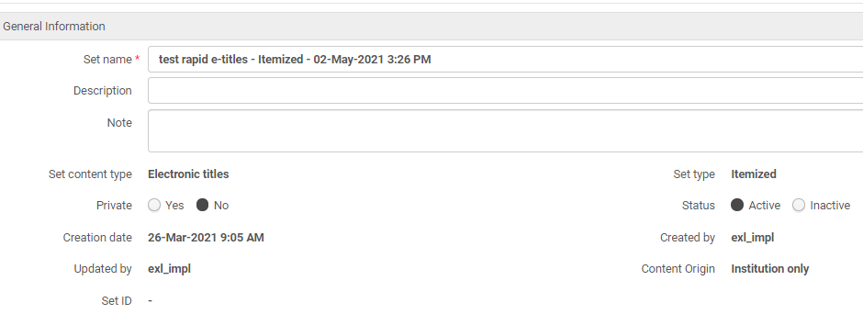
Converting Logical Sets to Itemized Sets
You can convert a logical set to an itemized set.

Slide 28
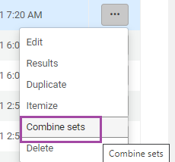
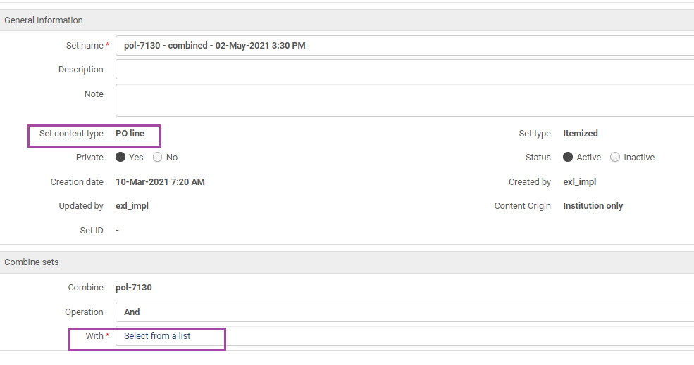
Combining Sets
Sets must be the same type
The combined set is an itemized set.

Slide 29
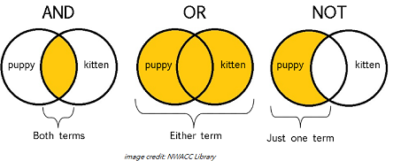
Combining Sets
And – Include only the members in common between the two sets in the new combined set.
Not – Include only the members that are in the first set and not in the second set in the new combined set.
Or – Include all of the members in both of the sets in the new combined set.

Slide 30
Combining Sets – creates a Job

Slide 31
Combining Sets – results in an Itemized Set

Slide 32
There’s more to sets!
Sets can be filtered using yes/no criteria

Slide 33
Filtering Sets
Relevant only for Resource Management content types
Filter set content based on fields that are not indexed/searchable (best practice advice)
Uses Indication Rules

Slide 34
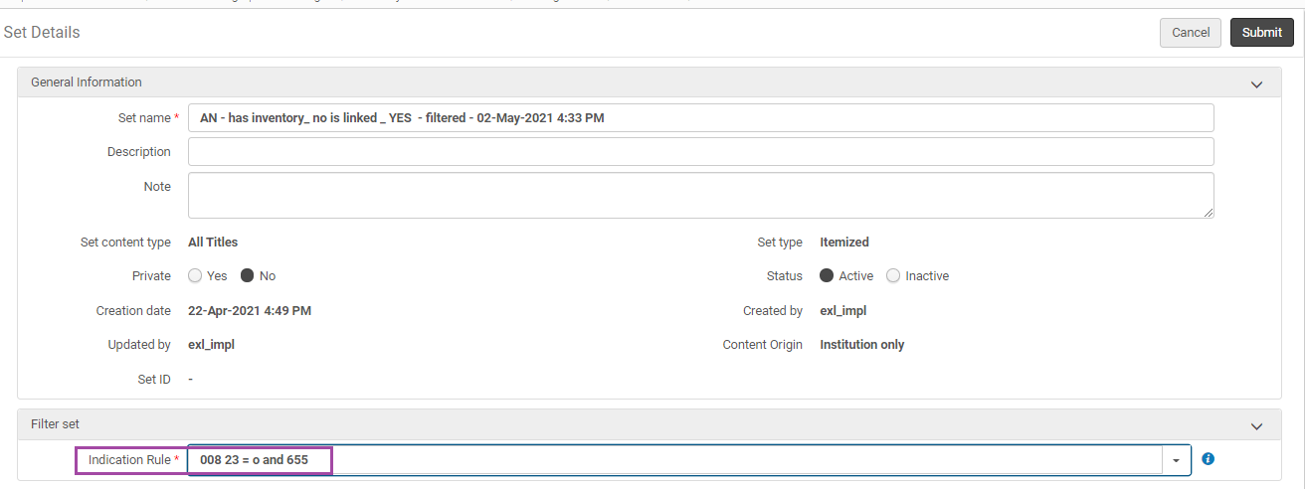
Indication Rules – filter a set by MARC fields and subfields

Slide 35
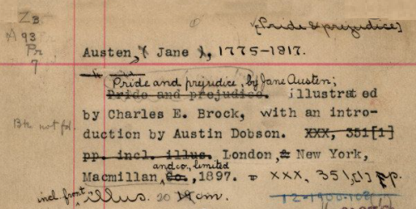
Creating Indication Rules
Indication Rules are helpful when you need a set that is based on metadata elements that are not indexed
For example, exclude government documents (where the 008 field byte 28 equals #, blank, or u)
Read more about Filtering Sets in the Online Help, and the Best Practices and How To’s

Slide 36
Where can I create sets from?
Search for and save Sets from your Institution Zone, the Community Zone, or your Network Zone.

Slide 37
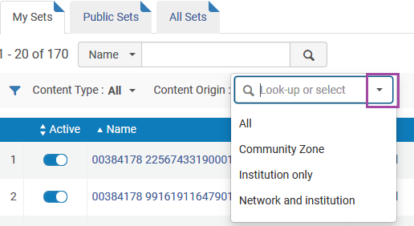
Sets – from Network Zone
If your Institution is part of a consortium, choose – Content Origin > Network and Institution
Search and manage your linked bib records

Slide 38
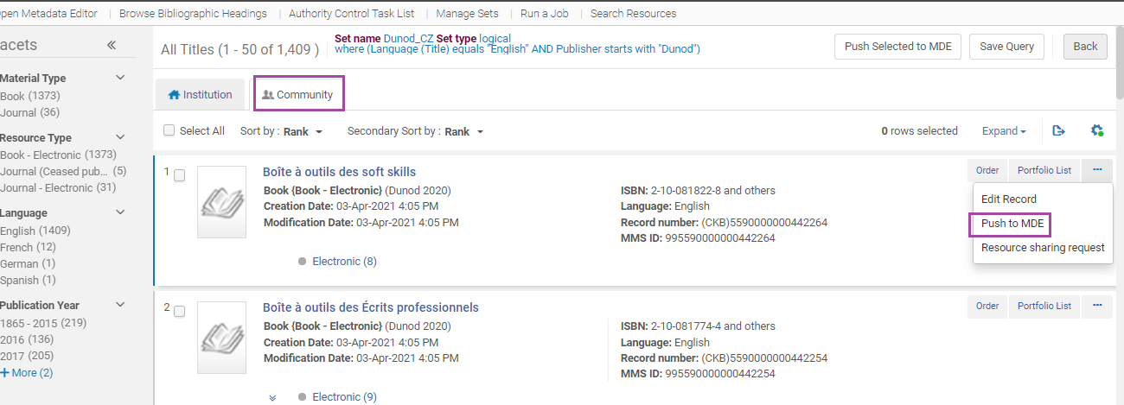
Sets – from Community Zone
For Community Zone sets, this option is available for bibliographic and authority records
For example, create a set and “Push to MDE”, order, export to Excel for more analysis.

Slide 39
Agenda:
An Introduction to Sets
Creating and Editing Sets
Set Manipulation
Running jobs on sets of data
Restore a job
Documentation, blogs, knowledge articles.
Agenda

Slide 40
Running a Set based Job
From Admin > Run a Job
Find the job based on –
Name (OCLC Republish, Export Bibliographic Records…)
Type (Information Update, Publish, Users)
Content Type (Physical Title, Purchase Order Line…)

Slide 41
Running a Set based Job
Select the Job
Use any filters, Job name, Content Type

Slide 42
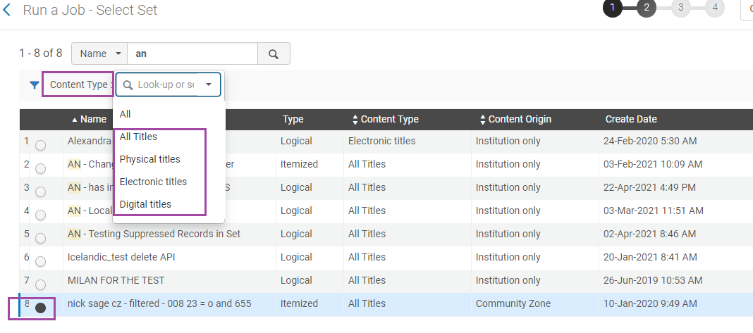
Running a Set based Job
Select the Set
Note: Only the relevant Content Type will show up!

Slide 43
Running a Set based Job
Complete the parameters
Inspect the estimate for Set size

Slide 44
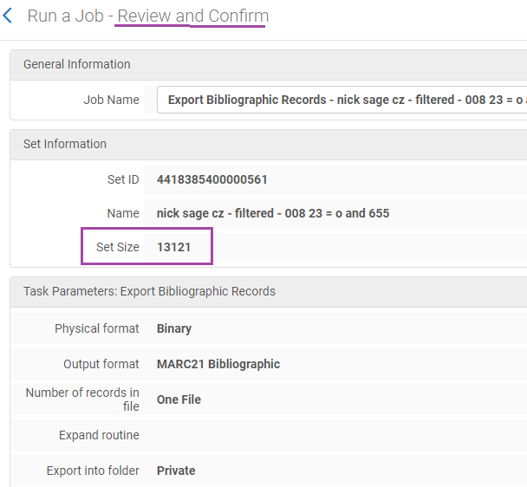
Running a Set based Job
Confirm again! Inspect the information which Alma provides
If everything is correct, submit the job. If not, use the back button in the wizard to correct errors

Slide 45
Running a Set based Job
See Job progress in – Monitor Jobs, then, History
Check the Report, Events for added information

Slide 46
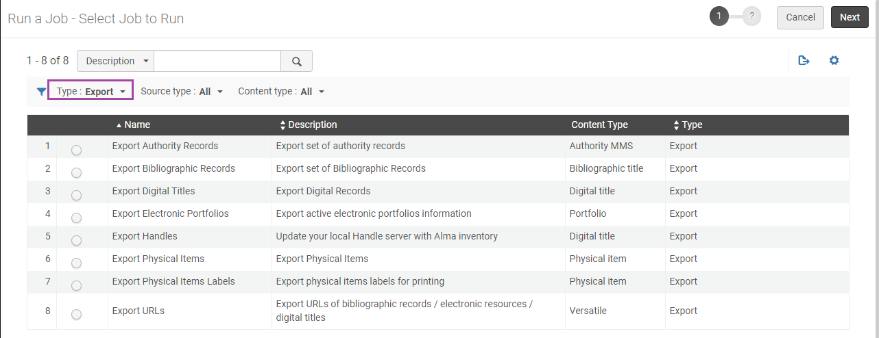
Other useful Jobs: Export Jobs

Slide 47
Also popular: Publishing

Slide 48
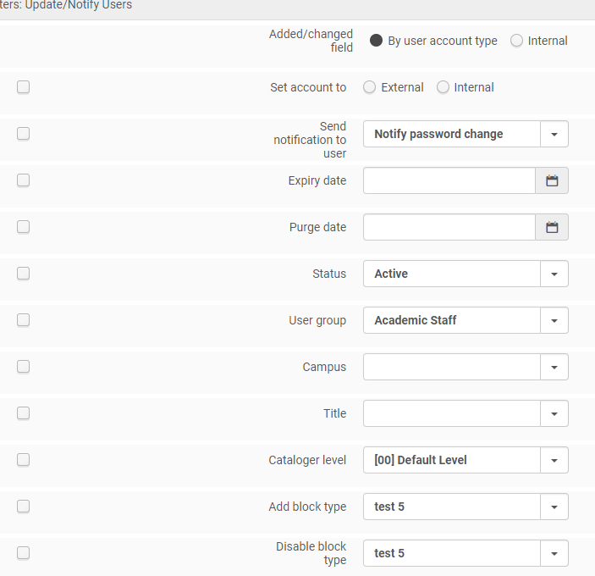
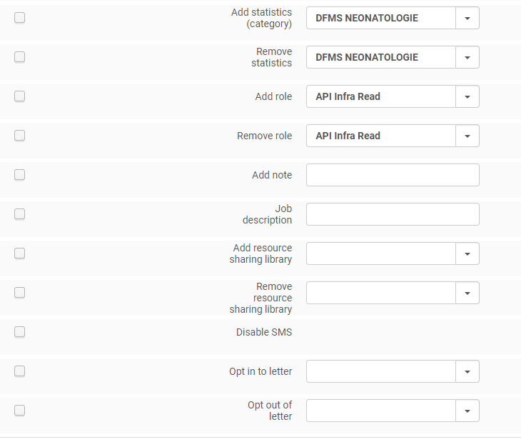
Take a look at: Update/Notify Users, parameters

Slide 49
Using Normalization Rule as a Job
Check out the steps

Slide 50
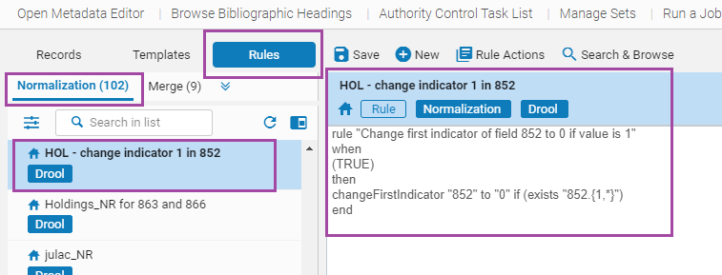
Normalization / Information Update, closer look
Use Case: Need to update 852 first indicator for a location which changes Call Number shelving
Ensure a Normalization Rule exists at Metadata Editor:

Slide 51
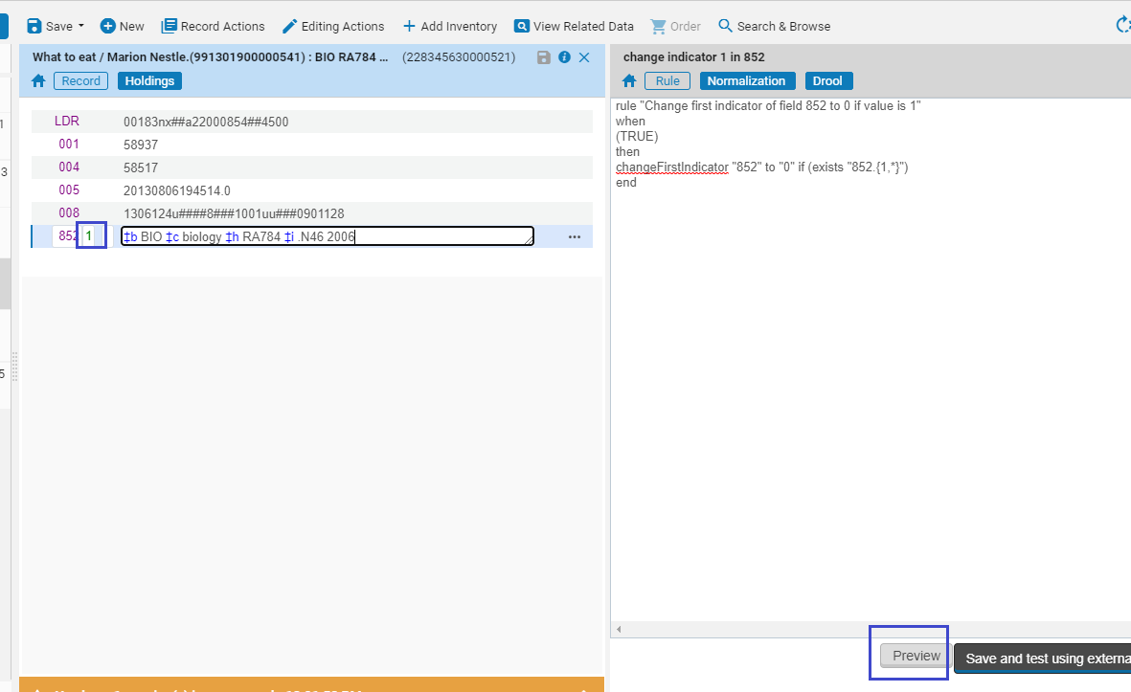
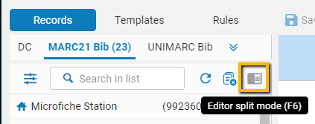
Normalization / Information Update
Edit a Holding Record > Split Screen, load the rule > Preview

Slide 52
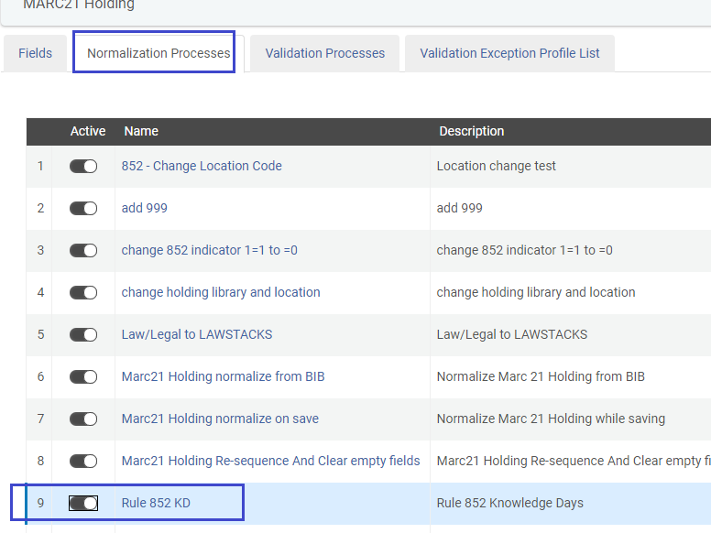
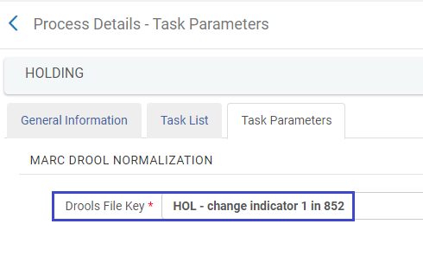
Normalization / Information Update
Add the Process to: Configuration > Resources > Metadata Configuration > MARC21 Holdings > Normalization Processes
The Process is linked to the Normalization Rule

Slide 53
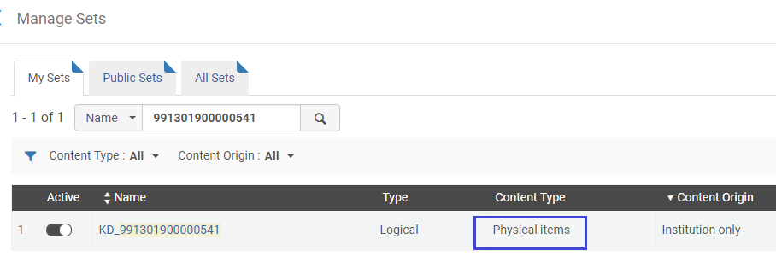
Normalization / Information Update
Create a Physical Items Set for the item(s)
Consult see OLH for Content Type

Slide 54
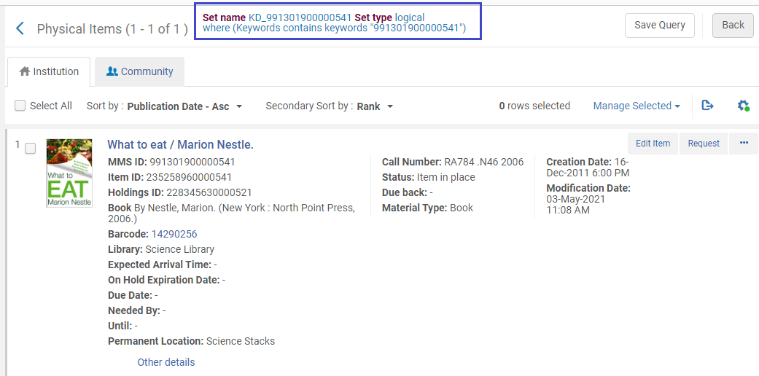
Normalization / Information Update
In “Physical Items” > find item barcode 14290256 > Save Query
If larger scope is needed - use Advanced Search, Analytics, or export to Excel and load as Itemized Set

Slide 55
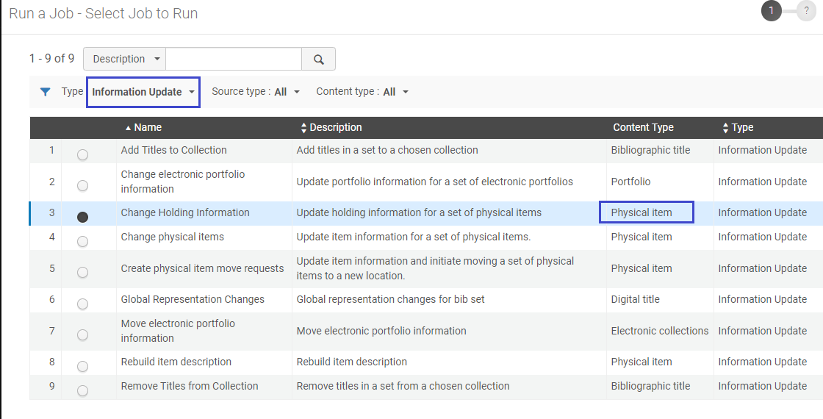
Normalization / Information Update
Admin > Run a Job > Change Holding Information

Slide 56
Normalization / Information Update
Select the Physical Items set – (search by name, or content type)

Slide 57
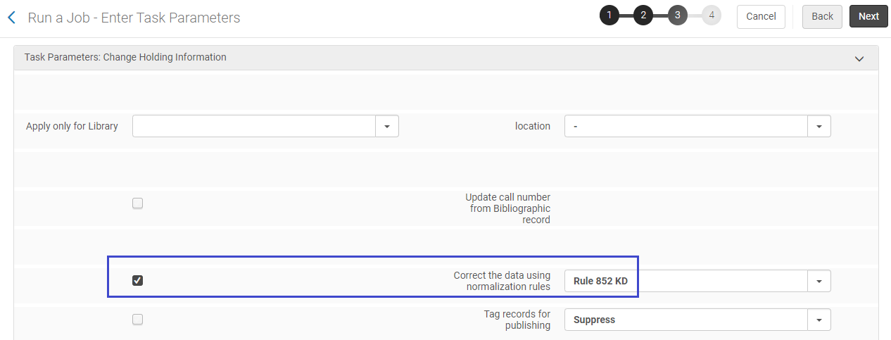
Normalization / Information Update
Fill in the parameters

Slide 58
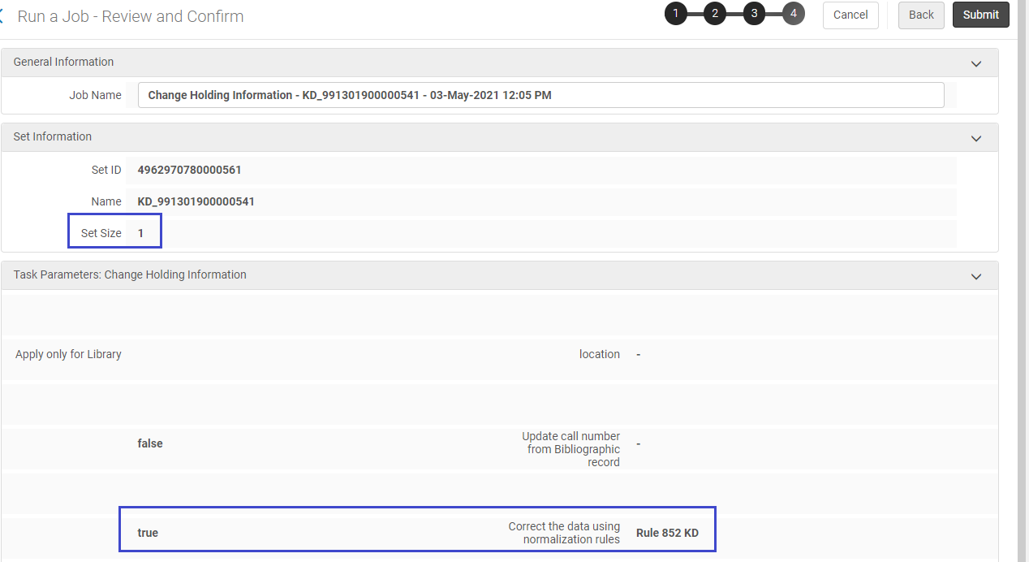
Normalization / Information Update
Double-check, Confirm, and Confirm

Slide 59
Normalization / Information Update
Job is “Running”, and then is in “History”

Slide 60
Normalization / Information Update
Job has completed, check the report and data

Slide 61
Agenda:
An Introduction to Sets
Creating and Editing Sets
Set Manipulation
Running jobs on sets of data
Restore a job
Documentation, blogs, knowledge articles.
Agenda

Slide 62
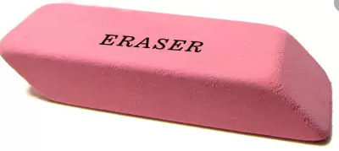
Restore a Job
To restore records, must have Role of Repository Manager
Can restore:
Withdraw items
Delete portfolios
Delete bibliographic records
KORMARC/MARC 21/UNIMARC normalization
Change holdings information
Authorities-preferred term correction
You can restore up to 5000 records. Open a Support case if you have more than 5000 set members.

Slide 63
Restore a Job
Resources > Advanced Tools > Restore Jobs
Or: Manage Deleted Repository

Slide 64
Restore a Job
Again, estimates before the job runs are helpful

Slide 65
Restore a Job
The calculation of records is higher for this job, as it includes more entities (such as: bib, holding and items)
Notes:
FYI

Slide 66
Some jobs can’t be “reversed”, workarounds may exist
Good idea – plan ahead, and test on a Sandbox first
Prepare, e.g., for “Purge Users”, read Best Practices
Tips and ideas to the rescue shared by the Community
Analytics data can be used –refreshed daily, with information on deleted data

Slide 67
Agenda:
An Introduction to Sets
Creating and Editing Sets
Set Manipulation
Running jobs on sets of data
Restore a job
Documentation, blogs, knowledge articles
Agenda

Slide 68
Next Steps and Resources
Online Help:
Managing Search Queries and Sets: https://knowledge.exlibrisgroup.com/Alma/Product_Documentation/010Alma_Online_Help_(English)/050Administration/070Managing_Jobs/060Managing_Search_Queries_and_Sets
Running Manual Jobs on Defined Sets: https://knowledge.exlibrisgroup.com/Alma/Product_Documentation/010Alma_Online_Help_(English)/050Administration/070Managing_Jobs/020Running_Manual_Jobs_on_Defined_Sets
Jobs, more detailed documentation: https://knowledge.exlibrisgroup.com/Alma/Product_Documentation/010Alma_Online_Help_(English)/050Administration/070Managing_Jobs/040Viewing_Running_Jobs#Job_Types_with_Their_Own_Management_Pages
Restoring Records Removed or Changed by Jobs: https://knowledge.exlibrisgroup.com/Alma/Product_Documentation/010Alma_Online_Help_(English)/050Administration/070Managing_Jobs/020Running_Manual_Jobs_on_Defined_Sets#Restoring_Records_Removed_or_Changed_by_Jobs

Slide 69
Next Steps and Resources
Blogs, articles:
Publish to external systems – read how to: Publish to RapidILL, publish to OCLC a selective set, publish Electronic Holdings to OCLC, publish to Third Iron (Browzine), to HathiTrust, and more.
Inspect deleted records: Add Deleted Records to a Set in Alma, and use it (sometimes indirectly) for Restoring Deleted Records
Knowledge Article, how to change “Missing” items to be “In Place”
Use the Cloud Apps: create a set and Bulk Scan-In, or Switch PO Line Types
Correcting “Technical – Migration” status after go-live

Slide 70
Next Steps and Resources
Knowledge Articles and Blogs (randomly selected):
How to link local portfolios (standalones) to the Community Zone:
https://knowledge.exlibrisgroup.com/Alma/Knowledge_Articles/How_to_link_local_portfolios_(standalones)_to_the_Community_Zone
Batch delete Process Type "Technical - Migration", or putting items in place in bulk: https://knowledge.exlibrisgroup.com/Alma/Knowledge_Articles/Items_not_in_place_(not_available)_-_how_to_fix_in_bulkbatch%3F
Create an itemized Users set based on Analytics
https://knowledge.exlibrisgroup.com/Alma/Knowledge_Articles/Create_Users_Set_for_expired_patrons_based_on_Analytics
How to Bulk Change PO Line Status?
https://knowledge.exlibrisgroup.com/Alma/Knowledge_Articles/How_to_Bulk_Change_PO_Line_Status%3F
xxx
Delete Your Sets
https://developers.exlibrisgroup.com/appcenter/delete-your-sets/

Slide 71
Amanda.Schriver@exlibrisgroup.com
Yaala.Ariel-Joel@exlibrisgroup.com

