Slide 1
Alma Digital - Copyright watermarks for image files
Yoel Kortick – Senior Librarian

Slide 2
Introduction
The three steps for defining copyright watermarks
Our sample image file
Let's set it up
Let's see it live

Slide 3
Introduction

Slide 4
Introduction
With the December 2021 Alma release it is possible to add copyright watermarks for image files.
The watermarks can appear in a specific position on the image or repeated across the image.
The watermarks are part of the overall copyright statement and allow the institution to ensure the proper use of the images.

Slide 5
The three steps for defining copyright watermarks

Slide 6
The three steps for defining copyright watermarks
The flow for defining and using copyright watermarks for image files is as follows:
Create a digital watermark
Attribute the watermark to a “Copyrights Statements – Digital”
Attribute the “Copyrights Statements – Digital” to a digital representation

Slide 7
Our sample image file

Slide 8
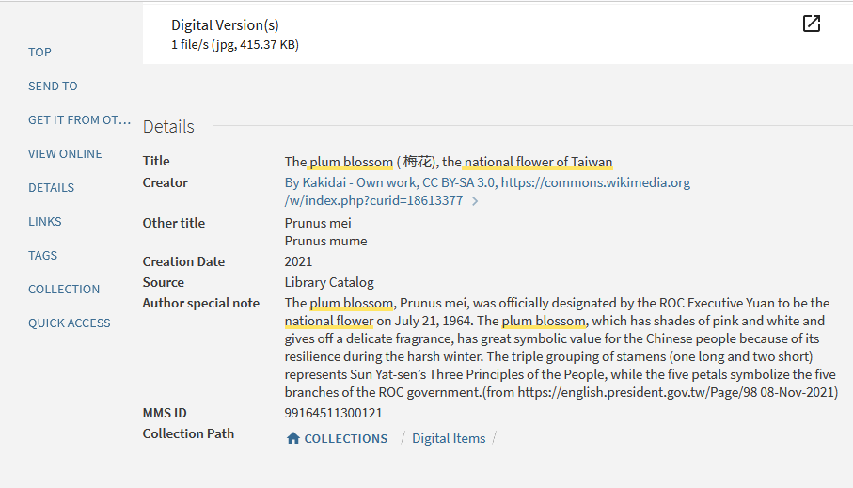
Our sample image file
We will use “The plum blossom ( 梅花), the national flower of Taiwan”

Slide 9
Our sample image file
It currently appears without the watermark

Slide 10
Our sample image file
Here it is in full screen mode

Slide 11
Let's set it up

Slide 12
Let's set it up
We will define this image to be our watermark, and we will call it “Creative Commons”

Slide 13
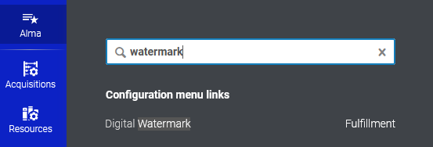
Let's set it up
Access the Digital Watermark configuration

Slide 14
Let's set it up
Add a watermark

Slide 15
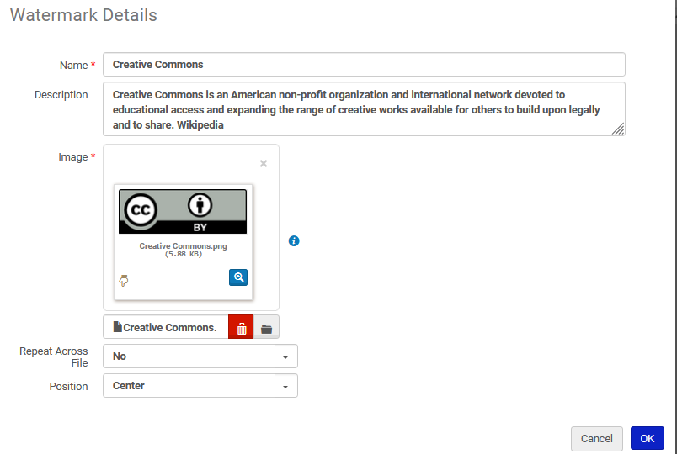
Let's set it up
Note that we have defined the watermark to appear in the center of the image
Here we have defined that the watermark will appear once and not “repeat across file”

Slide 16
Let's set it up
Now we have defined a digital watermark

Slide 17
Let's set it up
Attribute the watermark to a copyrights statement

Slide 18
Let's set it up
We will edit existing copyrights statement “Attribution 4.0 International (CC BY 4.0)”

Slide 19
Let's set it up
Add the watermark to the copyrights statement

Slide 20
Let's set it up
Note that it is also possible to add a column for the watermark to the list of copyrights statements

Slide 21
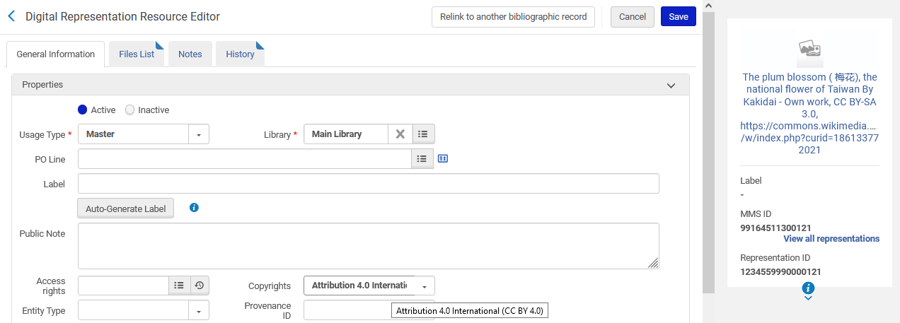
Let's set it up
Attribute the copyrights statement to a digital representation
This is the example we saw earlier that did not have a watermark
This is the copyrights statement that has the watermark

Slide 22
Let's see it live

Slide 23
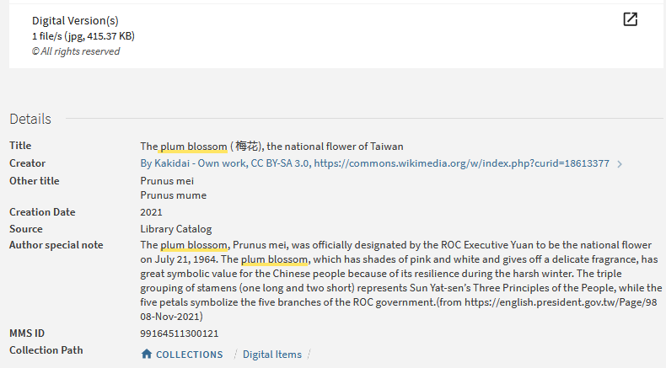
Let's see it live
We will click here

Slide 24
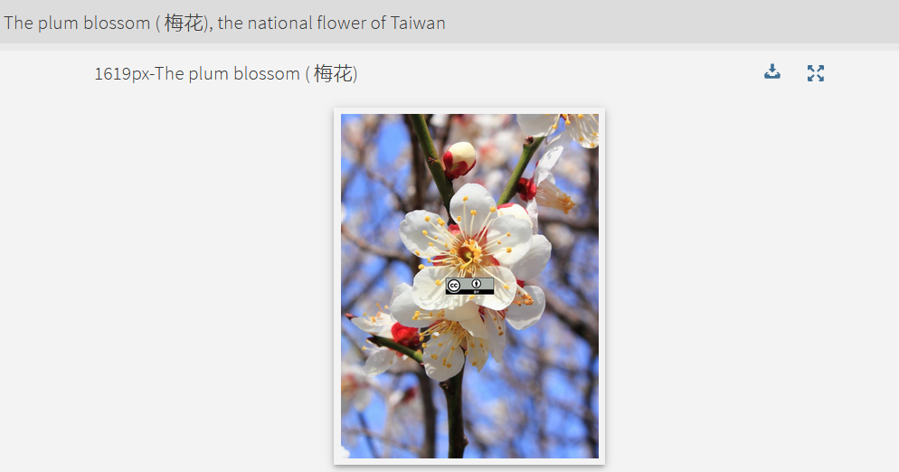
Let's see it live
The watermark appears in the center, as we previously defined.

Slide 25
Let's see it live
The watermark also appears in the full view

Slide 26
Let's see it live
The watermark also appears when the image is downloaded

Slide 27
xxx@exlibrisgroup.com

