Slide 1
How to add an image (icon) on the letterhead of the borrowing activity letter depending on the user group of the patron
Yoel Kortick – Senior Librarian

Slide 2
Agenda
The question
Identify the path and field name of the user group
Edit the XSL and add the condition
Testing the XSL with different users without sending the letter

Slide 3
The question

Slide 4
The question
Hi. I want to add an icon of the library to the header of the borrowing activity letter. I want the icon to be different depending on the user group of the patron.

Slide 5
Identify the path and field name of the user group

Slide 6
Identify the path and field name of the user group
We will need to make a condition based on the user group of the patron.
Therefore, we need to get the path and field name of the user group of the patron as it appears in the XML.
Go to “Configuration > General > Letters > Letter Configuration” and edit the “Borrowing Activity Letter”.
Go to the “Letter Examples” tab > Choose desired letter to preview > Preview the letter.
Download the XML
Look for the user group of the user.
Identify the name and path of the field

Slide 7
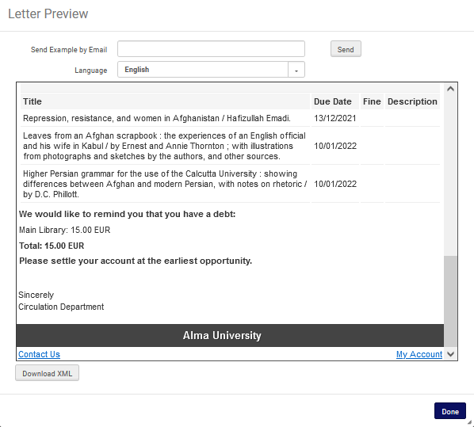
Identify the path and field name of the user group

Slide 8
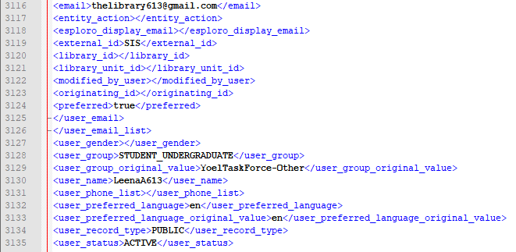
Identify the path and field name of the user group
Here we have opened the XML in notepad ++ and found the user group of the patron

Slide 9
Identify the path and field name of the user group
The path and name of field for the library of the ordered item is /notification_data/receivers/receiver/user/user_group
Here we used a notepad ++ plugin to get the path. It can also be done manually.

Slide 10
Edit the XSL and add the condition

Slide 11
Edit the XSL and add the condition
We will use this image if the patron user group is “Undergraduate” (which appears in the XML as STUDENT_UNDERGRADUATE):
https://upload.wikimedia.org/wikipedia/commons/thumb/9/95/Carnegie_Building.jpg/220px-Carnegie_Building.jpg

Slide 12
Edit the XSL and add the condition
We will use this image if the patron user group is “Graduate” (which appears in the XML as STUDENT_GRADUATE):
https://upload.wikimedia.org/wikipedia/commons/thumb/f/fa/HHL_Leipzig_Graduate_School_of_Management%2C_University_House.jpg/800px-HHL_Leipzig_Graduate_School_of_Management%2C_University_House.jpg

Slide 13
Edit the XSL and add the condition
An XSL condition to add the images based on the library name is on the next slide.
If you want the images to appear on the top of the letter then the text should be added after the following part of the letter
<xsl:attribute name="style">
<xsl:call-template name="bodyStyleCss" /><!-- style.xsl -->
</xsl:attribute>
And before the following part of the letter.
<xsl:call-template name="head" /><!-- header.xsl -->

Slide 14
Edit the XSL and add the condition
<xsl:attribute name="style">
<xsl:call-template name="bodyStyleCss" /><!-- style.xsl -->
</xsl:attribute>
<!-- begin add icons -->
<xsl:for-each select="notification_data">
<xsl:if test="/notification_data/receivers/receiver/user/user_group = 'STUDENT_UNDERGRADUATE'">
<center> <img src="https://upload.wikimedia.org/wikipedia/commons/thumb/9/95/Carnegie_Building.jpg/220px-Carnegie_Building.jpg" style="width:150px;height:150px;"/> </center>
</xsl:if>
</xsl:for-each>
<xsl:for-each select="notification_data">
<xsl:if test="/notification_data/receivers/receiver/user/user_group ='STUDENT_GRADUATE'">
<center> <img src="https://upload.wikimedia.org/wikipedia/commons/thumb/f/fa/HHL_Leipzig_Graduate_School_of_Management%2C_University_House.jpg/800px-HHL_Leipzig_Graduate_School_of_Management%2C_University_House.jpg" style="width:150px;height:150px;"/> </center>
</xsl:if>
</xsl:for-each>
<!-- end add icons -->
<xsl:call-template name="head" /><!-- header.xsl -->

Slide 15
Edit the XSL and add the condition
Edit the XSL of the letter as follows:
Go to “Configuration > General > Letters > Letter Configuration” and edit the “Borrowing Activity Letter”.
Go to the “Template” tab > Edit the letter> Preview the letter > Save.

Slide 16
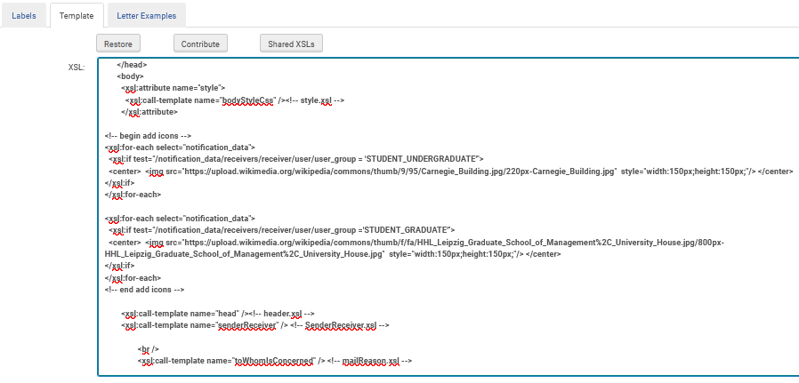
Edit the XSL and add the condition
Here is the edited XSL

Slide 17
Testing the XSL with different users without sending the letter

Slide 18
Testing the XSL with different users without sending the letter
We can test the XSL of the letter with different users without really sending the letter. This can be done as follows:
Download the XML (as we did in section “Identify the path and field name of the user group”)
Save a copy of the XML with text <user_group>STUDENT_UNDERGRADUATE</user_group> and save it as “FulUserBorrowingActivityLetter - Undergraduate.xml”
Save a copy of the XML with text <user_group>STUDENT_GRADUATE</user_group> and save it as “FulUserBorrowingActivityLetter - Graduate.xml”
Add these two XMLs via “Upload Letter Example (XML)” in the “Letter Examples” tab.
Preview each letter

Slide 19
Testing the XSL with different users without sending the letter
The two XMLs

Slide 20
Testing the XSL with different users without sending the letter
Add the XMLs in the “Letter Examples” tab

Slide 21
Testing the XSL with different users without sending the letter
Preview each letter.
We will start with the letter for the Graduate Student

Slide 22
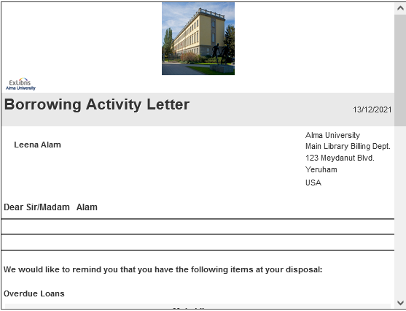
Testing the XSL with different users without sending the letter
It correctly has the image defined for the graduate student

Slide 23
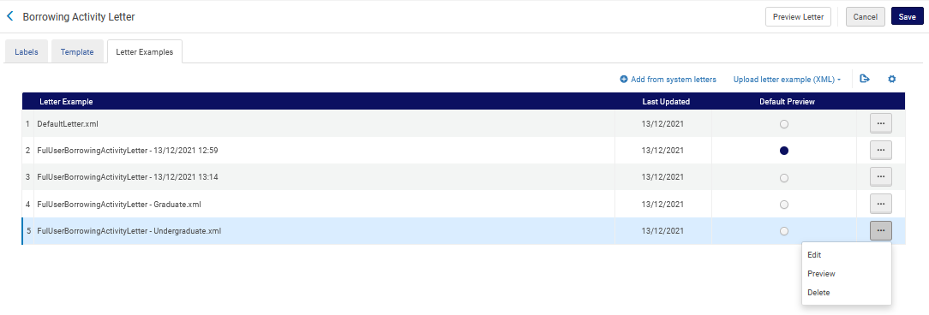
Testing the XSL with different users without sending the letter
Preview each letter.
We will start with the letter for the Undergraduate Student

Slide 24
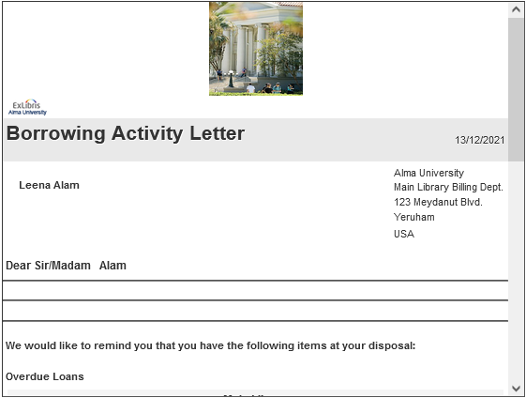
Testing the XSL with different users without sending the letter
It correctly has the image defined for the Graduate student

Slide 25
xxx@exlibrisgroup.com

