Slide 1
NERS 6795: Enhanced Ability to Filter a Set Using an Indication Rule
Yoel Kortick
Senior Librarian

Slide 2
Introduction

Slide 3
Introduction
From the Release Notes
See also NERS 2020

Slide 4
Introduction
Before this development the only method to filter a logical set using an indication rule was as follows:
Search the repository
Click “Save Query”
Save the query as a set
Access the sets at Admin > Manage Jobs and Sets > Manage Sets
Search for and find the set
Choose “Filter Set” from the list of row actions
Select desired indication rule and filter

Slide 5
Introduction
As we will now see, filtering logical sets using indication rules can now be done faster and with less clicks

Slide 6
The new method to filter a set using an indication rule

Slide 7
The new method to filter a set using an indication rule
The button for saving a query that appears for all types of repository Title searches (All Titles, Physical Titles, Electronic Titles, Digital Titles), is now called "Save and Filter Query" (previously was called "Save Query").
This was done only on repository Title searches since filtering logical sets is possible only on these search types.

Slide 8
The new method to filter a set using an indication rule
After clicking “Save and filter query” on previous slide the Set Details page opens, and the staff user can define the set to create from the search results.
On this page, a new button "Save and Filter" allows the staff user to initiate the process of saving a set that is to be filtered.

Slide 9
The new method to filter a set using an indication rule
After clicking “Save and filter”, a new page opens where the staff user can create the filtered set of that main set.
The main set is created in the background in the meantime.
Selecting "Filter This Set" enables the staff user to create an itemized set that consists of the filtering done on the main set according to the selected rule.

Slide 10
The new method to filter a set using an indication rule
When the new set is ready, it appears on the Set Details page of the main set.
A similar section appears for the original set from which this set was created, listing all its filtered sets.
The row actions list for the new set contains all the actions that can be achieved on this set, identical to the actions available from the Manage Sets page.

Slide 11
Let's see a real live example

Slide 12
Let's see a real live example
In the example here we will find all bibliographic records which have the word “Literature” (with a capital or lowercase “l” at the beginning) in subfield a.
When searching by the title index we find records with the word “literature” in many more field / subfield combinations than only 245 subfield a
However, we want only bibliographic records which have the word “Literature” in field 245 subfield a.

Slide 13
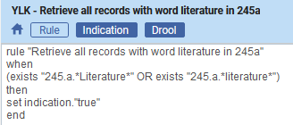
Let's see a real live example
We have an indication rule called “YLK - Retrieve all records with word literature in 245a” as follows:
It looks for the word “literature” with a capital or lowercase “l” anywhere in the 245 subfield a and if it exists then the result is “true”.

Slide 14
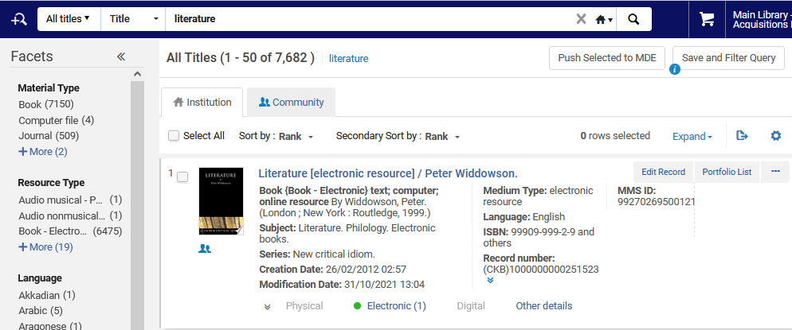
Let's see a real live example
If we do an “All Titles” search for word from title = “literature” we get 7,682 records

Slide 15
Let's see a real live example
Those 7,682 records could have the word “Literature” in many fields (not just the 245 subfield a).
This is because (as we see on the next slides) the title index includes many field / subfield combinations, not only 245 subfield a

Slide 16
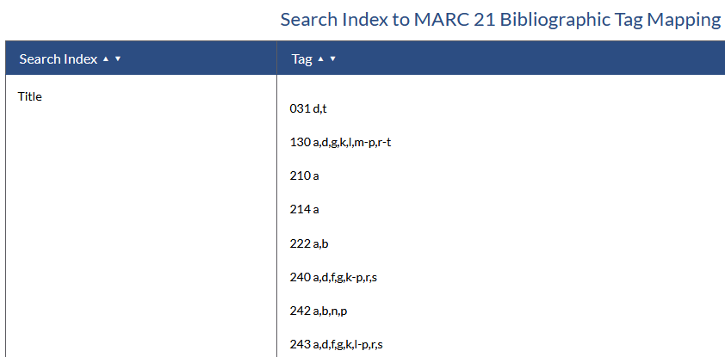
Let's see a real live example
Field / subfield combinations indexed to the “Tile” index

Slide 17
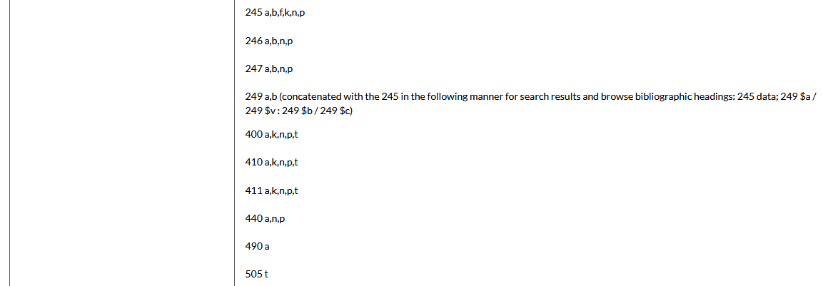
Let's see a real live example
Field / subfield combinations indexed to the “Tile” index

Slide 18
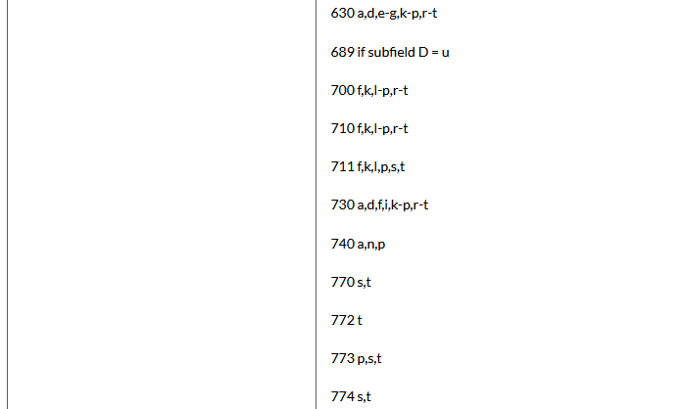
Let's see a real live example
Field / subfield combinations indexed to the “Tile” index

Slide 19
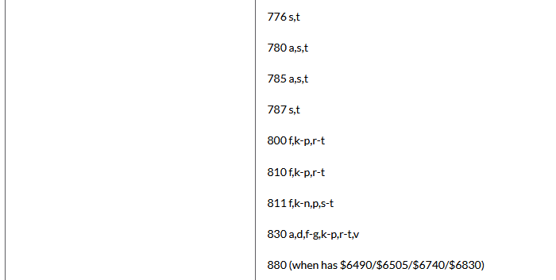
Let's see a real live example
Field / subfield combinations indexed to the “Tile” index

Slide 20
Let's see a real live example
As stated: We want only records which have “Literature” in the 245 subfield a, and not in the many other field / subfield combinations which are also indexed in the title.
Therefore, we will search and then click “Save and Filter Query”

Slide 21
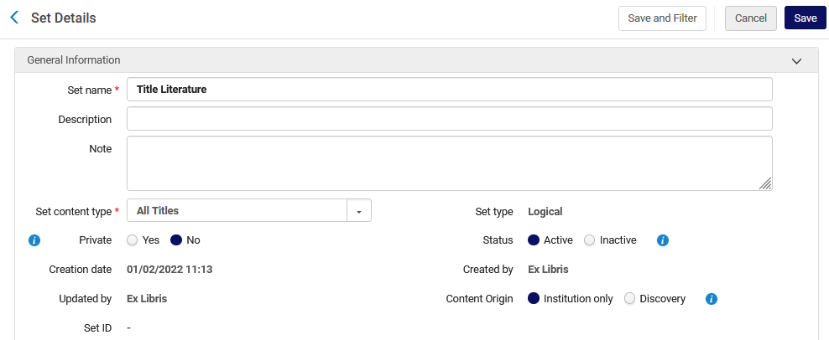
Let's see a real live example
Now we will name the set “Title Literature” and then choose “Save and Filter”

Slide 22
Let's see a real live example
We will filter the set with the indication rule “YLK – Retrieve all records with word literature in 245a” and call the filtered set “Title Literature – filtered – literature in 245a”. We click “Filter this set”

Slide 23
Let's see a real live example
The job “Filter set by indication” runs

Slide 24
Let's see a real live example
The job “Filter set by indication” completes

Slide 25
Let's see a real live example
We have our original set and the new filtered set:
New filtered set
Original set

Slide 26
Let's see a real live example
From the original set we can see all sets were created by filtering the set.
These appear in the bottom section of the set details in a section called “Sets created by filtering this set”

Slide 27
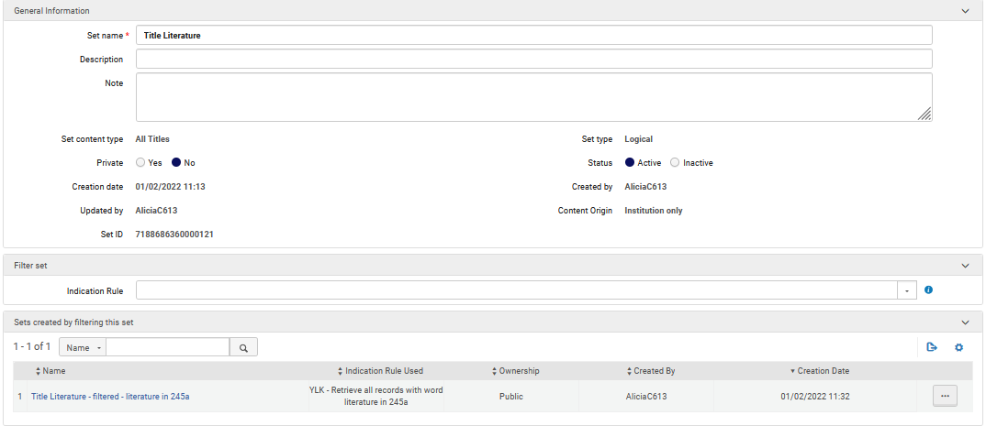
Let's see a real live example

Slide 28
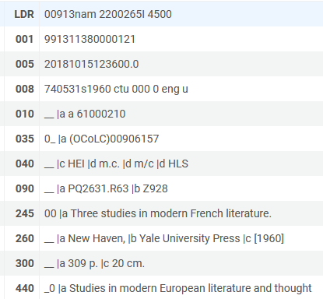
Let's see a real live example
All bibliographic records in the new set have the word “literature” in the 245 subfield a, for example:

Slide 29
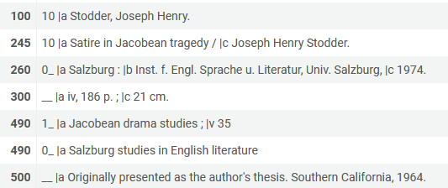
Let's see a real live example
All bibliographic records with “literature” in a different field (not 245 subfield a) which is sent to the title index are not in the filtered set, for example:
“literature is not in 245a
“literature is in a different field which is indexed to the title

Slide 30
xxx@exlibrisgroup.com

