Slide 1
Traditional Chinese Authority URI enrichment to Linked Data in Alma
Taiwan Linked Data Conference
March 18, 2022
Yoel Kortick
Senior Librarian, Ex Libris

Slide 2
Agenda
Why Linked Data
Linked Data and this presentation
Linked Data in Discovery Interface of an Alma Institution - Example 1
Linked Data in Discovery Interface of an Alma Institution - Example 2
Extracting Linked Data from Alma via APIs – Example 1
Extracting Linked Data from Alma via APIs – Example 2
Extracting Linked Data from Alma via general publishing profile
Viewing the Linked Data in Alma

Slide 3
Why Linked Data
3

Slide 4
Why Linked Data
Before we begin discussing the “Traditional Chinese Authority URI enrichment to Linked Data in Alma”, let’s first discuss why it is useful to use Linked Data in the first place.
Linked data is not just a “fancy buzz word” or “academic exercise” for librarians curating, storing and displaying data.
Linked data has real benefits for the library world.¹
¹ See also: Peter Neish (2015) Linked data: what is it and why should you care?, The Australian Library Journal, 64:1, 3-10, DOI: 10.1080/00049670.2014.974004

Slide 5
Why Linked Data
Linked Data can:
Enhance search results thereby making resources easier to find.
Be incorporated into online content relatively easily using well-known vocabularies. This will be seen this presentation regarding three “well-known vocabularies”:
TWNAF - Taiwan Name Authority File
LCSTT - List of Chinese Subject Terms
NCSCLT - New classification scheme for Chinese libraries
Provide an open interactive system, with external links and the ability to make information easily accessible, re-usable and with the possibility of serendipitous discovery of other resources.²
² Alemu, G., Stevens, B., Ross, P., & Chandler, J. (2012). Linked Data for libraries: Benefits of a conceptual shift from library-specific record structures to RDF-based data models. New Library World, 113(11), 549-570. http://dx.doi.org/10.1108/03074801211282920

Slide 6
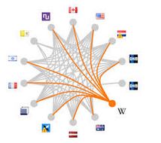
Why Linked Data
The linked data is typically used as a starting point to “crawl” to additional sources.
In a Linked Data context, ideally one would simply follow the links and “crawl” from one data description to another.
https://www.careerguide.com/blog/wp-content/uploads/2017/10/Data-Career-1.jpg
https://www.pregmed.org/wp-content/uploads/2015/04/A-Crawling-Baby.jpg

Slide 7
Linked Data and this presentation
7

Slide 8
Linked Data and this presentation
Linked data in Alma brings references to a variety of sources, for example:
Vocabulary field Linked data URI Label
bibo:isbn10 http://www.isbnsearch.org/isbn/
bibo:isbn13 http://www.isbnsearch.org/isbn/
bibo:issn http://worldcat.org/issn/
bibo:oclcnum http://www.worldcat.org/oclc/
dct:creator http://viaf.org/viaf/sourceID/
dct:creator http://id.loc.gov/authorities/names/
dct:subject http://id.loc.gov/authorities/subjects/
dct:language http://id.loc.gov/vocabulary/iso639-2/

Slide 9
Linked Data and this presentation
This presentation will focus on sources unique to Taiwan for the Traditional Chinese Authority data from http://ld.ncl.edu.tw “Linked Open Data Taiwan @ Library”, for example:
Name Authority: http://ld.ncl.edu.tw/authority (Code: TWNAF)
Subject term: http://ld.ncl.edu.tw/subject (Code: LCSTT)
Classification scheme: http://ld.ncl.edu.tw/classification (Code: NCSCLT)
The sources for each of these authorities is explained on the next slide.

Slide 10
Linked Data and this presentation
The three sources of the URI enrichment for the Traditional Chinese authorities are in the Alma Community Zone, and are explained in Authority Vocabularies in the Community Zone
The Name Authority TWNAF is the "Taiwan Name Authority File"
The Subject Term LCSTT is the "List of Chinese Subject Terms"
The Classification Scheme NCSCLT is "New classification scheme for Chinese libraries"

Slide 11
Linked Data in Discovery Interface of an Alma Institution - Example 1
11

Slide 12
Linked Data in Discovery Interface of an Alma Institution - Example 1
We will now look at an example whereby an Alma institution has included the linked data in the discovery results.
Technical aspects are explained in the Tech Blog “Using the linked data integration API to enhance discovery from Steve Meyer of the University of Wisconsin: https://developers.exlibrisgroup.com/blog/Using-the-Linked-Data-Integration-API-to-Enhance-Discovery

Slide 13
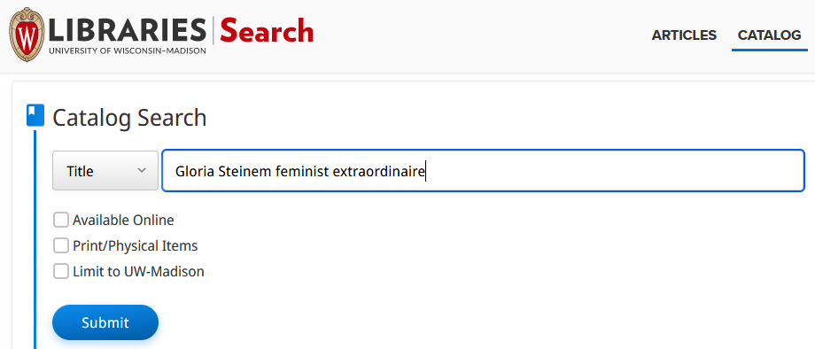
Linked Data in Discovery Interface of an Alma Institution - Example 1
We will search https://search.library.wisc.edu/search/system for title “Gloria Steinem feminist extraordinaire”

Slide 14
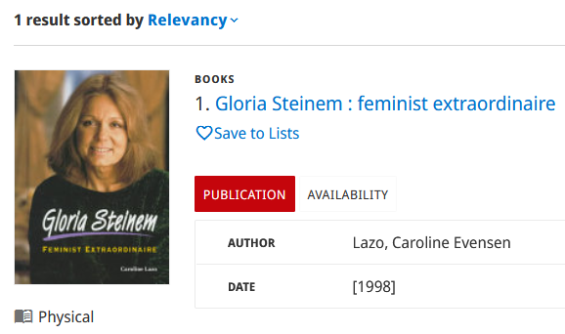
Linked Data in Discovery Interface of an Alma Institution - Example 1
Now from results we will click the title for the “full view”.

Slide 15
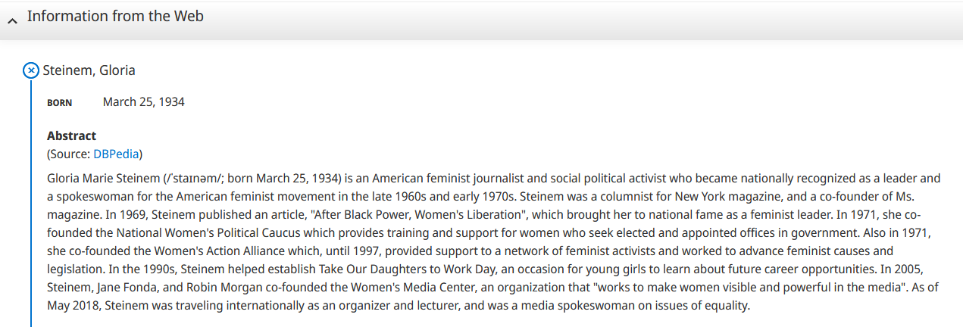
Linked Data in Discovery Interface of an Alma Institution - Example 1
In lower section of the “full view” in section “Information from the web” we see information from http://dbpedia.org/resource/Gloria_Steinem

Slide 16
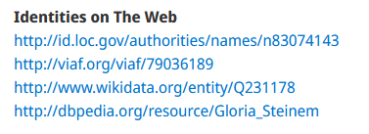
Linked Data in Discovery Interface of an Alma Institution - Example 1
There is also information from Wikidata and other sources

Slide 17
Linked Data in Discovery Interface of an Alma Institution - Example 2
17

Slide 18
Linked Data in Discovery Interface of an Alma Institution - Example 2
Now we will look at another example from a different Alma Institution: The Hong Kong University of Science and Technology.
The Primo search is at https://julac.hosted.exlibrisgroup.com/primo-explore/search?vid=HKUST
We will search the library catalog for title “Lean in women work and the will to lead”

Slide 19
Linked Data in Discovery Interface of an Alma Institution - Example 2
From the results we will click the title to see the full view

Slide 20
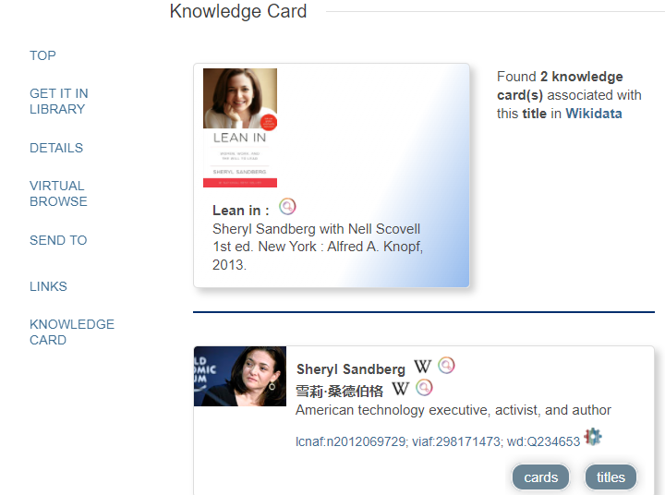
Linked Data in Discovery Interface of an Alma Institution - Example 2
Now we have a link to the “Knowledge Card”
Link to Wikidata
Link to LC Name Authority record
Link to viaf

Slide 21
Extracting Linked Data from Alma via APIs
21

Slide 22
Extracting Linked Data from Alma via APIs
Linked data can be extracted from Alma via APIs and via publishing
After extracting it can be used in discovery for aiding the user.
To use the APIs for linked data a Linked Data integration profile must be set active.

Slide 23
Extracting Linked Data from Alma via APIs
The syntax to use APIs is as follows:
For format JSONLD
https://open-na.hosted.exlibrisgroup.com/alma/{Institution Code}/bibs/{MMSID}.jsonld
For format BIBFRAME
https://open-na.hosted.exlibrisgroup.com/alma/{Institution Code}/bf/entity/instance/{MMSID}
For format RDA
https://open-na.hosted.exlibrisgroup.com/alma/{Institution Code}/rda/entity/manifestation/{MMSID}

Slide 24
Extracting Linked Data from Alma via APIs – Example 1
24

Slide 25
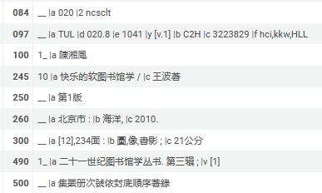
Extracting Linked Data from Alma via APIs – Example 1
Our first example will be MMSID 99438187700121, title 快乐的软图书馆学 :

Slide 26
Extracting Linked Data from Alma via APIs – Example 1
The syntax for MMSID 99438187700121 in institution EXLDEV1_INST-eu is as follows:
For format JSONLD
https://open-na.hosted.exlibrisgroup.com/alma/EXLDEV1_INST-eu/bibs/99438187700121.jsonld
For format BIBFRAME
https://open-na.hosted.exlibrisgroup.com/alma/EXLDEV1_INST-eu/bf/entity/instance/99438187700121
For format RDA
https://open-na.hosted.exlibrisgroup.com/alma/EXLDEV1_INST-eu/rda/entity/manifestation/99438187700121

Slide 27
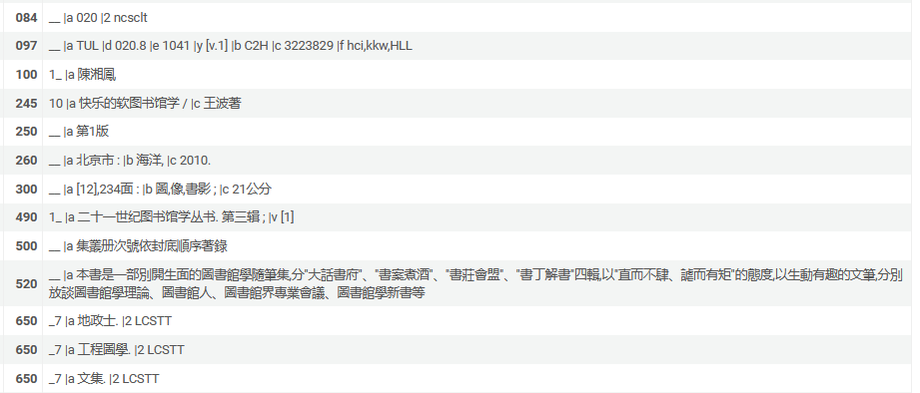
Extracting Linked Data from Alma via APIs – Example 1
Here is a partial screenshot of MMSID 99438187700121

Slide 28
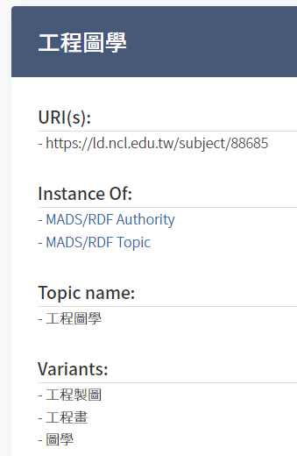
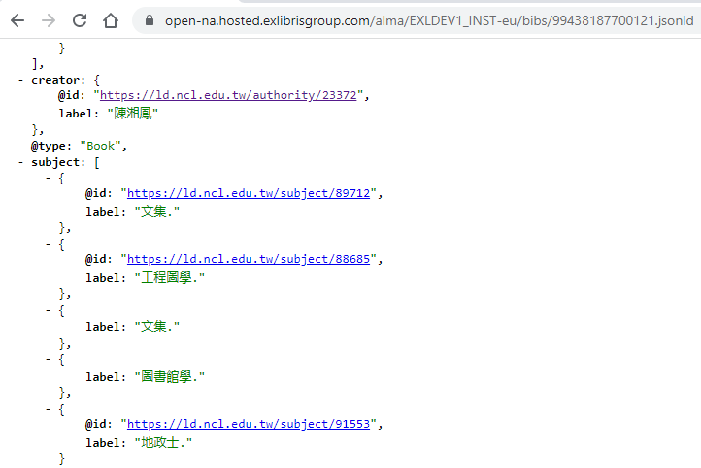
Extracting Linked Data from Alma via APIs – Example 1
Here is the JSONLD
These sources are from “Linked Open Data Taiwan @ Library” http://ld.ncl.edu.tw/

Slide 29
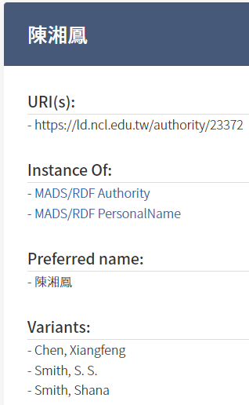
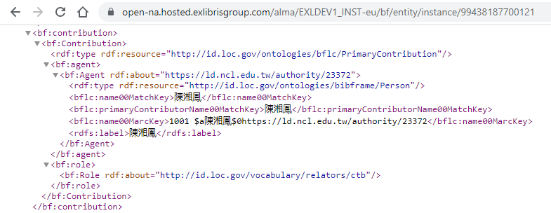
Extracting Linked Data from Alma via APIs – Example 1
Here is the BIBRAME
These sources are from “Linked Open Data Taiwan @ Library” http://ld.ncl.edu.tw/

Slide 30
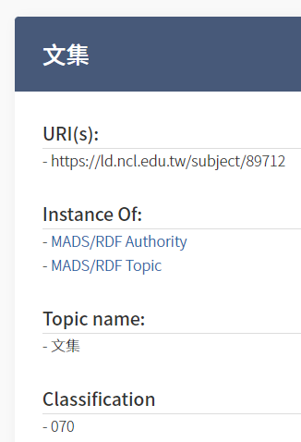
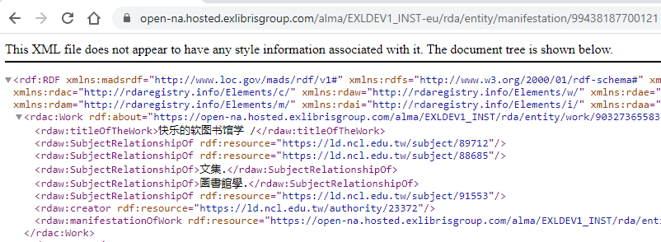
Extracting Linked Data from Alma via APIs – Example 1
Here is the RDA
These sources are from “Linked Open Data Taiwan @ Library” http://ld.ncl.edu.tw/

Slide 31
Extracting Linked Data from Alma via APIs – Example 2
31

Slide 32
Extracting Linked Data from Alma via APIs – Example 2
Our second example will be MMSID 99438286700121, title 挺身而進 : 女性、工作、抱負 / 雪柔.桑德伯格著 ; 洪慧芳譯 = Lean In : women, work and the will to lead

Slide 33
Extracting Linked Data from Alma via APIs – Example 2
The syntax for MMSID 99438286700121 in institution EXLDEV1_INST-eu is as follows:
For format JSONLD
https://open-na.hosted.exlibrisgroup.com/alma/EXLDEV1_INST-eu/bibs/99438286700121.jsonld
For format BIBFRAME
https://open-na.hosted.exlibrisgroup.com/alma/EXLDEV1_INST-eu/bf/entity/instance/99438286700121
For format RDA
https://open-na.hosted.exlibrisgroup.com/alma/EXLDEV1_INST-eu/rda/entity/manifestation/99438286700121

Slide 34
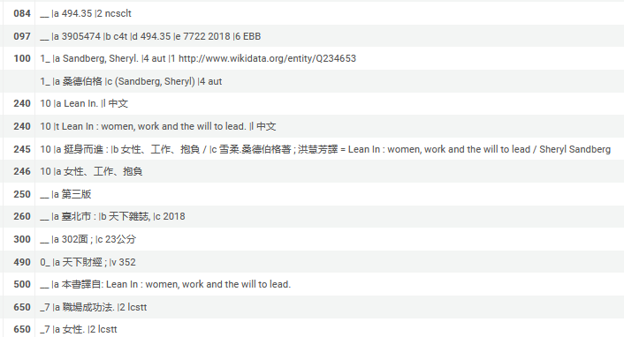
Extracting Linked Data from Alma via APIs – Example 2
Here is a partial screenshot of MMSID 99438286700121

Slide 35
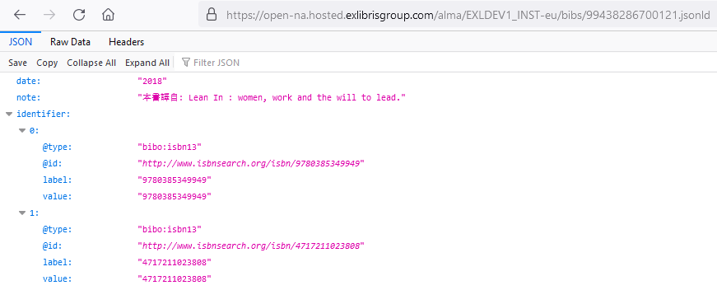
Extracting Linked Data from Alma via APIs – Example 2
Here is the JSONLD part 1
On the next slide we will look at this URL from www.isbnsearch.org

Slide 36
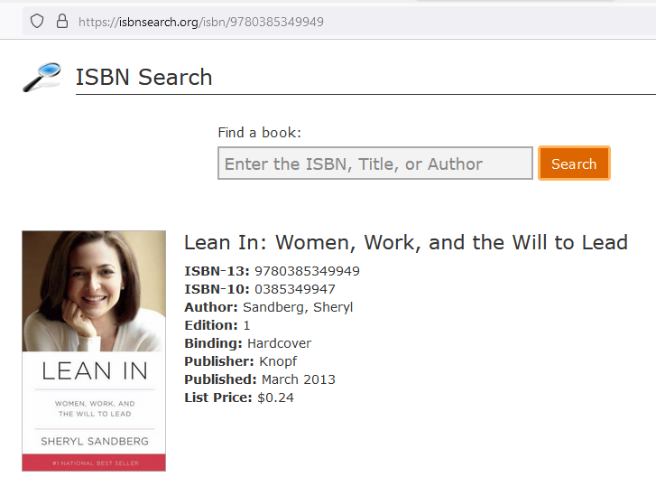
Extracting Linked Data from Alma via APIs – Example 2

Slide 37
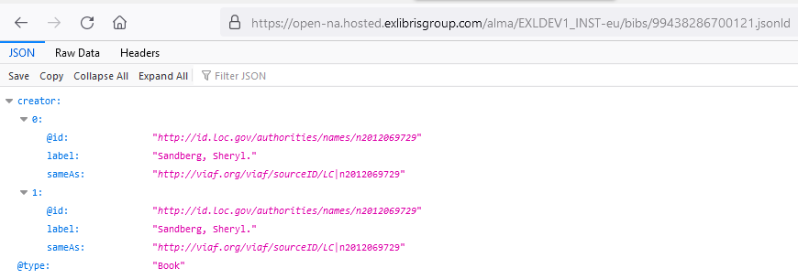
Extracting Linked Data from Alma via APIs – Example 2
Here is the JSONLD part 2
On the next slide we will look at this URL from id.loc.gov

Slide 38
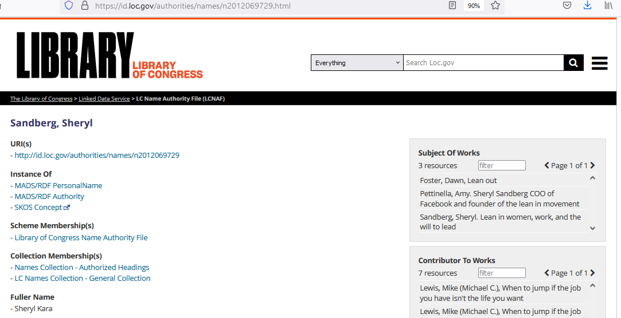
Extracting Linked Data from Alma via APIs – Example 2

Slide 39
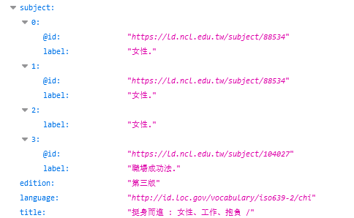
Extracting Linked Data from Alma via APIs – Example 2
Here is the JSONLD part 3
On the next slide we will look at this URL from ld.ncl.edu

Slide 40
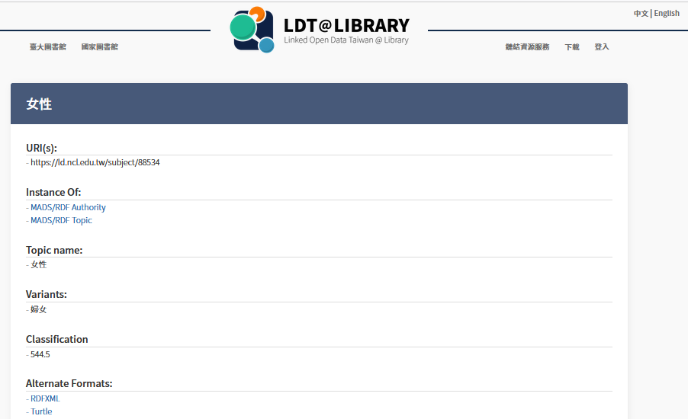
Extracting Linked Data from Alma via APIs – Example 2

Slide 41
Extracting Linked Data from Alma via general publishing profile
41

Slide 42
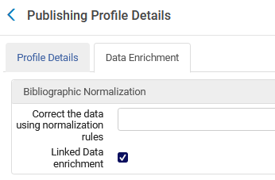
Extracting Linked Data from Alma via general publishing profile
Here is the Data Enrichment tab of the General Publishing profile

Slide 43
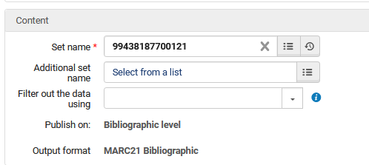
Extracting Linked Data from Alma via general publishing profile
In the example here we are publishing to format MARC21 with Linked Data.

Slide 44
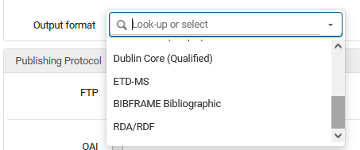
Extracting Linked Data from Alma via general publishing profile
We could have published to BIBFRAME or RDA

Slide 45
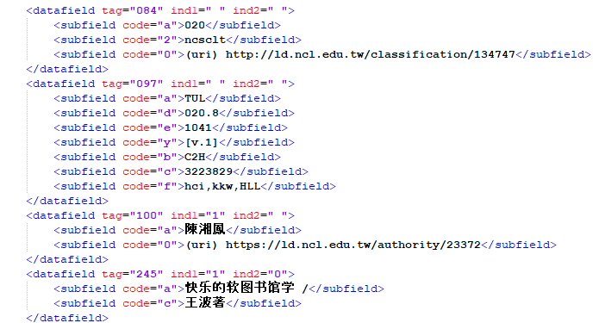
Extracting Linked Data from Alma via general publishing profile
The records get published with the linked data (part 1 of 2)
These sources are from “Linked Open Data Taiwan @ Library” http://ld.ncl.edu.tw/

Slide 46
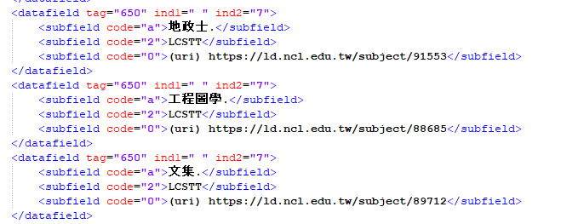
Extracting Linked Data from Alma via general publishing profile
The records get published with the linked data (part 2 of 2)
These sources are from “Linked Open Data Taiwan @ Library” http://ld.ncl.edu.tw/

Slide 47
Viewing the Linked Data in Alma
47

Slide 48
Viewing the Linked Data in Alma
The linked data can be viewed in Alma from a variety of places:
The repository search results page
The “record view”
The metadata editor

Slide 49
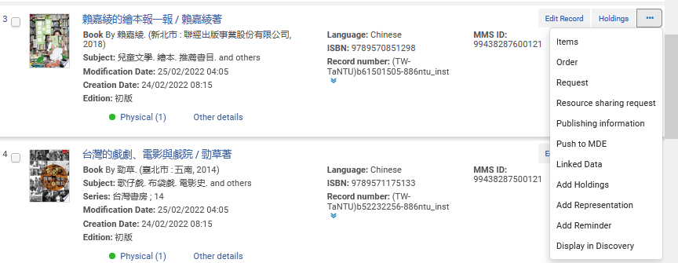
Viewing the Linked Data in Alma
From the repository search results

Slide 50
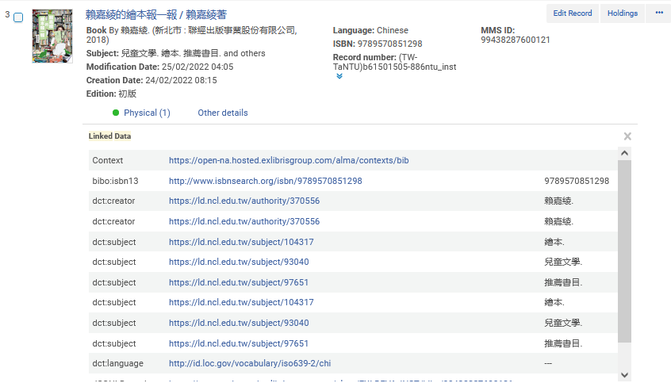
Viewing the Linked Data in Alma
From the repository search results
These sources are from “Linked Open Data Taiwan @ Library” http://ld.ncl.edu.tw/

Slide 51
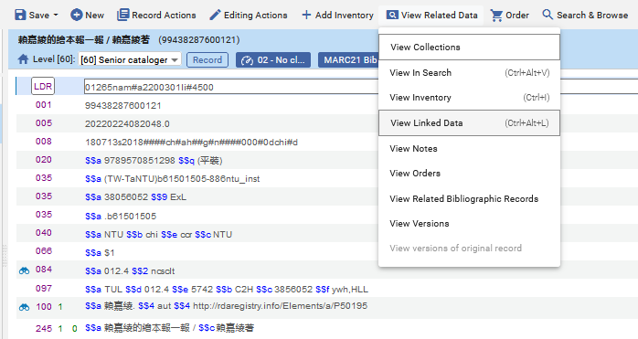
Viewing the Linked Data in Alma
We can also see the “Linked Data” in the Metadata Editor

Slide 52
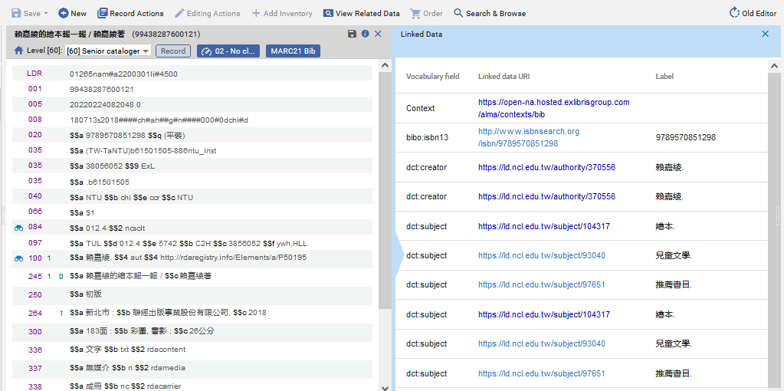
Viewing the Linked Data in Alma
We can also see the “Linked Data” in the Metadata Editor
These sources are from “Linked Open Data Taiwan @ Library” http://ld.ncl.edu.tw/

Slide 53
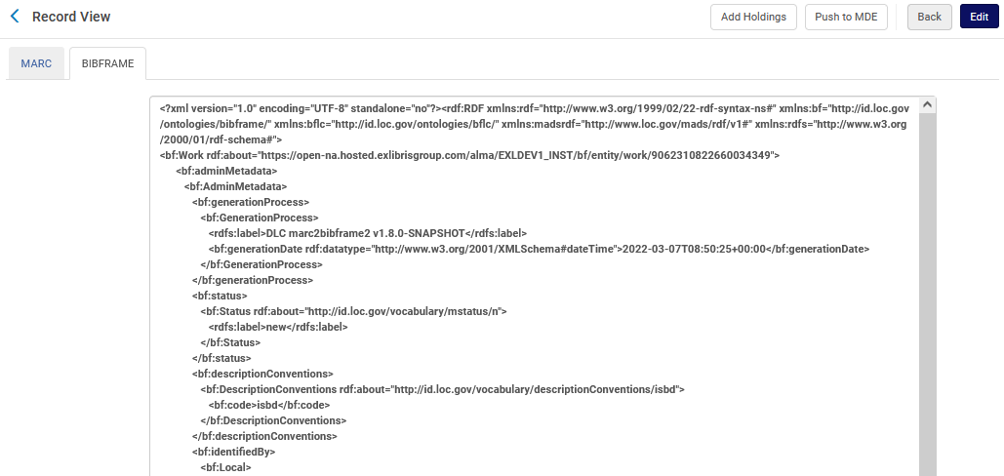
Viewing the Linked Data in Alma
The record in BIBFRAME can be seen in the BIBFRAME tab of the record view

Slide 54
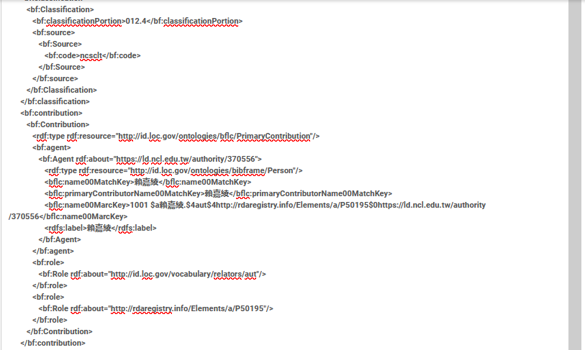
Viewing the Linked Data in Alma
The record in BIBFRAME can be seen in the BIBFRAME tab of the record view
This is a source from “Linked Open Data Taiwan @ Library” http://ld.ncl.edu.tw/

Slide 55
xxx@exlibrisgroup.com

