Slide 1
Linked Open Data – Vision and Reality
March 2022
Itai Veltzman, Director of Product Management
Library Solutions

Slide 2
Agenda
Why Linked Open Data?
Where we want to go?
Here we are
Coming soon

Slide 3
We want a global metadata ecosystem that enables users to find what they need and access it in the best way.
The library vision
1/9

Slide 4
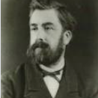
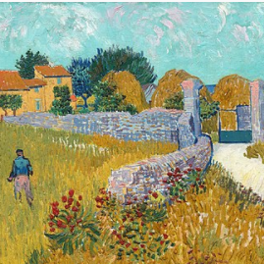
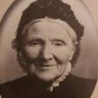
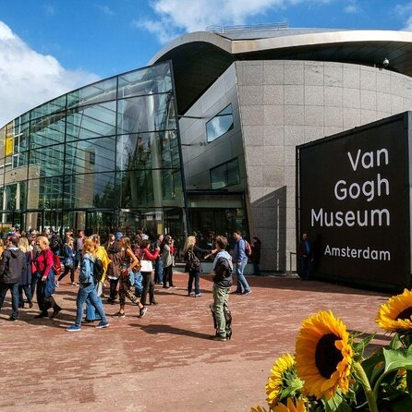
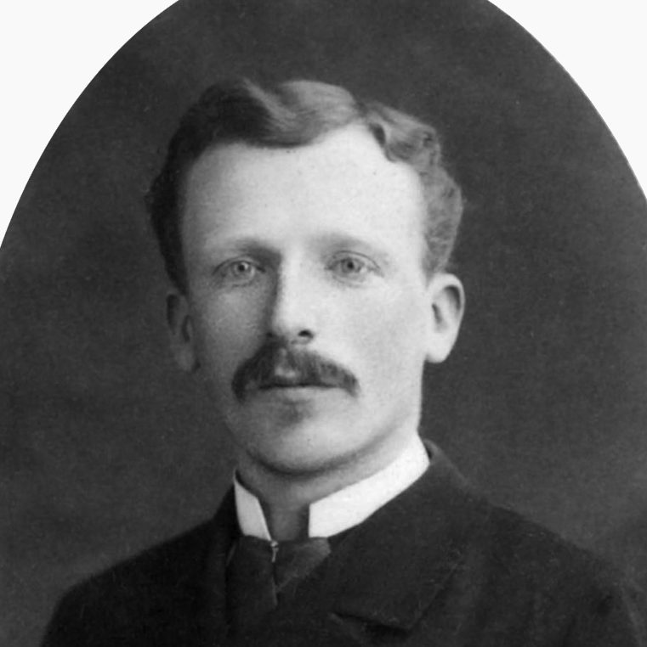
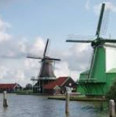
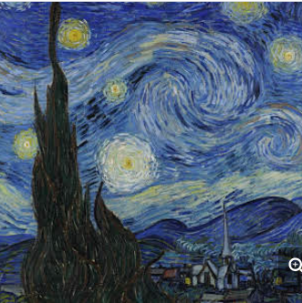
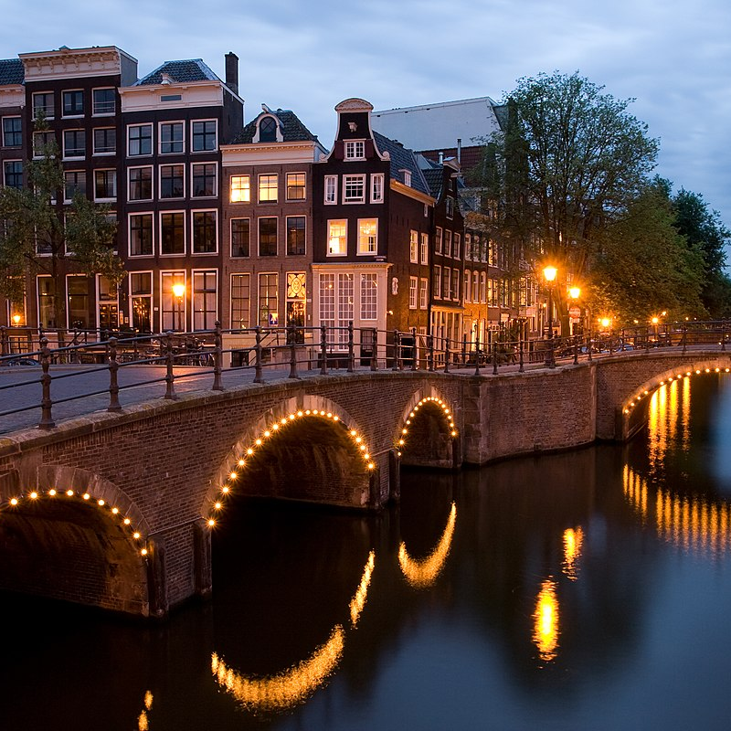
Semantic web search – linked data as the building blocks
Anna Carbentus van Gogh
Anton Mauve
Farmhouse in Provence
Educated by
Son of
Son of
The painter of
Theo van Gogh
Van Gogh Museum
Brother of
Archives at
The Starry Night
place of birth
Location
The painter of
Painting technique
Occupation
Oil paint
Zaandam
Country
Amsterdam
Artist
Netherlands
Notes:
We see here how the semantic search works behind the scenes.
All the data is linked to each other and as result of a search we will see linked information.

Slide 5
Libraries are locked in the MARC fortress
Notes:
Limitations of MARC Records
Difficult to integrate MARC records with non-MARC data
Designed for human use - encoded in natural language rather than as data. Lack the ability to interact with machine applications
MARC records do not integrate with the Semantic Web
We are looking for
Connect Data
Connect People
Enhance Collaboration

Slide 6
Libraries need Linked Data
Discovery
Interoperability
Cataloging
Efficient cataloging Higher accuracy with less manual work. Easier to create relationships. Focus on special collections and unique materials
Better Discoverability Display enrichment, easier navigation and accuracy. Enabling sophisticate querying making it quicker to find what you want
Improved interoperability Open to the global network of data outside of libraries systems such as research
4/9
Notes:
Allow semantic web experience
Data redundancy
Librarians don’t have to repeatedly create the same data
Higher quality
Rich metadata, data accuracy
Access to rare information
Different point of views
Getting easily full information aspects
Multiple languages

Slide 7
Global Metadata Ecosystem
ID.LOC.GOV
Cataloging
5/9
Notes:
How can we enable this?
Interoperate with Global Eco systems (Sinopia, LoC, SharedVDE, Wikidata, GND, etc…)
Provide platform infrastructure for managing Resources, Persons, Subjects, etc…

Slide 8
What exist today in Alma?
Interoperability
Cataloging
Records enrichment
Alma Refine
Display in search
Automatically with URIs for language, identifiers, names, and subjects
supports the refine workflow within Alma. It works currently with Getty, Wikidata, and Geonames Linked open Vocabularies
In result and record view (also as BIBFRAME)
Publish and Export
REST APIs
Endpoints
Entire catalog: BIBFRAME, RDA/RDF
In: BIBFRAME, RDA/RDF and JSON-LD​
Ability to reach either work, instance or authority
6/9

Slide 9
Linked Open Data Roadmap 2022
Cataloging
Ability to store and have basic use for Linked Open Data records
User will be able to upload and search for work and instance cataloged as linked open data. It will be also possible to mange inventory and preform fulfillment workflows for these instances.
Integrate 3rd party Linked Data editor
Cataloger will be able to create new linked data records and store them in Alma for used with basic functionality (e.g. Sinopia)
7/9

Slide 10
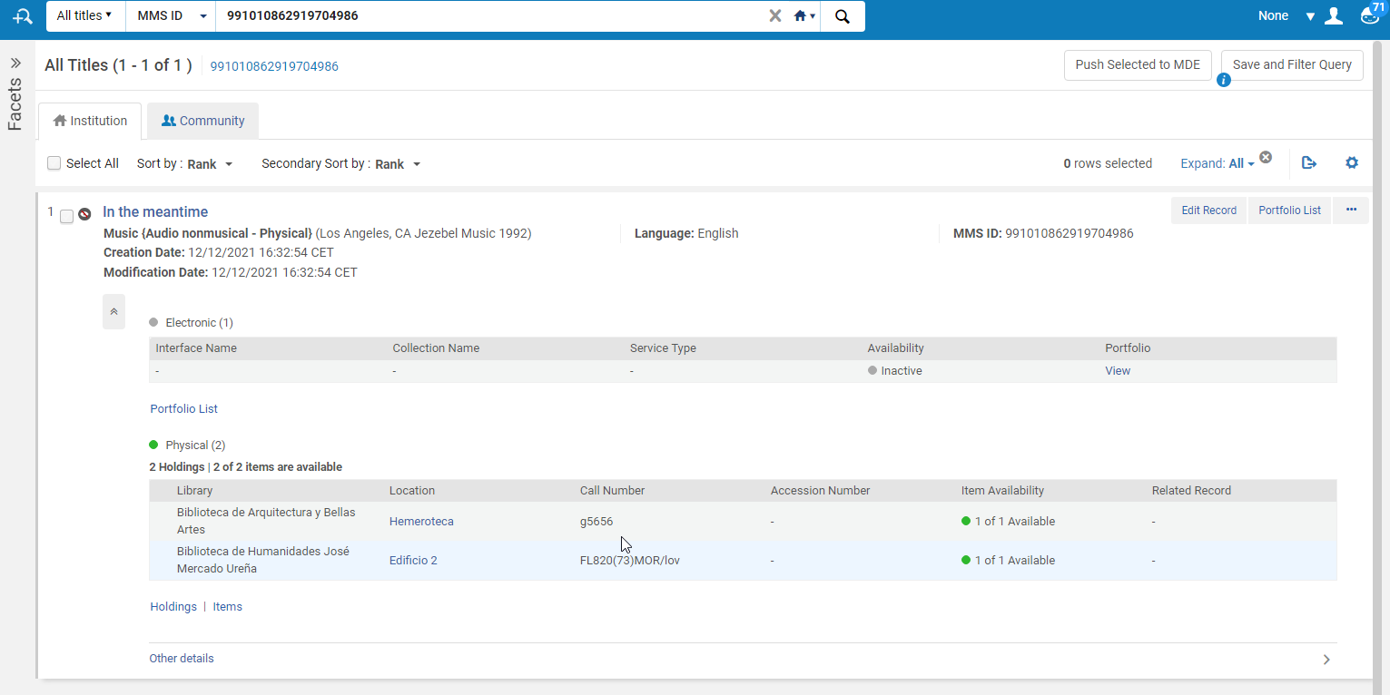
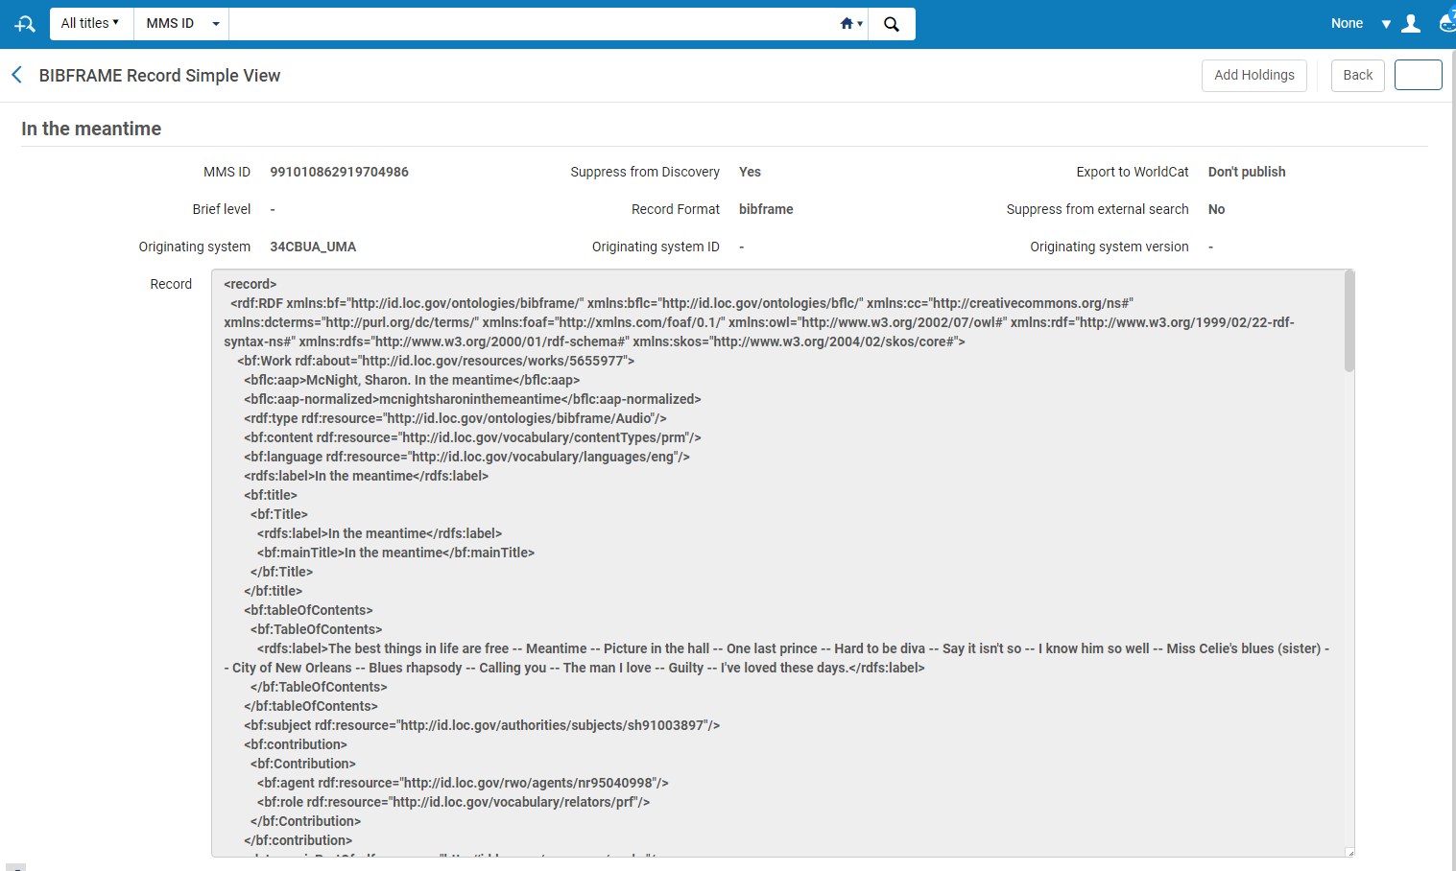
Sneak peak to development
8/9

Slide 11
Linked Open Data Roadmap 2023 and beyond
Cataloging
Info Cards
Display information on linked entities based on URL/URI as part of the repository search
Linked Open Data editor
Cataloger will be able to create new linked data records in Alma and use lookup to external linked open vocabularies
Import
Cataloger manager will be able to import new linked open data from external systems
From Authorities to Entities
Cataloger will be able to manage entities as new way to manage local authorities
9/9

Slide 12
Itai.veltzman@exlibrisgroup.com

