Slide 1
The New and Improved Alma Overlap Analysis Tool
Managing
Electronic
Resources
Yoel Kortick
Senior Librarian

Slide 2
Agenda
Introduction
Use Cases
Accessing the Overlap Analysis
A comparison of one electronic collection in the CZ to all of the IZ
A comparison of one electronic collection in the CZ to all of the IZ – examples from the output
A comparison of one electronic collection in the IZ to all of the IZ
A comparison of one electronic collection in the IZ to all of the IZ – examples from the output
A comparison of a list of titles (identifiers of titles) to all of the IZ
A comparison of a list of titles (identifiers of titles) to all of the IZ – examples from the output

Slide 3
Introduction
3

Slide 4
Introduction
To achieve better collection development analysis capabilities of libraries' electronic holdings, the Overlap Analysis Tool has been improved to support additional use cases by introducing new functionality.
In addition to functional changes, a new interface is now introduced for the Overlap Analysis Tool to enable easy and intuitive report creation and summary results.

Slide 5
Introduction
To support these use cases and additional use cases, new comparing options have been added:
Ability to select a Community Zone collection as a source for comparison.
Ability to select the entire Institution Zone as a target for comparison.
Add Network Zone holdings as an option for overlap analysis.
For more information see Working with Overlap and Collection Analysis

Slide 6
Use Cases
6

Slide 7
Use Case One
Use Case One: A comparison of one electronic collection in the CZ to all of the IZ
Institution is considering purchasing a new electronic collection.
Before doing so institution can take an electronic collection from the Community Zone that it is considering purchasing and check to see if it has significant overlap with titles already owned by the institution.
In other words: does it make sense for the institution to purchase the electronic collection from the CZ? Does the institution already have access to the majority of titles via other providers?
If there is a lot of overlap, then probably it is not recommended to purchase.
If there is little or no overlap, then perhaps it is recommended to purchase.

Slide 8
Use Case One
Use Case One:
E-Resources in Potential Specific Collection in Community Zone which institution may purchase
E-Resources in Entire Institution Zone
Overlap ?

Slide 9
Use Case Two – Option 1
Use Case Two – Option 1: A comparison of one electronic collection in the IZ to all of the IZ
Institution is considering canceling an existing (already purchased) electronic collection.
Before doing so the institution can take an electronic collection in the Institution Zone that it is considering canceling and check to see if it has significant overlap with all other titles already owned by the institution.
In other words: does it make sense for the institution to cancel the electronic collection? Will a lot of titles be lost because they are not in other electronic collections?
If there is a lot of overlap, then probably it is recommended to cancel.
If there is little or no overlap, then perhaps it is not recommended to cancel.

Slide 10
Use Case Two – Option 1
Use Case Two – Option 1:
E-Resources in Specific Collection in Institution Zone
E-Resources in Entire Institution Zone
Overlap ?

Slide 11
Use Case Two – Option 2
Use Case Two – Option 2: A comparison of one electronic collection in the IZ to a subset of the IZ
Institution is considering canceling an existing (already purchased) electronic collection.
Before doing so institution can take an electronic collection in Institution Zone that it is considering canceling and check to see if it has significant overlap with a subset of other titles already owned by the institution.
In other words: does it make sense for the institution to cancel the electronic collection? Will a lot of titles be lost because they are not in other electronic collections?
If there is a lot of overlap, then probably it is recommended to cancel.
If there is little or no overlap, then perhaps it is not recommended to cancel.

Slide 12
Use Case Two – Option 2
Use Case Two – Option 2:
E-Resources in Specific Collection in Institution Zone
E-Resources in a subset of the Institution Zone
Overlap ?

Slide 13
Use Case Three
Use Case Three: A comparison of a list of titles (identifiers of titles) to all of the IZ
Institution is considering purchasing the list of specific titles (which may be part of an electronic collection).
The vendor sends a list of titles to the institution (or the institution downloads a list from some source).
The institution compares the list of titles that it is considering purchasing and checks to see if it has significant overlap with titles already owned by the institution.
In other words: does it make sense for the institution to purchase the list of titles? Does the institution already have access to the majority of titles via other providers?
If there is a lot of overlap, then probably it is not recommended to purchase.
If there is little or no overlap, then perhaps it is recommended to purchase.

Slide 14
Use Case Three
Use Case Three:
E-Resources in list of titles
E-Resources in Entire Institution Zone
Overlap ?

Slide 15
Accessing the Overlap Analysis
15

Slide 16
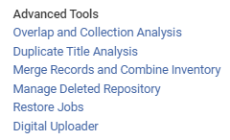
Accessing the Overlap Analysis
The Overlap Analysis is accessed at Alma Menu > Resources > Advanced Tools > Overlap and Collection Analysis.

Slide 17
Accessing the Overlap Analysis
Click "New Analysis" and choose desired Analysis Type

Slide 18
Use Case One: A comparison of one electronic collection in the CZ to all of the IZ
18

Slide 19
A comparison of one electronic collection in the CZ to all of the IZ
In this example the institution is considering purchasing the electronic collection "Elsevier ScienceDirect eBooks Referex Miscellaneous" which exists in the Community Zone.
As part of the institution’s considerations, they want to know how many titles in this electronic collection
Already exist in the institution
Are unique (do not exist already in the institution)

Slide 20
A comparison of one electronic collection in the CZ to all of the IZ
Choose "Compare Collections"

Slide 21
A comparison of one electronic collection in the CZ to all of the IZ
Give the analysis a name and description

Slide 22
A comparison of one electronic collection in the CZ to all of the IZ
Choose the collection (source) for which you want to evaluate overlap

Slide 23
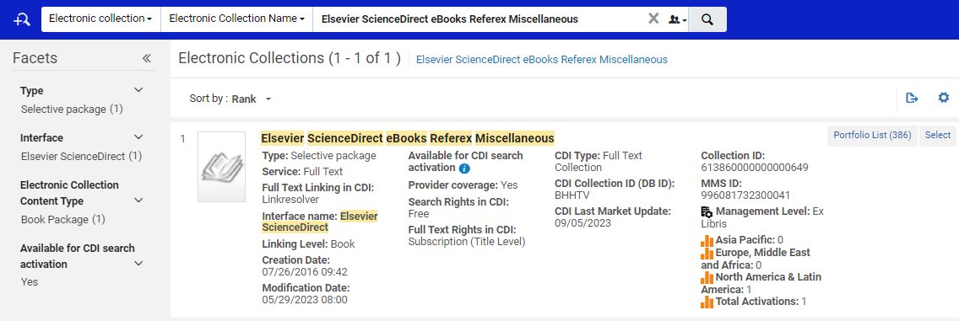
A comparison of one electronic collection in the CZ to all of the IZ
Search for and select the desired collection (Elsevier ScienceDirect eBooks Referex Miscellaneous)
Searching the CZ

Slide 24
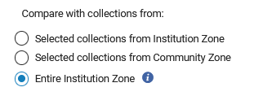
A comparison of one electronic collection in the CZ to all of the IZ
Choose the type of comparison. We will compare with the entire IZ

Slide 25
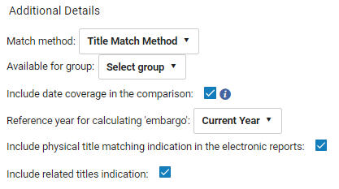
A comparison of one electronic collection in the CZ to all of the IZ
We are choosing:
Match method by title
Include date coverage as part of the overlap (particularly relevant for journals).
Include physical title matching indication in the electronic reports
Include related titles indication

Slide 26
A comparison of one electronic collection in the CZ to all of the IZ
Click "Generate"

Slide 27
A comparison of one electronic collection in the CZ to all of the IZ
The analysis completes
We will view the report

Slide 28
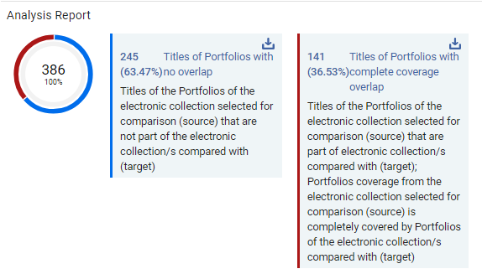
A comparison of one electronic collection in the CZ to all of the IZ
In the report we see that of the 386 titles in CZ collection "Elsevier ScienceDirect eBooks Referex Miscellaneous":
245 titles (63.47%) have no overlap.
141 titles (36.53%) have complete coverage overlap.

Slide 29
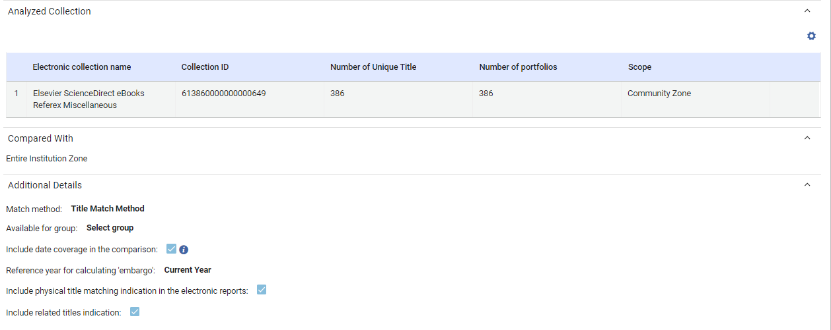
A comparison of one electronic collection in the CZ to all of the IZ
In the report we can also see exactly what was analyzed and how

Slide 30
A comparison of one electronic collection in the CZ to all of the IZ
From the analysis report we can download files of the titles which did have overlap and the titles which did not have overlap
Download titles which did not have overlap
Download titles which did have overlap

Slide 31
A comparison of one electronic collection in the CZ to all of the IZ
Here is (part of) file "Compare Collections - Titles of portfolios with no overlap.xlsx"
This is the "Identifier" because we chose "Title Match Method"
We will look at this example soon

Slide 32
A comparison of one electronic collection in the CZ to all of the IZ
Here is (part of) file "Compare Collections - Titles of portfolios with complete coverage overlap.xlsx"
This is the "Identifier" because we chose "Title Match Method"
We will look at this example soon

Slide 33
A comparison of one electronic collection in the CZ to all of the IZ
Now the institution needs to decide if they should purchase the electronic collection "Elsevier ScienceDirect eBooks Referex Miscellaneous"
As part of the decision-making process the institution now knows that
141 titles (36.53%) have complete coverage overlap.
245 titles (63.47%) have no overlap.
Thus: if the institution purchases this electronic collection, they will have 245 new titles.

Slide 34
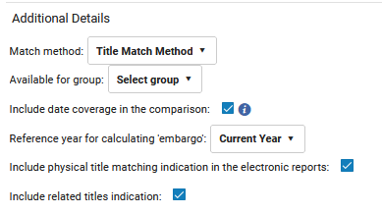
A comparison of one electronic collection in the CZ to all of the IZ
Note that because we chose this when running the job
The output file "Compare Collections - Titles of portfolios with complete coverage overlap" has these fields:

Slide 35
A comparison of one electronic collection in the CZ to all of the IZ – examples from the output
35

Slide 36
A comparison of one electronic collection in the CZ to all of the IZ – examples from the output
As we will see in the next slide:
In file "Compare Collections - Titles of portfolios with complete coverage overlap.xslx" title "Advances in computers" meets all three of the following criteria:
It is in the "Source" collection "Elsevier ScienceDirect eBooks Referex Miscellaneous" in the CZ
It is in the "Target" Institution Zone with electronic inventory
It is in the "Target" Institution Zone with physical inventory

Slide 37
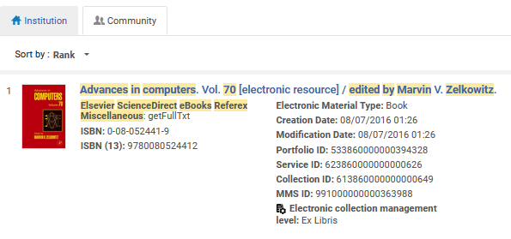
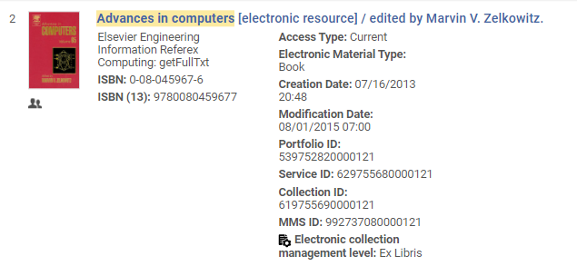
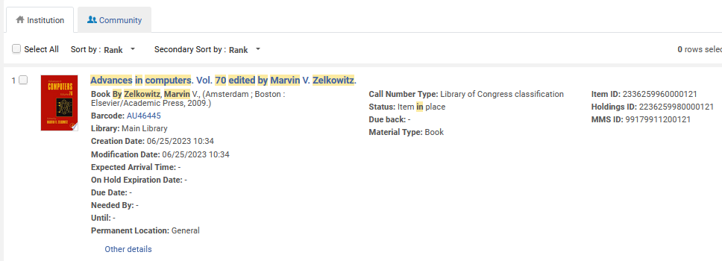
A comparison of one electronic collection in the CZ to all of the IZ – examples from the output
The "Source" collection "Elsevier ScienceDirect eBooks Referex Miscellaneous" in the CZ
The "Target" Institution Zone with electronic inventory
The "Target" Institution Zone with physical inventory

Slide 38
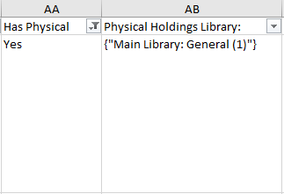
A comparison of one electronic collection in the CZ to all of the IZ – examples from the output
Title "Advances in computers" therefore appears in output file "Compare Collections - Titles of portfolios with complete coverage overlap.xslx "
It also has a "Yes" indication in column "Has Physical Matching"
It also has an indication of the holdings library and location with number of items in column "Physical Holdings Library: Location (Items count)"

Slide 39
A comparison of one electronic collection in the CZ to all of the IZ – examples from the output
Title "Numerical time-dependent partial differential equations for scientists and engineers" appears in output file "Compare Collections - Titles of portfolios with no overlap.xslx".
It has no overlap because it does not appear in the IZ.

Slide 40
Use Case Two: A comparison of one electronic collection in the IZ to all of the IZ
40

Slide 41
A comparison of one electronic collection in the IZ to all of the IZ
In the example here the institution has already purchased and activated from the CZ the electronic collection "Taylor & Francis Library & Information Science Collection".
Now the institution is considering cancelling the subscription.
Before doing so the institution will first check to see what titles are unique to this collection and therefore would be lost of the subscription were cancelled.
The match method used will be by ISSN.

Slide 42
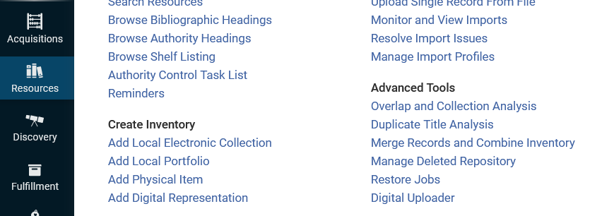
A comparison of one electronic collection in the IZ to all of the IZ
Choose "Resources > Advanced Tools > Overlap and Collection Analyses"

Slide 43
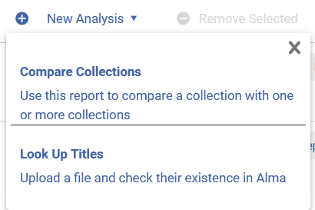
A comparison of one electronic collection in the IZ to all of the IZ
Choose "New Analysis > Compare Collections"

Slide 44
A comparison of one electronic collection in the IZ to all of the IZ
Give the analysis a name and description

Slide 45
A comparison of one electronic collection in the IZ to all of the IZ
Choose the collection (source) for which you want to evaluate overlap

Slide 46
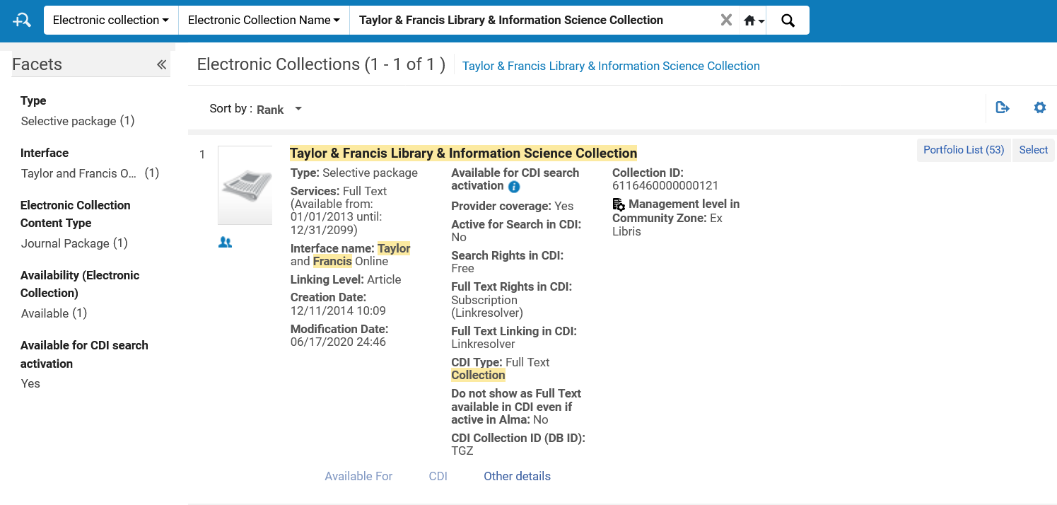
A comparison of one electronic collection in the IZ to all of the IZ
Search for and select the desired collection
Searching the IZ

Slide 47
A comparison of one electronic collection in the IZ to all of the IZ
Choose the type of comparison. We will compare with the entire IZ

Slide 48
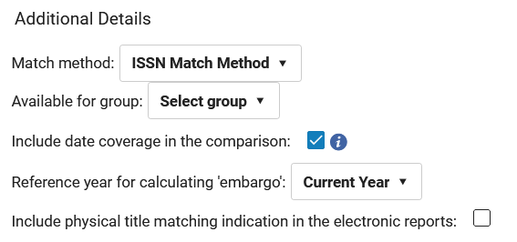
A comparison of one electronic collection in the IZ to all of the IZ
Select the match method. We are choosing to match by ISSN.
Choose if you wish to include date coverage as part of the overlap.
Select Reference year for calculating ‘embargo’.

Slide 49
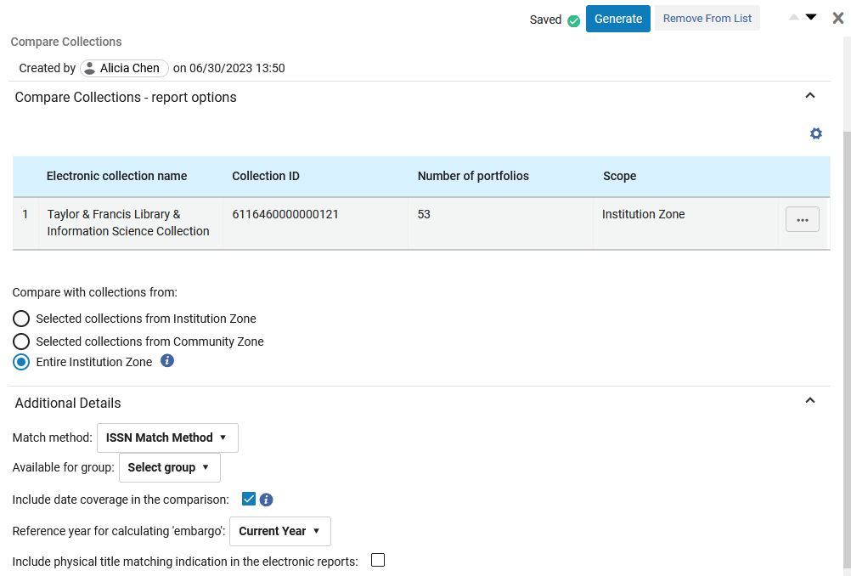
A comparison of one electronic collection in the IZ to all of the IZ
Click "Generate"

Slide 50
A comparison of one electronic collection in the IZ to all of the IZ
The analysis completes
Now we will view the report

Slide 51
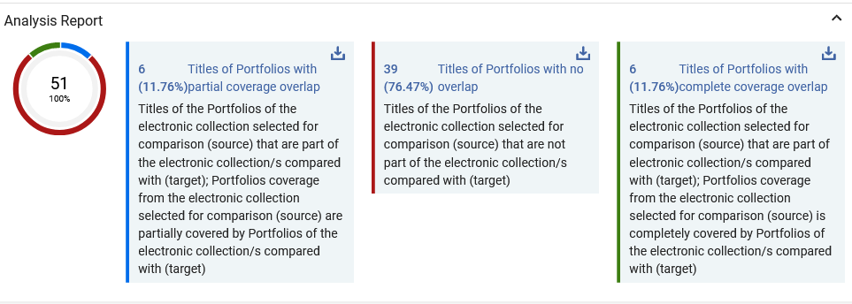
A comparison of one electronic collection in the IZ to all of the IZ
Here we see that of the 51 titles in collection "Taylor & Francis Library & Information Science Collection", when comparing with the rest of the IZ:
6 titles (11.76%) have partial coverage overlap)
39 titles (76.47%) have no overlap.
6 titles (11.76%) have complete coverage overlap)

Slide 52
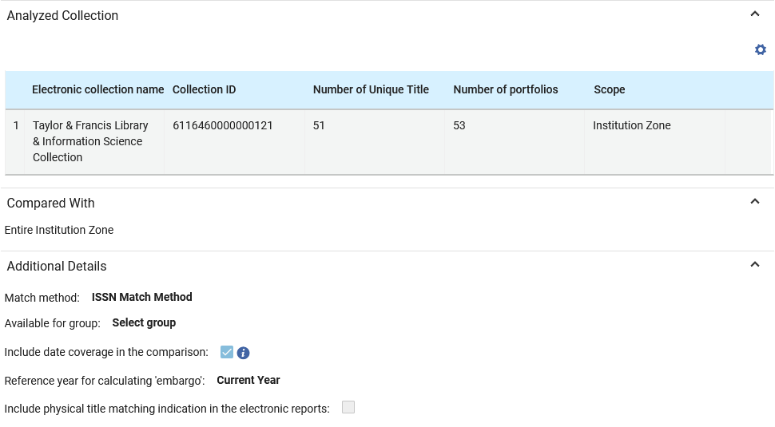
A comparison of one electronic collection in the IZ to all of the IZ
In the report we can also see exactly what was analyzed

Slide 53
A comparison of one electronic collection in the IZ to all of the IZ
From the analysis report we can download files of the titles which did have overlap and the titles which did not have overlap
Download titles with partial coverage overlap
Download titles with no overlap
Download titles with complete coverage overlap

Slide 54
A comparison of one electronic collection in the IZ to all of the IZ
Here is (part of) file "Compare Collections - Titles of portfolios with complete coverage overlap.xlsx"
This is the "Matching Identifier" because we chose "ISSN Match Method"

Slide 55
A comparison of one electronic collection in the IZ to all of the IZ
Here is (part of) file "Compare Collections - Titles of portfolios with partial coverage overlap.xlsx"

Slide 56
A comparison of one electronic collection in the IZ to all of the IZ
Here is (part of) file "Compare Collections - Titles of portfolios with no overlap.xlsx"

Slide 57
A comparison of one electronic collection in the IZ to all of the IZ
Now the institution needs to decide if they should cancel the electronic collection "Taylor & Francis Library & Information Science Collection"
As part of the decision-making process the institution now knows that
6 titles (11.76%) have partial coverage overlap)
39 titles (76.47%) have no overlap.
6 titles (11.76%) have complete coverage overlap)
Thus: if the institution cancels this electronic collection, they will lose 39 titles. These titles do not exist in other electronic collections in the IZ.

Slide 58
A comparison of one electronic collection in the IZ to all of the IZ– examples from the output
58

Slide 59
A comparison of one electronic collection in the IZ to all of the IZ – examples from the output
Title “Library acquisitions: practice & theory" ISSN 03646408 appears in file "Compare Collections - Titles of portfolios with complete coverage overlap.xlsx"

Slide 60
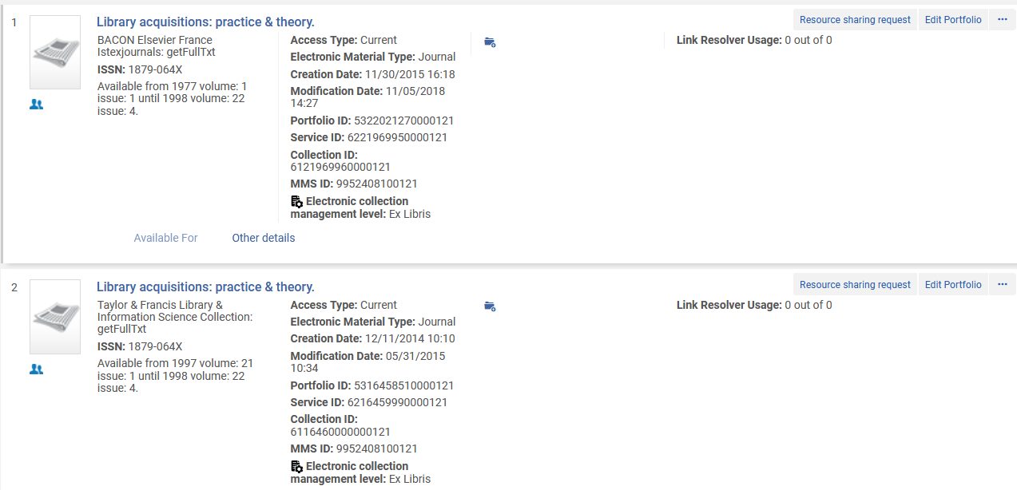
A comparison of one electronic collection in the IZ to all of the IZ – examples from the output
We see that this title has complete coverage overlap.
Same coverage in different collections

Slide 61
A comparison of one electronic collection in the IZ to all of the IZ – examples from the output
Title "Music reference services quarterly : MRSQ" ISSN 15409503 appears in file "Compare Collections - Titles of portfolios with no overlap.xlsx"

Slide 62
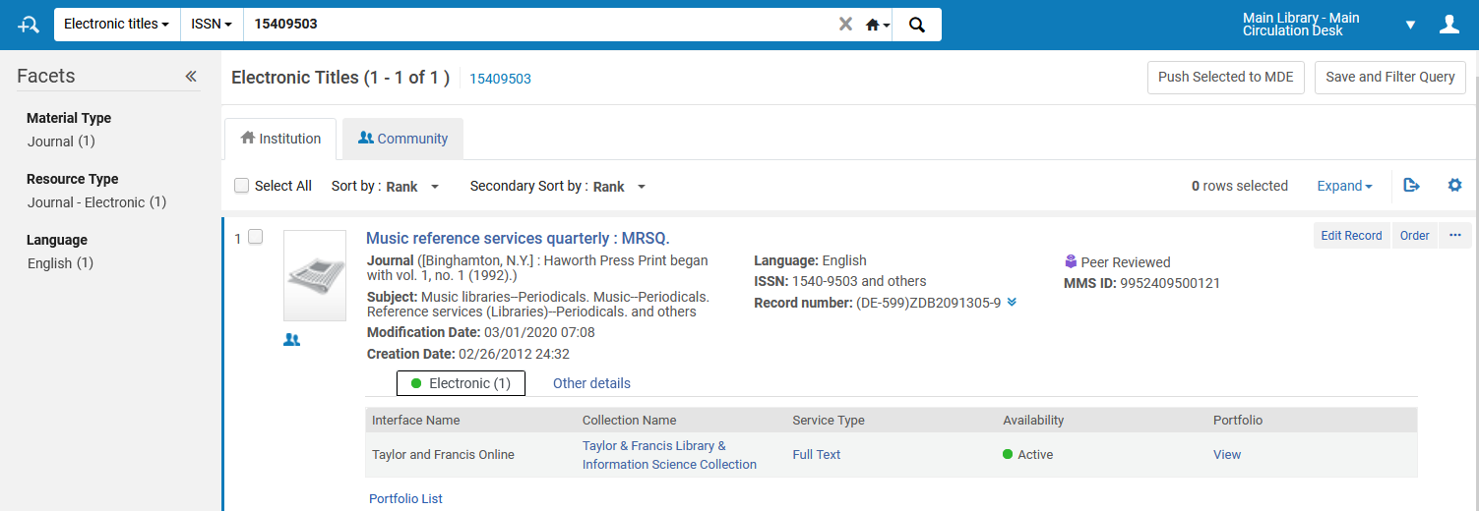
A comparison of one electronic collection in the IZ to all of the IZ
We see that this title has no overlap. It is only in collection "Taylor & Francis Library & Information Science Collection"

Slide 63
Use Case Three: A comparison of a list of titles (identifiers of titles) to all of the IZ
63

Slide 64
A comparison of a list of titles (identifiers of titles) to all of the IZ
In the scenario here the institution has received a list of titles from the vendor.
The file has a column with the title and a column with the ISSN.
We will upload the file and compare it to what we have already in the institution, thereby we will be able to know:
Which titles in the input file we already have
Which titles in the input file we do not already have

Slide 65
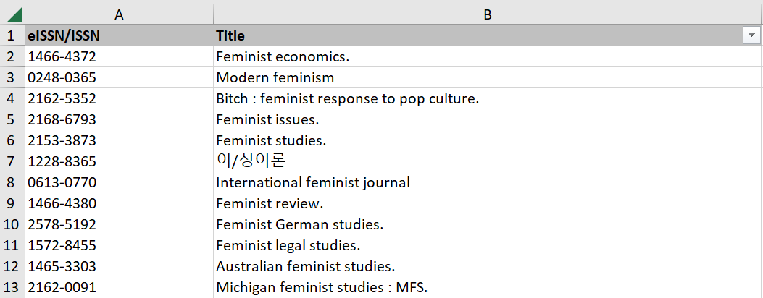
A comparison of a list of titles (identifiers of titles) to all of the IZ
Here is (part of) the input file

Slide 66
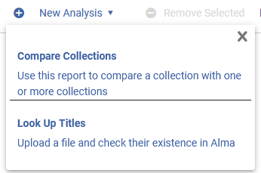
A comparison of a list of titles (identifiers of titles) to all of the IZ
We will again run the "Overlap and Collection Analysis" and this time we will choose "Look up titles"

Slide 67
A comparison of a list of titles (identifiers of titles) to all of the IZ
We give the report a name and description

Slide 68
A comparison of a list of titles (identifiers of titles) to all of the IZ
We will now do as follows:
Upload a file called "Input file from vendor citvey et ltd.xlsx"
In the section "Select the populations you would like to compare the titles from the input file with:" we will choose "Institution Zone Electronic Resources (including Community Zone activated resources)
In the section "Choose the report out format" choose "One excel line per match"
We will not select "Include physical title matching indication in the electronic reports
Click "Generate"

Slide 69
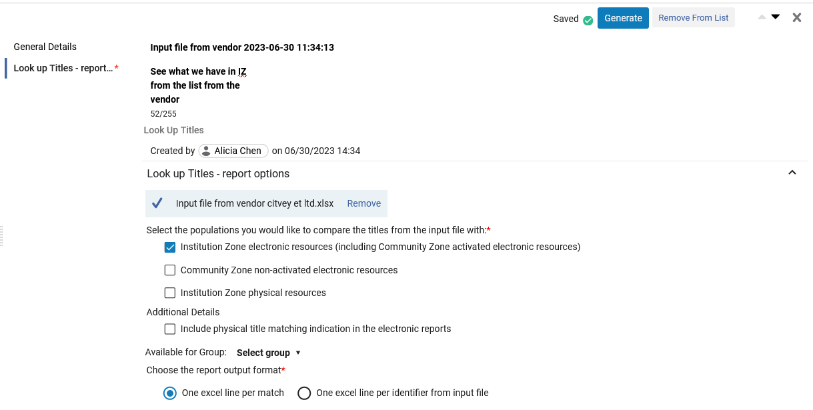
A comparison of a list of titles (identifiers of titles) to all of the IZ

Slide 70
A comparison of a list of titles (identifiers of titles) to all of the IZ
Job completes
Now we will view the report

Slide 71
A comparison of a list of titles (identifiers of titles) to all of the IZ
In the output see that it states " 35 (94.59%) Input file titles found in the Institution Zone electronic resources". Download the file.
Download the file

Slide 72
A comparison of a list of titles (identifiers of titles) to all of the IZ
See that the output file "Look Up Titles - Institution Zone electronic resources" has four tabs for:
Matches with Single Resource
Matches with Multiple Resources
No Matches or No Resources
Analysis Information (parameters which were used in the jobs)

Slide 73
A comparison of a list of titles (identifiers of titles) to all of the IZ– examples from the output
73

Slide 74
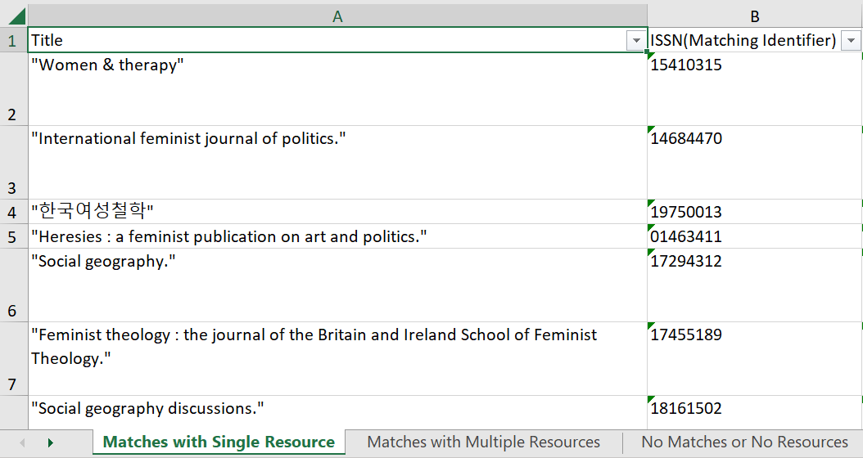
A comparison of a list of titles (identifiers of titles) to all of the IZ – examples from the output
Here is an example from "Matches with Single Resource"

Slide 75
A comparison of a list of titles (identifiers of titles) to all of the IZ – examples from the output
Here is the example in Alma from "Matches with Single Resource"
Single resource

Slide 76
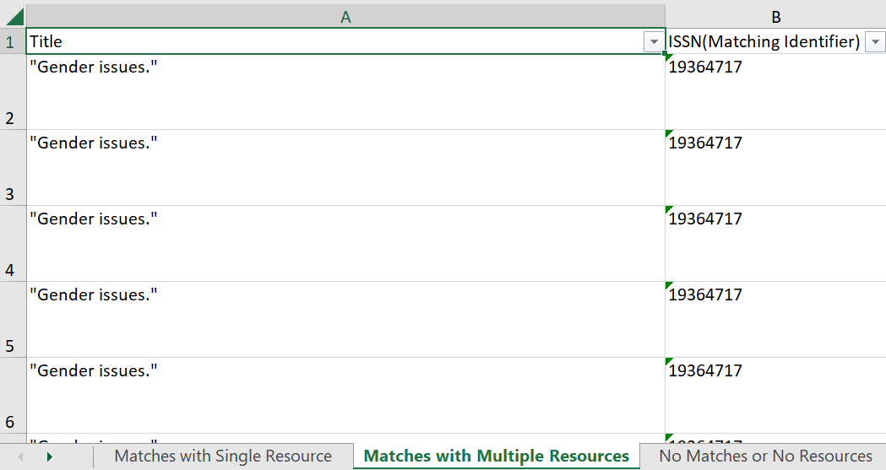
A comparison of a list of titles (identifiers of titles) to all of the IZ – examples from the output
Here is an example from "Matches with Multiples Resources"

Slide 77
A comparison of a list of titles (identifiers of titles) to all of the IZ – examples from the output
Here is the example in Alma from "Matches with Multiples Resources"
Multiple resources

Slide 78
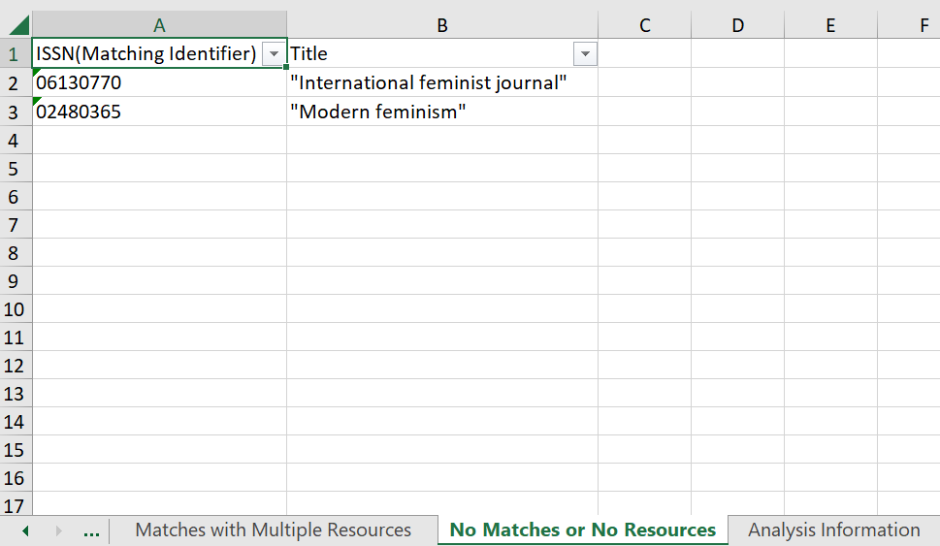
A comparison of a list of titles (identifiers of titles) to all of the IZ – examples from the output
Here is an example from "No Matches or No Resources"

Slide 79
A comparison of a list of titles (identifiers of titles) to all of the IZ – examples from the output
Here is the example in Alma from "No Matches or No Resources"

