Slide 1
Display Local Call Number and Other Classification Number in Search Results
Yoel Kortick
Senior Librarian

Slide 2
Display Local Call Number and Other Classification Number in Search Results
As of the May 2022 Alma release it is possible to configure the Local Call Number and Other Classification Number to appear in the brief search results of an “All Titles” repository search.
To configure this feature, select the configuration icon from the search results page and select “Local Call Number” and “Other Classification Number”.

Slide 3
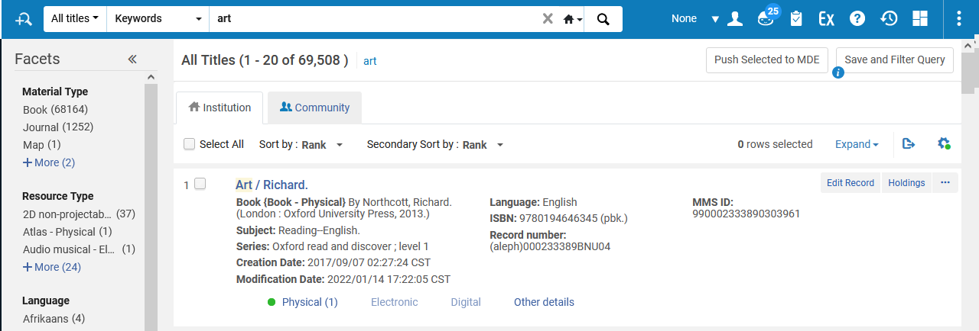
Display Local Call Number and Other Classification Number in Search Results
“All Titles” search
Select the configuration icon

Slide 4
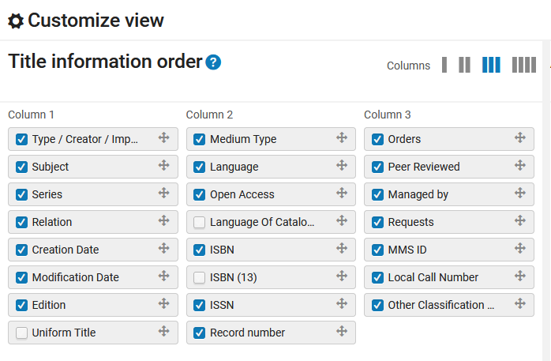
Display Local Call Number and Other Classification Number in Search Results
Select “Local Call Number” and “Other Classification Number”

Slide 5
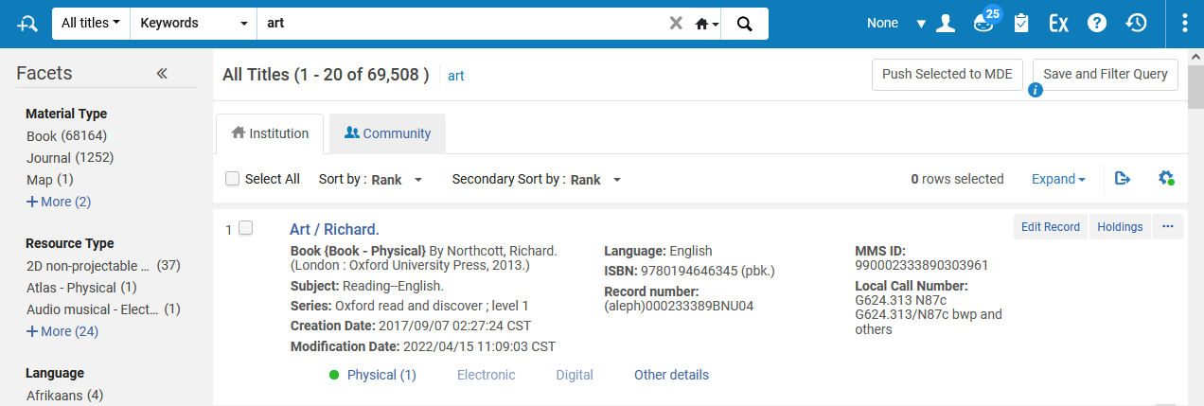
Display Local Call Number and Other Classification Number in Search Results
Now if there is a “Local Call Number” it will appear in the search results

Slide 6
Display Local Call Number and Other Classification Number in Search Results
Before
After

Slide 7
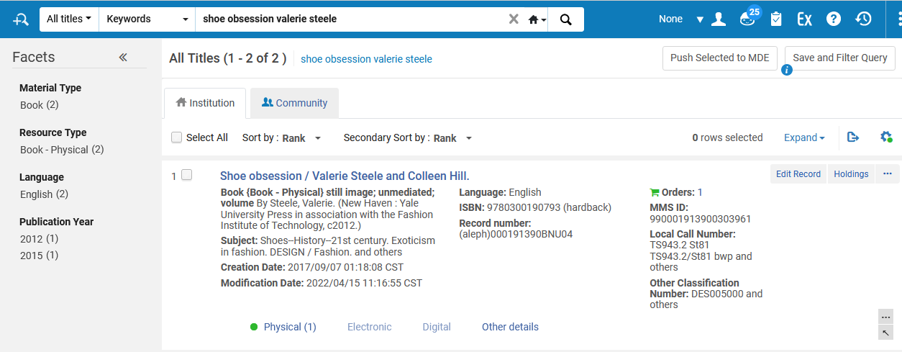
Display Local Call Number and Other Classification Number in Search Results
Now if there is a “Other Classification Number” it will appear in the search results

Slide 8
Display Local Call Number and Other Classification Number in Search Results
Before
After

