Slide 1
How to retrieve the "Year To Date Loans" in Alma Analytics
Yoel Kortick
Senior Librarian

Slide 2
Agenda
The question and example
The measure and filter for the Alma Analytics report
Creating the Alma Analytics report
The results of the Alma Analytics Report

Slide 3
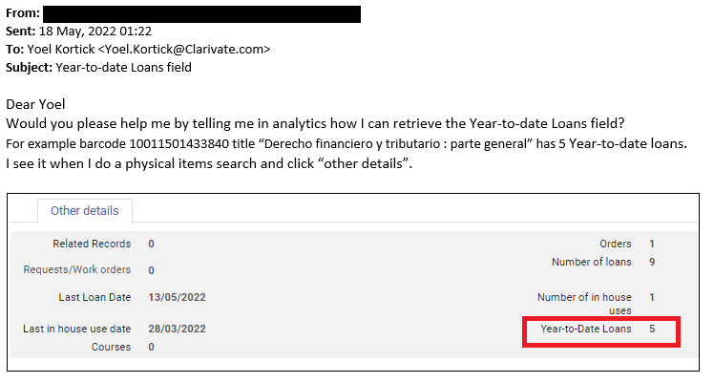
The question and example

Slide 4
The question and example
The "Year To Date Loans" field shows all loans which are not "In House" (it shows all loans loaned to a patron) where the loan date is from the beginning of the current calendar year.
This means that in the example here barcode 10011501433840 was loaned to a patron 5 times since January 1, 2022 (today is May 18, 2022).

Slide 5
The measure and filter for the Alma Analytics report
There are several ways to get the "Year To Date" value. We will show one specific method.
We will use the "Fulfillment" subject area.

Slide 6
The measure and filter for the Alma Analytics report
Because we want all loans made to a patron (not "In House" Loans) we will use the measure "Loans (Not In House)" in the "Loan" folder
Because we want all loans made to a patron in the current calendar year, we will use the field "Loan Date Filter" in the "Loan Date" folder and filter by "equal to Current Year"

Slide 7
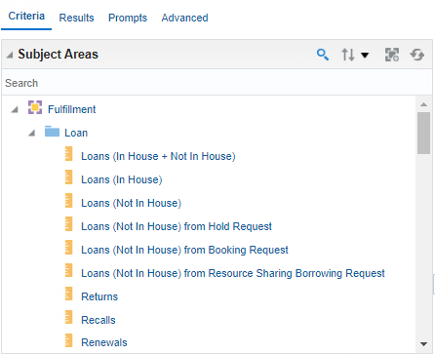
The measure and filter for the Alma Analytics report
The measure "Loans (Not In House)" in the "Loan" folder

Slide 8
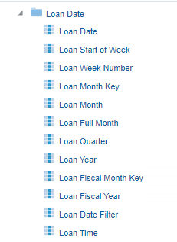
The measure and filter for the Alma Analytics report
The field "Loan Date Filter" in the "Loan Date" folder

Slide 9
Creating the Alma Analytics report
We create a report with the following fields:
"Barcode" from the "Loan Details" folder
"Title" from the "Bibliographic Details" folder
"Loan Year" from the "Loan Date" folder
"Loan Date Filter" from the "Loan Date" folder
"Loans (Not In House)" from the "Loan" folder

Slide 10
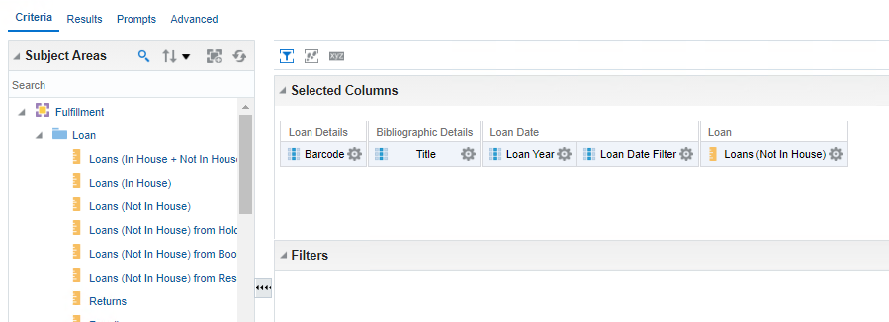
Creating the Alma Analytics report
We create a report with the following fields:

Slide 11
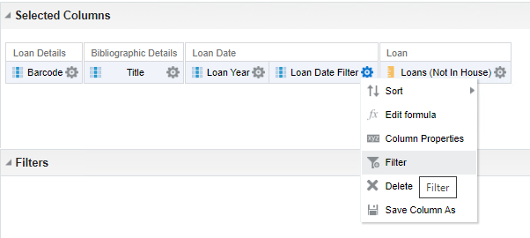
Creating the Alma Analytics report
Filter by "Loan Date Filter"

Slide 12
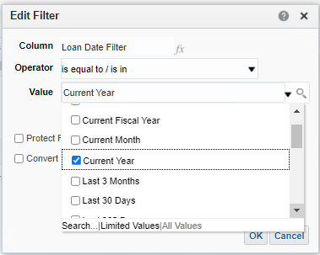
Creating the Alma Analytics report
Filter by "Loan Date Filter" = Current Year

Slide 13
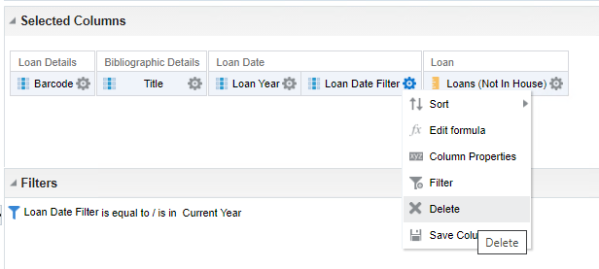
Creating the Alma Analytics report
Now that we have the filter for "Loan Date Filter" we can remove it from display and leave the filter
Remove this
Leave this

Slide 14
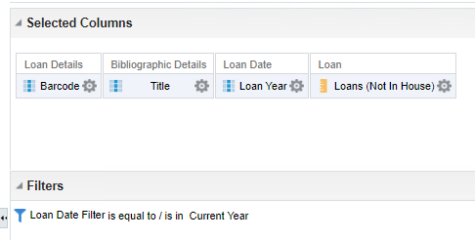
Creating the Alma Analytics report
Now we have the following

Slide 15
The results of the Alma Analytics report
Here are the results

Slide 16
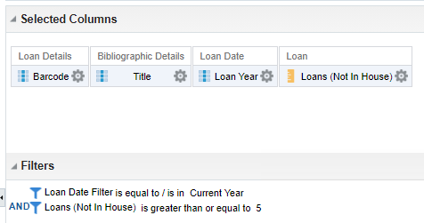
Creating the Alma Analytics report
Let’s now get only items with 5 or more year to date loans. We add a filter by "Loans )Not In House)" is greater than or equal to 5

Slide 17
The results of the Alma Analytics report
Here are results, including barcode 10011501433840 title "Derecho financiero y tributario : parte general" with 5 year to date loans (as was also seen in Alma)

Slide 18
The results of the Alma Analytics report
Let’s check barcode 10011501435644 title "Sala de treball 2 (Planta -1 ) - Biblioteca de Ciències Socials (2 hores)". It should have 311 year to date loans in Alma

Slide 19
The results of the Alma Analytics report
We find it in Alma and will click "Other Details"

Slide 20
The results of the Alma Analytics report
And we see 311 year to date loans, exactly like Alma Analytics

