Slide 1
Recent Developments in Primo VE
Jenny Draeger—Training Services Team Lead
Part of the 2022 ELUNA Knowledge Days Series

Slide 2
Agenda
Collection Discovery
Option to Hide Offensive Subject Terms
Get It – Custom Order of Locations
Group Locations by Library in Get it
Support the Indexing of Enhanced Holdings Information
Primo VE to Primo VE—Allow Searching in Remote Institutions from Other Instances
Restricted Search Groups for Other Indexes

Slide 3
Agenda
Collection Discovery
Option to Hide Offensive Subject Terms
Get It – Custom Order of Locations
Group Locations by Library in Get it
Support the Indexing of Enhanced Holdings Information
Primo VE to Primo VE—Allow Searching in Remote Institutions from Other Instances
Restricted Search Groups for Other Indexes

Slide 4
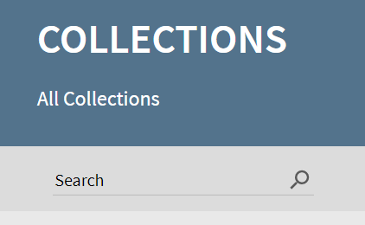
Collection Discovery
Searches across all collections
Previously, users could search for items
within a specific collection or sub-collection only and find items only in
that collection or sub-collection.
With this enhancement, a search box has been added to the
Collections Lobby to allow users to search for items in all collections and
their sub-collections in the Collections Lobby.
Introduced in November 2021

Slide 5
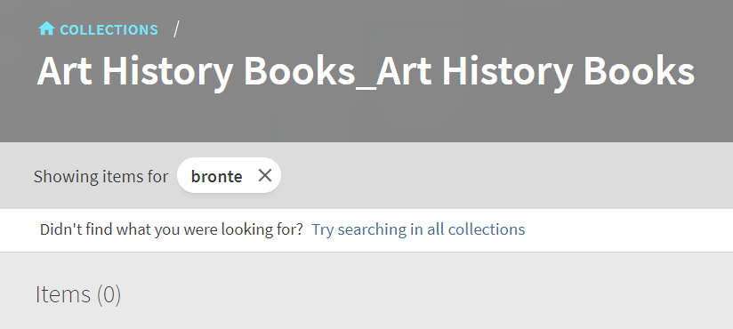
Collection Discovery
After performing a search from a
specific collection or sub-collection,
users can now expand the search to
all collections in the Collections Lobby by selecting the Try searching in
all collections option, which opens the Collections Lobby page and
performs the same search in all collections and their sub-collections.

Slide 6
Collection Discovery
Enabled by default
Labels can be customized in Alma menu > Discovery > Labels > Collection Discovery Labels
default.nui.colldiscovery.items.AllCollections.title: Items in all collections
default.nui.colldiscovery.items.expandSearch: Didn't find what you were looking for?
default.nui.colldiscovery.items.expandSearchLink: Try searching in all collections
default.nui.colldiscovery.items.noItemsFound: No items found (0)

Slide 7
Collection Discovery
Analytics for Collection Searches
Group | Subgroup | Action | Description
Collection Discovery | Collection Discovery | Search in All Collections | User performed a search from the Collections Lobby.
Collection Discovery | Collection Discovery | Click on "Try searching in all collections" | After performing a search within a collection/sub-collection, the user expanded the search to all collections.
Collection Discovery | Collection Discovery | Search in a collection or sub collection | User performed a search within a specific collection/sub-collection.

Slide 8
Agenda
Collection Discovery
Option to Hide Offensive Subject Terms
Get It – Custom Order of Locations
Group Locations by Library in Get it
Support the Indexing of Enhanced Holdings Information
Primo VE to Primo VE—Allow Searching in Remote Institutions from Other Instances
Restricted Search Groups for Other Indexes

Slide 9
Option to Hide Offensive Subject Terms
To Support Diversity, Equity, and Inclusion (DEI)
This functionality allows you to create a list of inappropriate or offensive words and phrases (in any language) that should be hidden in Subject fields that appear in the full display, brief results, and facets.
When configured, the excluded words/phrases are not case-sensitive and must match the contents of the Subject field exactly.
Introduced December 2021

Slide 10
Option to Hide Offensive Subject Terms
Configuration > Discovery > Other > DEI – List of terms to exclude from Subject Heading
Per line, add the offensive word or phrase (in any language) that you want to exclude from display in the subject headings.
The exact words/phrases are not case-sensitive. For more details, see Configuring the DEI Exclude List for Primo VE.

Slide 11
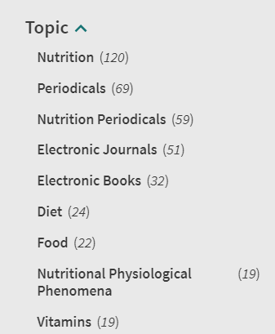
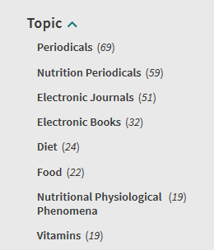
Option to Hide Offensive Subject Terms
Before Configuration After Configuration

Slide 12
Agenda
Collection Discovery
Option to Hide Offensive Subject Terms
Get It – Custom Order of Locations
Group Locations by Library in Get It
Support the Indexing of Enhanced Holdings Information
Primo VE to Primo VE—Allow Searching in Remote Institutions from Other Instances
Restricted Search Groups for Other Indexes

Slide 13
Get It – Custom Order of Locations
Previously, the locations in Get It were sorted either by alphabetic order or by best location.
With this enhancement, you can now create a default sort order for all views and override it with custom ordering per view.
For more details, see Configuring the Order of Locations in Primo Search Results.
Introduced in December 2021

Slide 14
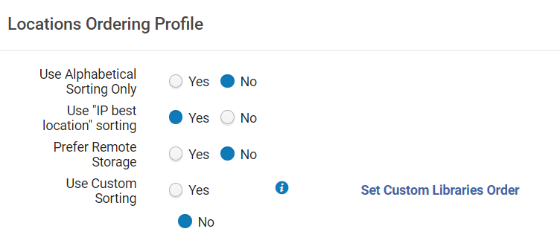
Get It – Custom Order of Locations
Functionality is disabled by default
Locations Ordering Profile
Configuration > Fulfillment > Discovery Interface Display Logic > Locations Ordering Profile
Set Use Custom Sorting to Yes

Slide 15
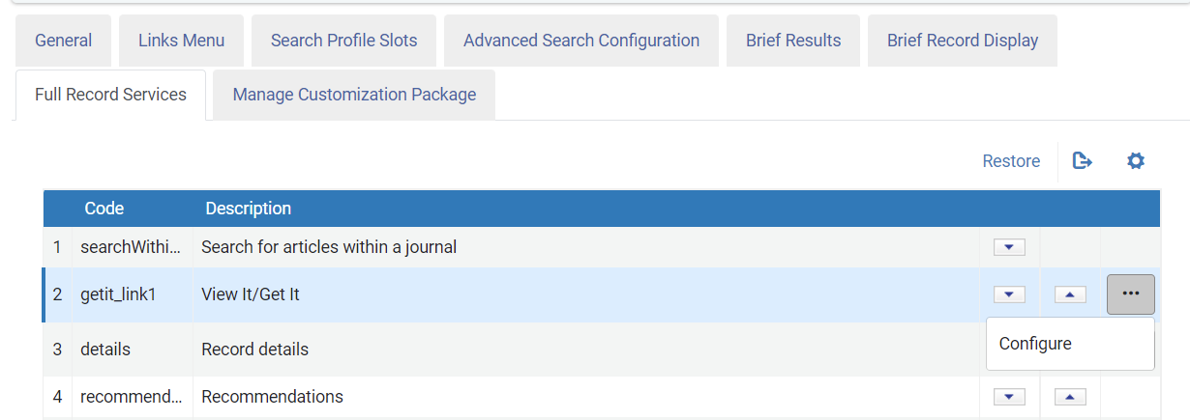
Get It – Custom Order of Locations
Configure custom sorting for at least one library in your view on the Full Record Services tab in View Configuration
Configuration > Discovery > Display Configuration > Configure Views > Edit view > Full Record Services tab

Slide 16
Click Add location and configure preferred order of libraries
Save your settings when done

Slide 17
Group Locations by Library in Get It
If your institution has many libraries that hold the same item at different locations, you can now group these locations by library in Get It.
Introduced in April 2022

Slide 18
Group Locations by Library in Get It
Functionality is disabled by default
Discovery Customer Settings mapping table
Configuration > Discovery > Other > Customer Settings
getit_group_by_library = true
GetIT! Tab1 Labels code table
Configuration > Discovery > Display Configuration > Labels
nui.locations.headerLibraries – Libraries

Slide 19
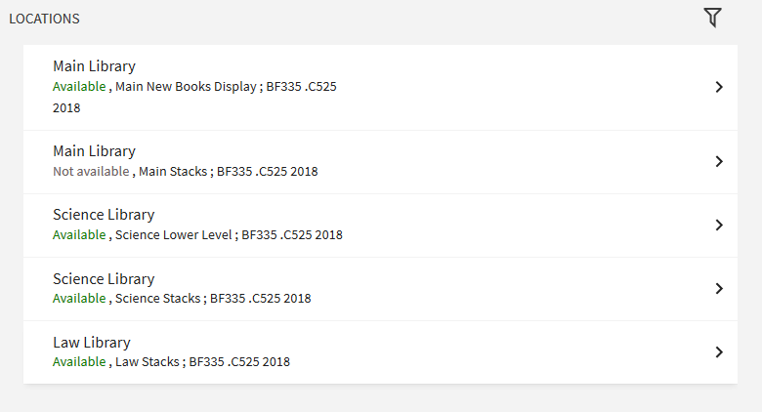
Group Locations by Library in Get It
Grouped by Location Grouped by Library

Slide 20
Agenda
Collection Discovery
Option to Hide Offensive Subject Terms
Get It – Custom Order of Locations
Group Locations by Library in Get it
Support the Indexing of Enhanced Holdings Information
Primo VE to Primo VE—Allow Searching in Remote Institutions from Other Instances
Restricted Search Groups for Other Indexes

Slide 21
Support the Indexing of Enhanced Holdings Information
In addition to metadata provided in the bibliographic record, Primo VE now supports the indexing of holdings information so that users can search for information that is included in the holdings record.
After this feature is configured and your records have been re-indexed, users can perform basic and advanced searches to find records based on holdings information.
Introduced in January 2022

Slide 22
Support the Indexing of Enhanced Holdings Information
Functionality is not enabled by default
Fulfillment Customer Parameters mapping table
Configuration > Fulfillment > General > Other Settings
The uresolver_enable_getit_holding_configuration parameter should be set to true to enable the new Holdings Search Configuration mapping table.
Holdings Search Configuration mapping table
Configuration> Discovery > GetIt Configuration > Holdings Search Configuration
Specify fields and subfields to be indexed.

Slide 23
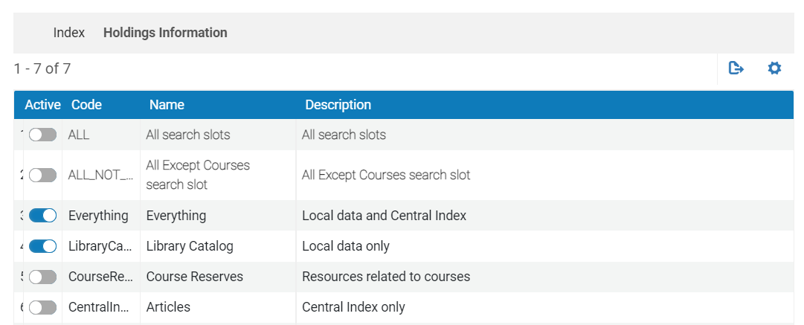
Support the Indexing of Enhanced Holdings Information
A record's holdings information is not searchable until the record is re-indexed. The system automatically re-indexes new and modified records every 15 minutes.
Advanced Search Configuration tab on View Configuration page
Configuration > Discovery > Display Configuration > Configure Views > Edit view > Advanced Search Configuration tab > Add Index

Slide 24
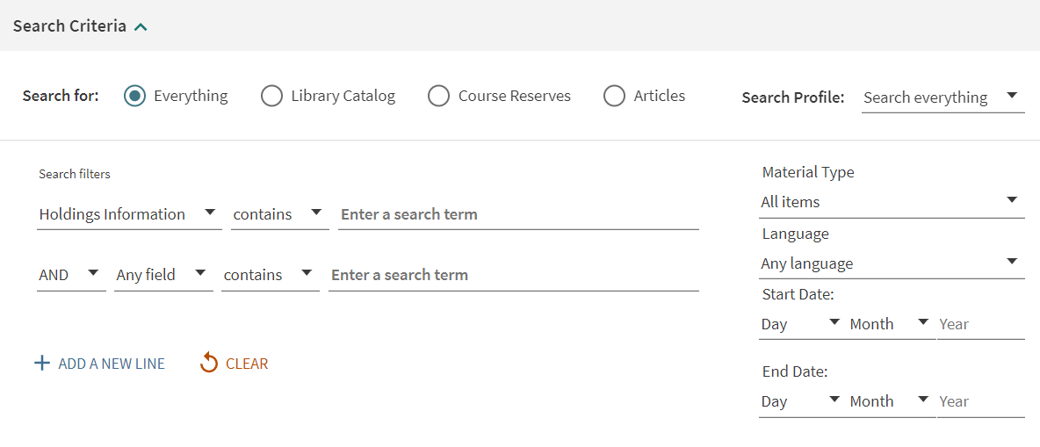
Support the Indexing of Enhanced Holdings Information
Advanced Search in Primo VE

Slide 25
Agenda
Collection Discovery
Option to Hide Offensive Subject Terms
Get It – Custom Order of Locations
Group Locations by Library in Get it
Support the Indexing of Enhanced Holdings Information
Primo VE to Primo VE—Allow Searching in Remote Institutions from Other Instances
Restricted Search Groups for Other Indexes

Slide 26
Primo VE to Primo VE—Allow Searching in Remote Institutions from Other Instances
In December 2021, a feature was added that allows users to see availability information at a remote institution and delivery options if they are signed in and have permissions at that remote institution.
As of January 2022, this functionality was expanded to institutions that are on different instances.
Remote availability information is displayed in the Get It From Other Institutions section of the record’s Full Display page.

Slide 27
Primo VE to Primo VE—Allow Searching in Remote Institutions from Other Instances
Define Primo VE Deep Search Scope
Configuration > Discovery > Search Configuration > Search Profiles > Other Indexes tab > Add Other Index > Deep Search
Configuration has not changed but a new field, Display Institution Name, has been added to this form

Slide 28
Restricted Search Groups for Other Indexes
With this enhancement, you can limit searches of Deep Search and Search Webhook scopes to users that are within the following restrictions:
IP address
On campus
Restricted
User group
Users who do not meet these restrictions receive the following message:
You must be signed-in or on campus to search in this resource.
Introduced in April 2022

Slide 29
Restricted Search Groups for Other Indexes
Functionality is not enabled by default
Define Primo VE Webook and/or Primo VE Search Scope Page
Configuration > Discovery > Search Configuration > Search Profiles > Other Indexes tab > Define allowed users

Slide 30
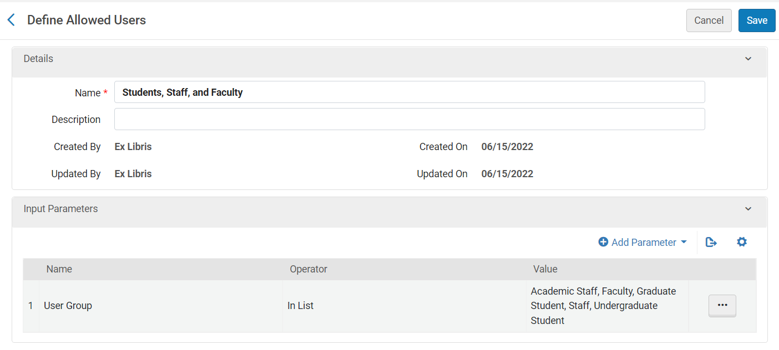
Restricted Search Groups for Other Indexes
Define Allowed Users
Add Parameter
Save your configurations

Slide 31
Restricted Search Groups for Other Indexes
Error Messages Labels Code table
Configuration > Discovery > Display Configuration > Labels > Error Messages Labels
nui.search.tnsearch.error.authorization – You must be signed-in or on campus to search in this resource.

Slide 32
Resources
32

Slide 33
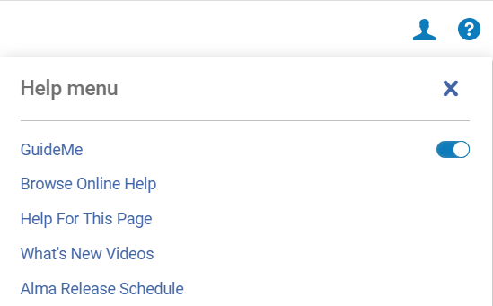
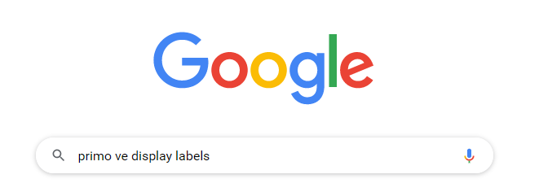
Resources
Primo VE Release Notes
Primo VE Documentation
Help For this Page
Documentation is indexed in Google

Slide 34
Customer Education Webinars
Education & Knowledge Webinars
https://exlibrisgroup.com/customer-education-webinars/
Announcements in Alma

Slide 35
Thank you for attending
Knowledge Days 2022

