Slide 1
SUSHI Usage and SUSHI Potential Usage
Yoel Kortick
Senior Librarian

Slide 2
Agenda
Introduction
The Interface
The Platform
The SUSHI Account
SUSHI Usage
SUSHI Potential Usage

Slide 3
Introduction

Slide 4
Introduction
The term "SUSHI Usage" refers to the situation whereby the Interface of an Electronic Collection corresponds to a Platform which has a SUSHI account in the CZ and that SUSHI account is active in the institution (COUNTER reports are harvested for that platform).
The term "SUSHI Potential Usage" refers to the situation whereby the Interface of an Electronic Collection corresponds to a Platform which has a SUSHI account in the CZ and that SUSHI account is not active in the institution (COUNTER reports are not harvested for that platform).

Slide 5
Introduction
This presentation will show two examples of "SUSHI Usage" and one example of "SUSHI Potential Usage".
Before we "jump in" to these examples we need to define, explain and show some related entities:
The Interface
The Platform
The SUSHI Account

Slide 6
The Interface

Slide 7
The Interface
A vendor interface (sometimes colloquially also known as a platform) is a framework in which the vendor supplies electronic collections and resources to the institution.

Slide 8
The Interface – Example 1
Most of the Electronic Collections have an Interface.
For example, on the next slide we are looking in the "General" tab of the Electronic Collection editor at Electronic Collection ID 61467305590004646 "American Institute of Aeronautics and Astronautics Publications".
We see that the Interface Name is "American Institute of Aeronautics and Astronautics"

Slide 9
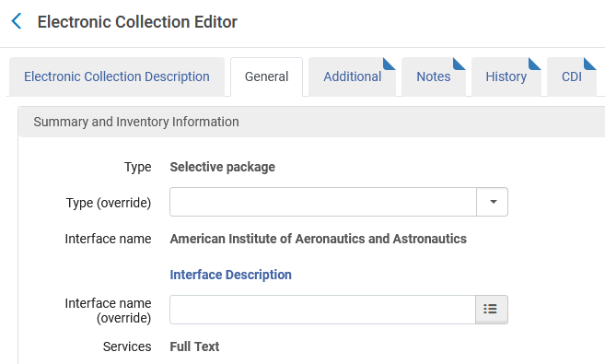
The Interface – Example 1

Slide 10
The Interface – Example 2
In this second example, on the next slide, we are looking in the "General" tab of the Electronic Collection editor at Electronic Collection ID 61638753180004646 "Women and Social Movements, International".
We see that the Interface Name is "Alexander Street"

Slide 11
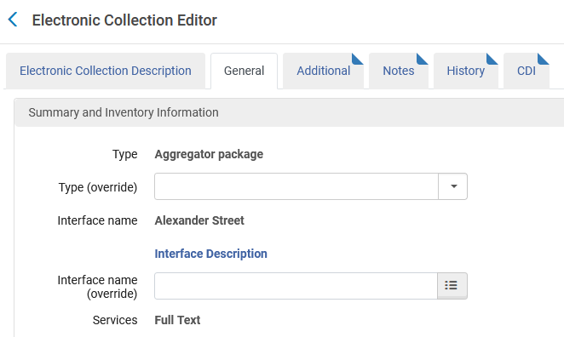
The Interface – Example 2

Slide 12
The Platform

Slide 13
The Platform
Every interface has a corresponding platform.
The platform appears in COUNTER reports (regardless of whether they are loaded manually or harvested via SUSHI).
The platform is a key component of
Usage reports (created in the Usage Data subject area of Alma Analytics)
Cost per Use reports (created in the "Cost Usage" section of the E-Inventory subject area of Alma Analytics)

Slide 14
The Platform
Using our previous two examples, we will see that
For Interface "American Institute of Aeronautics and Astronautics" the corresponding platform is "the_american_institute_of_aeronautics_and_astronautics"
For Interface "Alexander Street" the corresponding platform is "search_alexanderstreet_com"

Slide 15
The Platform
Note: The platforms mentioned here ("the_american_institute_of_aeronautics_and_astronautics" and "search_alexanderstreet_com")
Appear "normalized" (replace spaces and periods with underlines, change uppercase to lowercase, etc.)
Appear in the electronic collection editor in the field COUNTER Platform derived from Interface

Slide 16
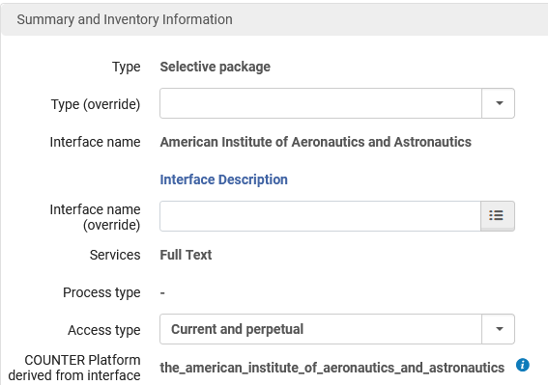
The Platform
For Interface "American Institute of Aeronautics and Astronautics" the corresponding platform is the_american_institute_of_aeronautics_and_astronautics

Slide 17
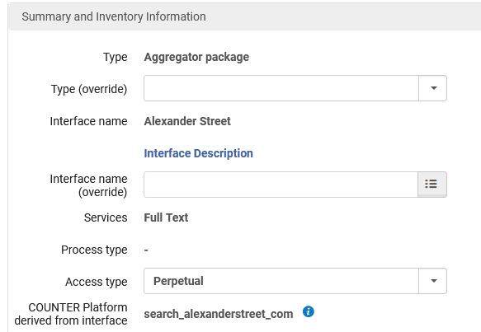
The Platform
For Interface "Alexander Street" the corresponding platform is "search_alexanderstreet_com"

Slide 18
The SUSHI Account

Slide 19
The SUSHI Account
Here is the SUSHI Account for "American Institute of Aeronautics & Astronautics"

Slide 20
The SUSHI Account
If we look at a COUNTER report harvested from SUSHI Account for "American Institute of Aeronautics & Astronautics" we see that the platform is the_american_institute_of_aeronautics_and_astronautics (in a non-normalized form)

Slide 21
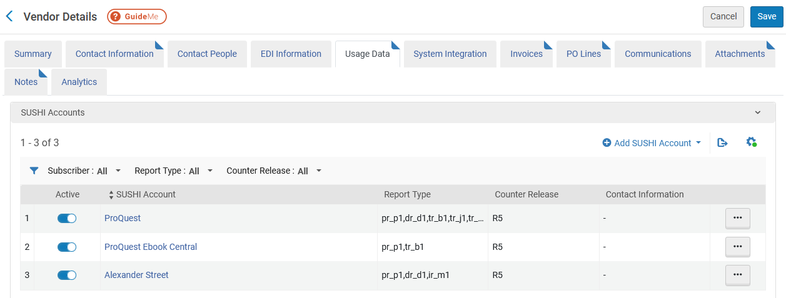
The SUSHI Account
Here is the SUSHI Account for "Alexander Street"

Slide 22
The SUSHI Account
If we look at a COUNTER report harvested from SUSHI Account for "Alexander Street" we see that the platform is search_alexanderstreet_com (in a non-normalized form)

Slide 23
SUSHI Usage

Slide 24
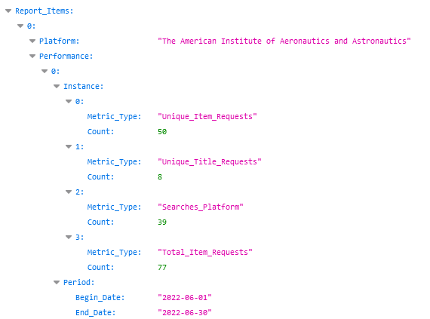
SUSHI Usage
Here is part of a PR_P1 COUNTER report harvested via SUSHI account "American Institute of Aeronautics & Astronautics"
Platform
Usage
Usage Date

Slide 25
SUSHI Usage
On the next slide we will see
An Alma Analytics Usage Data report on top
The COUNTER report harvested by SUSHI account "American Institute of Aeronautics & Astronautics" on the bottom.
We will see the same date, platform and usage in the Analytics report that we see in the COUNTER report

Slide 26
SUSHI Usage
Same Platform
Same Usage Measures
Same Usage Date

Slide 27
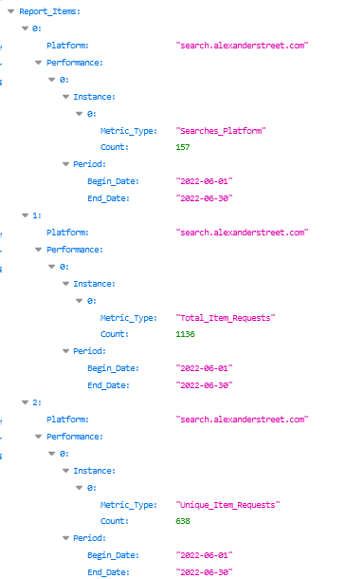
SUSHI Usage
Here is part of a PR_P1 COUNTER report harvested via SUSHI account "Alexander Street".
This COUNTER report has a slightly different format than the previous one we saw which was harvested via SUSHI account "American Institute of Aeronautics & Astronautics"
Platform
Usage
Usage Date

Slide 28
SUSHI Usage
On the next slide we will see
An Alma Analytics Usage Data report on top
The COUNTER report harvested by SUSHI account "Alexander Street" on the bottom.
We will see the same date, platform and usage in the Analytics report that we see in the COUNTER report

Slide 29
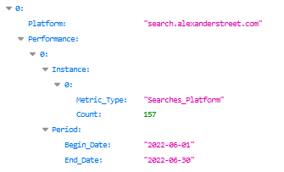
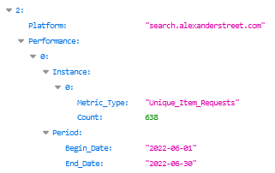
SUSHI Usage

Slide 30
SUSHI Usage
Summary
In both previous cases for
Interface and platform for American Institute of Aeronautics & Astronautics
Interface and platform for Alexander Street Press
there was both
An electronic collection with an interface
A SUSHI account which harvests COUNTER reports for the platform which corresponds to the interface.
This is "SUSHI usage".
SUSHI could potentially be used for this collection, and it is being used.

Slide 31
SUSHI Potential Usage

Slide 32
SUSHI Potential Usage
We will now see an example of SUSHI Potential Usage
Electronic collection ID 61669917070004646 title "Journal of Studies on Alcohol and Drugs" has
Interface Name: "Journal of Studies on Alcohol and Drugs"
COUNTER Platform derived from interface: "jsad"

Slide 33
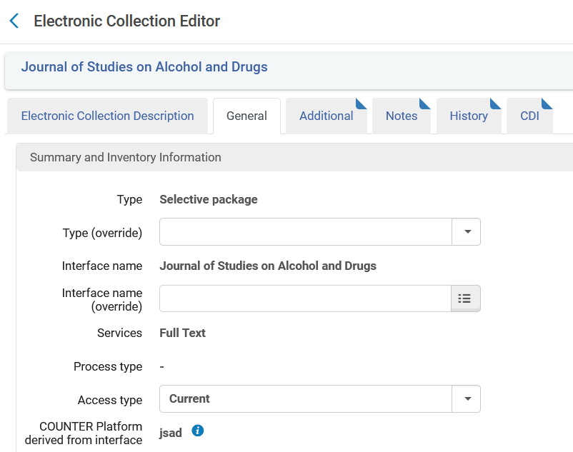
SUSHI Potential Usage
Interface
Platform

Slide 34
SUSHI Potential Usage
The SUSHI vendor for platform JSAD does exist in the CZ
This is the SUSHI vendor in the CZ for platform JSAD

Slide 35
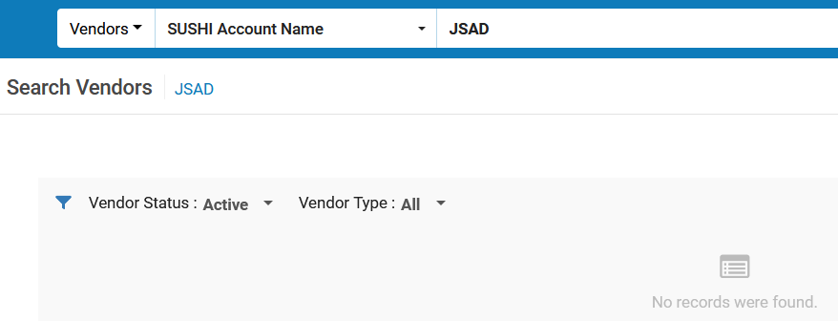
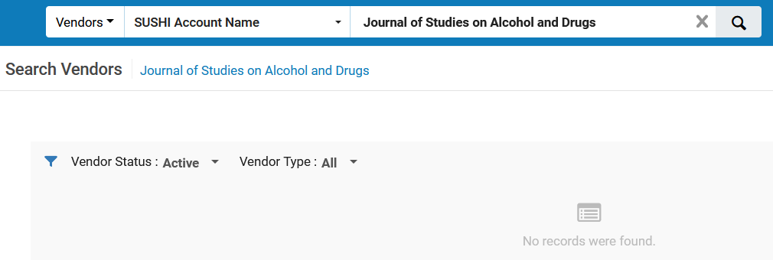
SUSHI Potential Usage
The SUSHI vendor does not exist in the institution. It is in the CZ but has not been created in the institution.

Slide 36
SUSHI Potential Usage
Summary
In the previous case for "Journal of Studies on Alcohol and Drugs"
There was an Electronic Collection with an interface
There was not a SUSHI account which harvests COUNTER reports for the platform which corresponds to the interface.
This is "SUSHI Potential usage".
SUSHI could potentially be used for this Electronic Collection, but it is not being used.

