Slide 1
CDI (Central Discovery Index)
Yoel Kortick
Senior Librarian

Slide 2
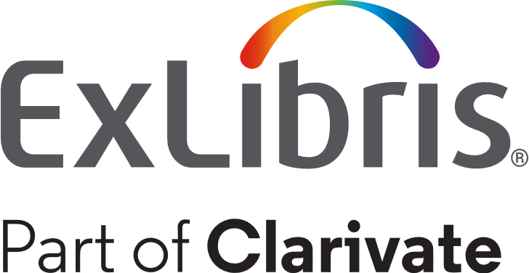
Agenda
Introduction
Searching the CDI
For example
Publish electronic records to Central Discovery Index
Viewing all CDI citations
The Institutional Setting "EasyActive" or "FullyFelixible"
Viewing and searching CDI Attributes
CDI Attributes
See also

Slide 3
Introduction

Slide 4
Introduction
CDI is a Central Discovery Index.
It is a searchable database of citations collected from scholarly e-resources including journal articles, e-books, legal documents and more.
It supports both Summon and Primo
Formerly there were two separate indexes: the Primo Central and Summon Indexes. CDI replaces them both.

Slide 5
Introduction
With CDI there is a single activation for electronic resources. The activation does not require that the staff user activate a resource in multiple places.
There is no separate admin interface as there previously was in the "pre-CDI days" with "Primo Central Index".
Each institution chooses which collections to activate/deactivate in CDI
CDI collections activated in Alma are reflected in discovery within 48 hours of activation (depending on the job "Publish electronic records to Central Discovery Index")

Slide 6
Searching the CDI

Slide 7
Searching the CDI
Typically search scopes in Discovery which include CDI will be called "Books, Article and More" or "Article and More" or "Catalog and Articles" or "Everything".
It will be something indicating that the search scope includes not only material from the institution's repository but also from the CDI.
There may also be a scope of only CDI records.

Slide 8
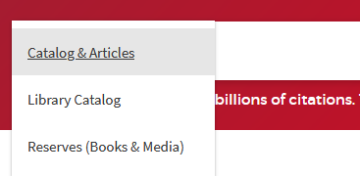
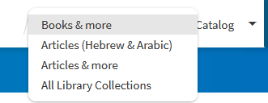
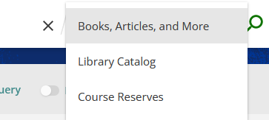
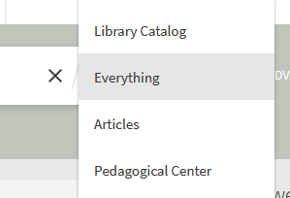
Searching the CDI
For example
For example
For example
For example

Slide 9
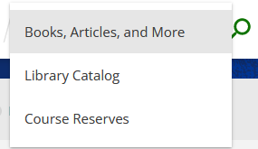
Searching the CDI
Let's take a look at this example in Primo where the end user can choose to search "Books, Article and More".
We will see how it is defined to include records from both the institution's repository and from CDI.

Slide 10
Searching the CDI
When searching this option, the results URL includes the following:
Scope
View
&tab=Everything&search_scope=MyInst_and_CI&vid=01PITT_INST:01PITT_INST
Let's go see what the MyInst_and_CI scope is in the 01PITT_INST:01PITT_INST view and what it includes.

Slide 11
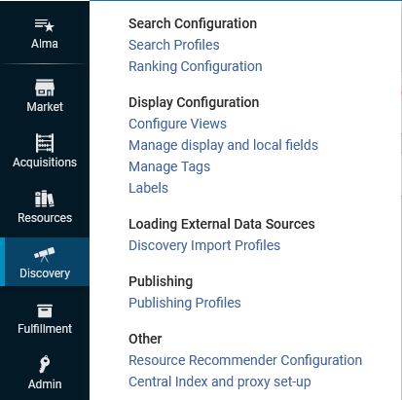
Searching the CDI
We will access the different views from within Alma

Slide 12
Searching the CDI
Here is the "search profile slots" tab of the view 01PITT_INST:01PITT_INST which we saw in the URL of the search results

Slide 13
Searching the CDI
Here is the correlation between the search profile slots configured in this Alma view and what the end user sees when searching Primo.

Slide 14
Searching the CDI
Let's look at what the search profile "MyInst_and_CI" (Named "Books, Article and More") includes. We will edit the search profile.

Slide 15
Searching the CDI
And now let's view the details of "MyInst_and_CI"

Slide 16
Searching the CDI
It includes two scopes:
Central Index = All records in the Central Index for the institution's Central Index profile
My Institution = All records in the repository of the institution (which are published to Primo)

Slide 17
Searching the CDI
Note that this type of search profile is called "Blended" because it includes both CDI records and the institution's repository.

Slide 18
Searching the CDI
So, in summary, in this case, when a user searches 'Books, Articles, and More', he or she is searching both the CDI and the institution's repository

Slide 19
For example

Slide 20
For example
On the next slide we see an example where the user searches "Books, Articles, and More" for keywords "Diet human immune".
The first two results are an example of "blended" search results.
The first result, title "Gut-microbiota-targeted diets modulate human immune status" is a citation from CDI for an article.
The second result, title "Diet and human immune function" is a physical book in the institution's local repository.

Slide 21
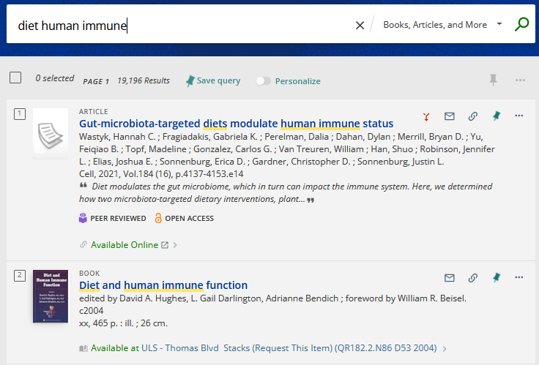
For example
From CDI
From Repository

Slide 22
For example
Now we will focus on a citation from CDI which appears in the search results and analyze why it is included in the results.
On the next slide we see an example where the user searches "Books, Articles, and More" for keywords "Advil headache".
The first result is a citation from CDI for article title "Advil's Legal Headache"

Slide 23
For example
A user searches as follows in Primo
And receives this result

Slide 24
For example
This is a citation from CDI.

Slide 25
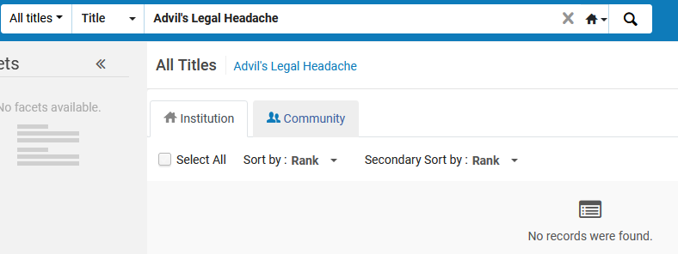
For example
This citation from CDI is not in the Alma repository. It is in CDI.
Not in Alma Repository

Slide 26
For example
The reason this citation from CDI is in the search results is because it is in an activated electronic resource which the institutions holds for the specific coverage period of the citation.
Because the institution has 'ABA Journal' with coverage which includes 1988 Vol. 74 activated (and published to Primo Central) this citation appears in the search results.

Slide 27
For example
On the next two slides we see that title "ABA Journal" (in which the citation article is published) is active in electronic collection "EBSCOhost Academic Search Premier" from 1984 onwards.
The article citation from CDI is for 1988, so it is within the coverage of the electronic resource which the institution has activated.
Therefore, this citation is included in the search results, and it appears in Primo as "Available Online"

Slide 28
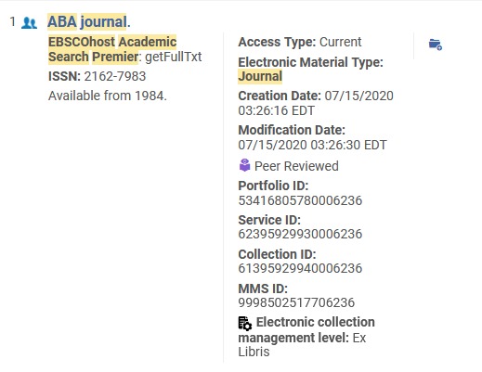
For example
ABA Journal has been activated and coverage includes 1988

Slide 29
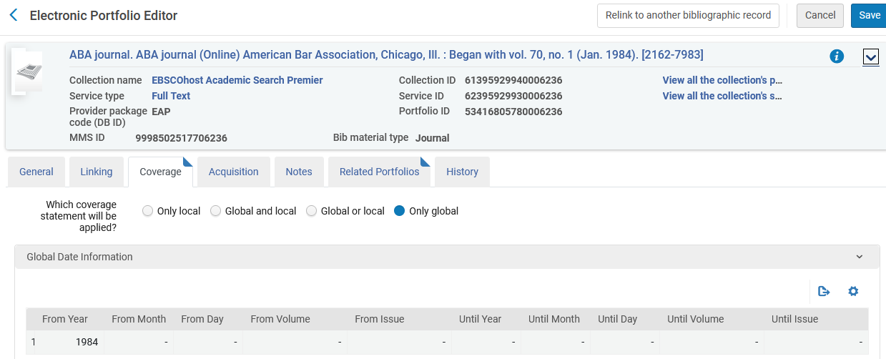
For example
ABA Journal has been activated and coverage includes 1988

Slide 30
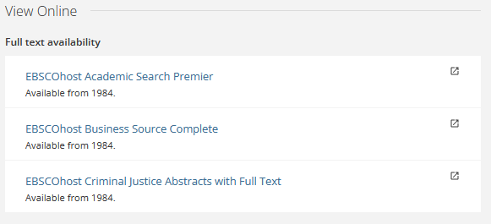
For example
When the user clicks the "available online" he or she can access the article

Slide 31
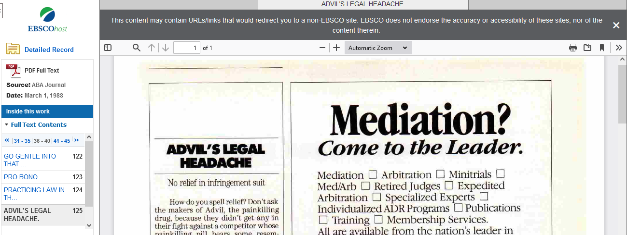
For example

Slide 32
Publish electronic records to Central Discovery Index

Slide 33
Publish electronic records to Central Discovery Index
In the previous examples when we searched scope "Books, Articles, and More" for keywords
"Diet human immune" CDI somehow "knew" that title "Gut-microbiota-targeted diets modulate human immune status" was something for which the institution has electronic resource coverage and therefore displayed it.
"Advil headache" CDI somehow "knew" that title "Advil's Legal Headache" was something for which the institution has electronic resource coverage and therefore displayed it.

Slide 34
Publish electronic records to Central Discovery Index
How did CDI "know" that the institution has electronic resource coverage for these articles?
This is because of the job "Publish electronic records to Central Discovery Index"
This job runs daily and publishes the Electronic Resources that are active for full-text, such as ebooks or ejournals, including the coverage dates to CDI.
The holdings file "tells" CDI: "this electronic content is held by the institution" and then matches the content with the CDI citations.

Slide 35
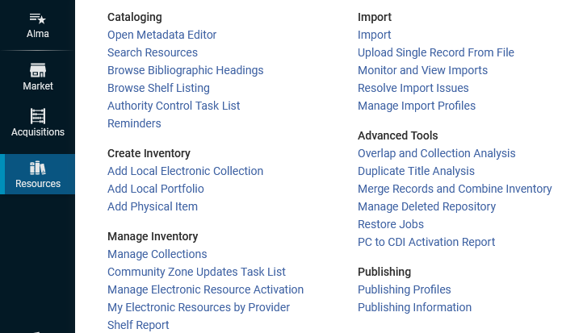
Publish electronic records to Central Discovery Index
This job is accessed from the Alma "Resources" menu under "Publishing > Publishing Profiles"

Slide 36
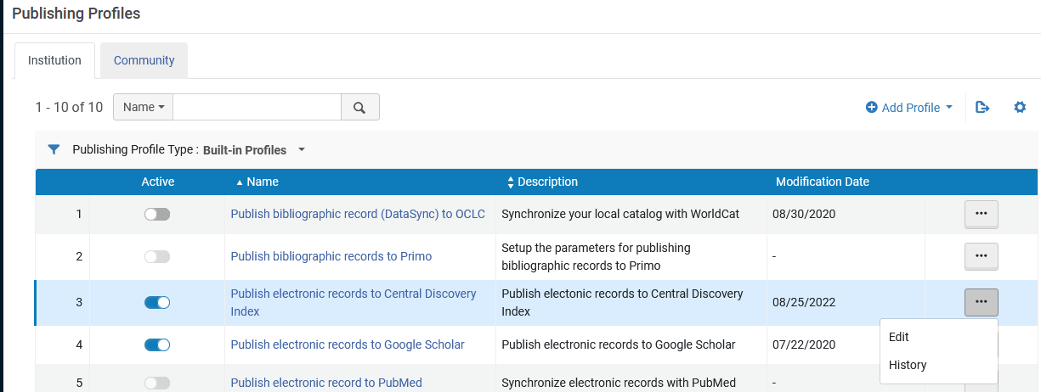
Publish electronic records to Central Discovery Index
Here is the job

Slide 37
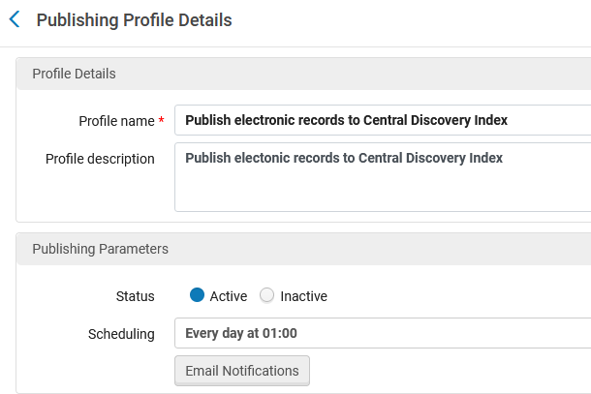
Publish electronic records to Central Discovery Index
"Publish electronic records to Central Discovery Index" should be active and scheduled to run daily.

Slide 38
Viewing all CDI citations

Slide 39
Viewing all CDI citations
As we have seen, when the end user searches the CDI index in discovery, he or she retrieves citations for which the institution has an active full text portfolio with relevant coverage.
Colloquially this is often referred to as a "filtered" search because it filters for resources accessible to the institution for the coverage period in question.
This means that end users of two different institutions may both search the CDI in their discovery and receive different results (even though it is the same CDI index).

Slide 40
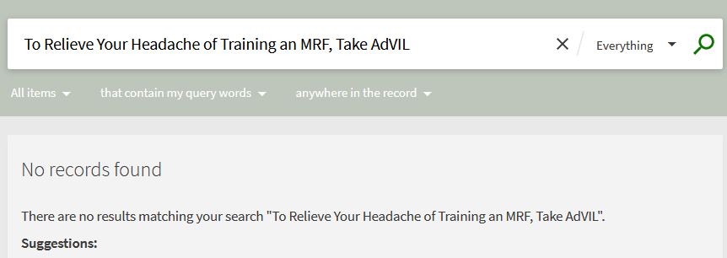
Viewing all CDI citations
User in institution A searches for "To Relieve Your Headache of Training an MRF, Take AdVIL" and receives no results from CDI

Slide 41
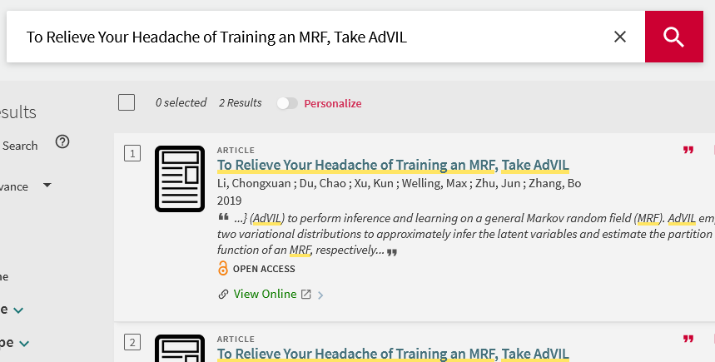
Viewing all CDI citations
User in institution B searches for "To Relieve Your Headache of Training an MRF, Take AdVIL" and receives two results from CDI

Slide 42
Viewing all CDI citations
In order to see all CDI citations including ones which are not accessible by the institution the "Expand My Results" option can be used

Slide 43
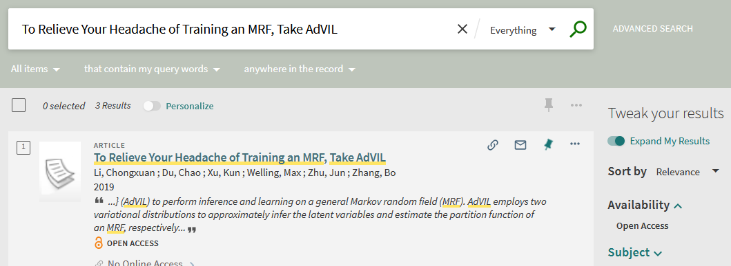
Viewing all CDI citations
With the "Expand My Results" we find three records, where we found 0 without expanding the results

Slide 44
Viewing all CDI citations
When using "Expand My Results" and retrieving records for which the institution does not have an active full text portfolio with relevant coverage there will be a "No Online Access" message

Slide 45
Viewing all CDI citations
A real-life use case for using the "Expand My Results" would be that a user searches for an article and does not find it. He or she then wants to know if it is not retrieved because of A or B
The institution does not have access to it
Because it is not indexed in CDI.
If it is found via "Expand My Results" and not found via a regular search then that means it is indexed in CDI and the institution does not have access to it.
If it is not found via a regular search and also not found via "Expand My Results" then that means that CDI has not indexed it as a citation.

Slide 46
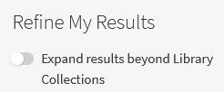
Viewing all CDI citations
The "Expand My Results" is often customized by the institutions.
For example
For example
For example
For example

Slide 47
Viewing all CDI citations
Note that the only citations which will not appear in the "expand my results" are the citations from collections and databases that are not free to search. These collections and databases, which require a subscription to be able to search for them, are a very small minority of the total citations in CDI.
The citations which are not free to search are primarily Abstracting & Indexing (A&I) Databases.

Slide 48
Viewing all CDI citations
It is possible to do an advanced search for electronic collections which are (or are not) free to search in CDI

Slide 49
The Institutional Setting "EasyActive" or "FullyFelixible"

Slide 50
The Institutional Setting "EasyActive" or "FullyFelixible"
There is an institutional setting "behind" the scenes for each institution, with minor differences between them:
EasyActive setting (described in depth here)
FullyFlexible setting (described in depth here)
When we say "behind the scenes" we mean that it is not accessible to the institution staff user. It is accessible only to Ex Libris staff.

Slide 51
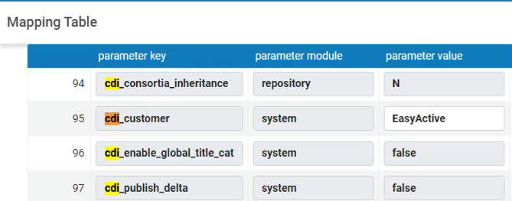
The Institutional Setting "EasyActive" or "FullyFelixible"
The vast majority of institutions that have gone live since 2020 are using EasyActive

Slide 52
The Institutional Setting "EasyActive" or "FullyFelixible"
The primary difference between the two settings is:
When FullyFlexible is used, collections with "activate for search in CDI" must be activated in Alma in order for the institution to see these resources in the "Expand My Search" of Primo.
When EasyActive is used, collections with "activate for search in CDI" do not need to be activated in Alma in order for the institution to see these resources in the "Expand My Search" of Primo. These resources will be automatically searchable in the "Expand My Search" of Primo.

Slide 53
The Institutional Setting "EasyActive" or "FullyFelixible"
It is possible to switch from FullyFlexible to EasyActive.
It is not possible to switch from EasyActive to FullyFlexible.

Slide 54
The Institutional Setting "EasyActive" or "FullyFelixible"
While this is a "hidden" setting controlled by Ex Libris, it is possible to know which setting you have in the following manner:
Search for an electronic collection in the CZ which is active in the IZ.
Click the "Action Items".
If you see a link for "Activate for search in CDI" then you are using "FullyFlexible". Otherwise, you have "EasyActive".

Slide 55
The Institutional Setting "EasyActive" or "FullyFelixible"
This institution is using FullyFlexible
This may state "Deactivate for Search in CDI" if it was already activated for search.

Slide 56
The Institutional Setting "EasyActive" or "FullyFelixible"
This institution is using EasyActive
There is no "Activate for Search in CDI"

Slide 57
Viewing and searching CDI attributes

Slide 58
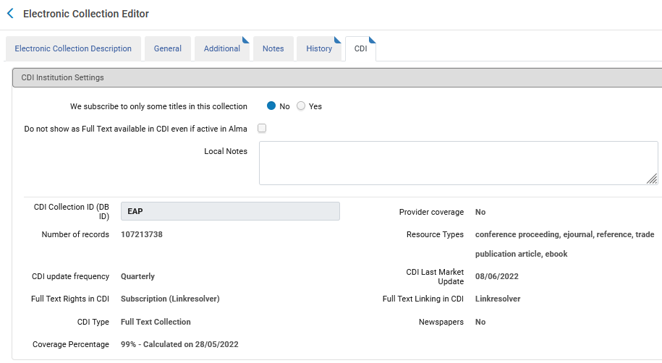
Viewing and searching CDI attributes
The CDI attributes of the Electronic Collection can be seen in the CDI tab of the Electronic Collection.

Slide 59
Viewing and searching CDI attributes
The CDI attributes of the Electronic Collection can also be seen in the repository search results of the Electronic Collection.

Slide 60
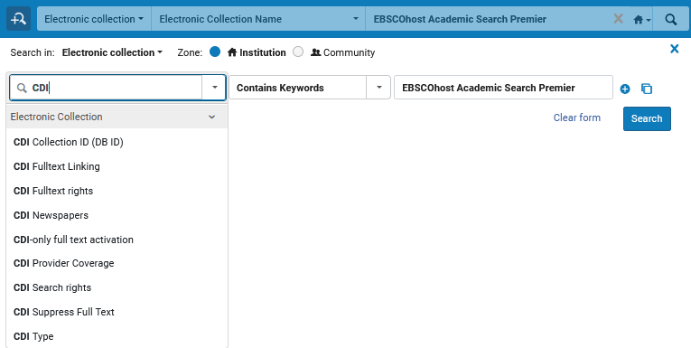
Viewing and searching CDI attributes
The CDI attributes of the Electronic Collection can also be searched via the Electronic Collection advanced search.

Slide 61
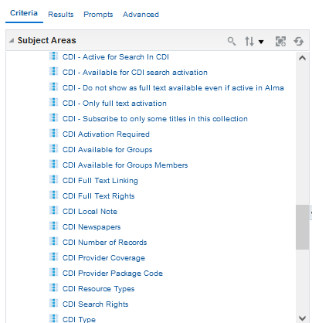
Viewing and searching CDI attributes
The CDI attributes of the Electronic Collection can also be reported on in Alma Analytics via the "E-Inventory" subject area "Electronic Collection" folder.

Slide 62
CDI Attributes

Slide 63
CDI Attributes
We will now review selected CDI attributes.
For more on these CDI attributes as well as additional CDI attributes it is recommended to see
Managing Electronic Resources
Activating Targets/Collections for CDI by Collection Type for Discovery

Slide 64
CDI Attributes
We subscribe to only some titles in this collection – (slide 1 of 2)
Select "Yes" to indicate a selective subscription (where you subscribe to only part of the content)
Select "No" to indicate a non-selective subscription for this collection (where you subscribe to all the content in the collection).
This option is available only for Aggregator/Selective collections (not for Database types of collections where no portfolios exist). The default setting is Yes.
Selecting No should be done only in case your subscription is non-selective (for example for aggregator collections or where you subscribe to the full content of the collection) and will cause the Full Text Available indicators to appear for all records in the collection.

Slide 65
CDI Attributes
We subscribe to only some titles in this collection – (slide 2 of 2)
It is recommended to set the value to No for Link in Record link type of collections as these are typically non-selective subscriptions and this will make sure that also non-ID content is flagged as available.
It is recommended to keep the default setting Yes for Linkresolver link type of collections because setting the value to No may result in linking failures, if the collection in CDI contains additional content that is not reflected in the object portfolio list in Alma.

Slide 66
CDI Attributes
Do not show as Full Text available in CDI even if active in Alma (slide 1 of 4)
Select this option to suppress this collection when publishing holdings information to CDI. As a result, content will not be flagged as Full text available in the filtered search, unless it is also available from another collection where it is active and not suppressed.
The collection will still appear on your link resolver, and users can link to the full text when coming from other search engines or platforms.

Slide 67
CDI Attributes
Do not show as Full Text available in CDI even if active in Alma (slide 2 of 4)
When a collection is 'suppressed', its content is also not searchable in the expand search, unless the collection set to active for search or unless the same content is available from other active collections.
Note: This option appears only for collections with either of the following settings:
The Available for CDI search Activation field is set to Yes.
The Available for CDI search Activation is set to No, but the collection has portfolios in Alma.

Slide 68
CDI Attributes
Do not show as Full Text available in CDI even if active in Alma (slide 3 of 4)
Results:
All portfolios for the collection are removed from the CDI holdings file. This will ensure that the content is not flagged as 'Full text available' unless it is also available from another collection where it is active and not suppressed.
The collection will still appear on your link resolver, and users can link to the full text when coming from other search engines or platforms.
Content from collections where the full text is suppressed is also not searchable in the expand search unless set to active for search or unless the same content is available from other active collections.
The local bibliographic records are not affected and are published to the local Primo Index for discovery.

Slide 69
CDI Attributes
Do not show as Full Text available in CDI even if active in Alma (slide 4 of 4)
Why use this option:
Prevent content from certain collections from appearing in Primo results for example for Open Access collections – where you would like to have only the full text active for the link resolver, but you do not want the same full text visible in the filtered search in discovery because it could clutter the result lists for your users.
Prevent duplicate ebook results where bib records are published to Primo local and in addition the CDI records appear in the result list. This option will make sure that the CDI records do not appear in the result list. Note that this will also eliminate the chapter level records in CDI.

Slide 70
CDI Attributes
CDI Collection ID – A 'View Only' field Used when publishing the CDI holdings file of the institution.

Slide 71
CDI Attributes
Provider Coverage – A 'View Only' field. Indicates how a collection is indexed in CDI.
If set to 'Yes', the collection is indexed with data received directly from provider.
If set to 'No', we do not get a database directly from the provider, but at least 80% of the content of the collection is covered in CDI by data received from other providers.
Number of records – A 'View Only' field. Number of records currently indexed in CDI. The number is updated in Alma for each collection twice a year.

Slide 72
CDI Attributes
Resource Types – A 'View Only' field. Lists up to 5 of the most frequently index resource types for the collection. This list is updated in Alma for each collection twice a year.
CDI update frequency – A 'View Only' field. estimated update frequency of the collection in CDI. Values can be weekly, monthly, quarterly or yearly. The update frequency is based on the average update frequency of the last 12 months and is updated in Alma for each collection twice a year.

Slide 73
CDI Attributes
CDI Last Market Update – A 'View Only' field. Last date that at least one record in the Electronic collection was updated in the CDI index. This field is currently updated quarterly.
The CDI Last Market Update – A 'View Only' field. Dynamic by nature, as CDI is continuously updated by many sources on an ongoing basis. Currently, the update frequency of this field is quarterly due to technical challenges. We are working to improve and automate this process, and our goal is to reach a 6-week update cycle by the end of 2022, for all collections which are in CDI.

Slide 74
CDI Attributes
Full Text Rights in CDI – A 'View Only Field'. values are:
Open Access – All collections that do not require a subscription to access full text.
Subscription (Collection Level) – All collections that require a subscription for full text and are set to available on the collection level. They do not use the link resolver for selectively setting the collection content to available.
Subscription (Linkresolver) – All collections that require a subscription for full text and the availability setting is performed selectively on the item level, based on your link resolver activations.

Slide 75
CDI Attributes
Full Text Linking in CDI – Either "LinkResolver, Link in Record, or Hybrid. See also 'CDI Type'
CDI Type – A 'View Only' field. Type of database in CDI. Values can be:
A&I Database: Citation-only database. Records from the collection do not provide full text linking in CDI. However, some of the records from the A&I database may be included in the CDI filtered search, with 'Full text available' indication, in case there are active portfolios in Alma from other collections.
Full Text Collection: Records from the collection provide full text linking in CDI.
Hybrid: Only part of the collection has a direct link to full text on the provider platform.

Slide 76
CDI Attributes
Newspapers – A 'View Only' field. values are:
Yes – All collections with content that is available in both the Newspaper Search interface and the Regular Primo search interface.
Yes, Newspapers Search only – All collections with content that is available exclusively via the Newspaper Search interface, not via the Regular Primo search interface.
No – All collections that are not available using the Newspaper Search interface because they do not contain newspapers.

Slide 77
CDI Attributes
Coverage Percentage – A 'View Only' field. Items that are available for CDI indicate the coverage percentage of the records in CDI.
This indicator also includes the last date of calculation for this statistic. This information only displays if the coverage percentage has been calculated.
If the date is not populated, it will not be displayed.

Slide 78
See also

Slide 79
See also
Using the Central Discovery Index (CDI) in Alma
Under 'Alma > Product Documentation'. A main page pointing to specific CDI documentation
CDI - The Central Discovery Index
Under 'Primo > Content Corner'. A main page pointing to specific CDI documentation
An Overview of the Ex Libris Central Discovery Index (CDI)
Under 'Primo > Content Corner'
Publishing to Central Discovery Index
Under 'Alma > Product Documentation'
CDI Collection Lists for Alma Customers
Under 'Electronic Resource Management > Alma Single Activation Source for CDI > CDI Collection Lists for Alma Customers

