Slide 1
Hide Repeated Labels and delimiters for repeated metadata
Yoel Kortick
Senior Librarian

Slide 2
Hide repeated labels
The “Hide Repeated Labels” options determines whether one of the following behaviors will occur:
If a bibliographic record has multiple occurrences of the same MARC field, then when viewing the digital object, the fields will appear in the “description” section:
When “Hide Repeated Labels” is not checked: The label will appear once for each occurrence of the field (if there are three fields then the label will appear three times)
When “Hide Repeated Labels” is checked: The label will appear once and under the label will be the contents of each field.

Slide 3
Hide repeated labels
As a “side comment”: Note that the order and name of the bibliographic field labels in the Alma Viewer are defined at ‘Configuration > Fulfillment > Digital Fulfillment > Delivery Profiles Metadata > Select Relevant Profile’

Slide 4
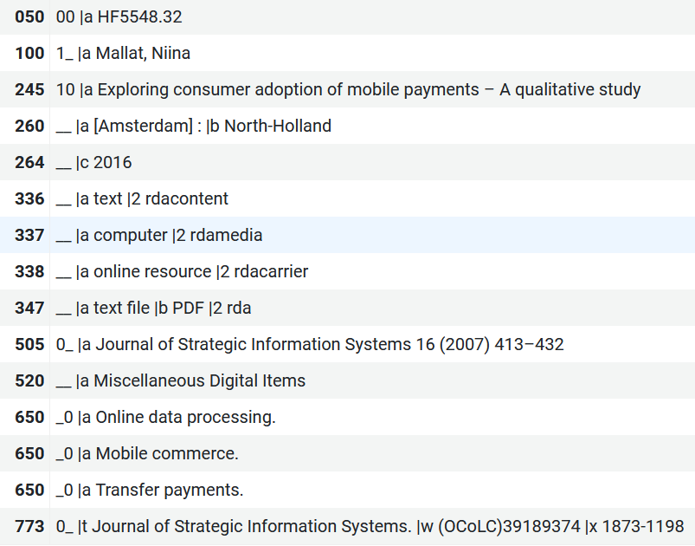
Hide repeated labels
Title “Exploring consumer adoption of mobile payments – A qualitative study” has three 650_0 fields

Slide 5
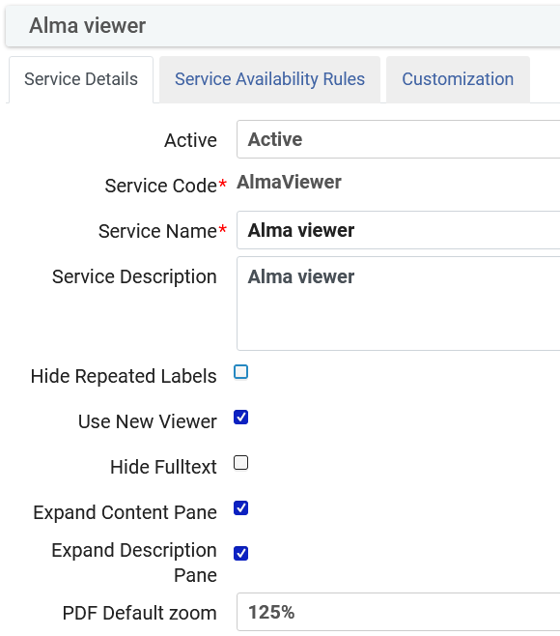
Hide repeated labels
In the Alma Viewer definitions, we have not checked “Hide Repeated Labels”

Slide 6
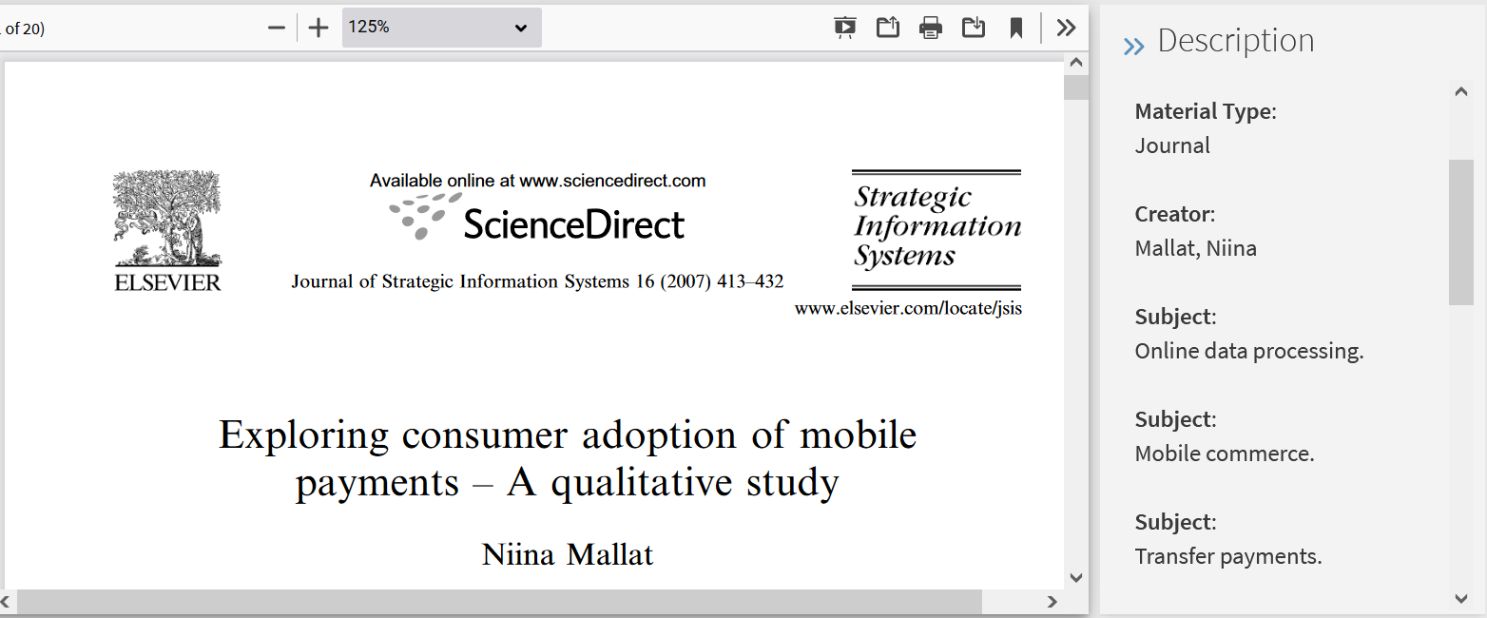
Hide repeated labels
In the Alma Viewer we see the label “Subject” for each 650_0

Slide 7
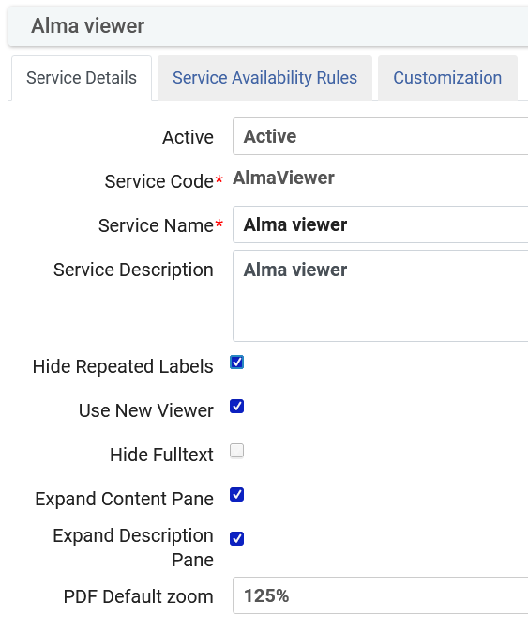
Hide repeated labels
Now in the Alma Viewer definitions, we have checked “Hide Repeated Labels”

Slide 8
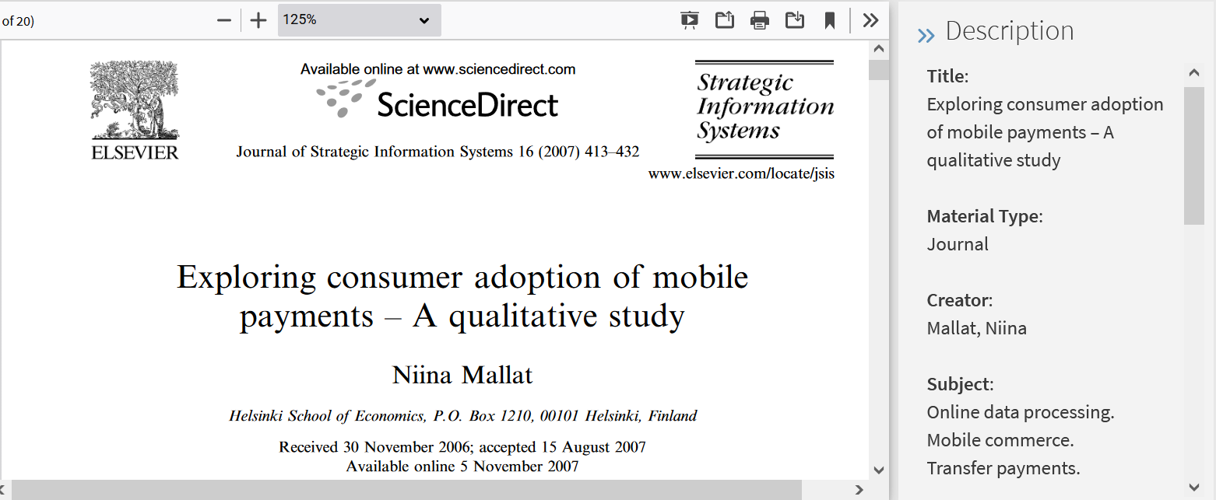
Hide repeated labels
In the Alma Viewer we see one label “Subject” for all each 650_0 occurrences

Slide 9
Hide repeated labels
It is also possible to use a delimiter between the multiple occurrences of a field.
The delimiter can be entered in the field “Delimiter for Grouping Repeated Delivery Metadata” which is located at ‘Configuration > Fulfillment > Discovery Interface Display Logic > Other Settings”

Slide 10
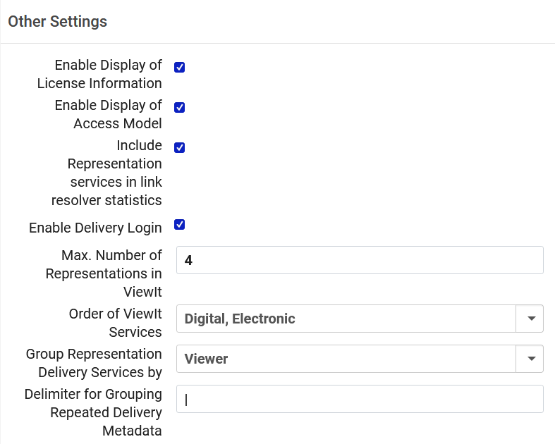
Hide repeated labels
Here we have defined the delimiter to be a pipe sign (|)

Slide 11
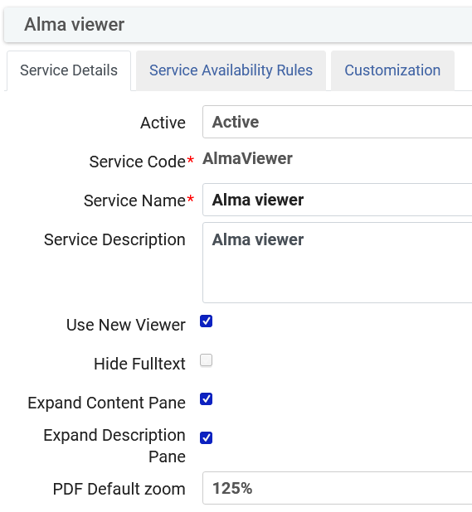
Hide repeated labels
Note that when there is a value in the field “Delimiter for Grouping Repeated Delivery Metadata” the “Hide Repeated Labels” option will not appear in the Alma View definitions:
We no longer have the “Hide Repeated Labels” option because we defined a delimiter

Slide 12
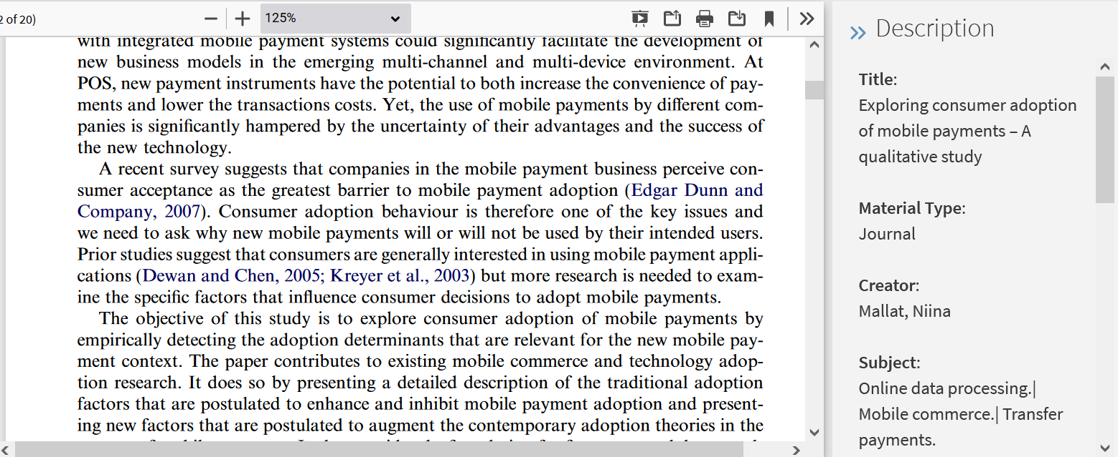
Hide repeated labels
The subjects now appear in the “Description” section with the delimiters

