Slide 1
How to add an image (icon) on the letterhead of the borrowing activity letter depending on the language of the letter
Yoel Kortick – Senior Librarian

Slide 2
Agenda
The question
Identify the path and field name of the language
Edit the XSL and add the condition
The results

Slide 3
The question

Slide 4
The question
Hi. I want to add an icon of the library to the header of the borrowing activity letter. I want the icon to be different depending on the language of the letter.

Slide 5
Identify the path and field name of the language

Slide 6
Identify the path and field name of the language
We will need to make a condition based on the language of the letter.
Therefore, we need to get the path and field name of the language of the letter as it appears in the XML.
Go to “Configuration > General > Letters > Letter Configuration” and edit the “Borrowing Activity Letter”.
Go to the “Letter Examples” tab > Choose desired letter to preview > Preview the letter.
Download the XML
Look for the language.
Identify the name and path of the field

Slide 7
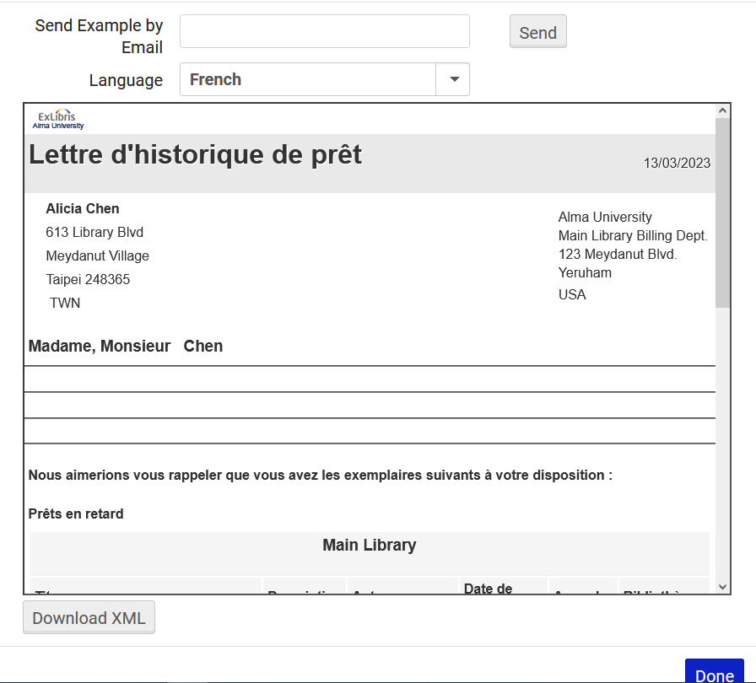
Identify the path and field name of the language

Slide 8
Identify the path and field name of the language
Here we have opened the XML in notepad ++ and found the language
Here we used a notepad ++ plugin to get the path. It can also be done manually.

Slide 9
Identify the path and field name of the language
The path and name of field for the library of the ordered item is /notification_data/receivers/receiver/preferred_language

Slide 10
Edit the XSL and add the condition

Slide 11
Edit the XSL and add the condition
We will use this image if the language is English:
https://upload.wikimedia.org/wikipedia/commons/thumb/b/b6/Open_Library_tight_logo.svg/710px-Open_Library_tight_logo.svg.png

Slide 12
Edit the XSL and add the condition
We will use this image if the language is French:
https://upload.wikimedia.org/wikipedia/commons/thumb/5/54/Logo_Biblioth%C3%A8que_pour_Tous.svg/512px-Logo_Biblioth%C3%A8que_pour_Tous.svg.png

Slide 13
Edit the XSL and add the condition
An XSL condition to add the images based on the library name is on the next slide.
If you want the images to appear on the top of the letter then the text should be added after the following part of the letter
<xsl:attribute name="style">
<xsl:call-template name="bodyStyleCss" /><!-- style.xsl -->
</xsl:attribute>
And before the following part of the letter.
<xsl:call-template name="head" /><!-- header.xsl -->

Slide 14
Edit the XSL and add the condition
<xsl:attribute name="style">
<xsl:call-template name="bodyStyleCss" /><!-- style.xsl -->
</xsl:attribute>
<!-- begin add icons -->
<xsl:for-each select="notification_data">
<xsl:if test=" /notification_data/receivers/receiver/preferred_language = 'fr'">
<center> <img src="https://upload.wikimedia.org/wikipedia/commons/thumb/5/54/Logo_Biblioth%C3%A8que_pour_Tous.svg/512px-Logo_Biblioth%C3%A8que_pour_Tous.svg.png" style="width:150px;height:150px;"/> </center>
</xsl:if>
</xsl:for-each>
<xsl:for-each select="notification_data">
<xsl:if test=" /notification_data/receivers/receiver/preferred_language = 'en'">
<center> <img src="https://upload.wikimedia.org/wikipedia/commons/thumb/b/b6/Open_Library_tight_logo.svg/710px-Open_Library_tight_logo.svg.png" style="width:150px;height:150px;"/> </center>
</xsl:if>
</xsl:for-each>
<!-- end add icons -->
<xsl:call-template name="head" /><!-- header.xsl -->
French
English

Slide 15
Edit the XSL and add the condition
Edit the XSL of the letter as follows:
Go to “Configuration > General > Letters > Letter Configuration” and edit the “Borrowing Activity Letter”.
Go to the “Template” tab > Edit the letter> Preview the letter > Save.

Slide 16
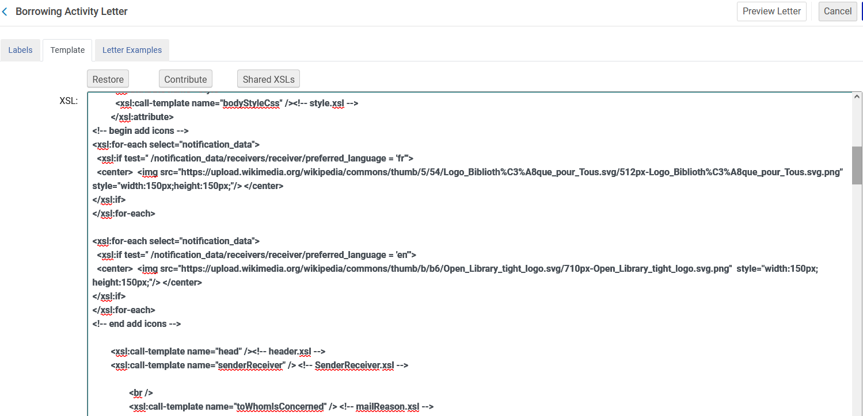
Edit the XSL and add the condition
Here is the edited XSL

Slide 17
The results

Slide 18
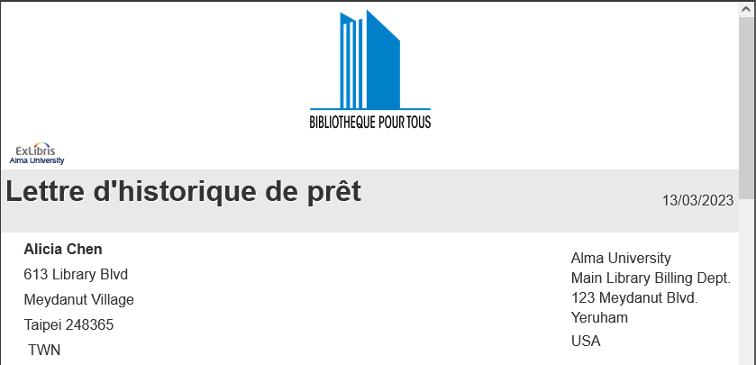
The results
When the letter is in French, we have the icon we designated for French letters

Slide 19
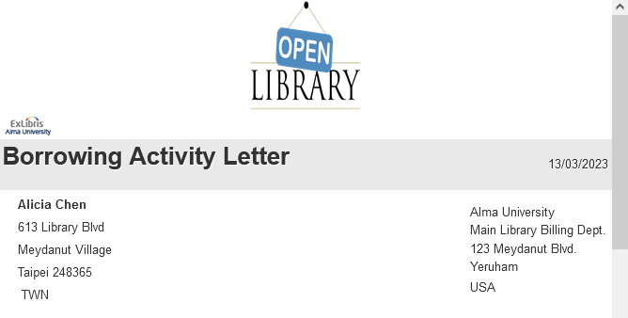
The results
When the letter is in English, we have the icon we designated for English letters

Slide 20
xxx@exlibrisgroup.com

