Slide 1
An Introduction to Primo Analytics Data Visualization (DV)
Yoel Kortick
Senior Librarian

Slide 2
Introduction
Accessing DV and creating a workbook
Displaying and filtering data
Accessing a saved DV workbook
Using multiple visualizations in the same workbook
Some examples

Slide 3
Introduction
In this presentation we will show a general introduction to OAS (Oracle Analytics Server) Data Visualization, specifically how it is used with Alma in the framework of Alma Analytics.
The general introduction will be done by actually using the data visualization.
See also blogs about specific Data Visualization functionality at https://developers.exlibrisgroup.com/blog/?tag=data-visualizationdv

Slide 4
Introduction
First we will create a data visualization workbook and save it, and then access it.
Next we will add an additional visualization in the same “canvas” of the same workbook, using two different methods. Along the way we will show how different visualizations may be accessed and changed.
Finally, we will show a few examples of other data visualization workbooks.

Slide 5
Introduction
This current presentation gives a high level overview.
For more additional “Deep Dive” Data Visualization topics see also
YouTube videos at YouTube videos about OAS (Oracle Analytics Server) and DV (Data Visualization)
Developer Network blog posts at: Blogs about DV (Data Visualization)

Slide 6
Accessing DV and creating a workbook

Slide 7
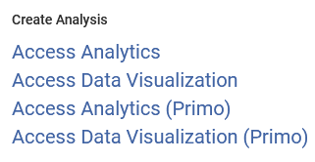
Accessing DV and creating a workbook
Data Visualization is accessed from the Analytics menu of Alma:

Slide 8
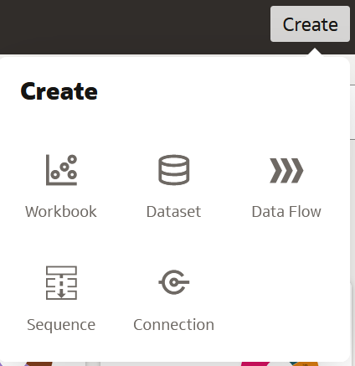
Accessing DV and creating a workbook
The Oracle Business Intelligence home page will open in a new tab and from there you can create a new workbook:

Slide 9
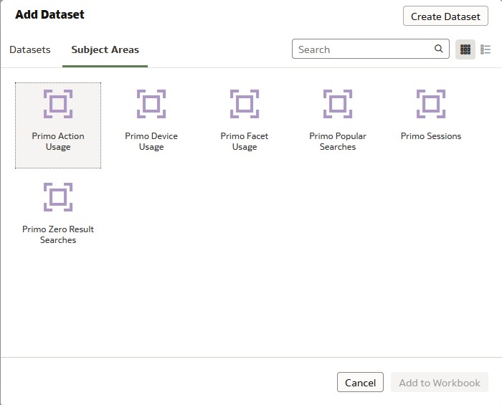
Accessing DV and creating a workbook
When creating a workbook an Alma Analytics subject area may be chosen:

Slide 10
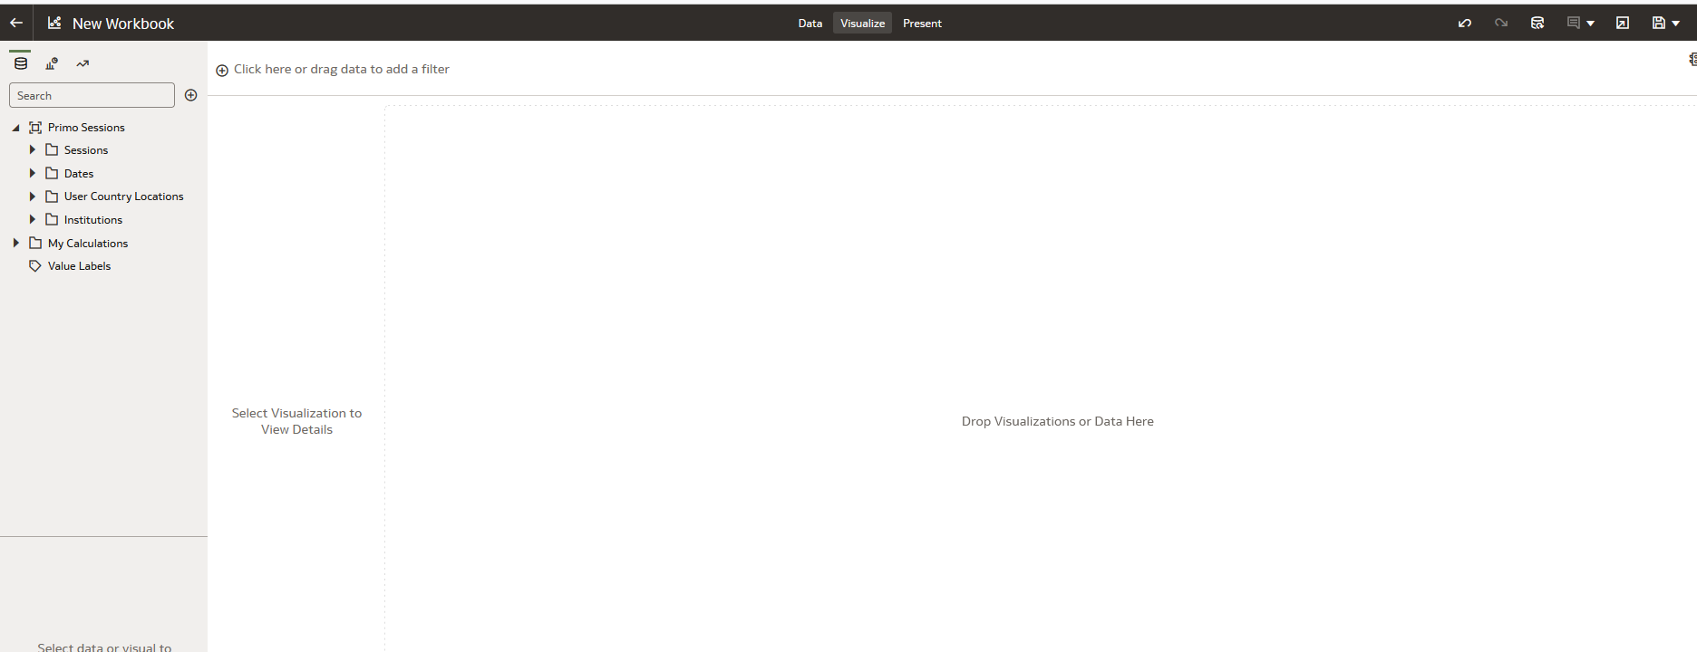
Accessing DV and creating a workbook
After adding a subject area, the following appears:
Data Panel
Grammer Panel
Canvas

Slide 11
Displaying and filtering data

Slide 12
Displaying and filtering data
To display and filter data:
Drag fields from the subject area on the left to the canvas on the right to display them.
Drag fields from the subject area on the left to the filter section on the top to filter them (this can also be done by other methods such as right clicking fields and choosing “Create filter”).

Slide 13
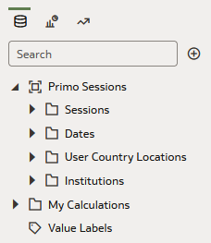
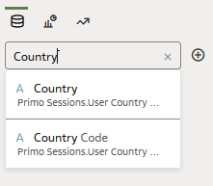
Displaying and filtering data
From within the data elements section of the navigation pane it is possible to search for fields:

Slide 14
Displaying and filtering data
On the next slide we are using the “Primo Sessions” subject area and
Drag to the canvas the “Country” and the “# Sessions"
Drag to the upper "Filters" section the “Country“ and the “# Sessions"
Filter by “# Sessions" >= 500
In the initial results we will right click the “Country" which is “New Zealand" and choose "remove selected".

Slide 15
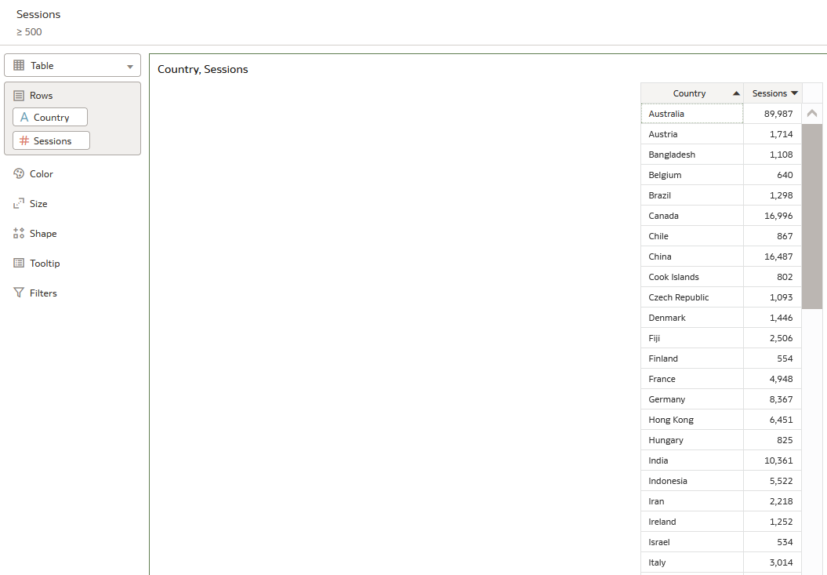
Displaying and filtering data
Here is the filter on top

Slide 16
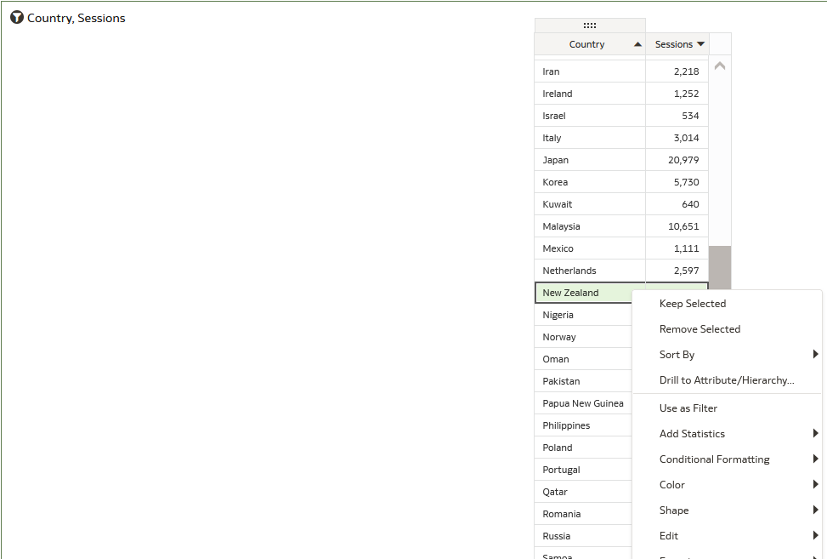
Displaying and filtering data
In the initial results we will right click the “Country" which is “New Zealand" and choose "remove selected".

Slide 17
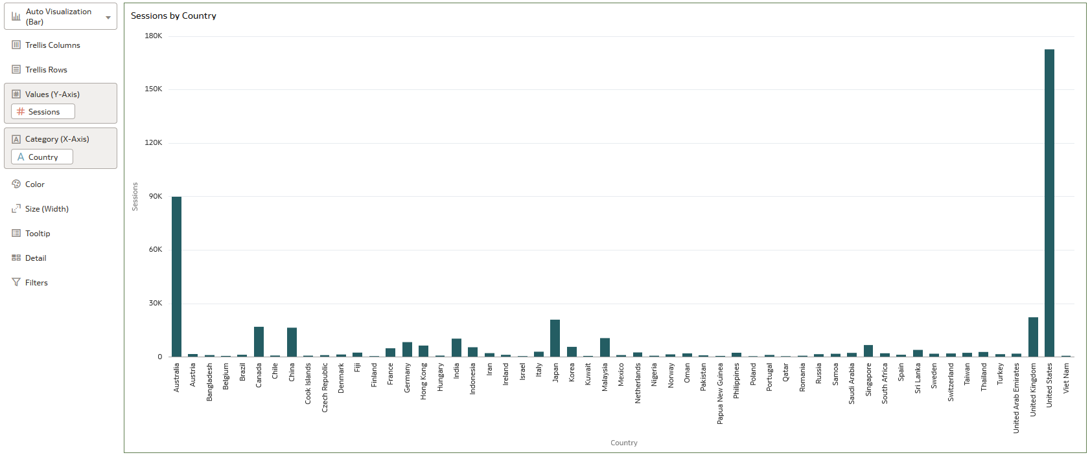
Displaying and filtering data
If we choose “Auto Visualization” then (in this case)the DV will choose for us a bar graph

Slide 18
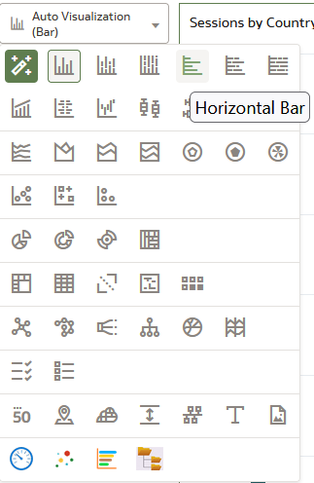
Displaying and filtering data
We can click the visualization (where now it states "Auto Visualization (Bar))" and choose a different visualization. Here we choose Horizontal Bar.

Slide 19
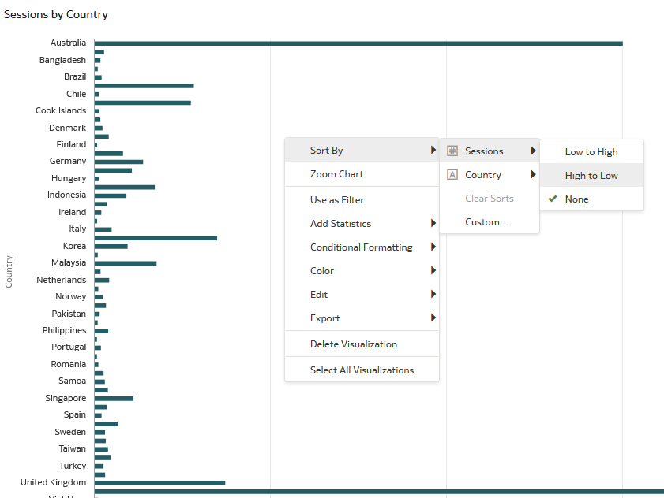
Displaying and filtering data
The values can be sorted as desired by right clicking and choosing "sort". We will sort the # Sessions by high to low.

Slide 20
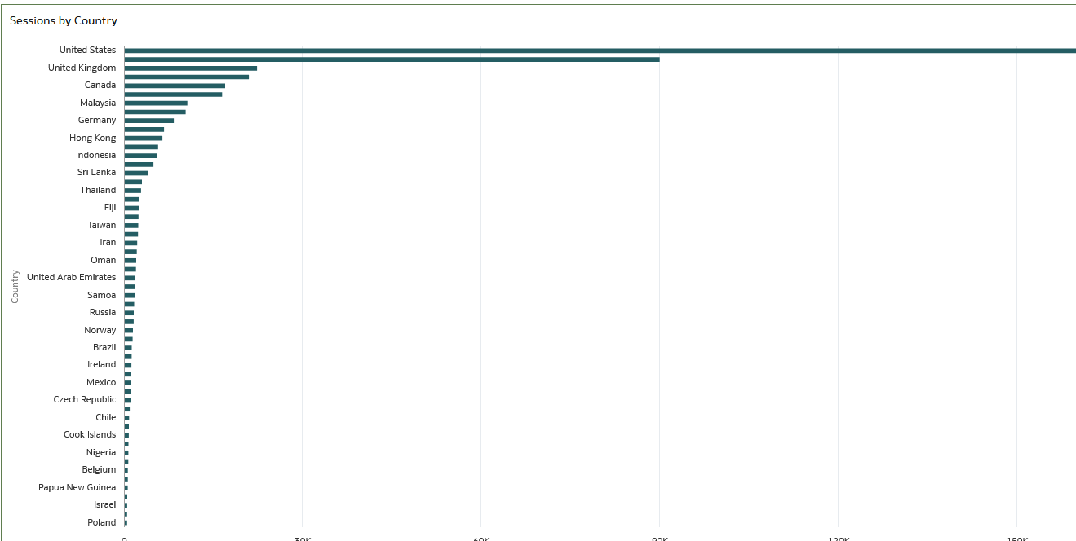
Displaying and filtering data
The data is now sorted:

Slide 21
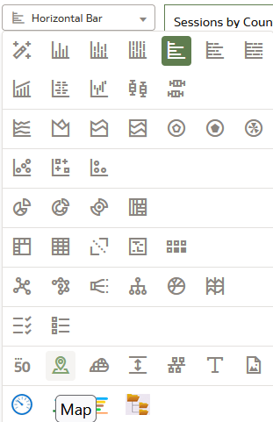
Displaying and filtering data
Now we will change the visualization to a map

Slide 22
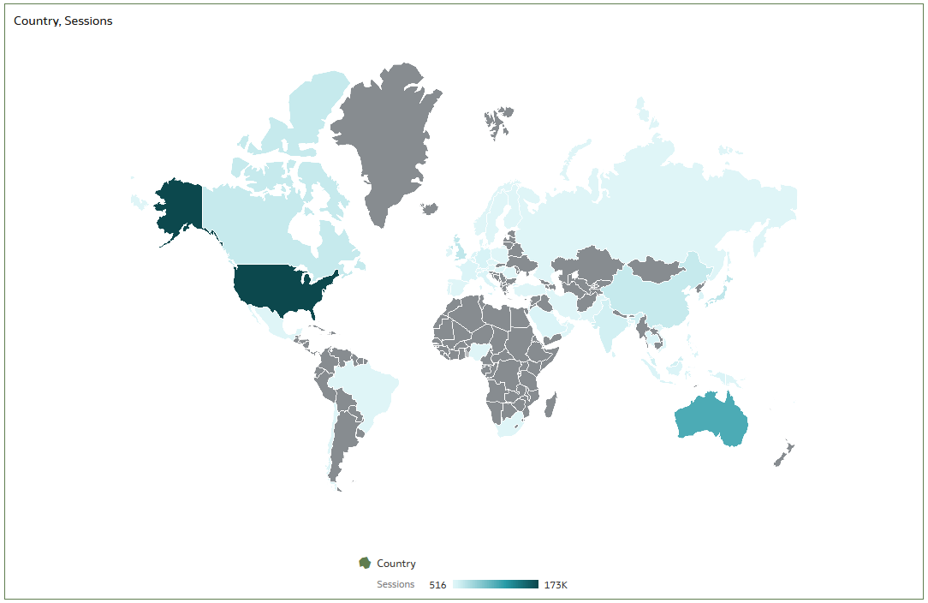
Displaying and filtering data
The new map visualization

Slide 23
Displaying and filtering data
Save the workbook via the "Save" button on the top right:

Slide 24
Accessing a saved DV workbook

Slide 25
Accessing a saved DV workbook
The workbook can then later be accessed from the Data Visualization home page (which is accessed as we saw from within Alma choosing "Data Visualization" from the Alma menu).
There are multiple ways to access and open the saved workbook. One way is:
Click the three lines on top left
Choose "Catalog"
Navigate to where the workbook was saved
Right click the workbook and choose "open"

Slide 26
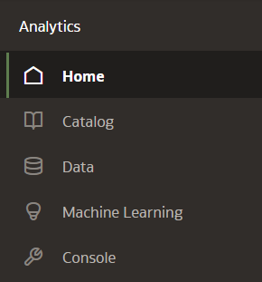
Accessing a saved DV workbook
Click the three lines on top left and choose "Catalog"

Slide 27
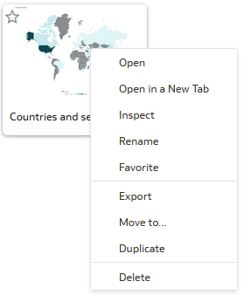
Accessing a saved DV workbook
Navigate to where the workbook was saved
Right click the workbook and choose "open"

Slide 28
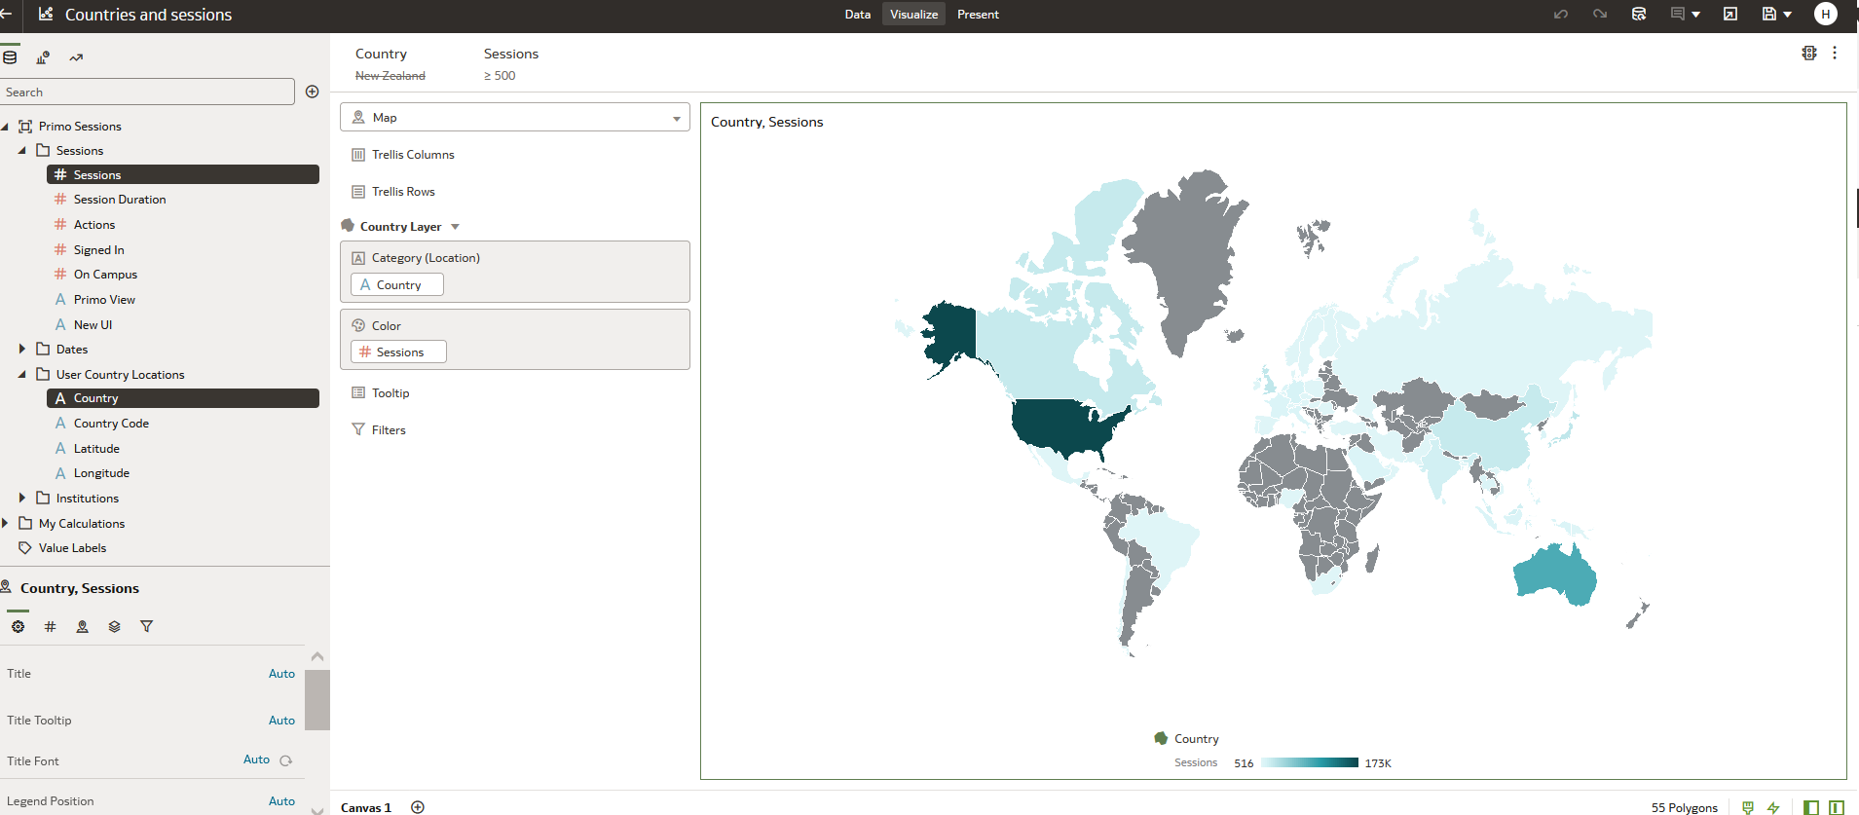
Accessing a saved DV workbook
The workbook opens

Slide 29
Using multiple visualizations in the same workbook

Slide 30
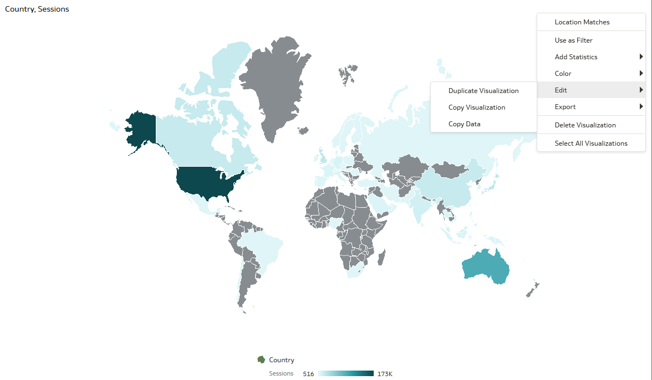
Using multiple visualizations in the same workbook
It is possible to have two different visualizations based on the same data on the same canvas. To do so first duplicate the visualization. “Menu (on top right of visualization) > Edit > Duplicate Visualization”.

Slide 31
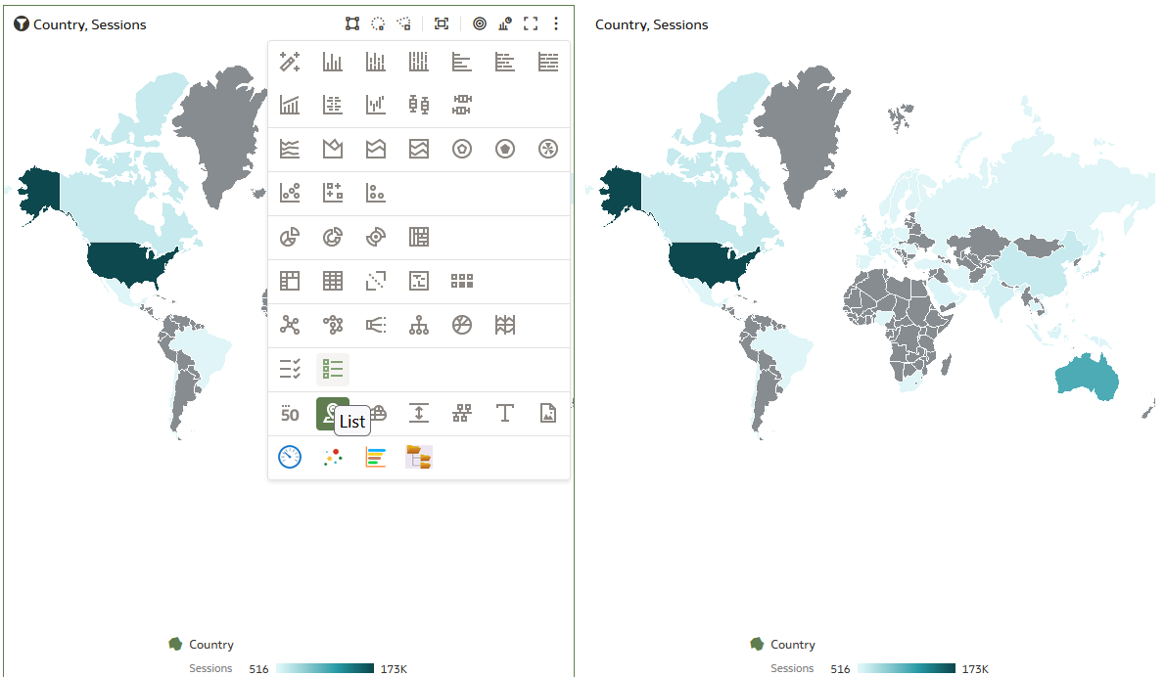
Using multiple visualizations in the same workbook
Now we have two identical visualizations and will change one of them to a list

Slide 32
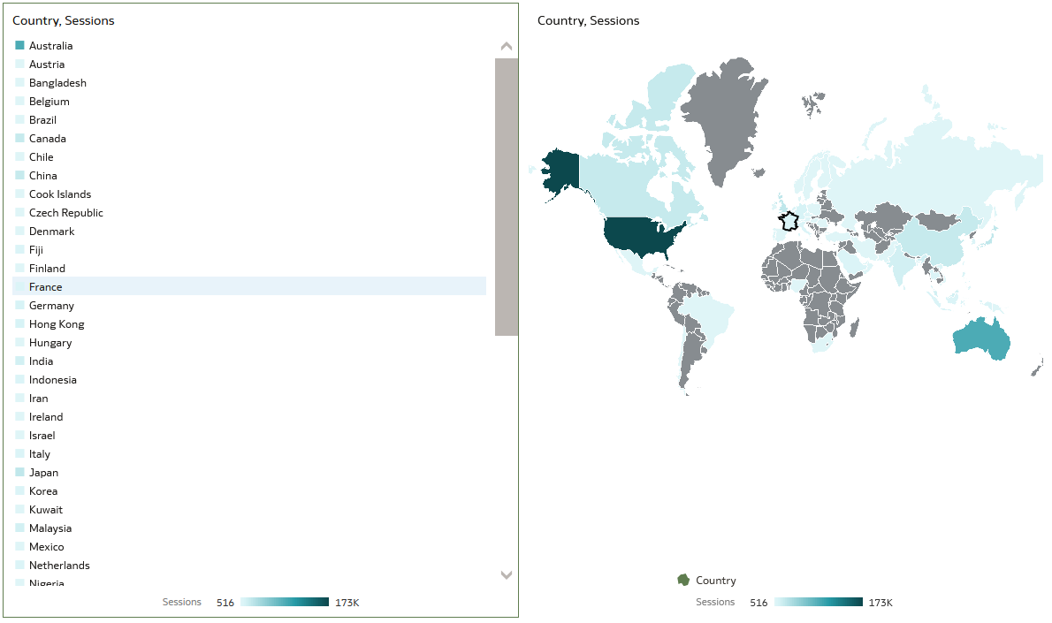
Using multiple visualizations in the same workbook
Now we have two different visualizations with the same data on the same canvas. One is a “Map" and one is a "List":

Slide 33
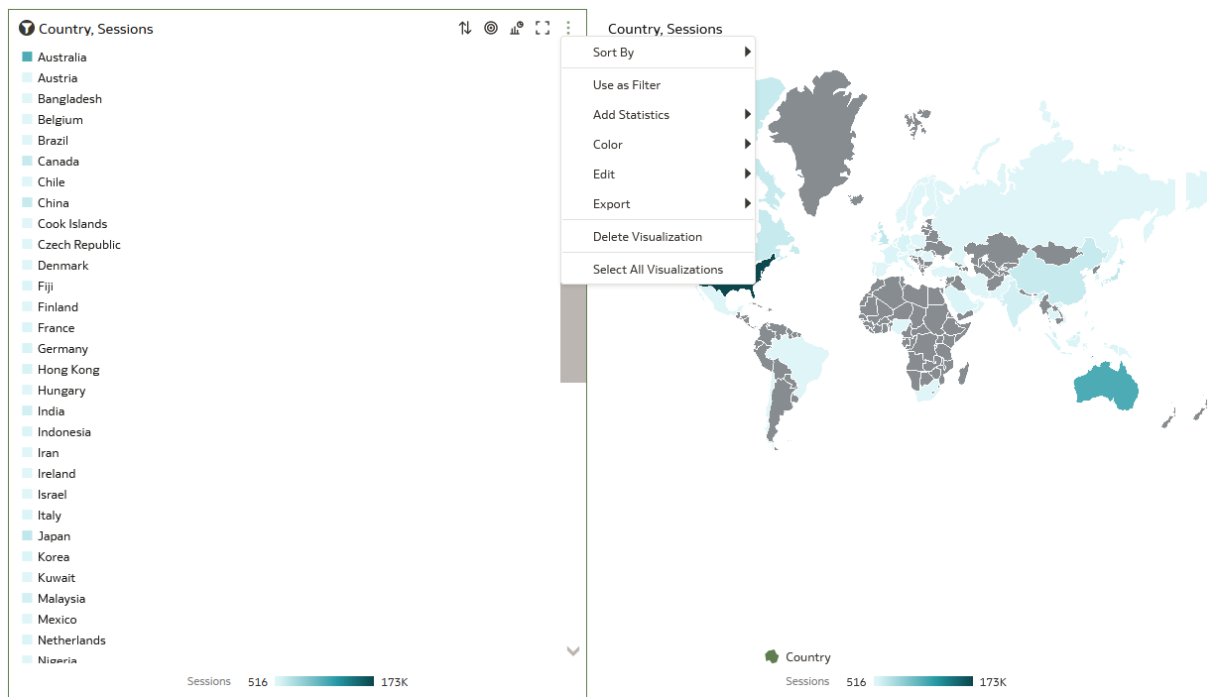
Using multiple visualizations in the same workbook
Now we will delete the "List" visualization:

Slide 34
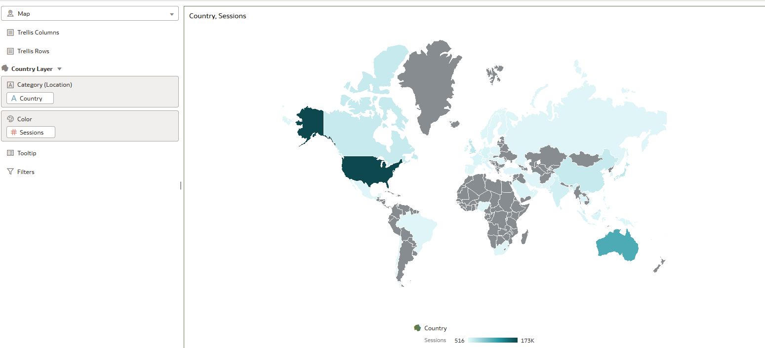
Using multiple visualizations in the same workbook
Now again we have one visualization on the canvas:

Slide 35
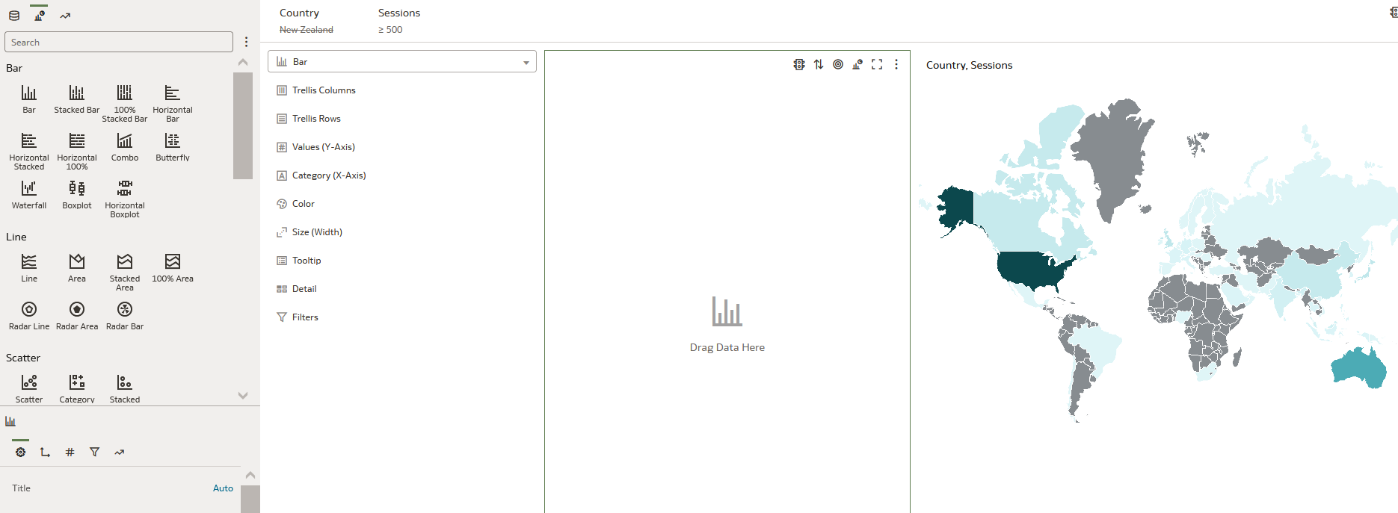
Using multiple visualizations in the same workbook
We can also have two visualizations on the same canvas with different data. Here we have clicked the "Visualizations" icon in the left pane and dragged in a new blank "Bar" visualization.

Slide 36
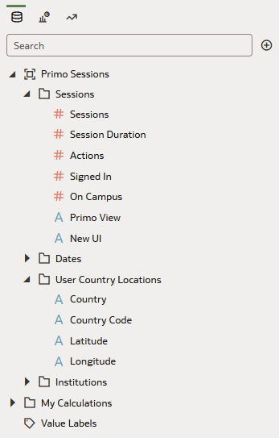
Using multiple visualizations in the same workbook
With the new blank "Bar" visualization selected we can make a new visualization, for example with # sessions by Year. First we select the "Data Elements" icon in the data panel.

Slide 37
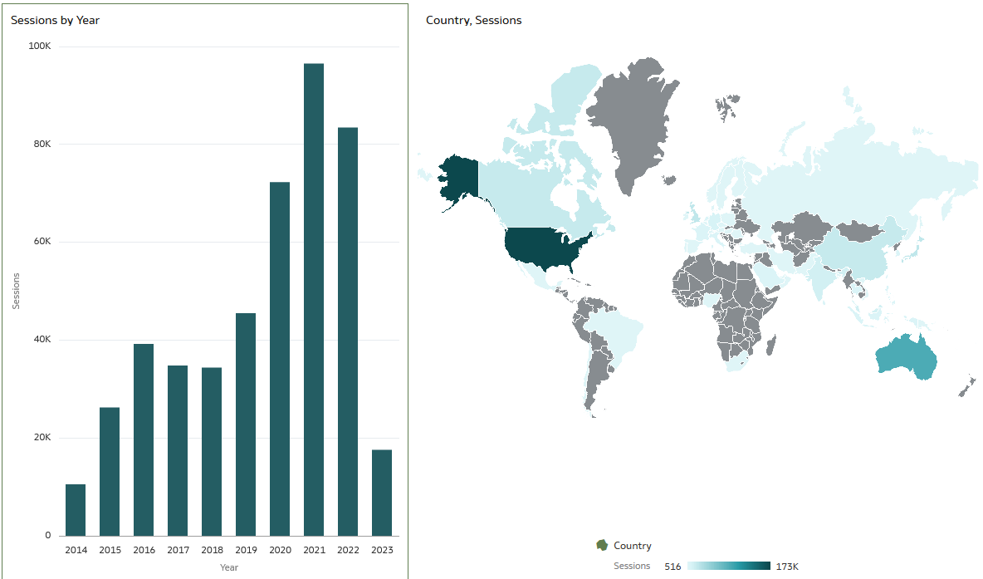
Using multiple visualizations in the same workbook
And now we drag in to the "Bar" visualization the number # session and the year. Now we have two visualizations with different data in the same canvas. Note that in this case the filters on the top apply to both visualizations in the same canvas.

Slide 38
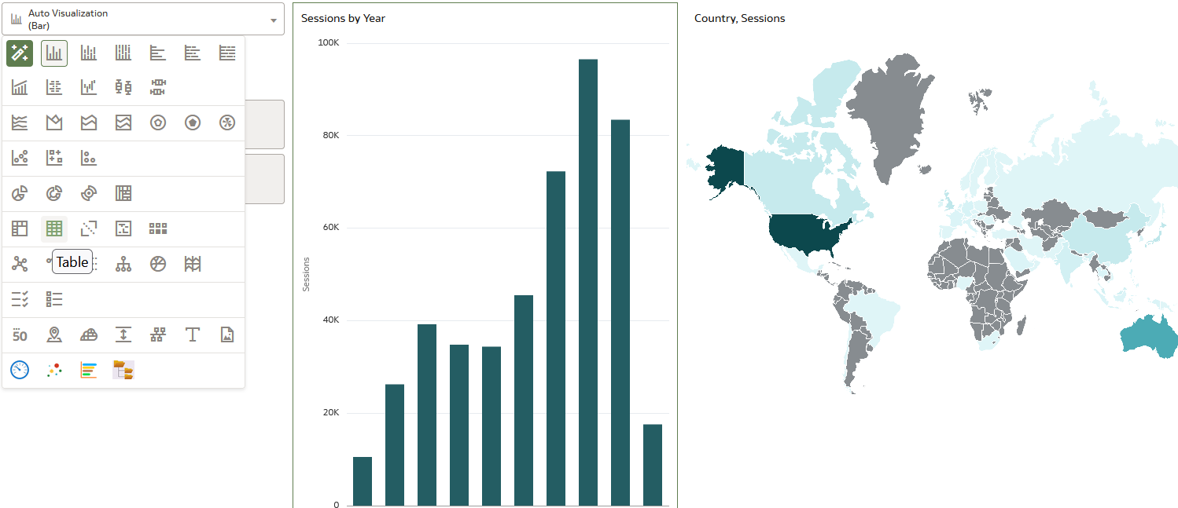
Using multiple visualizations in the same workbook
Now instead of the "Bar" visualization on the left we will choose “Table"

Slide 39
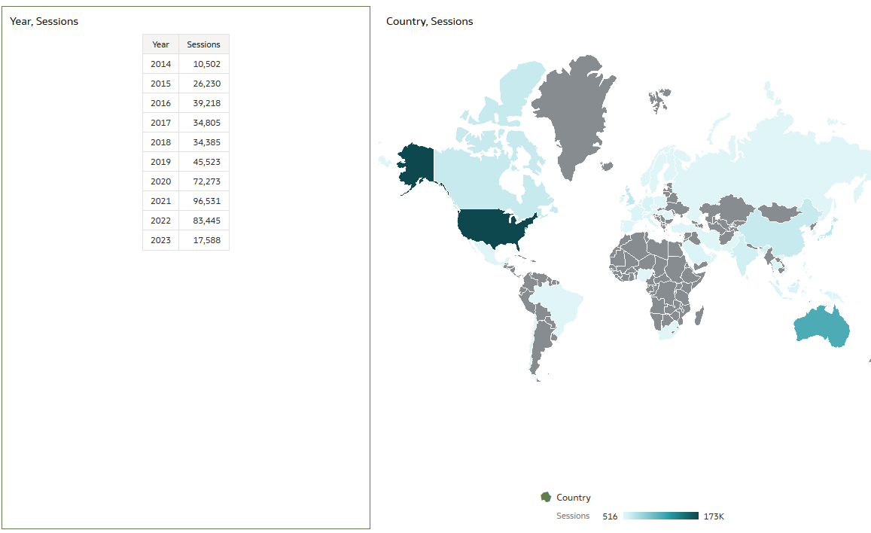
Using multiple visualizations in the same workbook
Now we have a table with the year and total number of sessions, and a map with the total number of sessions per country.

Slide 40
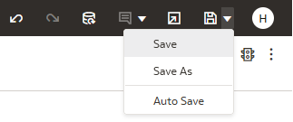
Using multiple visualizations in the same workbook
And now we can save the workbook again, this time with a new name

Slide 41
Some examples

Slide 42
Some examples
Primo device usage for last 365 days

Slide 43
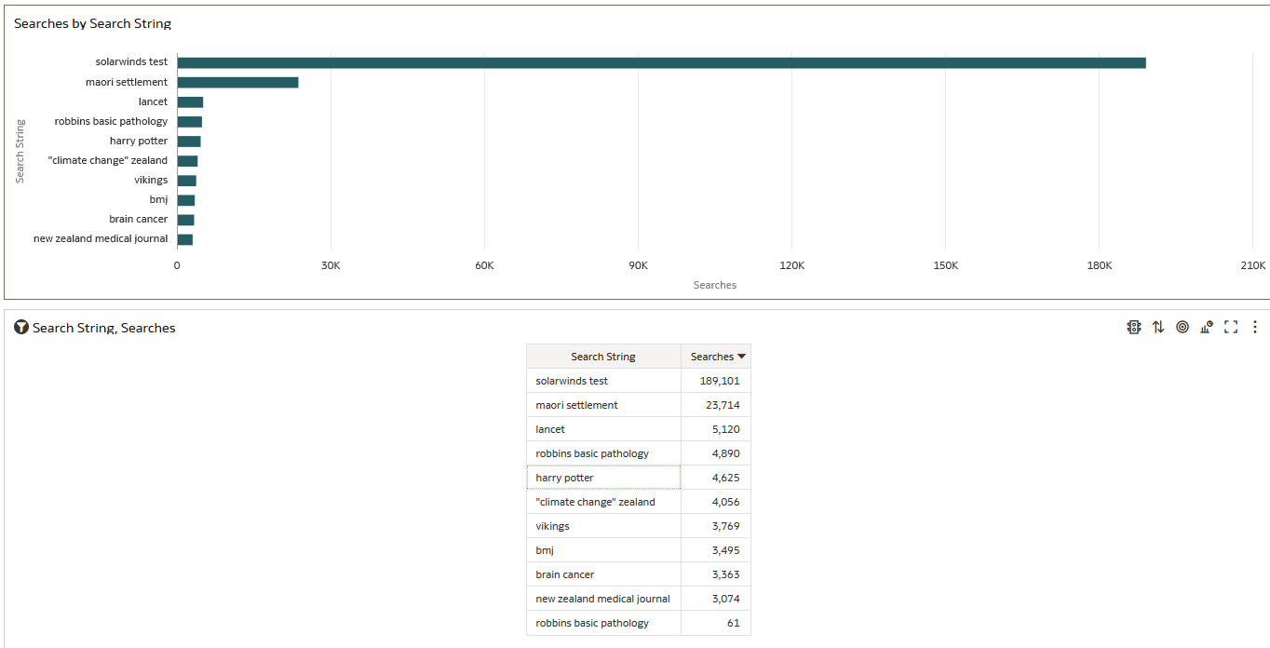
Some examples
Top Ten Primo Searches

Slide 44
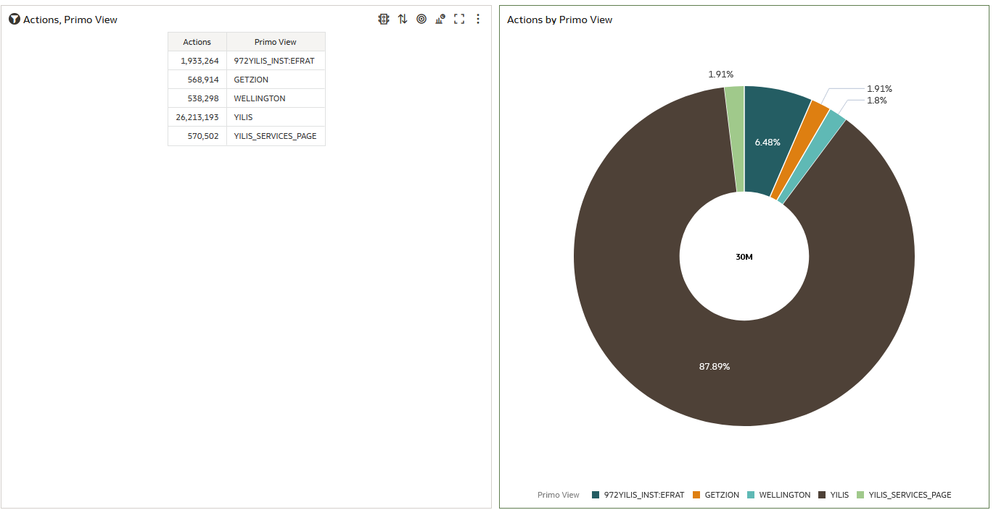
Some examples
Top 5 Primo Views by number of actions

Slide 45
Thank you!
xxx@exlibrisgroup.com

