Slide 1
How to create local portfolios and local electronic collections
Yoel Kortick
Senior Librarian

Slide 2
Introduction
The plan for this presentation
Creating the local portfolios
The bibliographic records of the new portfolios
Creating the local electronic collection
View the new local portfolios in the new local electronic collection in discovery
Agenda

Slide 3
Introduction

Slide 4
Introduction
A local portfolio and local electronic collection is typically created if the portfolio and electronic collection does not already exist in the community zone.
After creating a portfolio and local electronic collection, it is possible to contribute it to the community zone for the benefit of the larger Alma community.
See separate presentation on contributing to the community zone.

Slide 5
The plan for this presentation

Slide 6
The plan for this presentation
In our example here we will first create two local portfolios:
Title "The Health Benefits of BBQ Grilling" with URL https://www.willowranchrestaurant.com/blog/bbq-restaurant/the-health-benefits-of-bbq-grilling
Title "Health Benefits of Grilling Food" with URL https://nyhealth.com/news/health-benefits-of-grilling-food

Slide 7
The plan for this presentation
Next, we will create a local electronic collection called "Resources about barbecuing"
Finally, we will add the two local portfolios which we created to the local electronic collection which we created.

Slide 8
Creating the local portfolios

Slide 9
Creating the local portfolios
Before we create a new portfolio, we will talk about the two possible "Creation Types":
Create new title: This method will create not only the new portfolio but also a new bibliographic record based on the fields entered in the "New Portfolio page". Later the new bibliographic record can be edited by a professional cataloger (or any staff user with cataloging roles). This method is recommended if there does not already exist a bibliographic record for the portfolio.
Use existing title: This method allows the staff user to link the portfolio to an already existing bibliographic record. This method is recommended if there already exists a bibliographic record for the portfolio.

Slide 10
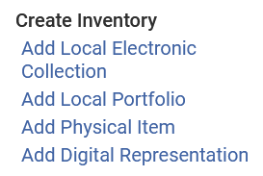
Creating the local portfolios
A local portfolio is accessed from "Resources > Create Inventory > Add Local Portfolio". We will now add the first portfolio.

Slide 11
Creating the local portfolios
Here is the "Descriptive Information" section of the first portfolio
We are creating a new title which means that a new bibliographic record will be created. If we has chose ‘Use existing title" then we would need to choose the existing title (bibliographic record) below in the ‘Choose title" field.
This is all of the bibliographic information which we have.

Slide 12
Creating the local portfolios
Here is the "General Information" section of the first portfolio
We are creating this portfolio as a "Standalone" meaning it is not connected to an electronic collection. Later we will connect it to an electronic collection. If we had already created the local electronic collection, then we could already choose "part of an electronic collection" and link it to the electronic collection now.

Slide 13
Creating the local portfolios
Here is the "Coverage Information" section of the first portfolio
We are leaving this section blank, as it is not relevant for our portfolio

Slide 14
Creating the local portfolios
Here is the "Inventory and Linking Information" section of the first portfolio
This is the URL of the portfolio. We have also already stated that it is active, so it will already be accessible to user in the discovery interface.

Slide 15
Creating the local portfolios
Here is the "Notes" section of the first portfolio
Later we will see where this "Public Note" appears to the user in discovery

Slide 16
Creating the local portfolios
We will now click "Save and done"

Slide 17
Creating the local portfolios
The first new portfolio is created.
The new portfolio is active (blue icon) because we checked "Active" in the availability status.

Slide 18
Creating the local portfolios
We will now add the second portfolio.

Slide 19
Creating the local portfolios
Here is the "Descriptive Information" section of the second portfolio
We are creating a new title which means that a new bibliographic record will be created. If we has chose ‘Use existing title" then we would need to choose the existing title (bibliographic record) below in the ‘Choose title" field.
This is all of the bibliographic information which we have.

Slide 20
Creating the local portfolios
Here is the "General Information" section of the second portfolio
We are creating this portfolio as a "Standalone" meaning it is not connected to an electronic collection. Later we will connect it to an electronic collection. If we had already created the local electronic collection, then we could already choose "part of an electronic collection" and link it to the electronic collection now.

Slide 21
Creating the local portfolios
Here is the "Coverage Information" section of the second portfolio
We are leaving this section blank, as it is not relevant for our portfolio

Slide 22
Creating the local portfolios
Here is the "Inventory and Linking Information" section of the second portfolio
This is the URL of the portfolio. We have also already stated that it is active, so it will already be accessible to user in the discovery interface.

Slide 23
Creating the local portfolios
Here is the "Notes" section of the second portfolio
Later we will see where this "Public Note" appears to the user in discovery

Slide 24
Creating the local portfolios
We will now click "Save and done"

Slide 25
Creating the local portfolios
The second new portfolio is created.
The new portfolio is active (blue icon) because we checked "Active" in the availability status.

Slide 26
The bibliographic records of the new portfolios

Slide 27
The bibliographic records of the new portfolios
As we will see, the bibliographic records which were automatically created from the information we added to the "Add new portfolio" page are very brief.
To make these resources more "discoverable" we will enrich the records with additional bibliographic information.

Slide 28
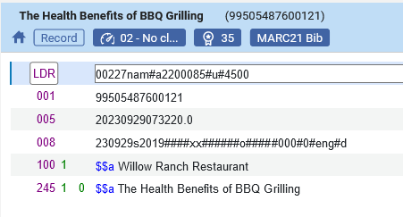
The bibliographic records of the new portfolios
Here is the bibliographic record created from the first new portfolio

Slide 29
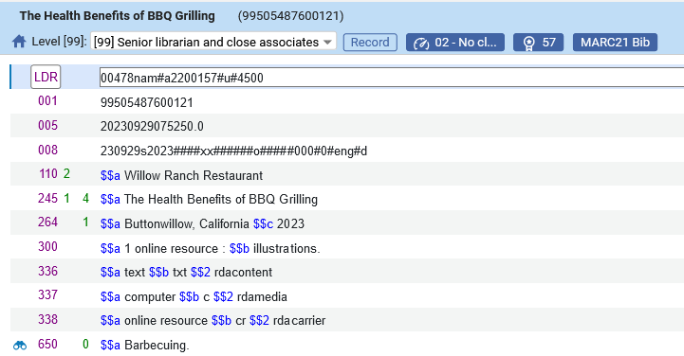
The bibliographic records of the new portfolios
Here is the edited bibliographic record created from the first new portfolio
We edited as follows:
Changed the 100 to 110
Changed 24510 to 24514
Added the following fields: 264, 300, 336, 337, 338, 650

Slide 30
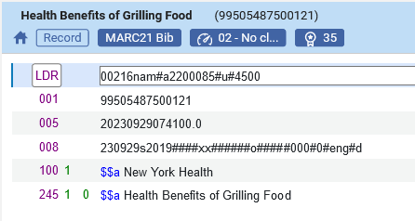
The bibliographic records of the new portfolios
Here is the bibliographic record created from the second new portfolio

Slide 31
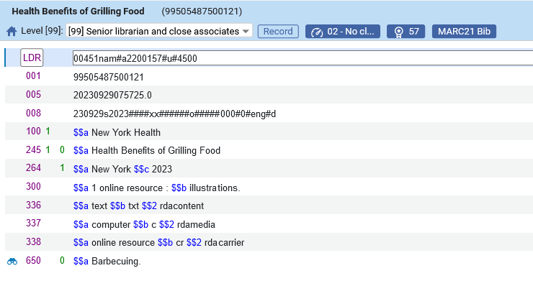
The bibliographic records of the new portfolios
Here is the edited bibliographic record created from the second new portfolio
We edited as follows:
Changed the 100 to 110
Changed 24510 to 24514
Added the following fields: 264, 300, 336, 337, 338, 650

Slide 32
Creating the local electronic collection

Slide 33
Creating the local electronic collection
Before we create the local electronic collection, we will create a set of portfolios which we want to add to the set.
There are several ways to add portfolios to the electronic collection, and one way is via a set.

Slide 34
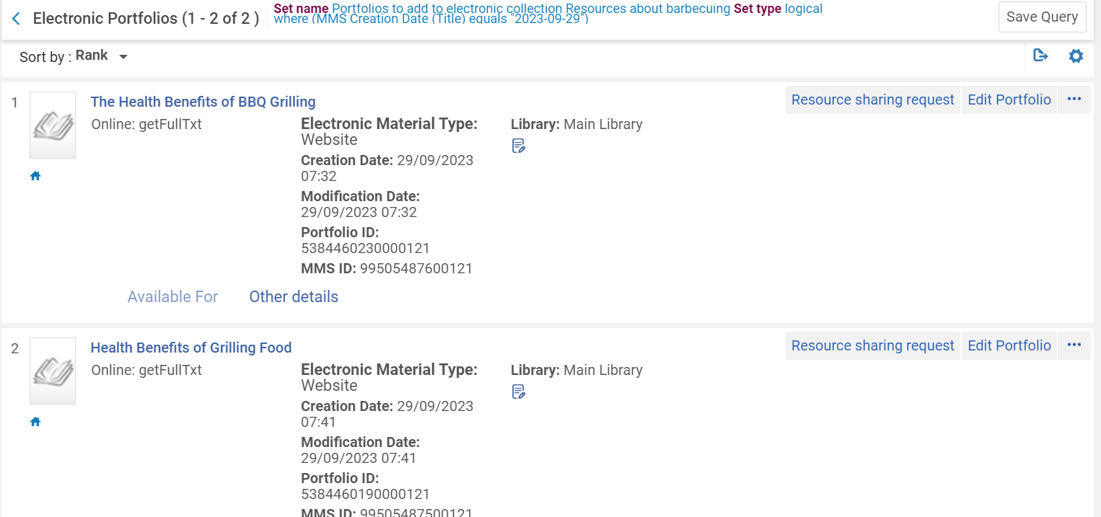
Creating the local electronic collection
Here are the two portfolios in the eset

Slide 35
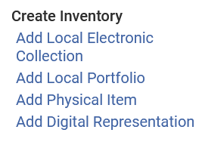
Creating the local electronic collection
The local electronic collection is created via the menu "Resources > Create Inventory > Add Local Electronic Collection"

Slide 36
Creating the local electronic collection
After filling in the self-explanatory information we will click "Save and Continue"

Slide 37
Creating the local electronic collection
We have set the electronic collection to "Available", and we will now switch from the "Activation" tab to the "Portfolios" tab.

Slide 38
Creating the local electronic collection
From the "Portfolios" tab we will choose "Add > Add From Set".

Slide 39
Creating the local electronic collection
We will now choose the set and click "Submit"

Slide 40
Creating the local electronic collection
A job runs and adds the local portfolios to the local electronic collection

Slide 41
Creating the local electronic collection
The local electronic collection has been created but is not yet active
The new electronic collection is not yet active (grey icon)

Slide 42
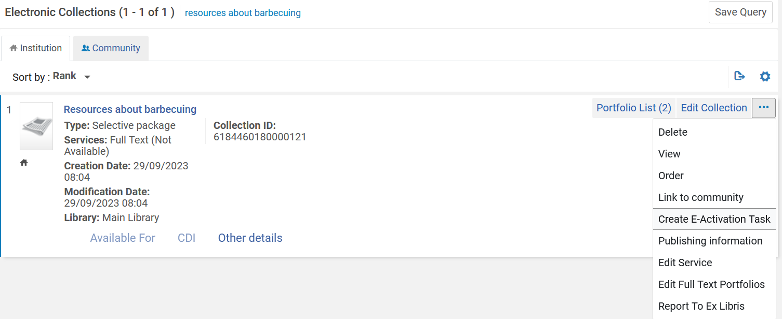
Creating the local electronic collection
We will create an "E-Activation Task"

Slide 43
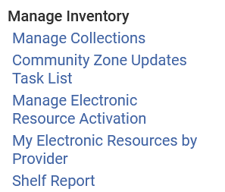
Creating the local electronic collection
We will now access the "Electronic Resource Activation Task List" at "Resources > Manage Inventory > Manage Electronic Resource Activation"

Slide 44
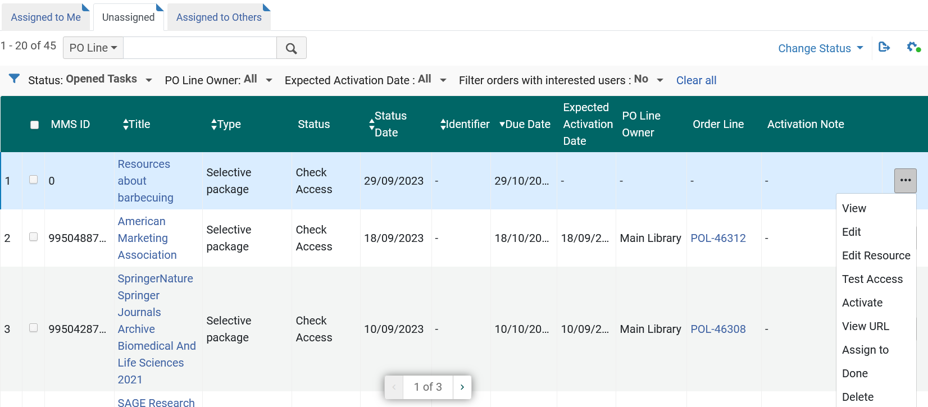
Creating the local electronic collection
We will activate the Electronic Collection

Slide 45
Creating the local electronic collection
We will confirm

Slide 46
View the new local portfolios in the new local electronic collection in discovery

Slide 47
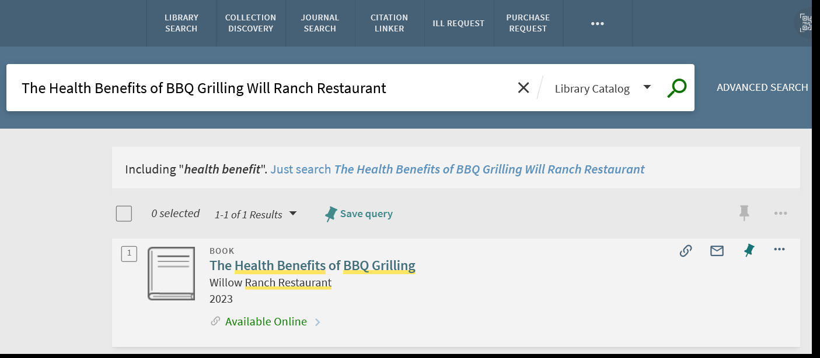
View the new local portfolios in the new local electronic collection in discovery
If we search now in the repository, we see the new local portfolios. Here is the first local portfolio.
We will click "Available Online"

Slide 48
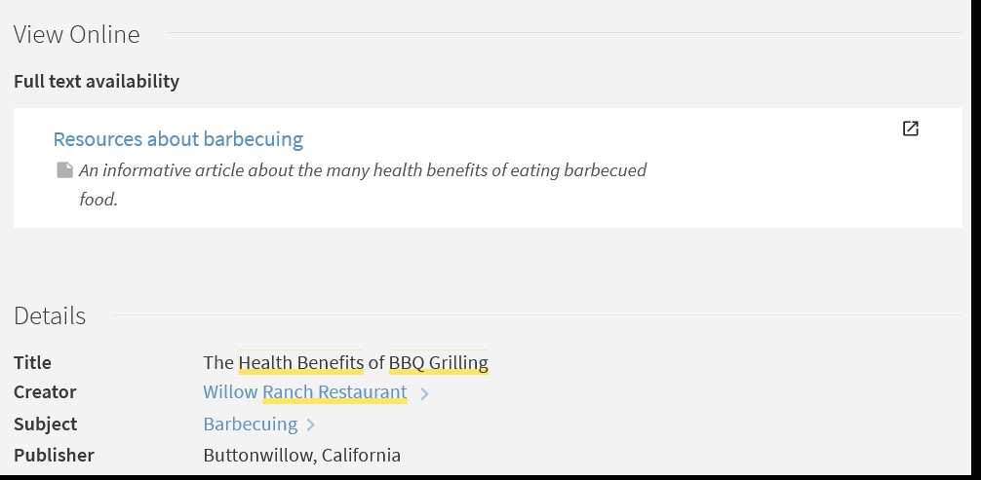
View the new local portfolios in the new local electronic collection in discovery
We will click here for access
This is the public note we added to the portfolio
This is the additional metadata we added to the bibliographic record

Slide 49
View the new local portfolios in the new local electronic collection in discovery
After clicking the link, we arrive to the URL of the portfolio

Slide 50
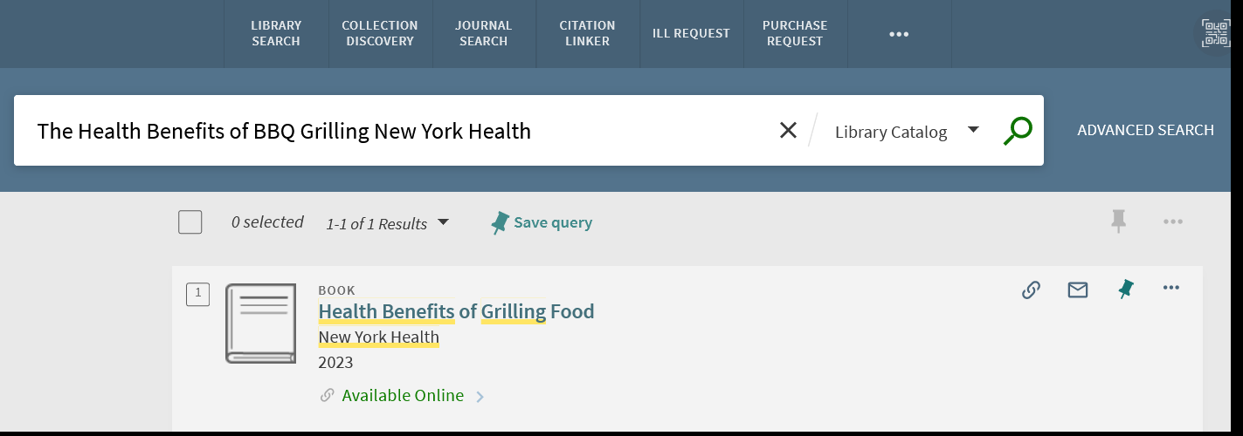
View the new local portfolios in the new local electronic collection in discovery
Here is the second local portfolio.
We will click "Available Online"

Slide 51
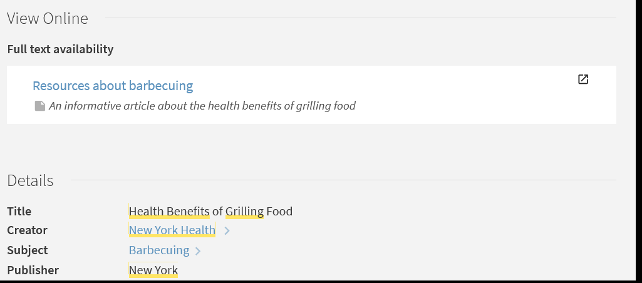
View the new local portfolios in the new local electronic collection in discovery
We will click here for access
This is the public note we added to the portfolio
This is the additional metadata we added to the bibliographic record

Slide 52
View the new local portfolios in the new local electronic collection in discovery
After clicking the link, we arrive to the URL of the portfolio

Slide 53
xxx@exlibrisgroup.com

