Slide 1
Electronic Resource Management Overview and Background
Managing
Electronic
Resources
Yoel Kortick
Senior Librarian

Slide 2
Agenda
E-Resources Workflow
Terminology
Collections, Portfolios and Titles
Electronic Collection type “Database”
Inventory Model in Alma
User Roles

Slide 3
E-Resources Workflow

Slide 4
E-Resources Workflow
Get bib data
Order resource *
Activate
Pay *
Maintain
* Not mandatory

Slide 5
E-Resources Workflow
Have bibliographic Data: There must be a bibliographic data. Could be from community zone, from vendor, manually catalogued, copied from external resource, manually catalogued, etc.
Order the resource: This is not mandatory, as it is possible to activate electronic resources without using Alma acquisitions.
Activate the resource: With physical inventory the there is “receival”, and with electronic inventory there is “activation”. The activation makes the resource accessable to the end user and available in discovery (Primo or Summon).
Pay for the resource: The “paying” for the resource via an invoice may be done either before, at the time of, or after activation. This depends on how the vendor works with the institution. (This is similar to physical inventory in that the payment may be done either before, at the time of, or after item arrival).
Maintain: If the institution needs to maintain the electronic resource over time (in which case the POL type is “continuous” or “subscription”) then the subscription will need to be renewed before expiration.

Slide 6
Terminology

Slide 7
Terminology
In addition to this presentation see also Managing Electronic Resources
Title: Individual resource (book, journal, etc.), usually available from multiple vendors
Portfolio: Single title from a specific vendor and typically contained within a specific collection
Collection: Group of portfolios that are titles made available together by a vendor (also referred to as a “package”)

Slide 8
Terminology
Electronic Collection in Alma
We searched “Electronic Collections” in the “Institution Zone”
Electronic Collections Name
This Electronic Collection has 86 portfolios

Slide 9
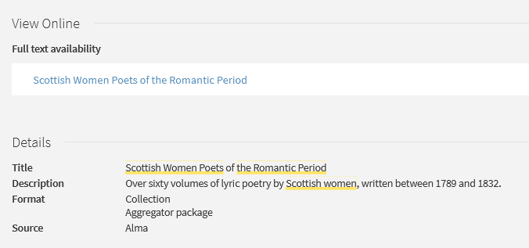
Terminology
Electronic Collection in Primo

Slide 10
Terminology
Electronic Portfolio in Alma
We searched “Electronic portfolios” in the “Institution Zone”
Electronic portfolio title

Slide 11
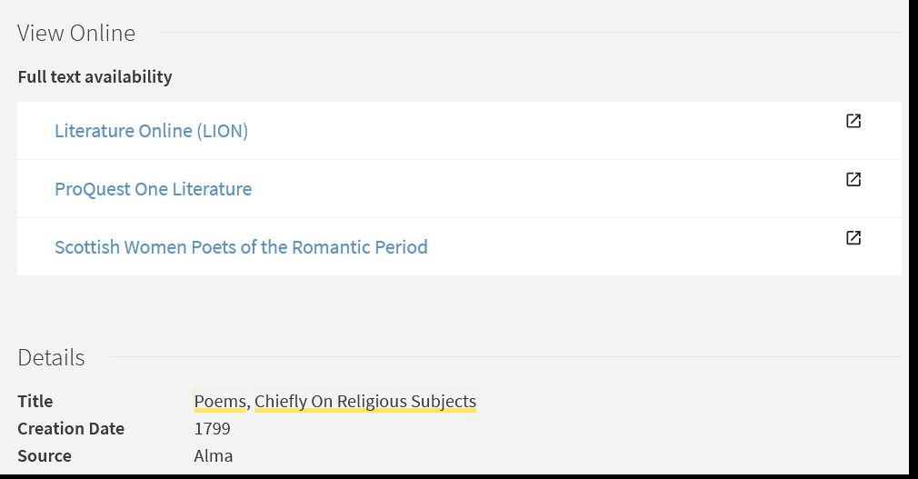
Terminology
Electronic Portfolio in Primo

Slide 12
Collections, Portfolios and Titles

Slide 13
Collections, Portfolios and Titles
The same title (MMS ID) could be in several different portfolios (Portfolio ID). For example:
Provided by different vendors
Provided by one vendor in different Electronic Collections (therefore, found in different collections)
Available with different coverage dates

Slide 14
Collections, Portfolios and Titles
One MMS ID
Has three portfolios

Slide 15
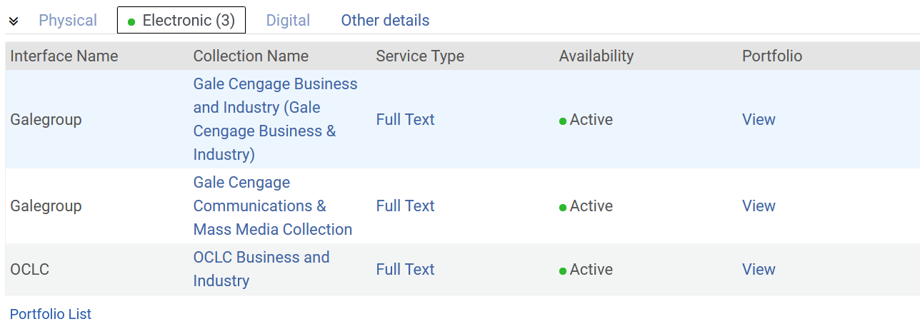
Collections, Portfolios and Titles
The three active portfolios are in three different electronic collections

Slide 16
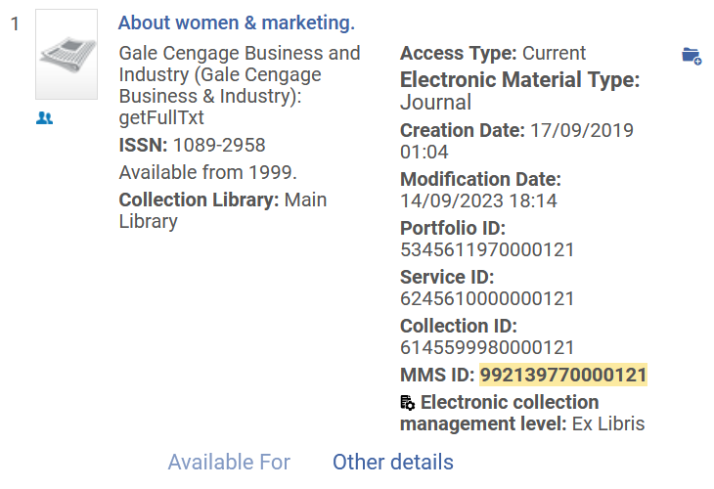
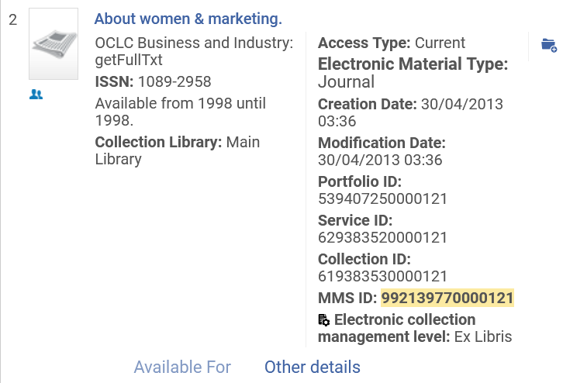
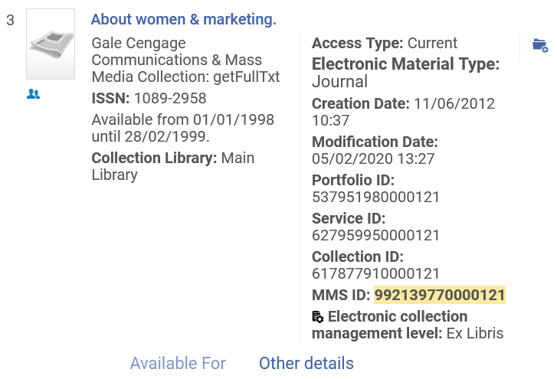
Collections, Portfolios and Titles
Each portfolio has its own portfolio ID

Slide 17
Electronic Collection type “Database”

Slide 18
Electronic Collection type “Database”
Regarding the term “Database”:
In Alma, a Database is a Collection with no portfolios
This is typically a resource of abstracting and indexing “citation-only” content
See Managing Electronic Resources:
Vendors sometimes refer to other entities as a “Database”.

Slide 19
Electronic Collection type “Database”
The “Encyclopedia of Ludic Terms” is an electronic collection of type Database

Slide 20
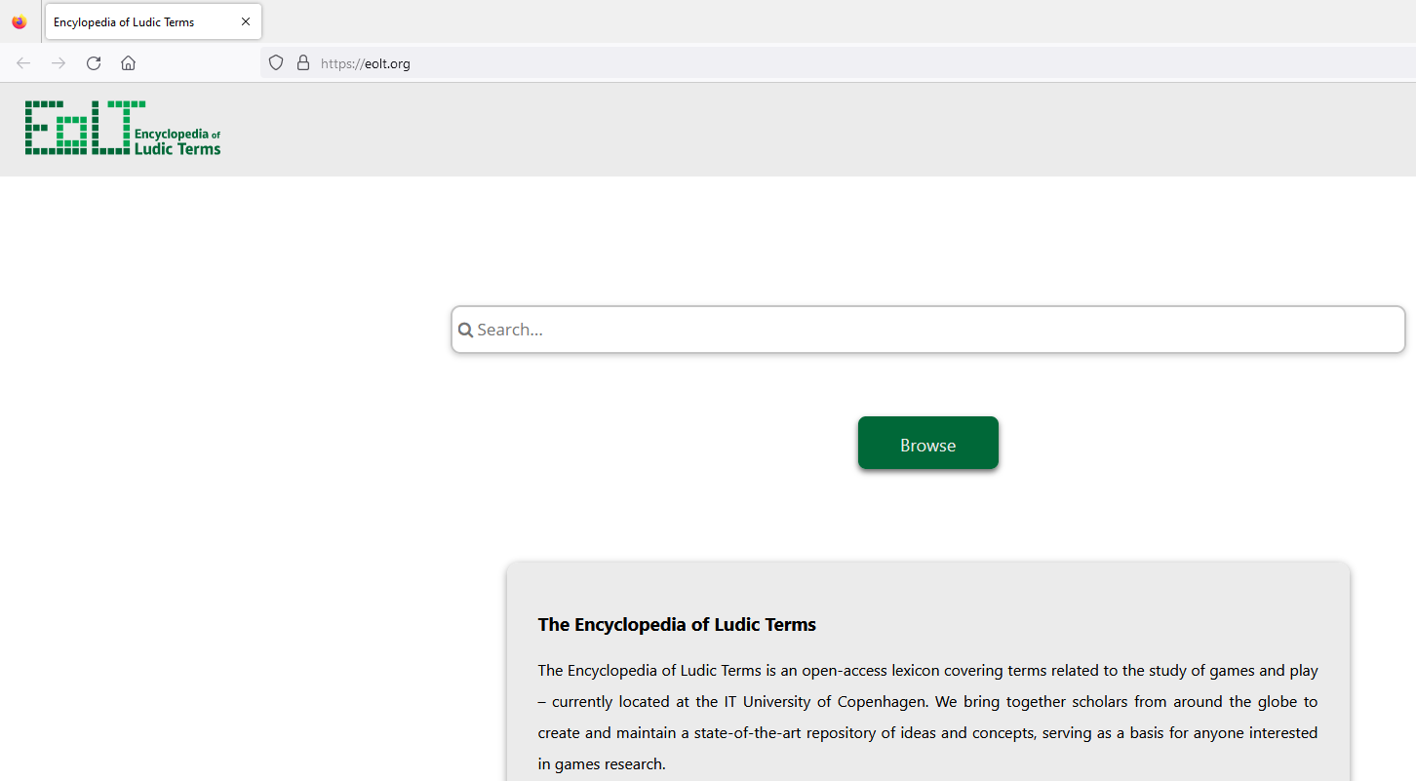
Electronic Collection type “Database”
The database has no portfolios. It links to a URL (web site) which can be searched

Slide 21
Inventory Model in Alma

Slide 22
Inventory Model in Alma
P = Physical. Bibliographic record with holdings and items attached to the holdings
E = Electronic. Bibliographic record with portfolios. May be part of an electronic collection or “standalone”
D = Digital. Bibliographic record with digital representation, and digital objects attached to the representation

Slide 23
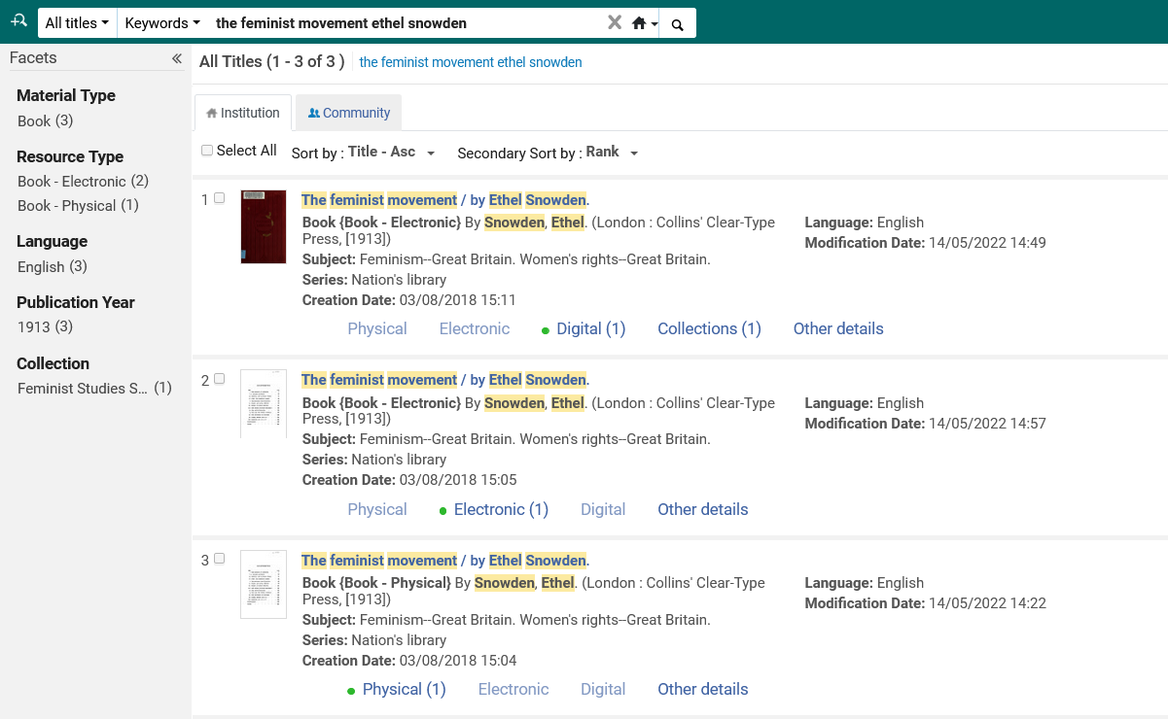
Inventory Model in Alma

Slide 24
Inventory Model in Alma
The Electronic Collection
The “Top” of the hierarchy of the electronic inventory is the “Electronic Collection”
Collections are groups of titles sold and / or managed together by the vendor.
Each of the titles in an electronic collection is called a “Portfolio”. As we already saw, a title could appear in more than one electronic collection from more than one vendor.

Slide 25
Inventory Model in Alma
The Electronic Collection
There are three types of electronic collections in Alma:

Slide 26
Inventory Model in Alma
Types of Electronic Collections
An “Aggregator Package” = An electronic collection for which the library typically will activate the entire collection (and not only specific portfolios).*
A “Selective Package” = An electronic collection for which the library typically will activate specific portfolios (and not the entire collection). *
A “Database” = Already discussed. An electronic collection with no portfolios. Points to a URL (website) that can be searched.
* Note that "Selective" package and "Aggregator" package behave the same when the flag "Automatically activate new portfolios" is checked in the electronic collection activation wizard. (more on this in a later session)

Slide 27
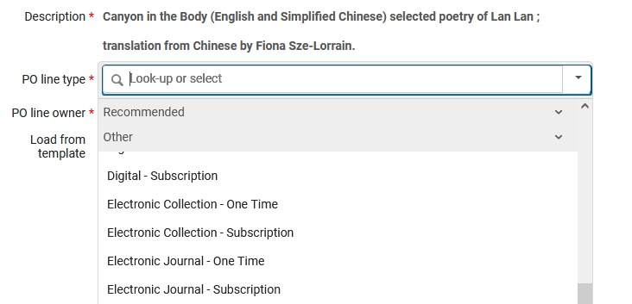
Inventory Model in Alma
The POL for Electronic Inventory
The Electronic Inventory POL (Purchase Order Line) type may be
“Continuous” (“Subscription”)
“One Time”.
This list will differ per institution depending on what POL types are activated at “Configuration > Acquisitions > Purchase Orders > PO Line Types”

Slide 28
Inventory Model in Alma
The POL for Electronic Inventory
The different POL types behave the same when they have the same “Continuity” and “Inventory Format”.
They differ merely in name (Description). This is why typically they are not all activated.
For example, below,
“Electronic Book - One Time” and “Electronic Title - One Time” behave the same.
“Electronic Journal - Subscription” and “Electronic Title - Subscription” behave the same.
[Description] | [Continuity] | [Inventory Format]
Electronic Book - Subscription | Continuous | Electronic
Electronic Book - One Time | One-Time | Electronic
Electronic Journal - Subscription | Continuous | Electronic
Electronic Journal - One Time | One-Time | Electronic
Electronic Collection - Subscription | Continuous | Electronic
Electronic Collection - One Time | One-Time | Electronic
Electronic Title - Subscription | Continuous | Electronic
Electronic Title - One Time | One-Time | Electronic
License Upgrade | One-Time | Electronic

Slide 29
Inventory Model in Alma
The POL for Electronic Inventory
Electronic Inventory POL of type Continuous (Subscription​)
Renewal Dates​
Automated or manual renewals​
Licenses can be used​
​
Electronic Inventory POL of type One-Time​
No Renewal Dates​
Licenses can be used​

Slide 30
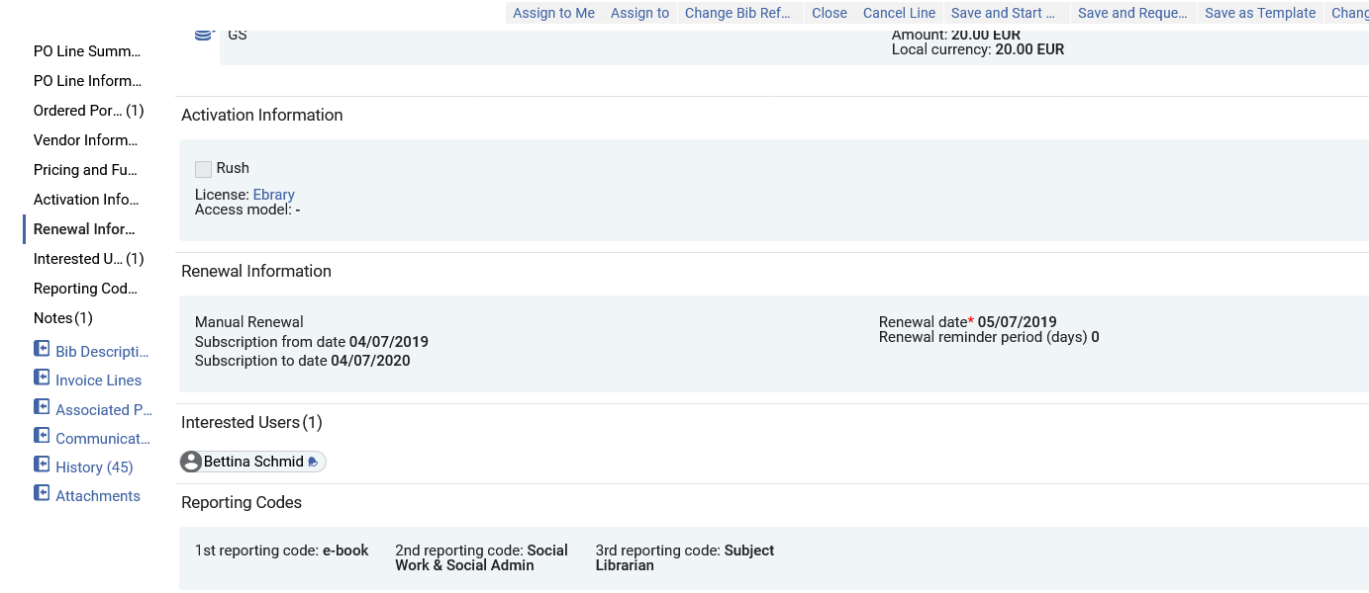
Inventory Model in Alma
The POL for Electronic Inventory
Example of POL of type Continuous (Subscription​)

Slide 31
Inventory Model in Alma
The Electronic Portfolio
An Electronic Portfolio is the specific coverage, services, and link information relevant for an electronic title. Portfolios may be defined as standalone entities or as part of an electronic collection.
Electronic Collections organize electronic resources for delivery and publication.
The electronic resources can be of type journals, books, dissertations, manuscripts, etc.
The electronic resources identify the service and provider of a resource.

Slide 32
Inventory Model in Alma
The Electronic Portfolio – Example one of two
We will now see the 78929 portfolios for this Electronic Collection “EZB-FREE-00999 freely available EZB journals”

Slide 33
Inventory Model in Alma
The Electronic Portfolio – Example one of two
And we will edit the portfolio “Advancing women in leadership”

Slide 34
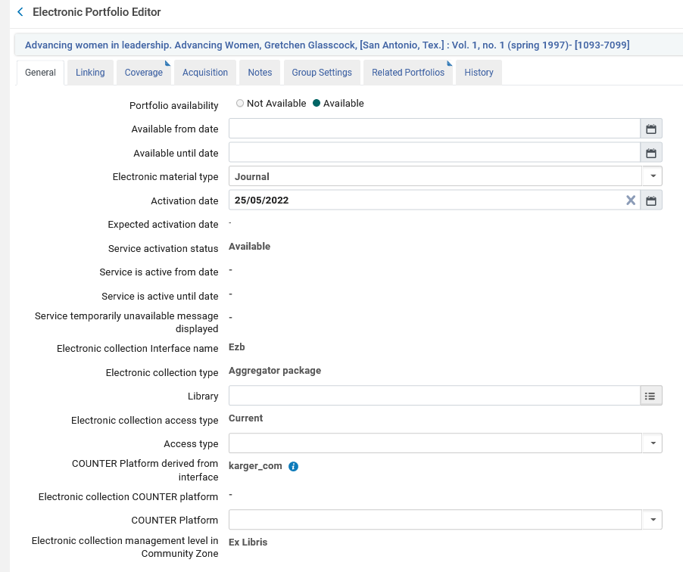
Inventory Model in Alma
The Electronic Portfolio – Example one of two
It is active
It is a journal
It is part of an electronic collection of type “Aggregator package”

Slide 35
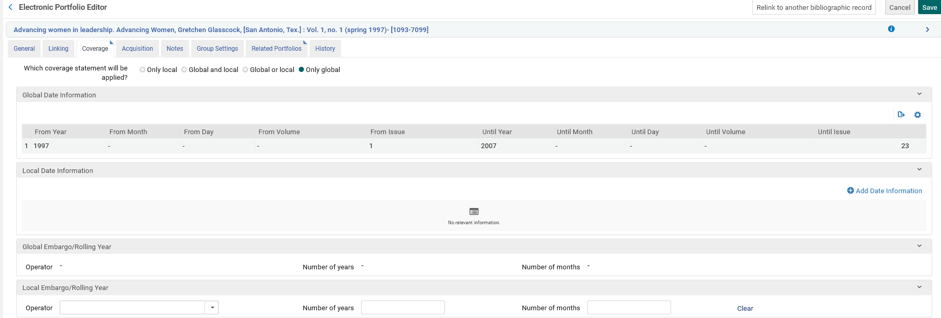
Inventory Model in Alma
The Electronic Portfolio – Example one of two
It is Available from 1997 issue: 1 until 2007 issue: 23

Slide 36
Inventory Model in Alma
The Electronic Portfolio – Example two of two
We will now see the 86 portfolios for this Electronic Collection “Scottish Women Poets of the Romantic Period

Slide 37
Inventory Model in Alma
The Electronic Portfolio – Example two of two
And we will edit the first portfolio

Slide 38
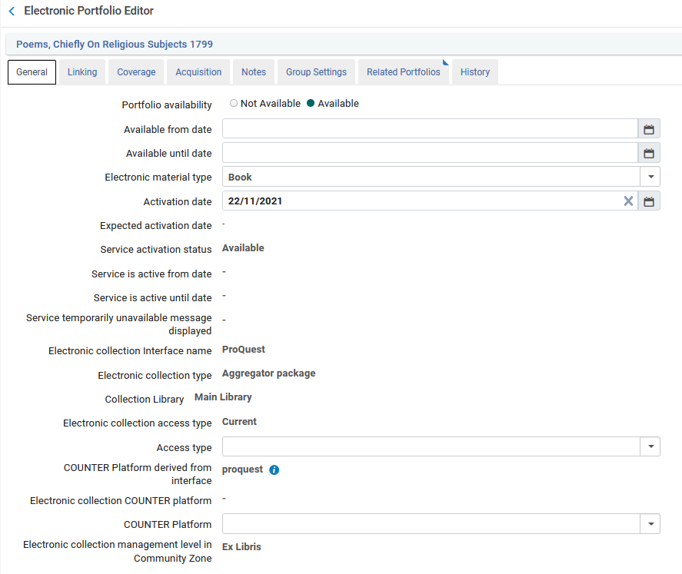
Inventory Model in Alma
The Electronic Portfolio – Example two of two
It is active
It is a book
It is part of an electronic collection of type “Aggregator package”

Slide 39
Inventory Model in Alma
The Electronic Service
In the vast majority of cases electronic collections which are not type “Database” have service “Full Text”.
Electronic Collections of type “Database” have no service (“None”).
Relatively few Electronic Collections have “Selected Full Text” and this is typically something that was used in the past.

Slide 40
Inventory Model in Alma
Regarding electronic inventory:
When searching in Alma we can search for (among many other options):
Electronic Titles
Electronic Portfolios
Electronic Collections

Slide 41
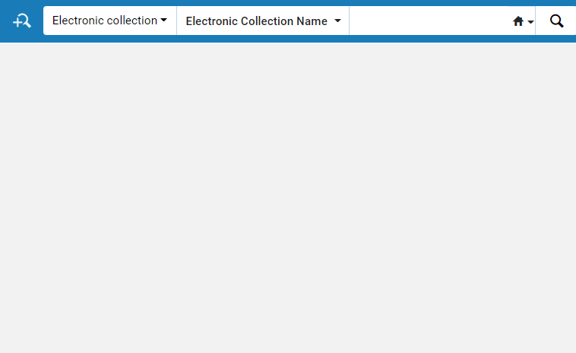
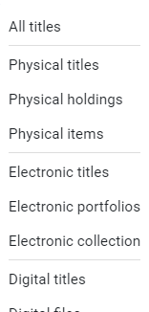
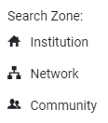
Inventory Model in Alma
Electronic Collection
Electronic Portfolio
Electronic Title
All Titles
“Network” is relevant for Network Zone Consortia only and will not appear for “standalone” institutions

Slide 42
Inventory Model in Alma
In the advanced search it is possible to search for electronic portfolios according to information from the electronic collection.
For example, it is possible to search for all portfolios in electronic collection “EZB-FREE-00999 freely available EZB journals” which have “Word from title = Leadership”.
Search Electronic Portfolios
Search by Electronic Collection information

Slide 43
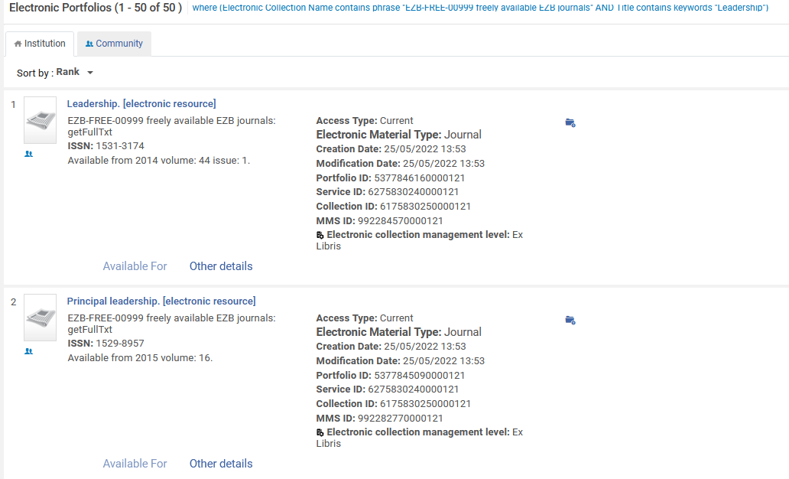
Inventory Model in Alma
The results are Electronic Portfolios

Slide 44
Inventory Model in Alma
In the advanced search it is possible to search for electronic collections according to information from the electronic portfolio.
For example, it is possible to search for all electronic collections which have a portfolio fo material type “Book” and “Word from title = Leadership”.
Search Electronic Collections
Search by Electronic Portfolio information

Slide 45
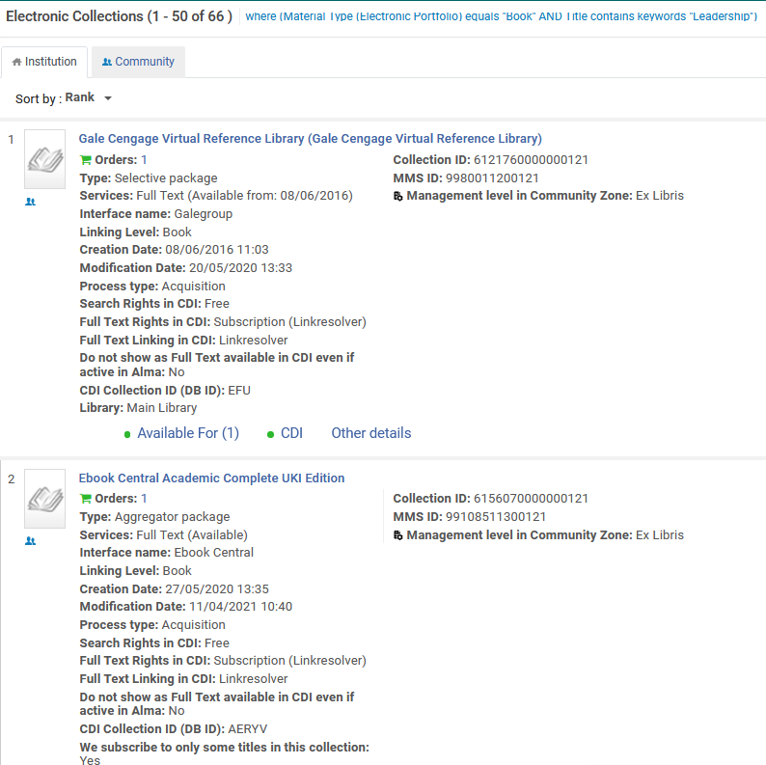
Inventory Model in Alma
The results are Electronic Collections
Let’s look at “Ebook Central Academic Complete UKI Edition”

Slide 46
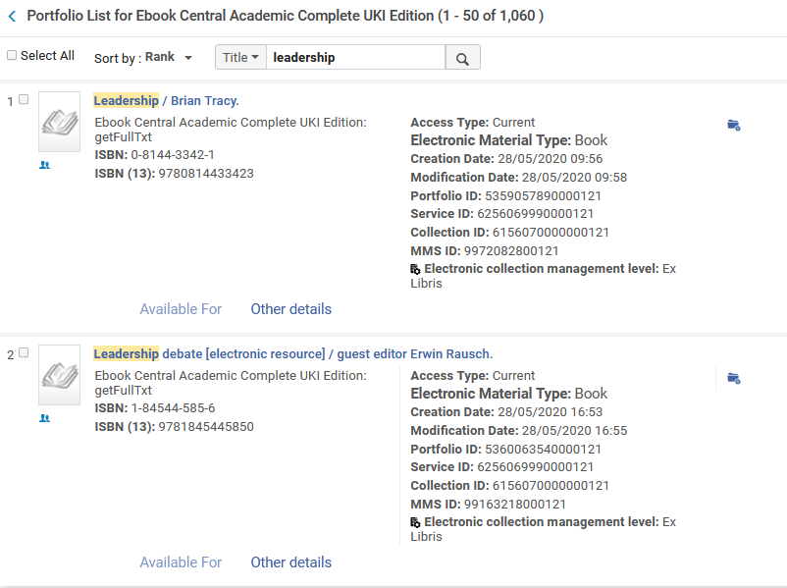
Inventory Model in Alma
As per our search, this electronic collection has a portfolio (actually several portfolios) with word from title “Leadership” and material type “Book”.

Slide 47
User Roles

Slide 48
User Roles
We will now discuss user roles associated with electronic inventory management.
Some of these roles are unique to electronic inventory management, while others are needed for electronic inventory management as well as for managing non-electronic resources (for example role “Invoice Operator” is necessary for approving invoices of either electronic resources or physical resources).
See also User Roles – Descriptions and Accessible Components

Slide 49
User Roles
Roles specific to Electronic Inventory
CDI Inventory Operator = can activate and deactivate a CDI electronic collection, remove the CDI-only full-text activation, and edit fields in the CDI tab in the Electronic Collections Editor.
Electronic Inventory Operator = can activate e-resources, and link an electronic portfolio to another bibliographic record
Electronic Inventory Operator - Extended = Like Electronic Inventory Operator but can also delete electronic inventory
Electronic Inventory Operator – Limited = Like Electronic Inventory Operator but cannot link an electronic portfolio to another bibliographic record

Slide 50
User Roles
Roles not specific to Electronic Inventory
Repository Manager = Manages inventory-related actions, including adding, editing and deleting notes, assigning e-resource activation to operators, managing inventory, managing repository jobs, and adding, editing, deleting, and linking inventory in the MD Editor.
Invoice Operator = Creates, edits, and reviews invoices. Reassigns invoices to other invoice operators.
Invoice Manager = Manages invoice creation, review and approval activities, and assigning invoices to other operators.

