Slide 1
How to make license information appear in Primo View It (View Online)
Managing
Electronic
Resources
Yoel Kortick
Senior Librarian

Slide 2
Agenda
The question
Introduction
Our sample resource with a license
Before we configure Alma to show the license information
Configuring Alma to show the license information
After we configure Alma to show the license information
Configuring which license terms to display in Primo View It

Slide 3
The question

Slide 4
The question
We have licenses attached to many of our electronic collections, but we do not see the license information in Primo. During the recent webinar you showed the View Online tab and there was a link to the license. I also see a link to the license in the Primo of other libraries. How come in our Primo we do not see a link to the license? Do we need to configure something?

Slide 5
Introduction

Slide 6
Introduction
In addition to this presentation, it is recommended to also see Displaying License Information in the View It.
If an electronic collection or an electronic portfolio has a license, then it is possible to display a link to show the license information (license terms) from within the Primo View It tab.
Note that the license is displayed to the end user but does not have a functional effect. It is for informational purposes only.

Slide 7
Our sample resource with a license

Slide 8
Our sample resource with a license
We will use the license “A. Chen Publishing”

Slide 9
Our sample resource with a license
The electronic collection “iG Publishing: Pearson Education Taiwan” uses the license “A. Chen Publishing”
This electronic collection is active and has 98 portfolios.
On the next slide we see the “General” tab of the “Electronic Collection Editor”, and we can see that license “A. Chen Publishing” is attributed to this electronic collection

Slide 10
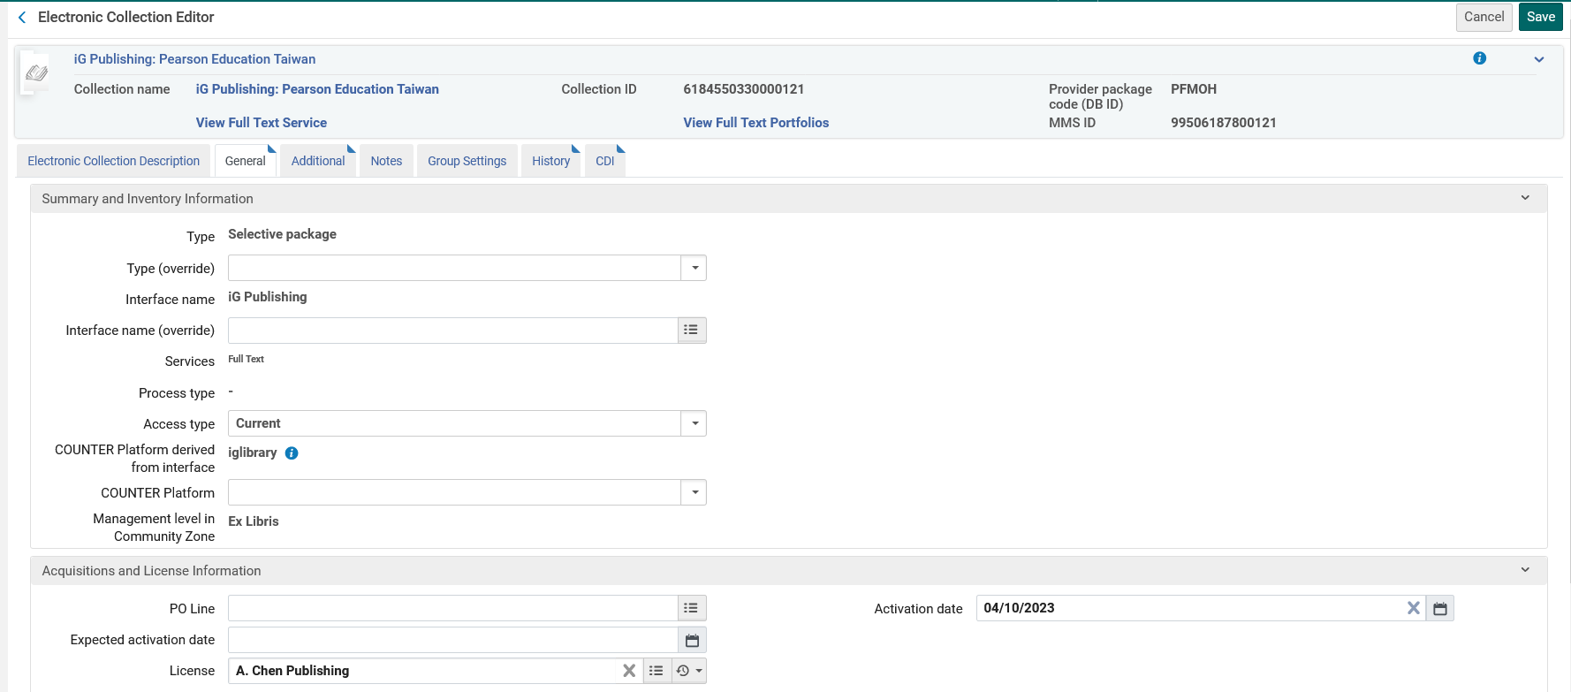
Our sample resource with a license
The License

Slide 11
Our sample resource with a license
One of the portfolios in the electronic collection “iG Publishing: Pearson Education Taiwan” is “There's no business that's not show business : marketing in an experience culture”

Slide 12
Before we configure Alma to show the license information

Slide 13
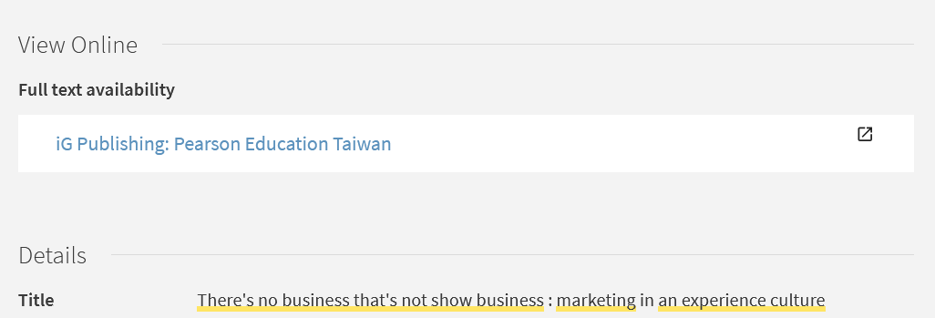
Before we configure Alma to show the license information
In the Primo View It tab for “There's no business that's not show business : marketing in an experience culture” we do not see the license information or a link to the license information
No license information

Slide 14
Configuring Alma to show the license information

Slide 15
Configuring Alma to show the license information
To configure Alma to show the license information do as follows:
Navigate to “Configuration > Fulfillment > Discovery Interface Display Logic > Other Settings”
Check the box next to “Enable Display of License Information”
Save.

Slide 16
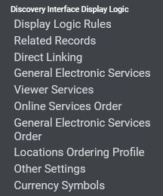
Configuring Alma to show the license information
Navigate to “Configuration > Fulfillment > Discovery Interface Display Logic > Other Settings”

Slide 17
Configuring Alma to show the license information
Check the box next to “Enable Display of License Information” and save.
We have now checked the box next to “Enable Display of License Information”

Slide 18
After we configure Alma to show the license information

Slide 19
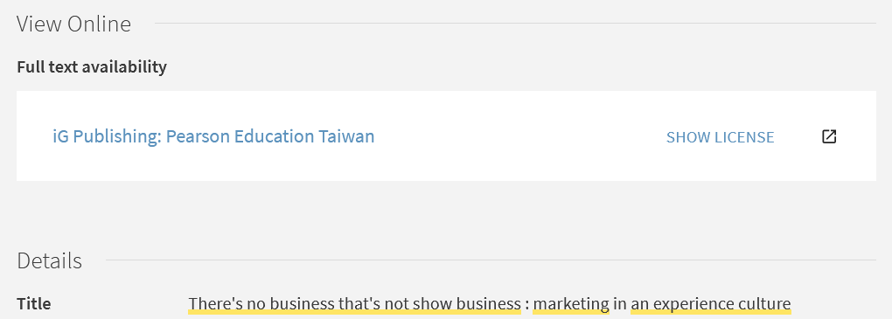
After we configure Alma to show the license information
In the Primo View It tab let’s again see “There's no business that's not show business : marketing in an experience culture”.
Now we do see a link to the license information

Slide 20
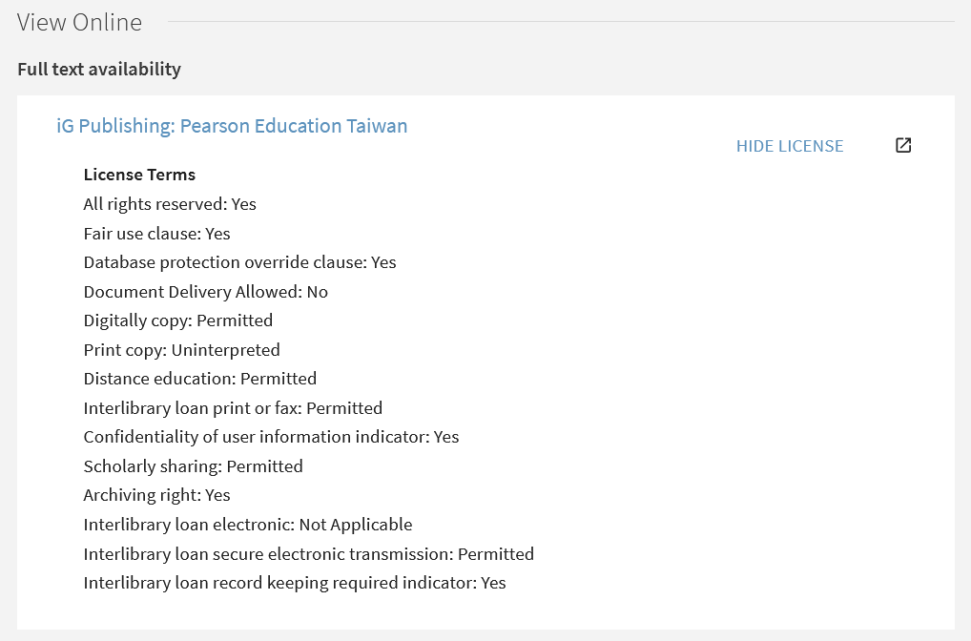
After we configure Alma to show the license information
After clicking “Show License”
After clicking “Show License” the link changes to “Hide License” and we see selected “License Terms”

Slide 21
Configuring which license terms to display in Primo View It

Slide 22
Configuring which license terms to display in Primo View It
It is possible to configure which license terms will display in the View It tab.

Slide 23
Configuring which license terms to display in Primo View It
To configure which license terms will display in the View It tab:
Navigate to “Configuration > Acquisitions > Licenses > Manage License Terms”
In the “Display to public” tab select “Yes” or “No”
See also: Adding a License Term.

Slide 24
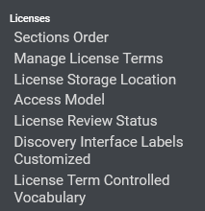
Configuring which license terms to display in Primo View It
Navigate to “Configuration > Acquisitions > Licenses > Manage License Terms”

Slide 25
Configuring which license terms to display in Primo View It
In the “Display to public” tab select “Yes” or “No”

Slide 26
Configuring which license terms to display in Primo View It
Perhaps for example we do not want the term “Database protection override clause” to appear
We want to remove this from the display

Slide 27
Configuring which license terms to display in Primo View It
For the term “Database protection override clause” we have changed the value for “Display To Public” to “No”.
We want to remove this from the display

Slide 28
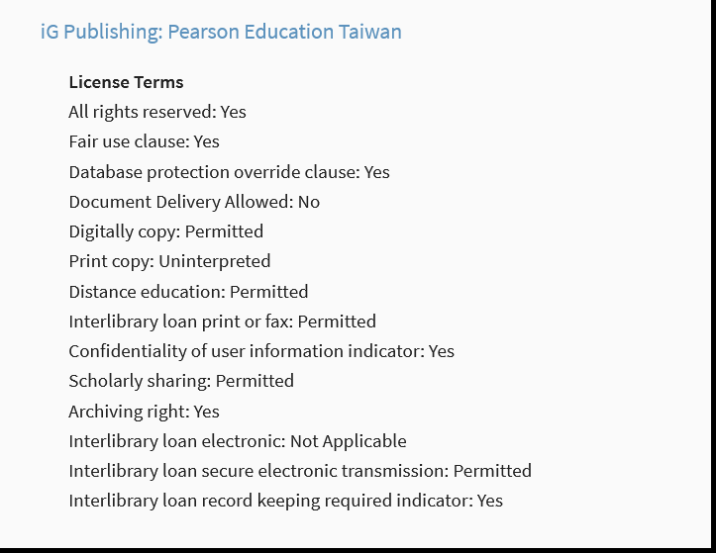
Configuring which license terms to display in Primo View It
Before

Slide 29
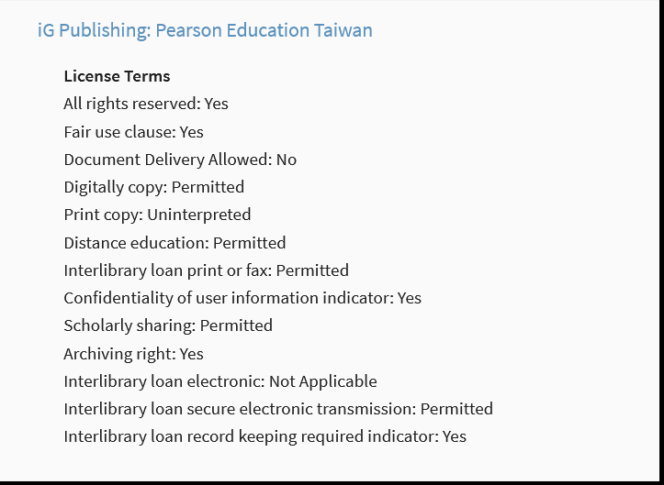
Configuring which license terms to display in Primo View It
After
The term has been removed

Slide 30
xxx@exlibrisgroup.com

