Slide 1
Understanding the meaning and implications of Expand My Results in Primo VE
Managing
Electronic
Resources
Yoel Kortick
Senior Librarian

Slide 2
Agenda
The question
The active portfolio for the journal
The two sample articles in the journal
The "Expand My Results" in Primo VE
Removing the "Expand My Results" from Primo VE

Slide 3
The question

Slide 4
The question
We have a subscription to the journal “Journal of oral & facial pain and headache” (ISSN: 2333-0376). The portfolio in Alma in active. I see some of the articles from this journal when I search CDI in Primo. But other articles I do not see. How come?

Slide 5
The question
For example, I do see this when searching CDI:
SCHIFFMAN, E. et al. Diagnostic Criteria for Temporomandibular Disorders (DC/TMD) for Clinical and Research Applications: recommendations of the International RDC/TMD Consortium Network and Orofacial Pain Special Interest Group. Journal of oral & facial pain and headache, v. 28, n. 1, p. 6–27, 2014.
But I do not see this when searching CDI:
MANFREDINI, D. et al. Epidemiology of bruxism in adults: a systematic review of the literature. Journal of oral & facial pain and headache, v. 27, n. 2, p. 99–110, 2013.

Slide 6
The active portfolio for the journal

Slide 7
The active portfolio for the journal
Here is the active portfolio of the journal
As we can see here, the resource is available from Jan. 1, 2014, volume 28 issue 1.

Slide 8
The active portfolio for the journal
Here is the “coverage” tab of the active portfolio of the journal
Here we see that the resource is available from Jan. 1, 2014, volume 28 issue 1.

Slide 9
The two sample articles in the journal

Slide 10
The two sample articles in the journal
This article is found in CDI.
The reason it is found is because it is within the coverage of the journal.
The journal coverage is available from Jan. 1, 2014, volume 28 issue 1.
The article is in Vol. 28.
SCHIFFMAN, E. et al. Diagnostic Criteria for Temporomandibular Disorders (DC/TMD) for Clinical and Research Applications: recommendations of the International RDC/TMD Consortium Network and Orofacial Pain Special Interest Group. Journal of oral & facial pain and headache, v. 28, n. 1, p. 6–27, 2014.

Slide 11
The two sample articles in the journal
This article is not found in CDI.
The reason it is not found is because it is not within the coverage of the journal.
The journal coverage is available from Jan. 1, 2014, volume 28 issue 1.
The article is in Vol. 27.
MANFREDINI, D. et al. Epidemiology of bruxism in adults: a systematic review of the literature. Journal of oral & facial pain and headache, v. 27, n. 2, p. 99–110, 2013.

Slide 12
The two sample articles in the journal
Only articles within the coverage of the journal will be found when searching CDI (unless, as we will soon see, “Expand My Results” is checked)

Slide 13
The "Expand My Results" in Primo VE

Slide 14
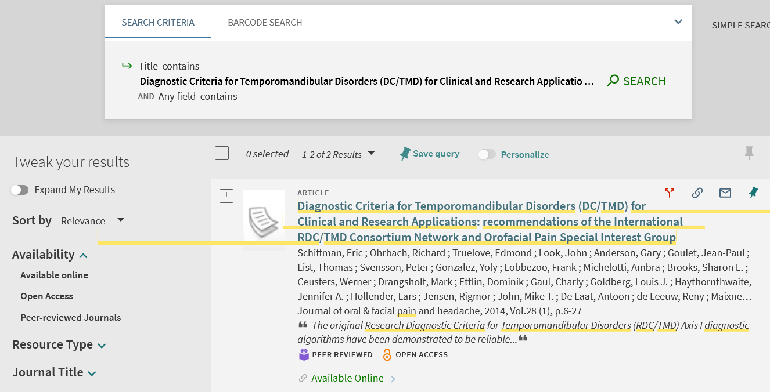
The "Expand My Results" in Primo VE
Here we do find the article which is within the coverage of the resource.
Note that “Expand My Results” is not checked

Slide 15
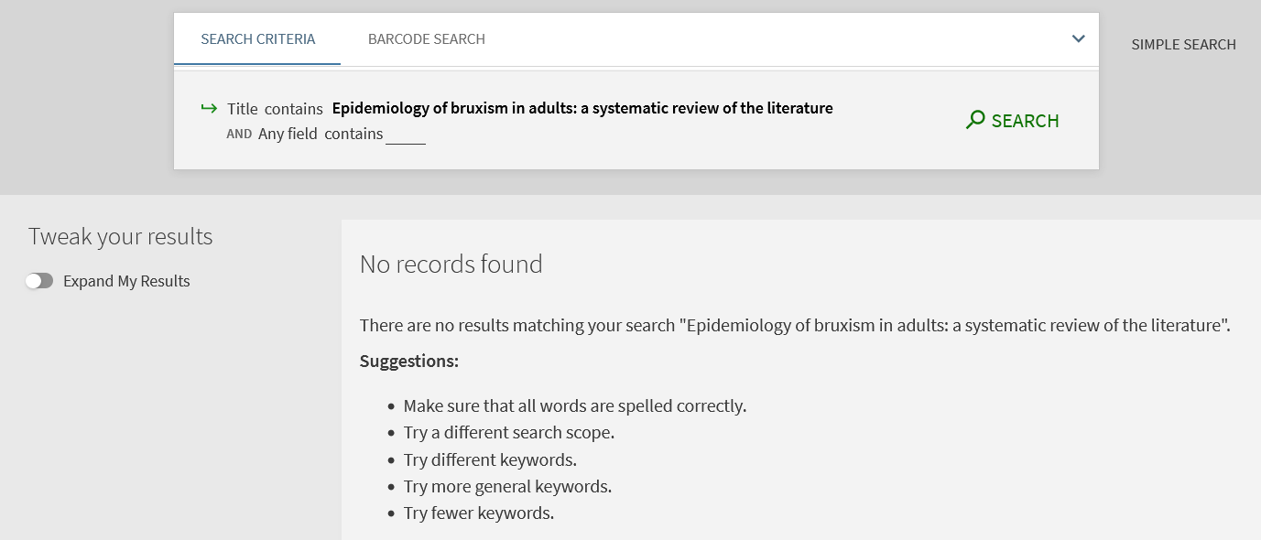
The "Expand My Results" in Primo VE
Here we do not find the article which is not within the coverage of the resource.
Note that “Expand My Results” is not checked

Slide 16
The "Expand My Results" in Primo VE
If, however, we search for the article which is not within coverage of the resource in Alma, and we do check “Expand My Results” in Primo VE, then we will find the article.
The “Expand My Results” allows the end user to see all results answering the search query, regardless of whether the institution has access to the resources in the results.

Slide 17
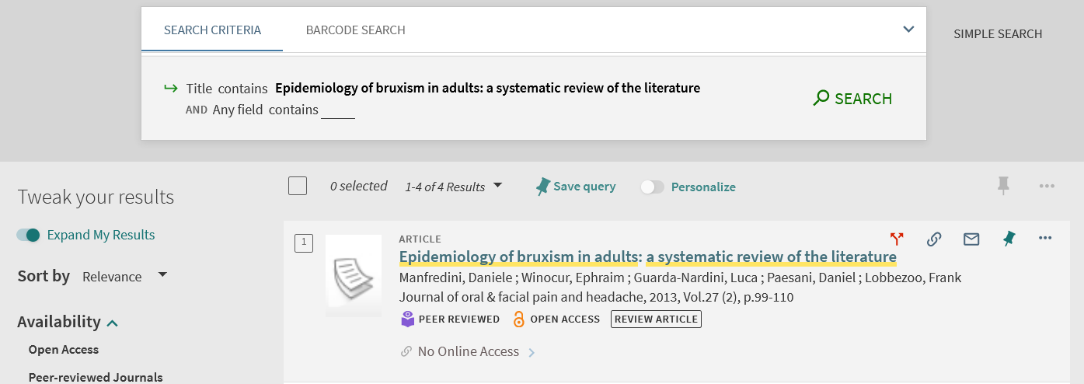
The "Expand My Results" in Primo VE
Now we do find the article, but with “No Online Access”
Note that “Expand My Results” is checked
There is no access to the article because it is not within the coverage of the resource

Slide 18
Removing the "Expand My Results" from Primo VE

Slide 19
Removing the "Expand My Results" from Primo VE
To remove the “Expand My Results”:
Navigate to “Configuration > Discovery > Search Configuration > Search Profiles”
Edit any search profiles that include "Central Index"
Uncheck the "Filter by Availability" option
Save.

Slide 20
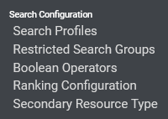
Removing the "Expand My Results" from Primo VE
Navigate to “Configuration > Discovery > Search Configuration > Search Profiles”

Slide 21
Removing the "Expand My Results" from Primo VE
Edit any search profiles that include "Central Index".

Slide 22
Removing the "Expand My Results" from Primo VE
Uncheck the "Filter by Availability" option

Slide 23
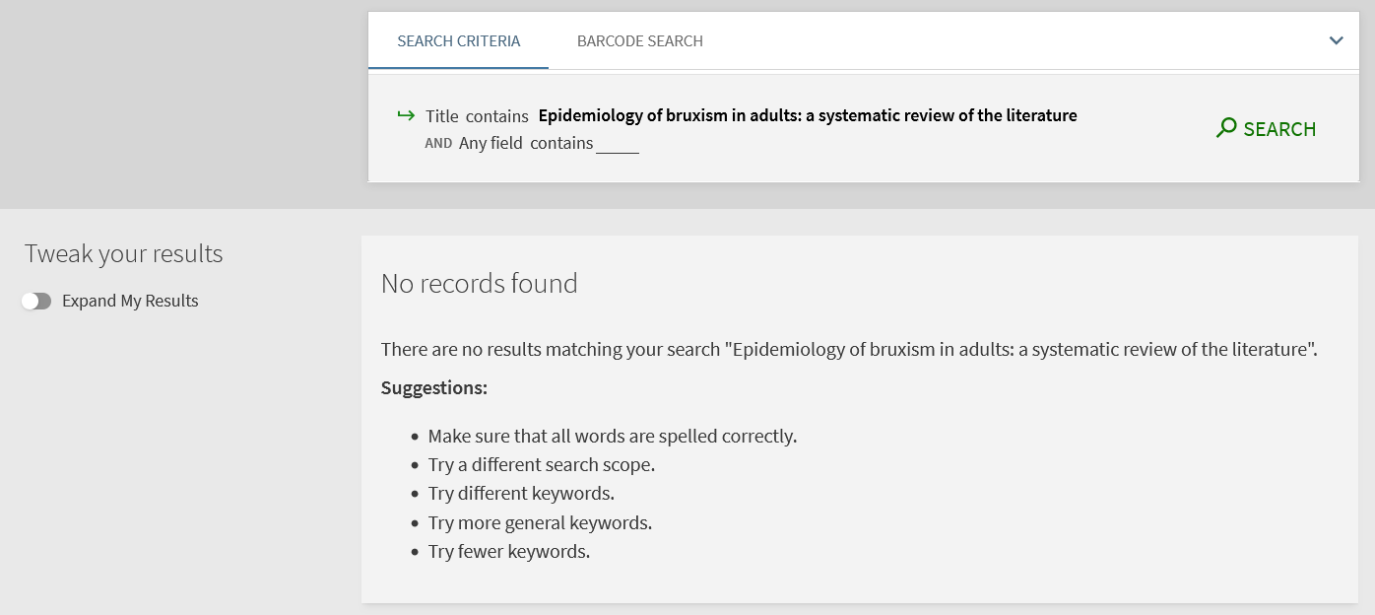
Removing the "Expand My Results" from Primo VE
Appearance before unchecking the "Filter by Availability" option

Slide 24
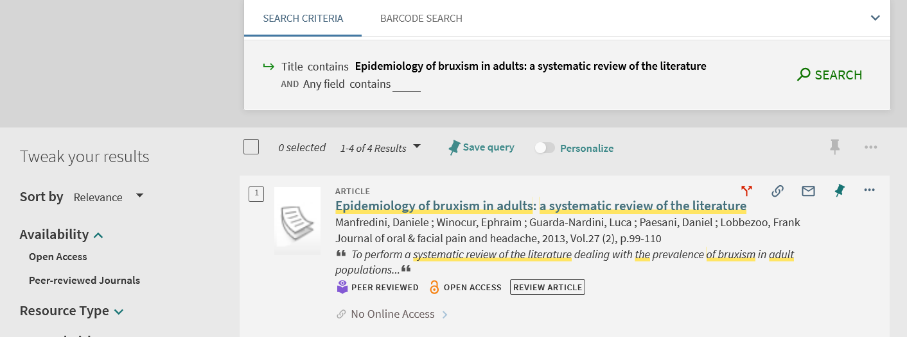
Removing the "Expand My Results" from Primo VE
Appearance after unchecking the "Filter by Availability" option
It behaves as if “Expand My Results” is checked

Slide 25
xxx@exlibrisgroup.com

