Slide 1
How to use Display Logic Rules to make only certain collections appear in Primo View It (View Online)
Managing
Electronic
Resources
Yoel Kortick
Senior Librarian

Slide 2
Agenda
The question
How the system behaves now
Using Display Logic Rules to make one specific electronic collection appear
The results of the Display Logic Rules
Note: We could have done it with one rule

Slide 3
The question

Slide 4
The question
We have the title “Meat trades journal” (ISSN 0025-6412) in three different electronic collections. When it appears in the Primo “View It” the end user sees a link from all three electronic collections. We want only one of the electronic collections to appear. In a recent webinar on a different topic, I asked about this, and you said something about using “Display Logic Rules”. Could you tell me exactly what you meant?

Slide 5
The question
The three electronic collections are:
Culinary Arts Collection
Nexis UK
Gale Cengage Business Collection
The only one we want to appear in Primo “View It” is “Nexis UK”.

Slide 6
How the system behaves now

Slide 7
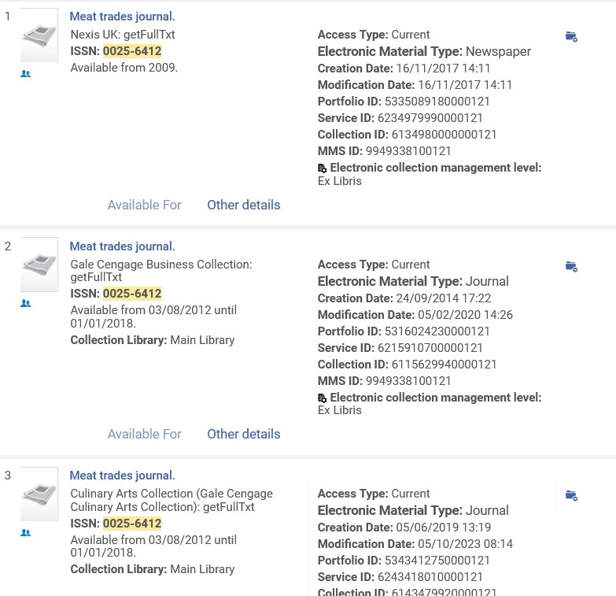
How the system behaves now
Here in the Alma repository search showing the title “Meat trades journal” (ISSN 0025-6412) in three different electronic collections:
Culinary Arts Collection
Nexis UK
Gale Cengage Business Collection

Slide 8
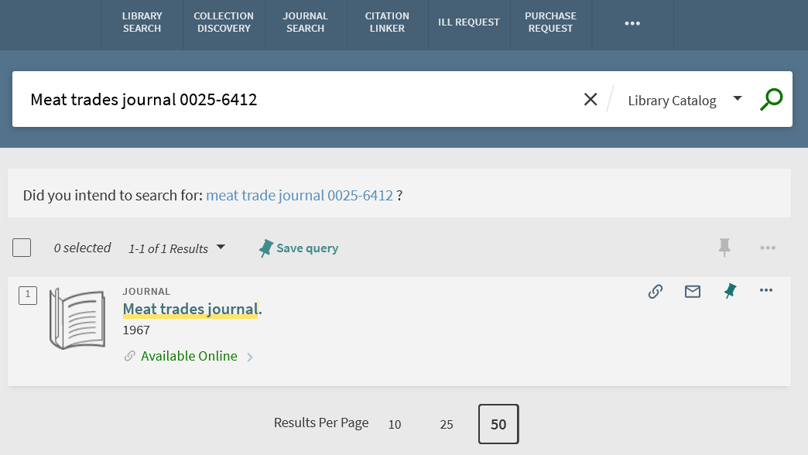
How the system behaves now
In Primo we search for the resource, find it, and will click “Available Online”

Slide 9
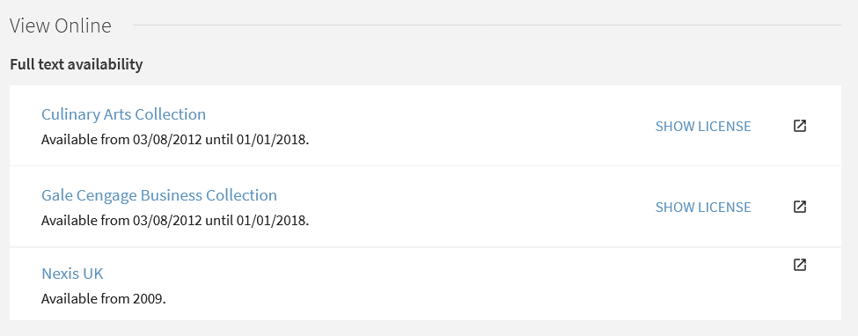
How the system behaves now
All three electronic collections appear as a link to view the resource.

Slide 10
Using Display Logic Rules to make one specific electronic collection appear

Slide 11
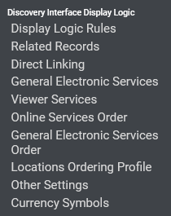
Using Display Logic Rules to make one specific electronic collection appear
Discovery Interface Display Logic Rules can be added, deleted, edited, activated and deactivated at “Configuration > Fulfillment > Discovery Interface Display Logic > Display Logic Rules”

Slide 12
Using Display Logic Rules to make one specific electronic collection appear
We will add a new rule

Slide 13
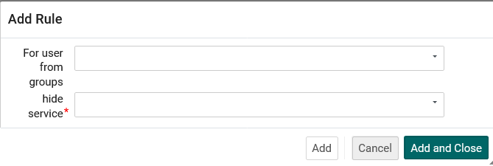
Using Display Logic Rules to make one specific electronic collection appear
We could limit the rule by the user group of the logged in user (but we will not).
We will choose “Full Text” for the “Hide Service” field, and then additional fields will appear.

Slide 14
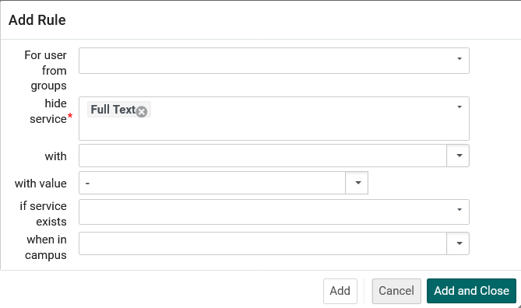
Using Display Logic Rules to make one specific electronic collection appear
We have chosen “Full Text” for the “Hide Service” field, and now additional fields appear.

Slide 15
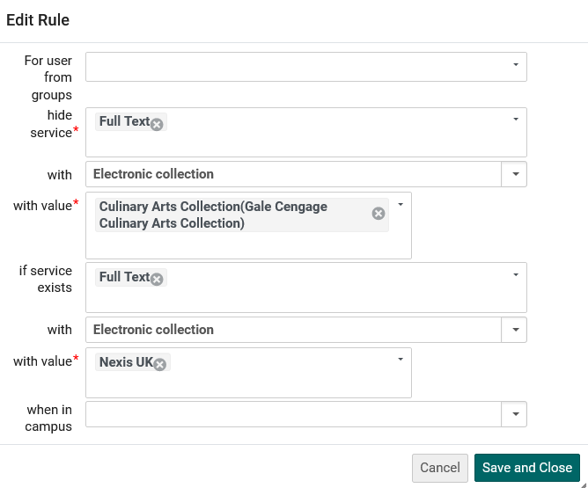
Using Display Logic Rules to make one specific electronic collection appear
Here we state as follows:
Hide service “Full Text” with value electronic collection “Culinary Arts Collection” if there is service “Full text” with value electronic collection “Nexis UK”

Slide 16
Using Display Logic Rules to make one specific electronic collection appear
Now we will add another new rule

Slide 17
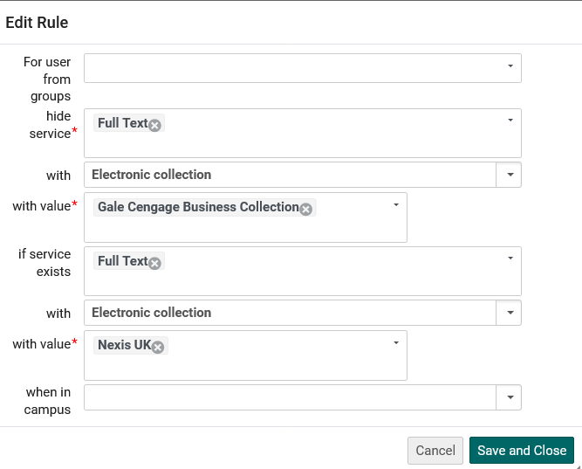
Using Display Logic Rules to make one specific electronic collection appear
Here we state as follows:
Hide service “Full Text” with value electronic collection “Gale Cengage Business Collection” if there is service “Full text” with value electronic collection “Nexis UK”

Slide 18
The results of the Display Logic Rules

Slide 19
The results of the Display Logic Rules
In Primo we again search for the resource, find it, and click “Available Online”

Slide 20
The results of the Display Logic Rules
Now we see only “Nexis UK” and the other two electronic collections are hidden.

Slide 21
The results of the Display Logic Rules
Note that in some cases, depending on the nature of the rules, the order is important. This is because two different rules could potentially work on the same conditions.

Slide 22
Note: We could have done it with one rule

Slide 23
Note: We could have done it with one rule
Instead of these two rules (which differ only in the “with value” under electronic collection hide service):

Slide 24
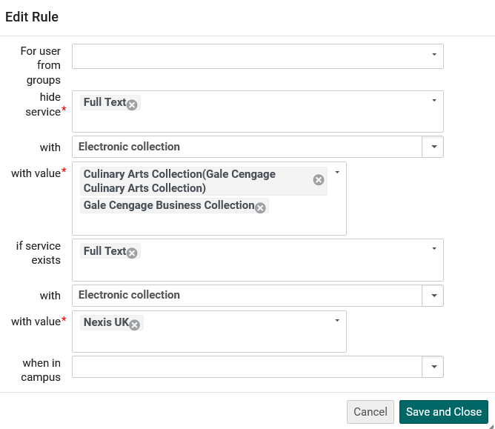
Note: We could have done it with one rule
We could have made one rule with two values in the “with value” under electronic collection hide service
Now we have two values here

Slide 25
Note: We could have done it with one rule
The one combined rule works like the two separate rules.
We see only “Nexis UK” and the other two electronic collections are hidden.

Slide 26
Note: We could have done it with one rule
The advantage of using two separate rules is that there is more “granularity” than using one combined rule.
Several rules could be made, each with one electronic collection in the “with value” under electronic collection hide service.
The combination of the several individual rules would allow the staff user to activate and deactivate the rules to have very specific results.

Slide 27
xxx@exlibrisgroup.com

