Slide 1
An Overview of the Alma Link Resolver Usage Subject Area
Yoel Kortick – Senior Librarian

Slide 2
Agenda
Introduction
The measurements
The default dashboard "Usage via Alma Link Resolver"

Slide 3
Introduction

Slide 4
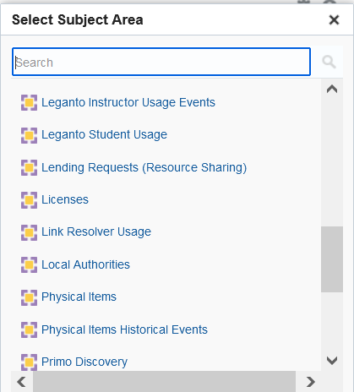
Introduction

Slide 5
Introduction
This subject area can be used to create reports that provide both specific details of link resolver usage as well as a broad perspective of how the Alma link resolver is used.
This provides libraries with a useful means of determining proper electronic collection development.
The Usage Data subject area includes COUNTER data from vendors, while the Link Resolver Usage subject area takes data directly from the Alma link resolver.

Slide 6
Introduction
The Alma Link Resolver includes not only Primo searches but also searches from an external source such as PubMed or a native vendor interface.
The next slide shows an example of a search from an external source.

Slide 7
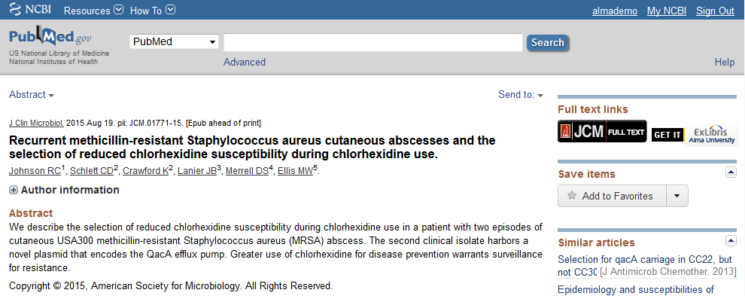
Introduction
Link to the article at Alma University

Slide 8
The measurements

Slide 9
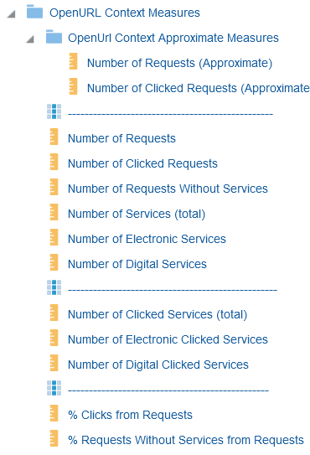
The measurements
The folder "OpenURL Context Measures" contains several measurements

Slide 10
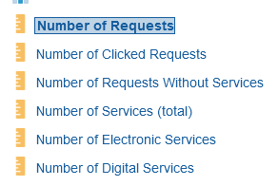
Number of Requests
A "Number of Requests" entry will be created any time an open URL request is sent to the Alma Link resolver
The default dashboard "Usage via Alma Link Resolver" of when this "Request" entry will be created are
If a user clicks a link to the Alma Link resolver from an external source such as PubMed or a vendor native interface
If a user clicks “Available Online" from the Primo search results for an electronic resource

Slide 11
Number of Requests
Example 1 for "Number of Requests"
From PubMed Click Link to the article at Alma University

Slide 12
Number of Requests
Example 2 for "Number of Requests"
From Primo results click “Available Online"

Slide 13
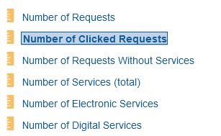
Number of Clicked Requests
The "Number of Clicked Requests" states whether or not at least one of the services was clicked.
The value will be 0 or 1.
‘0’ means no services were clicked
‘1’ means that at least 1 service was clicked.

Slide 14
Number of Clicked Requests
If someone clicks 1 or more of these services, then the ""Number of Clicked Requests" " will be "1"

Slide 15
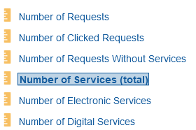
Number of Services
The "Number of services" is the number of services offered per incoming open URL request.
The incoming URL request may come from
The "View It" tab within Primo
The electronic services page after clicking from another source

Slide 16
Number of Services
Two services

Slide 17
Number of Services
One service

Slide 18
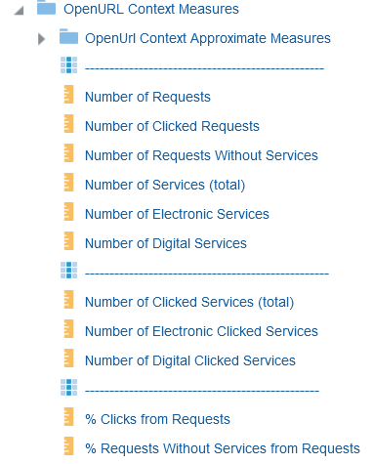
Number of Clicked Services
The "Number of Clicked Services" is the number of services used by (clicked by) the end user.

Slide 19
Number of Clicked Services
The "Number of Clicked Services" example

Slide 20
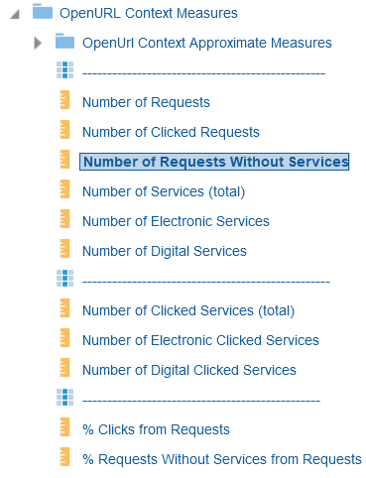
Number of requests without services
A "Number of requests without services" will be created for each incoming open URL which does not result in any services.
The "Request without services" will exist if the Alma Link resolver returns no results

Slide 21
Number of requests without services
"Number of requests without services"

Slide 22
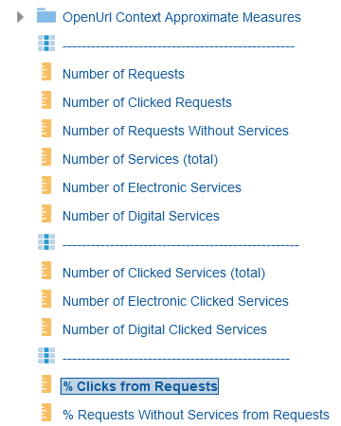
% Clicks from Requests
The "% Clicks from Requests" is the "Number of clicked Requests" divided by the "Number of Requests"
In other words, "of all the total requests how many were actually clicked"

Slide 23
% Clicks from Requests
The "% Clicks from Requests"

Slide 24
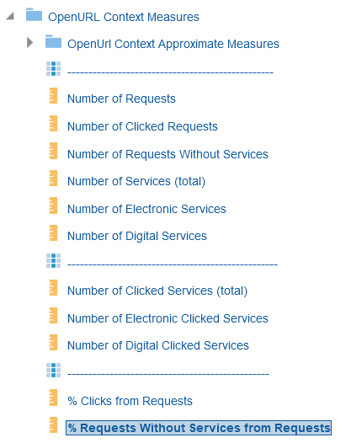
% Requests Without Services from Requests
The "% Requests Without Services from Requests" is the "Number of Requests Without Services" divided by the "Number of Requests"
In other words, "of all the incoming open URL requests how many did not have services"

Slide 25
% Requests Without Services from Requests
The "% Requests Without Services from Requests"

Slide 26
The default dashboard "Usage via Alma Link Resolver"

Slide 27
The default dashboard "Usage via Alma Link Resolver"
The "Usage via Alma Link Resolver" default dashboard is in folder "/shared/Alma/Usage via Alma Link Resolver/Dashboards"

Slide 28
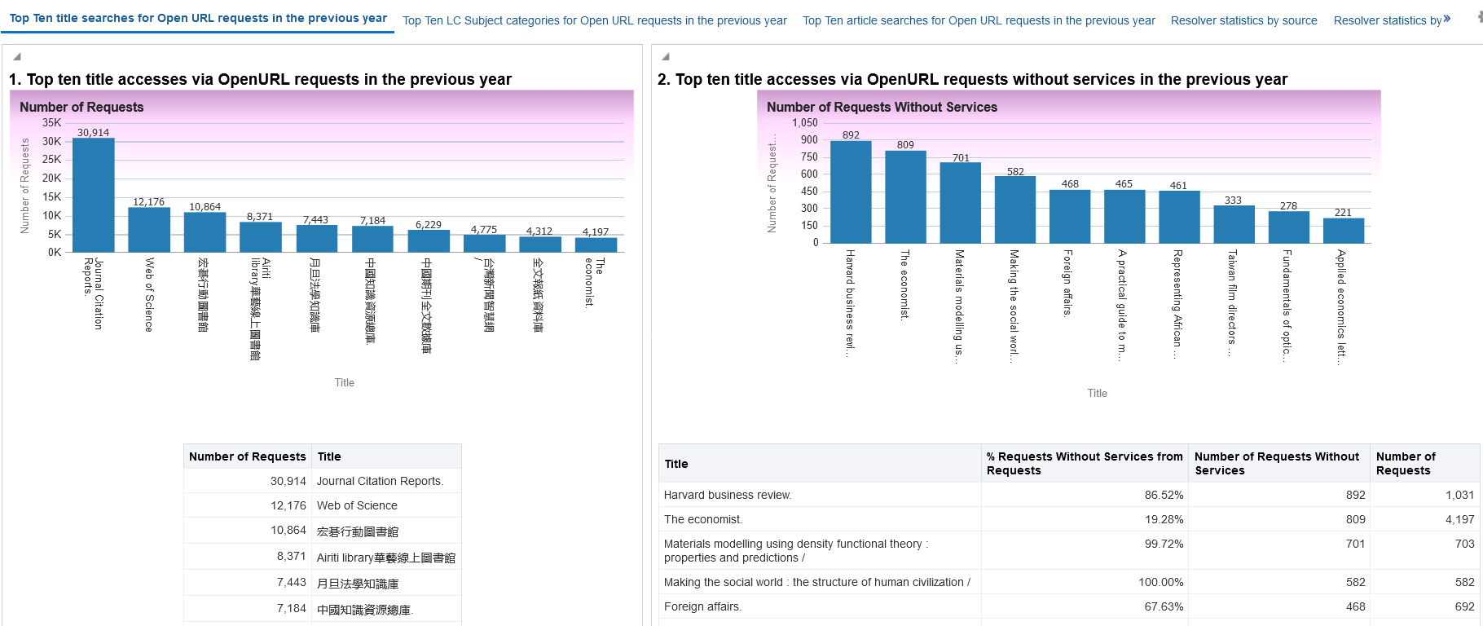
The default dashboard "Usage via Alma Link Resolver"

Slide 29
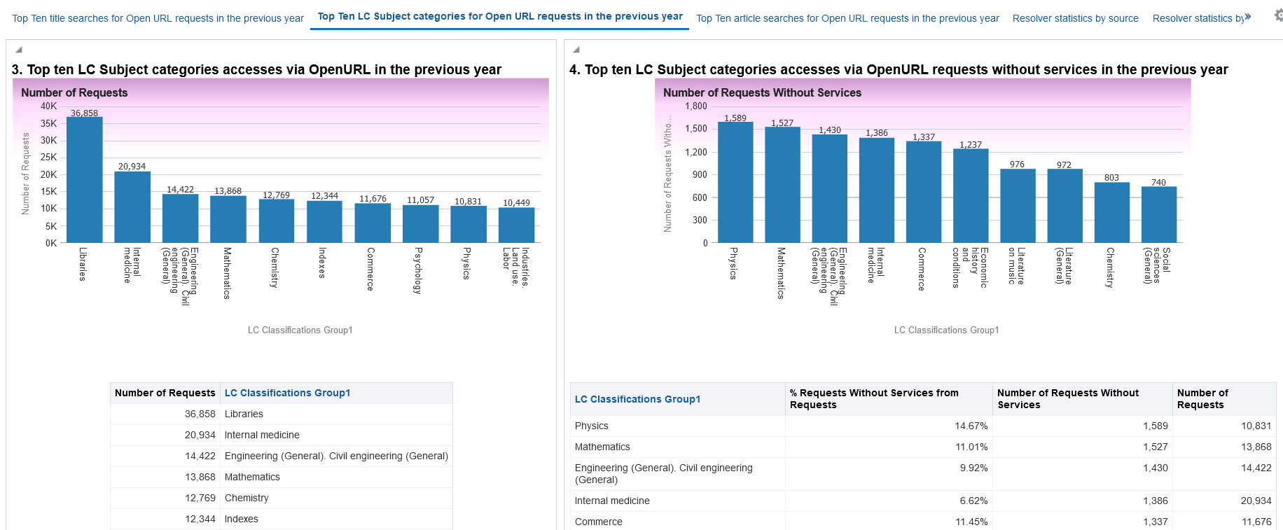
The default dashboard "Usage via Alma Link Resolver"

Slide 30
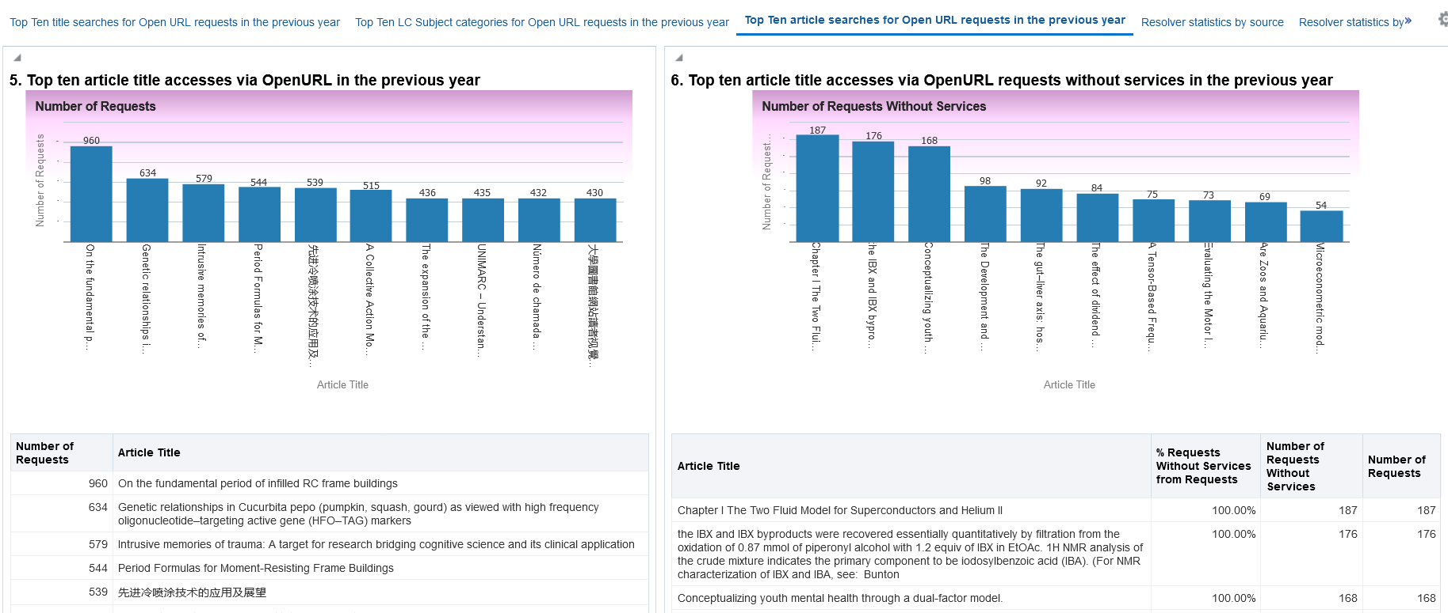
The default dashboard "Usage via Alma Link Resolver"

Slide 31
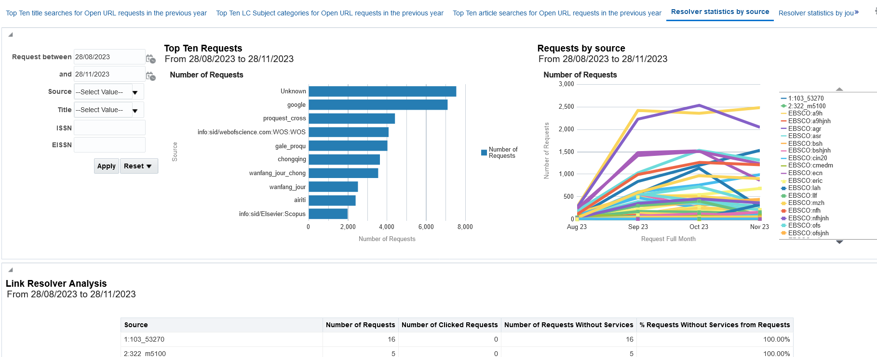
The default dashboard "Usage via Alma Link Resolver"

Slide 32
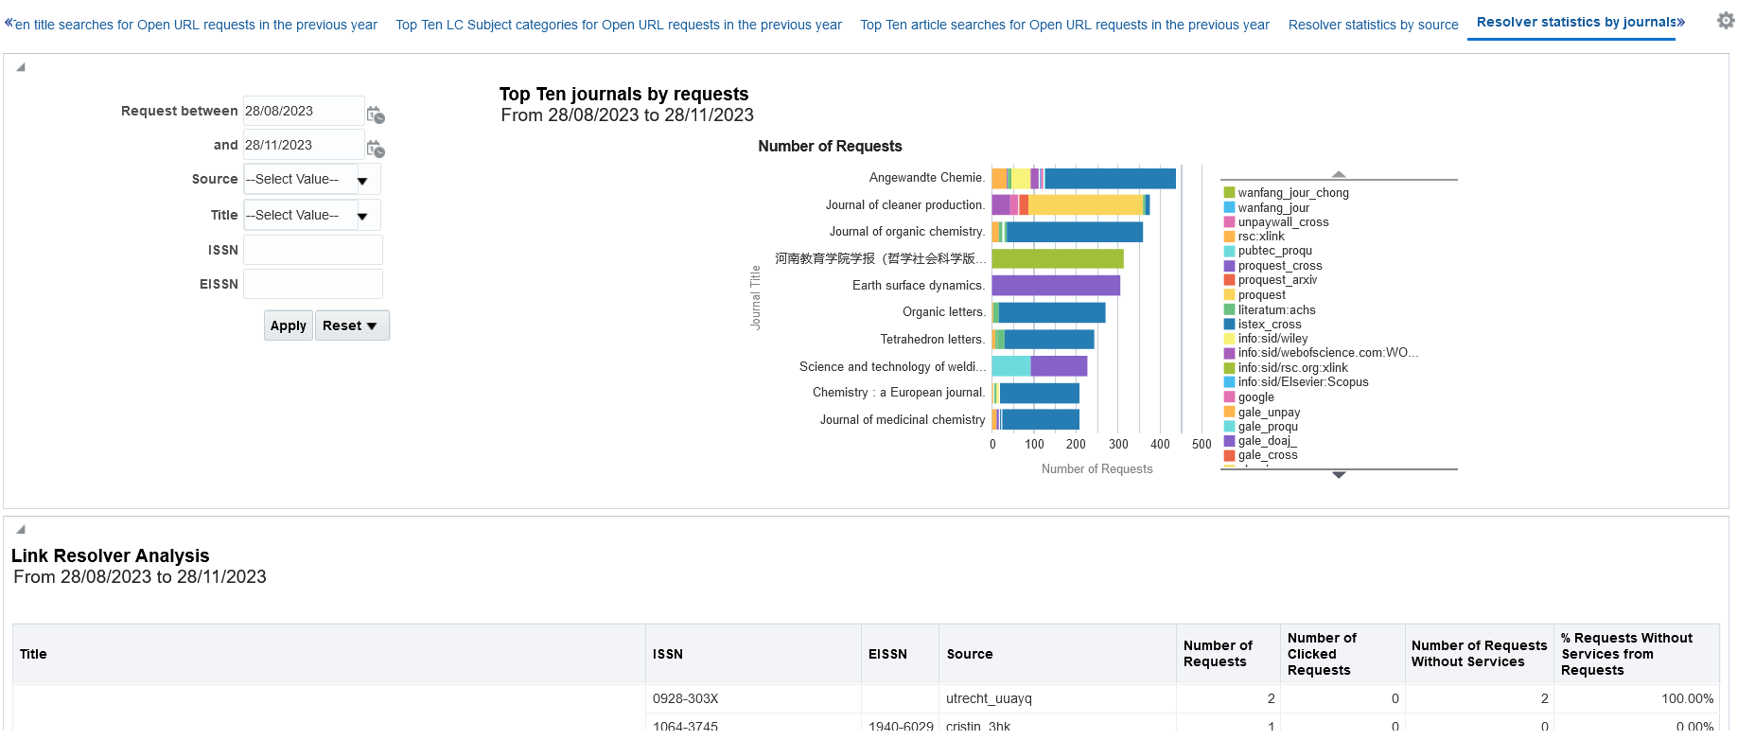
The default dashboard "Usage via Alma Link Resolver"

Slide 33
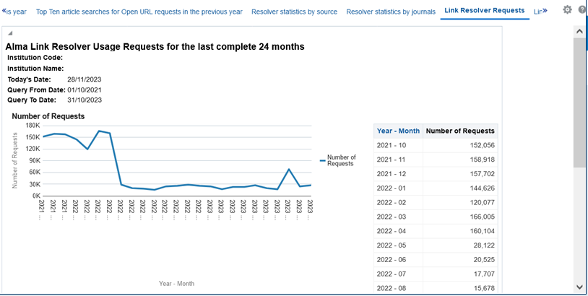
The default dashboard "Usage via Alma Link Resolver"

Slide 34
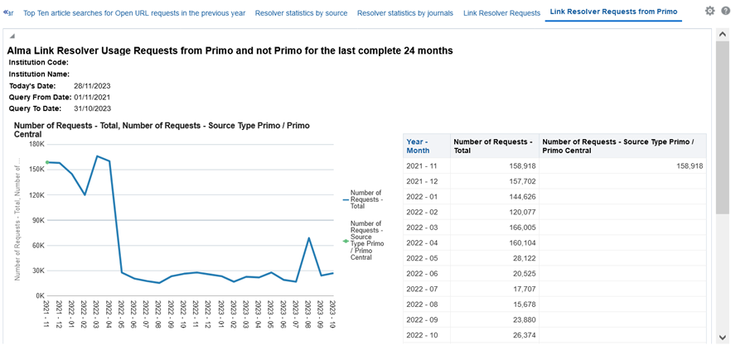
The default dashboard "Usage via Alma Link Resolver"

