Slide 1
Upload Electronic Holdings from ProQuest Ebook Central
Managing
Electronic
Resources
Yoel Kortick
Senior Librarian

Slide 2
Agenda
Introduction
The setup
The update from ProQuest
Summary

Slide 3
Introduction
3

Slide 4
Introduction
In addition to this presentation see also the online help at
Automatic Upload of Electronic Holdings
Upload Electronic Holdings from ProQuest Ebook Central for Subscriptions/Owned/DDA
ProQuest Ebook Central Upload Electronic Holdings Transition

Slide 5
Introduction
ProQuest Ebook Central Upload Electronic Holdings integration allows the institution to automatically manage (activate/deactivate) the electronic resources to which the institution has access via the ProQuest Ebook Central platform
The ProQuest Ebook Central Upload Electronic Holdings integration can identify which resources the institution has access to based on the institution’s Ebook Central site ID.
This service eliminates the need for human intervention when activating the electronic resources of the Ebook Central platform for any electronic title, whether it is part of a subscription, a PDA/DDA program, or individually owned/purchased titles.

Slide 6
Introduction
ProQuest Ebook Central Upload Electronic Holdings integration ensures that the institution’s institution-specific electronic holdings for ProQuest Ebook Central collection are up-to-date and reflect the institution’s purchase.
ProQuest Ebook Central Upload Electronic Holdings integration handles the following ProQuest Ebook Central titles:
Owned – Ebook titles that were purchased as perpetual-access, single Ebook titles
Subscription – Ebook titles that are part of a subscription (live or on trial)
DDA – Ebook titles that are part of the ProQuest PDA/DDA (Patron Driven Acquisition/Demand Driven Acquisition) program

Slide 7
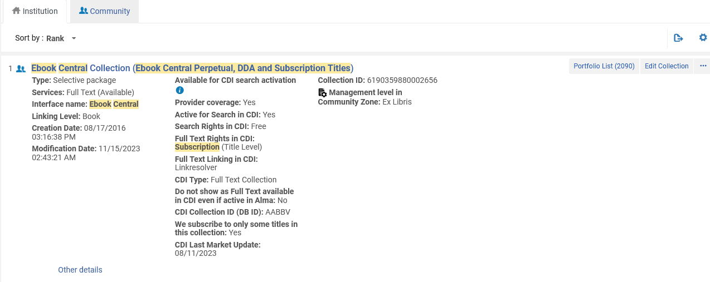
Introduction
To support this capability, the institution must activate the electronic collection “Ebook Central Perpetual, DDA and Subscription Titles” (Community Zone Collection ID 614330000000000002) from the Community Zone.
Active collection linked to CZ

Slide 8
The setup
8

Slide 9
The setup
These are the four steps of the setup:
Obtain from ProQuest an Ebook-Central site ID.
Ensure that the electronic collection “Ebook Central Perpetual, DDA and Subscription Titles” (Community Zone Collection ID 614330000000000002) is activated in the institution.
Add an integration profile of type “Upload Electronic Holdings” and choose “ProQuest Ebook Central” as the “Provider”.
In the integration profile fill in the Ebook-Central site ID (which you received from ProQuest) and choose a scheduling option.

Slide 10
The setup
The first step is to obtain from ProQuest an Ebook-Central site ID.
The Ebook-Central site ID is used by ProQuest to identify the institution and thereby provide the holdings files for the institution.
This Ebook-Central site ID will be put into the integration profile.

Slide 11
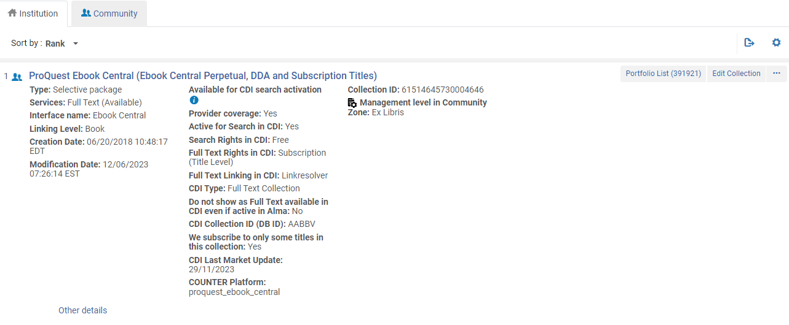
The setup
The second step is to ensure that the electronic collection “Ebook Central Perpetual, DDA and Subscription Titles” (Community Zone Collection ID 614330000000000002) is activated in the institution. For example:
Active collection linked to CZ

Slide 12
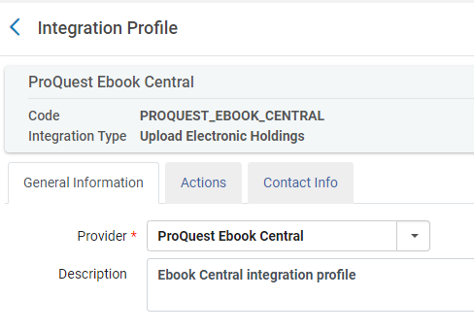
The setup
The third step is to add an integration profile of type “Upload Electronic Holdings” and choose “ProQuest Ebook Central” as the “Provider”.
This is done from the “Profile List” page at “Configuration > General > External Systems > Integration Profiles”

Slide 13
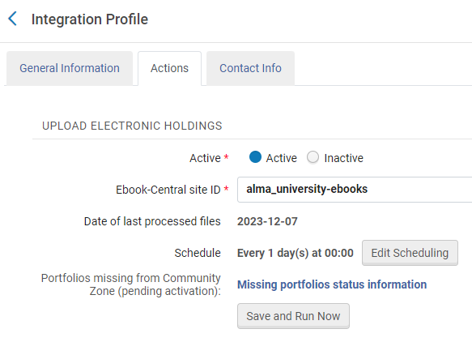
The setup
The fourth step is to fill in the Ebook-Central site ID (which you received from ProQuest) in the integration profile and choose a scheduling option.

Slide 14
The update from ProQuest
14

Slide 15
The update from ProQuest
The job “Upload Electronic Holdings” for vendor ProQuest will run as scheduled. In this case, every day at 00:00

Slide 16
The update from ProQuest
Here from the “Monitor Jobs” we see the last two runs of the upload electronic holdings for ProQuest

Slide 17
The update from ProQuest
Let’s take a look at the report for the job run on Dec. 7, 2023.

Slide 18
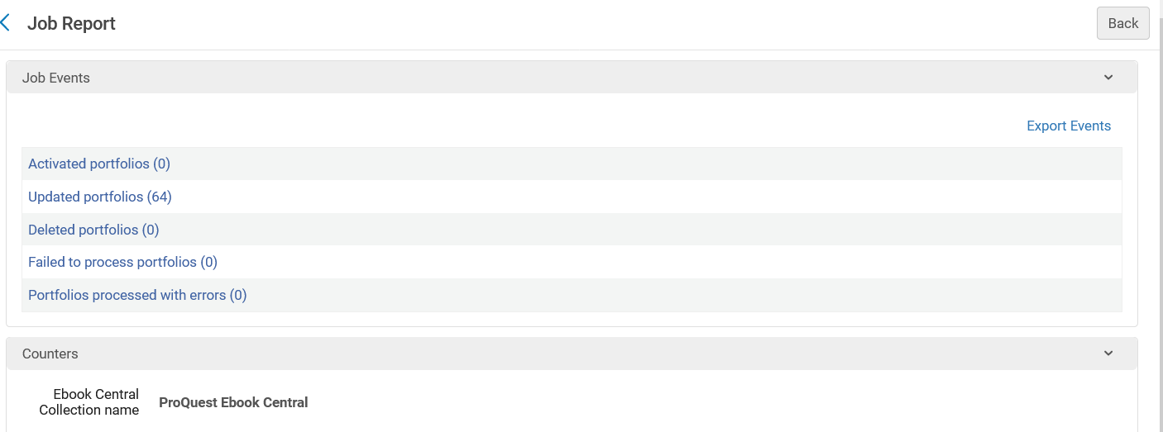
The update from ProQuest
64 Portfolios were updated

Slide 19
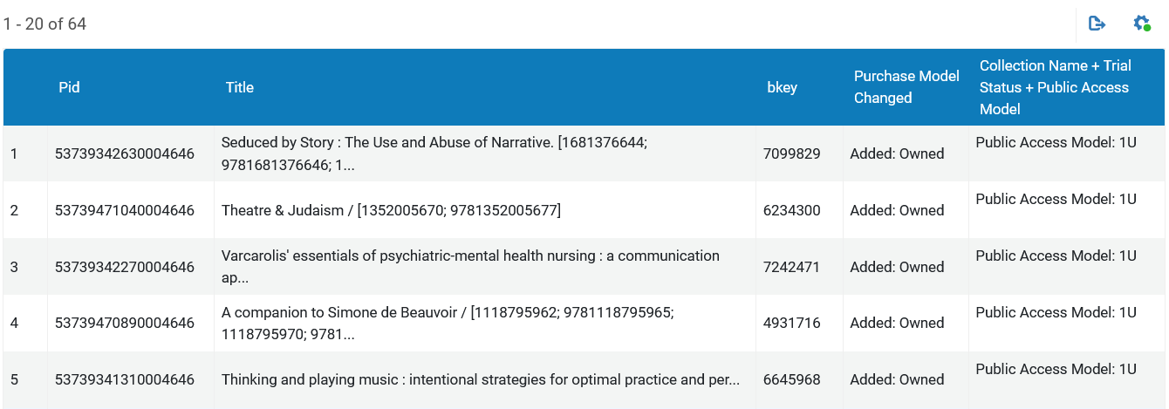
The update from ProQuest
If we click the link “Updated Portfolios” we can see which portfolios were updated
We will take a look at this updated portfolio in Alma

Slide 20
The update from ProQuest
We can see that the portfolio was updated Dec. 07 (exactly as the Upload Electronic Holdings job report states) and that it belongs to electronic collection ProQuest Ebook Central (Ebook Central Perpetual, DDA and Subscription Titles)

Slide 21
The update from ProQuest
Let’s look at another report, this time from the job which ran on Nov. 22, 2023

Slide 22
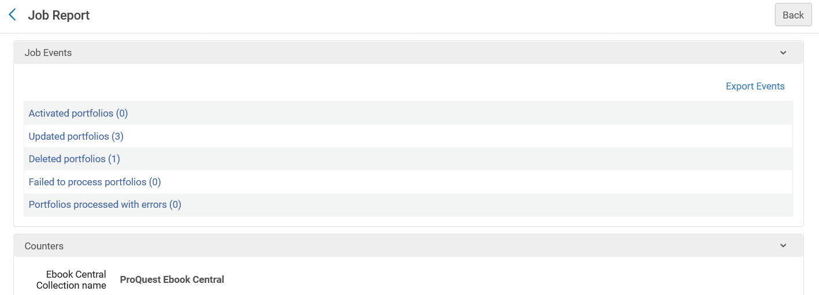
The update from ProQuest
This time we see not only that portfolios were updated, but also deleted.

Slide 23
The update from ProQuest
If we click the link “Deleted Portfolios” we can see which portfolios were deleted.
We will take a look at this updated portfolio in Alma Analytics and see when it was deleted

Slide 24
The update from ProQuest
And we can see via Alma analytics that this portfolio was (as the Upload Electronic Holdings job report states) deleted on Nov. 22, 2023

Slide 25
The update from ProQuest
Let’s look at another report, this time from the job which ran on Nov. 23, 2023

Slide 26
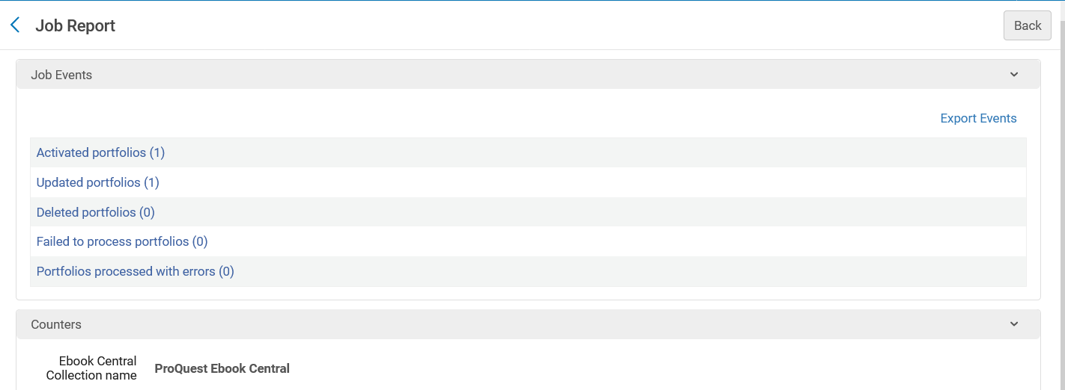
The update from ProQuest
This time we see not only that portfolios were updated, but also activated.

Slide 27
The update from ProQuest
If we click the link “Activated Portfolios” we can see which portfolios were activated.
We will take a look at this updated portfolio in Alma

Slide 28
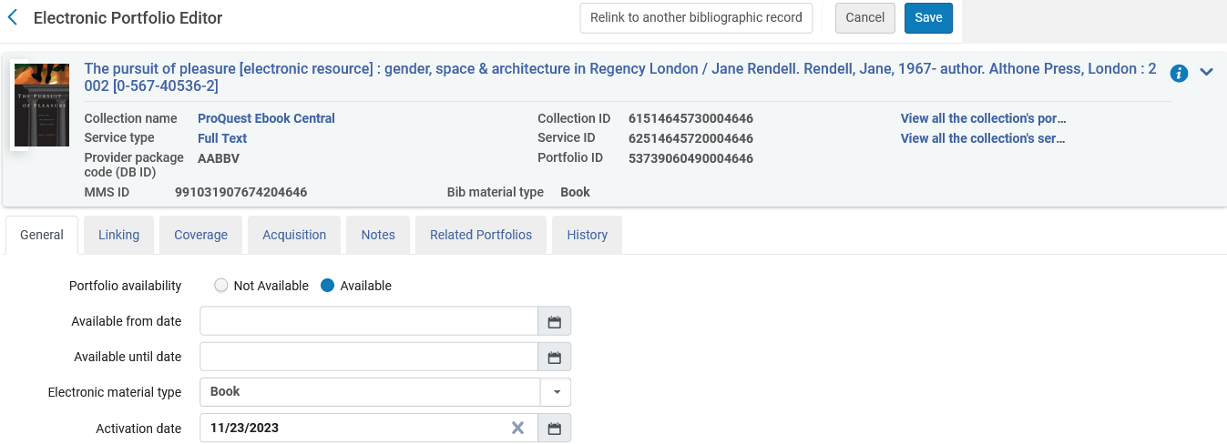
The update from ProQuest
In the electronic portfolio editor, we see that the portfolio was activated on Nov. 23, 2023 (exactly as the Upload Electronic Holdings report states)

Slide 29
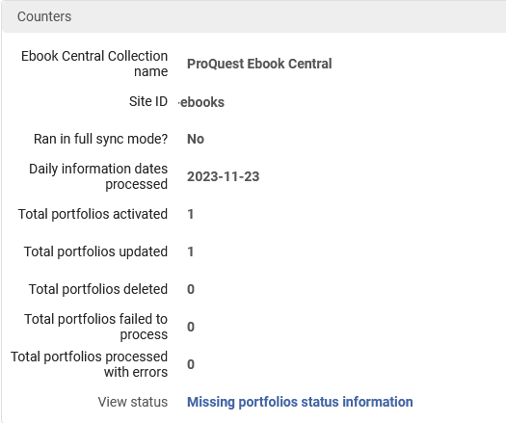
The update from ProQuest
The report also contains a link to the “Missing portfolios status information”

Slide 30
The update from ProQuest
Regarding the “Missing portfolios status information” report:
In cases where the Upload Electronic Holdings process ran and was not able to activate the relevant portfolios from the Community Zone, Alma will keep trying to see if these titles were added to the Community Zone in order to activate them for the institution.
The "Last update date” is the last date when the profile tried to activate the portfolios from the CZ.

Slide 31
The update from ProQuest

Slide 32
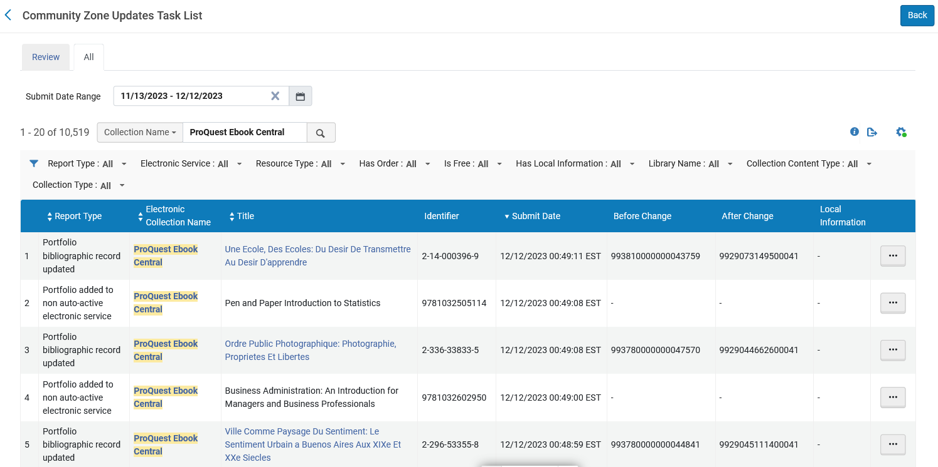
The update from ProQuest
All changes can also be seen via the Community Zone Updates Task List. Here we have filtered by Electronic Collection Name “ProQuest Ebook Central”

Slide 33
Summary
33

Slide 34
Summary
Via a simple setup the institution is able to automatically receive updates from ProQuest to update the holdings of the electronic resources.
Portfolios can be automatically updated, activated and deleted, and are specific to the purchase of the institution. We saw three specific examples in Alma where this occurred.
No manual work is needed.
This is a great time saver, replacing the need to get the files from the vendor, make sure they are in proper format, and manually load them to Alma.

