Slide 1
Bibliographic record and physical inventory retention in Alma
Yoel Kortick
Senior Librarian

Slide 2
Agenda
Introduction
Bibliographic Record Retention
Testing the Bibliographic Record Retention
Globally updating records for Bibliographic Record Retention
Physical inventory retention
Alma Analytics
Future plans

Slide 3
Introduction

Slide 4
Introduction
“Bibliographic record Retention” allows libraries to prevent the deletion of a bibliographic record.
This feature is of particular importance for libraries with collaborative collections whereby the library wishes to protect specific records from deletion.
This is also important for libraries desiring to make sure that important records such as rare materials, faculty publications, donations and other important records do not accidentally get removed from the catalog.

Slide 5
Introduction
“Physical Inventory Retention” allows libraries to mark items as “committed to retain” to prevent the items from being withdrawn (deleted).
This feature is of particular importance and especially useful, for example, when several libraries pool their resources together and some of the library's items should be retained even when internal usage is low.
This is often referred to as “Collaborative Collections” and frequently has particular significance for resource sharing.

Slide 6
Introduction
We are discussing here “retention” for bibliographic records and physical inventory. Note that if an item is marked as committed to retain, the associated holdings record and bibliographic also cannot be deleted.
Note, however, that tentative future roadmap plans include retention for holdings records as well.
With this tentative future development, it will also be possible to prevent the deletion of holdings records. The manner in which this will be done will be similar to the existing “retention” for bibliographic records which will be discussed here.

Slide 7
Introduction
In addition to this presentation see also:
“Bibliographic Record Retention” in the Alma August 2023 release notes and in Working with Bibliographic Records.
“Item Retention Indication for Managing Collaborative Collections” in the Alma August 2022 release notes.
“Collection Retention” in the 2022 Alma Roadmap Highlights for Physical Resource Management.
“Retention Information” in Working with Items.

Slide 8
Bibliographic Record Retention

Slide 9
Bibliographic Record Retention
To use “Bibliographic Record Retention” the table “Bibliographic Collection Retention definition” needs to be defined.
This table can be accessed at “Configuration > Resources > Collection Retention > Bibliographic Collection Retention Definition”

Slide 10
Bibliographic Record Retention
In the table “Bibliographic Collection Retention definition” the institution can specify conditions for record retention.
The institution can use the table in either of the following ways:
Add a field and subfield to the table in order for the record to be protected from deletion if the field and subfield contains any value.
Add a field and subfield to the table and also specify a specific value for the subfield, and only records which contain this value in the field and subfield will be protected from deletion.

Slide 11
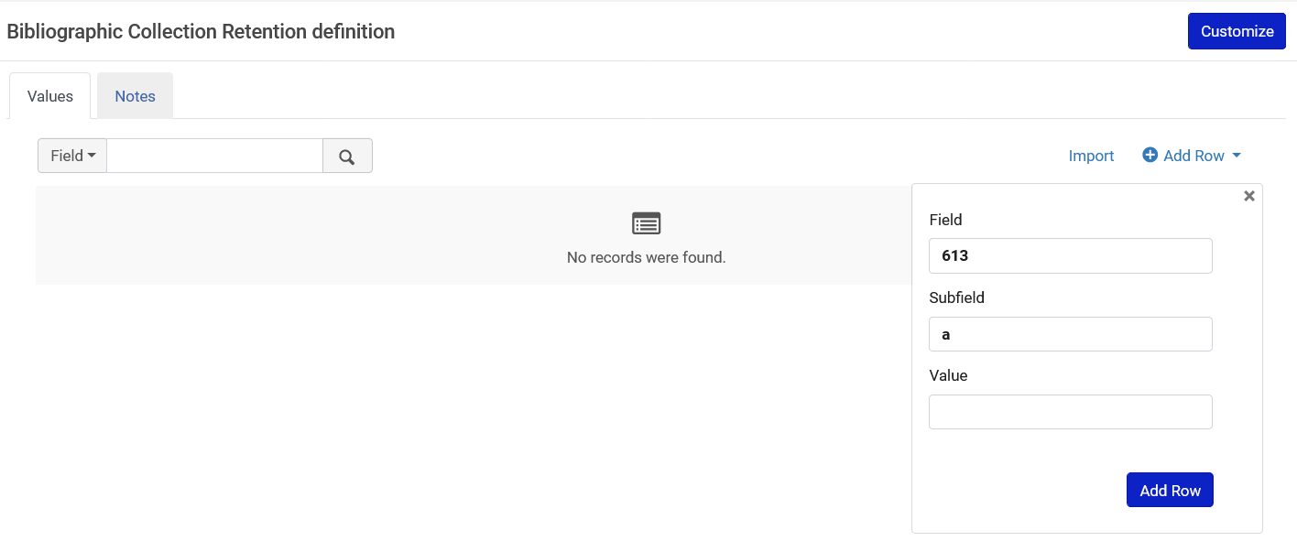
Bibliographic Record Retention
We will now add a field without a specific subfield value

Slide 12
Bibliographic Record Retention
This means: If the record has a 613 subfield a with any value, then it cannot be deleted.
This is blank, so therefore any value in the subfield will prevent deletion.

Slide 13
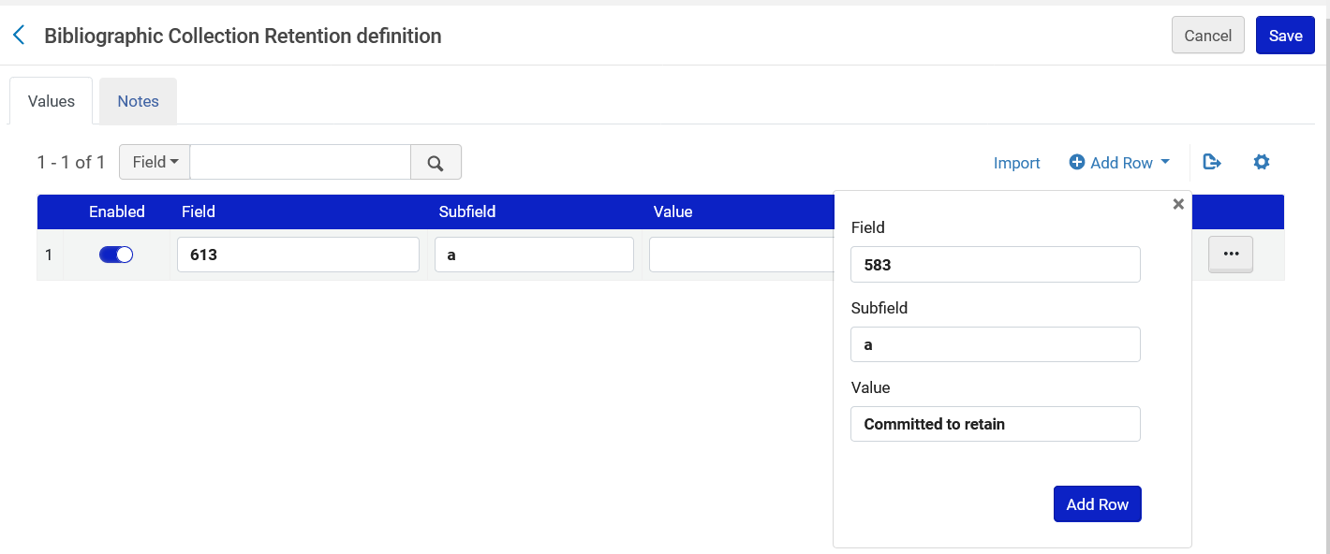
Bibliographic Record Retention
We will now add a field with a specific subfield value

Slide 14
Bibliographic Record Retention
This means: If the record has a 583 subfield a with value “Committed to retain”, then it cannot be deleted.
This has a specific value, so therefore only the presence of this specific value in the subfield will prevent deletion.

Slide 15
Testing the Bibliographic Record Retention

Slide 16
Testing the Bibliographic Record Retention
Title “Beyond words : anthology of poems / Alicia Chen” (MMSID 99481786100121) has a 613 subfield a with text “Do not delete”.
Alma should prevent us from deleting the record because we stated in the table “Bibliographic Collection Retention definition” that the 613 subfield a can have any value.

Slide 17
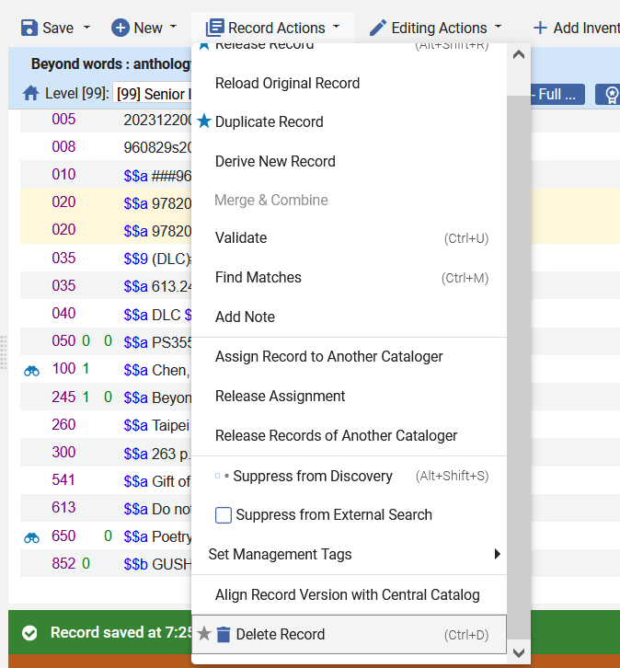
Testing the Bibliographic Record Retention
Let’s try to delete

Slide 18
Testing the Bibliographic Record Retention
We cannot delete the record and receive an explanatory error message.

Slide 19
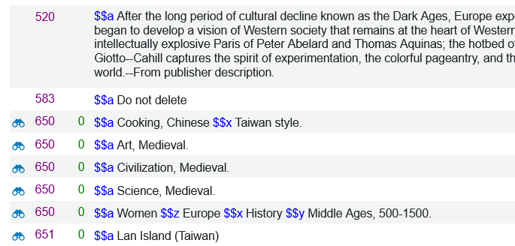
Testing the Bibliographic Record Retention
Title “The Mysteries of the Middle Ages : the rise of feminism, science, and art in Taiwan / by Alicia Chen” (MMSID 99177464800121) has a 583 subfield a with text “Do not delete”.
Alma should not prevent us from deleting the record because we stated in the table “Bibliographic Collection Retention definition” that the 583 subfield a must have the specific value “Committed to retain”.

Slide 20
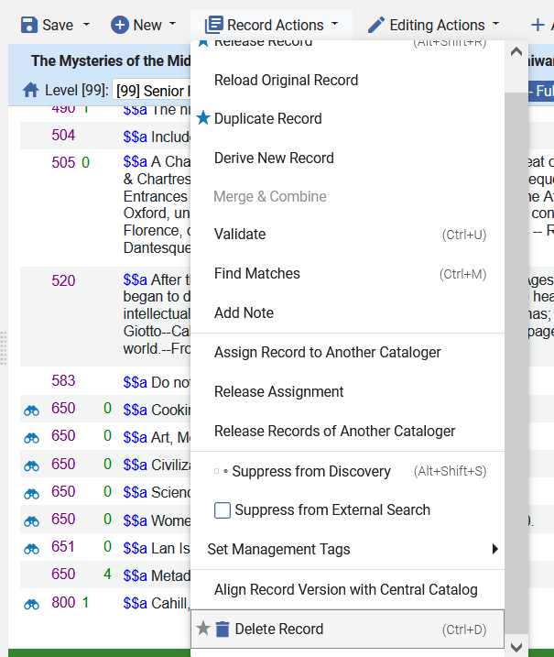
Testing the Bibliographic Record Retention
Let’s try to delete

Slide 21
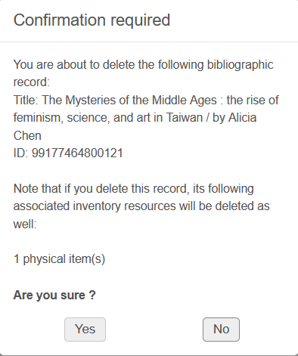
Testing the Bibliographic Record Retention
We can delete the record.

Slide 22
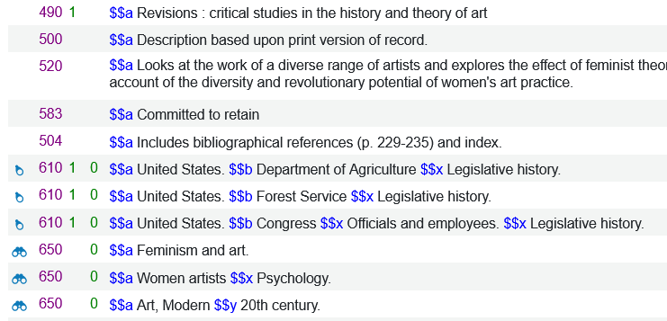
Testing the Bibliographic Record Retention
Title “Feminism and contemporary art in Taiwan : the revolutionary power of women's laughter / Alicia Chen” (MMSID 99177675100121) has a 583 subfield a with text “Committed to retain”.
Alma should prevent us from deleting the record because we stated in the table “Bibliographic Collection Retention definition” that the 583 subfield a must have the specific value “Committed to retain”.

Slide 23
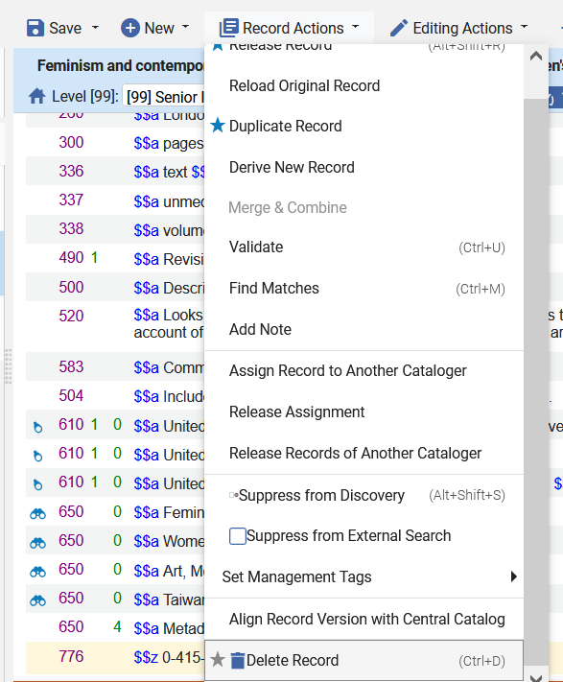
Testing the Bibliographic Record Retention
Let’s try to delete

Slide 24
Testing the Bibliographic Record Retention
We cannot delete the record and receive an explanatory error message.

Slide 25
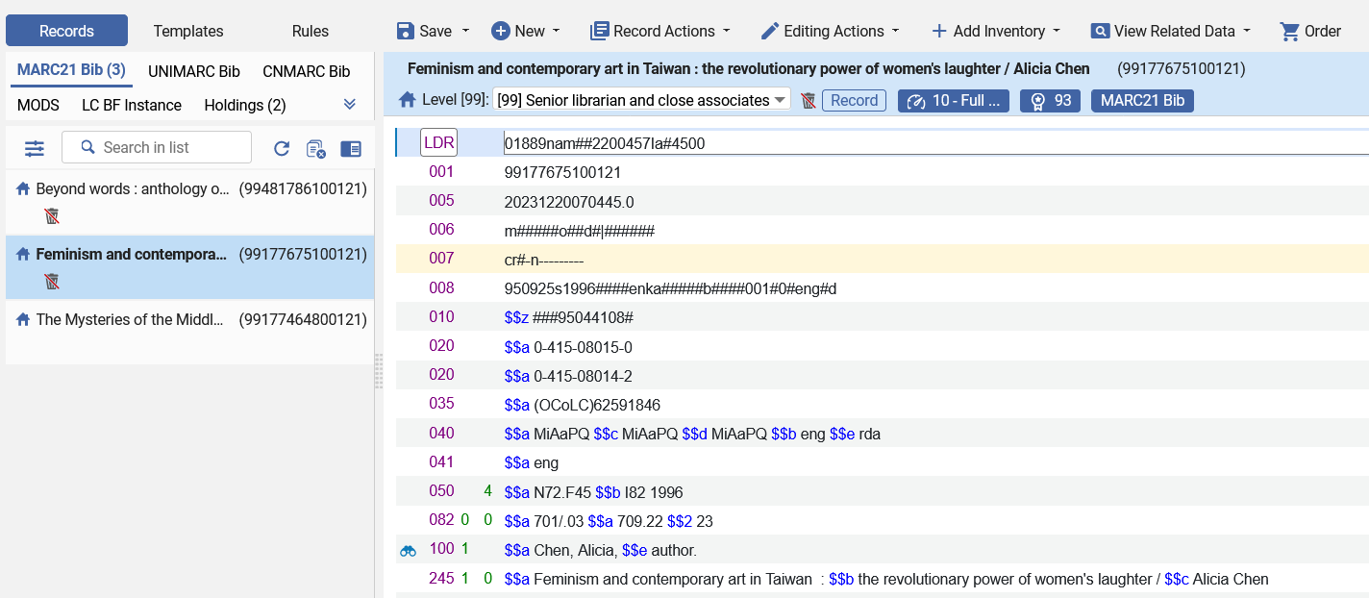
Testing the Bibliographic Record Retention
Note also that bibliographic records which cannot be deleted have a clear indication in the Metadata Editor.
This indication will appear when the record is indexed (either by saving in the Metadata Editor, running a normalization process, or in the semi-annual re-indexing).

Slide 26
Testing the Bibliographic Record Retention
Summary:
Our table “Bibliographic Collection Retention definition” contains these two lines:
As a result:
Any value in the 613 a (the mere presence of a 613 a) prevented us from being able to delete the record.
The presence of a 583 a was not enough for us to be prevented from deleting the record. The 583 a had to have the specific value “Committed to retain”.

Slide 27
Globally updating records for Bibliographic Record Retention

Slide 28
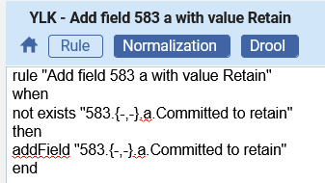
Globally updating records for Bibliographic Record Retention
This normalization rule will add a 583 subfield a with value “Committed to retain” if it does not already exist
rule "Add field 583 a with value Retain"
when
not exists "583.{-,-}.a.Committed to retain"
then
addField "583.{-,-}.a.Committed to retain"
end

Slide 29
Globally updating records for Bibliographic Record Retention
The normalization rule “YLK - Add field 583 a with value Retain” has been added to a normalization process called “YLK - Add field 583 a with value Retain”

Slide 30
Globally updating records for Bibliographic Record Retention
We have a set of bibliographic records named “Records to add Committed to retain to 583 a” which we would like to update:

Slide 31
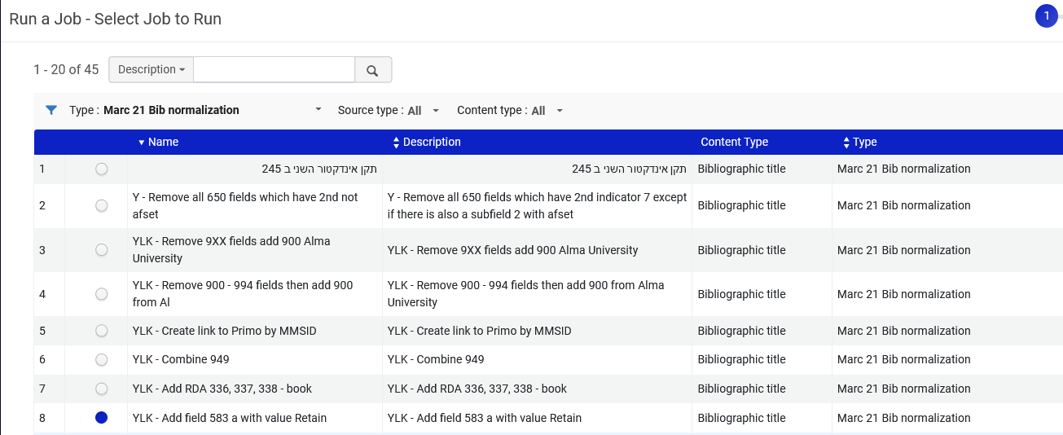
Globally updating records for Bibliographic Record Retention
Via “Admin > Manage Jobs and Sets > Run a job” we filter by type “Marc 21 Bib normalization” and run the job (Normalization Process) “YLK - Add field 583 a with value Retain”

Slide 32
Globally updating records for Bibliographic Record Retention
We choose the set “Records to add Committed to retain to 583 a”

Slide 33
Globally updating records for Bibliographic Record Retention
The job runs and successfully completes and (as we see on the next slide) the records get updated.

Slide 34
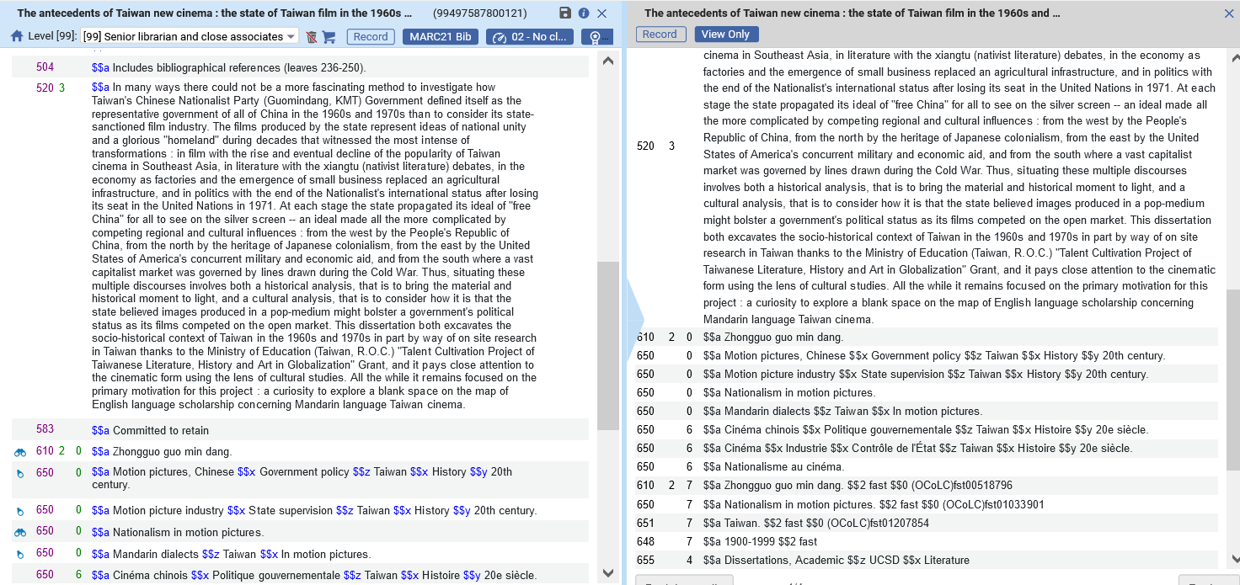
Globally updating records for Bibliographic Record Retention
After
Before
No 583 field
583 field added

Slide 35
Globally updating records for Bibliographic Record Retention
It is also possible to search for bibliographic records which are committed to retain.

Slide 36
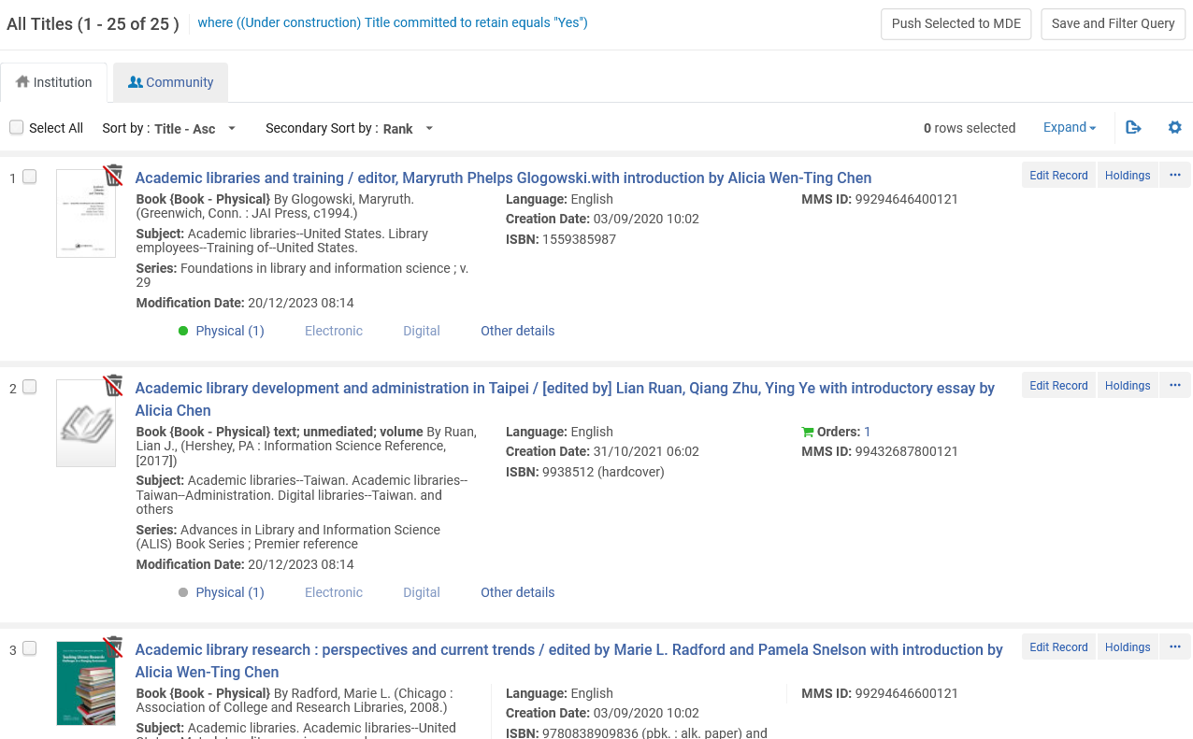
Globally updating records for Bibliographic Record Retention
All results are “committed to retain” and have a corresponding icon in the repository search results.

Slide 37
Physical inventory retention

Slide 38
Physical inventory retention
It is possible to mark physical items as “Committed to Retain” and this will prevent the item from being able to be withdrawn (deleted).
It is also possible to add a “Retention Reason” and a “Retention Note”.
This is also supported in the import, export and API workflows
Here is the “Retention Information” section of the physical item editor:

Slide 39
Physical inventory retention
The list of values for the “Retention Reason” can be configured by the institution at “Configuration > Resources > Collection Retention > Item Retention Reason”

Slide 40
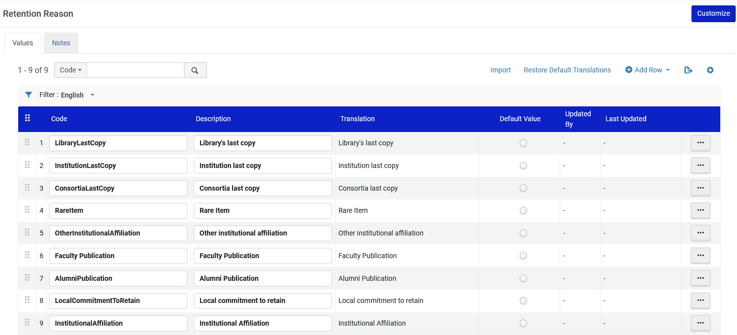
Physical inventory retention
An example of the Retention Reason table

Slide 41
Physical inventory retention
Here we are editing barcode AU65402, which is part of title “City women : contemporary Taiwan women writers / edited by Eva Hung and Alicia Chen”.
We have set the “Committed to Retain” as “Yes” and given a “Retention Reason” as “Faculty Publication”.

Slide 42
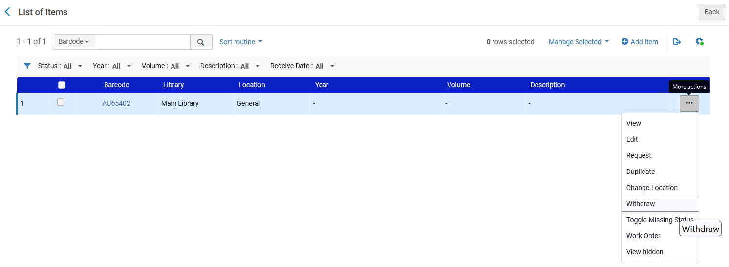
Physical inventory retention
If we try to withdraw the item …

Slide 43
Physical inventory retention
Then we cannot withdraw it and receive a message “The item is marked as “Committed to retain” and cannot be deleted”

Slide 44
Physical inventory retention
It is also possible to globally update several items at once using the job “Change Physical items information”.
This job can work on sets of type “Physical holdings”, “Physical titles” or “Physical items”.
We will run this job on a set of type “Physical holdings”.

Slide 45
Physical inventory retention
We will create a set of type “Physical holdings” for all holdings records which have a 583 field with subfield a with value “Committed to retain”.
To search holdings records by 583 subfield a we can use the “Physical holdings” Action note index (which includes the 583 field subfield a).

Slide 46
Physical inventory retention
From the results we will create a set of “Physical holdings”

Slide 47
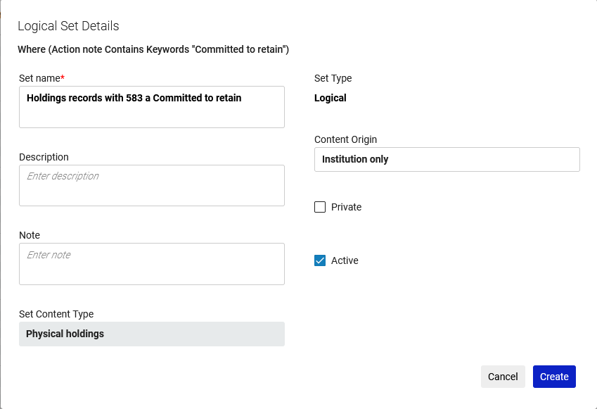
Physical inventory retention
We create the set.

Slide 48
Physical inventory retention
The set has been created.

Slide 49
Physical inventory retention
Now we will run the job “Change Physical items information”

Slide 50
Physical inventory retention
We will run the job on the set of type “Physical holdings” which we just created.

Slide 51
Physical inventory retention
In the job we will change “Set item committed to retain to:” as “Yes” and set the “Retention reason” to “Faculty Publication”.

Slide 52
Physical inventory retention
The job successfully completes

Slide 53
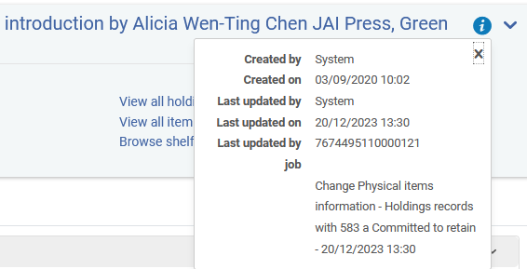
Physical inventory retention
All physical items associated with holdings records in the set have been updated by the job

Slide 54
Physical inventory retention
None of these items can be withdrawn.

Slide 55
Alma Analytics

Slide 56
Alma Analytics
It is possible in Alma Analytics to retrieve both the
Bibliographic records which are committed to retain
Physical items which are committed to retain.
In the shared folder (in multiple subject areas) “Bibliographic Details” the field “Title Committed to Retain” can be filtered with “Yes” to retrieve all titles which are committed to retain.
In the “Physical Items” subject area, “Physical Item Details” folder, the fields “Has Committed to Retain”, “Retention Note” and “Retention Reason” can be used to retrieve all items which are committed to retain. For example, “Has Committed to Retain” can be filtered by “Yes”.

Slide 57
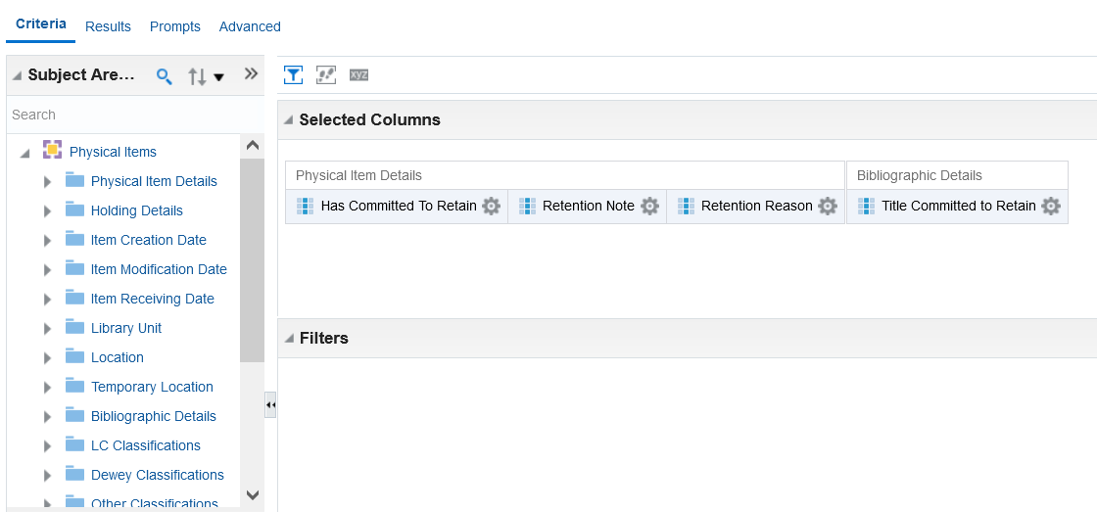
Alma Analytics
The fields in Alma Analytics:

Slide 58
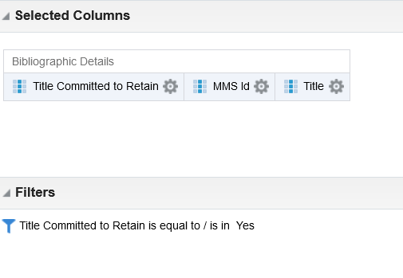
Alma Analytics
Here we will filter by “Title Committed to Retain” = “Yes”

Slide 59
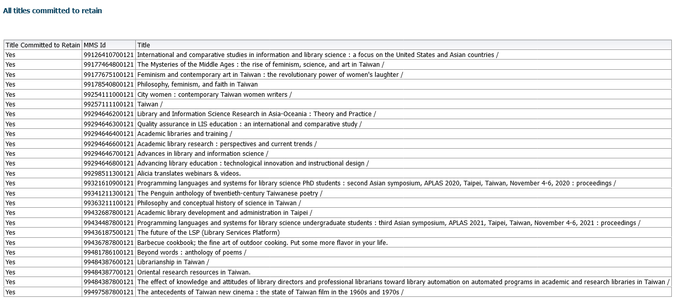
Alma Analytics
Now we have all titles which are Committed to Retain

Slide 60
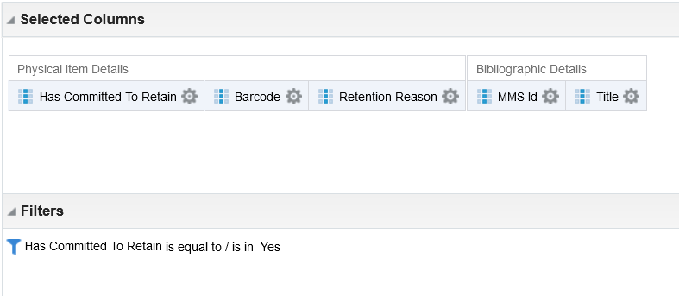
Alma Analytics
Here we will filter by “Title Committed to Retain” = “Yes”

Slide 61
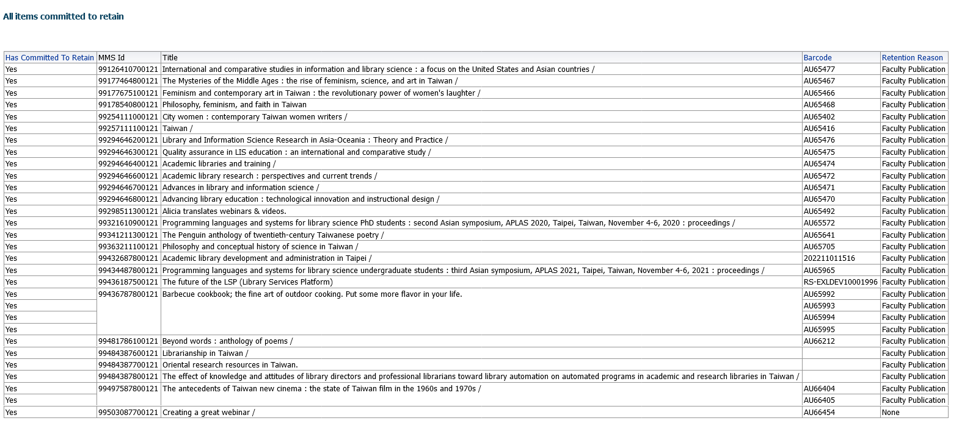
Alma Analytics
Now we have all items which are Committed to Retain

Slide 62
Future plans

Slide 63
Future plans
As mentioned in the introduction, tentative future roadmap plans include retention for holdings records as well.
With this tentative future development, it will also be possible to prevent the deletion of holdings records.
The manner in which this will be done will be similar to the existing “retention” for bibliographic records which has been demonstrated here.

