Slide 1
How to Restrict Editing Bibliographic Fields by Network Zone Members
Yoel Kortick
Senior Librarian

Slide 2
Agenda
The Network Zone Consortia Environment
Defining the Inventory Network Groups
Attributing groups to a resource – the examples
The effects of the inventory network group in Primo
Repository search

Slide 3
The Network Zone Consortia Environment

Slide 4
The Network Zone Consortia Environment
This presentation relates specifically to managing electronic resources in the Network Zone Consortia Environment.
In such an environment there is a Network Zone as well as multiple Member Institutions.
In this specific presentation the electronic resources, whether they be an entire electronic collection or one specific portfolio, are managed in the Network Zone.
We will focus here on managing the availability of the resources in the Member Institutions. This presentation will not deal with acquisitions-related issues

Slide 5
The Network Zone Consortia Environment
In the example here we have a network zone and three member institutions:
Member / Network | Name | Inst. Code
Network | Ex Libris University Consortium | EXLDEMO2_INST
Member | Alma University | EXLDEV1_INST
Member | Open University | EXLDEMO3_INST
Member | University of Knowledge | EXLDEMO1_INST

Slide 6
Defining the Inventory Network Groups

Slide 7
Defining the Inventory Network Groups
In this flow the access to the resources is controlled via the "available for" group settings in the Network Zone.
Alma makes use of the "inventory network groups" defined in the "resources" configuration menu.
This is commonly referred to as Distributed Access to Electronic Resources from the Network Zone

Slide 8
Defining the Inventory Network Groups
When using the "inventory network groups" it is possible to define a group which would be any of the following
All of the institutions
Specific groups of institutions
Each specific institution
One or more groups could then be associated with a specific resource (portfolio) or entire electronic collection
The inventory network groups are accessed via configuration menu > resources > general > inventory network groups

Slide 9
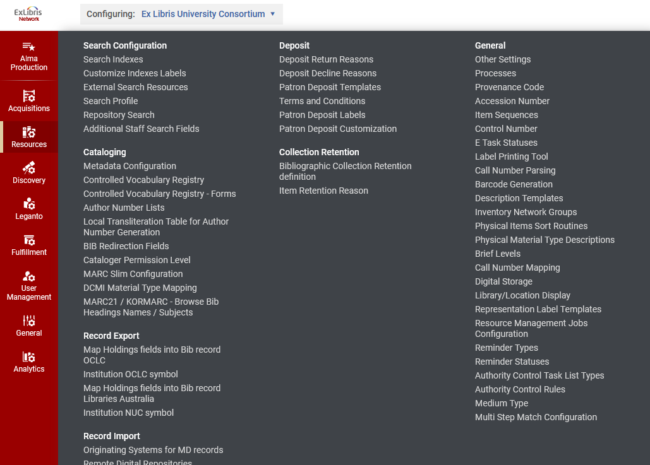
Defining the Inventory Network Groups
We are in the Network Zone

Slide 10
Defining the Inventory Network Groups
Here we have several different groups. One is for all institutions. Others are for one institution or a combination thereof.
Single specific institutions
Two specific institutions
All institutions

Slide 11
Defining the Inventory Network Groups
Here for example, we have two specific institutions belonging to inventory network group named "Alma University and Open University Institutions"
Two specific institutions

Slide 12
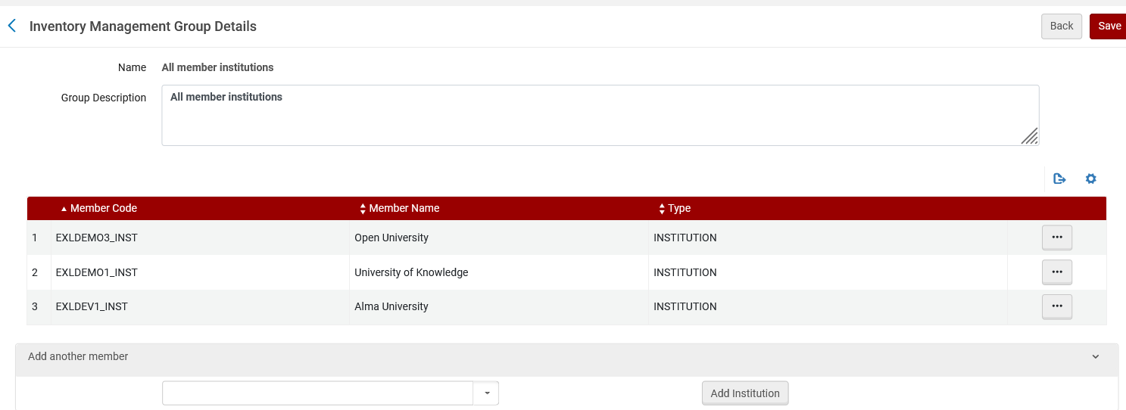
Defining the Inventory Network Groups
Here for example, we all three member institutions belonging to inventory network group named "All member institutions"
All three member institutions

Slide 13
Defining the Inventory Network Groups
Here for example, we have one specific institution belonging to inventory network group named "University of Knowledge"
Single specific institution

Slide 14
Attributing groups to a resource – the examples

Slide 15
Attributing groups to a resource – the examples
Example one
Electronic collection "British and Irish Women's Letters and Diaries: Second Edition"
Activate from CZ then edit Group Settings of electronic collection editor
Make it available for Alma University
Example two
Electronic collection " Women and Social Movements: Development and the Global South, 1919-2019 (Video)" exists in network
Edit Group Settings of electronic collection editor
Make it available for Alma University and Open University and University of Knowledge
Example three
Electronic portfolio "Feminist Phenomenology" exists in network
Edit Group Settings of electronic portfolio editor
Make it available for Alma University and Open University
Example four
Electronic portfolio "Companion to Environmental Studies"
Activate from CZ then do not do anything to the group settings

Slide 16
Attributing groups to a resource – the examples
Note that our examples here include both electronic collections as well as portfolios.
If the portfolio is part of an electronic collection, then it will inherit the inventory management groups from the electronic collection.
If the portfolio is part of an electronic collection and it is given a specific inventory management group, then the specific inventory management group will override the inherited values of the collection

Slide 17
Example 1

Slide 18
Attributing groups to a resource – Example 1
From the Network Zone institution, we search the Community Zone for electronic collection "British and Irish Women's Letters and Diaries: Second Edition".
We then activate the collection.

Slide 19
Attributing groups to a resource – Example 1
The electronic collection is now activated in the Network Zone and from the Network Zone "institution" tab we edit the collection

Slide 20
Attributing groups to a resource – Example 1
Now we will edit the group settings and add a setting

Slide 21
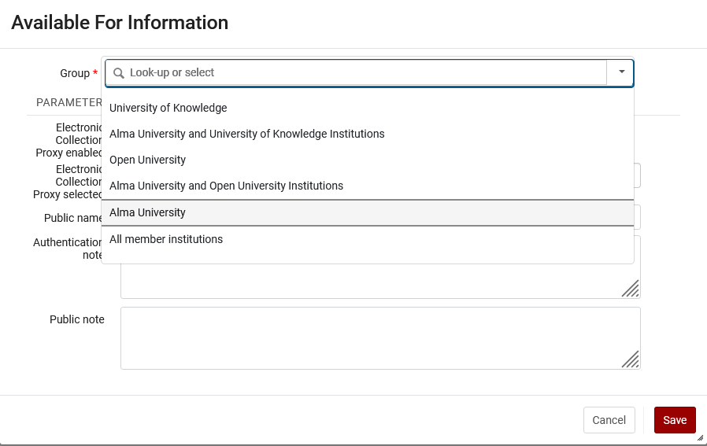
Attributing groups to a resource – Example 1
We will choose to make it available for Alma University

Slide 22
Attributing groups to a resource – Example 1
Now it is available for Alma University

Slide 23
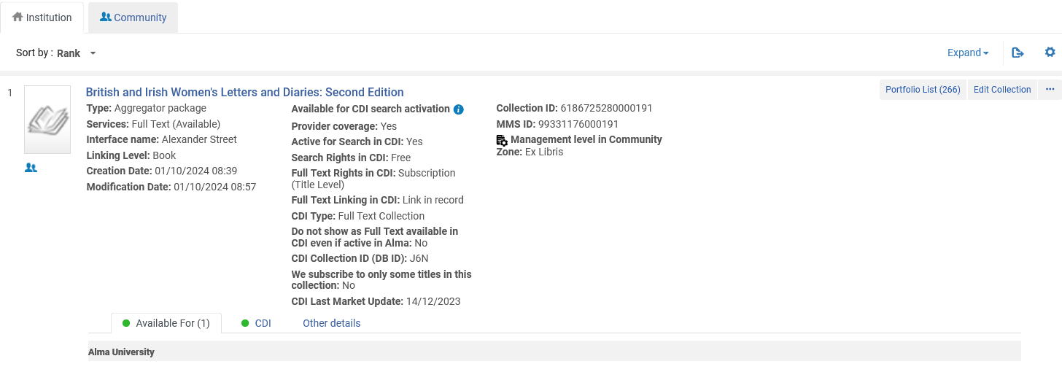
Attributing groups to a resource – Example 1
Now it is available for Alma University (as seen in repository search in the institution tab of the Network Zone institution)

Slide 24
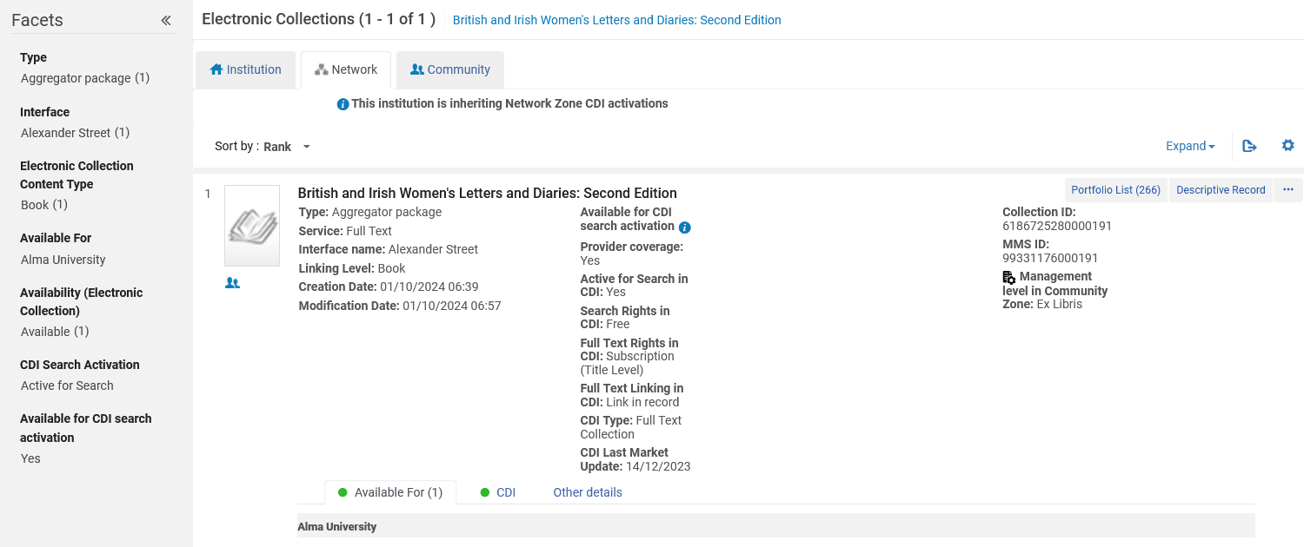
Attributing groups to a resource – Example 1
This is repository search for electronic collections while logged into Alma University and searching the network zone

Slide 25
Attributing groups to a resource – Example 1
If we search Alma University Institution Tab with search scope "Institution" we will not find it

Slide 26
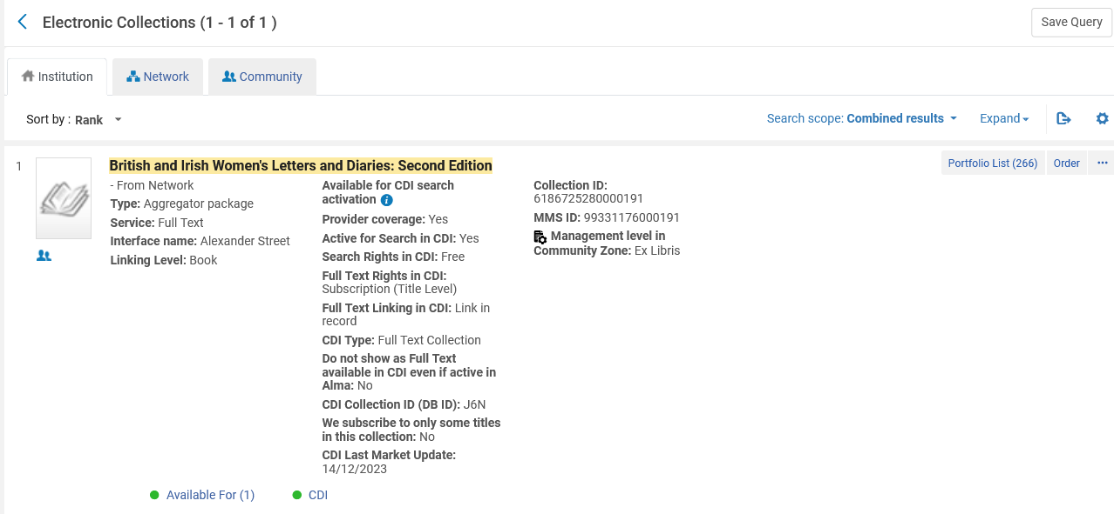
Attributing groups to a resource – Example 1
But … we will change the search scope to "Combined results", and we find it
Indication that it is from the network
Changed the Search scope to "Combined results"

Slide 27
Attributing groups to a resource – Example 1
Now it is available for Alma University

Slide 28
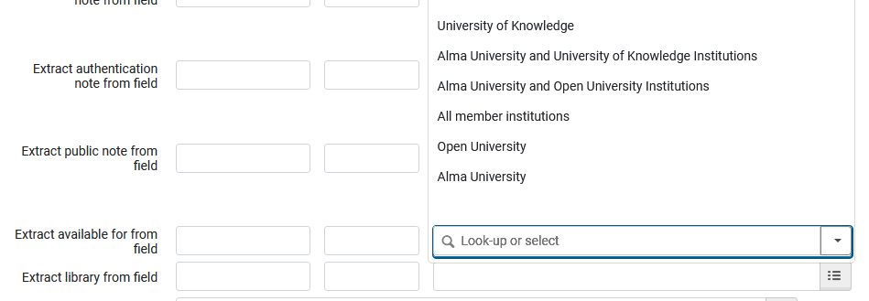
Attributing groups to a resource – Example 1
Note that in our example we manually added the "Available for" values. If the records were imported via an import profile this could be done automatically

Slide 29
Example 2

Slide 30
Attributing groups to a resource – Example 2
We are logged into the Network Zone and in the "institution" tab we see that the collection "Women and Social Movements: Development and the Global South, 1919-2019 (Video)" already exists in the Network Zone.
Electronic Collection is managed in the CZ
Edit the collection

Slide 31
Attributing groups to a resource – Example 2
While in the electronic collection editor we switch to the "group settings" tab and add the group "All member institutions" (includes all three institutions)

Slide 32
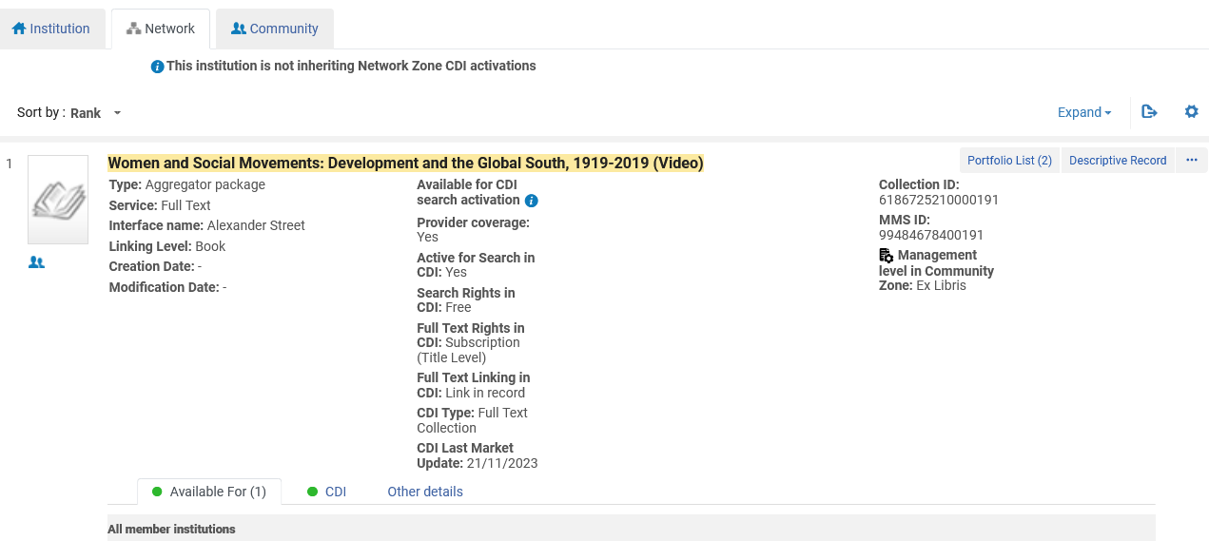
Attributing groups to a resource – Example 2
This is repository search for electronic collections while logged into one of the member institutions and searching the network tab

Slide 33
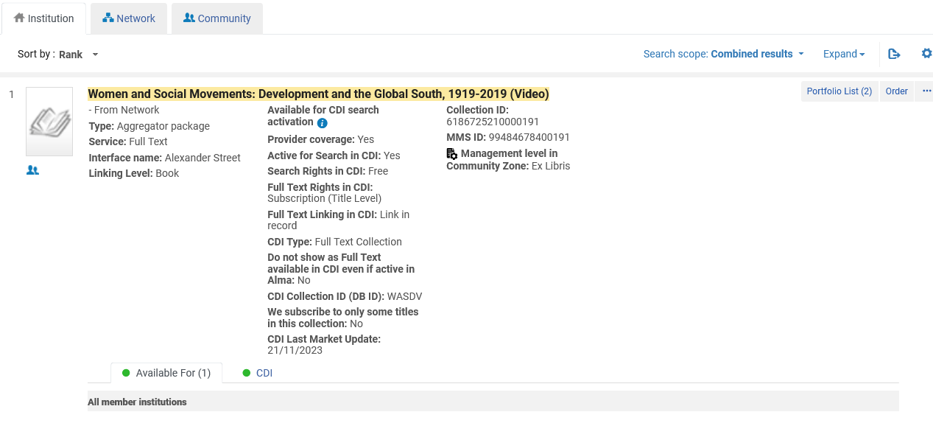
Attributing groups to a resource – Example 2
This is electronic collection repository search logged into one of the member institutions, searching the institution tab with search scope "combined results"
Indication that it is from the network

Slide 34
Example 3

Slide 35
Attributing groups to a resource – Example 3
Here we are in the institution tab of the network zone and edit existing portfolio "Feminist Phenomenology" which is in collection "Springer Nature Philosophy and Religion (R0) eBooks 2000-2004".
Electronic Collection is managed in the CZ
Edit the portfolio

Slide 36
Attributing groups to a resource – Example 3
In the "Group Settings" tab we "Add Settings For Group"

Slide 37
Attributing groups to a resource – Example 3
We added the group "Alma University and Open University Institutions" which includes institutions Alma University and Open University,

Slide 38
Attributing groups to a resource – Example 3
If we search the network zone institution for this portfolio via an "Electronic Portfolios" search we can see the "available for"

Slide 39
Attributing groups to a resource – Example 3
If we search the Network Zone tab in one of the member institutions, then we can see the "Available For"

Slide 40
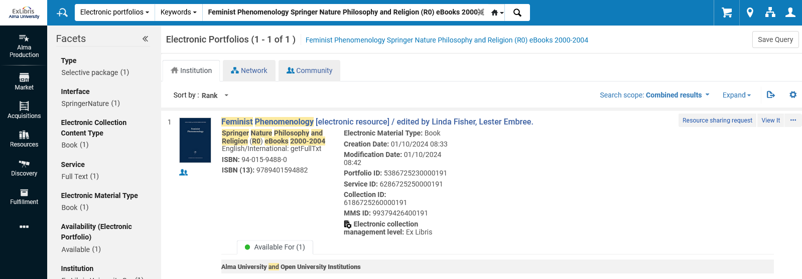
Attributing groups to a resource – Example 3
If we search the institution tab of Alma U or Open U (the institutions for whom it is available) with search scope "combined results" then we will find it.
Alma University
Combined results

Slide 41
Attributing groups to a resource – Example 3
But in U of Knowledge, for whom it is not available, we do not find it in the institution tab with search scope "combined results".
U of Knowledge
Combined results

Slide 42
Example 4

Slide 43
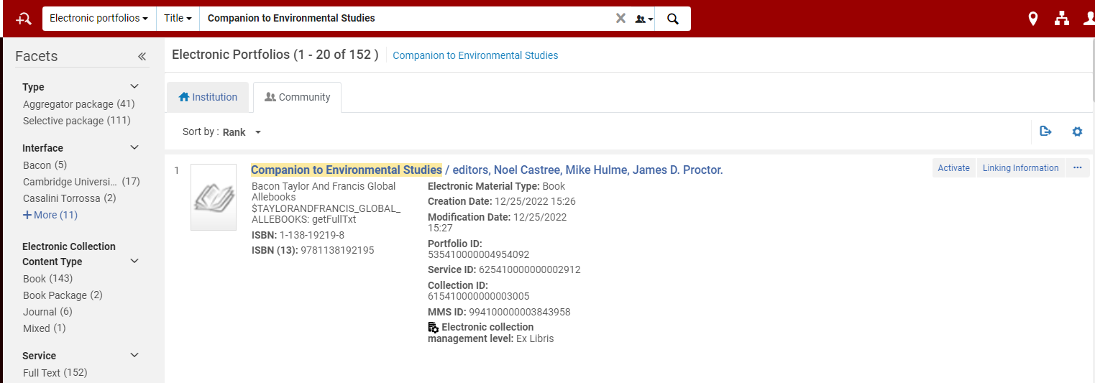
Attributing groups to a resource – Example 4
In the network institution we search the community zone for portfolio "Companion to Environmental Studies" and activate it

Slide 44
Attributing groups to a resource – Example 4
Portfolio "Companion to Environmental Studies" is now linked to the community zone. Here it is in the network institution.

Slide 45
Attributing groups to a resource – Example 4
There are no group settings.

Slide 46
Attributing groups to a resource – Example 4
If we search the network zone institution for this portfolio via an "Electronic Portfolios" search we can see that the "available for" link is greyed out

Slide 47
Attributing groups to a resource – Example 4
If we search the network zone tab in one of the member institutions, then we can also see that the "available for" link is greyed out

Slide 48
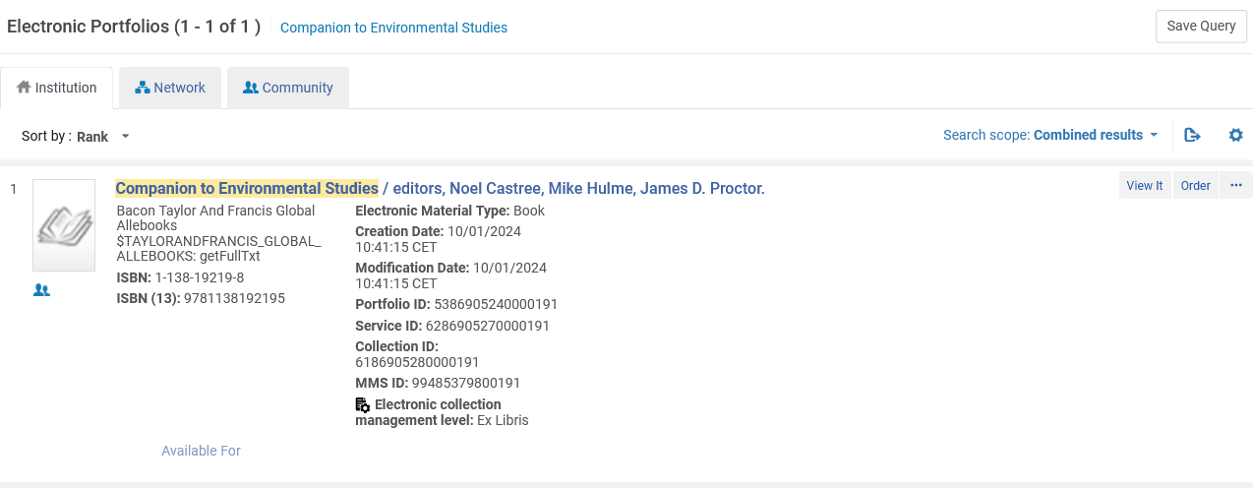
Attributing groups to a resource – Example 4
If we search the institution tab of any of the institutions using search scope "combined results" then we do find it.

Slide 49
Attributing groups to a resource – Example 4
When we do not put in an Inventory Network Group the resources is available for all institutions.
You may be asking yourself why, if putting no inventory network group means it is available for all institutions, is it necessary to use an inventory network group which includes all institutions? In other words: what is the difference between example 2 in which we used an inventory network group containing all institutions and example 4 where we used no inventory network group? They are both available for all institutions.

Slide 50
Attributing groups to a resource – Example 4
Answer: It may be a matter of consortia policy to always use inventory network groups regardless of whether the resource is available for one, some, or all institutions.
Answer: There is a difference in the repository search results when using an inventory network group and not using an inventory network group. We will see more on this later in the section on repository search.

Slide 51
The effects of the inventory network group in Primo

Slide 52
The effects of the inventory network group in Primo
We will now look at the four examples in Primo
We will see that they do and do not appear in Primo exactly according to the "Available For" Inventory Network Groups which we defined for each resource.

Slide 53
The effects of the inventory network group in Primo
Electronic collection "British and Irish Women's Letters and Diaries: Second Edition" is available only for Alma University.

Slide 54
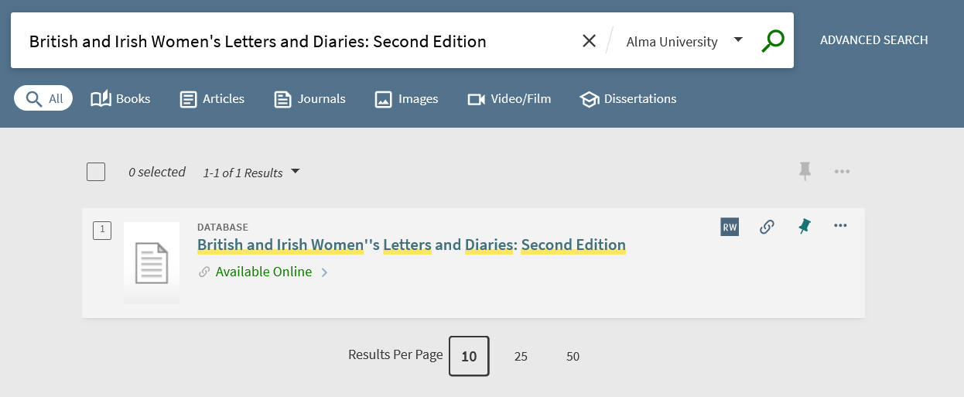
The effects of the inventory network group in Primo
It does appear in Primo for Alma University.

Slide 55
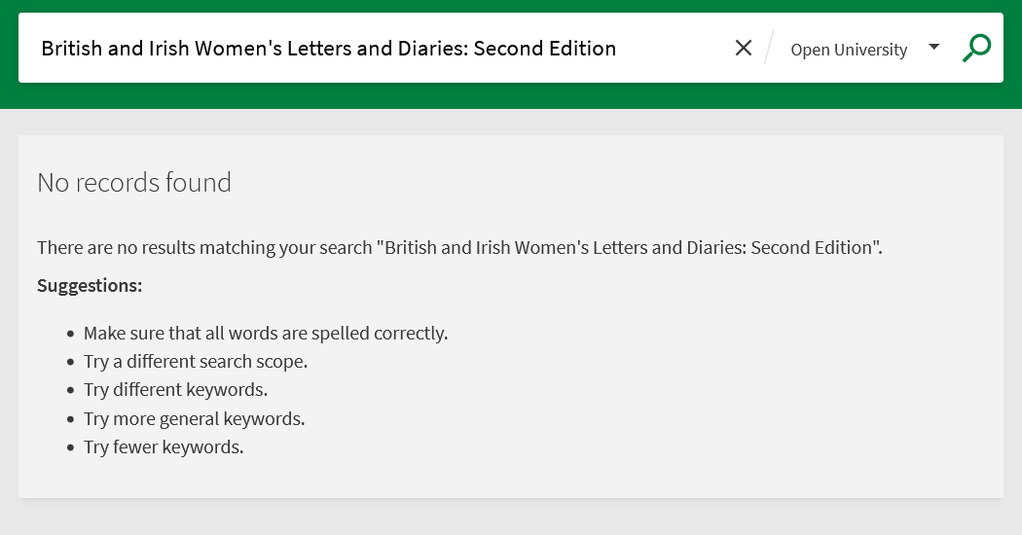
The effects of the inventory network group in Primo
It does not appear in Primo for Open University.

Slide 56
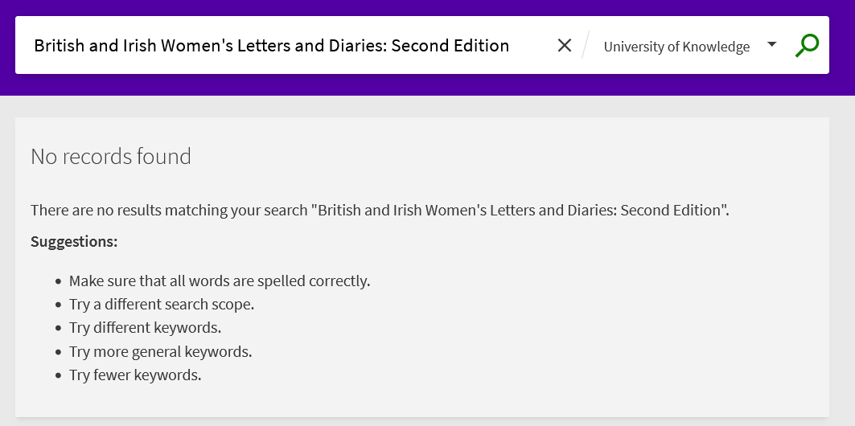
The effects of the inventory network group in Primo
It does not appear in Primo for University of Knowledge.

Slide 57
The effects of the inventory network group in Primo
Electronic collection "Women and Social Movements: Development and the Global South, 1919-2019 (Video)" is available for Alma University and Open University and University of Knowledge

Slide 58
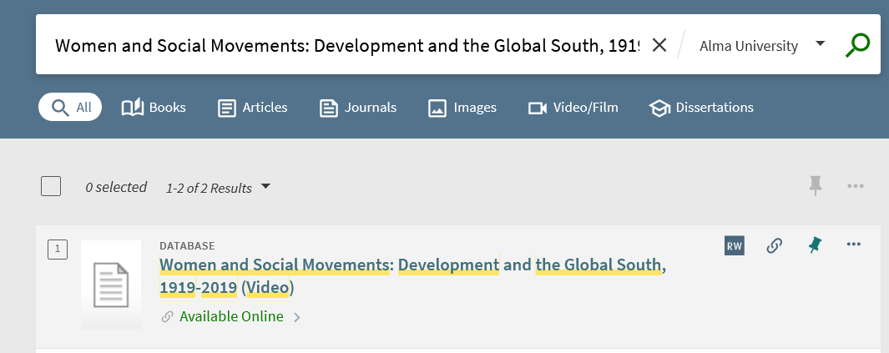
The effects of the inventory network group in Primo
It does appear in Primo for Alma University.

Slide 59
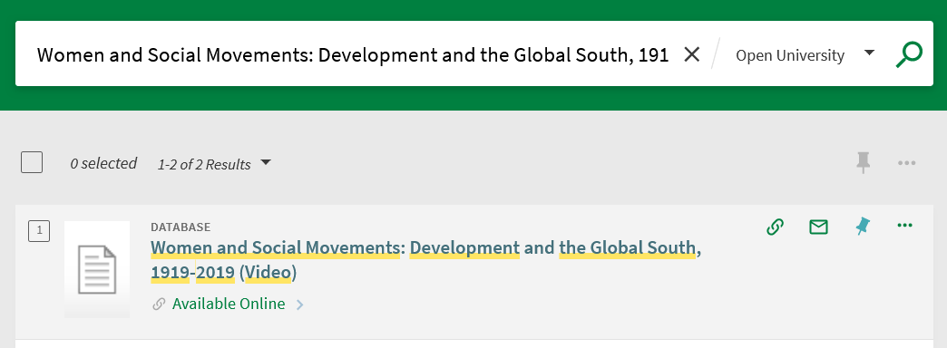
The effects of the inventory network group in Primo
It does appear in Primo for Open University.

Slide 60
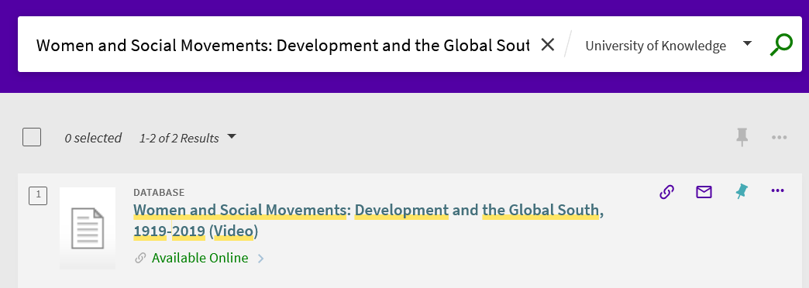
The effects of the inventory network group in Primo
It does appear in Primo for University of Knowledge.

Slide 61
The effects of the inventory network group in Primo
Electronic portfolio "Feminist Phenomenology" is available for Alma University and Open University

Slide 62
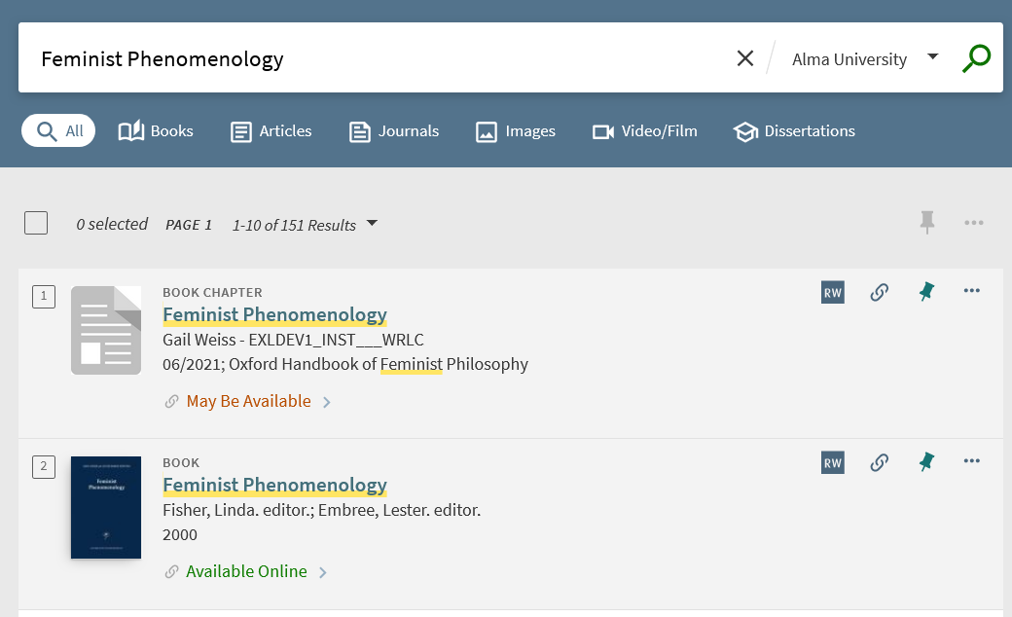
The effects of the inventory network group in Primo
It does appear in Primo for Alma University.

Slide 63
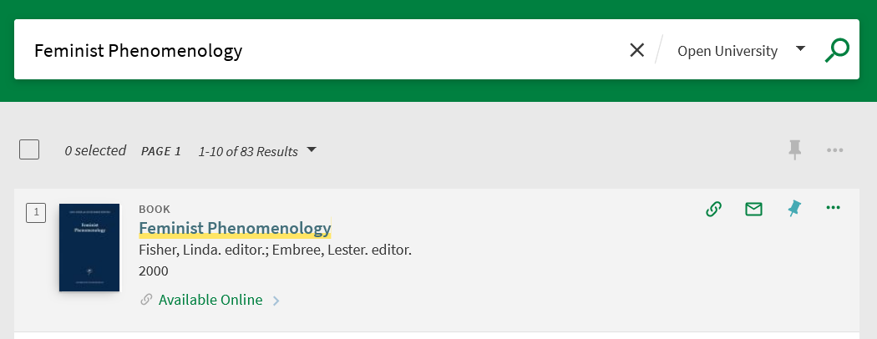
The effects of the inventory network group in Primo
It does appear in Primo for Open University.

Slide 64
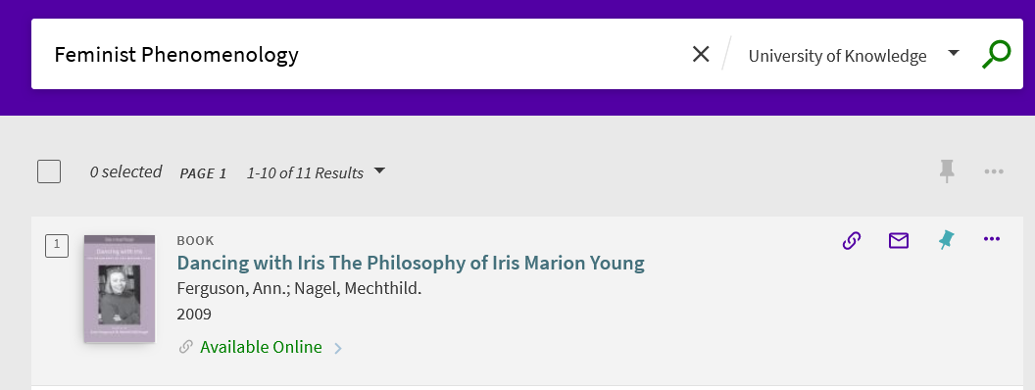
The effects of the inventory network group in Primo
It does not appear in Primo for University of Knowledge.
These are other results which contain the string

Slide 65
The effects of the inventory network group in Primo
Electronic portfolio "Companion to Environmental Studies" has no group settings and therefore is available for all institutions

Slide 66
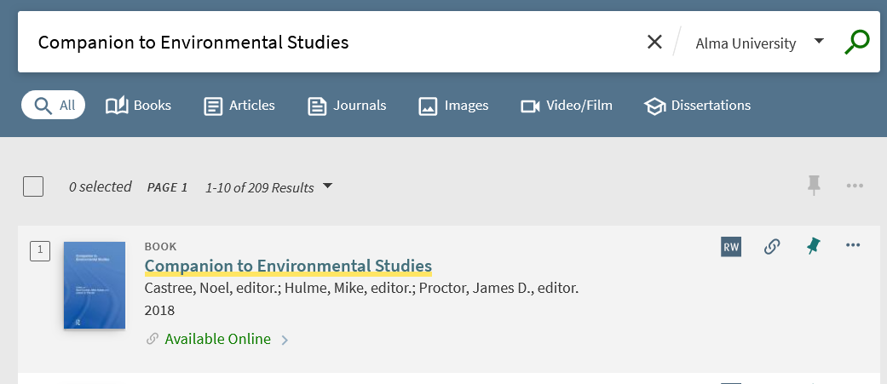
The effects of the inventory network group in Primo
It does appear in Primo for Alma University.

Slide 67
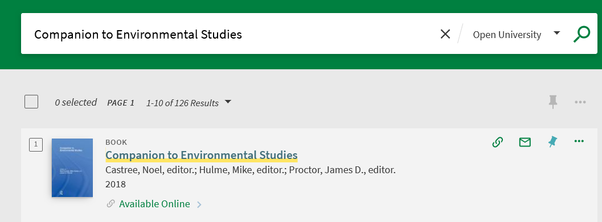
The effects of the inventory network group in Primo
It does appear in Primo for Open University.

Slide 68
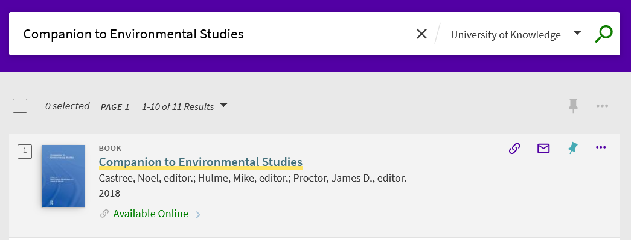
The effects of the inventory network group in Primo
It does appear in Primo for University of Knowledge.

Slide 69
Repository search

Slide 70
Repository search
For electronic collections, these four fields may be searched:
Collection Available for group
Collection Available explicitly for group
Collection available for
Collection available explicitly for
For electronic portfolios, these four fields may be searched:
Available for
Available for group
Available explicitly for
Available explicitly for group

Slide 71
Repository search
The indexes which are "for group" search by the name of the inventory network group (which may contain multiple institutions).
The indexes which are "for" search by the name of the institution which is in the group.
You can read more abut these fields at Search Fields , which is part of Searching In Alma .

Slide 72
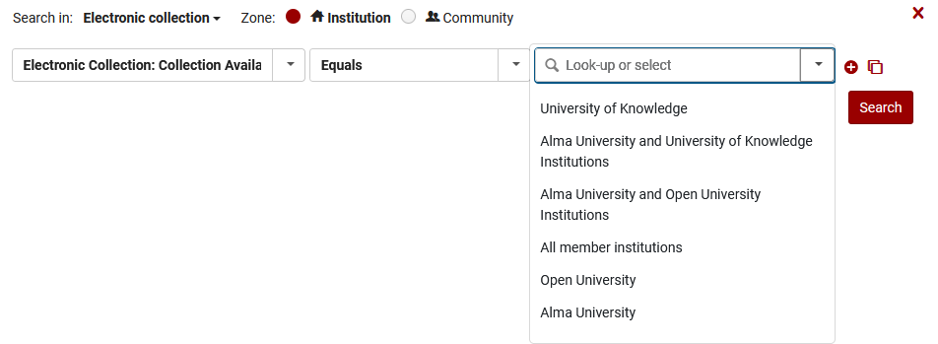
Repository search
This is an Electronic Collection advanced search by "Collection Available For Group"
These are our Inventory Network Groups

Slide 73
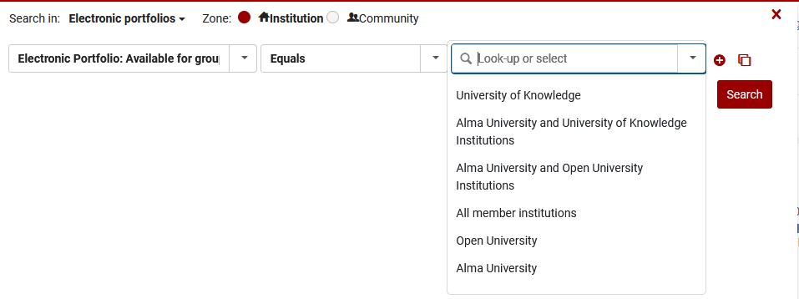
Repository search
This is an Electronic Portfolio advanced search by "Portfolio Available For Group"
These are our Inventory Network Groups

Slide 74
Repository search
Note that in addition to
Collection Available For Group
Portfolio Available For Group
There are also fields
Collection Available Explicitly For Group
Portfolio Available Explicitly For Group
The "Explicitly" means "Only"

Slide 75
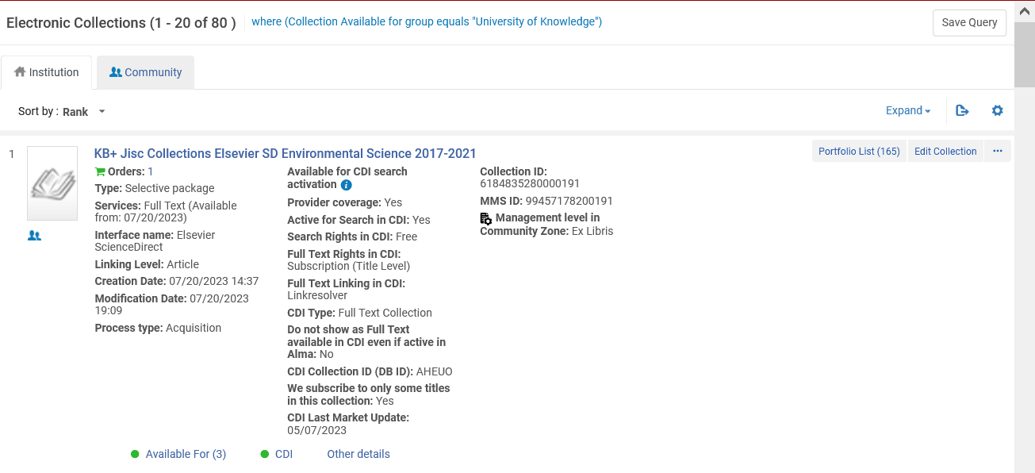
Repository search
These are collections available for group "University of Knowledge" and also perhaps other groups.

Slide 76
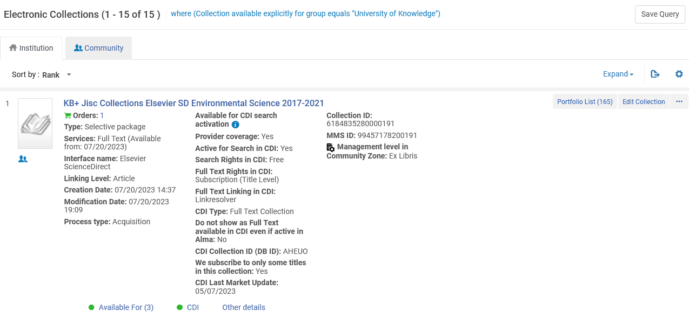
Repository search
These are collections available only for group "University of Knowledge".

Slide 77
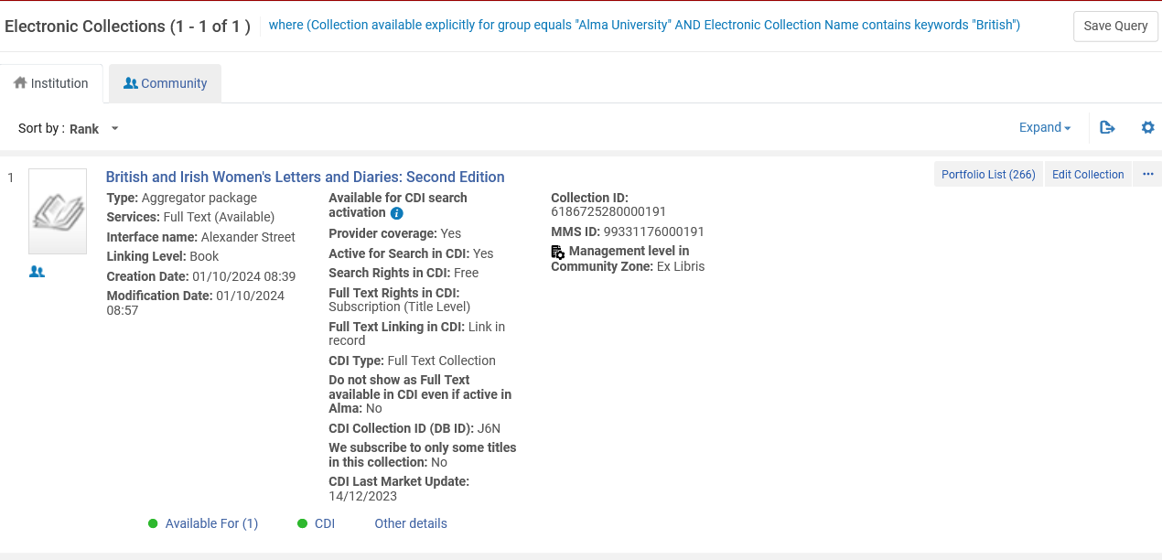
Repository search
This is the Electronic Collection that we made available only for group "Alma University"

