Slide 1
Alma Collaborative Network and Shared Catalog for Network Zone Consortia
Yoel Kortick
Senior Librarian

Slide 2
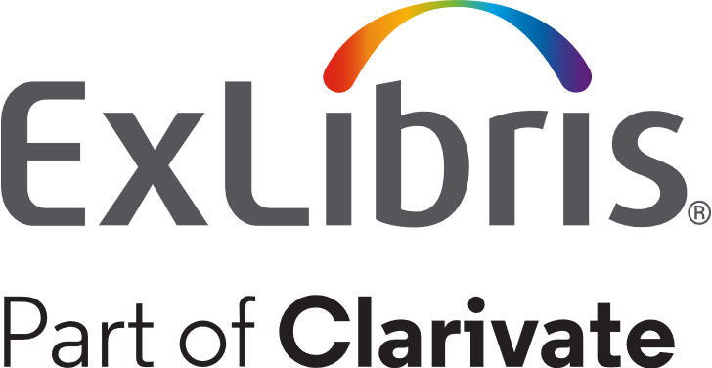
Agenda
Introduction
Repository search in Member Institution and Network Zone
Linking from My Institution to a Network Zone record

Slide 3
Introduction

Slide 4
Introduction
Alma supports data sharing and collaboration across institutions in a streamlined manner.
The Alma Network Zone (NZ) enables bibliographic data to be shared between collaborating institutions of the same Network Zone Consortia for cataloging and inventory purposes.
As part of the NZ, a Network tab appears as part of the Repository Search. Using this tab, collaborating institutions can search for resources within their shared network.

Slide 5
Introduction
The collaboration among the members of the consortia is not only related to bibliographic data but also to other aspects of library management such as
Acquisitions
Management of electronic resources
Resource sharing
Fulfillment and sharing of patrons

Slide 6
Introduction
This presentation will focus on the Shared Catalog in the framework of a Network Zone Consortia
Members of a Shared Catalog in the framework of a Network Zone Consortia are working together by managing a shared catalog in Alma to describe their institutional holdings
The shared catalog is a way to maximize cooperation, integration and sharing between institutions in a network
It still allows institutions to maintain local privacy and ownership of data

Slide 7
Introduction
In the example here we have a network zone and three member institutions:
Member / Network | Name | Inst. Code
Network | Ex Libris University Consortium | EXLDEMO2_INST
Member | Alma University | EXLDEV1_INST
Member | Open University | EXLDEMO3_INST
Member | University of Knowledge | EXLDEMO1_INST

Slide 8
Introduction
Network Zone
Ex Libris University Consortium
Member Institution
Alma University
Member Institution
Open University
Member Institution
University of Knowledge

Slide 9
Repository search in Member Institution and Network Zone

Slide 10
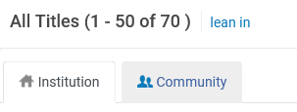
Repository search in Member Institution and Network Zone
In the following examples we will look at the "Institution" tab and the "Network" tab.
The "Network" tab only appears for institutions which are members of a Network Zone Consortia.
Part of a Network Zone Consortia | Not Part of a Network Zone Consortia

Slide 11
Repository search in Member Institution and Network Zone
Here is a search done by member institution "Open University" for records with "Taiwan" in the title.
The search is done in the "Network" scope.

Slide 12
Repository search in Member Institution and Network Zone
The results then show which consortia member intuitions have inventory for the record. This is in the "Held By" tab.
Here is title "Taiwan Review"
This resource is held by two institutions:
My Institution (Open University)
University of Knowledge

Slide 13
Repository search in Member Institution and Network Zone
Here is title "Taiwan Today"
This resource is held by all three institutions:
My Institution (Open University)
Alma University
University of Knowledge

Slide 14
Repository search in Member Institution and Network Zone
Here is title "Taiwan communications"
This resource is held by one institution:
Alma University

Slide 15
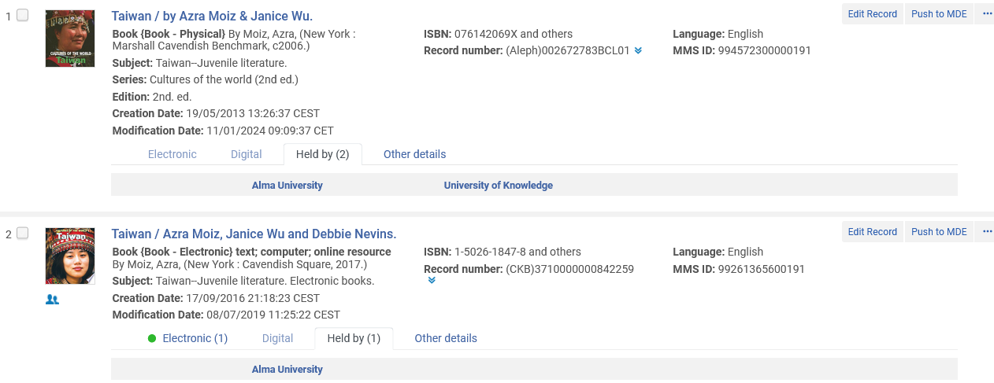
Repository search in Member Institution and Network Zone
Clicking the "Held By" link provides details of the inventory in holding institution
We are still searching the Network Zone scope from member institution "Open University.
Member institutions "Alma University" and "University of Knowledge" have inventory for this record
Member institution "Alma University" has inventory for this record

Slide 16
Repository search in Member Institution and Network Zone
While still searching the Network Zone scope from member institution "Open University" we will click "University of Knowledge" to get details of the inventory at "University of Knowledge"

Slide 17
Repository search in Member Institution and Network Zone
We now see details of the physical inventory at "University of Knowledge". We know it is physical inventory because it is in a "Holdings" tab.
We also see that for this record there is no inventory of other types
We also see which other institutions have inventory for this record and can click the link to the institution for details

Slide 18
Repository search in Member Institution and Network Zone
While still searching the Network Zone scope from member institution "Open University" we will click "Alma University" to get details of the inventory at "Alma University"

Slide 19
Repository search in Member Institution and Network Zone
We now see details of the inventory at "Alma". We know it is electronic inventory because it is in a "Portfolios" tab.

Slide 20
Repository search in Member Institution and Network Zone
Note also the "Click to view record in institution" icon.
This icon is displayed in the Network tab if the record is linked to the Member Institution which is searching the Network Zone scope.
We are still searching the Network Zone scope from member institution "Open University"

Slide 21
Repository search in Member Institution and Network Zone
The reason that the "Click to view record in institution" icon appears is because:
It is "held by" Member Institution "Open University".
We are still searching the Network Zone scope from member institution "Open University"

Slide 22
Repository search in Member Institution and Network Zone
After clicking the "Click to view record in institution" icon we are brought to the "Institution" search scope with the record retrieved.
We also have an icon "Click to view record in network"

Slide 23
Repository search in Member Institution and Network Zone
After clicking the "Click to view record in network" icon we are brought to the "Network" search scope with the record retrieved.

Slide 24
Repository search in Member Institution and Network Zone
This record does not have a "Click to view record in institution" icon when searching the network zone search scope.
No icon

Slide 25
Repository search in Member Institution and Network Zone
It does not have a "Click to view record in institution" icon because it is not held by "My Institution" (Member Institution "Open University")
Not held by My Institution

Slide 26
Linking from My Institution to a Network Zone record

Slide 27
Linking from My Institution to a Network Zone record
We will now show that if there is a bibliographic record in the network zone and we do not have inventory for this bibliographic record in our member institution then we can
Search for and find the record in the network zone and then either
Click "Catalog" and then from the metadata editor add inventory
Click "Order" and then create a POL which includes inventory
The bibliographic record in the network zone will then appear with "Held By" and "My Institution".
It is also possible to link from the Member Institution to the Network Zone record without adding inventory.

Slide 28
Linking from My Institution to a Network Zone record
Title "History of contemporary Taiwan Women Artists" does not have inventory in my institution.
We are still searching the network scope from member institution "Open University".

Slide 29
Linking from My Institution to a Network Zone record
We can add inventory in our Member Institution for this record by clicking "edit" and then adding inventory in the metadata editor.
We can also add inventory in our Member Institution by clicking "order"
We will click "Edit Record"

Slide 30
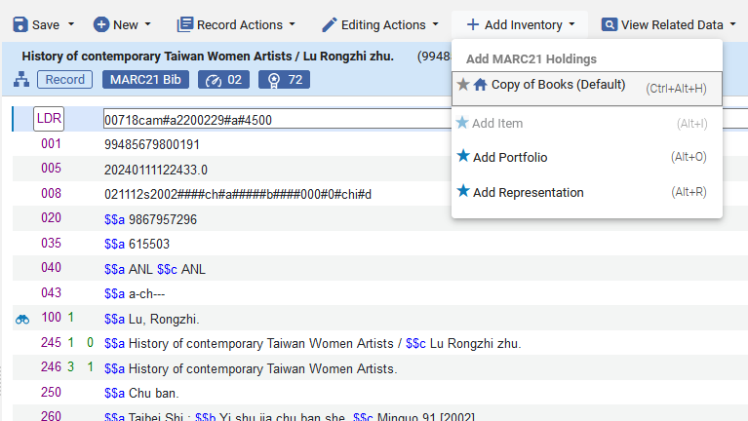
Linking from My Institution to a Network Zone record
The record opens in the metadata editor, and we will add inventory

Slide 31
Linking from My Institution to a Network Zone record
Now title "History of contemporary Taiwan Women Artists" does have inventory in my institution.

Slide 32
Linking from My Institution to a Network Zone record
Title "Haunted modernities gender, memory, and placemaking in postindustrial Taiwan" does not have inventory in my institution.
We are still searching the network scope from member institution "Open University".

Slide 33
Linking from My Institution to a Network Zone record
We can add inventory in our Member Institution for this record by clicking “order" and then creating an order which has inventory.
We will click "Order"

Slide 34
Linking from My Institution to a Network Zone record
We create an order which includes inventory.

Slide 35
Linking from My Institution to a Network Zone record
Now title "Haunted modernities gender, memory, and placemaking in postindustrial Taiwan" does have inventory in my institution.

Slide 36
Linking from My Institution to a Network Zone record
We will now see how is also possible to link from the Member Institution to the Network Zone record without adding inventory.
We are in Member Institution "Open University" and do not have title "The legal culture and system of Taiwan"

Slide 37
Linking from My Institution to a Network Zone record
Title "The legal culture and system of Taiwan" does exist in the Network Zone and is Held By Member Institution "University of Knowledge"
We will click the title

Slide 38
Linking from My Institution to a Network Zone record
After clicking the title, we have several options. One option is "Link"
We will click "Link"
After clicking "Link" we get this message:

Slide 39
Linking from My Institution to a Network Zone record
Now when we are in Member Institution "Open University" we do have title "The legal culture and system of Taiwan", but with no inventory
We also have the icon "Click to view record in network"

Slide 40
Linking from My Institution to a Network Zone record
From the network we have the icon "Click to view record in institution", but the "Held By" does not show inventory for "My Institution".
We also have the icon "Click to view record in institution"

Slide 41
Linking from My Institution to a Network Zone record
It is also possible to link a record from the Member Institution to the Network Zone.
On the next slide we see that title "Travel guided Taiwan" is in the Member Institution "Open University" but not in the Network Zone.

Slide 42
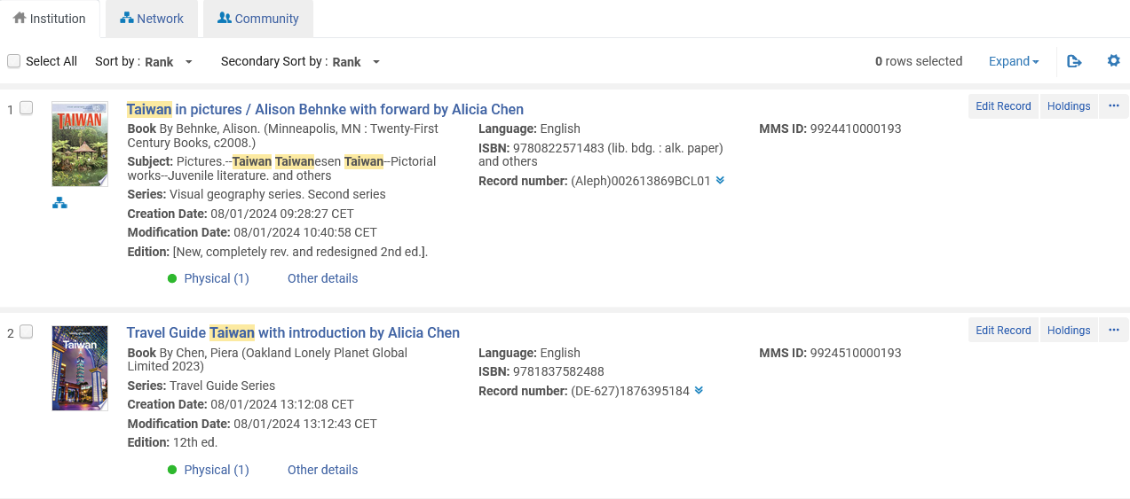
Linking from My Institution to a Network Zone record
This record is linked to the Network Zone
This record is not linked to the Network Zone

Slide 43
Linking from My Institution to a Network Zone record
We will edit the record which is not linked to the Network Zone

Slide 44
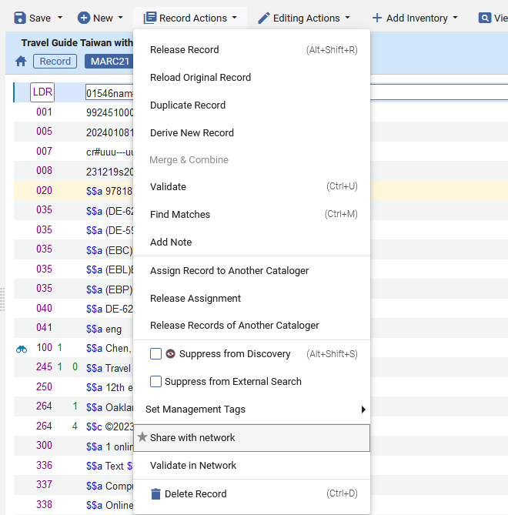
Linking from My Institution to a Network Zone record
We then choose "Record Actions > Share with network"

Slide 45
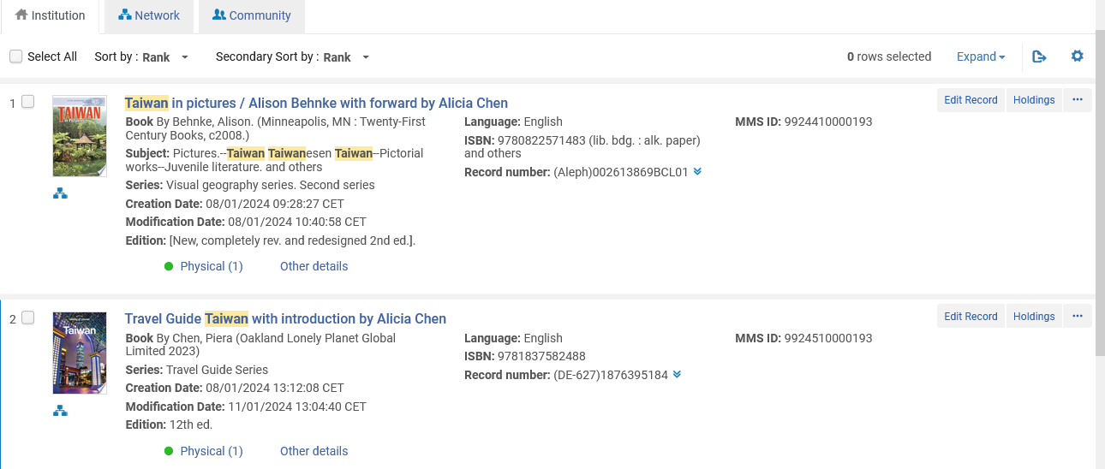
Linking from My Institution to a Network Zone record
Now the record is shared with the Network Zone

Slide 46
Linking from My Institution to a Network Zone record
Here is the record in the Network Zone

