Slide 1
Acquisitions Infrastructure - Vendors
Yoel Kortick
Senior Librarian

Slide 2
Agenda
Roles for managing vendors
The Search Vendors page
Vendor Accounts
Vendor Types
The Vendor Interface

Slide 3
Roles for managing vendors

Slide 4
Roles for managing vendors
To manage vendors and vendor accounts, the staff user must have the "Vendor Manager" role:

Slide 5
The Search Vendors page

Slide 6
The Search Vendors page
Vendors are managed from the "Search Vendors" page.
The "Search Vendors" page can be accessed in two ways:
Via menu "Acquisitions > Acquisitions Infrastructure > Vendors"
By searching for a vendor

Slide 7
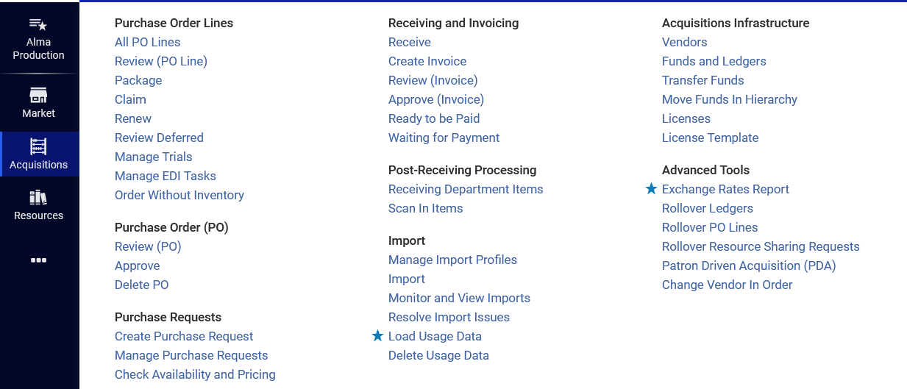
The Search Vendors page
Via menu "Acquisitions > Acquisitions Infrastructure > Vendors"

Slide 8
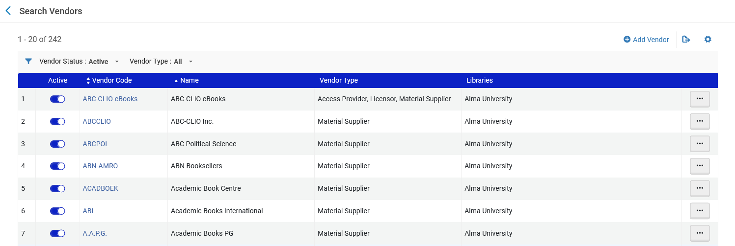
The Search Vendors page
Via menu "Acquisitions > Acquisitions Infrastructure > Vendors"
Includes by default all active vendors

Slide 9
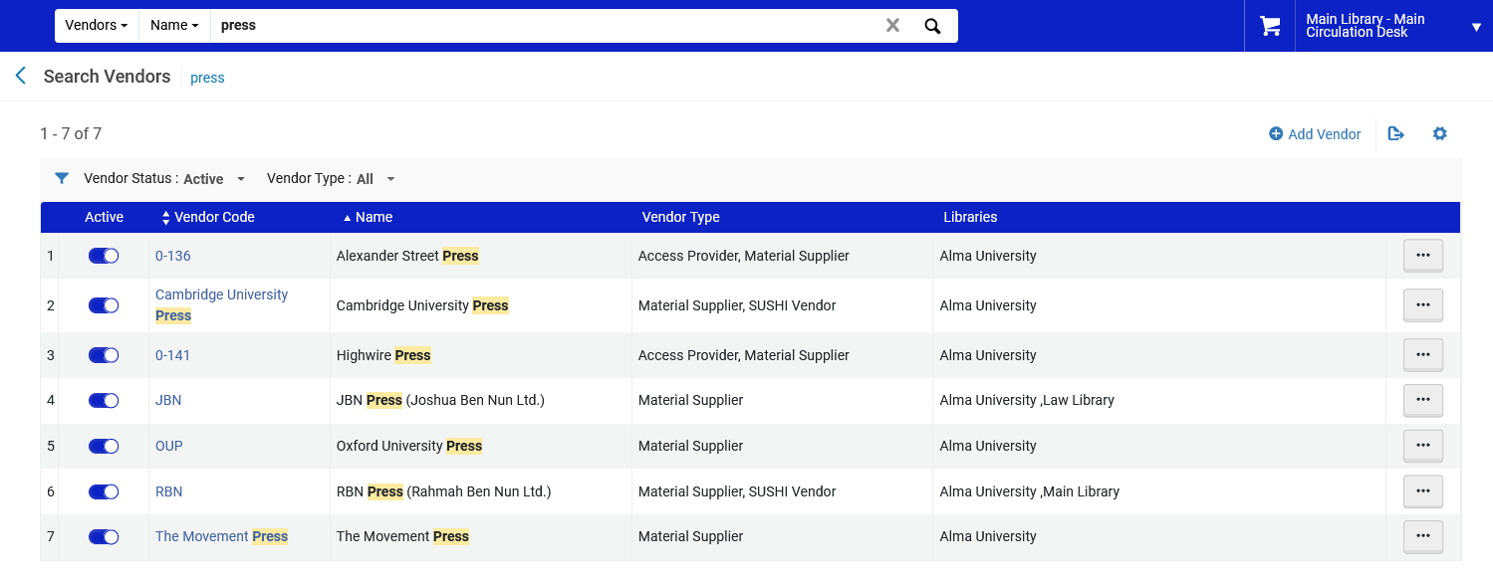
The Search Vendors page
By searching for a vendor
Includes by default all active vendors

Slide 10
Vendor accounts

Slide 11
Vendor accounts
Every POL (Purchase Order Line) in Alma must have a vendor that will supply the order.
Therefore, before creating a purchase order, the institution must create entries in Alma for the vendor.
For each vendor, there must be at least one vendor account.
The vendor account represents specific purchasing accounts at the vendor (for example one vendor may have one account for journals and one account for monographs).
We will now look at one vendor with several accounts

Slide 12
Vendor accounts
One vendor

Slide 13
Vendor accounts
Several accounts

Slide 14
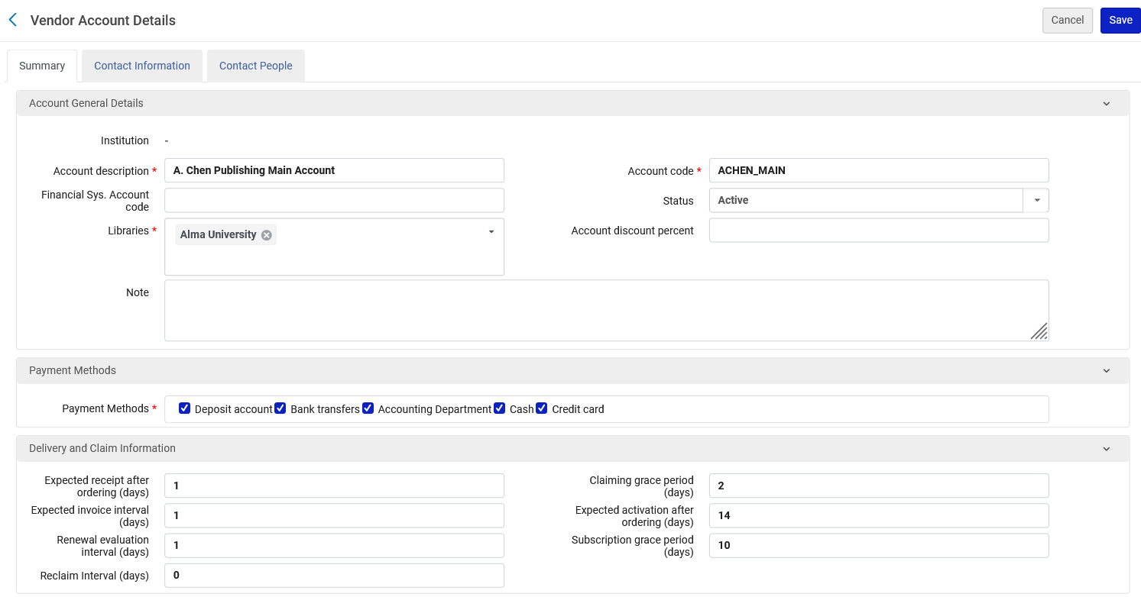
Vendor accounts
Each vendor account, for example, can have different Contact Information, Payment methods and Delivery and Claim information

Slide 15
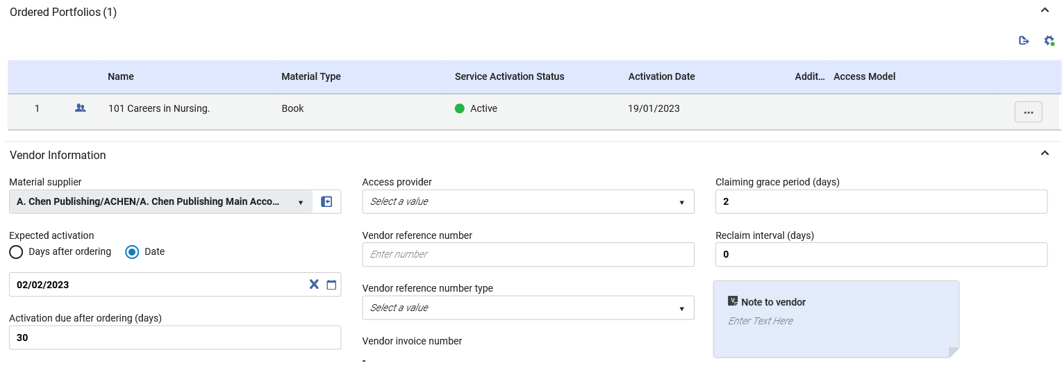
Vendor accounts
The vendor account is chosen in the POL when choosing the vendor

Slide 16
Vendor types

Slide 17
Vendor types
There are five types of vendors, and each vendor may be multiple types:

Slide 18
Vendor types
The vendor types are (see also Adding a Vendor and Vendor Account):
Material Supplier – Supplies the material or the subscription to the material. A material supplier receives orders and payment for resources in all formats.
Access Provider – Provides access to electronic resources.
Licensor – Provides licenses to other vendors' electronic resources. See Managing Licenses and Amendments.

Slide 19
Vendor types
Governmental – Provides material or access, and receives use tax (VAT) for an invoice payment from non-governmental vendors. See Adding a Vendor and Vendor Account.
SUSHI Vendor – Provides COUNTER (Counting Online Usage of NeTworked Electronic Resources) compliant usage statistics. See Managing COUNTER-Compliant Usage Data.

Slide 20
The Vendor Interface

Slide 21
The Vendor Interface
A vendor interface (sometimes known as a platform) is a framework in which the vendor supplies electronic collections and resources to the institution.
When ordering an electronic resource (Manually Creating a PO Line), it is possible to associate the PO line to the vendor interface using the Access provider field.
It is also possible to later (after creating the PO Line) to associate an electronic resource to the vendor interface using the Interface name field.

Slide 22
The Vendor Interface
Managing an interface includes configuring interface information and the administrative access to these interfaces at the vendor's system.
The configuration does not include the access to the resources themselves, which is configured when editing an electronic resource's service (see Adding a Local Electronic Collection).
The majority of the information in the vendor interface is for informational purposes only and has no effect on Alma's functionality.
For a list and description of the fields in the interface see "Administrative Information Fields" at Editing Vendor Interface Information

Slide 23
The Vendor Interface
In order to be able to add a vendor interface to a vendor the vendor must be of type "Access Provider"

Slide 24
The Vendor Interface
Here we have added an interface to the vendor "A. Chen Publishing "called "A. Chen Publishing Interface"

Slide 25
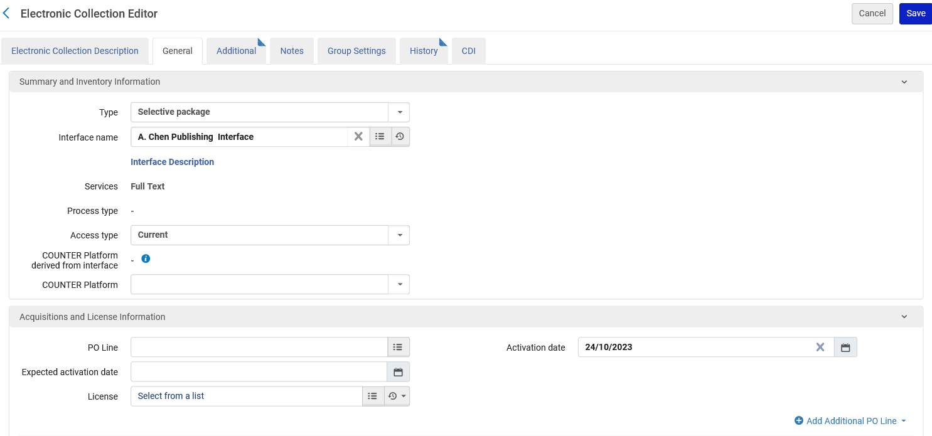
The Vendor Interface
In the electronic collection "Resources about barbecuing" we have added the interface "A. Chen Publishing Interface"

Slide 26
The Vendor Interface
After adding the vendor interface to an electronic resource, it will appear in the "Inventory" tab of the Vendor Interface

