Slide 1
Acquisitions Infrastructure – Funds and Ledgers
Yoel Kortick
Senior Librarian

Slide 2
Agenda
Roles for managing Funds and Ledgers
The Funds and Ledgers page
Fund and Ledger hierarchies – explained
Fund and Ledger hierarchies – real examples

Slide 3
Roles for managing Funds and Ledgers

Slide 4
Roles for managing Funds and Ledgers
To manage funds the staff user must have the following role:
Fund Manager
Fund-Ledger Viewer (view only)
To manage ledgers the staff user must have the following role:
Ledger Manager
Fund-Ledger Viewer (view only)
The role's scope may limit the staff user to funds or ledgers available only to particular libraries.

Slide 5
Roles for managing Funds and Ledgers

Slide 6
The Funds and Ledgers page

Slide 7
The Funds and Ledgers page
The funds and ledgers are managed on the Funds and Ledgers page.
This page can be accessed via one of the following ways:
Acquisitions > Acquisitions Infrastructure > Funds and Ledgers
Search for a fund in the persistent search box.

Slide 8
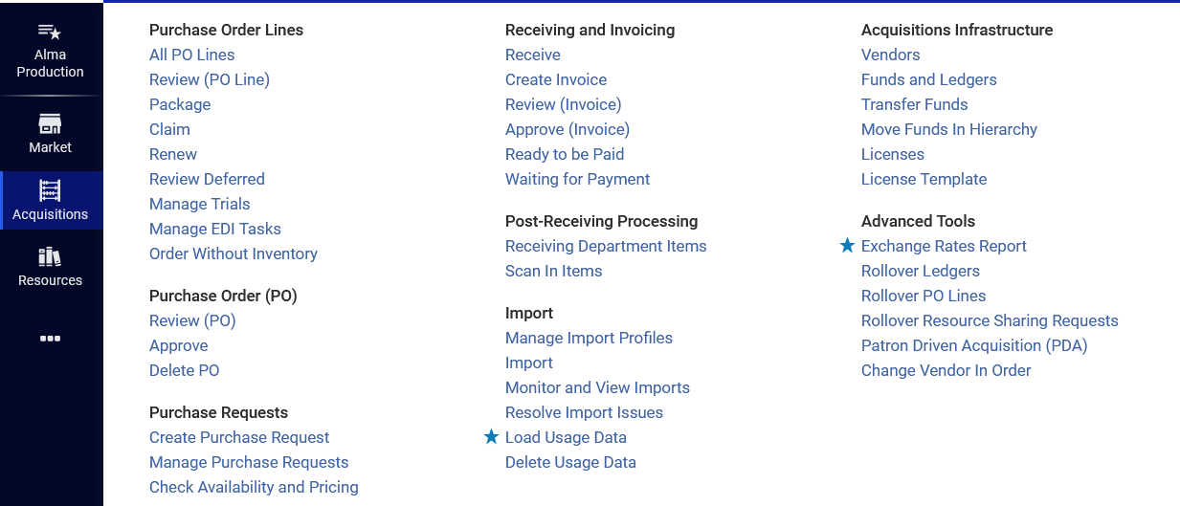
The Funds and Ledgers page
Via menu "Acquisitions > Acquisitions Infrastructure > Funds and Ledgers"

Slide 9
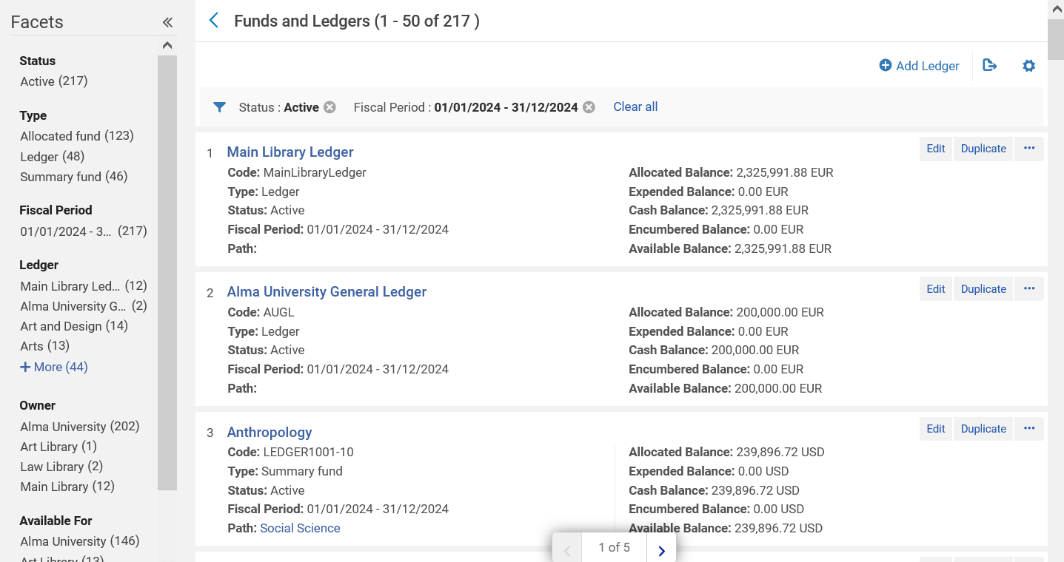
The Funds and Ledgers page
Via menu "Acquisitions > Acquisitions Infrastructure > Funds and Ledgers"
Includes by default all active funds and ledgers for current fiscal period

Slide 10
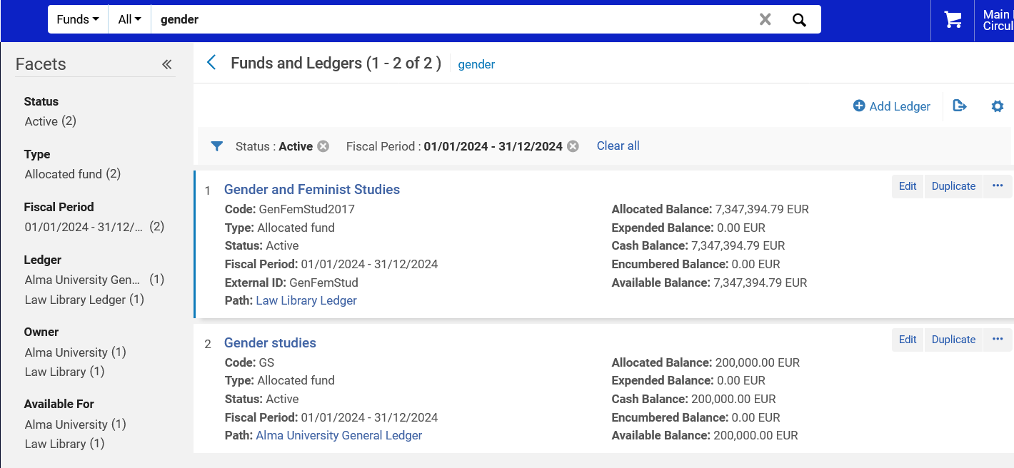
The Funds and Ledgers page
Search for a fund or ledger in the persistent search box brings the same page but includes only funds and ledgers matching the search.
Includes by default all active funds and ledgers for current fiscal period

Slide 11
Fund and Ledger hierarchies - explained

Slide 12
Fund and Ledger hierarchies - explained
A fund represents "money in an account".
A fund can be of type "allocated" or "summary".
A summary fund is a collection of allocated funds.
A ledger is a collection of funds, both of type "allocated" or "summary".
Ledgers are defined for a specific fiscal period.

Slide 13
Fund and Ledger hierarchies - explained
The Ledger is the highest level of the hierarchy.
The Ledger has under it Summary Funds and / or Allocated Funds
The Summary Fund is the middle level of the hierarchy.
The Summary Fund is below the Ledger and above the Allocated Fund.
The Allocated Fund is the lowest level of the hierarchy.
The Allocated Fund is either directly under the Summary Fund or directly under the Ledger.

Slide 14
Fund and Ledger hierarchies - explained
Ledger
Summary Fund
Allocated Fund
Allocated Fund
Allocated Fund
Ledger
Summary Fund
Summary Fund
Allocated Fund
Allocated Fund
Allocated Fund
Allocated Fund
Allocated Fund
Allocated funds are where all transactions occur

Slide 15
Fund and Ledger hierarchies – real examples

Slide 16
Fund and Ledger hierarchies – real examples
A fund can be allocated or summary.
A summary fund is not used for ordering and invoicing but provides aggregate reporting on subordinate funds.
An allocated fund contains money that has been paid out or has been reserved for an open purchase.
A Ledger Fund can be associated with a Summary or Allocated Fund.
A Summary Fund can only be associated with an Allocated Fund.
A specific Allocated Fund can only be associated with only one Ledger or Summary Fund, but not both.

Slide 17
Fund and Ledger hierarchies – real examples
Here is the situation we will now see
Alma University General Ledger
(Ledger)
Technology and Information Science
(Summary Fund)
Feminist and Gender Studies
(Summary Fund)
Feminist studies
(Allocated fund)
Gender studies
(Allocated fund)
Computer science
(Allocated fund)
Information science
(Allocated fund)

Slide 18
Fund and Ledger hierarchies – real examples
"Alma University General Ledger" is a ledger

Slide 19
Fund and Ledger hierarchies – real examples
Ledger "Alma University General Ledger" includes 6 funds: Two Summary Funds and four Allocated Funds

Slide 20
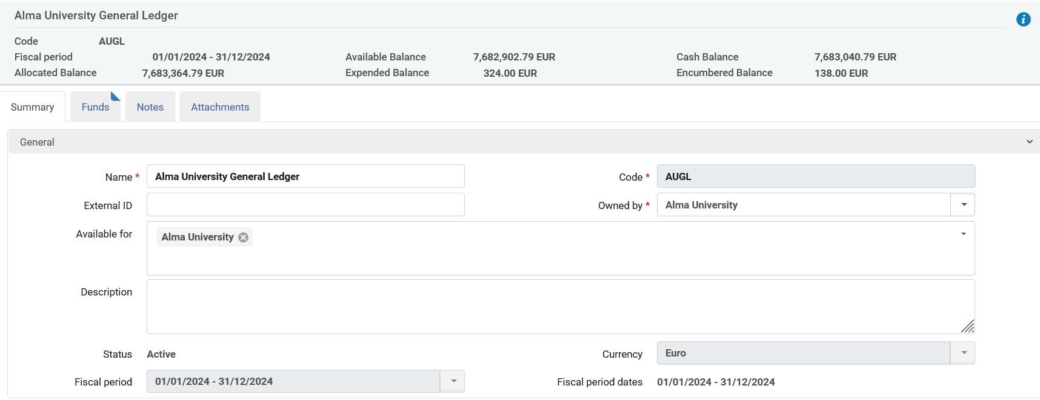
Fund and Ledger hierarchies – real examples
These balances reflect an aggregation of all funds "under" the ledger.
Funds associated with this ledger can be used for POLs associated with any library in the institution (Alma University)

Slide 21
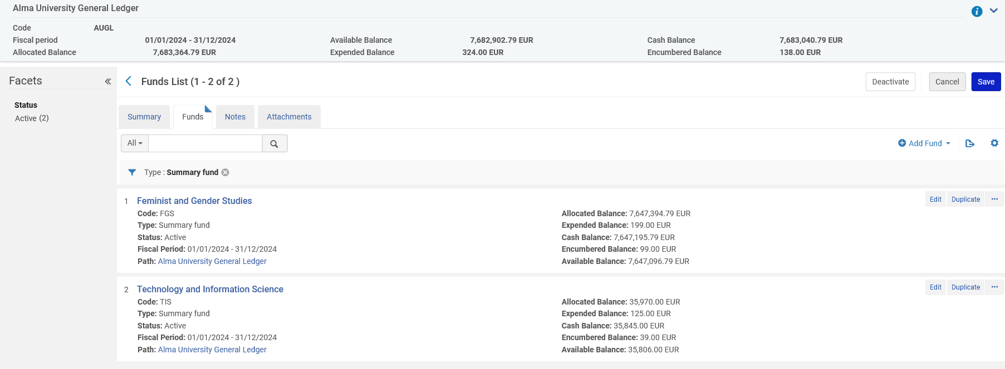
Fund and Ledger hierarchies – real examples
"Feminist and Gender Studies" and "Technology and Information Science" are examples of a summary funds under ledger "Alma University General Ledger"
These balances reflect an aggregation of all allocated funds "under" the summary fund.

Slide 22
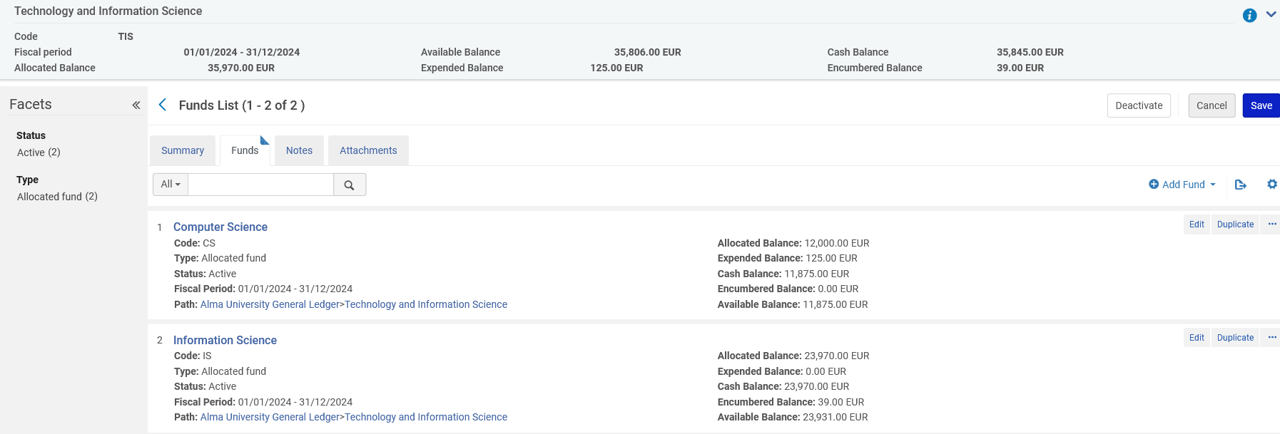
Fund and Ledger hierarchies – real examples
Law All Accounts Summary
Under summary fund "Technology and Information Science" there are two allocated funds
These balances reflect an aggregation of all two allocated funds "under" the summary fund.

