Slide 1
How to order and activate and invoiced an electronic collection from the Community Zone
Yoel Kortick
Senior Librarian

Slide 2
Introduction
The steps (high level)
Ordering the resource - type "one time"
Activating the resource - type "one time"
The process is complete - type "one time"
Ordering the resource - type "subscription"
Activating the resource - type "subscription"
The process is complete - type "subscription"
Invoicing (paying for) the orders
Invoicing (paying for) the orders – one time
Invoicing (paying for) the orders – subscription
Agenda

Slide 3
Introduction

Slide 4
Introduction
In this example we will create an acquisitions order for an electronic collection from the Community Zone and activate the electronic collection.
Note that in this example we will both order and activate the electronic collection, but it is also possible to only activate the electronic collection and not also create an acquisitions order.
We will also invoice (pay for) the order.

Slide 5
Introduction
The prerequisite here is that there exists in Alma both a vendor from whom to order the electronic collection and a fund to use in the order.
In one case we will order an electronic collection of type "One Time", then in a second case we will order an electronic collection of type "subscription".

Slide 6
The steps (high level)

Slide 7
The steps (high level)
In our example here we want to order the electronic collection "Caribbean Literature".
First, we will confirm that we do not already have this electronic collection by searching for it in the repository (Institution Zone).
After confirming that we do not already have the electronic collection we will search for it in the Community Zone.
After finding the electronic collection in the Community Zone we will create the order and then activate the electronic collection.
After activation, the electronic collection will be available in discovery for end users to access it.

Slide 8
Ordering the resource - type "one time"

Slide 9
Ordering the resource - type "one time"
We search for the electronic collection in the repository (in the Institution Zone) and do not find it.
Searching the institution
The electronic collection is not present

Slide 10
Ordering the resource - type "one time"
We search for the electronic collection in the Community Zone and do find it.
Searching the Community Zone

Slide 11
Ordering the resource - type "one time"
From the Community Zone record we will click "Order"

Slide 12
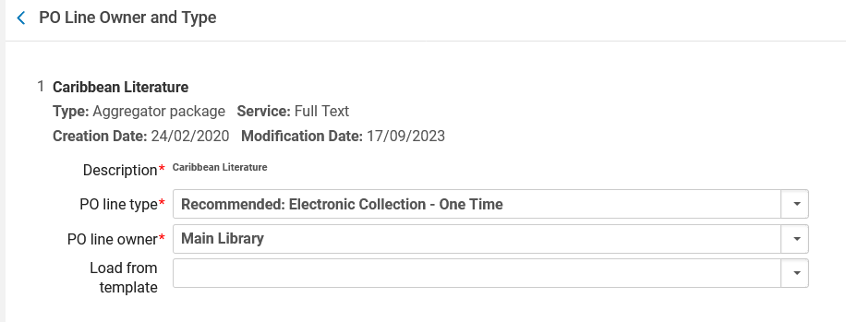
Ordering the resource - type "one time"
Create and send the order
In this example we are choosing PO line type "Electronic Collection – One Time"

Slide 13
Ordering the resource - type "one time"
We will leave the defaults in the "PO Line Information" section
Regarding the "Acquisition method" see Acquisition Methods at Manually Creating a PO Line
The default from the CZ for this electronic collection is that the material type is "Book Package"

Slide 14
Ordering the resource - type "one time"
The "Ordered Collections" section includes the electronic collection we are ordering, and it is currently not activated.
"Service Activation Status" is "Not active". We will activate it later.

Slide 15
Ordering the resource - type "one time"
In the "Vendor Information" section we choose the "Material supplier" (vendor) and optionally also the "Access provider"
The "Access provider" is the vendor interface of the material being ordered. It is not mandatory. Sometimes it is not filled if the "Material supplier" is also the "Access provider".

Slide 16
Ordering the resource - type "one time"
In the "Pricing and Funding" section we enter the price of the resource and the fund(s) being used for the order

Slide 17
Ordering the resource - type "one time"
In the "Activation Information" section we optionally can check that this is a "Rush" order, choose a license, and add an activation note.
We added here an activation note "Check access from off campus". Later we will see this in the Electronic Resource Activation Task List.

Slide 18
Ordering the resource - type "one time"
Note that because the POL type is "one time" we do not have "Renewal Information" in the POL.
We will later see in the POL of type "subscription" (continuous) that we do have "Renewal Information" in the POL.

Slide 19
Ordering the resource - type "one time"
When all necessary information is filled in, we can send the order.
"Save and Continue" will save the PO line and then it will go to the next stage, which typically is to be packaged into a PO and sent to vendor. For more information on packaging PO lines, see Packaging PO Lines into a PO.
"Order Now" will put the POL into a PO and send it now (provided there are no errors).
We will click "Order Now".

Slide 20
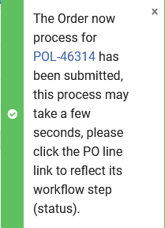
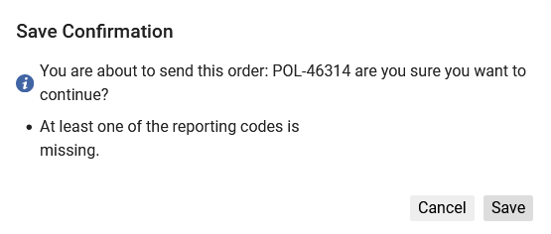
Ordering the resource - type "one time"
Get confirmation

Slide 21
Ordering the resource - type "one time"
The order is in status "Sent".

Slide 22
Activating the resource - type "one time"

Slide 23
Activating the resource - type "one time"
If we now search for the resource in the Institution Zone, we will see a "people" icon which is grey.
The "people" icon means that the resource is connected to the Community Zone.
The fact that it is grey means that it is not yet activated.

Slide 24
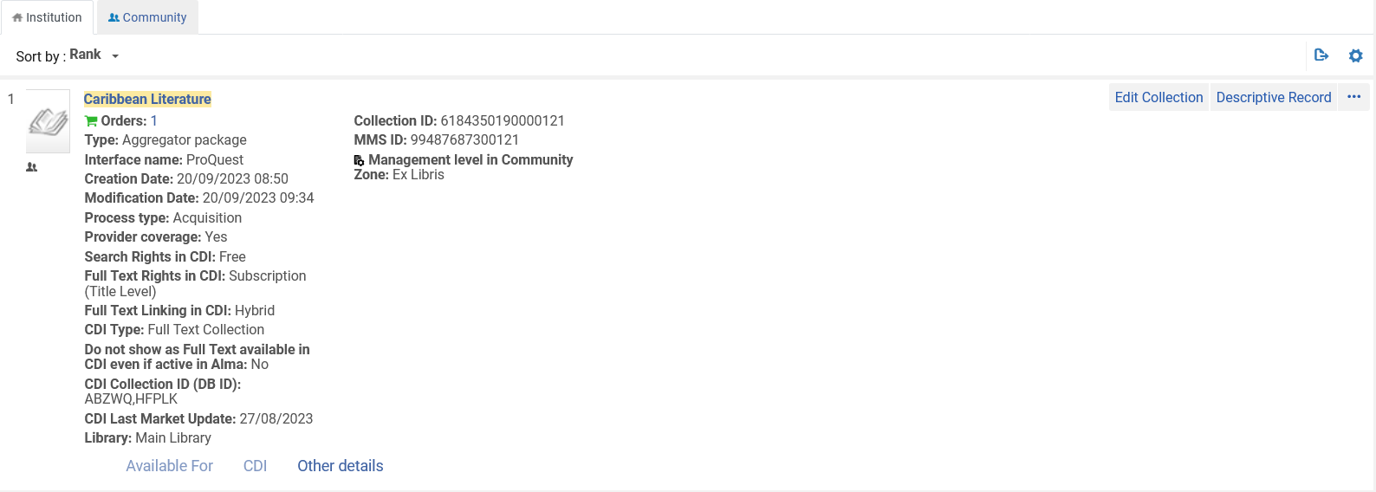
Activating the resource - type "one time"
Grey "people" icon

Slide 25
Activating the resource - type "one time"
If we now search for the resource in the Community Zone, we will see a "house" icon which is grey.
The "house" icon means that the resource is connected to the Institution Zone.
The fact that it is grey means that it is not yet activated.

Slide 26
Activating the resource - type "one time"
Grey "house" icon

Slide 27
Activating the resource - type "one time"
We will now activate the resource.
This can be done via the "Electronic resource Activation Task List"
The "Electronic resource Activation Task List" is accessed at "Resources > Manage Inventory > Manage Electronic Resource Activation"

Slide 28
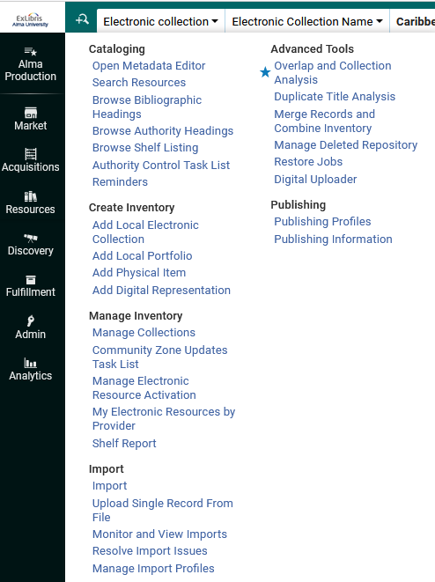
Activating the resource - type "one time"

Slide 29
Activating the resource - type "one time"
The ordered resource will appear in the "Unassigned" tab until a user edits it, and then it will be in the "Assigned to me" or "Assigned to others" tab.
Various activities may be performed on the resource from the "Electronic resource Activation Task List".
We will choose "Activate"

Slide 30
Activating the resource - type "one time"
This is the activation note we entered in the POL

Slide 31
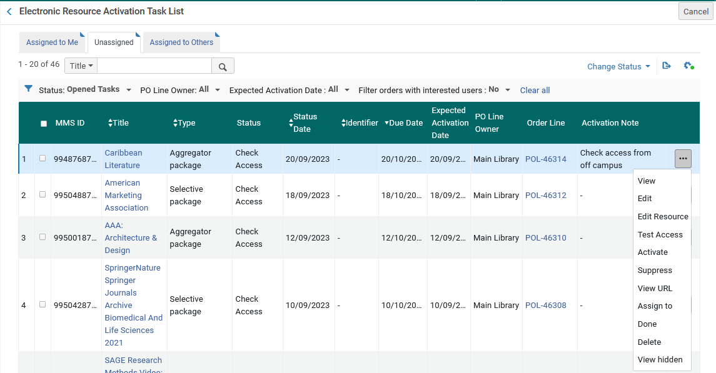
Activating the resource - type "one time"
For a description of the various options here see Managing Electronic Resource Activation. We will choose "Activate"

Slide 32
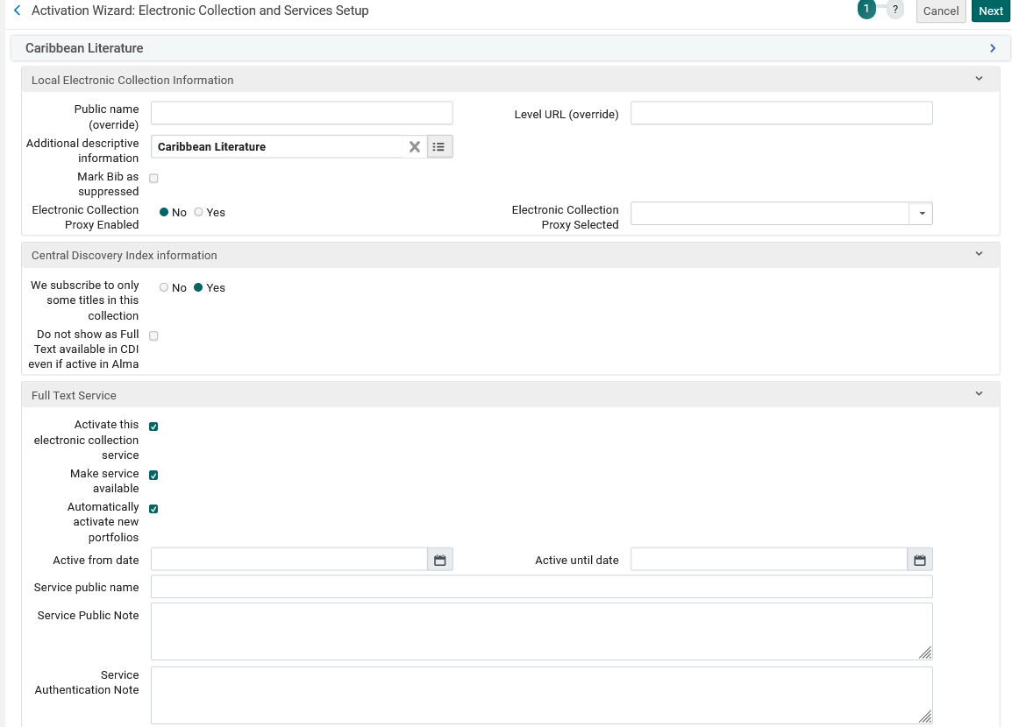
Activating the resource - type "one time"
By default, the Bibliographic record of the collection will be suppressed. We have unchecked the checkbox
The "Activation Wizard: Electronic Collection and Services Setup" page will open. Here is part of the first page with our selections.
Here we are activating the service (Full Text).
Here we are making the service be available in discovery
Here we have stated to Automatically activate new portfolios (added through Community Zone updates) associated with this electronic collection.

Slide 33
Activating the resource - type "one time"
Here is part of the last page of the activation wizard, where we have chosen to activate all portfolios (titles) in the collection.

Slide 34
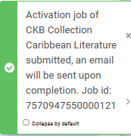
Activating the resource - type "one time"
Now we will select "Activate"

Slide 35
Activating the resource - type "one time"
The Electronic Activation job runs and completes

Slide 36
Activating the resource - type "one time"
When we are done with the activation process, we can change the status to "Done" and it will be removed from the list

Slide 37
The process is complete - type "one time"

Slide 38
The process is complete - type "one time"
If we search now in the repository, we no longer see a grey "people" icon next to the resource.
The "people" icon is now blue because the resource has been activated.
Similarly, if we search now in the Community Zone, we no longer see a grey "house" icon next to the resource.
The "house" icon is now blue because the resource has been activated.

Slide 39
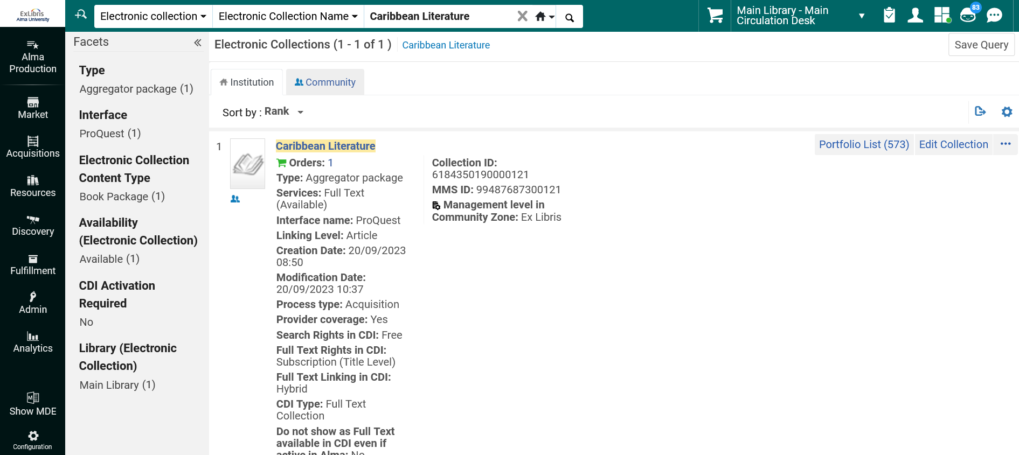
The process is complete - type "one time"
Searching in the Institution Zone
This means that the electronic collection is activated and linked to the Community Zone

Slide 40
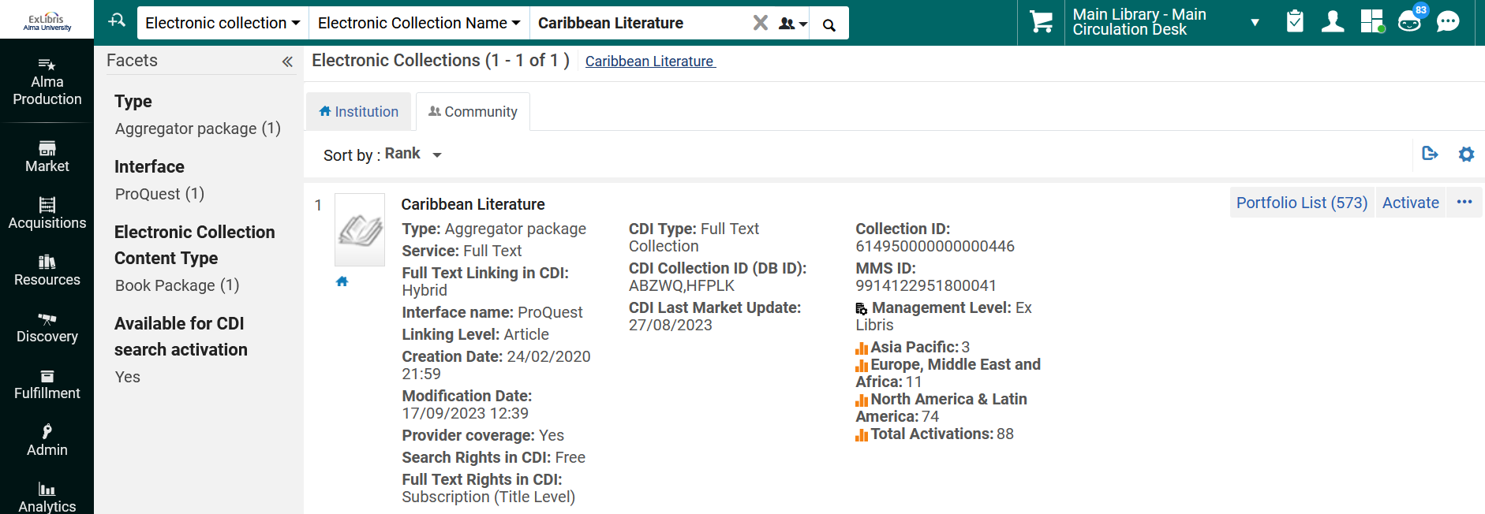
The process is complete - type "one time"
Searching in the Community Zone
This means that the electronic collection is activated and linked to the Institution Zone

Slide 41
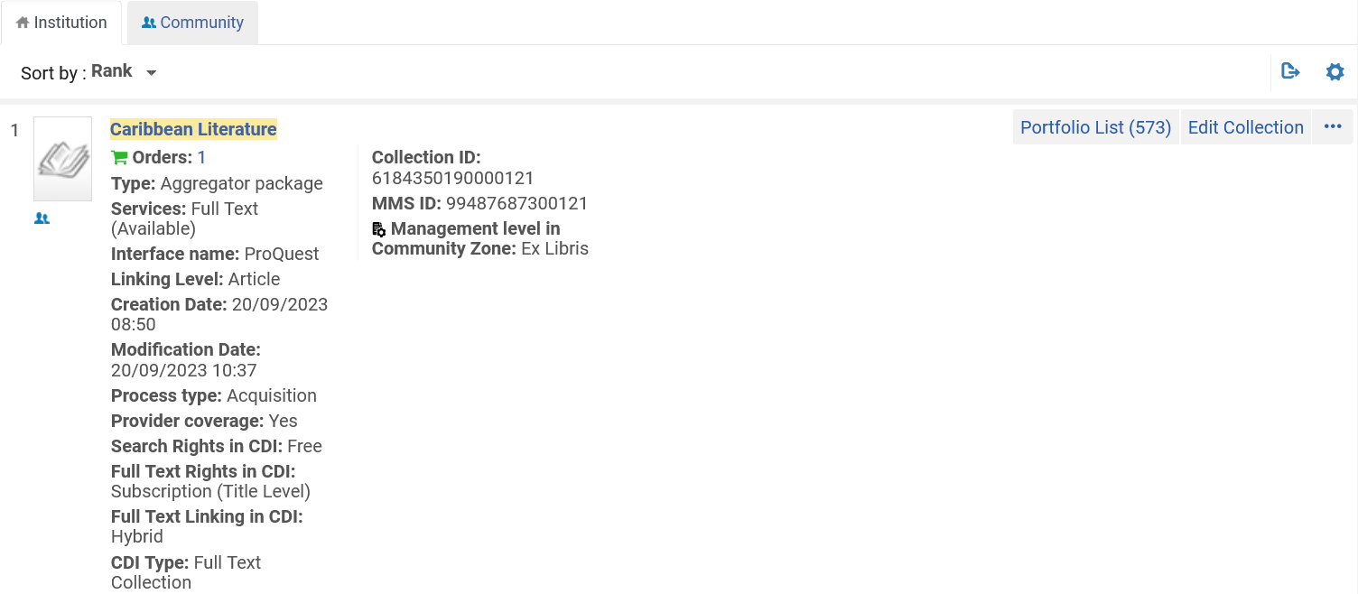
The process is complete - type "one time"
From the Institution Zone search we can click the "Portfolio List" to see the portfolios in this collection

Slide 42
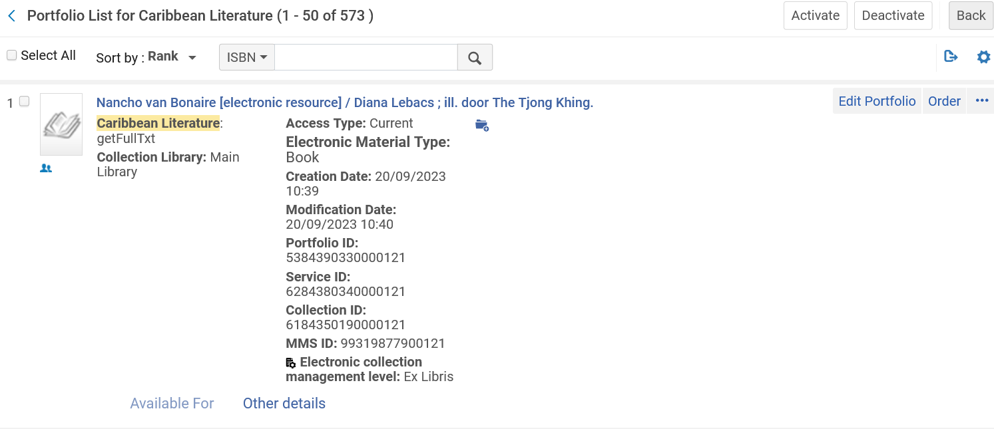
The process is complete - type "one time"
For example, this is one of the 573 activated portfolios in the Electronic Collection

Slide 43
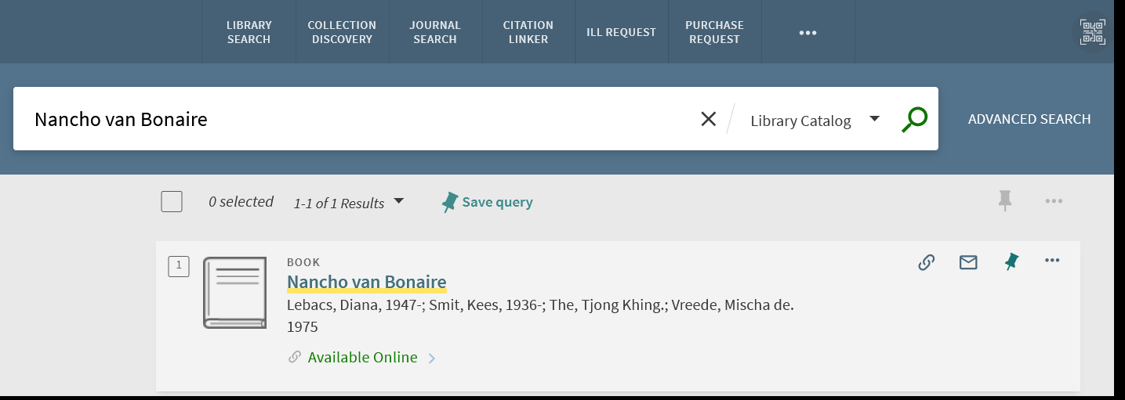
The process is complete - type "one time"
If we search for this portfolio in Primo, we see that it is available
We will now click "Available Online"

Slide 44
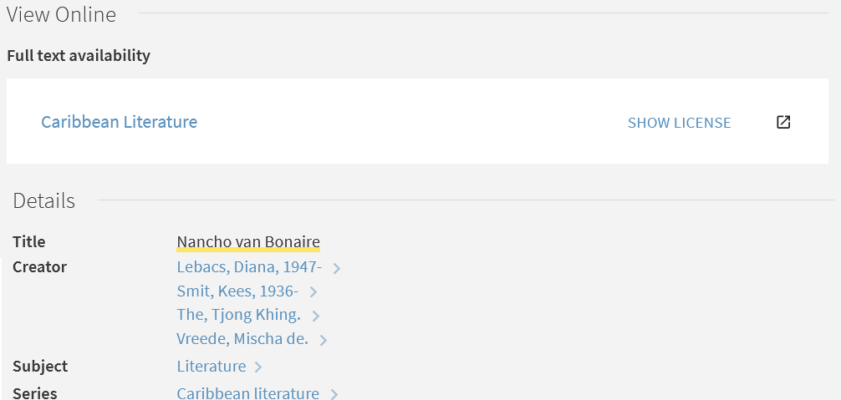
The process is complete - type "one time"
Now we can click the link of the Electronic Collection and access the resource

Slide 45
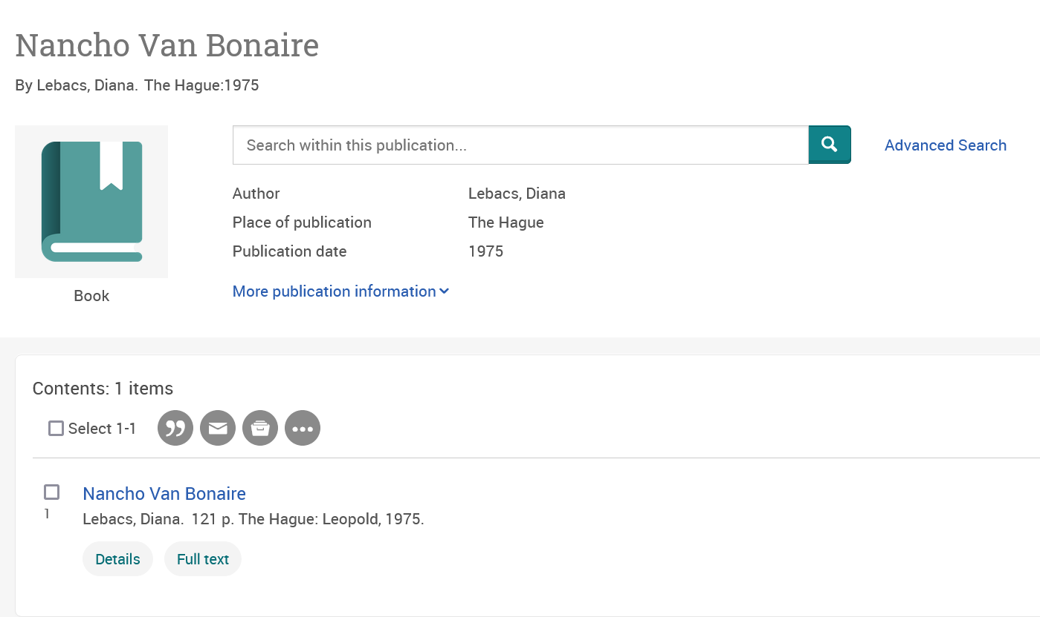
The process is complete - type "one time"

Slide 46
Ordering the resource - type "subscription"

Slide 47
Ordering the resource - type "subscription"
We will order electronic collection "Entertainment Industry Magazine Archive: Video Gaming"
We search for the electronic collection in the repository (in the Institution Zone) and do not find it.
Searching the institution
The electronic collection is not present

Slide 48
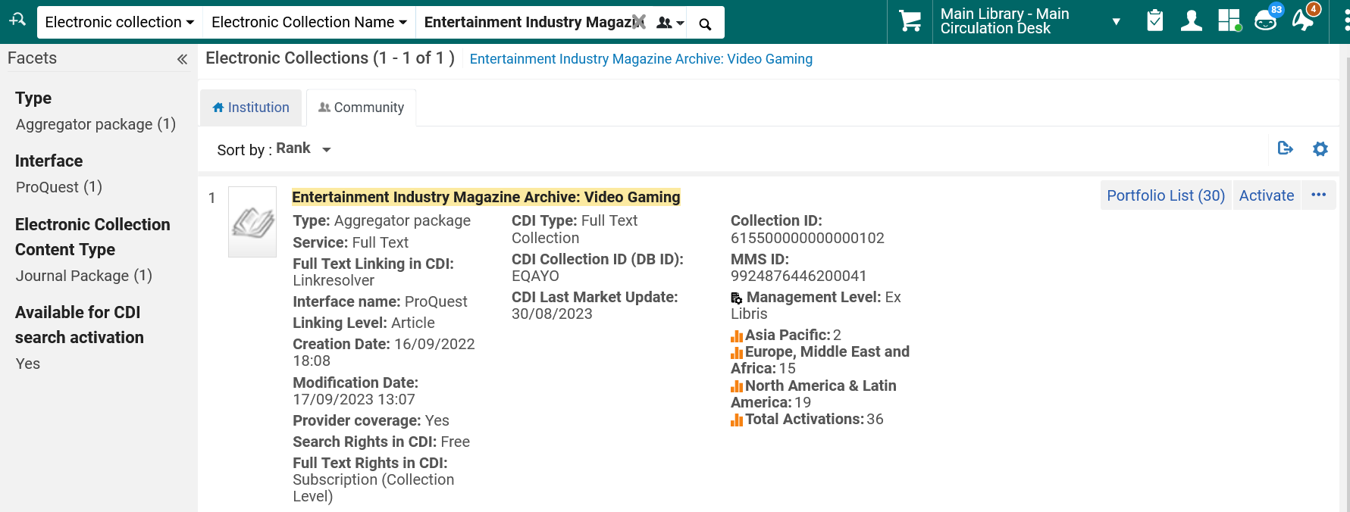
Ordering the resource - type "subscription"
We search for the electronic collection in the Community Zone and do find it.
Searching the Community Zone

Slide 49
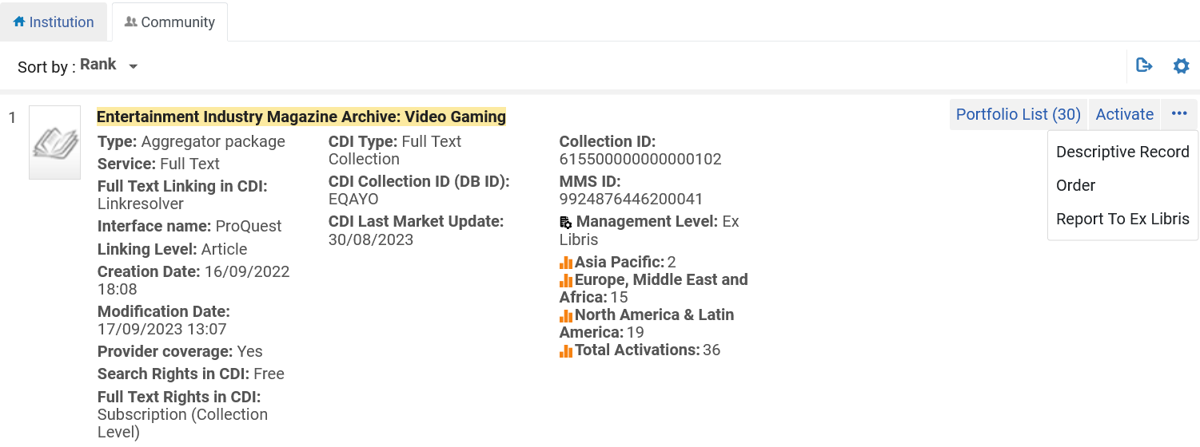
Ordering the resource - type "subscription"
From the Community Zone record we will click "Order"

Slide 50
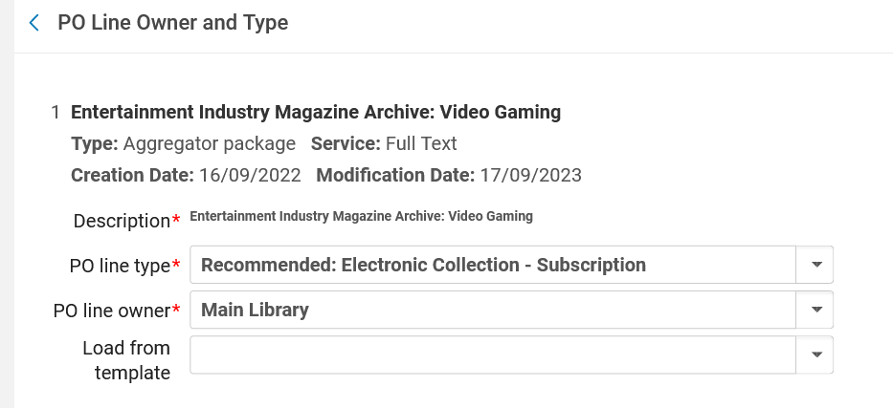
Ordering the resource - type "subscription"
Create and send the order
In this example we are choosing PO line type "Electronic Collection – Subscription"

Slide 51
Ordering the resource - type "subscription"
We will leave the defaults in the "PO Line Information" section
Regarding the "Acquisition method" see Acquisition Methods at Manually Creating a PO Line
The default from the CZ for this electronic collection is that the material type is "Journal Package"

Slide 52
Ordering the resource - type "subscription"
The "Ordered Collections" section includes the electronic collection we are ordering, and it is currently not activated.
"Service Activation Status" is "Not active". We will activate it later.

Slide 53
Ordering the resource - type "subscription"
In the "Vendor Information" section we choose the "Material supplier" (vendor) and optionally also the "Access provider"
The "Access provider" is the vendor interface of the material being ordered. It is not mandatory. Sometimes it is not filled if the "Material supplier" is also the "Access provider".

Slide 54
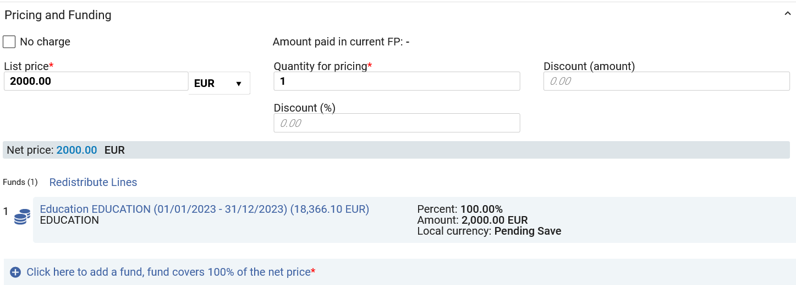
Ordering the resource - type "subscription"
In the "Pricing and Funding" section we enter the price of the resource and the fund(s) being used for the order

Slide 55
Ordering the resource - type "subscription"
In the "Activation Information" section we optionally can check that this is a "Rush" order, choose a license, and add an activation note.
We added here an activation note "We may need to enable a proxy for this". Later we will see this in the Electronic Resource Activation Task List.

Slide 56
Ordering the resource - type "subscription"
Because the POL type is "subscription" (continuous) we also have "Renewal Information" in the POL.
We will see this again later when it comes time to create the invoice.
For additional information on these fields see Processing Renewals

Slide 57
Ordering the resource - type "subscription"
When all necessary information is filled in we can send the order.
"Save and Continue" will save the PO line and then it will go to the next stage ,which typically is to be packaged into a PO and sent to vendor. For more information on packaging PO lines, see Packaging PO Lines into a PO.
"Order Now" will put the POL into a PO and send it now (provided there are no errors).
We will click "Order Now".

Slide 58
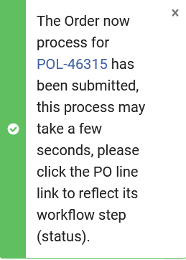
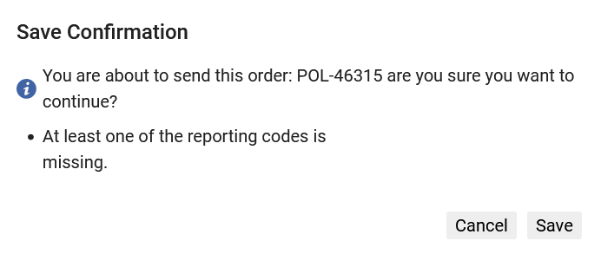
Ordering the resource - type "subscription"
Get confirmation

Slide 59
Ordering the resource - type "subscription"
The order is in status "Sent".

Slide 60
Activating the resource – type "subscription"

Slide 61
Activating the resource - type "subscription"
If we now search for the resource in the Institution Zone, we will see a "people" icon which is grey.
The "people" icon means that the resource is connected to the Community Zone.
The fact that it is grey means that it is not yet activated.

Slide 62
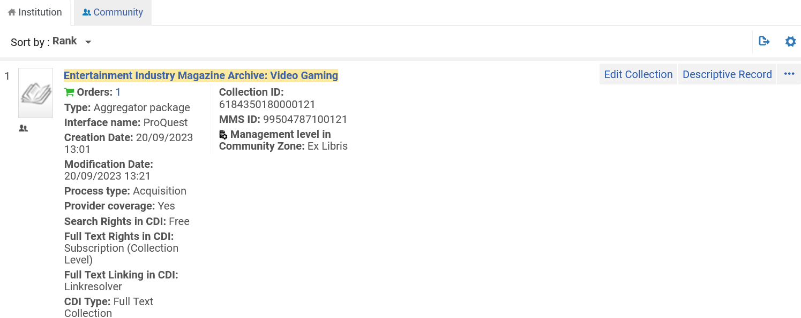
Activating the resource - type "subscription"
Grey "people" icon

Slide 63
Activating the resource - type "subscription"
If we now search for the resource in the Community Zone, we will see a "house" icon which is grey.
The "house" icon means that the resource is connected to the Institution Zone.
The fact that it is grey means that it is not yet activated.

Slide 64
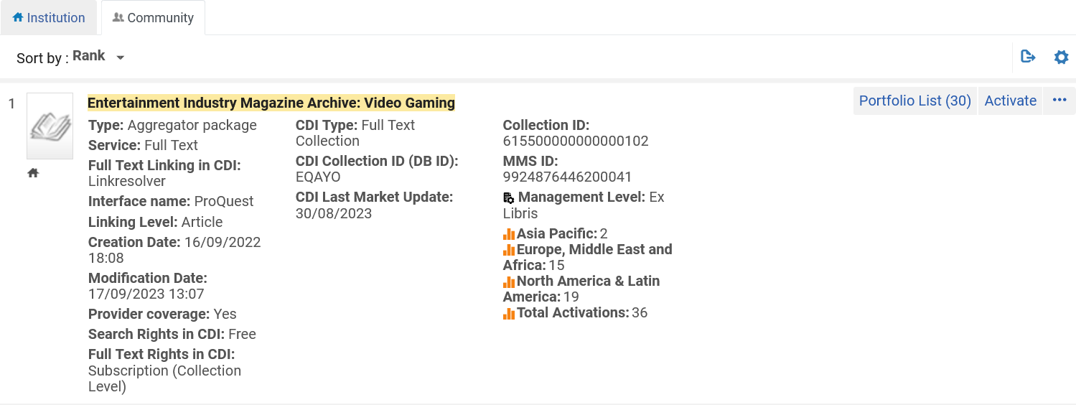
Activating the resource - type "subscription"
Grey "house" icon

Slide 65
Activating the resource - type "subscription"
We will now activate the resource.
This can be done via the "Electronic resource Activation Task List"
The "Electronic resource Activation Task List" is accessed at "Resources > Manage Inventory > Manage Electronic Resource Activation"

Slide 66
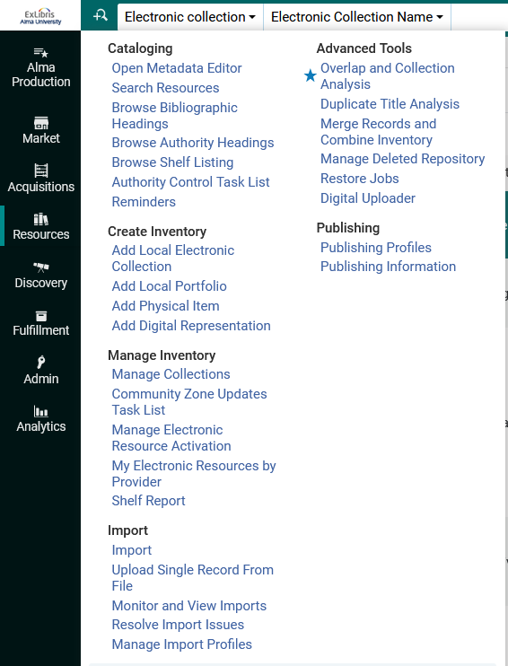
Activating the resource - type "subscription"

Slide 67
Activating the resource - type "subscription"
The ordered resource will appear in the "Unassigned" tab until a user edits it, and then it will be in the "Assigned to me" or "Assigned to others" tab.
Various activities may be performed on the resource from the "Electronic resource Activation Task List".
We will choose "Activate"

Slide 68
Activating the resource - type "subscription"
This is the activation note we entered in the POL

Slide 69
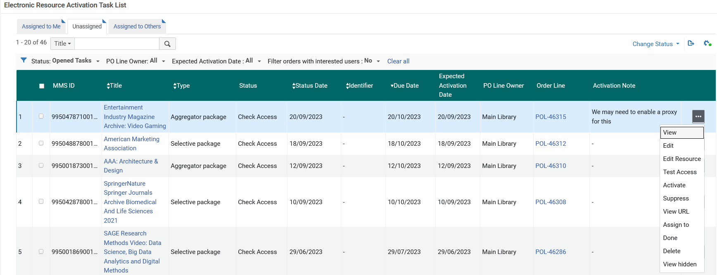
Activating the resource - type "subscription"
For a description of the various options here see Managing Electronic Resource Activation. We will choose "Activate"

Slide 70
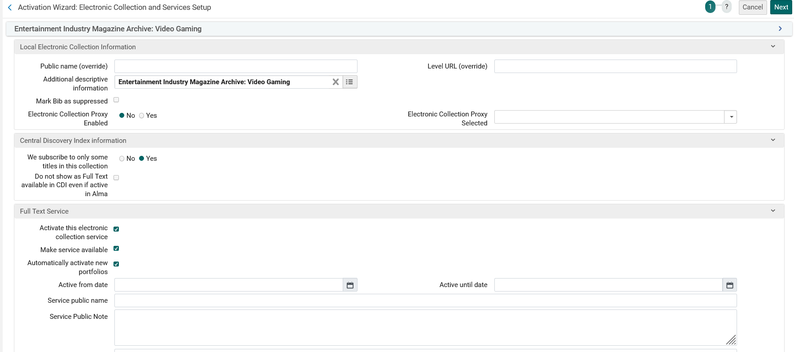
Activating the resource - type "subscription"
By default, the Bibliographic record of the collection will be suppressed. We have unchecked the checkbox
The "Activation Wizard: Electronic Collection and Services Setup" page will open. Here is part of the first page with our selections.
Here we are activating the service (Full Text).
Here we are making the service be available in discovery
Here we have stated to Automatically activate new portfolios (added through Community Zone updates) associated with this electronic collection.

Slide 71
Activating the resource - type "subscription"
Here is part of the last page of the activation wizard, where we have chosen to activate all portfolios (titles) in the collection.

Slide 72
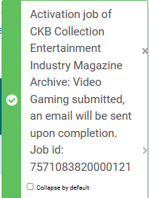
Activating the resource - type "subscription"
Now we will select "Activate"

Slide 73
Activating the resource - type "subscription"
The Electronic Activation job runs and completes

Slide 74
Activating the resource - type "subscription"
When we are done with the activation process, we can change the status to "Done" and it will be removed from the list

Slide 75
The process is complete - type "subscription"

Slide 76
The process is complete - type "subscription"
If we search now in the repository, we no longer see a grey "people" icon next to the resource.
The "people" icon is now blue because the resource has been activated.
Similarly, if we search now in the Community Zone, we no longer see a grey "house" icon next to the resource.
The "house" icon is now blue because the resource has been activated.

Slide 77
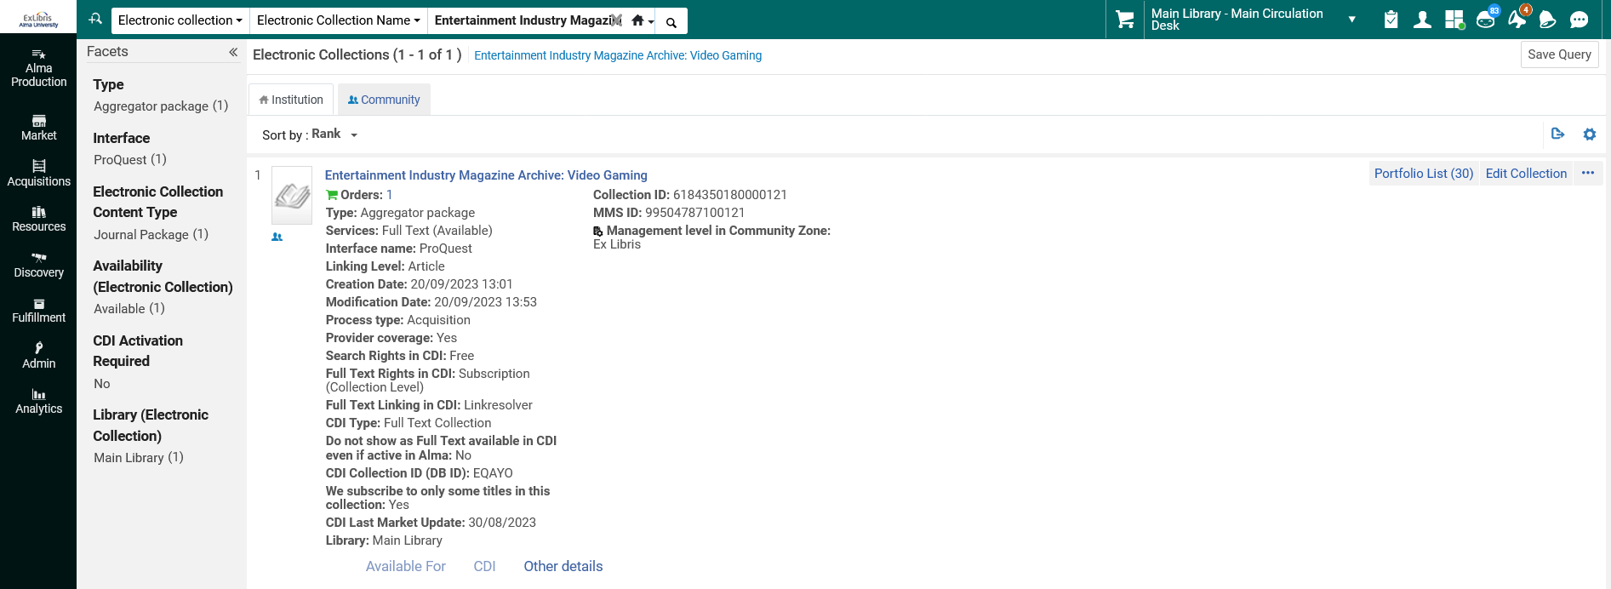
The process is complete - type "subscription"
Searching in the Institution Zone
This means that the electronic collection is activated and linked to the Community Zone

Slide 78
The process is complete - type "subscription"
Searching in the Community Zone
This means that the electronic collection is activated and linked to the Institution Zone

Slide 79
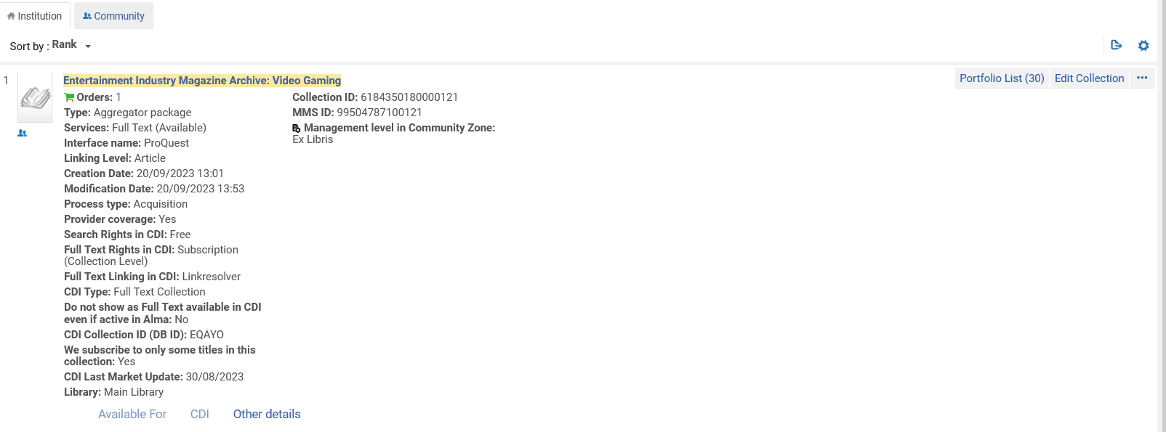
The process is complete - type "subscription"
From the Institution Zone search we can click the "Portfolio List" to see the portfolios in this collection

Slide 80
The process is complete - type "subscription"
For example, this is one of the 30 activated portfolios in the Electronic Collection

Slide 81
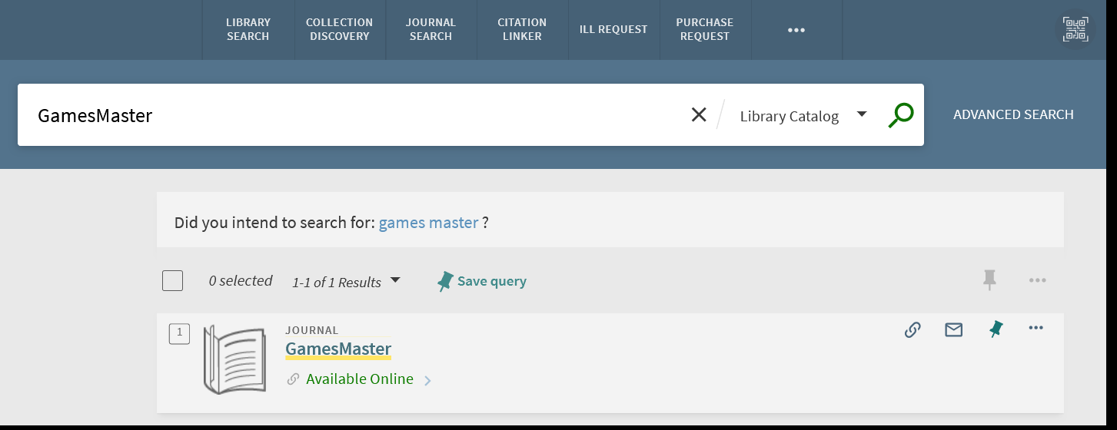
The process is complete - type "subscription"
If we search for this portfolio in Primo, we see that it is available
We will now click "Available Online"

Slide 82
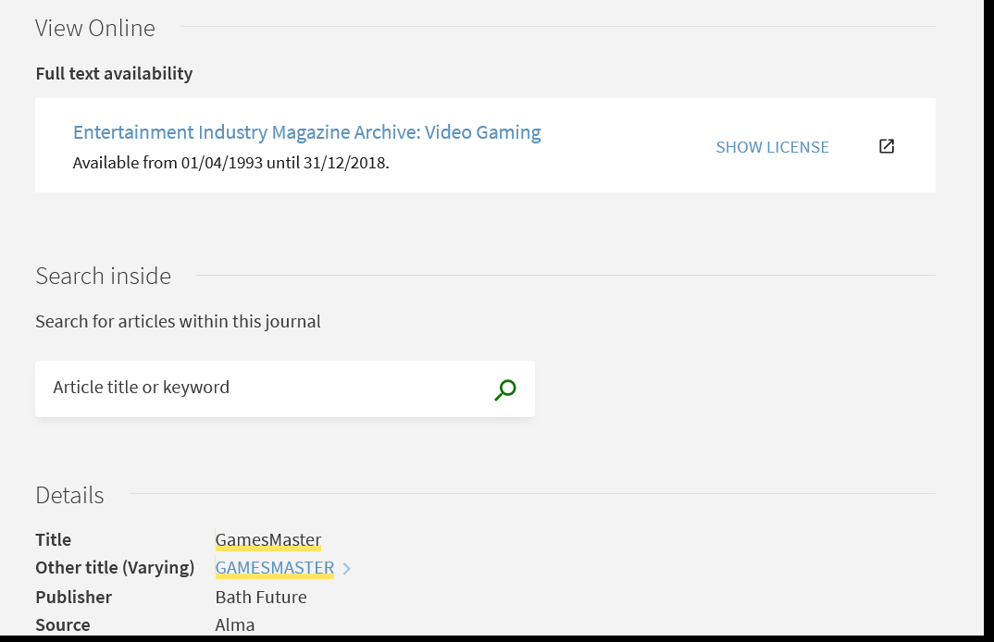
The process is complete - type "subscription"
Now we can click the link of the Electronic Collection and access the resource

Slide 83
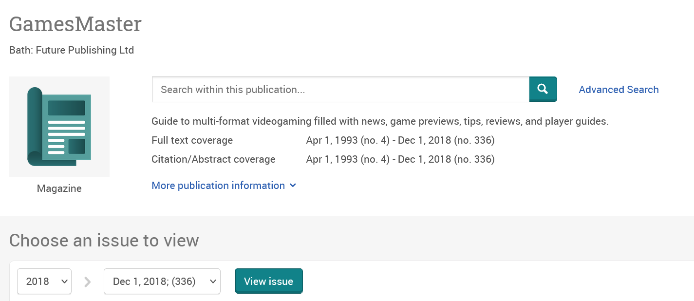
The process is complete - type "subscription"

Slide 84
Invoicing (paying for) the orders

Slide 85
Invoicing (paying for) the orders
We now have two orders for which the resource has been activated but nothing has been paid:
POL-46314
Title "Caribbean Literature".
POL Type: Electronic Collection - One Time
PO: PO-478713
POL-46315
Title "Entertainment Industry Magazine Archive: Video Gaming".
POL Type: Electronic Collection – Subscription
PO: PO-479713

Slide 86
Invoicing (paying for) the orders
POL-46314 (POL Type: Electronic Collection - One Time) is in status "Sent" and "Waiting for Invoice"

Slide 87
Invoicing (paying for) the orders
POL-46315 (POL Type: Electronic Collection – Subscription) is in status "Sent"

Slide 88
Invoicing (paying for) the orders
We will now manually create an invoice from the PO (Purchase Order) for each of the following orders:.
POL-46314
Title "Caribbean Literature".
POL Type: Electronic Collection - One Time
PO: PO-478713
POL-46315
Title "Entertainment Industry Magazine Archive: Video Gaming".
POL Type: Electronic Collection – Subscription
PO: PO-479713

Slide 89
Invoicing (paying for) the orders
Note that in our case we first activated the resources and then we are paying for them.
The order could be reversed whereby first the institution pays for the resources and then activates them.
Also, the activation and paying can be done at the same time.
This depends on flows of the vendor and the Alma institution.

Slide 90
Invoicing (paying for) the orders – one time

Slide 91
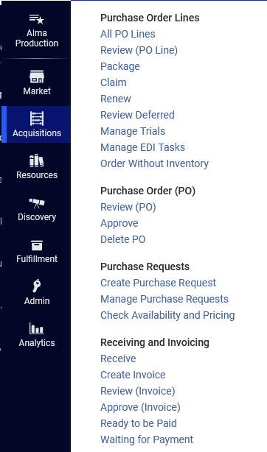
Invoicing (paying for) the orders – one time
Acquisitions > Receiving and Invoicing > Create Invoice

Slide 92
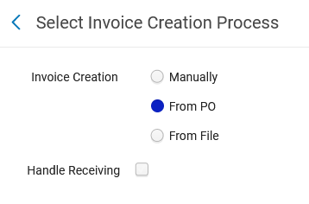
Invoicing (paying for) the orders – one time
We will choose "From PO"

Slide 93
Invoicing (paying for) the orders – one time
We will select the PO

Slide 94
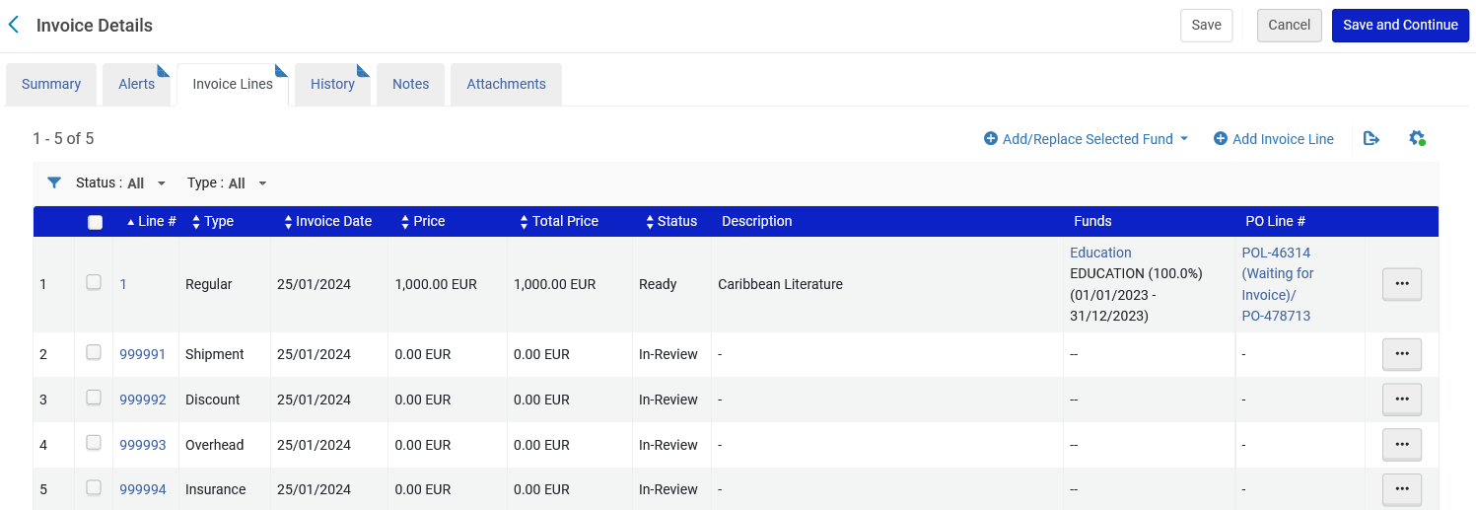
Invoicing (paying for) the orders – one time
An invoice is created with an invoice line associated with the POL

Slide 95
Invoicing (paying for) the orders – one time
We will switch to the "Summary" tab and pay the invoice
We are choosing here Payment Method "Cash" though often this will be done with a different method which will synchronize via an integration profile with the finance department.

Slide 96
Invoicing (paying for) the orders – one time
While still in the "Summary" tab we will complete the details and click "Save and Continue".

Slide 97
Invoicing (paying for) the orders – one time
Now the Invoice is closed

Slide 98
Invoicing (paying for) the orders – one time
Now the POL is closed

Slide 99
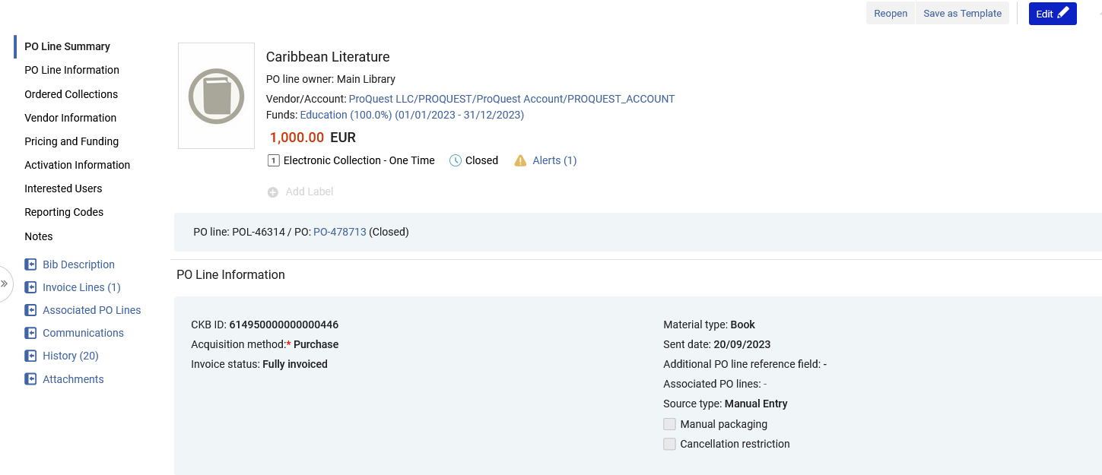
Invoicing (paying for) the orders – one time
There is an invoice line associated with the POL

Slide 100
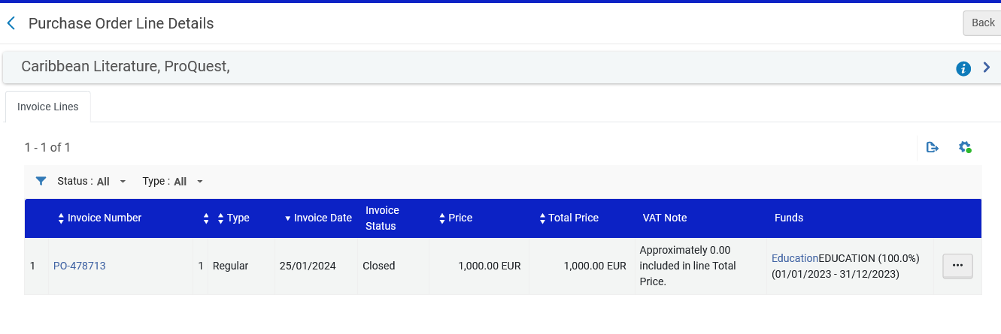
Invoicing (paying for) the orders – one time
There is an invoice line associated with the POL

Slide 101
Invoicing (paying for) the orders – one time
There is a transaction of type "Expenditure" on the fund

Slide 102
Invoicing (paying for) the orders – continuous

Slide 103
Invoicing (paying for) the orders – continuous
Before we create the invoice and pay, take note that POL-46315 has a subscription date from Sept. 1, 2023, to Aug. 31, 2024.
This was entered when the order was created
Subscription date
Note that we also put a renewal date in the POL

Slide 104
Invoicing (paying for) the orders – continuous
Acquisitions > Receiving and Invoicing > Create Invoice

Slide 105
Invoicing (paying for) the orders – continuous
We will choose "From PO"

Slide 106
Invoicing (paying for) the orders – continuous
We will select the PO

Slide 107
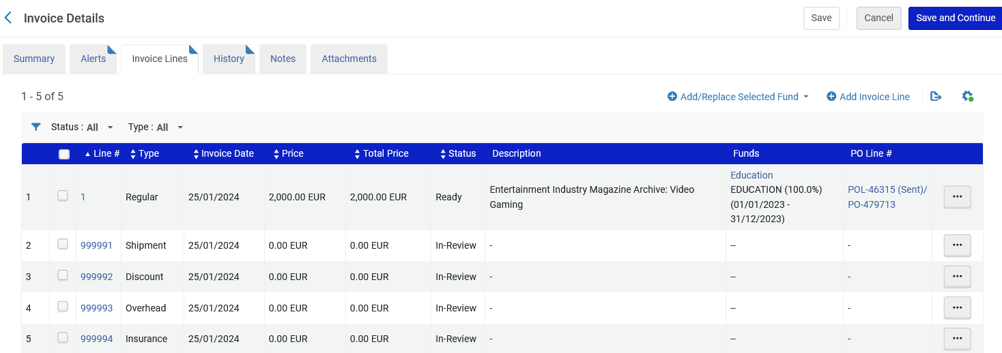
Invoicing (paying for) the orders – continuous
An invoice is created with an invoice line associated with the POL

Slide 108
Invoicing (paying for) the orders – continuous
The invoice line associated with the POL includes the subscription date range.

Slide 109
Invoicing (paying for) the orders – continuous
We will switch to the "Summary" tab and pay the invoice
We are choosing here Payment Method "Cash" though often this will be done with a different method which will synchronize via an integration profile with the finance department.

Slide 110
Invoicing (paying for) the orders – continuous
While still in the "Summary" tab we will complete the details and click "Save and Continue".

Slide 111
Invoicing (paying for) the orders – continuous
Now the Invoice is closed

Slide 112
Invoicing (paying for) the orders – continuous
Now the POL is not closed. It is type "continuous" with a renewal date.
When the time comes the institution can renew the POL subscription.

Slide 113
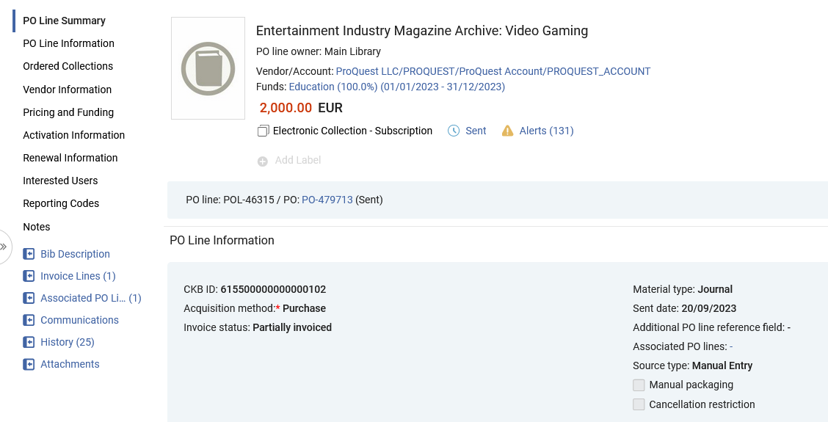
Invoicing (paying for) the orders – continuous
There is an invoice line associated with the POL

Slide 114
Invoicing (paying for) the orders – continuous
There is an invoice line associated with the POL

Slide 115
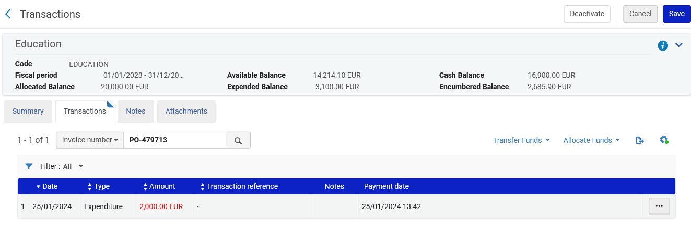
Invoicing (paying for) the orders – continuous
There is a transaction of type "Expenditure" on the fund

Slide 116
xxx@exlibrisgroup.com

