Slide 1
How to add a VAT (value added tax) percent to invoices and invoice lines
Yoel Kortick
Senior Librarian

Slide 2
Agenda
Introduction
Configuring the VAT codes
Adding a VAT percent to the general invoice with VAT Type Inclusive
Adding a VAT percent to the general invoice with VAT Type Exclusive
Adding a VAT percent per invoice line with Type Inclusive
Adding a VAT percent per invoice line with Type Exclusive
The "Expended from fund" checkbox
The "Expended from fund" checkbox with VAT Type Inclusive
The "Expended from fund" checkbox with VAT Type Exclusive

Slide 3
Introduction

Slide 4
Introduction
In this presentation we will investigate options for adding a VAT % to invoices, both on the level of the general invoice as well as on the level of the invoice line(s).
We will do this for two types of VAT:
Inclusive: The invoice total amount already includes VAT.
Exclusive: VAT is added in addition to the invoice total amount.

Slide 5
Introduction
Additionally, we will use the VAT codes functionality to add the percentages.

Slide 6
VAT Codes

Slide 7
VAT Codes
It is possible to add a VAT percent with or without VAT codes.
When we add the VAT percent in our examples here, we will use VAT codes.
VAT codes are used to establish a VAT percentage that can be assigned to an invoice or invoice line. The VAT code can therefore be selected
On the Invoice Details page when filling in an invoice
On the Add Invoice Line page when configuring an invoice line
Using the VAT codes to establish the VAT percentage is instead of manually entering a VAT percentage or amount on the invoice or invoice line level.

Slide 8
VAT Codes
The VAT Codes correspond to a specific percent.
When VAT codes are configured the VAT code field appears and the percent cannot be added manually.
When VAT Codes are not configured the VAT code field does not appear and the percent can be added manually.

Slide 9
VAT Codes
In this example the "VAT Code" is configured, so it appears. The "VAT %" is greyed out because it cannot be manually filled in.
"VAT Code" field
"VAT %" field is greyed out

Slide 10
VAT Codes
In this example the "VAT Code" is not configured, so it does not appear. The "VAT %" is not greyed out because it can be manually filled in.
There is no "VAT Code" field
"VAT %" field is not greyed out and can be filled in

Slide 11
Configuring the VAT codes

Slide 12
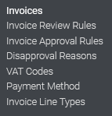
Configuring the VAT codes
The VAT codes are configured at "Configuration Menu > Acquisitions > Invoices > VAT Codes"

Slide 13
Configuring the VAT codes
Added explanatory text in the description
We have made the ‘Code’ be equal to the percentage for easy organizational purposes

Slide 14
Adding a VAT percent to the general invoice with VAT Type Inclusive

Slide 15
Adding a VAT percent to the general invoice with VAT Type Inclusive
If Inclusive is selected (total amount includes VAT), this indicates that the VAT is already figured into the total value of each invoice line.

Slide 16
Adding a VAT percent to the general invoice with VAT Type Inclusive
Throughout this presentation we will work on invoice PO-219714 which has a total of 50.00 EUR

Slide 17
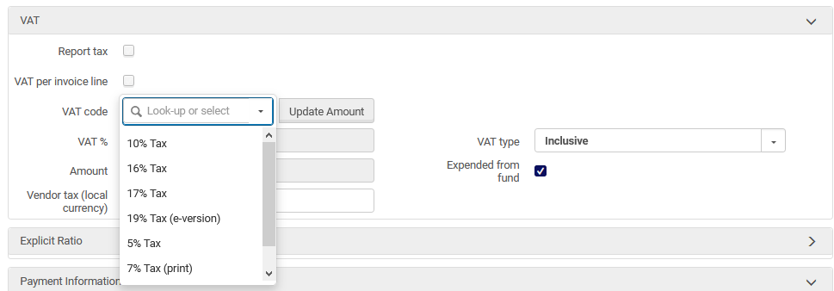
Adding a VAT percent to the general invoice with VAT Type Inclusive
When creating the invoice, in the VAT section of the invoice summary tab we do not check the "VAT per invoice line" and choose a VAT code
We are leaving "Expended from fund" checked and we will talk more about this later

Slide 18
Adding a VAT percent to the general invoice with VAT Type Inclusive
We have chosen 17 %, selected "VAT type = Inclusive" and then clicked "Update Amount"
In this case we have chosen "VAT type = Inclusive"
The VAT amount of 7.26 was automatically calculated and added

Slide 19
Adding a VAT percent to the general invoice with VAT Type Inclusive
If the invoice total was 50, and we chose VAT % = 17, then why is the amount 7.26?
The formula when VAT type = "inclusive" is as follows:
VAT Amount = Invoice Total – (Invoice Total / 1.VAT%)
In our case:
VAT Amount = 50.00 – (50.00/1.17)
VAT Amount = 7.26

Slide 20
Adding a VAT percent to the general invoice with VAT Type Inclusive
Note that when using VAT type = "inclusive" the VAT % does not get added to the invoice line, but there is a note added to the invoice line regarding the inclusion of the VAT %

Slide 21
Adding a VAT percent to the general invoice with VAT Type Inclusive
In the "Summary" tab we do not see the addition of the VAT amount.

Slide 22
Adding a VAT percent to the general invoice with VAT Type Exclusive

Slide 23
Adding a VAT percent to the general invoice with VAT Type Exclusive
This time we have chosen 17 %, selected "VAT type = Exclusive" and then clicked "Update Amount"
In this case we have chosen "VAT type = Exclusive"
The VAT amount of 8.5 was automatically calculated and added
We are leaving "Expended from fund" checked and we will talk more about this later

Slide 24
Adding a VAT percent to the general invoice with VAT Type Exclusive
If the invoice total was 50, and we chose VAT % = 17, then why is the amount 8.5?
The formula when VAT type = “exclusive" is as follows:
VAT Amount = Invoice Total * VAT%
In our case:
VAT Amount = 50.00 * .17
VAT Amount = 8.5

Slide 25
Adding a VAT percent to the general invoice with VAT Type Exclusive
Note that when using VAT type = "exclusive" the VAT % gets added to the "Total Price" of the invoice line

Slide 26
Adding a VAT percent to the general invoice with VAT Type Exclusive
In the "Summary" tab we see the addition of the VAT amount.

Slide 27
Adding a VAT percent per invoice line with VAT Type Inclusive

Slide 28
Adding a VAT percent per invoice line with VAT Type Inclusive
In our previous examples we did not check the checkbox "VAT per invoice line"
The checkbox "VAT per invoice line" allows the staff use to choose the VAT code per invoice line instead of once (in the "summary" tab) for the entire invoice (general invoice).
In this way each invoice line may have a different VAT percent.

Slide 29
Adding a VAT percent per invoice line with VAT Type Inclusive
The checkbox "VAT per invoice line" will appear only if the setting invoice_allow_vat_in_line_level = true.
This is set at "Configuration Menu > Acquisitions > General > Other Settings"

Slide 30
Adding a VAT percent per invoice line with VAT Type Inclusive
Selecting this option in the VAT section of the "Summary" tab of the invoice disables the other fields in this section that are relevant to configuring VAT on the invoice level.
Checked
Disabled

Slide 31
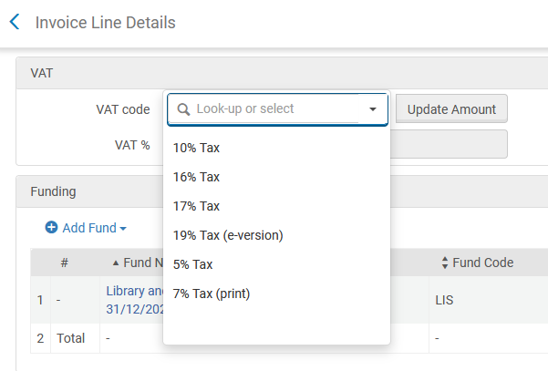
Adding a VAT percent per invoice line with VAT Type Inclusive
After selecting "VAT per invoice line" the "VAT Code" appears on each invoice line.

Slide 32
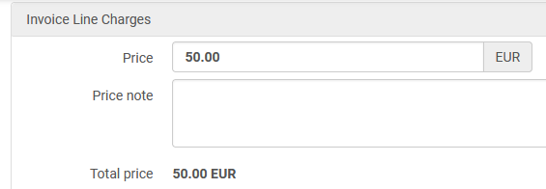
Adding a VAT percent per invoice line with VAT Type Inclusive
For an invoice line of 50.00 we have chosen VAT Code 17% and selected "Update Amount"
The VAT amount is 7.26. This uses the same formula we saw when choosing "VAT Type = Inclusive" from the invoice summary tab.

Slide 33
Adding a VAT percent per invoice line with VAT Type Inclusive
Like when we chose VAT type = "inclusive" from the Invoice Summary tab the VAT % does not get added to the invoice line, but there is a note added to the invoice line regarding the inclusion of the VAT %

Slide 34
Adding a VAT percent per invoice line with VAT Type Exclusive

Slide 35
Adding a VAT percent per invoice line with VAT Type Exclusive
Now we are selecting "VAT per invoice line" with "VAT Type" "Exclusive".

Slide 36
Adding a VAT percent per invoice line with VAT Type Exclusive
After selecting "VAT per invoice line" the "VAT Code" appears on each invoice line.
We have selected "17%" and clicked "Update Amount".
The VAT amount is 8.5. This uses the same formula we saw when choosing "VAT Type = Exclusive" from the invoice summary tab.

Slide 37
Adding a VAT percent per invoice line with VAT Type Exclusive
Like when we chose VAT type = "exclusive" from the Invoice Summary tab the VAT % gets added to the invoice line, and there is a note added to the invoice line regarding the inclusion of the VAT %

Slide 38
Adding a VAT percent per invoice line with VAT Type Exclusive
The amount of the invoice line with the VAT type exclusive is reflected in the summary tab of the invoice in the "Total Invoice lines amount" field, and this is the sum which will paid

Slide 39
The "Expended from fund" checkbox

Slide 40
The "Expended from fund" checkbox
In all the examples we did until now, the "Expended from Fund" checkbox has been checked.

Slide 41
The "Expended from fund" checkbox
Determines whether the VAT amount is to be expended from the invoice line’s fund. (if checked then the VAT amount is to be expended from the invoice line’s fund).
Can be unchecked only if "VAT per invoice line" is not checked.
When "VAT per invoice line" is checked the "Expended from Fund" checkbox will always be checked.
When "Expended from Fund" is unchecked a separate invoice line of type "Adjustment" gets created for the VAT amount but with no fund.
The "adjustment" invoice line does not create any transaction and cannot be edited. It is for informational purposes only.

Slide 42
The "Expended from fund" checkbox with VAT Type Inclusive

Slide 43
The "Expended from fund" checkbox with VAT Type Inclusive
Now we are adding 17% VAT for VAT Type "Inclusive", and we are not checking "Expended from fund"
We already saw why the amount is 7.26
Expended from fund is not checked

Slide 44
The "Expended from fund" checkbox with VAT Type Inclusive
A separate invoice line of type "Adjustment" gets created for the VAT amount but with no fund. This invoice line cannot be edited.
No fund

Slide 45
The "Expended from fund" checkbox with VAT Type Inclusive
The "Total price" of the invoice line which is connected to the POL changed from 50.00 to 42.74 (50.00 – the inclusive 7.26).
The amount actually paid will be 50.00 (which is the total of the invoice lines).

Slide 46
The "Expended from fund" checkbox with VAT Type Inclusive
The invoice line of type "adjustment" is included in the "Total invoice lines amount" in the "summary" tab of the invoice, and therefore is 50.00

Slide 47
The "Expended from fund" checkbox with VAT Type Exclusive

Slide 48
The "Expended from fund" checkbox with VAT Type Exclusive
Now we are adding 17% VAT for VAT Type "Exclusive", and we are not checking "Expended from fund"
We already saw why the amount is 8.50
Expended from fund is not checked

Slide 49
The "Expended from fund" checkbox with VAT Type Exclusive
A separate invoice line of type "Adjustment" gets created for the VAT amount but with no fund. This invoice line cannot be edited.
No fund

Slide 50
The "Expended from fund" checkbox with VAT Type Exclusive
The invoice line of type "adjustment" is included in the "Total invoice lines amount" in the "summary" tab of the invoice, and therefore is 58.50 (50.00 for the POL and 8.50 for the "adjustment" line).
The amount actually paid will be 50.00, and that is how much is connected to a fund.

