Slide 1
The Printout Queue and Quick Printing in Alma
Yoel Kortick
Senior Librarian

Slide 2
Agenda
Introduction
Setting up a "Printout Queue" Printer
Sending a letter to the "Printout Queue“
Using the "Printout Queue“
Using the “Quick Print"

Slide 3
Introduction

Slide 4
Introduction
It is possible to define a printer as a “Printout Queue”.
When a letter will be “Printed” and the “Printout Queue” printer is in use, a browser printer dialog box pops up. From the browser printer dialog box it is possible to directly print the letter to a an “actual physical” printer defined on the PC and also preview the letter.
Additionally, the “Printout Queue”, as the name suggests, sends letters to a queue from which the letter can later be previewed and printed to an “actual physical” printer.

Slide 5
Introduction
This functionality differs from other printing-related functionality present in Alma, whereby all printouts are sent to an email address and then either:
The letter is printed because the printer is defined to have an email address.
A third party tool such as Namtuk or Thunderbird can be employed to send the email to an “actual physical” printer.
Further, the Printout Queue and Quick Printing provide an option to view what was printed and “on demand” preview it or print it again.

Slide 6
Introduction
This functionality is relevant for letters which are, by design and purpose, intended to go to an actual physical printer.
For example
It is possible to send the letter “Resource Request Slip Letter” to the “Printout Queue” because this is designed to be printed to a piece of paper and then attached to the resource while it waits on the hold shelf.
It is not possible to print the “Order Claim Letter” to the “Printout Queue” because this is designed to be sent by email to a vendor, and not to paper.

Slide 7
Introduction
Here are the letters which can be sent to the “Printout Queue”:
Loan Receipt letter
Printed when the Circulation Desk configuration has "Creates loan receipts“ and an item is loaned and staff user clicks “Done”
Return Receipt Letter
Printed when the Circulation Desk configuration has "Creates return receipts“ and an item is returned and staff user clicks “Exit”
Hold Shelf Request Slip Letter
Printed when an item which has a hold request is scanned in at the circulation desk
Resource Request Slip Letter.
Printed when staff user does “Fulfillment > Resource Requests > Scan In Items” and then scans an item barcode and chooses “Print Slip”. Also printed from the “Pick from Shelf” list.
Fine Fee Payment Receipt Letter.
Printed when staff user does “Fulfillment > Checkout / Checkin > Manage Patron Services” and then retrieves a patron and clicks “Pay”
Ful Transit Slip Letter
Printed in multiple scenarios whereby an item is scanned in at the circulation desk of one library and must go to another library, for example due to a physical item request for pickup at a different library than the owning library

Slide 8
Introduction
The printing capabilities we will show and use here are dependent on the web browser.
Therefore, much of what will be shown here depends on
Which internet browser and browser version you are using
What setup you have in the internet browser
If what you see is not 100% identical to what is shown here that is “normal”.
In the examples here we are using Firefox with default out of the box settings.

Slide 9
Setting up a "Printout Queue" Printer

Slide 10
Setting up a "Printout Queue" Printer
The library manager can setup one or more printers per department/circulation desk as
An email printer
A “Printout Queue”
Both of the above

Slide 11
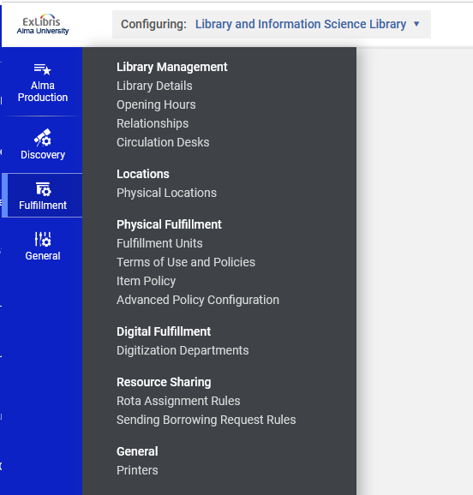
Setting up a "Printout Queue" Printer
While at the “Library and Information Science Library” we will access the Printers

Slide 12
Setting up a "Printout Queue" Printer
We will add a printer which will be defined (on the next slides) as a “Printout Queue”

Slide 13
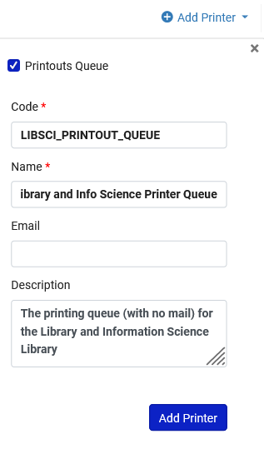
Setting up a "Printout Queue" Printer
New Checkbox signifying that this is a “Printout Queue”
When “Printout Queue” is checked field “email” is optional.

Slide 14
Setting up a "Printout Queue" Printer
Here is the new “Printout Queue” printer

Slide 15
Setting up a "Printout Queue" Printer
When “Printout Queue” is checked:
If there is no email, then the printout will go only to the “Printout Queue”
If there is an email, then the printout will go to the “Printout Queue” and to the email.
When “Printout Queue” is not checked:
Email is required and printout is sent to the email.

Slide 16
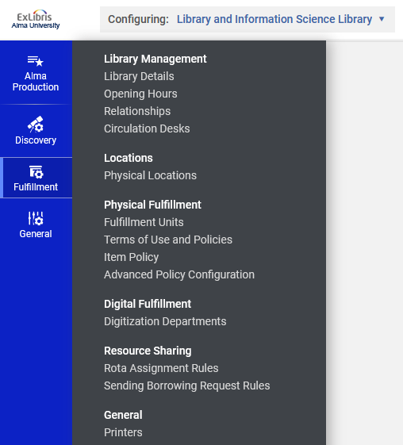
Setting up a "Printout Queue" Printer
We will associate the “Printout Queue” printer with relevant circulation desk

Slide 17
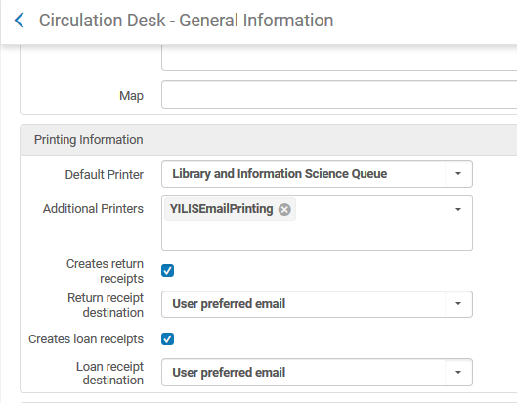
Setting up a "Printout Queue" Printer
“Printout Queue” printer is associated with relevant circulation desk

Slide 18
Setting up a "Printout Queue" Printer
Edit relevant circulation desk

Slide 19
Setting up a "Printout Queue" Printer
“Printout Queue” printer is associated with relevant circulation desk (in the “General Details” tab)

Slide 20
Sending a letter to the "Printout Queue"

Slide 21
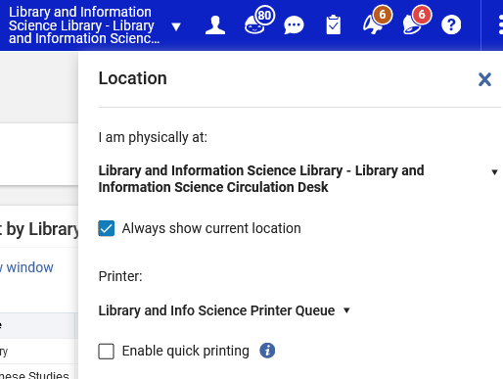
Sending a letter to the "Printout Queue"
I (as staff user) am currently at the Library and Information Science Library Main Circulation Desk, and I have chosen the printer we defined earlier “Library and Information Science Queue”
Note that we have not checked “Enable quick printing”. More on that topic later.
If there is only one printer associated with the circulation desk, then there will not be prompt to choose printer

Slide 22
Sending a letter to the "Printout Queue"
Patron Aaron Hacohen has a fine of 10.00 EUR

Slide 23
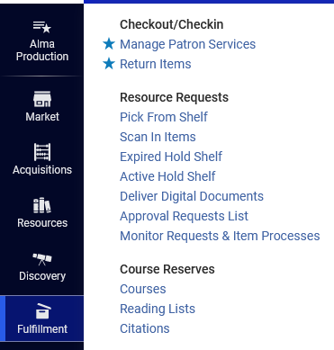
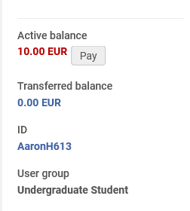
Sending a letter to the "Printout Queue"
Let’s scan in the patron and click “Pay”.

Slide 24
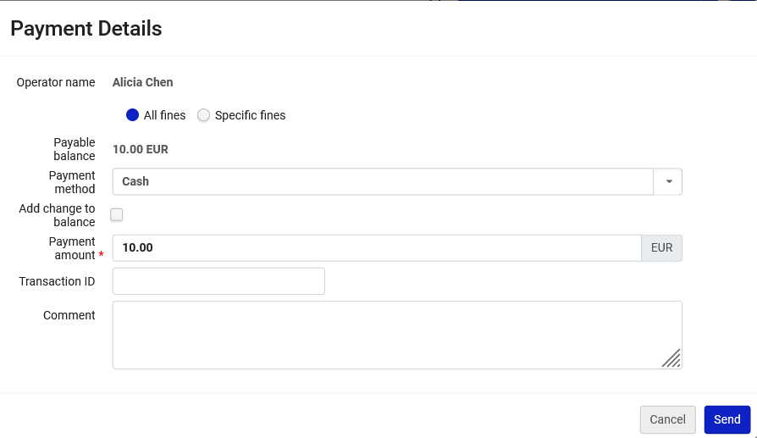
Sending a letter to the "Printout Queue"
Fill in payment details as desired and click and “send”

Slide 25
Sending a letter to the "Printout Queue"
Confirm

Slide 26
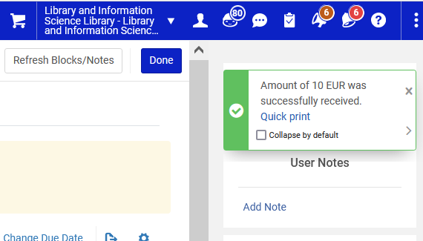
Sending a letter to the "Printout Queue"
Part of the message received includes a link to the “Quick print”
We will click this now

Slide 27
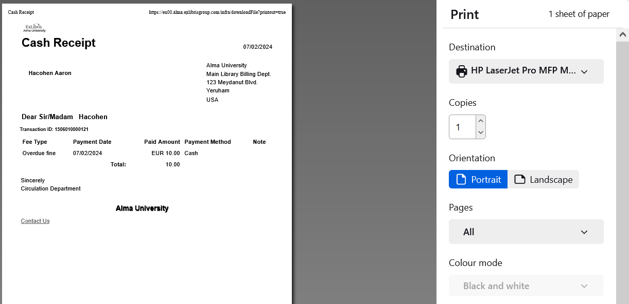
Sending a letter to the "Printout Queue"
Letter preview
After clicking the “Quick print” link the user gets the print dialog box and can print the letter to a real actual physical printer, as defined on the PC.

Slide 28
Sending a letter to the "Printout Queue"
The previous slide we just saw was from the workflow being done when using default out of the box settings in Mozilla Firefox.
Firefox opened a dialog box to print and also automatically show a preview of the letter.
Chrome and other browsers, depending on setup, may or may not show a preview of the letter.
As previously stated: what happens in the browser dialog box is dependent on the browser.

Slide 29
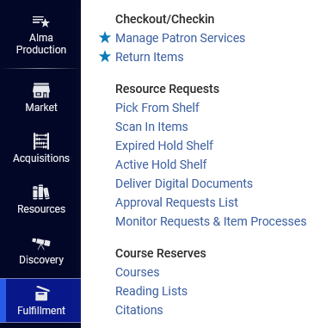
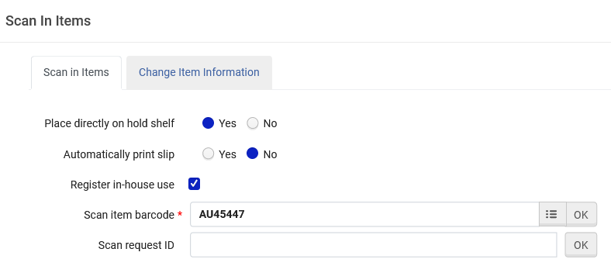
Sending a letter to the "Printout Queue"
Now we will scan in an item which has a physical item request on it.

Slide 30
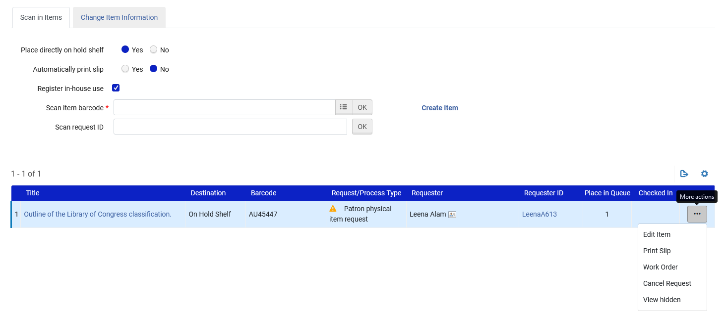
Sending a letter to the "Printout Queue"
Click “Print Slip”

Slide 31
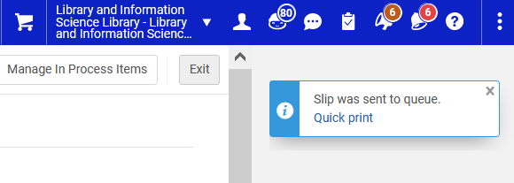
Sending a letter to the "Printout Queue"
And get a link to the “Quick Print”

Slide 32
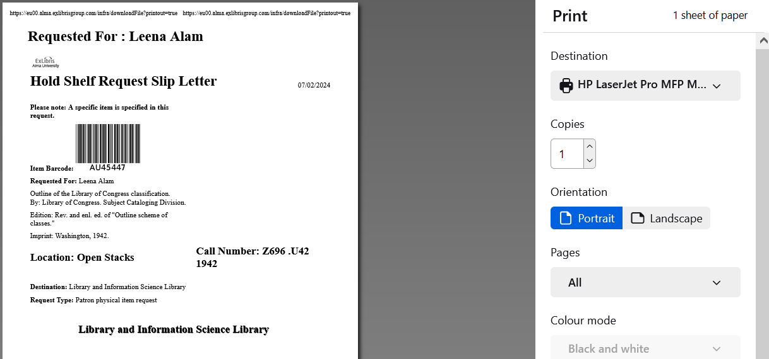
Sending a letter to the "Printout Queue"
Letter preview
After clicking the “Quick print” link the user gets the print dialog box and can print the letter to a real actual physical printer, as defined on the PC.

Slide 33
Using the "Printout Queue"

Slide 34
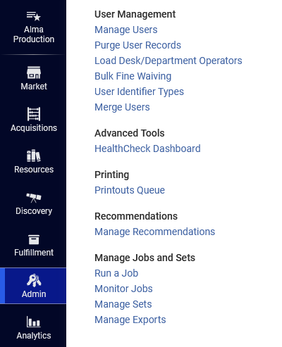
Using the "Printout Queue"
The letters which were just printed went to the “Printout Queue” where they can be previewed and printed again.
The “Printout Queue” is accessed at “Admin > Printing > Printouts Queue”

Slide 35
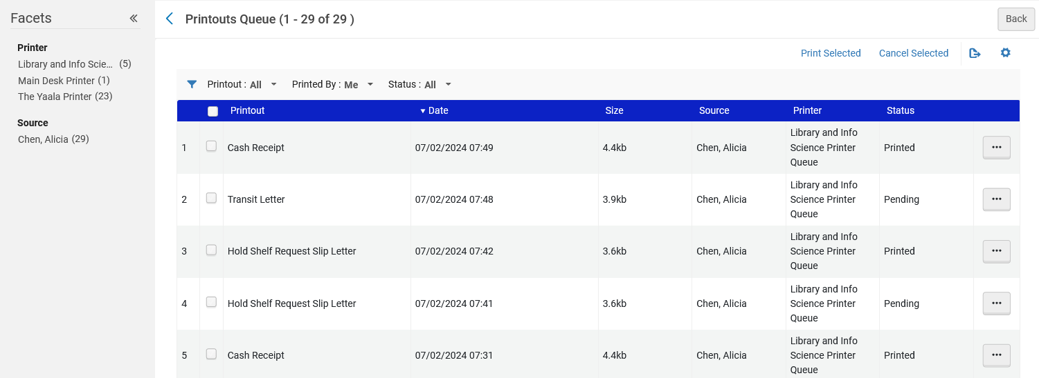
Using the "Printout Queue"
Printouts will remain here for 7 days and then are automatically removed
Can be multiselected and printed
Can be faceted by printer and source
Some letters are in status “Pending” because we did not yet really print them. We got the print dialog box and clicked “cancel”.

Slide 36
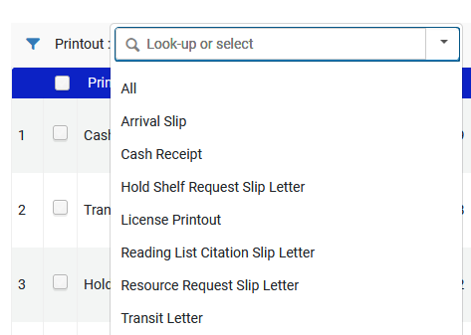
Using the "Printout Queue"
The printouts can be filtered by letter name

Slide 37
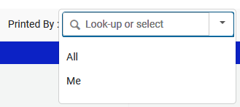
Using the "Printout Queue"
The printouts can be filtered by all or just mine

Slide 38
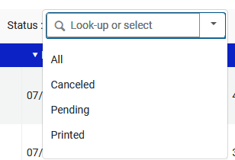
Using the "Printout Queue"
The printouts can be filtered by status

Slide 39
Using the "Printout Queue"
Each individual letter can be previewed, printed or canceled

Slide 40
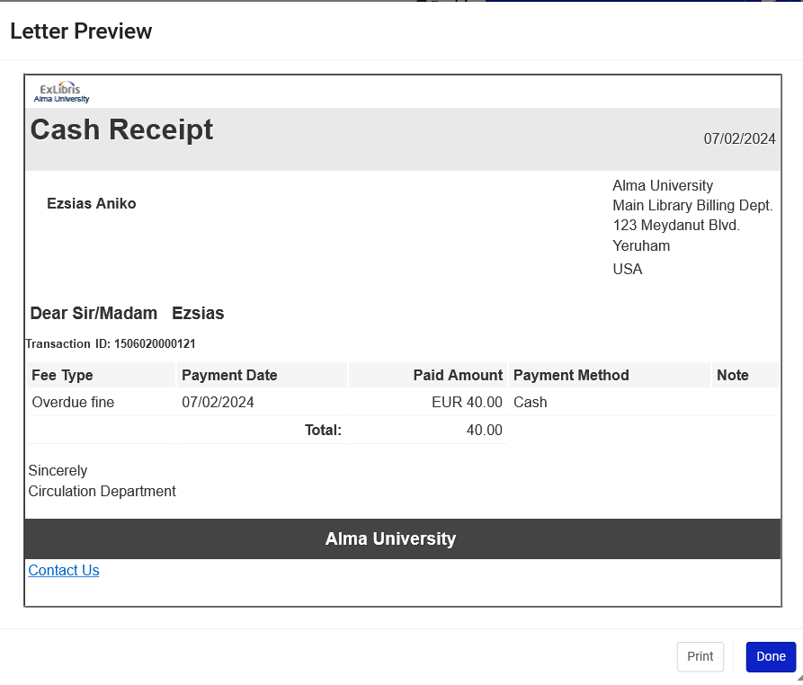
Using the "Printout Queue"
Here is a preview

Slide 41
Using the “Quick Print"

Slide 42
Using the “Quick Print"
Now we will define in the “Currently at” that we will use our “Printout Queue” printer with option “Enable Quick Printing”.
This causes the print dialog box to automatically open in the browser when a letter is printed.
There is no need for user to manually click another link.

Slide 43
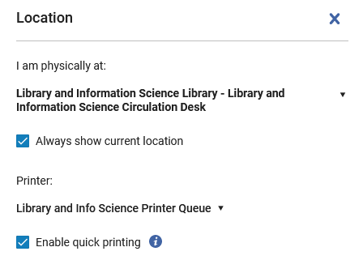
Using the “Quick Print"
“Enable quick printing”

Slide 44
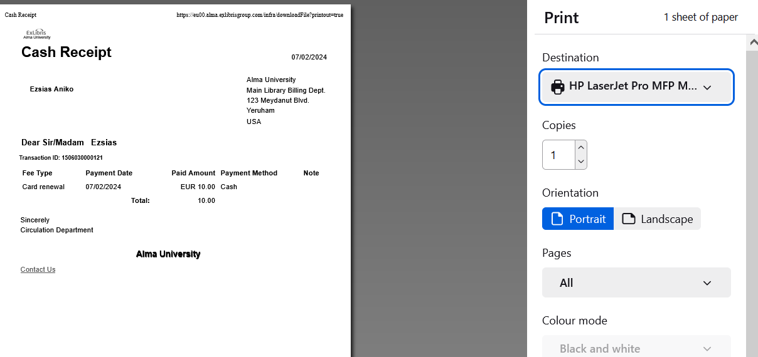
Using the “Quick Print"
Because we have selected option “Enable Quick Printing” the print dialog box will automatically open when, for example, the cash receipt is printed. We do not need to first click “Quick print” .

Slide 45
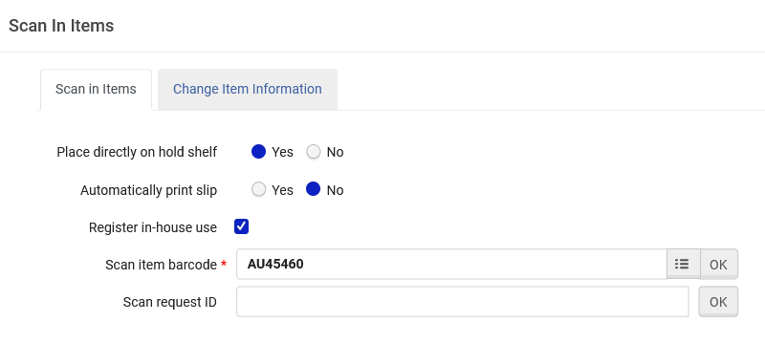
Using the “Quick Print"
Now, still with “Enable Quick Printing” checked, we will scan in an item which has a physical item request on it.

Slide 46
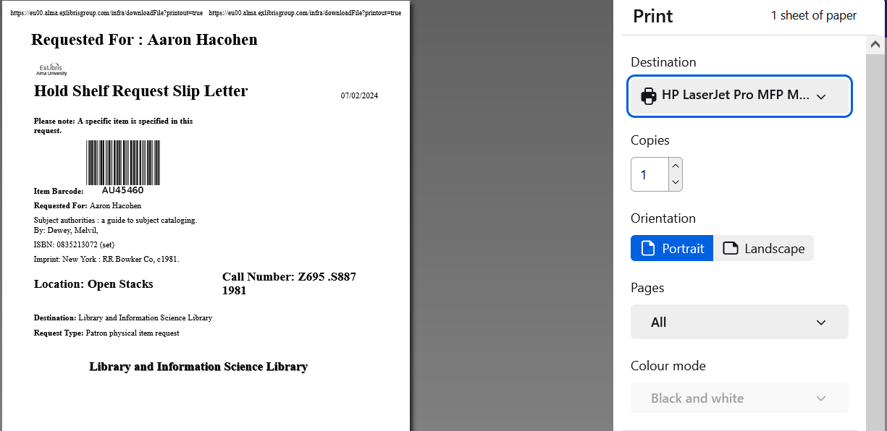
Using the “Quick Print"
Because we have selected option “Enable Quick Printing” the print dialog box will automatically open when, for example, the item barcode is scanned. We do not need to first click “Quick print” .

Slide 47
Using the “Quick Print"
These last two letters (Hold Shelf Request Slip Letter and Cash Receipt) were also sent to the Print Queue.
Letters are sent to the Print Queue regardless of whether or not “Enable Quick Printing” is checked.

