Slide 1
Serials Prediction Patterns and Serial Check-in
Yoel Kortick
Senior Librarian

Slide 2
Agenda
Introduction
The prediction pattern
Opening the predicted items
Receiving (check-in)

Slide 3
Introduction

Slide 4
Introduction
In order for prediction patterns to be used there must be
An 853/4/5 captions and pattern field in the holding record
Information registered in the ‘Next predicted item’s information’
Note:
Typically, there is also a POL (order) when creating predicted items, but technically it is not necessary)
When creating predicted items without a POL the items will not include calculated “expected arrival” dates. This is because the expected arrival dates come from vendor attached to POL.
When there is no POL the expected arrival date will be the issue date.

Slide 5
Introduction
Note that if there is no acquisitions order then the expected date of arrival cannot be automated.
For example, the issue’s “Expected Date of Arrival” will be taken from a combination of
The vendor “Subscription interval” in the order record
The “issue date” of the expected issue
Expected date of arrival = ‘issue date’ + ‘Subscription Interval’

Slide 6
Introduction
The 853/4/5 captions and pattern field in the holding record is needed because this is where information such as publication frequency and publication dates will be taken from.
The captions and pattern field must reside in the holding record which is associated with the specific order

Slide 7
Introduction
The “Next predicted item’s information“ is needed because this will determine the dates for the start and remainder of the specific issue cycle

Slide 8
The prediction pattern

Slide 9
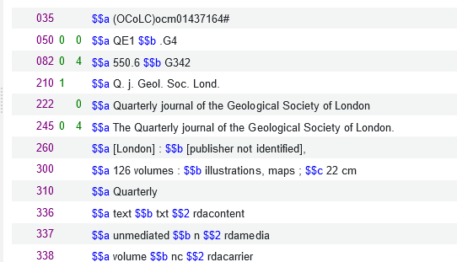
The prediction pattern
We have bibliographic record MMSID 99515786700121
Title “The Quarterly journal of the Geological Society of London.”
This is a quarterly journal

Slide 10
The prediction pattern
Library makes POL of type ‘Print Journal Subscription’ 46452 for this record
It will begin with: Volume 12 Issue 1 Year 2024
The order is made using vendor ‘A. Chen Publishing.’
The “Subscription interval” is “30”

Slide 11
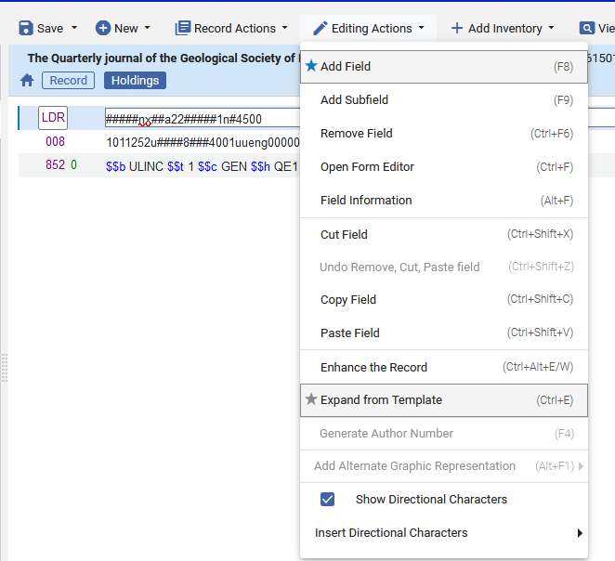
The prediction pattern
In the holding record (which gets created automatically when the order is created) the librarian adds field 853 for a quarterly journal.
The librarian can use a predefined template when adding field 853 and make only the necessary changes if needed.

Slide 12
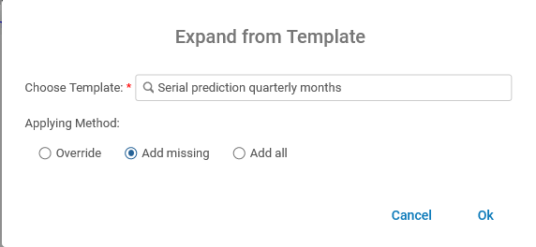
The prediction pattern
‘Out of the box’ there are many prediction patterns – one for nearly every possible situation. These contain 853 captions and pattern fields as well as 590 note fields.
We will choose ‘Serial prediction quarterly months’

Slide 13
The prediction pattern
The 853 gets added to the holding record from the template

Slide 14
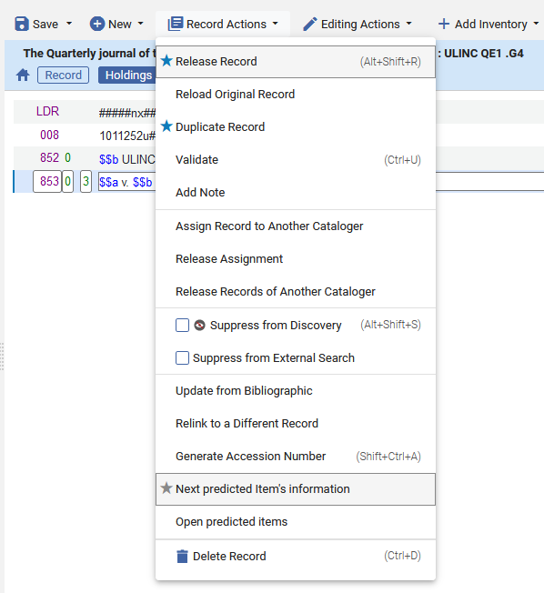
The prediction pattern
Put cursor on 853 field and choose ‘Record Actions > Next predicted item’s information’

Slide 15
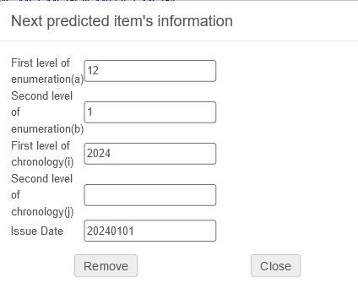
The prediction pattern
Fill in as desired. It will begin with: Volume 12 Issue 1 Year 2024
The first issue date is Jan. 1, 2024
Click ‘Close’ to save

Slide 16
The prediction pattern
In order for the predication pattern mechanism to work the ‘issue date’ of the expected items must be within the range of the subscription ‘from’ date and subscription ‘to’ date within the order.
The issue dates of the predicted items must be within this range

Slide 17
The prediction pattern
After the next predicted item’s information has been entered the 853 field will have a link to this information
Link to the Next predicted item’s information

Slide 18
The prediction pattern
The 853 captions and pattern field contains standard MARC information
Published 4 times a year
Prefix for enumeration a
The issue repeats each cycle
Prefix for enumeration b
Enumeration i will be in parentheses
Quarterly publication

Slide 19
Opening the predicted items

Slide 20
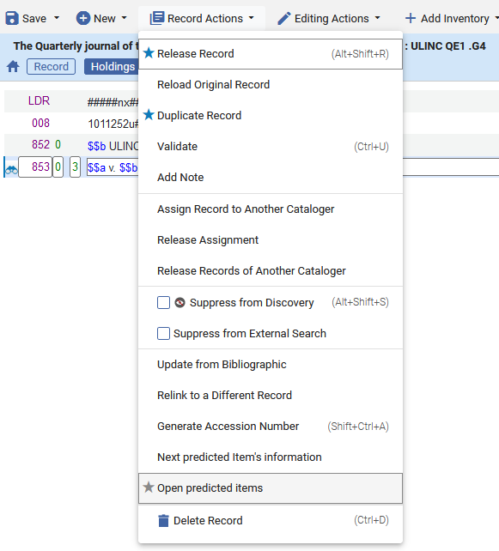
Opening the predicted items
Now we can ‘Open predicted items’

Slide 21
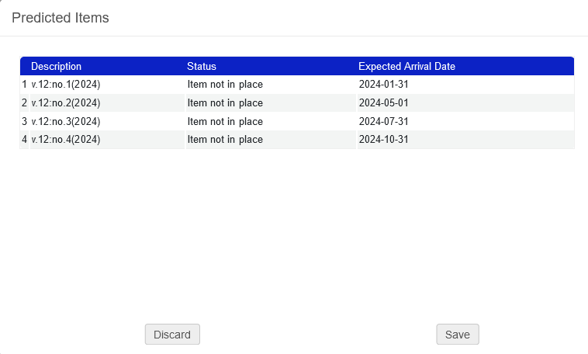
Opening the predicted items
The information for the predicted items of the cycle appears and the user can ‘save’ or ‘discard’
This information appears in accordance with the 853 field: $$a v. $$b no. $$i (year)
The expected arrival date is the ‘Issue date’ + the ‘Subscription Interval’
We will click “Save”

Slide 22
Opening the predicted items
The items get created

Slide 23
Opening the predicted items
In our example, we saw that the
1st issue has expected arrival date 2024-01-31
2nd issue has expected arrival date 2024-05-01
3rd issue has expected arrival date 2024-07-31
4th issue has expected arrival date 2024-10-31
The first ‘issue date’ was 20240101 and the order ‘subscription interval’ was ‘30’ therefore the first expected arrival date is 20180131 (which is 20180101 + 30)
853 subfield u had ‘4’ and subfield w had ‘q’ so it is quarterly with 4 issues per cycle: therefore ~90 days between each issue

Slide 24
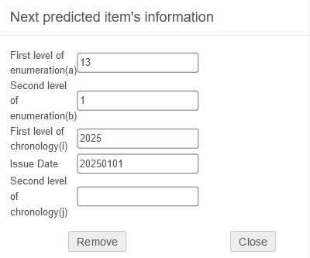
Opening the predicted items
After the cycle of issues is opened the ‘Next predicted item’s information’ automatically ‘jumps’ to the next cycle
Now it is Volume 13, year 2025. Previously it was volume 12, year 2024.

Slide 25
Receiving (check-in)

Slide 26
Receiving (check-in)
All four predicted items of the cycle have been created with no receiving date (because they have not yet been received)

Slide 27
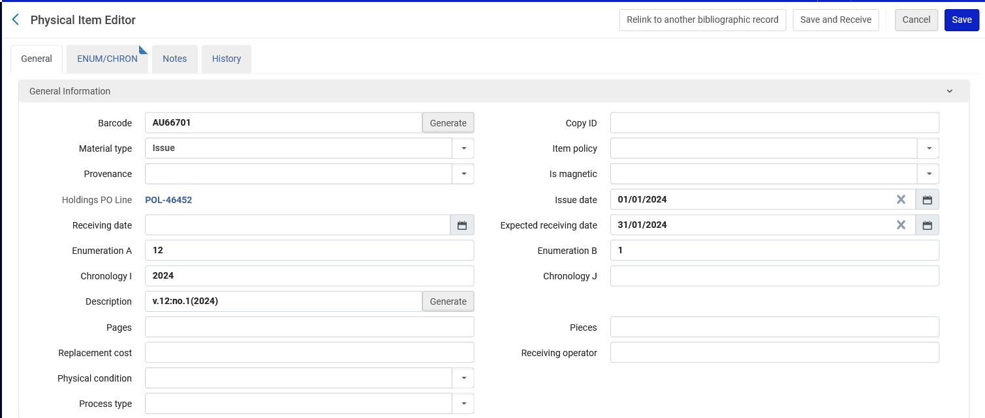
Receiving (check-in)
Each item has an expected receiving date
The description (as previously stated) is in accordance with 853 pattern field

Slide 28
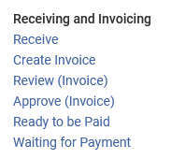
Receiving (check-in)
The staff user is at the acquisitions department (or a circulation desk which is defined to also function as an acquisitions desk) and does “Acquisitions > Receiving and Invoicing > Receive”

Slide 29
Receiving (check-in)
In the receiving workbench we retrieve the journal

Slide 30
Receiving (check-in)
We will choose “Actions > Manage Items”

Slide 31
Receiving (check-in)
Receive the relevant item(s)
We can click the checkbox(es) on the left and then click “Save and Receive” or we can do “Actions > Receive” per item.
We will now receive Volume 12 issue 1

Slide 32
Receiving (check-in)
The user now sees which items have already arrived and which items have not yet arrived

Slide 33
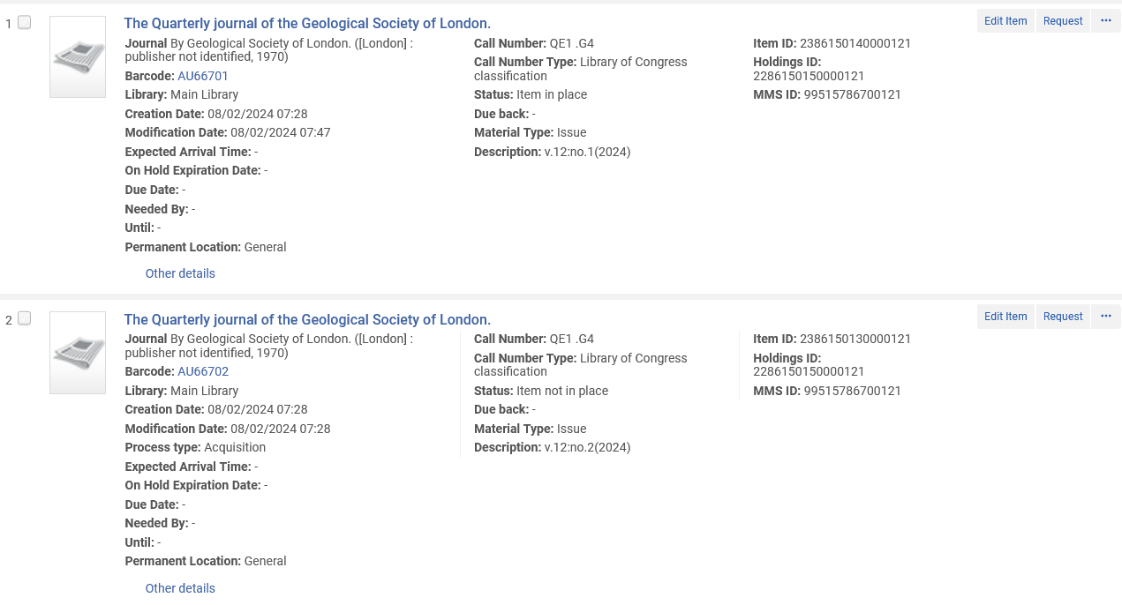
Receiving (check-in)
When doing a physical items search, we see that Vol. 12 issue 1 is in place but issues 2-4 are not in place (not arrived)

Slide 34
Receiving (check-in)
At a later stage, all items arrive

Slide 35
Receiving (check-in)
We can then open the next cycle of items from the list of items

Slide 36
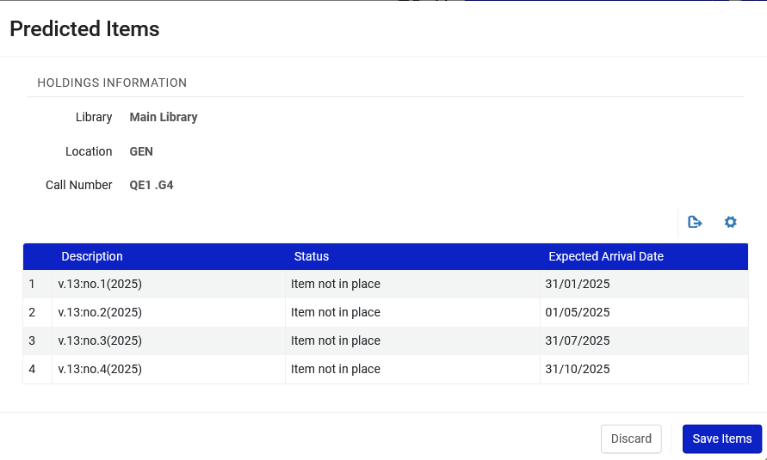
Receiving (check-in)
Now we have the next cycle and can save

Slide 37
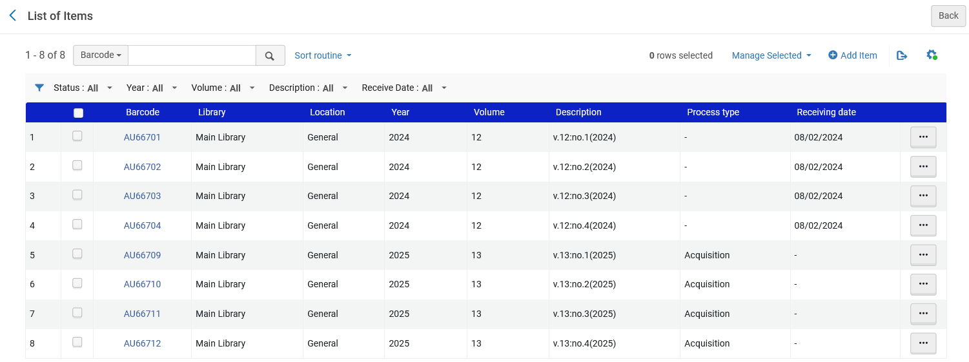
Receiving (check-in)
The items are created and ready to be received

