Slide 1
Shared Vendors for Network Zone Consortia
Yoel Kortick
Senior Librarian

Slide 2
Agenda
Introduction
In the NZ
In the member
Contributing to network
Edit global attributes
Summary

Slide 3
Introduction

Slide 4
Introduction
Alma allows for global vendor information to be shared between the Network Zone (NZ) of a consortium and member institutions.
Global attributes are distributed from the NZ.
Local attributes (such as vendor account, EDI information, access provider, and vendor interface) are not distributed and must be configured on the local level (in the member institution). It is also possible to distribute information in the other direction: from the member institution it is possible to contribute to the NZ so that it can later be shared from the NZ to all member institutions.
Note: throughout this presentation when we use the term “NZ” we mean “Network Zone”

Slide 5
Introduction
Still further, in the case of a shared vendor in the member institution it is possible for the member to update the global attributes in the NZ. After the changes are updated in the NZ they will be distributed to all members.
The advantage here is that each member institution does not need to create and maintain the vendor themselves, but rather they get the vendor information straight from the NZ.
Member institutions can use both the shared vendors as well as vendors they add locally.

Slide 6
Introduction
For more information about the use of shared vendors see “Sharing Vendor Information in a Network Zone” at: https://knowledge.exlibrisgroup.com/Alma/Product_Documentation/Alma_Online_Help_(English)/Managing_Multiple_Institutions_Using_a_Network_Zone/06_Acquisitions_in_Consortia/030Sharing_Vendor_Information_in_a_Network_Zone

Slide 7
Introduction
In the example here we have a network zone and three member institutions:
Member / Network | Name | Inst. Code
Network | Ex Libris University Consortium | EXLDEMO2_INST
Member | Alma University | EXLDEV1_INST
Member | Open University | EXLDEMO3_INST
Member | University of Knowledge | EXLDEMO1_INST

Slide 8
Introduction
Network Zone
Ex Libris University Consortium
Member Institution
Alma University
Member Institution
Open University
Member Institution
University of Knowledge

Slide 9
In the NZ

Slide 10
In the NZ
Here we are in the NZ viewing the vendors.
These will be distributed to the members.

Slide 11
In the NZ
For demonstrative purposes we will first create a new vendor and see that it also will be distributed.

Slide 12
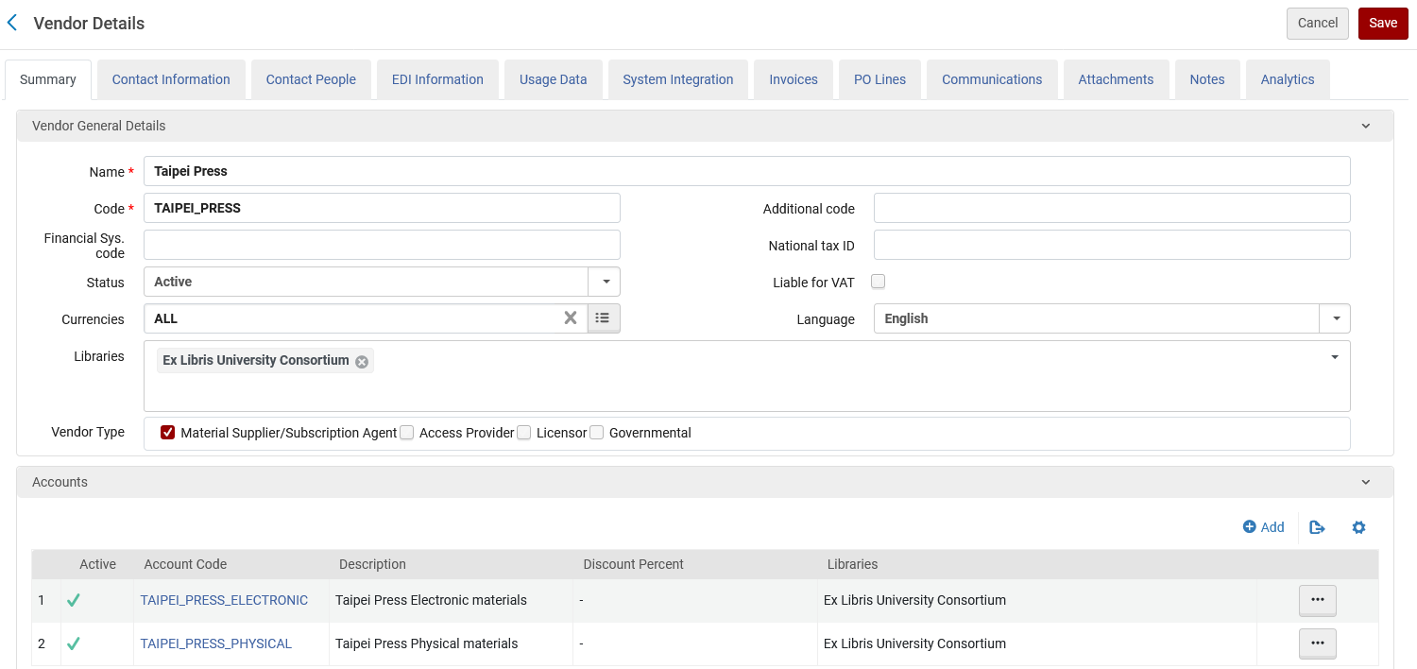
In the NZ
The new vendor is called “Taipei Press” and has two accounts: one for electronic resources and one for physical resources. It is a “material supplier”.

Slide 13
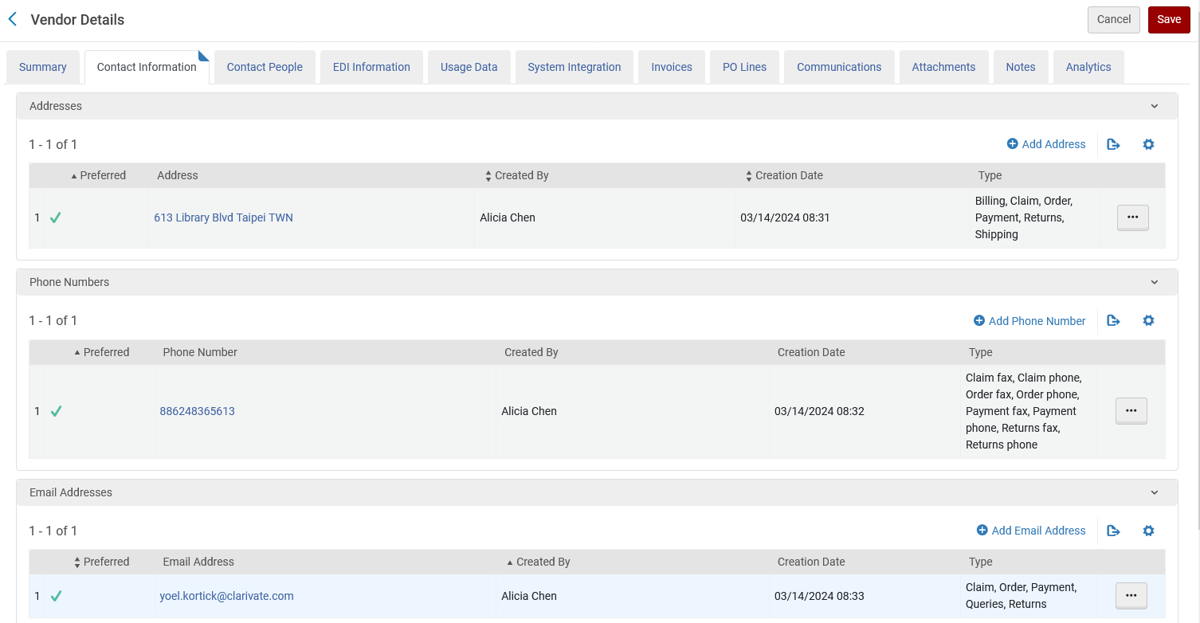
In the NZ
The new vendor also has contact information on the global level (not in the accounts)

Slide 14
In the NZ
The new vendor also has contact people on the global level (not in the accounts)

Slide 15
In the NZ
In order to be able to distribute the vendors the acq_distribution_job parameter must be set to “true”
This is accessed at “Configuration > Acquisitions > General > Other Settings”

Slide 16
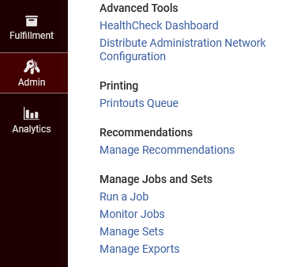
In the NZ
When the acq_distribution_job parameter is set to “true” the job “Distribute network Acquisition changes to members” will be active and run daily.
This can be seen at “Admin > Manage Jobs and Sets > Monitor Jobs”

Slide 17
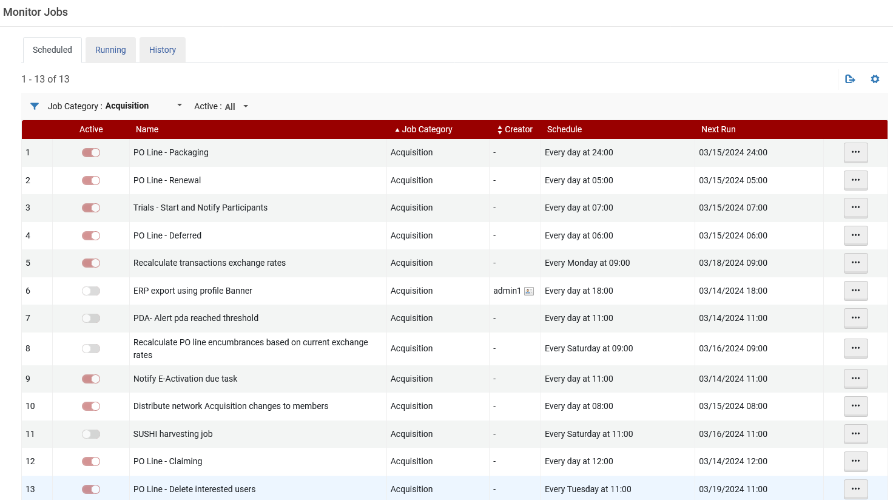
In the NZ

Slide 18
In the NZ
Here we can see that it has completed

Slide 19
In the NZ
In this report below we see that 1 record was processed.
This is because one vendor was added to the network (Taipei Press) since the last time the job ran.
We also see in the report that the vendor was distributed to all three member institutions of the network.

Slide 20
In the member

Slide 21
In the member
Now we will go to “Alma University” which is a member institution.
We see the vendor from the NZ and we see that it is shared and active (more about the “active” on the next slide).

Slide 22
In the member
In the previous slide we saw that the vendor which was shared is “active”.
Each member institution continues to define local information for vendors, such as vendor accounts, EDI information, access providers, and vendor interfaces.
In the case of a vendor which is a material supplier the vendor gets distributed as “active” and by default gets a vendor account which is the same name and code as the global vendor (the vendor from the NZ).
For vendors which are not material suppliers the vendor remains inactive in a member institution until certain local information, such as a vendor account, is added and the vendor is activated.
Vendors which are not material suppliers (for example “Access Provider” or “Licensor”) in any case do not have vendor accounts. They will remain inactive until further edited.

Slide 23
In the member
In the next slide we will view the shared vendor in the member institution in edit mode.
We will see that the shared vendor does not get the accounts from the network, but rather (in the case of a “material supplier) gets a default account which has the same name and code as the vendor (see explanation in previous slide).
The member institution can edit this or add new accounts as desired, and they will be local.
The global information such as vendor code and name is not editable.
The global contact information is distributed and can be viewed or duplicated but not edited (except for a special case of “edit global attributes” which will be discussed later).

Slide 24
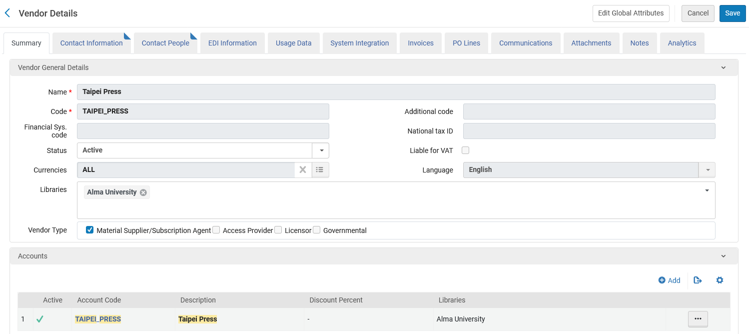
In the member
The shared vendor in edit mode in the member institution
More about this button later
Global information from network not editable
Default account with name and code of the vendor

Slide 25
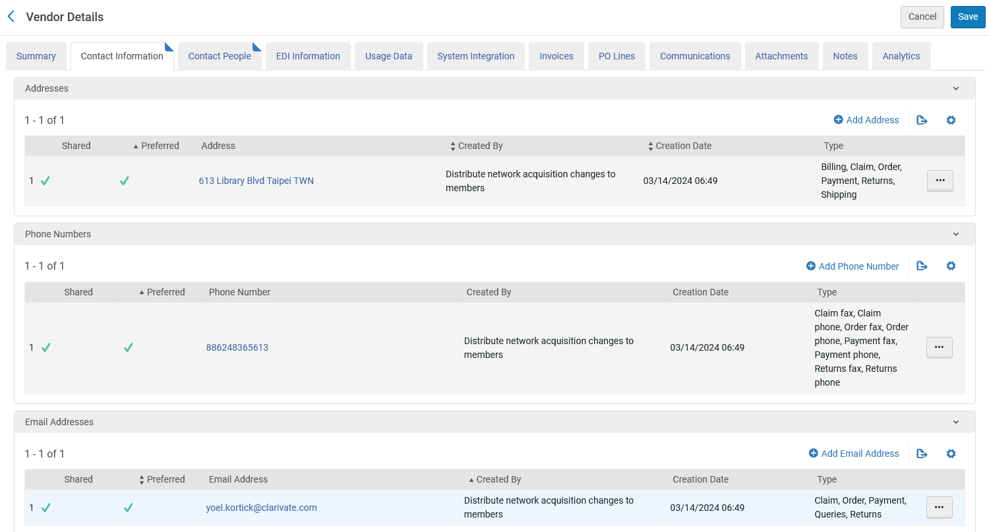
In the member
The vendor level contact information has also been distributed to the member institution

Slide 26
Contributing to network

Slide 27
Contributing to network
It is also possible to contribute vendor information from the member to the network.
Network Zone
Ex Libris University Consortium
Contribute vendor information to the network
Contribute vendor information to the network
Contribute vendor information to the network
Member Institution
Alma University
Member Institution
Open University
Member Institution
University of Knowledge

Slide 28
Contributing to network
To do this click “actions > contribute” for any non-shared (local) vendor in the member institution..
Here we do it for vendor “Alicia Ltd.”
Vendor is not shared
Click “Contribute”

Slide 29
Contributing to network
Receive message and confirm

Slide 30
Contributing to network
Receive confirmation that the vendor has indeed been contributed to the NZ from the member institution.

Slide 31
Contributing to network
In the member institution we now see that the contributed vendor is shared.

Slide 32
Contributing to network
The vendor is now in the NZ and can be shared with all members the next time the job “Distribute network Acquisition changes to members” is run.
We are in the NZ

Slide 33
Edit global attributes

Slide 34
Edit global attributes
It is also possible to “edit global attributes”.
In this situation a staff user in a member institution can open a shared vendor and via the “edit global attributes” option can edit the fields which normally are “greyed out” because they are part of the network.
The staff user can change these fields, and then they get changed in the NZ.
The updated information in the vendor record of the NZ will be shared with all members the next time the job “Distribute network Acquisition changes to members” is run.

Slide 35
Edit global attributes
For example, here in member institution we see that vendor “Taipei Press” is shared and we edit it.
Vendor is shared
We edit the vendor

Slide 36
Edit global attributes
All fields are greyed out (not editable) and we click “edit global attributes”
We click “Edit Global Attributes
Fields are greyed out

Slide 37
Edit global attributes
After we click “edit global attributes” we confirm the Confirmation Message.

Slide 38
Edit global attributes
Now we can edit the global fields (except the code).
We add a Financial Sys. code and click “Save”

Slide 39
Edit global attributes
The information has been updated in the NZ and will be distributed to the member institutions when the job “Distribute network Acquisition changes to members” is run.
We are in the NZ
This is the change we made when we were in the member institution

Slide 40
Summary

Slide 41
Summary
In order to save time and resources it is possible that an entire consortium can manage global vendor information in the NZ.
Via a regularly scheduled job the global vendor information gets distributed to members daily.

Slide 42
Summary
It is also possible for a member institution to contribute vendors to the NZ.
Once the vendor is in the NZ it will then be distributed to all members.

Slide 43
Summary
When the vendor is shared and in the member institution the global details can be updated by a member.
These changed global details will then get distributed from the network to all members.

