Slide 1
SFX TotalCare: User Interface Configuration - SFX Menu
Notes:
Hello and welcome to this session on User Interface Configuration for the SFX Menu.
This presentation is copyrighted and is the confidential property of Ex Libris Ltd. Information included in this presentation is periodically reviewed and updated. You may shared these training materials within your institution but not beyond.

Slide 2
Copyright Statement
All of the information and material inclusive of text, images, logos, product names is either the property of, or used with permission by Ex Libris Ltd. The information may not be distributed, modified, displayed, reproduced – in whole or in part – without the prior written permission of Ex Libris Ltd.
TRADEMARKS
Ex Libris, the Ex Libris logo, Aleph, Alma, SFX, SFXIT, MetaLib, DigiTool, Verde, Primo, Voyager, MetaSearch, MetaIndex and other Ex Libris products and services referenced herein are trademarks of Ex Libris, and may be registered in certain jurisdictions. All other product names, company names, marks and logos referenced may be trademarks of their respective owners.
DISCLAIMER
The information contained in this document is compiled from various sources and provided on an "AS IS" basis for general information purposes only without any representations, conditions or warranties whether express or implied, including any implied warranties of satisfactory quality, completeness, accuracy or fitness for a particular purpose.
Ex Libris, its subsidiaries and related corporations ("Ex Libris Group") disclaim any and all liability for all use of this information, including losses, damages, claims or expenses any person may incur as a result of the use of this information, even if advised of the possibility of such loss or damage.
© Ex Libris Ltd., 2014

Slide 3
Agenda
SFX Menu
SFX Menu Customizations
Summary & Additional Resources
Notes:
During this session, we’ll be focusing on the SFX Menu, and I’ll be showing the possibilities for customization, or in other words configuration, of the SFX menu.
As mentioned in the A-Z List configuration session, keep in mind that defaults are set for the customizations – so don’t feel like you need to make decisions on each and every one of the options I’ll be covering.

Slide 4

Objectives
Understanding customization options for the SFX Menu
Incorporate best practices
Notes:
The key objectives for this session are:
understanding the SFX Menu customization options that are available
keeping in mind some best practices for user interface customizations.

Slide 5
Agenda
SFX Menu
SFX Menu Customizations
Summary & Additional Resources
Notes:
So let’s first take a look at the SFX menu itself.

Slide 6
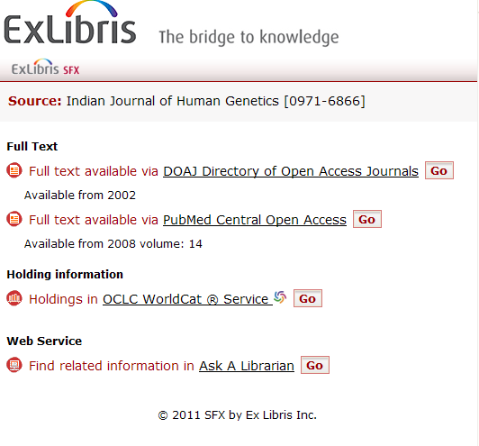
SFX Menu
http://hostname:port/instance?&rft_val_fmt=info....
SFX Base URL
Notes:
The URL for the SFX menu consists of your SFX Base URL, in addition to metadata from the OpenURL. Remember that your SFX base URL will be provided to you by your Ex Libris project team.
Note that the SFX menu won’t have anything displayed in it unless it has metadata from an OpenURL, which then allows the menu to show applicable targets and target services.
Because the SFX Menu is generally produced as a result of clicking on the SFX button in a source database, the content itself is going to vary quite a bit.
In terms of content, the Menu shows a summary of the object, then a list of basic and extended services that are available. It contains the names of targets and descriptions of different services. Note that targets with the same services can be grouped together.
All of these items and the order in which they appear in the SFX menu can be customized.

Slide 7
Agenda
SFX Menu
SFX Menu Customizations
Summary & Additional Resources
Notes:
Let’s talk now about the kinds of customizations that are available in the SFX menu.
Keep in mind that if you are in implementation, you’ll want to work with your Ex Libris project team for any SFX menu customization changes. If you are already live with SFX, you can log a Support case for any changes you want to see, as the support team will make these changes on your behalf as you are a TotalCare customer.
Also – you may want to review your Ex Libris SFX contract, as it will outline the types of changes that can be made and how often changes may be requested.

Slide 8
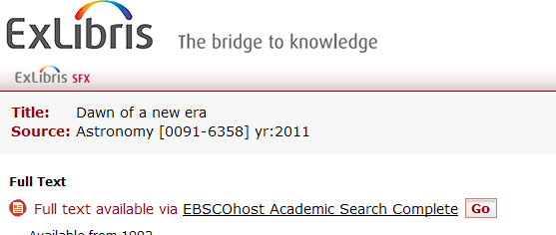

Menu Configuration: Header/Banner Images
Header image
Banner image
Note: Can also apply a header image for mobile interfaces
Notes:
Let’s take a look at the images first in the SFX menu.
There are header images and banner images that can be displayed in the SFX Menu - and these two images appear at the top of the menu. A header image appears first, in this example our large Ex Libris logo, and a banner image can appear below it, in this example our smaller SFX logo.
If you decide to use a header image, we recommend that the header image be no wider than 455-700 pixels, and though there isn’t a restriction on how tall the image is, keep in mind that the SFX menu will be in a pop-up window or embedded in another application, like Primo, so screen real estate may be of concern.
Note that a header image can also be applied for the SFX menu mobile interface.
As you see, the banner area is just below the header. Note that the banner includes the short summary of the citation, and it can also include a language translation drop-down menu as we’ll see shortly. You also have an option to turn off the SFX banner in the SFX menu if the user is in Primo and views the SFX menu.
If you decide to use a header and/or a banner, you will just need to provide the images to Ex Libris.
You can also choose to have no header or no banner image.

Slide 9
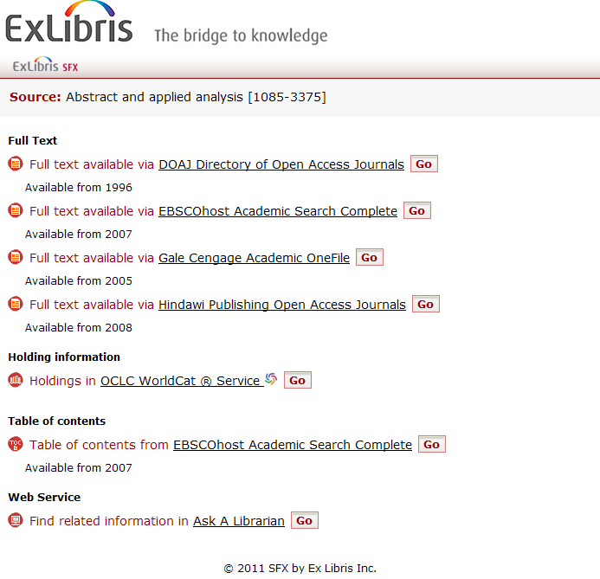
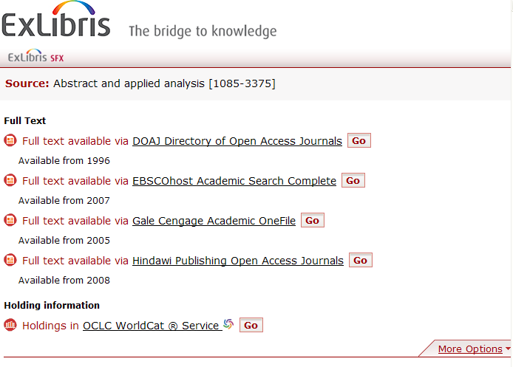
Menu Configuration: Collapsible Menu
No Collapsible Menu
Collapsible Menu
Notes:
Another display option is it’s possible to have a collapsed menu, showing only the basic services in the menu – what you feel are the most important services to display to users initially, and then have a more options tab to see the rest of the options that are available.
(click) If you choose not to have a collapsible menu, all options will be shown in the SFX menu. Notice that the full text links are listed first, then the holdings information, table of contents, and web services. If there was a target that provided abstract information, it would be below the full text services.
If you choose to have a collapsible menu, the menu would look like this (click). Now there’s only full text and holdings information viewable – and the user could click on the More Options to see the rest. If you decide that you want the menu collapsed, you can choose which services should appear initially, and you can also choose which side (left or right) you want the More Options tab to appear on.

Slide 10
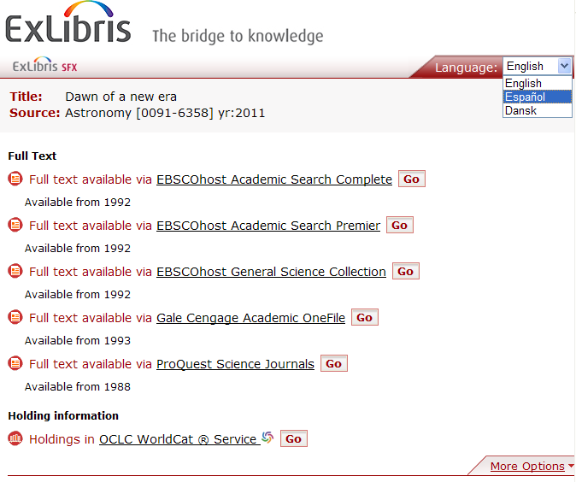
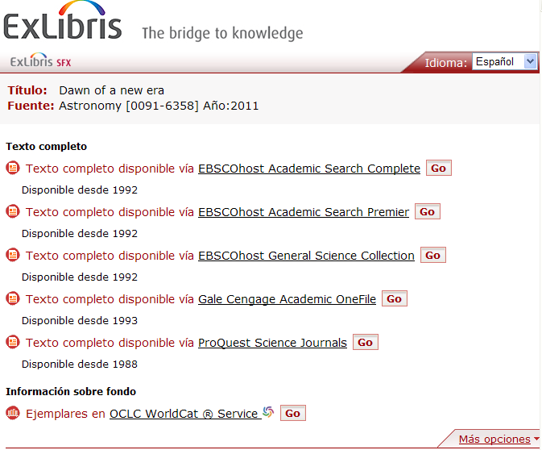
Menu Configuration: Languages
Notes:
Like the A-Z List, you can show a language dropdown in the SFX menu, and you can choose the languages you’d like to appear in the dropdown.
Also like the A-Z list, if you select a different language from the drop-down (click), the labels in the menu are translated, but the information that comes from the KnowledgeBase remains the same.

Slide 11
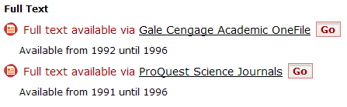
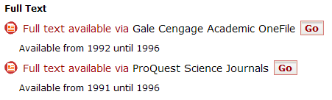
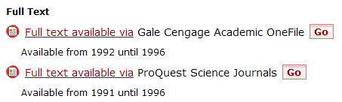
Menu Configuration: Hyperlinked Text
3 options:
Target Name
None
Service Name
Notes:
You can also decide if and where you want to place hyperlinks in the SFX menu to access target services.
(click) By default, the target name links to the full text in this example.
(click) If you chose to have no linked text, it would look like this. The user could still get to the full text using the ‘Go’ button.
(click) And lastly, this is what it would look like if you decided to use the service name to link to the full text.

Slide 12
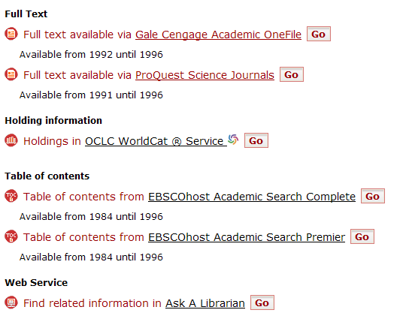
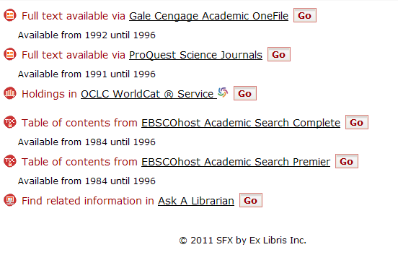
Menu Configuration: Headers
Display Headers
Do Not Display Headers
Notes:
The next option is to display or hide the headers.
If Display headers are enabled, then you’ll see section headers appear in the SFX menu for each type of service.
If Display headers are not enabled (click), then you will not see any section headers, but targets will still be grouped together. Notice in this example that full-text targets are listed together, and table of contents targets are listed together, but there are no section headers displayed.

Slide 13
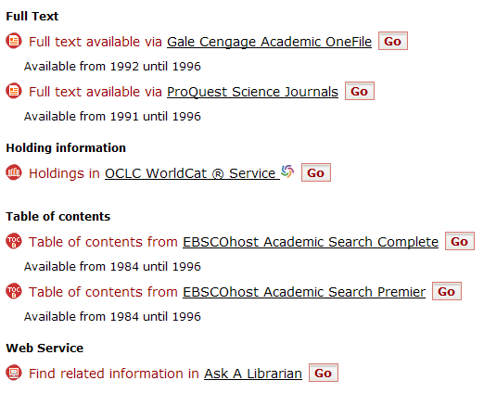
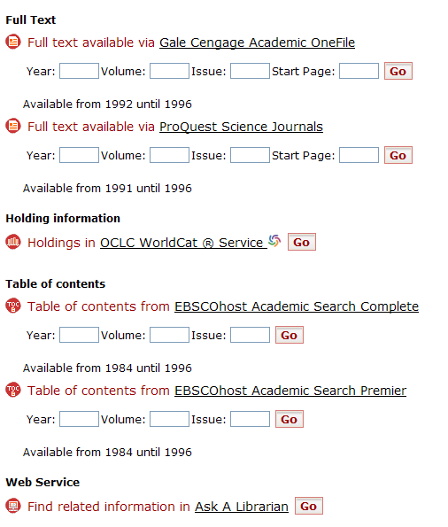
Menu Configuration: Fill Boxes
Do Not Show Fill Boxes
Show Fill Boxes
Notes:
You also have an option to show Fill-in boxes, which allows the user to input their own year, volume, issue, and start page information into the menu.
(click) Here’s the default – where we see the SFX menu as usual – with no fill-in boxes
(click) and here’s the SFX menu with fill-in boxes. Note that the fill-in boxes will automatically be populated with the year, volume, issue, and start page for the article that the user is looking for; however the user also has the option of clearing out the fill-in boxes to enter in a year, volume, issue, and start page for a different article they might be looking for. If the user clicks on the Go button, they will then be taken to full-text if it’s available for the article.

Slide 14
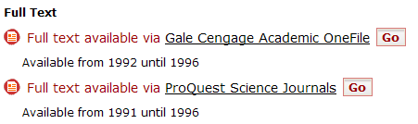
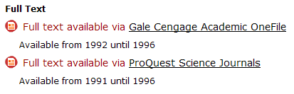
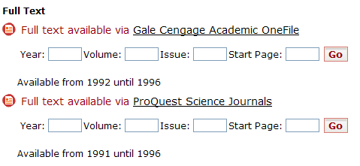
Menu Configuration: Go Button
Show Go button
Do Not Show Go Button
Note: Keep the Go Button
if you decide to
show the fill-in boxes!
Notes:
Speaking of the “Go” button… you can decide if you want the Go button to display or not.
(click) Here’s what it look like with the Go button.
(click) Here’s what it looks like without the Go button. Obviously if you decided not to make any of the text hyperlinked, you’d want to keep the Go button.
(click) Another thing to keep in mind is that if you decide to show the fill-in boxes, you’ll also want to keep the Go button. Otherwise it’s not clear how to submit the changed year/volume/issue information. It’s possible (you can press the Enter key while your cursor is in one of the text boxes), but it’s really not that intuitive.

Slide 15
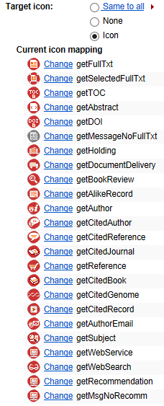
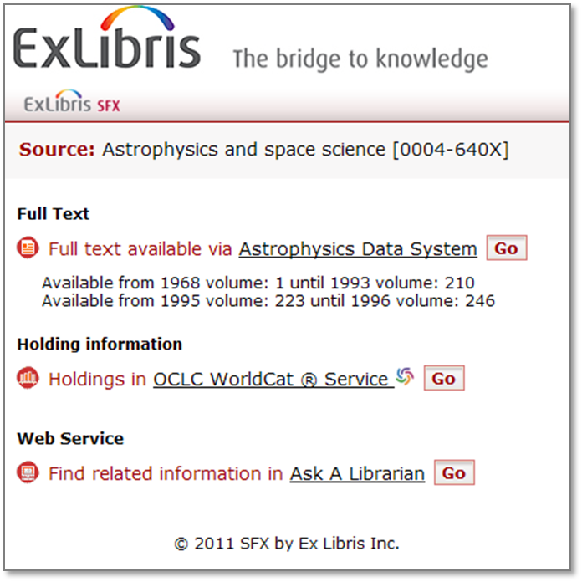
Menu Configuration: Target Icons
Use the default icons, hide the icons, use the same icon for all target services, re-assign the icons, or create your own!
Notes:
It’s also possible to customize the icons that appear next to each link in the menu. (click)
You can choose to make them all the same, remove them completely, or customize individual icons with your own icon. You can also request that your Ex Libris project team or support reassign the icons.

Slide 16
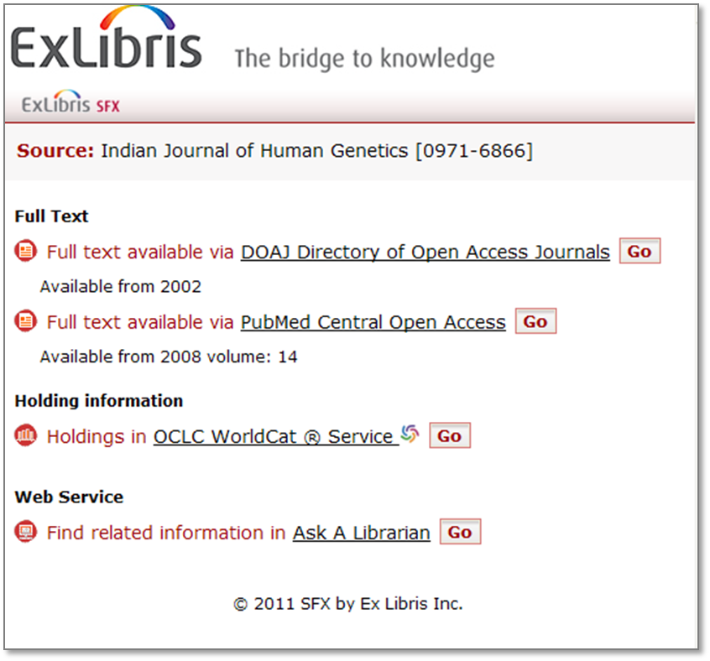
Menu Configuration: Service Precedence
Can choose the order that services display in SFX Menu
Notes:
So that covers many of the design elements available, now let’s talk about service precedence.
Basically, it’s possible to control the order of the services that we see, in order of priority. You can also decide what should be included in basic services which is important if you have a collapsible menu – so in other words, what services appear first in the SFX menu before the user has to click on the More Options tab.
In my example, I’ve chosen make getFullTxt the top service in the SFX menu – so it displays first if it’s available. Then getselectedfulltxt if it’s available (it’s not in this example), then Holdings information, then Web service information, and so on.

Slide 17
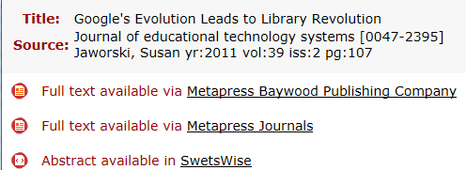
Menu Configuration: Target Precedence
Can choose which targets you want to display first in the SFX menu and which targets to display last in the menu
Notes:
In a similar way, you can also define the target precedence. In other words, in what order targets should display in the SFX menu. By default, they’re going to display in alphabetical order. An option here is to showcase your subscription resources first – so have those targets display first in the SFX menu, and then you could opt to put all of your free targets last.
Keep in mind that most likely your users are going to use the first link in the list. So using this example, if you have full text available from Metapress Baywood Publishing Company and Metapress Journal, they’re going to be using the Metapress Baywood Publishing Company full text link first because it appears first in the list. You may want to remember this when you’re running usage statistics, as the usage statistics for the target that you want to display first in the list will likely be pretty high.

Slide 18
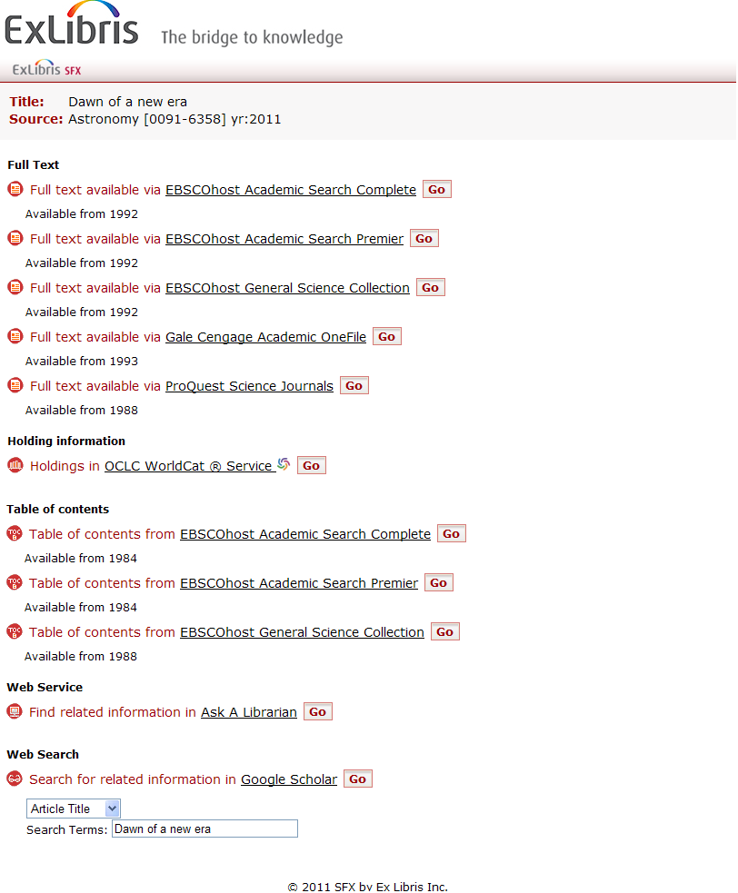
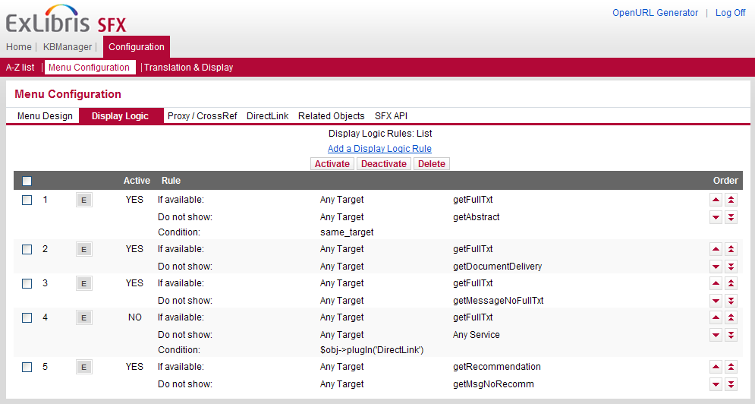
Menu Configuration: Display Logic
Notes:
Display logic can be a fun option to play with – and this screenshot of Display Logic is from the Support team view of the SFX Admin Center.
Perhaps full text is available through multiple targets, or full text and table of contents information is available in the same menu. In certain circumstances you may not want to give all of those options to your users – you really want a nice clean menu without a lot of extraneous information in it.
Here’s a great example. (click)
We can see here that the full text is available from three EBSCO databases, not to mention that it’s also available from two other vendors, Gale and ProQuest. The table of contents is also available for this article, again, from three EBSCO databases. You may decide that you really just want to display a full text link from each vendor, and you want to suppress the Table of Contents services in this case, because you’re already providing links to the full text.
Now, it's possible to shut one or more of these services off or inactivate the services, but you may not want to do that - because it could be that with another article the full text isn't available, and you'd want to make sure that at least you gave your users the option to get to the Table of Contents.
So Display Logic allows you to think about conditions you want to apply to the services that are displayed. (click)
Some of the default rules here can help you do just that. Again, this is a screenshot from behind the scenes, but this first rule, which I have active already, is saying that if the full text is available from a target, don't show the abstract. There's a condition - if I'm getting the full text from a target, I only want to suppress the abstract from the same target. The next rule states that if full text is available, I want to suppress document delivery.
You can actually get very specific with these logic rules, and this will help you create a clutter-free SFX Menu.

Slide 19
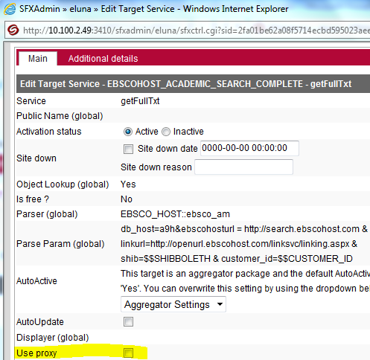
Menu Configuration: Proxy
Proxy types: EZ Proxy, WAM, Lib Proxy, Web Proxy
Proxy can be used:
  All of the time
  None of the time
  Selectively, depending on each target
Notes:
Let’s about now about using the Proxy server with the SFX menu.
When creating target URLs, SFX can direct end users to go through your proxy server. The proxy server determines the IP address of the user and checks to see whether the user on campus or off campus. If the user is on campus, they go straight to the to the target. If the user is off campus, they’re asked to log into the proxy server. The proxy then goes out to the databases to get the web pages and send them back to the user. Since your proxy is on the library’s network, the database vendors recognize the IP address as belonging to your institution.
SFX supports EZProxy, Innovative WAM, LIBPROXY, and WEB_PROXY – and you can select when you want to use the proxy:
All of the time for all targets – regardless of whether targets are free or subscription.
None of the time
Or selectively – based on a checkbox in the target service level for each target. This is where to control whether or not to use the proxy for each target. Your Ex Libris project team and the support team has access to the target service level and can set this up for you. Selectively controlling when to use the proxy can be handy if you find that your having technical issues with a particular database, or if you have a lot of free targets active – there’s no need to proxy a free target, and you can save your proxy server some traffic.

Slide 20
Menu Configuration: CrossRef
CrossRef: Official DOI registration agency for scholarly and professional publications
http://www.crossref.org/
DOI (Digital Object Identifier) example:
  10.1103/PhysRevE.62.1457
Notes:
Let’s talk a little about CrossRef and how it’s used with SFX. By default, CrossRef is enabled to work with SFX.
CrossRef is the official DOI registration agency for scholarly and professional publications – DOI stands for Digital Object Identifier – it’s a standard identifier for articles and other digital objects that allows you to link directly to them based on the DOI itself. Using the DOI example here, the 10.1103 typically represents the publisher for the article. The other information seen in the DOI represents title of the journal, the volume and the page number for the article.
During your implementation, you’ll be asked to register with CrossRef as a library affiliate. There are a number of reasons why we have you do this…

Slide 21
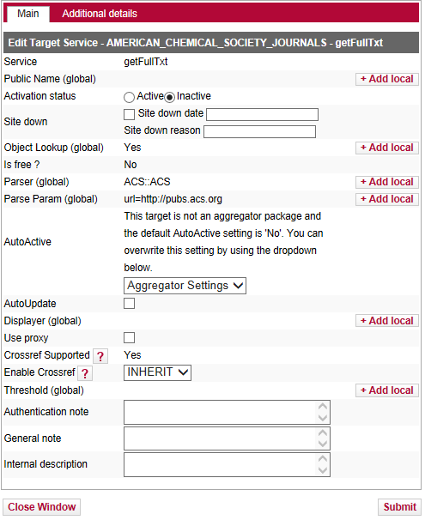
Menu Configuration: CrossRef
Enables article level linking
  if target requires a DOI, SFX can reach out to CrossRef to retrieve the DOI
Enhances SFX services
  if source sends DOI through the OpenURL, SFX can reach out to CrossRef to retrieve other metadata about the article
Ensures CrossRefs/DOIs link to appropriate copy
  provides other alternatives to access full-text
Notes:
The first reason why we ask you to register with CrossRef is to enable article-level linking. Also during your implementation, Ex Libris will probably be activating the DOI target in your KnowledgeBase – so when the SFX server receives a DOI, DOI linking can be provided.
In other cases SFX targets may require a DOI to create an article level link. However, the SFX source doesn't always send the DOI as metadata in the OpenURL. When it's not there, SFX can retrieve the DOI from the CrossRef database.
Behind the scenes, the targets that use DOI linking contain a field called 'CrossRef Supported with a 'yes' value in the View and Edit windows of the target service.
(click) Another reason to register with CrossRef is that sometimes an SFX source sends a DOI through the OpenURL, but doesn't send any other metadata. SFX can use the CrossRef database to augment the OpenURL so that the targets will have more information to work with.
(click) And lastly, CrossRef can ensure that your users are linking to the appropriate copy: By default, when your users click on a CrossRef or DOI link in a source, they're going to be linked to the full text at the publisher's Web site. However, this may not be the link you want - for example, you may host the journal locally, or subscribe to the journal through an aggregator. As a CrossRef library affiliate, you can ensure that when your users click on a CrossRef or DOI link, they're going to go to your SFX server, and not directly to the publisher’s site.

Slide 22
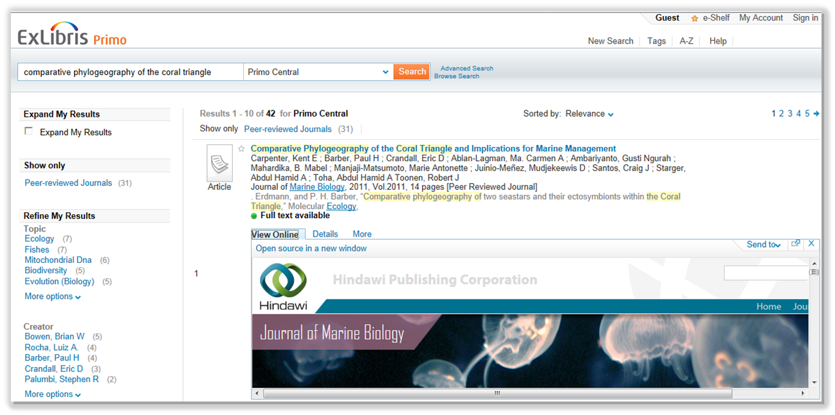
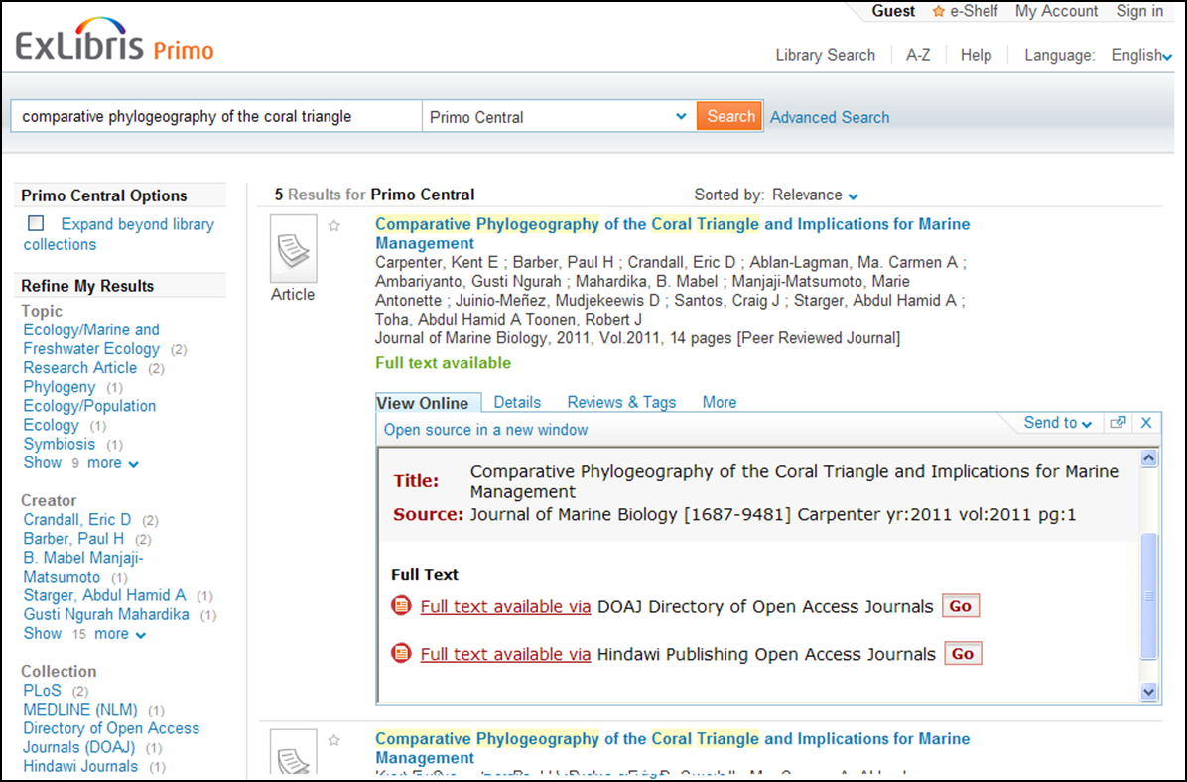
Menu Configuration: DirectLink
DirectLink bypasses the SFX menu, and takes the user directly to article full-text
Notes:
Let’s talk about Directlink now. You may remember this setting from the SFX Introduction. In short, when DirectLink is enabled, the user can click on the SFX button in the source system and be passed directly to the full text, bypassing the SFX Menu completely.
To show you the difference between DirectLink turned off vs. on, let’s use an example of Primo as a source where the user starts his/her search.
(click) With DirectLink off, when the user clicks on the View Online tab in Primo – or if they click on the SFX button in other sources - they will always see the SFX Menu as an intermediate step between the source and the target databases. Generally speaking, with DirectLink off, the user will have the ability to choose which target they want to use, or take advantage of any additional services shown in the menu.
(click) However, with DirectLink on, the user will be taken directly to full-text when they click on the SFX button in the source - or in Primo, the View Online tab. They will not see the SFX menu when full text is available.
With DirectLink on, the user no longer needs to make an extra decision and an extra click, and they’re brought directly to the full text – bypassing the SFX menu.

Slide 23
Menu Configuration: DirectLink Options
Turn direct linking on or off
Determine if direct linking should only be used for getFullTxt service, or other services
Determine if direct linking should only be used for only certain sources
If there are multiple targets that have full text:
  Determine if direct linking should be used in that case
  If so, should the first target in the list show the full text; works in conjunction with target precedence
Notes:
Now there are several decisions you can make about Directlink.
(click) First, you can decide if you want it turned on or off.
(click) If you decide to turn directlinking on, you can determine which target services it should be used for. Typically, it is used for getFullText services where the user will be taken to full-text. So this means that if only an abstract or table of contents is available, the user will get the SFX menu.
(click) You can decide which sources you want direct linking to work with.
(click) In the event that the full text is available from more than one target, you can decide if want direct linking enabled in that case. If you choose not to enable direct linking if there are multiple targets that have the full-text, then the SFX menu will display in that case and the user can choose which target to view the full-text from.
If you decide to enable direct linking if there are multiple targets that have the full-text, then you can decide which target full-text you want to link directly to – for example, perhaps showing the full-text from the first target that displays in the list - which will work in conjunction with target precedence if you have the established.
There are a few other Direct Linking options that are not mentioned here. You can learn more about them from your Ex Libris project team or in the SFX General Users Guide.

Slide 24
Menu Configuration: Other Options
Related objects can be displayed in or hidden from the SFX menu
  e.g., Decide if you want related journal titles (titles absorbed by, continued by) to display
SFX menu mobile user interface can be enabled/disabled
Notes:
I’ll just sum up very briefly a few more options.
For related objects: You can decide if related objects should display in the SFX menu. For example, titles that are continued by or absorbed by other titles. This is similar to the related objects options that we covered in the A-Z List configuration session, but this would be if you want related titles to display in the SFX menu.
Also, the SFX menu mobile user interface can be enabled or disabled. We talked briefly about the Mobile user interface in the A-Z List configuration session. Note that if the SFX menu mobile interface is disabled, the A-Z list mobile interface is still enabled.

Slide 25
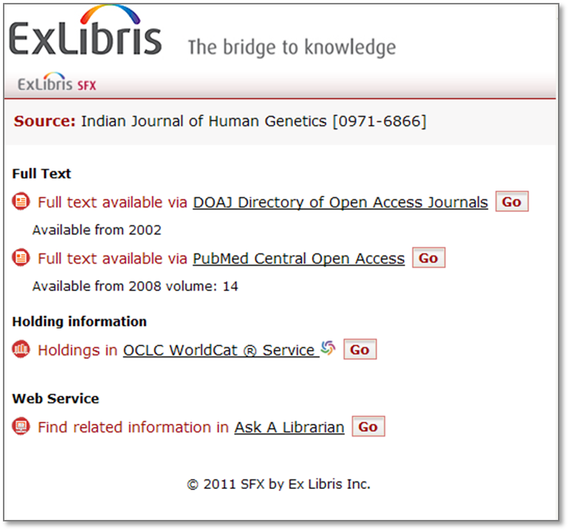
Translations and Display
Can translate and/or re-label text labels in the SFX Menu
Notes:
Lastly, just like we saw in the A-Z List configuration session, the wording for text elements that are used in the SFX Menu can be changed.
If you want to change the wording for any of the labels in the SFX menu, you can ask your Ex Libris project team or Support to change it for you.
This can apply to one or more of the languages that you want to make available to your users.

Slide 26

SFX Menu Configuration: Best Practices
Defaults are good
Keep it simple
Will affect usage
Therefore, will affect usage statistics
Notes:
When you start thinking about how to customize the SFX Menu, remember that in general, (click) defaults are good! Start from there, and as you start testing and becoming more familiar with SFX, you may start to notice things you want to change.
(click) Next, remember to keep it simple. You want to make sure your users know exactly what they need to click on to get to the full text, holdings information, or document delivery. But you don’t want to necessarily hide options that are going to be useful to your users.
(click) Remember also that the choices you make in regard to target and service precedence, display logic and direct linking are going to affect how your users gain access to your electronic resources. (click) Therefore, they’re going to affect your usage statistics. An example is if you’ve implemented target precedence. Users may have a tendency to click on the first link they see in the SFX menu, so that first target and service that displays may get a lot of use which you’ll notice in your usage statistics.

Slide 27
Agenda
SFX Menu
SFX Menu Customizations
Summary & Additional Resources
Notes:
This brings us to the end of this session.

Slide 28
Summary
Understanding customization options for the SFX Menu
Incorporate best practices
Notes:
To summarize, the key points we covered are:
SFX menu customization possibilities that are available
some general best practices for SFX menu customizations

Slide 29

Additional Resources
Accessible from Documentation Center:
(http://www.customercenter.exlibrisgroup.com/)
  General User’s Guide
  Advanced User’s Guide
  EL Commons Website
    http://www.exlibrisgroup.org
Notes:
Here’s where you can find more information on SFX menu configurations. These can all be found in the Ex Libris Documentation Center.
The General User’s Guide will have more details on the SFX menu customization options we talked about in this session.
The Advanced User’s Guide will have information on SFX menu customization options that Ex Libris does on the server.
Additionally, the EL Commons website is one place where customers can share information and customizations they have implemented.
Thanks for viewing this session!

