Slide 1
Introduction
Notes:
Hello, and welcome to this session. Today I’ll be introducing you to SFX.
Please note that this presentation is copyrighted and is the confidential property of Ex Libris Ltd. Information included in this presentation is periodically reviewed and updated. You may share these training materials within your institution but not beyond.

Slide 2
Copyright Statement
All of the information and material inclusive of text, images, logos, product names is either the property of, or used with permission by Ex Libris Ltd. The information may not be distributed, modified, displayed, reproduced – in whole or in part – without the prior written permission of Ex Libris Ltd.
TRADEMARKS
Ex Libris, the Ex Libris logo, Aleph, Alma, SFX, SFXIT, MetaLib, DigiTool, Verde, Primo, Voyager, MetaSearch, MetaIndex and other Ex Libris products and services referenced herein are trademarks of Ex Libris, and may be registered in certain jurisdictions. All other product names, company names, marks and logos referenced may be trademarks of their respective owners.
DISCLAIMER
The information contained in this document is compiled from various sources and provided on an "AS IS" basis for general information purposes only without any representations, conditions or warranties whether express or implied, including any implied warranties of satisfactory quality, completeness, accuracy or fitness for a particular purpose.
Ex Libris, its subsidiaries and related corporations ("Ex Libris Group") disclaim any and all liability for all use of this information, including losses, damages, claims or expenses any person may incur as a result of the use of this information, even if advised of the possibility of such loss or damage.
© Ex Libris Ltd., 2014

Slide 3
Agenda
What is SFX?
User experience
How SFX works
SFX Implementation
SFX and Primo
Summary and additional resources
Notes:
In this session, first I’ll talk briefly about what SFX is, and then you’ll see how your users will experience and interact with it.
Next, you’ll learn how SFX works and be introduced to concepts and terminology that will help you understand SFX better.
Lastly, I’ll introduce you to the SFX implementation process, as well as talk about how it works with Primo, Ex Libris’ discovery system.
Then we’ll just wrap things up and I’ll mention some additional resources that are available to you.

Slide 4

Objectives
How To…
  Identify SFX elements
  Define user experience and workflows
  Implement SFX (high-level process)
  Integrate SFX & Primo (associated settings)
Notes:
The key objectives for this session are:
Understanding what SFX can do and how it works - especially in terms of SFX elements and terminology and the user experience. You’ll see the SFX terminology throughout the documentation and application itself so it’s important to understand what the terms mean.
Knowing what to expect at the beginning your implementation
Knowing how SFX operates with Primo and to begin thinking about a couple of options that have to do with SFX and Primo integration. The SFX/Primo integration will be discussed more in a separate session.

Slide 5
Agenda
What is SFX?
User experience
How SFX works
SFX Implementation
SFX and Primo
Summary and additional resources
Notes:
So let’s start with what exactly is SFX…

Slide 6
What is SFX?
Link resolver
  Uses citation data to find and link to related records
Uses the OpenURL standard
  Syntax for transferring bibliographic metadata from one information provider to another
A-Z List
Analysis Tools and Usage Statistics
Notes:
First and foremost, SFX is a link resolver. A link resolver uses the data in a citation from a database or discovery system to find and link to related records (like the abstract or full text) in a different database. It can also link to a variety of resources, such as your library’s catalog or an interlibrary loan service.
SFX uses the OpenURL standard. OpenURL is what makes open linking in the web-based environment possible. It provides the syntax for transferring bibliographic metadata from one information provider to another.
SFX provides your end users with an A to Z list of your resources, and also provides library staff tools to analyze your e-resource collections and report on their usage.

Slide 7
Agenda
What is SFX?
User experience
How SFX works
SFX Implementation
SFX and Primo
Summary and additional resources
Notes:
Now that we’ve defined at a high-level what SFX is, let’s look at SFX from a user perspective.
We’re going to look at the SFX user experience from a couple of different angles.

Slide 8
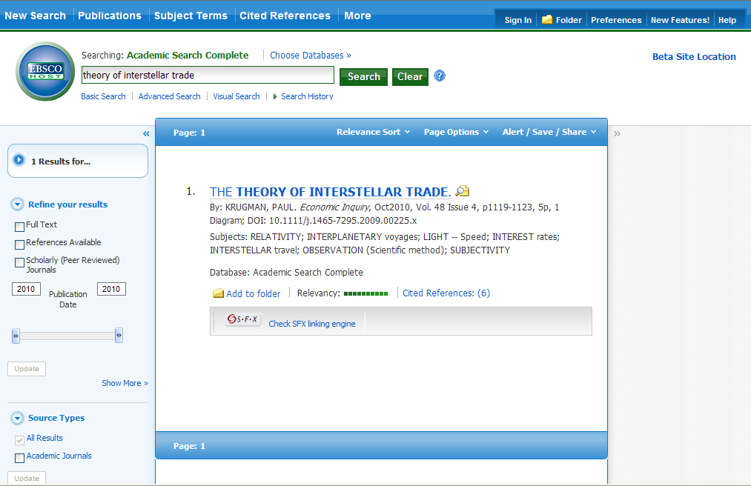
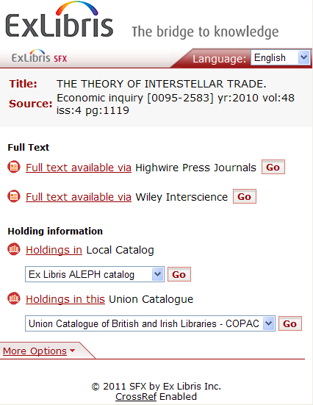
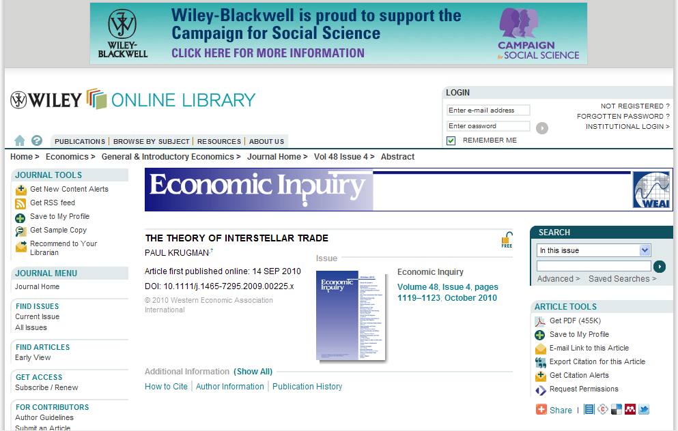
User Experience: Starting at Source
Notes:
The first SFX term we’re going to cover (as it relates to the user experience) is source. The source is where the user starts his or her search. In this case, we’re using the scenario where the user starts the search in an Ebsco database. The source in this example is Ebsco’s Academic Search Complete.
The general workflow here is that the user does their search in Ebsco and pulls up a list of results and sees a citation of interest. Because the library doesn’t happen to have access to the full text in EBSCO, the user only sees the citation in Ebsco. But your library also has a subscription with Wiley Online and Wiley Online has the article full text.
If you have both of these databases set up to work with SFX, your users will be able to click on the SFX button in EBSCO (click) and be presented with a list of links to related records such as full text, holdings information or other services. (click)
From there, your users can click GO and be brought to the full text in Wiley Online.

Slide 9
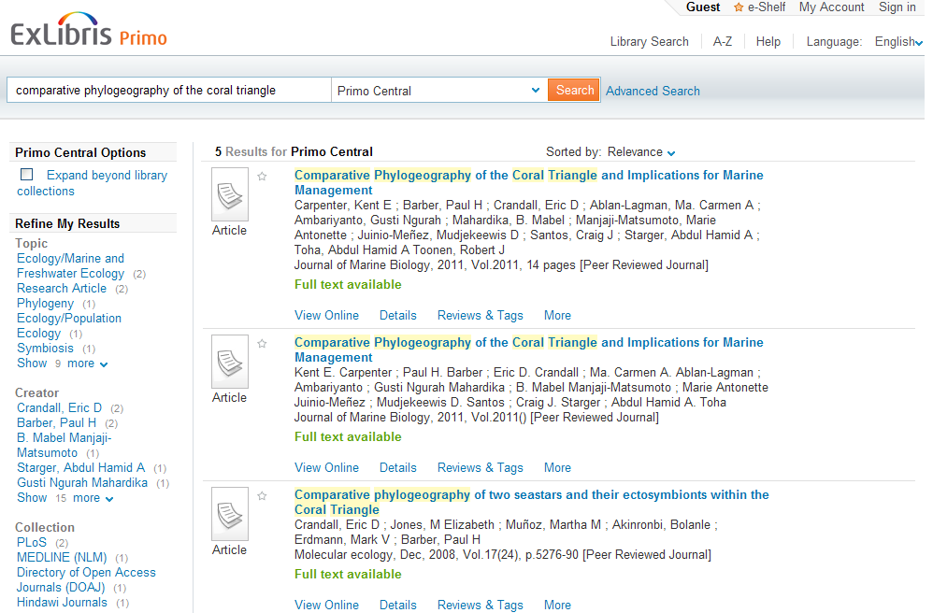
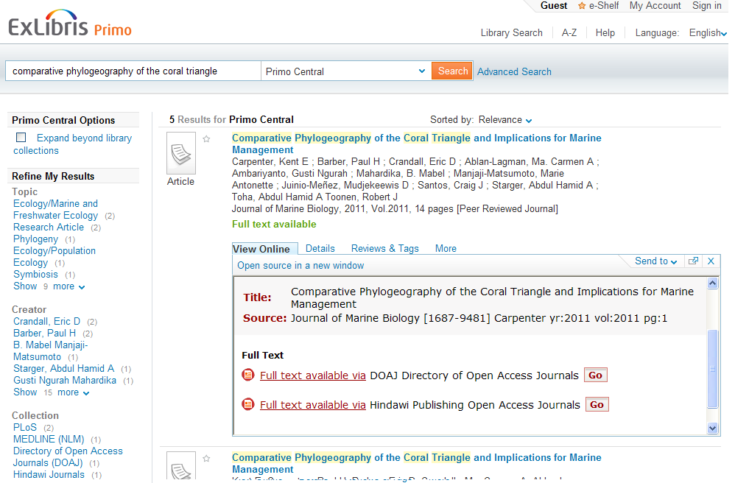

User Experience: Starting in Primo
Notes:
In a similar way, your users may find a citation of interest while searching your library’s OPAC or Primo.
They would be able to click the SFX button in your OPAC, or in Primo’s case the “View Online” link, and then be brought to the full text article or eBook by clicking on the Go button.

Slide 10
Agenda
What is SFX?
User experience
How SFX works
SFX Implementation
SFX and Primo
Summary and additional resources
Notes:
Now that we’ve talked about the user experience, let’s talk about how SFX works behind the scenes.

Slide 11
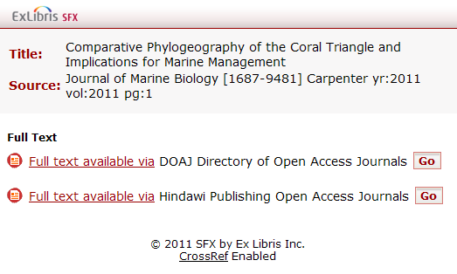
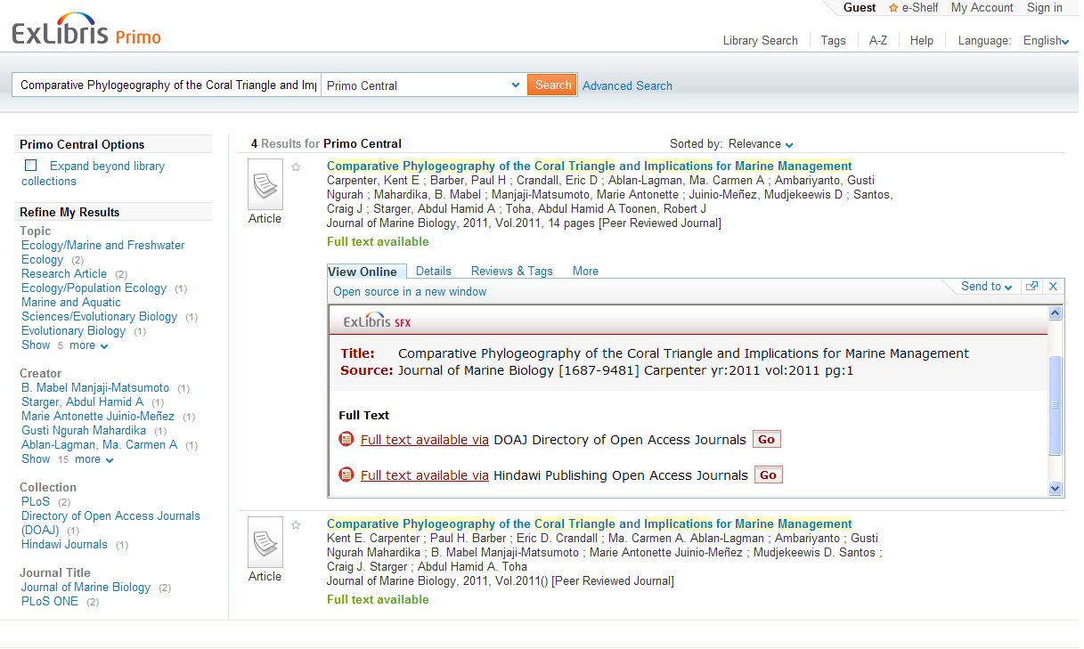



How SFX Works
?
Source
Target
Notes:
SFX uses the information that it gets from the source system (in this example, Primo), and checks to see if your library subscribes to that content using SFX. If your library does subscribe to the content, it will generate an SFX Menu with the link to go to that content in the target system, in this case the Hindawi site.
This all happens very quickly. What the user sees is either the SFX button or the “View online link’. When they click on it, they’re presented with a menu of options, and when they choose one of them, they get the full text article or service that they’re after in the target system.
The target is where the user wants to go, or in other words, the service they are looking for (e.g., fulltext, abstract, etc.)

Slide 12



Source
OpenURL
SFX
Context
Object
Services
Thresholds
SFX
Menu
Target URL
Target
Notes:
Let’s take a closer look. When the user clicks on the SFX button (or View Online) in the source system, the source generates an OpenURL containing information about that citation. That OpenURL is sent to the SFX server where the data from the OpenURL is augmented with information from either the SFX KnowledgeBase or an external provider, like CrossRef.
SFX gathers up this metadata and generates a context object. Using the context object, SFX looks up the services (such as full-text, abstracts, etc.) that are available. For example, the context object may include the ISSN of the journal that the article was published in. It uses the ISSN to see if your library subscribes to any database providers that carry this journal, as well as whether full-text, abstracts, etc. are available.
Once SFX has identified potential providers, it then uses the thresholds to determine whether or not the article itself is available from that provider. (Thresholds are conditions – such as date coverages – more on this in a few minutes.) So if the article citation is from 2011, SFX checks to make sure that you have coverage for that date. The user is then presented with a menu of links that go to the full text article and other library services.
When the user clicks on one of the links in this menu, a target URL is generated and the user is brought to the full text article. This target URL is different than the OpenURL, as it contains the additional augmented data, and can also contain authentication information specific to your institution so the user can access the full-text of the article.

Slide 13
OpenURL Example
http://10.100.3.189:3410/eluna?&rft_val_fmt=info:ofi/fmt:kev:mtx:journal&genre=article&sid=ProQ:ProQ%3Aericshell&atitle=Google%27s+Evolution+Leads+to+Library+Revolution&issn=0047-2395&date=2011-01-01&volume=39&issue=2&spage=107&au=Jaworski%2C+Susan%3BSullivan%2C+Roberta&jtitle=Journal+of+Educational+Technology+Systems
Notes:
Since I mentioned OpenURLs, here is an example of an openURL. Note that lots of metadata is contained in it.
For example:
Your SFX URL will appear first in the OpenURL. This is where the source is sending the OpenURL – to your SFX instance.
SID = Source ID; where the user did their search and clicked on the SFX button. In this case, it’s a ProQuest database where they did their search. Proquest sent this OpenURL to your SFX to check availability and options for how to access the article.

Slide 14

Sources and Targets
Source
  Database or discovery system where users are searching
Target
  Database that contains what users are searching for
Notes:
Let’s talk a little more about SFX terminology. The source and target systems are the beginning and ending points for your users.
The source is the database or discovery system where the SFX request is initiated. The source can be a database like PubMed, EBSCO, or Gale, or it can be your library’s OPAC or Primo.
The target is the database where your users find what they’re looking for. This could be the full text of an article, abstract information, or it could be a service where they can request document delivery or interlibrary loan. (Basically, any link that appears in the SFX menu is considered a target.)

Slide 15
Services and Parameters
Services
  Connection information
Types of Services
  getFullTxt
  getAbstract
  getHoldings
  getWebService
Parameters
  Authentication used to request information from target
Notes:
Services provide the means of communication between the source and target systems; it’s connection information.
For sources, Vendors provide Ex Libris with the information used in the source service. The source service defines and interprets the data contained in the OpenURL that SFX receives from the source.
The target service will structure, define and submit the request for what the user is looking for (e.g., the full text, abstract or other service that the user is looking for.)
While there are 24 different types of services, the most frequently used are getFullTxt, getAbstract, getHoldings and getWebService. Web Services can include a document delivery service, Interlibrary Loan form, or a link to your Ask A Librarian service
Services can also contain the authentication information necessary to connect to that database– that authentication information is set up in the parameters. Typically these are called Linking Parameters.

Slide 16
Object and Object Portfolio
Object
  Serial title or monograph title
Object Portfolio
  Collection of objects associated with a target / target service
Notes:
An object in SFX is a serial title or monograph title. While your users may be searching for a specific article within a journal, SFX defines the object at the serial or monographic level.
An object portfolio is the collection of e-journals or e-books associated with any given target/target service. For example, EBSCO’s Academic Search Premier’s object portfolio for its fulltext service contains about 22,000 publications, or objects.

Slide 17
Thresholds
Thresholds
  Conditions placed on targets, services, or objects
Global and Local Thresholds
Types of Thresholds
  Date
  Need Attribute
  Authentication
Notes:
SFX also uses conditions that are placed on targets, services or object portfolios to ensure that the users’ requests can be fulfilled. These conditions are called ‘thresholds’. SFX will only display a link in the SFX menu if that target, object or service is available. This availability is calculated based on your subscription to the target, object or service AND the criteria defined in the threshold. Because objects are defined in SFX at the serial level, it’s necessary to specify your library’s coverage for those serials. For example, your user may want an article from 1999, while your library’s subscription only goes back to 2000. In that case, the particular target or service won’t display to the user in the SFX menu because the library doesn’t have the date coverage for it.
SFX has default (or global) thresholds in place based on the standard packages supplied by the vendors. However, your library’s coverage may differ from these defaults, so SFX allows you to customize these thresholds and make them local. Local thresholds will override the global ones without replacing them, in case you need to revert back to the global later on.
The most common reasons to use thresholds are
When your library’s coverage does not include the entire run of the publication, or when you have an embargo (i.e., date coverage that your library subscribes to)
When you know that the database requires a specific attribute, such as the author’s last name, or volume and issue.
If you want to restrict access to a publication to a smaller group or individual within your institution.

Slide 18
Agenda
What is SFX?
User experience
How SFX works
SFX Implementation
SFX and Primo
Summary and additional resources
Notes:
So we’ve talked about how SFX works behind the scenes, as well as some important terminology. We’ll revisit the terminology again in the Activating Resources session.
Let’s shift gears and talk about your SFX implementation.

Slide 19
SFX Implementation
What type of customer are you?
Implementation Workbook
SFX Resources
Authentication
Notes:
If you’re just getting started with SFX, you’ll be working with an project manager to help you get SFX installed and configured for your institution.
The type of customer you are will determine how your implementation is run, and how much training you need.
We’ll take a look at the Implementation Workbook and SFX Resources spreadsheet, a few tools that will help you gather the information your project manager needs to configure SFX,
And we’ll also briefly touch on how your off-site users are authenticated and how that authentication will work in SFX.

Slide 20
What type of customer are you?
TotalCare
Direct
Local
Notes:
For our TotalCare customers, Ex Libris provides full software and hardware maintenance for SFX. This includes software and hardware updates as well as the maintenance of your KnowledgeBase.
If you’re a TotalCare customer, we’ll be configuring and customized SFX for you based on input and feedback we receive during the implementation. Since you won’t have access to the admin interface or the server, you won’t need to know how maintenance is performed.
For our Direct customers, we provide the hardware maintenance, while you retain control of the software and the KnowledgeBase.
If you’re a direct customer, we’ll help you with your configurations and customizations, but we’ll also show you how things are done in the admin interface. But you won’t have to worry about how to maintain the server.
Local customers have a local installation of SFX and are responsible for both their software and hardware maintenance.
If you’re a local customer, we’ll provide assistance and instruction for every aspect of SFX.

Slide 21
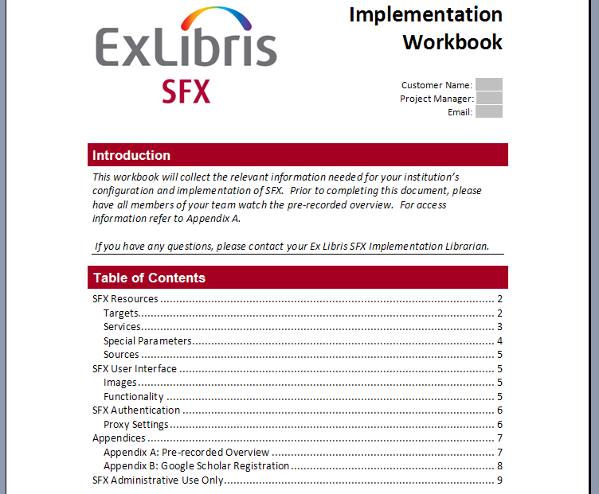
Implementation Workbook
Notes:
Whether you’re a TotalCare or Direct customer, or have your own local installation, when you start your implementation, we’ll send you some materials that will help you get started with SFX. These will include the Implementation Workbook and the SFX Resources sheet.
The implementation workbook is split into three sections: your resources, the user interface, and authentication. Each section is designed to collect the information we need to configure and customize SFX for your institution. Remember that we’re here to help, and if you have any questions when you are filling out the workbook, please don’t hesitate to contact your project manager.

Slide 22
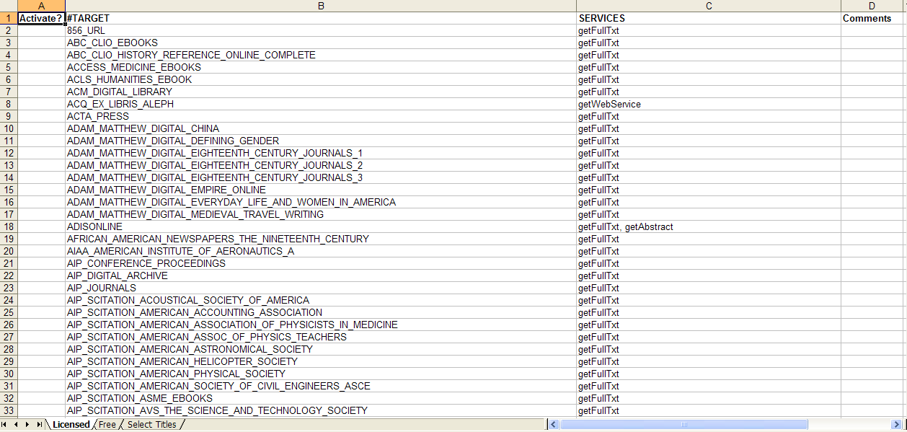
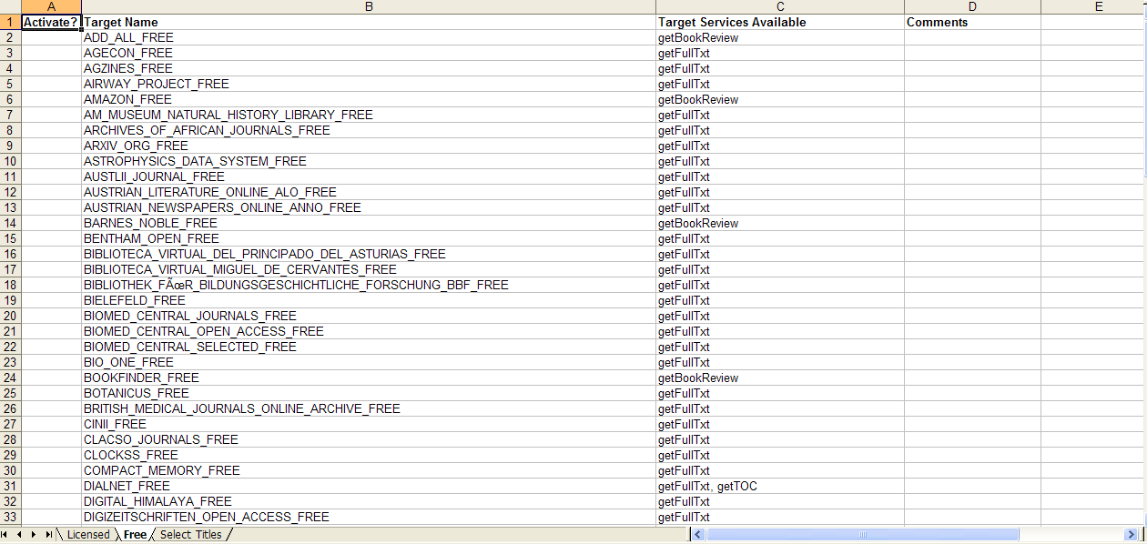
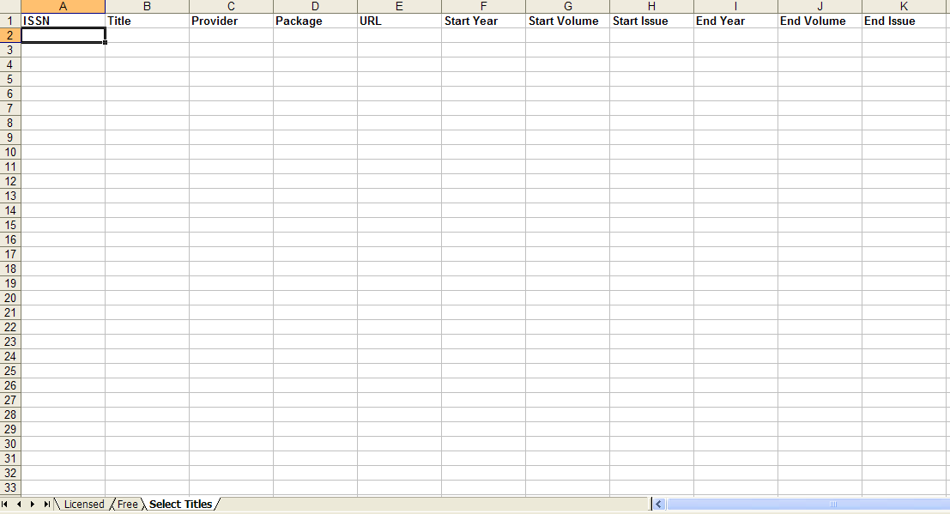
SFX Resources
Notes:
During your implementation, we’ll configure your resources in SFX. When we send you the workbook, we’ll also include a spreadsheet called “SFX Resources”, and the instructions for how to fill it out. There are three tabs in this Excel spreadsheet. The first is “Licensed”, and you’ll see the list of Target Names and Services available in SFX. The target names are titles of aggregator packages. If you subscribe to one of these packages and would like to activate it, you’d indicate that in the first column. You’d only indicate the standard packages in this tab – so for example if you subscribed to EBSCO Academic Search Premier, you’d want that active in SFX. Remember that the target has an object portfolio associated with it, so by activating the target we’re activating ALL of those publications as well. You’ll also notice that the Services column usually says “getFulltxt”, but in some cases there’s more than one service available, like ‘getFulltext’ and ‘getAbstract’ on line 18. For these cases, please indicate which services you want active in the ‘Comments’ column. (Your project manager will give you more details on how to indicate which services you want activated in SFX.)
The second tab is a “Free” list of targets that are available in SFX. If you would like any or all of these activated, you’d record your preferences here in the first column. Once again, if there are multiple services for a target, there’s a ‘Comments’ column where you can indicate which services you’d like. The third tab is “Select Titles” – in this tab, this is where you would identify the titles your library has purchased from individual providers (not as an aggregator package). In order to set these titles up in SFX, we would need information for each of the fields in this sheet. For example most libraries that subscribe to Elsevier Science Direct or Wiley Online may choose individual titles from the collection, so the default vendor package may not be the same list of titles your library subscribes to.

Slide 23
Authentication
VPN
Proxy
Notes:
In terms of Authentication, SFX will function the same way as your licensed resources for your off-site users. For example, if you have previously required off-site users to connect to your internal network via VPN before accessing licensed resources, that requirement will not change with SFX. If you use a proxy server to authenticate your off-site users before they continue on to your licensed resources, that workflow also will not change.
Your project manager will work with you to configure authentication for your off-site users based on your institution’s specific needs.

Slide 24
Agenda
What is SFX?
User experience
How SFX works
SFX Implementation
SFX and Primo
Summary and additional resources
Notes:
Our last topic is how SFX and Primo interact – and in particular some options that you’ll want to start thinking about if you are implementing both applications. Note that there is a separate session on SFX-Primo Integration, which will give you more details.

Slide 25
SFX and Primo
Accessing SFX via Primo
Settings in SFX that affect Primo
Primo Central
Notes:
We’ll see how SFX is accessed through Primo, and some of the settings in SFX that control what your users see.
Then we’ll talk about how SFX and Primo Central work together.

Slide 26
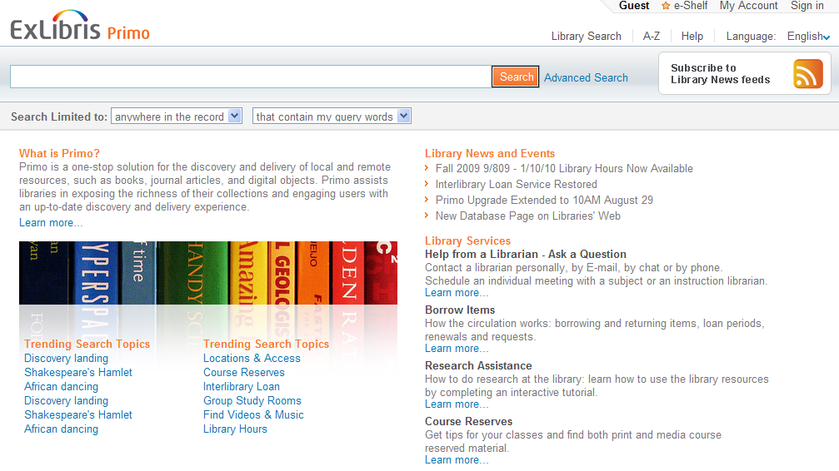
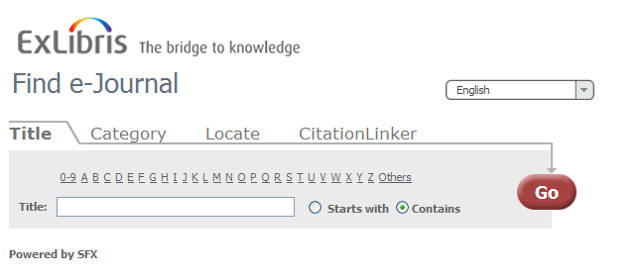
Accessing SFX via Primo: A-Z List
Notes:
The first way to access SFX through Primo is the A-Z link in the top right menu.
This will give your users a way through Primo to search for a list of (for example) e-journals that your library subscribes to or has access to. The A-Z list is actually comes from SFX.

Slide 27
Accessing SFX via Primo: View Online
Notes:
But most of the time your users will be using SFX’s link resolving capabilities when they click “View Online”.
One thing to remember is that the ‘View Online’ link doesn’t always invoke SFX – in Primo, it’s possible to use a URL in the citation’s record to access online content as well. The give-away in this example, however, is that we’re seeing the SFX menu as an intermediate step. A user would click the Go button for the full-text they want to see.

Slide 28
SFX Settings: DirectLink OFF
Notes:
If you’ve purchased Primo, when you configure the display for the SFX Menu, remember that your users may be seeing the SFX menu embedded in Primo’s search results. It’s also possible to control when the menu itself is displayed using DirectLink.
With DirectLink off, the user will always see the SFX Menu as an intermediate step between the source and the target databases.
With DirectLink off, the user will have the ability to choose which source they want to use, and take advantage of the additional services shown in the menu.

Slide 29
SFX Settings: DirectLink ON
Notes:
However, with DirectLink on, the user will only see the source and target, and not the SFX menu when full text is available.
With DirectLink on, the user no longer needs to make an extra decision and an extra click, and they’re brought directly to the full text.

Slide 30
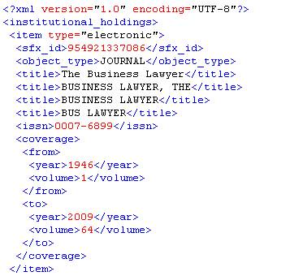
Primo Central: Google Scholar Export
Registered with Google Scholar?
  If so, SFX can generate an export file of your full text resources
  Same export file used for Primo Central
Notes:
Also during your implementation, you’ll be asked whether or not you would like to register with Google Scholar – if you are not already registered with Google Scholar. As part of that registration, Google needs to have a current list of your full text resources. Within SFX, it’s possible to generate and export a file that they can use.
This exported file contains the active getFulltxt data from the SFX database, and is used to indicate in search results when electronic full text is available from your library.
The same file that is generated for Google Scholar, is also used by Primo Central. Your project team will make sure that this functionality is set up for you. You’ll just need to let you know project team know if are registered with Google Scholar. We’ll talk more about the Google Scholar and Primo Central process in the SFX-Primo Integration session.

Slide 31
Agenda
What is SFX?
User experience
How SFX works
SFX Implementation
SFX and Primo
Summary and additional resources
Notes:
This brings us to the end of our session.

Slide 32
Summary
How To…
  Identify SFX elements
  Define user experience and workflows
  Implement SFX (high-level process)
  Integrate SFX & Primo (associated settings)
Notes:
To briefly summarize what we covered, we looked at:
SFX elements and terminology
What SFX can do and how it works in terms of user experience as well as behind-the-scenes.
What to expect at the beginning your implementation
How SFX operates with Primo, and some integration options for you to start thinking about.

Slide 33

Additional Resources
Accessible from Documentation Center:
(http://www.customercenter.exlibrisgroup.com/)
General User’s Guide
Advanced User’s Guide
Notes:
For more information on SFX, the General User’s Guide provides a good overview and general information about how to use SFX, and the Advanced User’s Guide provides more detailed information. Both of these documents can be found on the Ex Libris Documentation Center – which can be accessed from the Ex Libris Customer Center. You’ll need a login, so if you don’t already have a login, please feel free to contact your project manager.
Thanks for viewing this session!

