Slide 1
Delivering the Experience that Users Expect: Core Principles for Designing Library Discovery Services
Name

Slide 2
The Future is Here
Notes:
User experience (UX) is high on the agenda of most libraries.
Much like ‘Back to the Future’, some of the services that once seemed to be science fiction, are now becoming a reality.
Others are likely to remain a dream…

Slide 3
Agenda
1
UX Principles for Web and Discovery
2
Selecting the Right Technology
3
UX in Action – Primo User Interface
Notes:
In this session we wish to go over the core principles for designing Web services, and how what do they mean for designing library discovery services.
We will take a look into the guiding criteria for selecting the right technologies, and provide real-life example from the new Primo user interface.

Slide 4
A Rapidly Changing Landscape
Habits
Design frameworks
Needs
Devices
Infrastructure
USER BEHAVIOR
TECHNOLOGIES
FUNCTIONALITY | DESIGN | PERFORMANCE
DYNAMIC ADJUSTMENTS
Notes:
Change is not a one time thing. Change is constant
This mean that we need to adapt and respond quickly for changes in user behavior and evolving technologies:
Advancing and adapting the type of services and functionalities that we provide to users
Keeping design in line with the latest trends in Web design
Improving performance over time

Slide 5
Key Insights into User Experience
Ex Libris User Studies
Primo Central Log Analysis
Customer Feedback
Increased use of mobile devices
Learning through discovery
Diverse needs of students & faculty
Reading lists: key gateway to the library for undergraduates
Known-items searches
> 50% of queries
Differences across disciplines
Notes:
The first thing to do, before approaching any UX project is to understand users’ needs, to help you define the guiding principles of your design. Then, at each stage of the project, you can verify that every decision you make is aligned with those principles.
The following are the key insights that we derived out of the Ex Libris User Study that we conducted in 2015. (see report here: http://www.exlibrisgroup.com/category/UserStudiesWhitePaper)

Slide 6
Addressing Diverse Discovery Needs
Quick delivery of the most relevant results
Search and Find
Personalization
Quick delivery of the most relevant results
Search results tailored to user’s profile and preferences
Optimization
Learning
Exploration
Human learning through a discovery process
Serendipitous discovery via recommendations, trails & browsing
Notes:
Users’ discovery needs can be split into 4 main categories:
Search & find
Learning
Exploration
Personalization
Search and find—the core functionality of a discovery system. Users search in a variety of ways for specific items and for information on general topics and expect rapid delivery of the most relevant results. Sophisticated search and relevance-ranking algorithms present the user with the content that is most relevant to the context of the search.
Exploration—discovery without boundaries. Experienced scholars and students often follow navigation trails in addition to conducting searches. Recommendations, citation trails, and other metadata associations highlight connections between items, as do browsing and virtual browsing, helping searchers discover related resources.
Learning—an aspect of information seeking valued by undergraduate and graduate students alike. Participants in the study emphasized that searching and exploration are accompanied by learning—acquiring new knowledge, understanding a research area in greater depth, or gaining an overview of a topic.
Personalization—the fulfillment of users’ expectation that their search results will be tailored to their needs. The ranking of search results should be weighted according to the personalization options that a user has selected (such as one’s discipline or one’s need for the most recently published materials).

Slide 7
Designing for Today’s User:
Core Principles

Slide 8
UX Core Principles for Web Design
One Experience across Devices
Intuitive Design
Action-oriented
Personalization
Serendipitous Discovery
Notes:
These are the 5 core principles that we at Ex Libris believe contribute to the success of a UX project.
One experience across devices – PC, mobile, tablets
Intuitive design to simplify daily tasks
Action-oriented design – to minimize users’ effort and get them directly to where they need to go
Personalization – make everything tailored to the specific user’s needs
Serendipity – enable users to make discoveries beyond their immediate need
We’ll expand on each one in the next few slides.

Slide 9
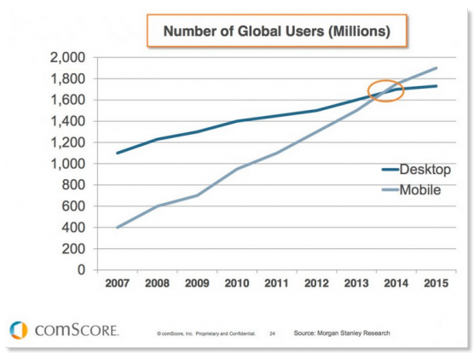
One Experience across Devices
ONE EXPERIENCE ACROSS DEVICES
MOBILE IS THE NEW “BLACK”
Notes:
Mobile usage is surpassing the use of PC. It is bringing a change in users’ expectations from applications and services. In the mobile experience, users expects everything to be accessible immediately.
To maximize the use of any system and improve the user experience, vendors and providers must develop content, applications, and services that can be viewed and used seamlessly on multiple devices.

Slide 10
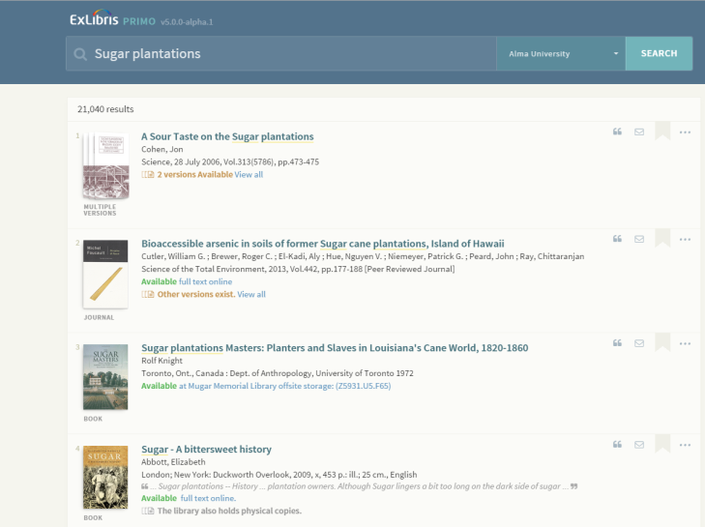
One Experience: What Does it Mean in the World of Discovery?
Identify important functionality and prioritize
Adjust clickable buttons to touch experience
Leverage personalized mobile experience
Notes:
What does it mean in the world of discovery?
Library patrons no longer need to physically go to the library to use its services. Access is available almost everywhere.
Developers must take mobile display and functionality into consideration from the very beginning of the design and development process and make an effort to create a clean, aesthetic look for the application.
Users need to be able access to all available content and relevant information, including loans, holdings, and full text, just as if the device was a PC.
The mobile experience must fulfill users’ discovery needs, providing features such as personalization and exploration options.

Slide 11
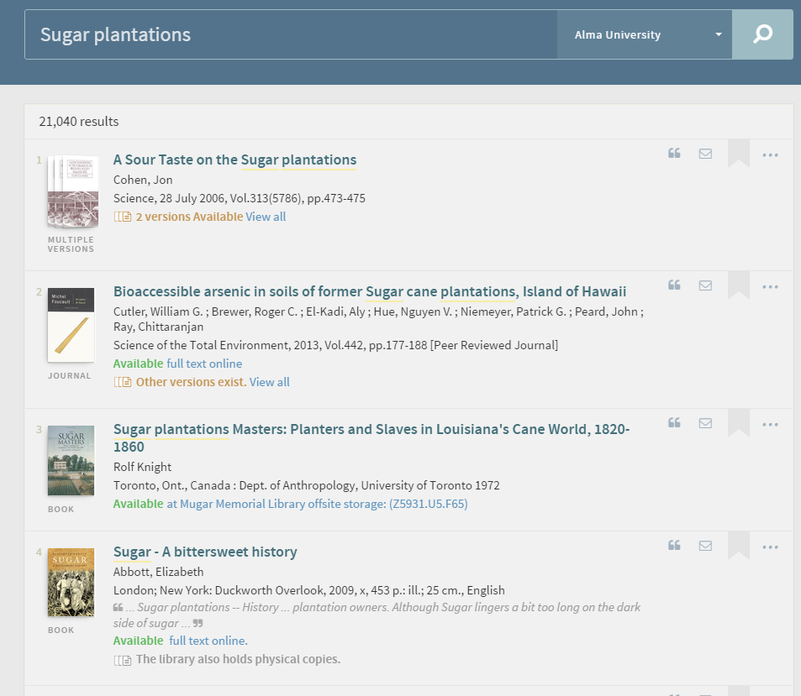
Intuitive Design to Simplify Tasks
INTUITIVE DESIGN
CLEAN LOOK & FEEL | DIGESTIBLE | “GLANCEBILTY” | GRADUAL EXPOSURE
WHAT DOES IT MEAN IN THE WORLD OF DISCOVERY?
Display relevant data only
Display relevant services only
Minimize tabs and dropdowns
Consistent view
Notes:
Patrons should be able to easily navigate and achieve their goals quickly. This requires a clean look & feel and ability to glance quickly through result sets.
Also, each type of user—student, faculty, or library staff—has different goals and needs. As a result, the application must “understand” the user and then, based on the user’s profile and actions, and gradually expose relevant information and options, so that users are not inundated with information.
What does it mean in the world of discovery?
Expose only the relevant data and services
Minimize or hide tabs or menus that are not relevant for the current stage of the discovery process
Maintain a consistent view across all screens and actions

Slide 12
Action-oriented
ACTION-ORIENTED
WHAT IS MY NEXT STEP? | ONE-CLICK DISTANCE | INTERACTIVE DESIGN
WHAT DOES IT MEAN IN THE WORLD OF DISCOVERY?
Pre and post search options to quickly zoom-in on relevant results
Quick access to full text and OPAC functionality
Highlight favorite results
Notes:
An action-oriented design means understanding the user’s intent and enabling the user to realize it as fast as possible. i.e. have the relevant button in a one-click distance.
What does it mean in the world of discovery?
In most cases, the search flow ends with the user’s obtaining a physical item or viewing an electronic one. In some cases, users might want to explore. If a user is in the first phase of research and is creating a list of items to read later, the discovery system should provide options to print the list, send it by email, or add the items to the user’s favorites, all in a single click.
Pre-search and post-search options for quickly zooming in on relevant results. For example, filters and search scopes, auto-complete, auto-spelling corrections…
Quick access to OPAC functionality and full text
Highlight favorite results, so that the user can explore them later on

Slide 13
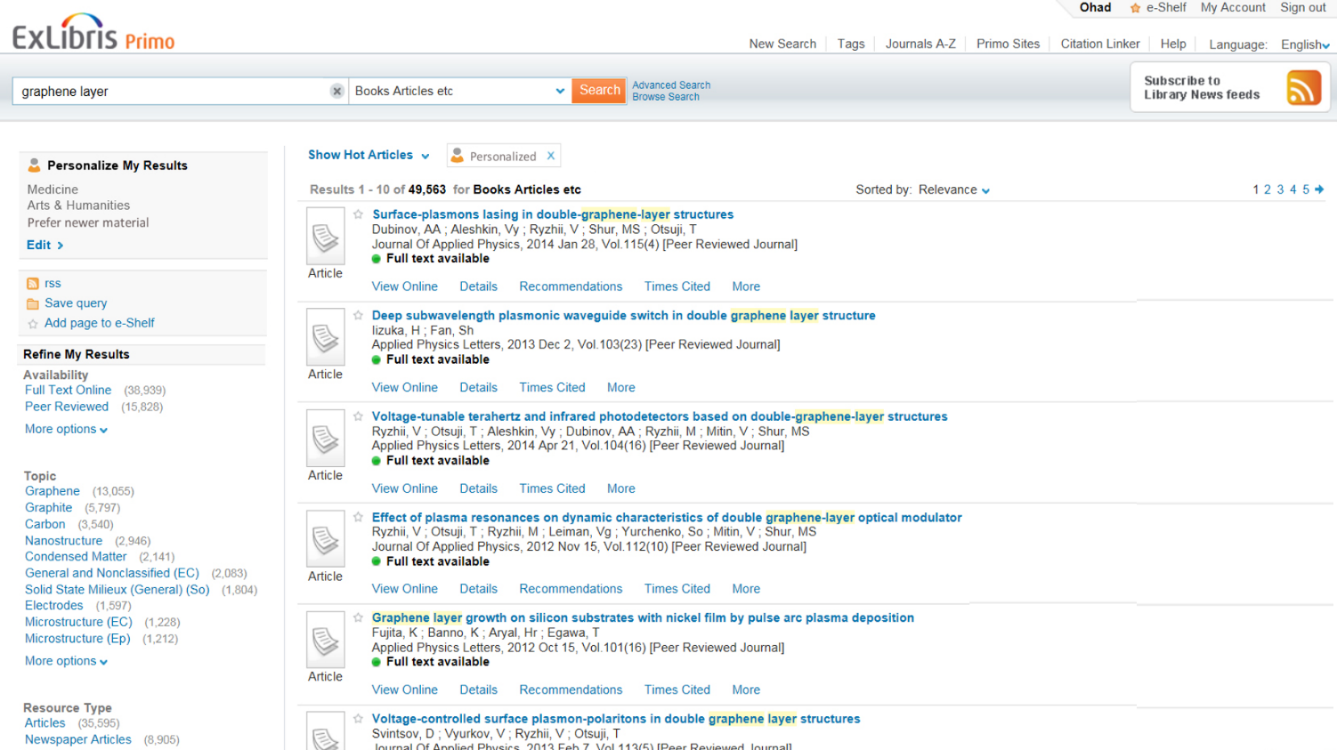
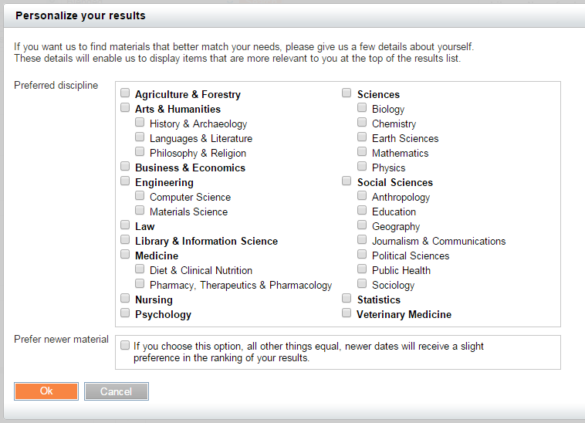
Personalization
PERSONALIZATION
ONE SIZE DOESN’T FIT ALL | UNDERSTAND PERSONAS
WHAT DOES IT MEAN IN THE WORLD OF DISCOVERY?
Discipline
Recency
Materials type
Degree
Notes:
One size doesn’t fit all. The design of an application should make users feel that it was tailor made, suggesting the best matches for the query at hand and relevant action options based on who the user is, the user’s previous selections, and perhaps even the user’s location.
Personalization can be provided through options defined by the user (”active” personalization) and also through anticipation of the user’s intent (“passive” personalization), based on the tracking of his or her pattern of activity.
Some industries, like the academic world, might consider active personalization as too intrusive or a violation of privacy policies. Machine-based personalization might therefore be too early or not relevant in this domain, and libraries should focus on user’s selections to personalize results.
What does it mean in the world of discovery?
Personalization can be done especially according to the following criteria:
Field of research
Recently of published materials
The need for specific types of materials (for example, articles, books, e-books, or images)

Slide 14
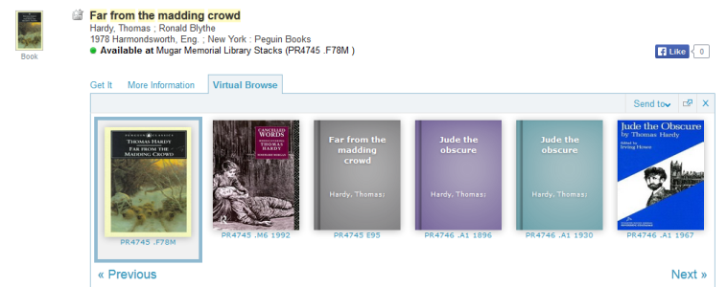
Serendipity
SERENDIPITY
“PLEASANT SURPRISES” | ADDRESS RELATED NEEDS | WISDOM OF THE CROWD | TRAILS
WHAT DOES IT MEAN IN THE WORLD OF DISCOVERY?
Recommendations
Citation trails
Browse
Notes:
What about information that users are unaware of? Serendipitous discovery means expanding the result set from obvious information to related yet important information that the user may not know of.
This goes hand in hand with exploration – based on recommendations, relying on selections made by other users and the wisdom of the crowd.
What does it mean in the world of discovery?
A discovery system should enable users to explore beyond what they can find through a keyword search.
For example:
Article recommendations (bX)
Citation trails and trails of additional works by an author
Browse (A-Z, Virtual shelf browse…)

Slide 15
Selecting the Right Technology for a Great Experience and Optimal Performance
Notes:
A crucial element for reaching the proper balance between mobility, speed, and personalization is the selection of a technology that is appropriate for the specific application’s user interface.

Slide 16
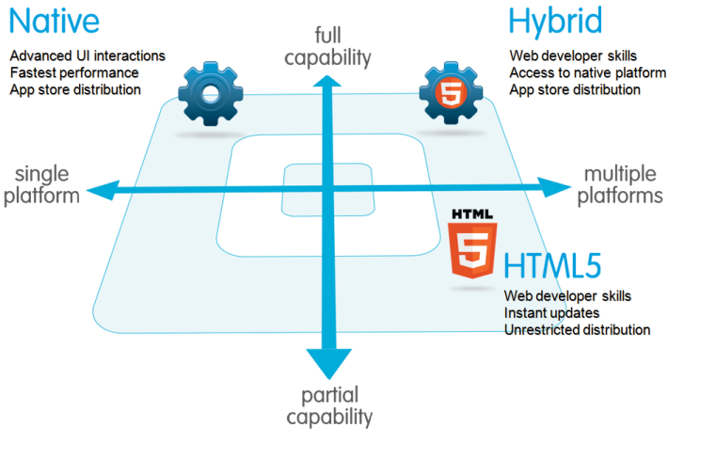
Native Vs. Responsive
TECHNOLOGY
Notes:
Various technological approaches exist for making content accessible on mobile devices. Each approach is used to develop a different kind of app.
Native apps are those that are developed for a specific mobile operating system.
HTML5 apps, on the other hand, are accessible on various platforms, such as computers, smartphones, and tablets. Hybrid apps contain features of both native apps and HTML5 apps.
The main advantages of a native application are that it is customized for the particular type of device, it has an excellent response time, it is available offline, and it interoperates with the device’s built-in features. On the other hand, opting for a native app usually comes at a high price – developing and maintaining a separate application for each device’s platform, design a different experience for each device, etc.
Because of the diversity of operating systems and screen resolutions, more and more organizations are developing their apps in HTML 5 responsive design. Apps developed with this technology are much easier to maintain (only one code base is required), they do not have to be downloaded from app stores, and they provide the same experience across all devices. And, users will get the same familiar design on all their devices, whether PC or mobile.

Slide 17
The Right Technology for Addressing Requirements
TECHNOLOGY
CLIENT SIDE VS. SERVER SIDE | REST APIS | SINGLE PAGE APPLICATIONS | ACCESSIBILITY | SECURITY & PRIVACY
WHAT DOES IT MEAN IN THE WORLD OF DISCOVERY?
Single page application – performance
Endless scrolling vs. pagination
Regulatory requirements
Notes:
The growing range of available UI technologies offers two main approaches: client side and server side.
The current trend is the client-side approach, with single-page applications (applications that load all of the required resources during the loading of the first page).
Benefits of the client-side approach include the following:
A responsive web design can be easily developed.
The server-side business logic and REST APIs are decoupled from the client side.
Performance is excellent, through the use of single-page applications.
When opting for the client-side approach, one must choose an appropriate framework to work with (for example, Angular, Ember, or Backbone).

Slide 18
UX in Action: The Primo New User Interface
Notes:
Let’s look at how we applied the UX principles in the new Primo UI.

Slide 19
Primo User Interface: Discovery On the Go from Any Device
HTML 5, responsive design
Desktop, mobile and tablet
Click for Demo
Notes:
One of the key advantages of the new UI is the way is displays over mobile and tablet devices, making Primo searches available from any device, any time.
Demo: Please use Chrome browser.

Slide 20
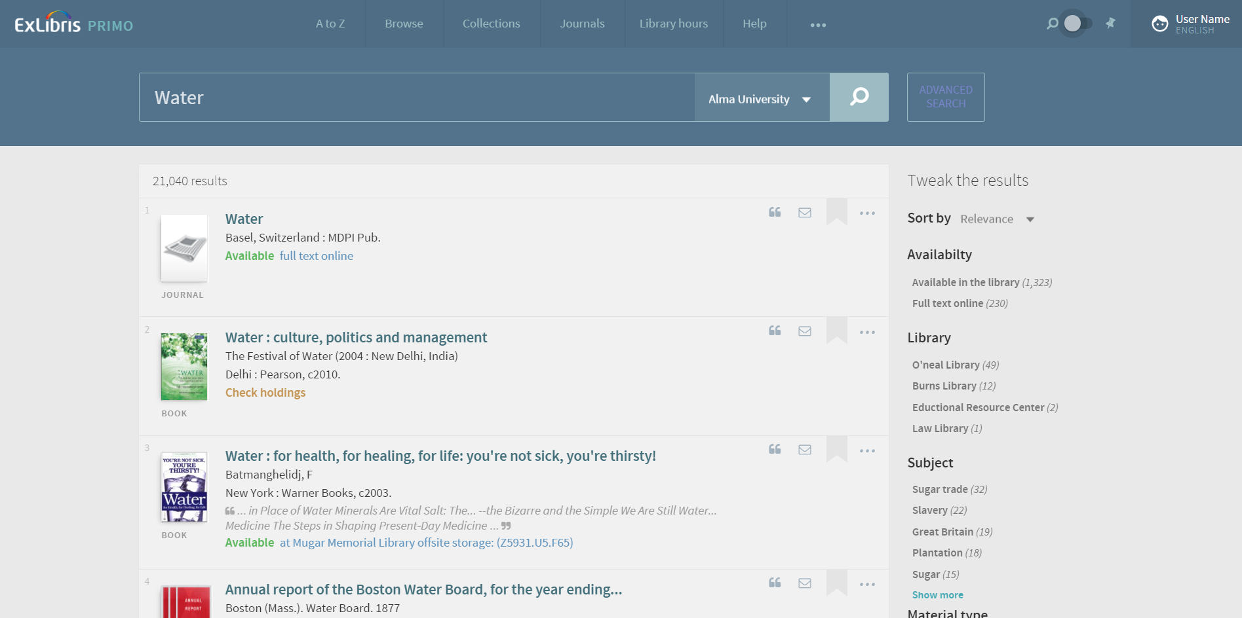
Clear, Intuitive Design
Notes:
The interface of the result list is clean, presenting only data that can help the user easily determine which item to select. If the full text is available, a full-text link is positioned with the item in the result list.
Note the row of icons to the right of each item. Anticipating the user’s next actions, these icons lead directly to the action menu.

Slide 21
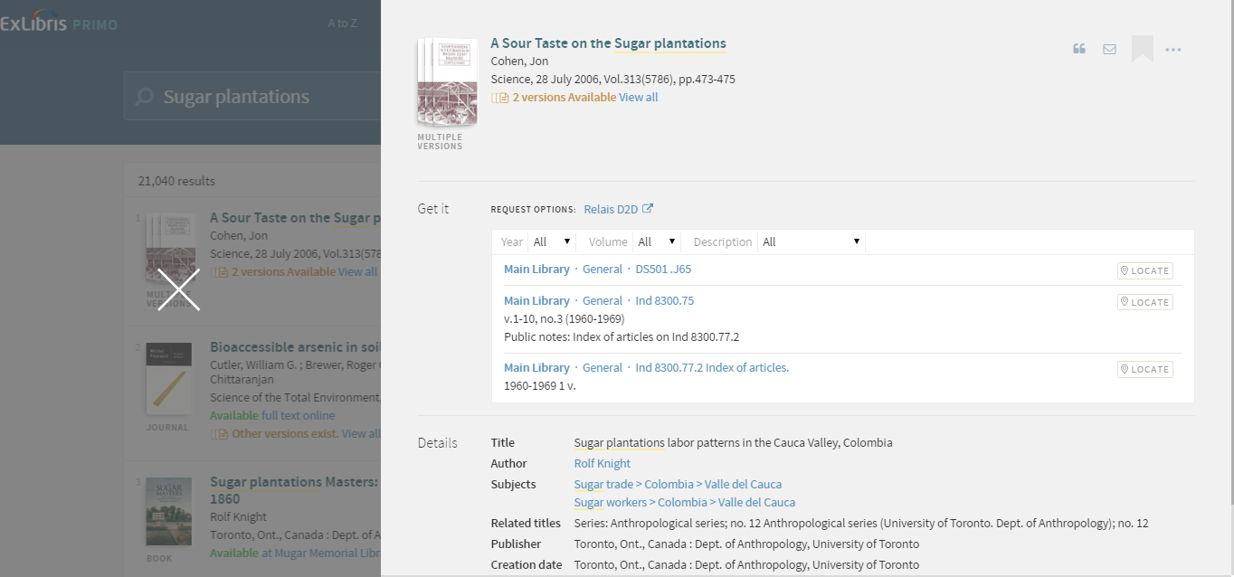
Gradual Exposure of Information
Notes:
Once the user selects an item, all the available information about it appears.
This process is the essence of “gradual exposure.”

Slide 22
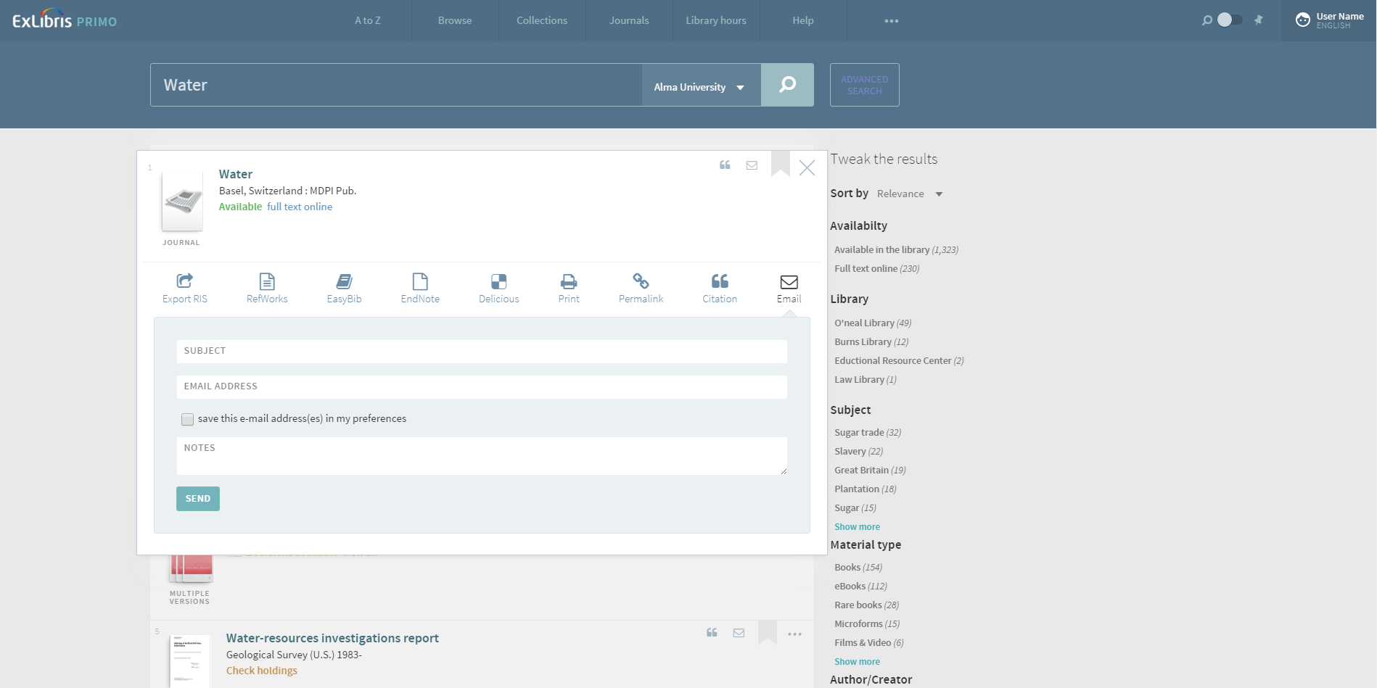
Action Menu: One Click from the Result List
Notes:
The Primo action menu is one click from the result list. It enables users to perform actions such as viewing information about an item, sending the information to themselves or a colleague, adding the item to their list of favorites, and saving the item in a reference tool.

Slide 23
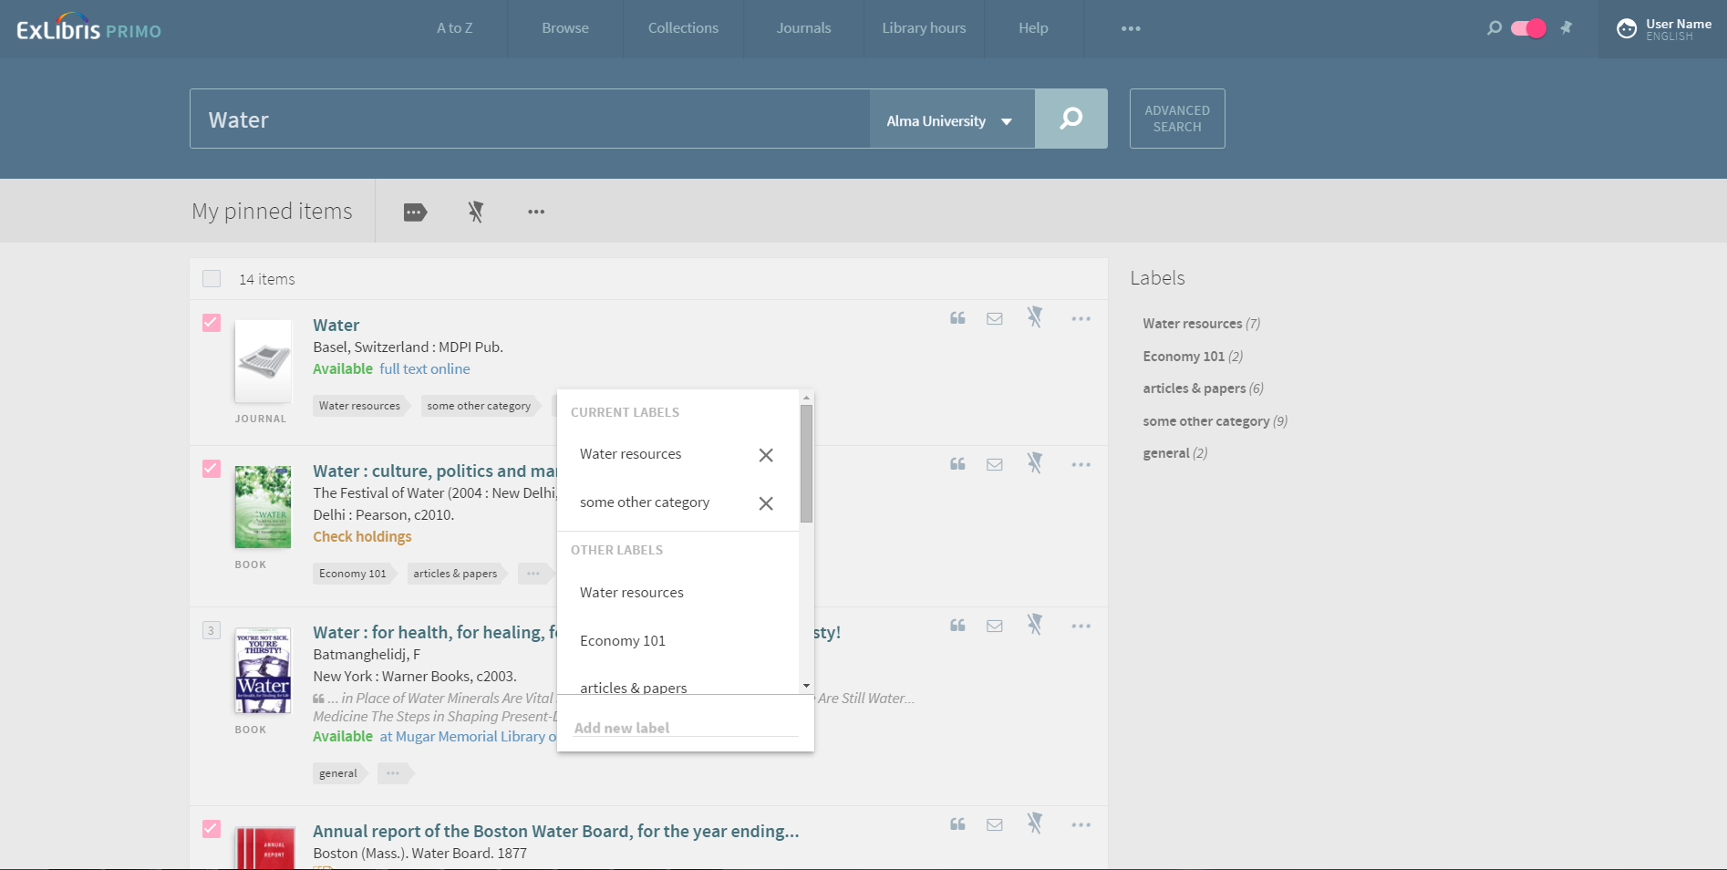
Favorites Screen: A Consistent Display for all Workflows
Notes:
The list of favorites has the same look and feel and provides the same information and action icons as the result list. The list of favorites and the result list are refined in the same way as well.

Slide 24
?
QUESTIONS

Slide 25
THANK YOU

