Slide 1
Alma Collaborative Networks
Overview
Asaf Kline
Senior Product Manager

Slide 2
Copyright Statement and Disclaimer
All of the information and material, including text, images, logos and product names, is either the property of, or used with permission by, Ex Libris Ltd. The information may not be distributed, modified, displayed or reproduced – in whole or in part – without the prior written permission of Ex Libris Ltd.
TRADEMARKS
Ex Libris, the Ex Libris logo, Aleph, SFX, SFXIT, MetaLib, DigiTool, Verde, Primo, Voyager, MetaSearch, MetaIndex and other Ex Libris products and services referenced herein are trademarks of Ex Libris, and may be registered in certain jurisdictions. All other product names, company names, marks and logos referenced may be trademarks of their respective owners.
DISCLAIMER
The information contained in this document is provided on an "AS IS" basis for general information purposes only without any representations or warranties, whether express or implied, including any implied warranties of satisfactory quality, completeness, accuracy or fitness for a particular purpose.
Ex Libris, and its subsidiaries and related corporations disclaim any and all liability for use of this information, even if advised of the possibility that loss, damage or expenses may arise.
© Ex Libris Ltd., 2012

Slide 3
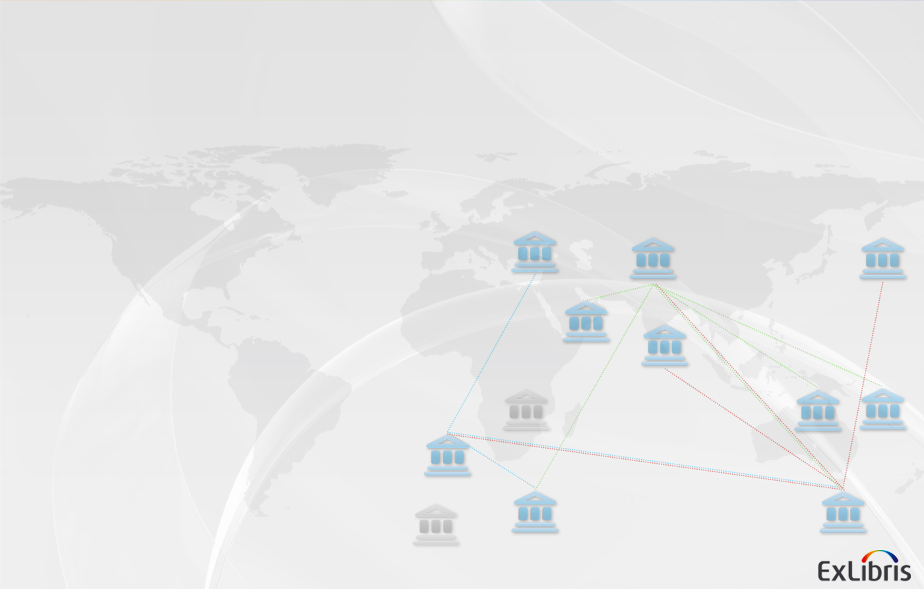
Agenda
1.
Background
2.
More on Zones
3.
Cataloging and Resource Management
4.
A bit on Fulfillment

Slide 4

The Challenge
Maximize cooperation, integration and sharing between institutions in a network
Support each institution’s particular workflows and standards
Maintain local privacy and ownership of data
Standardize and streamline the connection points to make them seamless and reliable

Slide 5

What is a Collaborative Network?
Group of institutions with relationships/collaboration in a specific library business area (e.g. collection development, resource sharing, remote storage)
Each institution can be part of many networks in multiple business areas

Slide 6

Forms of Collaboration
Collaboration can be done on
  Data - Institutions can work together by exposing and/or sharing their data and providing services for this data
  Processes - Institutions can work together by coordinated process and/or creating joint processes to gain efficiencies

Slide 7


The Alma Approach
Institutions will use a Collaborative Zone, where shared data will be managed
Each institution manages its Private Zone, using its own internal standards and workflows
Each institution controls which of its data it is willing to share with other network members

Slide 8


The Alma Approach
Collaboration

Slide 9
The Alma Approach
Collection Development Collaboration
Notes:
Looking at other’s holdings
Negotiating a shared license
Actually purchasing together

Slide 10
The Alma Approach
Cataloging
Collaboration
Alma and
non-Alma
partners
Notes:
Central catalog
Seamless search and editing, using web browser

Slide 11
The Alma Approach
Resource Sharing
Collaboration
Alma and
non-Alma
partners
External broker
Notes:
By nature this is a wider network
Built on protocols

Slide 12
1.
Background
2.
More on Zones
3.
Cataloging and Resource Management
4.
A bit on Fulfillment

Slide 13


Linked records
Community Zone
Private Zone
Global Authorities
Local Catalog
Community Catalog
Inventory
Collapse
The Trial
Central
KnowledgeBase
Academic Search Premier
Academic Search Premier

Slide 14











Private Zone
Alma
University A
University B
Catalog
Catalog
Physical Holdings
Electronic Holdings
Digital Holdings
Physical Holdings
Electronic Holdings
Digital Holdings
Budgets
Licenses
Vendors
Budgets
Licenses
Vendors
Requests
& Usage
Users
& Staff
Workflows
& Config
Requests
& Usage
Users
& Staff
Workflows
& Config

Slide 15
Alma Collaborative Zone
Alma
Alma
University A
University B
Catalog
Catalog
Physical Holdings
Electronic Holdings
Digital Holdings
Physical Holdings
Electronic Holdings
Digital Holdings
Budgets
Licenses
Vendors
Budgets
Licenses
Vendors
Requests
& Usage
Users
& Staff
Workflows
& Config
Requests
& Usage
Users
& Staff
Workflows
& Config

Slide 16

Alma Collaborative Zone
Alma
Collaborative Zone
  Catalog
  Inventory
  Vendors
  Licenses
  …
University A
University B
  Catalog
  Inventory
  Vendors
  Licenses
  …
  Catalog
  Inventory
  Vendors
  Licenses
  …
Notes:
16

Slide 17
Collaborative Network
A Collaborative Zone for all shared data between the institutions in the Collaborative Network
      Shared Catalog
      Shared Inventory
      Shared licenses, vendors
Shared processes among institutions
      Shared Selection processes for resources
      Acquisition of shared resources
      Cataloging of shared records

Slide 18
Agenda
1.
Background
2.
More on Zones
3.
Cataloging and Resource Management
4.
A bit on Fulfillment

Slide 19


Cataloging
University A
University B
Catalog
Catalog
Inventory
Inventory
The Trial
The Trial
Notes:
19

Slide 20

Collaborative Network - Cataloging
Shared Record
Collaborative Zone
Shared Record
Local Extensions
Catalog
Inventory
University A
University B
Catalog
Catalog
Inventory
Inventory
The Trial
The Trial
Notes:
20

Slide 21
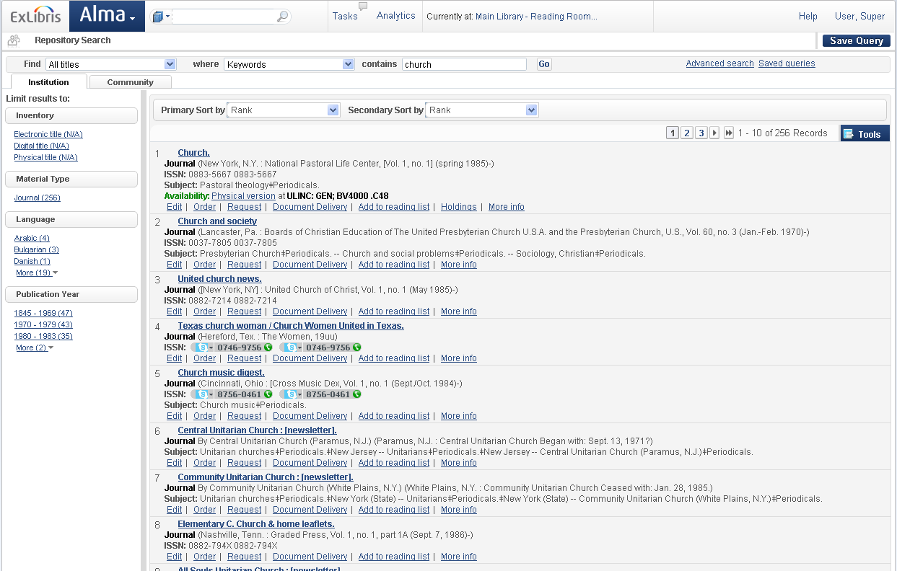
Collaborative Network - Searching
University A
Collaborative Zone
University B
Catalog
Catalog
Catalog
Inventory
Inventory
Inventory
Notes:
21

Slide 22
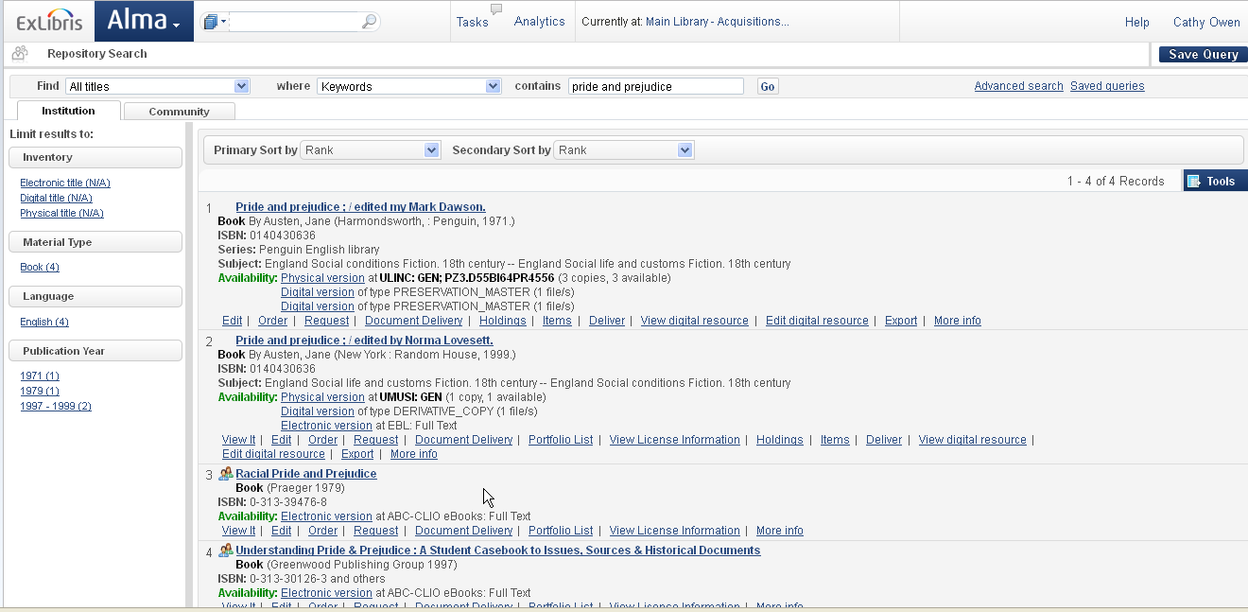
Searching

Slide 23
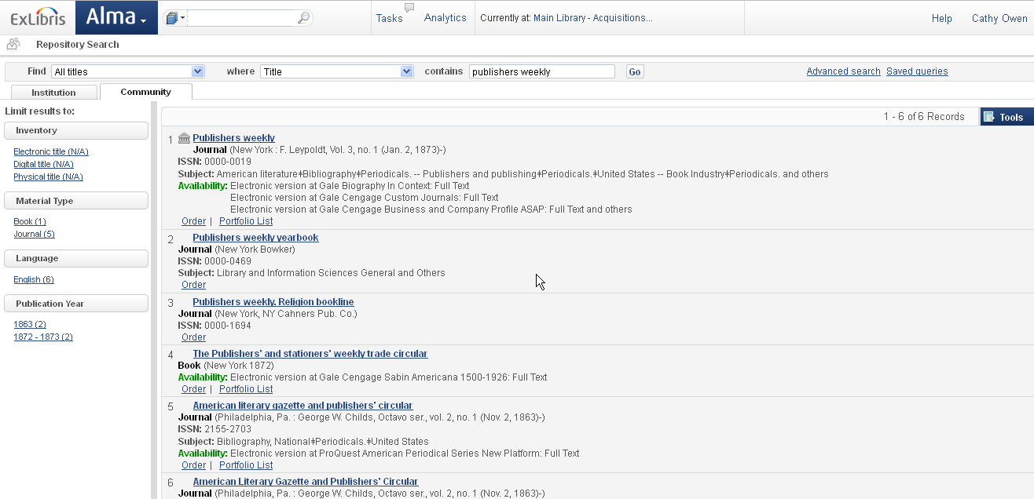
Searching

Slide 24
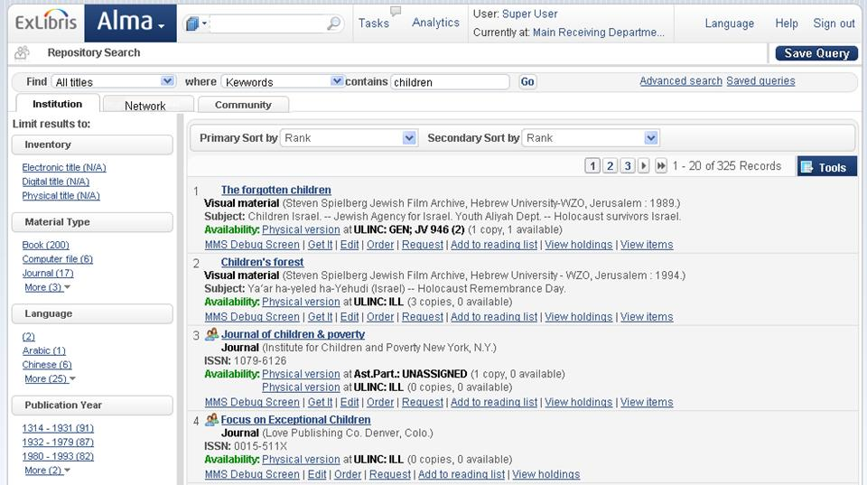
Collaborative Network: Searching

Slide 25


Collaborative Network: Import
Collaborative Zone
Catalog
Inventory
University A
Catalog
Inventory
The Trial
Notes:
25

Slide 26
Agenda
1.
Background
2.
More on Zones
3.
Cataloging and Resource Management
4.
A bit on Fulfillment

Slide 27


Resource Sharing
External Broker
e.g.
University B
University C
University D

Slide 28

Resource Sharing - Rota
Rota
Request
Workflow Profile
University B
Integration Profile
University C
Workflow Profile
Supplier of Last resort
Integration Profile

Slide 29
Resource Sharing – Borrowing Side
Borrower Institution
Partner/
Lending Institution
University A
Request
University C
Ship\Reject
Receive
Received
Return
Returned

Slide 30

Collaborative Network - Fulfillment
Patron of institution B wants to get services at a institution A desk, for a Institution A resource
Lookup/Search
Share
Patrons with
University
A
University
B
[Visitor]
John Smith
[Home Institution]
John Smith
Service
Patrons of
Patron @ A
Patron @ B

Slide 31

Collaborative Network - Fulfillment
Book from Institution B is returned at Institution A
University B book
Check in Item
Service
Items of
University
A
University
B

Slide 32
Agenda
1.
Background
2.
More on Zones
3.
Cataloging and Resource Management
4.
A bit on Fulfillment

Slide 33

Alma Collaborative Networks
  ‘Dynamic, on-demand’ collaboration
  Create multiple collaboration
  Empowering consortia with advanced collaboration capabilities
  Streamlines processes while maintaining user transparency
  Reduce costs by leveraging collaborations
  Flexible and easy to manage collaborations

Slide 34
Alma Collaborative Networks
  Alma and the 2CUL Partnership
  Tomorrow, 12th of September
  14:15-15:15
  Webinar on Collaborative Networks
  24th of September
  10:00 am, 4:00 pm,
  Western European Summer Time (GMT+01:00)

Slide 35
Thank You
  Asaf.Kline@exlibrisgroup.com

