Slide 1
Alma Cloud & Open Platform Overview
Dvir Hoffman
VP, Product Management & Marketing
Notes:
1

Slide 2
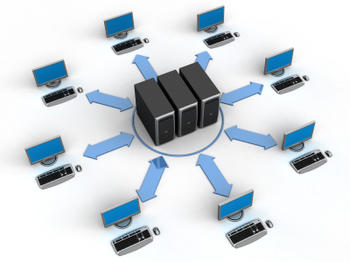
Cloud Computing in Few Words…
It is a resource delivery and usage model
Enables getting resources (Software and/or Hardware) via the network
Resources are dynamically and infinitely scalable and can be used anytime anywhere.
“The concept, quite simply, is the vast computing resources will reside somewhere out there in the ether (rather than in your computer room) and we’ll connect to them and use them as needed.”
        Jonathan Weber (The Times Online)

Slide 3

The Power of SaaS (Software-as-a-Service)
SaaS is a software application delivery model designed to be deployed as a service ‘in the cloud’.
Key characteristics
  A multi-tenant architecture
  Centralized update and management of software
  Updates are frequent and completely transparent to the users

Slide 4


Ex Libris Worldwide Data Centers
Canada
China
Chicago
Amsterdam
PRE PRODUCTION
Singapore

Slide 5

The Must-Have Features of Cloud-Based SaaS
Multi-tenancy
Security
Low TCO
Cloud
Based SaaS
Reliability
Openness
Scalability

Slide 6



The Cloud Computing SaaS Model:
Multi-tenant, Subscription
Multi-tenancy
Security
Low TCO
Reliability
Openness
Scalability
Multi-tenant
Subscription
Faster time to value
Economies of Scale
Scalability
Automatic Upgrades
“Without multi-tenancy, a SaaS offering can’t cultivate a Web 2.0-like community of developers who add functionality that all can share.”
        Eric Knorr (InfoWorld)

Slide 7











Relentless on Security – a Multi-Dimensional Approach
  Physical
24/7 security, biometric authentication, Redundant power systems including UPS and generators, video surveillance, authorized personnel
  Infrastructure
Hardening, change and configuration management, asset management, access control, patch management, password policy
  Network
Vulnerability scan and protection, Intrusion Prevention System (IPS), malware prevention, segregation, TSL/SSL encrypted communication
  Application
Security Development Lifecycle (SDLC), Continues monitoring ,vulnerability and Penetration tests, OWASP Top10
  Data
Data isolation (Oracle VPD), encryption, retention ,data
sanitization (DoD 5220.22-M)
  Identity & Access Control
SSO, S/LDAP, SAML/Shibboleth, Role-Based Access
Control (RBAC)
  Business Continuity
High availability, database cluster, storage redundancy, frequent snapshots, offsite backups, 24x7 HUB, ISO 22301 certified
  Monitoring & Incident Mgmt
24x7 monitoring, Ex Libris Security Officer, Ex Libris Privacy and regulation Officer, security and privacy breach notification
  Human Resources
Security awareness training, privacy policy, confidentiality
agreements, adherence to regulations
  Compliance & Audit
ISO 27001, ISO 27018, ISO 22301, SSAE-16 SOC, GDPR, Data processing agreements, independent audit, risk management

Slide 8
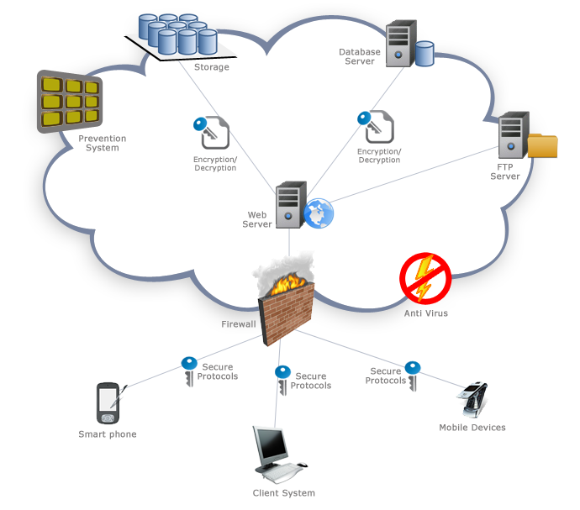
Alma Multi-Tiered Security Model
Multi-tenancy
Security
Low TCO
Reliability
Openness
Scalability
Secured
data
Secured
network
Secured
connection

Slide 9

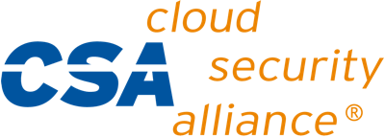






Certified with the Most Rigid Security Standards
  MAINTAIN EXISTING CERTIFICATIONS
ISO/IEC 27001:2013
Data centers are SSAE-16 certified (formerly SAS-70)
ICO Registered (UK Data Protection Act)
  CSA STAR – Self assessment
  ISO 27018:2014 Privacy Standard
  PLAN FOR NEW CERTIFICATION IN 2017:
US Federal - FedRAMP (Alma/Primo) - Cont. in 2018
ISO 22301: 2012 - Business Continuity Management Systems Requirements
22301:2012
GDPR – EU Data Protection Regulation
  PLAN FOR NEW REGULATION
  IN 2018:
Main principles similar to Data Protection Act (DPA)
Compliance, security, and data privacy are our priority
Ex Libris does not share customer data with 3rd parties
Dedicated Data Protection Officer (DPO)
GDPR becomes enforceable May 25, 2018

Slide 10





Alma Cloud Reliability
Multi-tenancy
Security
Low TCO
Reliability
Openness
Scalability
No single point of failure
Fault tolerant
Seamless and automatic updates
Monitoring the entire environment
Tracking Bottlenecks
Notes:
The physical hardware layer is virtualized to provide a flexible adaptive platform to improve resource utilization
The combination of Virtualization layer and the Management layer ensures that resources in a data center are efficiently managed and can be provisioned, deployed, and configured rapidly in order to support scalability

Slide 11




No Single Point of Failure
Multi-tenancy
Security
Low TCO
Reliability
Full Redundancy
  Multi levels data redundancy
  No single point of failure
Instant Failover
  No interruption in service
  Instant and transparent failover
Load Balanced
  Eliminating server stability issues
  Requests are handled by multiple servers
  Increases performance
  Protects from sudden traffic spikes
Openness
Scalability
FAILOVER LB
LB1
LB2
WEB1
WEB2
DB1
DB2

Slide 12
Data Center Design
Data Center Design
Multi-tenancy
Security
Multiple ISPs
Low TCO
Reliability
Openness
Scalability
Edge Routers
Firewalls
Application Protection
Load Balancers
Intrusion prevention and vulnerability protection
Networking
Host
Host
Storage
Server
Guest
Guest
Guest
Guest

Slide 13




Relentless on Security – a Multi-Dimensional Approach
Multi-tenancy
Security
Low TCO
Reliability
Openness
Scalability
  Snapshots
Several storage snapshots per day
  Full Backup
  Available on a daily base
  Replication
Using a secured remote storage facility
  Recovery
Data is consistent at remote and local facility
  Availability
Data available at any time locally and remotely

Slide 14
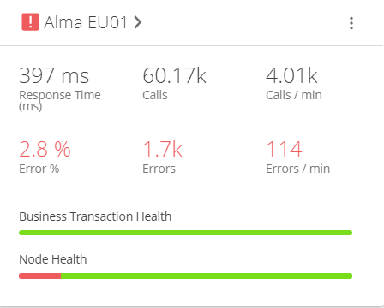
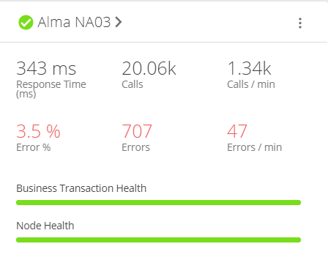
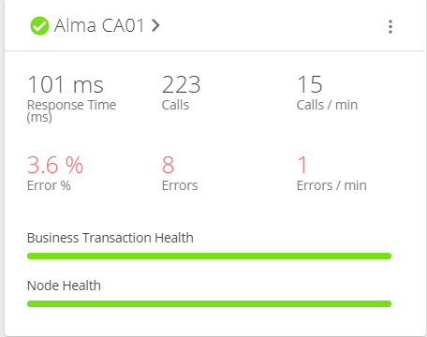
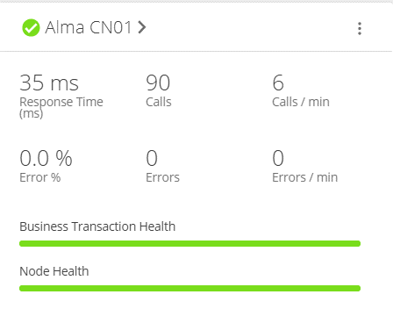
Proactive Performance Monitoring

Slide 15

Monitoring End User Experience
96.6% up to 3sec
96.1% avg up to 3sec
CA01
EU00
EU01
EU02
98.7% up to 3sec
NA01
NA02
NA03
CN01
96.1% avg up to 3sec
AP01
96.2% up to 3sec

Slide 16
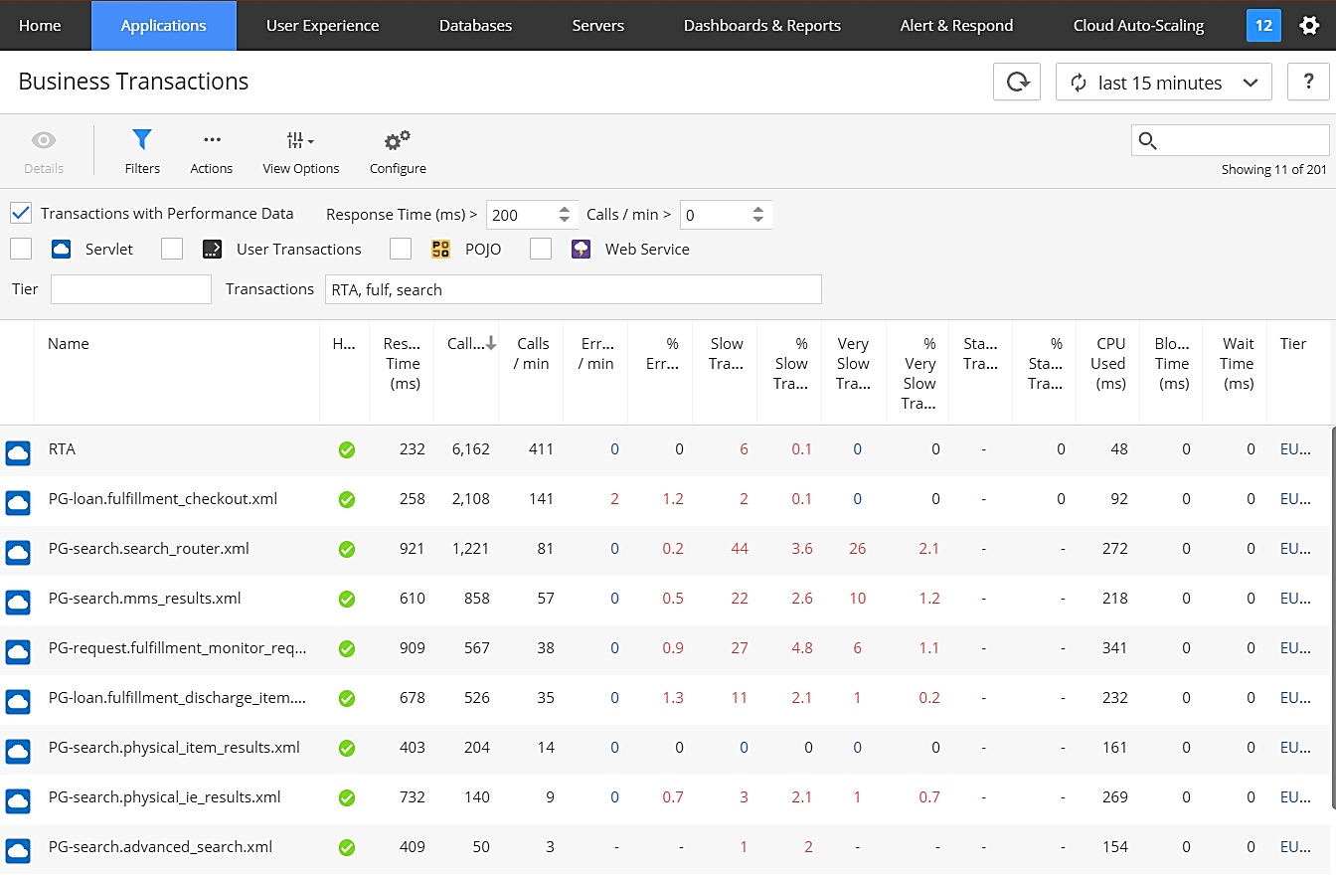
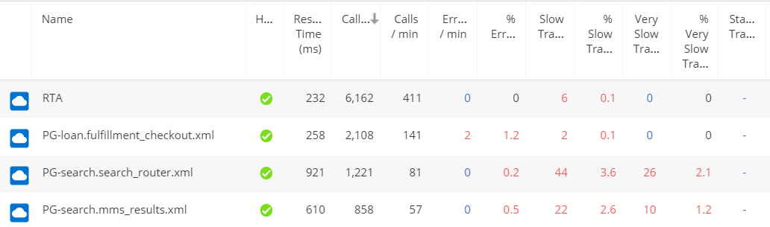
Monitoring Business Transaction
Real Time Availability (Primo)

Slide 17
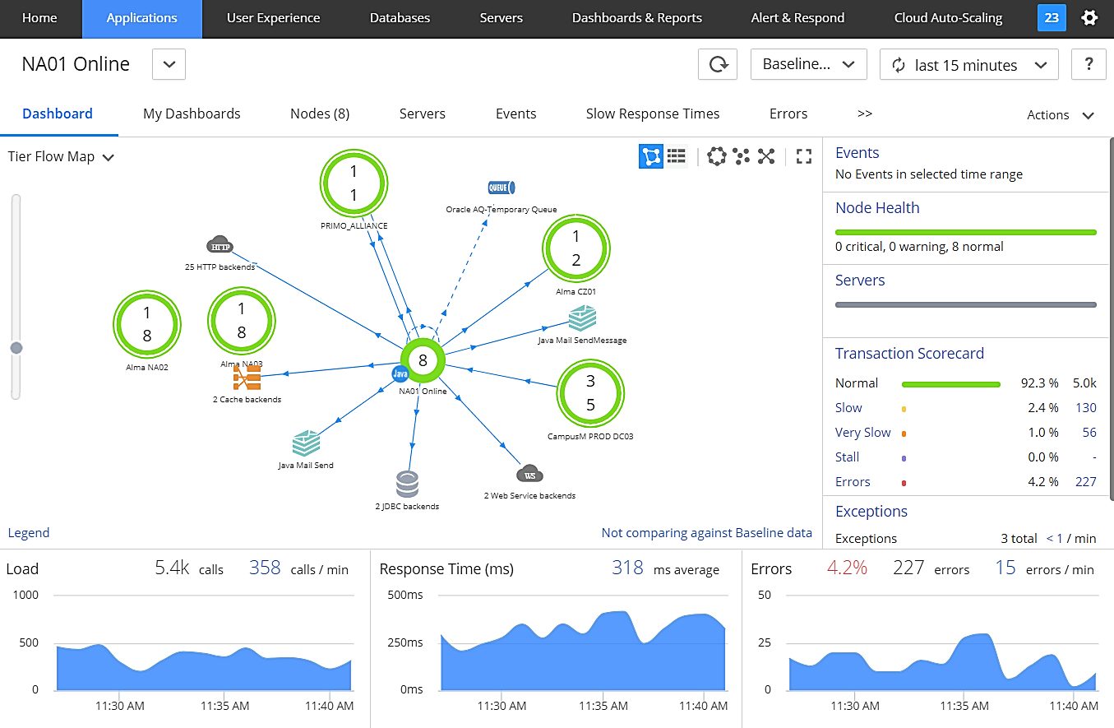
Internal Cloud Architecture Monitoring

Slide 18





Multi-Tiered Scalability
Multi-tenancy
Security
Low TCO
Reliability
Openness
Scalability
Capacity Monitoring
Environment Capacity Planning
Scalability Management
Scalable
Application Services
Scalable Integration interfaces
Scalable Web requests handling
Instant Scale via
virtualization
Scalable Hardware
Notes:
The physical hardware layer is virtualized to provide a flexible adaptive platform to improve resource utilization
The combination of Virtualization layer and the Management layer ensures that resources in a data center are efficiently managed and can be provisioned, deployed, and configured rapidly in order to support scalability

Slide 19



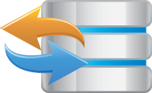

The Alma Developers Platform
Multi-tenancy
Security
Low TCO
Reliability
Openness
Scalability
Alma integrations are achieved using a number of techniques
RESTful APIs,
Publishing
Services
Data Extract
& Import
Adapters &
Interfaces
Online integrations with applications
Extending workflows
Exposing repository information to discovery tools
Sharing data with 3rd party solutions
Leveraging industry standards, adapters and integration interfaces
Notes:
Alma exposes data for integration purposes in a number of ways:
Web Services - Specialized Web Services for specifically tailored purposes
Publishing - The publishing process is used for ongoing synchronization of an external discovery system’s knowledge of Alma’s repository
Data Extraction & Import - Inventory parts of the Alma database may be exported and imported

Slide 20

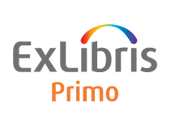



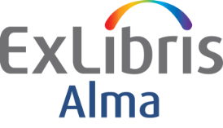

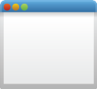

The Alma Developers Platform
Multi-tenancy
Security
Low TCO
Reliability
Openness
Scalability
scholar
Publishing
RESTful APIs & Web Services
Data Extract & Import
Course
Management
Bursar
Systems
Finance
Systems
Mobile
Student
Info
Systems
Bulk BIB Record Manipulation
Resource
Sharing
Vendor
Systems

Slide 21



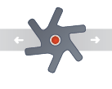



API Platform – Deploying a Secure & Scalable API Infrastructure
DEVELOPER PORTAL
Documentation
Tech Blog
Code & Apps
API Console
Forum
DEVELOPERS
API PROXY
Access Control
Threat Protection
Routing
Caching
Throttling
api
MOBILE APPS
API CONTROL & ANALYTICS
Policy Management
Versioning
API Analytics
API Monitoring
Auditing
THIRD PARTY APPS
INTEGRATIONS

Slide 22







Alma APIs in Action
Patron card via portal
Custom Portal/discovery
Real time synchronization with SIS
Sentry Security Gate check
Cash payment integration
Course Reading List for Mobile
Reading Lists integration

Slide 23

APIs: Growth in the last 3 years
More than
70M API In August 2017
2015
2017

Slide 24
APIs Are Critical To Our Success
50%
of all transactions
via APIs

Slide 25
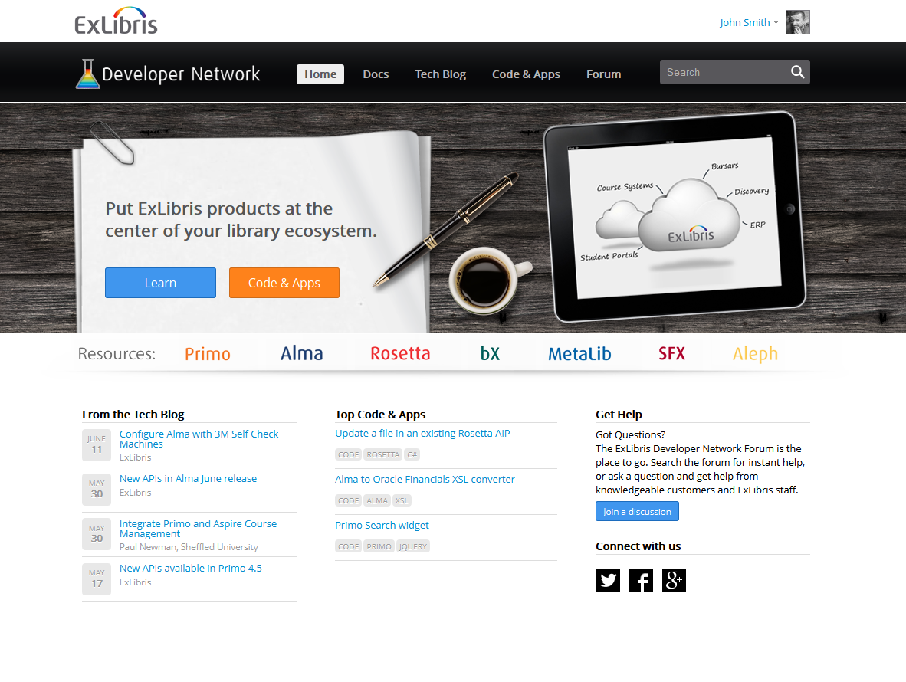
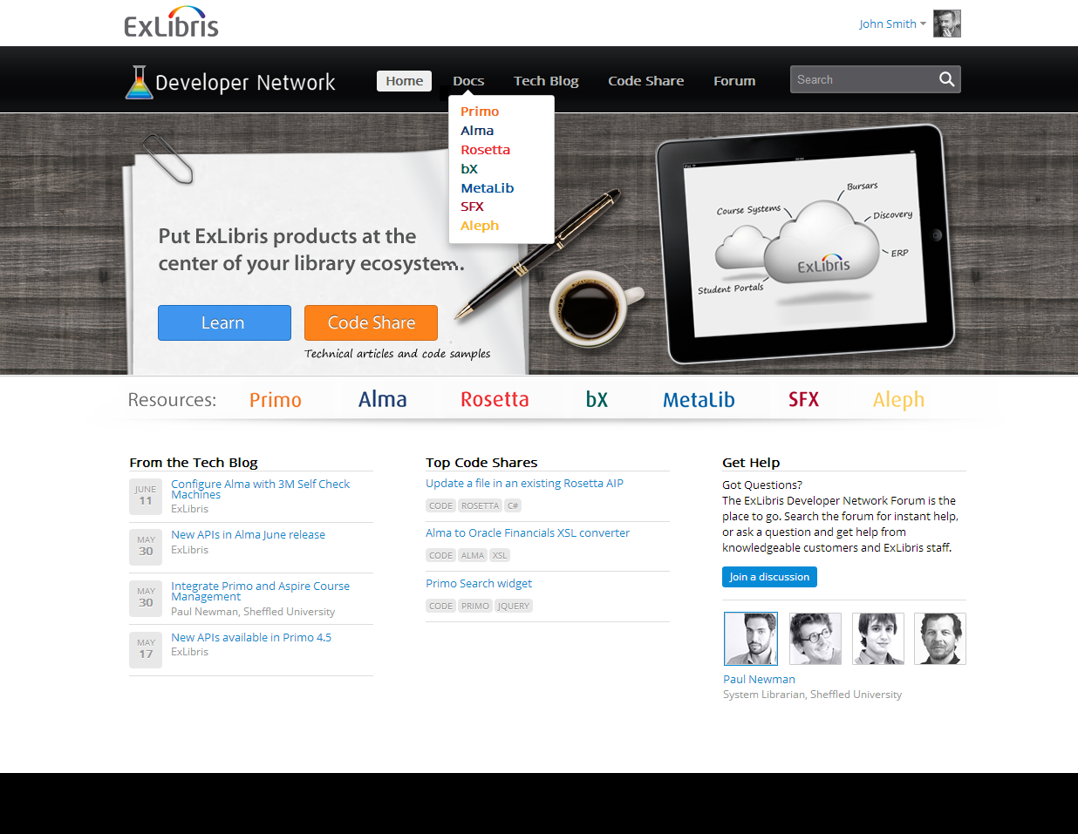
ExLibris Developer Network
© Ex Libris Ltd., 2014 - Internal and Confidential

Slide 26
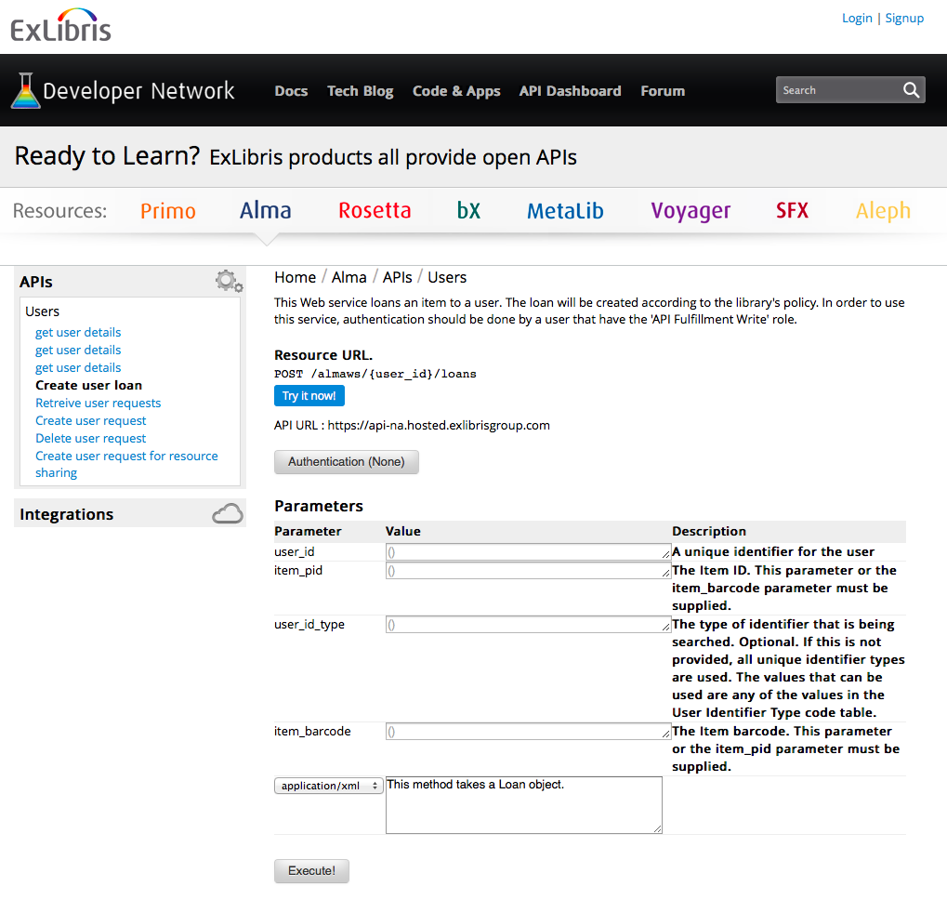
API Console – Easy to Learn & Test APIs

Slide 27
System Management & Administration:
Before and After Moving to the Cloud
Multi-tenancy
Security
Low TCO
Reliability
Openness
Scalability
Server, network and DBA
Application
Support and service calls
O/S management
Oracle upgrades
Back-ups
Disaster recovery
Test environments
Security infrastructure
Service packs
Version upgrades
Client deployment
Test application environment
Under the hood diagnostics
Implementing proposed fixes and testing solutions
Capacity planning & tuning
Logging-debugging
Firewall
Command line
Liaison between local server/app teams and Ex Libris
Configuration and customization
Logging & tracking service calls
Green = cloud managed
Purple = changed
Blue = unchanged

Slide 28







Alma Sandbox Environments
Standard Sandbox
Premium Sandbox
Standard Ex Libris data
Copy of customer’s data
Data
Standard Ex Libris configuration
Copy of customer’s configuration
Configuration
Number of records limited
Yes
No (based on subscription limits)
Early access to new release (upgraded before production)
Yes
Yes
Suitable for training staff
Yes
Yes
Suitable for functional / configuration testing
Yes
Yes
API
Suitable for API development testing
Yes
Yes
Cost Structure
Included in standard Alma subscription fee
Available for additional annual fee

Slide 29
Thank you
For more details: Securing Next-Generation Library Services

