Slide 1
Alma – Focusing On What Customers Need
PRESENTER NAME

Slide 2
Alma Key Roadmap Differentiators
Boosting Collaborations
Unified Management
Optimized Workflows
Extendable Platform
Analytics

Slide 3
Boosting Collaborations
Unified Management
Optimized Workflows
Extendable Platform
Analytics

Slide 4
Collaboration by Contribution – Community Zone
Feb 15’
May 15’
June/July 15’
Community Zone is open for editing bibliographic records for all customers
Community Zone opened to contribution of Electronic Portfolios
Community Zone opened to contribution of Electronic Collections

Slide 5
Community Zone Contribution Use

Slide 6
On the Horizon for Community Zone Contribution
Already in Alma
Near Term
Edit Bibliographic records in the Community Zone
Edit or Add Portfolios of Community Zone
Contribute Local Electronic Collections
Contributors of electronic collections will be able to update contributed collections
Contribute bibliographic records of databases
Longer Term
Loading content from PQ
Contribute original cataloged bibliographic records to the Community Zone
'Like' for contributed collections

Slide 7
Community Zone Authorities
Recently Added
LCMPT - Library of Congress Medium of Performance Thesaurus for Music
BARE - BIBSYS Authority Registry
National Library of NZ - Māori Subject Headings
Planned to be added
Library and Archives Canada (LAC) – Name/Title/Subject
National Library of Israel - Multi Lingual Thesaurus
SUDOC - French Name/Subject/Title Authorities
SBN – Italian Name and Titles Authority

Slide 8
Strong Support for Consortia
Network Zone
Shared Catalog with Institution level annotations
Centrally-Managed Cataloging definitions (Normalization, Templates)
Centralized Primo Publishing
Shared Import Profile Templates
Option to work only in the NZ shared catalog
Collaborative Acquisitions:
Joint Acquisitions – central mgmt. & purchasing
Joint Negotiations – central mgmt. & institution level purchasing
Consortial PDA
Shared Vendor Management
Consortial Resource Sharing (ISO ILL)
External Broker Integrations – OCLC Navigator, Relais D2D, INN-Reach, ILLiad, VDX
Centralized Management of Resource Sharing Configurations
Walk-in Loaning
Direct Requesting (in non-home institution)
Return anywhere
Centralized Management of Policies and Terms of Use
Pickup anywhere – planned for H1 2016
Metadata Mgmt.
Acquisitions
Resource Sharing
Fulfillment
Analytics
Centralized Mgmt. of Configuration Tables
Centralized Mgmt. of Notification Templates
Network Level User Accounts
Central job monitoring
Shared Community Reports
Network Level Reporting
Administration

Slide 9
Collaborative Acquisitions
Central Acquisitions
Central management and purchasing of Electronic Resources
Central Negotiations
Central negotiation management of license and content of Electronic Resources with distributed purchasing by members
Shared Vendors
Vendor records can be managed and shared in a collaborative network

Slide 10
Central Configuration
Wide functional coverage
Resource sharing configuration
Fulfilment configuration
Import profiles
Vendors
Notifications
Printouts
Almost all other configuration (e.g. user groups, cancelation reasons, cataloger level)
Opportunity to standardize consortia workflows & services
Empowering the consortia

Slide 11
Collaborations in Alma
Already in Alma
Near Term
Shared Catalog
Joint Acquisition Models
Purchase
Negotiation
PDA
Resources Sharing
Consortial
Wider Area/Peer
Extensive Broker Integrations
Fulfilment
Loan Anywhere, Request and Return Anywhere
Administration and Configuration
Fulfillment – Pickup Anywhere
Improved Management of Shared Electronic Resources
Longer Term
Hybrid Network – Alma/Non Alma
Advanced shared configurations and policies management
Network level users policies

Slide 12
Boosting Collaborations
Unified Management
Optimized Workflows
Extendable Platform
Analytics

Slide 13
Completing the Vision - Unified Resource Management
Alma
Unified Data
Fulfillment
Metadata Management
Unified Workflows
Acquisitions
Unified Management
Analytics

Slide 14
Managing Digital Resources with Alma
Phase 1 | Phase 2 | Phase 3
Integration with Remote DAM Systems | Special Collections Workflows | Institutional Repository Workflows
Harvest metadata Digital inventory Link from Primo to remote system | Staff deposit Cloud storage in Amazon Viewer, delivery from Primo Ingest, bulk loaders | End user deposit Maintenance jobs APIs/SWORD Analytics
Integrates with DAM systems (Rosetta, Digitool, Fedora, ContentDM) | Replacing 3rd party digital repositories and support for cloud storage | Replacements of institutional repositories including extended workflows coverage
EOY 2014 | EOY 2015 | EOY 2016

Slide 15
Cloud Storage @ Amazon S3
Infrastructure
Leverage Amazon for storage and bandwidth – doesn’t affect core Ex Libris services and data centers
Security
Utilize Amazon’s security infrastructure to provide data silos and ensure secure access
Global distribution
Amazon S3 is available globally in multiple regions, allowing fast access and compliance with data residency requirements
Trusted Brand
Digital content is the asset- storage in a trusted repository with 99.999999999% durability
Third Party Tools
There are many third party tools which integrate with Amazon’s storage service, providing institutions with direct access to their resources
Cost Effective
Storage is a commodity and prices are coming down. Storage and bandwidth costs are cheaper than private cloud

Slide 16
Staff Upload of Digital Materials

Slide 17
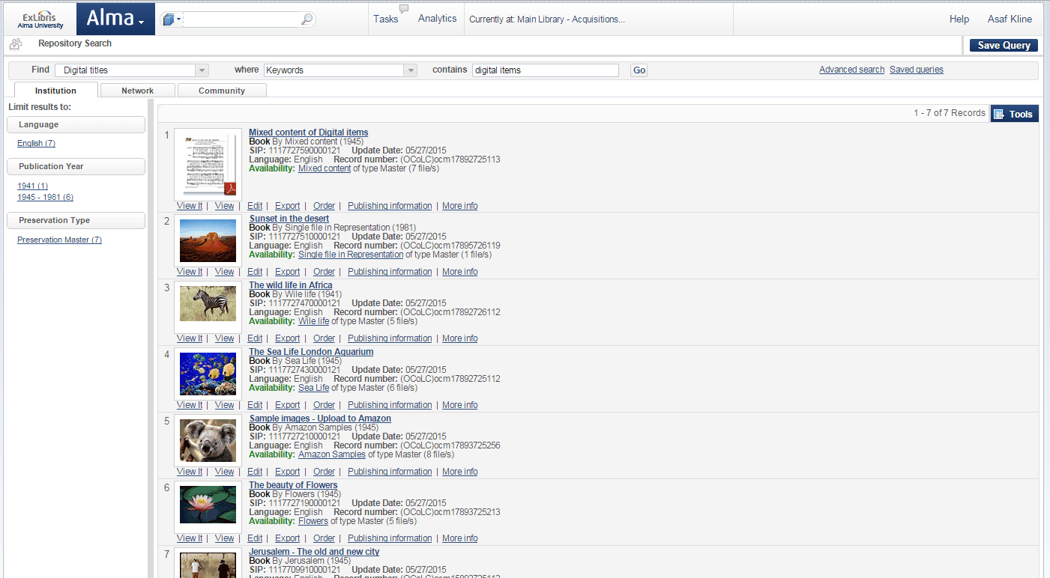
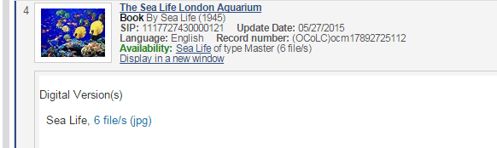
Unified Staff Search

Slide 18
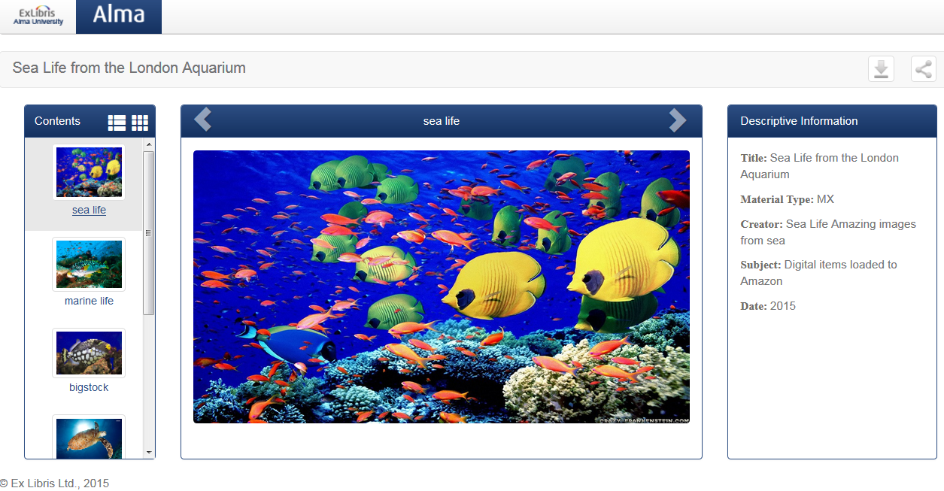
Modern Web Viewers

Slide 19
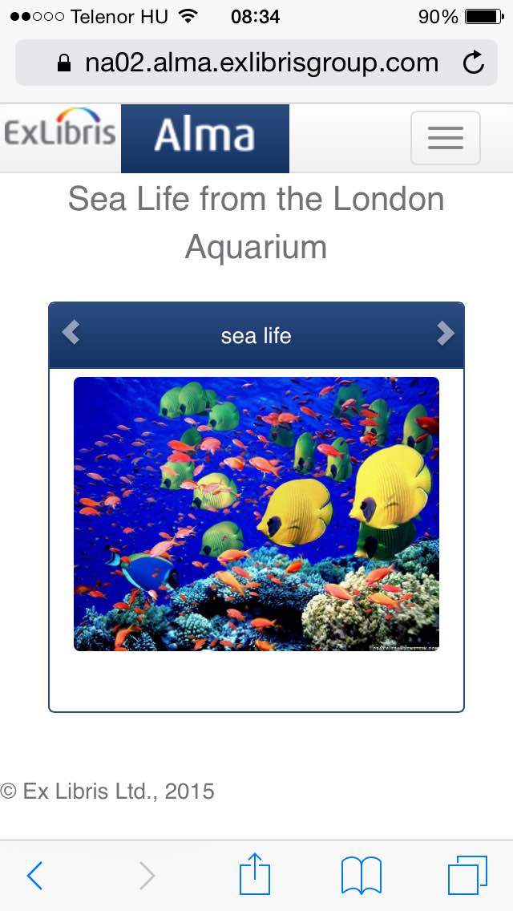
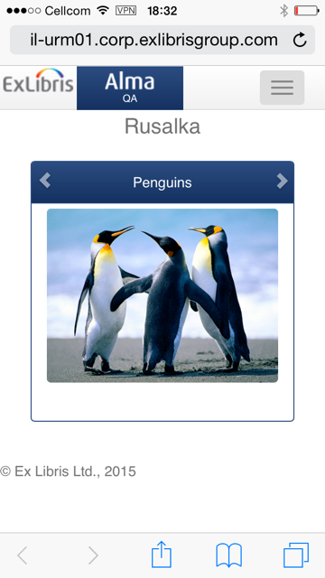
Modern Viewers and Mobile View

Slide 20
Optimized Workflows
Boosting Collaborations
Unified Management
Extendable Platform
Analytics

Slide 21
Optimizing Workflows: Real-Time Acquisition
Streamlined process
Immediate
Save staff time
Partner Selection Platform
Alma
PO Line
Order Details

Slide 22
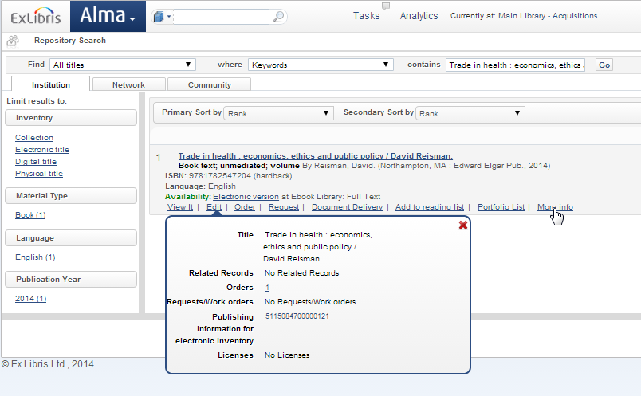
Acquisition Methods – YBP Real-Time Acquisition

Slide 23
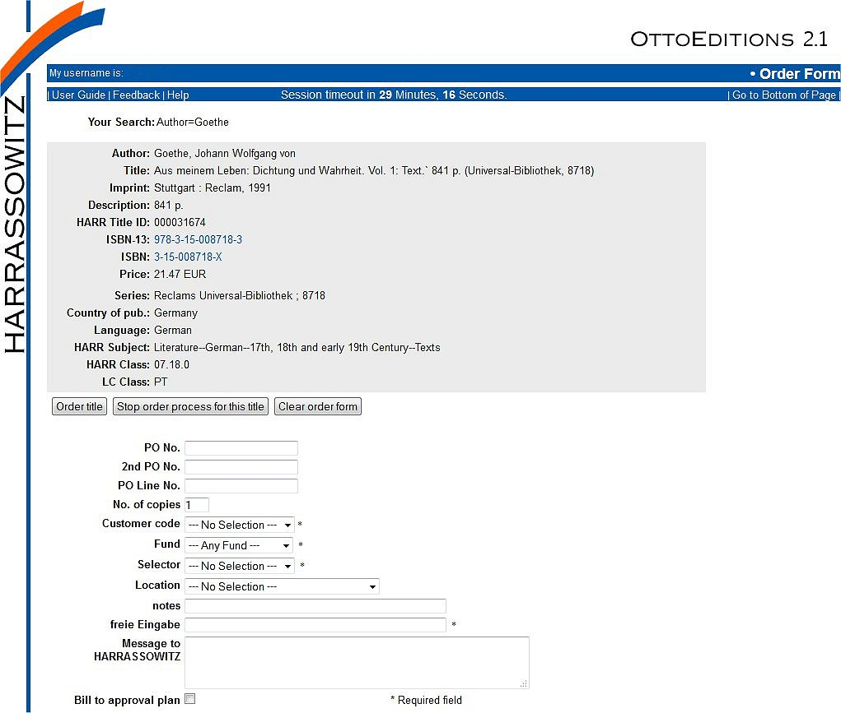
Acquisition Methods – Harrassowitz Ongoing Integration

Slide 24
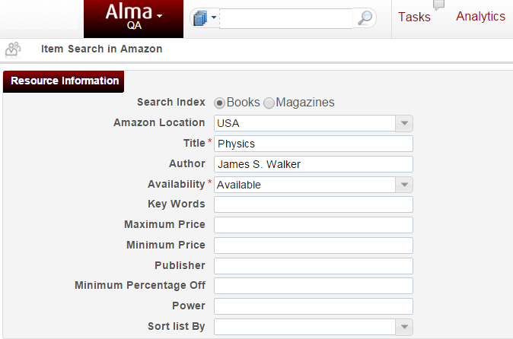
Alma Integration with Amazon
1
2
3

Slide 25
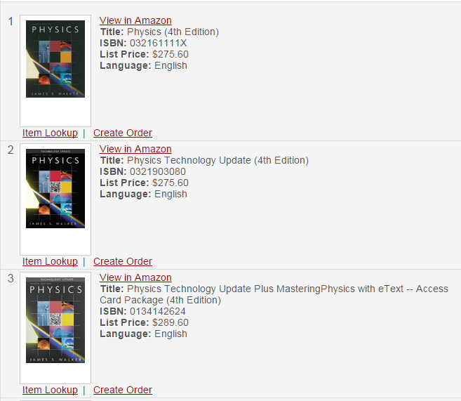
Acquisition Methods – Integration with Amazon
1
2
3

Slide 26
Acquisition Methods – Integration with Amazon
1
2
3

Slide 27
Optimizing Acquisitions – Looking further ahead
Real-Time Availability and Pricing
Patron Purchase Request
Evidence-Based Selection (EBS)
Article Processing Charges (APC)

Slide 28
Advanced Acquisition Models
Already in Alma
Near Term
Amazon
Patron Purchase Request
Intota innovative capabilities such as DDA flow
Real Time Acquisition
Integration with PQs Acq. platforms
Real-time availability & pricing
PDA
Joint Acquisitions
Purchase
Negotiation
Shelf Ready (EDI, EOD)
RT Acquisition (YBP, HARRASOWITZ)
Longer Term
Article Processing Charge (APC)
Multi Format Legal Deposit
License Renewal Workflow

Slide 29
Boosting Collaborations
Unified Management
Optimized Workflows
Extendable Platform
Analytics

Slide 30
Developers Network
Ex Libris Developer Network launched in May 2014
At launch- 21 total REST APIs
6- BIBs
5- Resource Sharing Partners
10- Users
Nice picture about APIs, integration between systems, roadmap…?
Now there are Over 100 REST APIs in 7 areas!

Slide 31
Alma APIs Growth Since Developer Network Launch

Slide 32
Over 24 Million API Calls/Month
Alma is OPEN
12x growth in 9 months

Slide 33
APIs Developments
Recently Added
CRUD APIs for Remote Digital Repositories
Linked Data API
Workflows APIs: Scan-In, Next step in digitization
Create BIB and HOL records APIs
Planned to be added
CRUD APIs for Alma Digital Representations
BIBs – create physical item
Process orchestration
License information

Slide 34
Boosting Collaborations
Unified Management
Optimized Workflows
Extendable Platform
Analytics

Slide 35
Continuing to Execute our Analytics Vision
Prescriptive Analytics
Difficulty
Predictive Analytics
HOW CAN we make it happen?
Descriptive Analytics
WHAT WILL
Happen?
HOW should we take action?
Ability to model, manage, and adapt
WHY
Did it happen?
Data-driven planning and forecasting
WHAT happened?
Managed Reporting
Dashboard for managers and analysts
Ad Hoc Reporting
Analytics
Increase in ad hoc reporting and Information on demand
Dashboards
Scorecards & Benchmarking
Primarily batch and some ad hoc reports
Value
Hindsight
Insight
Foresight

Slide 36
Alma Analytics
Already in Alma
Near Term
Extensive set of analytics subject areas:
Acquisitions
Fulfilment
Inventory
Link Resolver usage
And more….
Network Analytics
Book Report 1, 2 usage
Customizable Dashboard
Improved ETL (daily refresh)
Increase Export capabilities
Combined Acquisitions-Inventory-Usage analysis capabilities
Extended COUNTER support
Benchmark Analytics
Medium to Longer Term
Adding innovative capabilities from Intota-Assmt. (Books, Hathi, etc.)
Title Level and Overlap Analysis
Predictive Analytics

Slide 37
Collaborative Networks Benchmark Analytics
Benchmark and compare among other member institutions of the consortia
Ability to create customized reports by
the consortia itself
Beyond collection management analysis
Analytical reporting built-in and fully integral
part of system

Slide 38
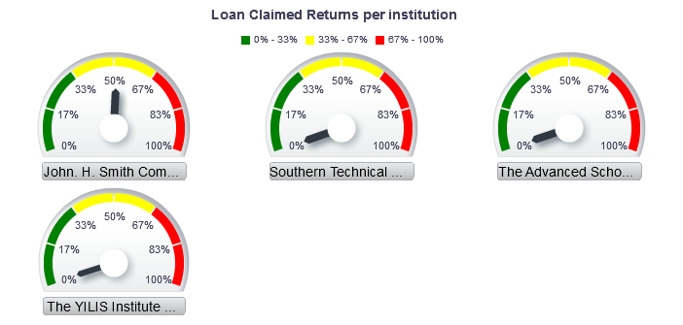
Collaborative Networks Benchmark Analytics

Slide 39
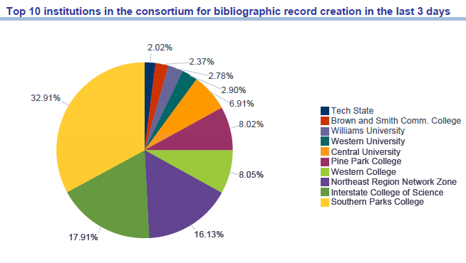
Collaborative Networks Benchmark Analytics

Slide 40
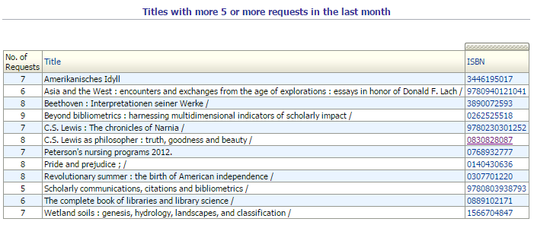
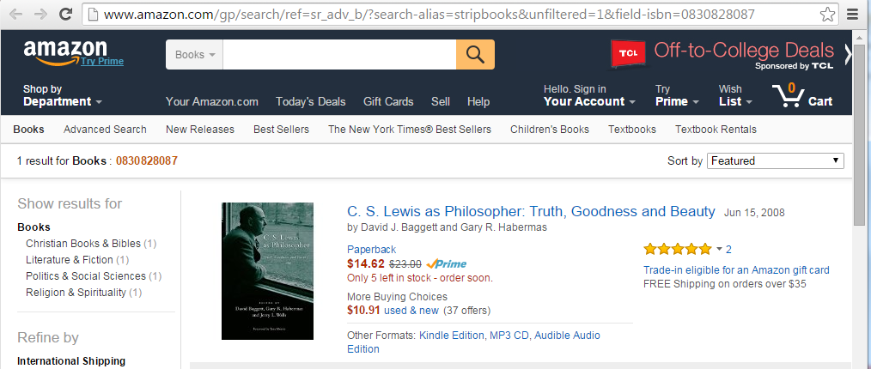
Actionable Analytics Reports

Slide 41
Actionable Analytics Reports
We arrive to the item at Amazon Books
This URL was defined in the column ‘action’
This ISBN was taken from the report

Slide 42
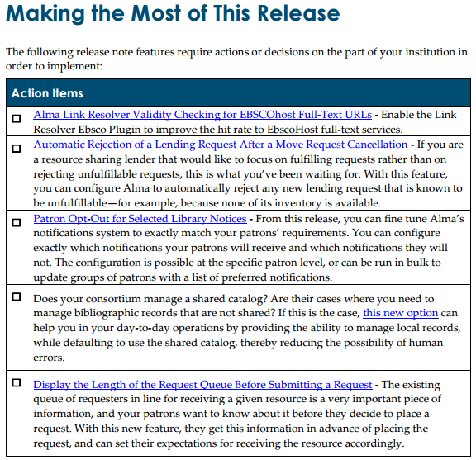
‘Actionable’ Release Notes

Slide 43
THANK YOU

