Slide 1
Resource Sharing Locate
Moshe Shechter | Alma Product Manager

Slide 2
Agenda
1
Locate Types
2
Locate & Automation in Alma
3
Locate Profiles
4
Locate Configurations
5
The Locate Process
6
Holdings Attributes

Slide 3
Locate Types

Slide 4
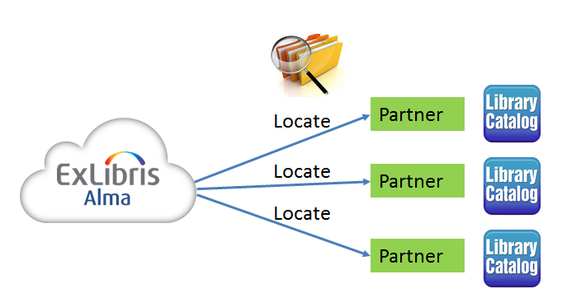
Borrowing Locate
Locating a borrowing request in the partners’ catalogs – This process is referred to as ‘Borrowing Locate’. In this process, Alma searches the catalogs of all of the rota’s partners to determine whether the partner owns the requested record. If the locate fails, the partner is removed from the rota.

Slide 5
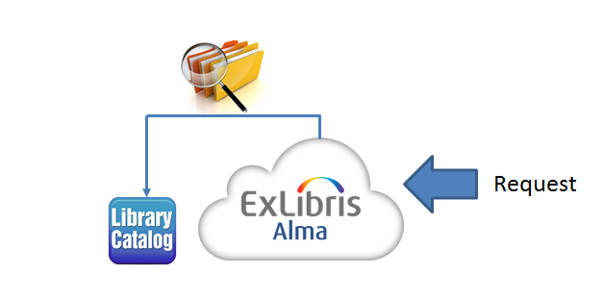
Lending Locate
Locating a lending request in the lender’s catalog – This process is referred to as ‘Lending Locate’. In this process, Alma searches the locate catalog to find a match in the local repository for the metadata of a request from an external requester.

Slide 6
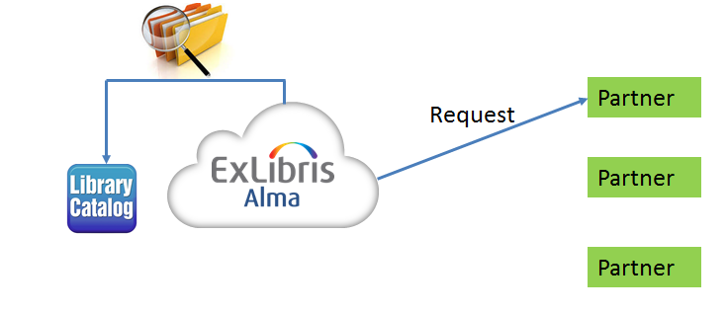
Self Ownership
Locating a borrowing request at the borrower’s catalog prior to sending the request to the partner. This type of search, referred to as ‘Self-Ownership’, determines whether a patron’s resource request may be filled by local inventory, or whether the request must be directed to an external resource sharing partner.

Slide 7
Locate & Automation in Alma

Slide 8
Locate & Automation in Alma
The locate process is crucial for supporting automation of the resource sharing process.
Borrowing requests will be blocked from being sent to lenders if there is a locally owned match for the requested material.
Only partners that own the requested resource will be requested for a resource. This saves time and effort otherwise spent negotiating a request with lenders who cannot fulfill the request.
Lenders automatically know whether they own the requested resource, and can see the status of the relevant inventory at a glance in order to quickly and efficiently fulfill a request.

Slide 9
Borrower Locate Profiles

Slide 10
Borrower Locate Profiles

Slide 11
Borrower Locate Profiles

Slide 12
Borrower Locate - Z39.50
If the locate target (lender) is not an Alma institution, its catalog may be searched by Alma using the Z39.50 protocol. Obviously, for this type of locate to work the target partner must be running an openly accessible Z39.50 server.
Note that Alma may define locate targets of this type only if the locate target institution is part of Alma’s searchable external targets. If a partner is searchable in this manner but the partner’s catalog is not in Alma’s list of searchable external targets, Ex Libris Data Services must be contacted to make that catalog a searchable target.

Slide 13
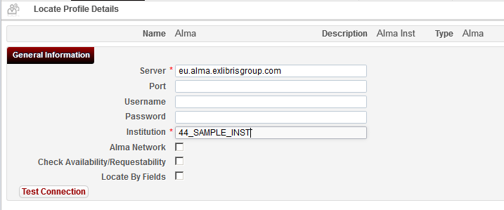
Borrower Locate - Alma
If the locate target (lender) is an Alma institution, its catalog may be searched using Alma APIs. This has the advantage of supporting more fine-tuned locate options, as will be described in the following section.

Slide 14
Locate Configurations

Slide 15
The Partner Record – Borrower
Running a locate process for a given partner depends on the locate profile that is attached to the partner.

Slide 16
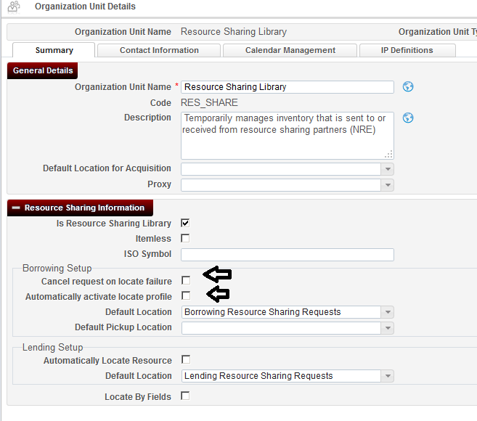
Resource Sharing Library Configurations – Borrower
Automatically activate locate profile – Setting this attribute will cause the locate process to be automatically triggered when a borrowing request is created from any interface – Alma, Primo or API.
Note that the automatic locate may be activated only if the Automatic Rota Assignment Rules have also been activated to automatically attach a rota to the request. The locate process will run on the automatically attached rota

Slide 17
Resource Sharing Library Configurations – Borrower
Cancel Request on locate failure – Setting this parameter will cause Alma to automatically cancel a request for which the locate process was not able to find any potential partner.

Slide 18
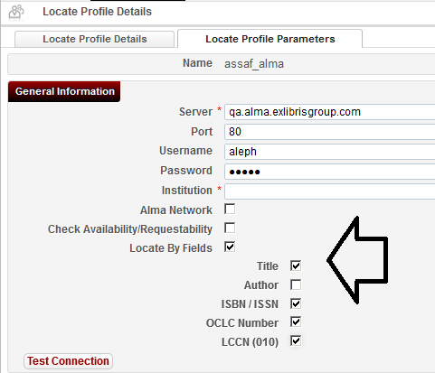
Resource Sharing Library Configurations – Borrower
If the Locate By Fields sub-fields are selected to define which fields are to be searched, these fields will be used for the locate process (unless there’s a known record ID)

Slide 19
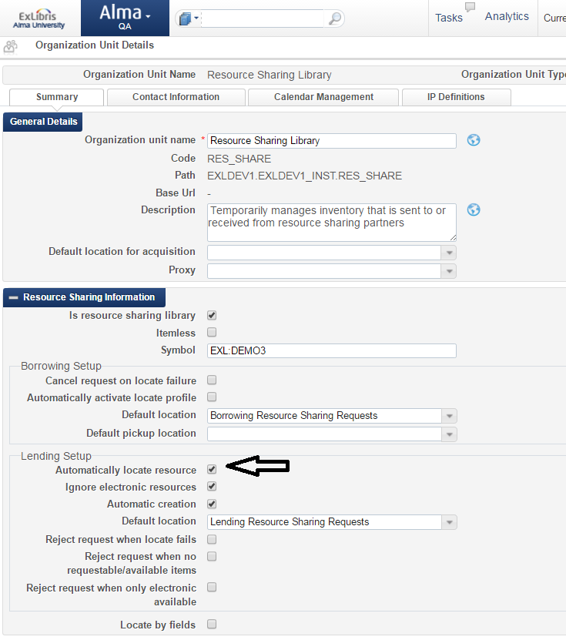
Resource Sharing Library Configurations – Lender
The lending locate process may be triggered automatically when the lending request is created. This happens if the resource sharing library’s Automatically Locate Resource attribute is set.

Slide 20
Resource Sharing Library Configurations – Lender
The lending locate process may be configured to ignore electronic resources if the resource sharing library’s Ignore Electronic Resources attribute is set. The locate will fail if the locate match has only electronic inventory

Slide 21
Resource Sharing Library Configurations – Lender
The lending locate process may be configured to automatically reject new requests if one of the following happens during the lender locate:
No match was found
One match was found, but it’s physical items are not requestable/available
One match was found, but it has only electronic inventory

Slide 22
Resource Sharing Library Configurations – Lender
The lending locate process may be configured to automatically reject new requests if one or more of the resource sharing library’s Reject Request … attributes is set.

Slide 23
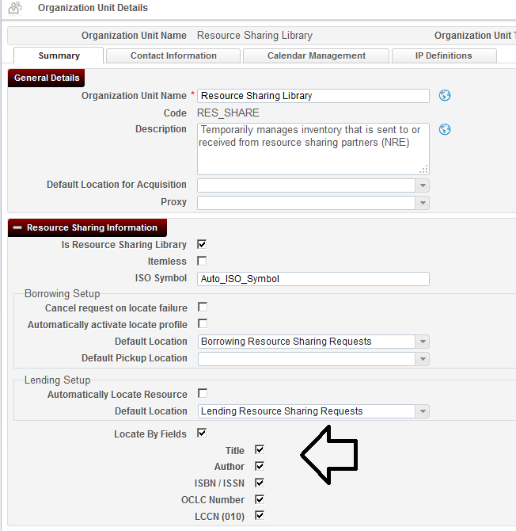
Resource Sharing Library Configurations – Lender
If the request has not been received with a record ID (i.e. no NZ or shared Primo search) then the Locate By Fields configuration in the resource sharing library is used to locate the record.

Slide 24
The Locate Process

Slide 25
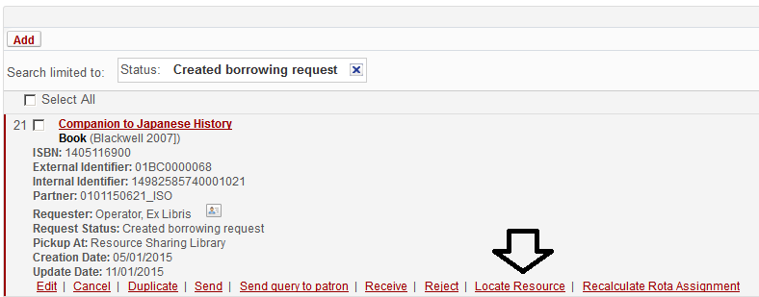
The Locate Process – Borrower
The locate process may be manually activated from the request’s edit form or from the task list, if the request has assigned rota.

Slide 26
The Locate Process – Borrower
The locate process is actually a background job that runs search queries against all of the partners in the rota, as per the definitions of the locate profiles. The locate process may take some time to complete.

Slide 27
The Locate Process – Borrower
For Z39.50 locate profiles, Alma triggers a Z39.50 query as per the locate profile definitions. One or more matching results is considered a success.

Slide 28
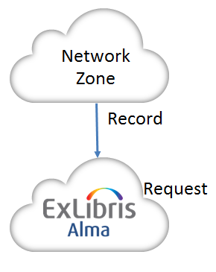
The Locate Process – Borrower
The Alma locate profile search depends on the metadata that is known at the borrowing side.
Lender and requester share the same Network Zone or the same Fulfillment Network.
This may happen if the request is placed from the Alma network zone, or from a Primo Network Zone record

Slide 29
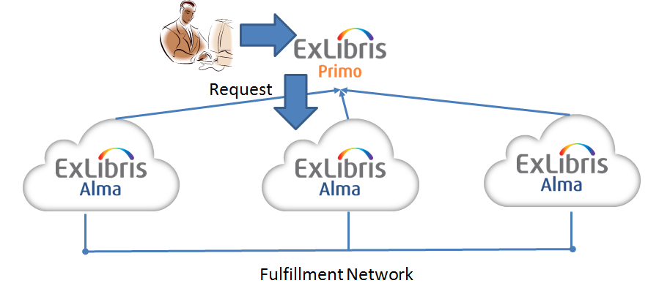
The Locate Process – Borrower
The Alma locate profile search depends on the metadata that is known at the borrowing side.
Another scenario is where there is a record that is de-duplicated from a number of institutions’ records, and the institutions share a fulfillment network.

Slide 30
The Locate Process – Borrower
In these cases Alma knows in advance which partner owns the requested title. The processing of the borrowing locate process may be described as follows:
The request is stored in Alma with the list of network zone members or fulfillment network members that own the resource.
Every partner whose institution ID is part of the same network zone or the same fulfillment network as the requesters AND the institution ID IS found to be linked, the requested record will be considered a locate success.
Every partner whose institution ID is part of the same network zone or the same fulfillment network as the requesters AND the institution ID is NOT found to be linked to the requested record will be considered a locate fail.

Slide 31
The Locate Process – Borrower
The Alma locate profile search depends on the metadata that is known at the borrowing side.
Lender and requester do not share the same Network Zone or the same Fulfillment Network. The locate process then depends on the locate profile setup.
If the Locate By Fields sub-fields are selected to define which fields are to be searched, these fields will be used for the locate process.

Slide 32
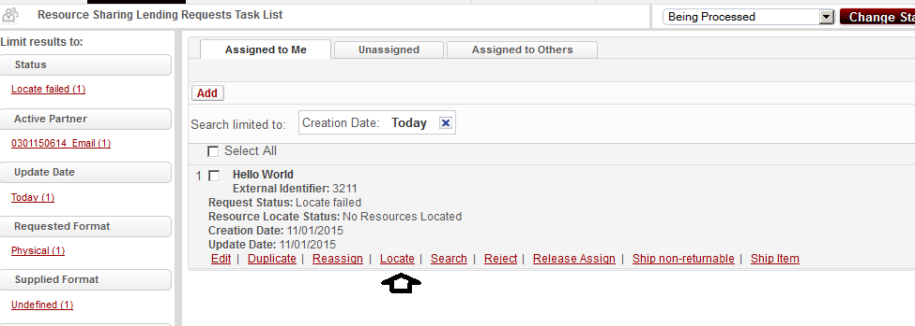
The Locate Process – Lender
The locate process may be triggered manually using the Locate action

Slide 33
The Locate Process – Lender
The locate process will succeed if the there is a single match, and it will fail if there is more than one match or if there are no results. In either failure case, the search query will be displayed, and the operator will be able to manually attach the lending request to the local repository or change the search query.

Slide 34
The Locate Process – Lender
If the request has been received with a record ID (based on NZ or shard Primo search), the lending request will be automatically linked to the identified record.
If the request has not been received with a record ID, the Locate By Fields configuration in the resource sharing library is used to locate the record.
If there is no Locate By Fields configuration specified in the resource sharing library, the following fields will be used, in the order they are listed below:
LCCN
OCLC Number
Title + ISBN/ISSN

Slide 35
The Locate Process – Self Ownership
The process of determining self-ownership is similar to the lending locate process, taking the following into considerations:
The Locate By Fields configuration in the resource sharing library
If there is no Locate By Fields configuration in the resource sharing library, the following fields will be used, in the order they are listed below:
LCCN
OCLC Number
Title + ISBN/ISSN
Note that self-ownership when checked at the Primo GetIt tab is based on the resolving of the incoming OpenURL to an existing resource, and is therefore based on the resolver’s matching mechanism rather than the above mentioned configurations.

Slide 36
Holdings Attributes

Slide 37
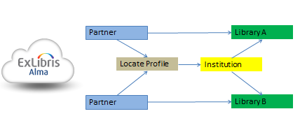
Holdings Attributes – Borrower
The locate action may be configured to succeed only if the target partner has holdings at a specific library, by setting the partner record with a Holdings Code that matches the lender’s required library code

Slide 38
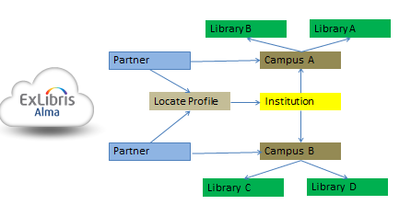
Holdings Attributes – Borrower
The Holdings Code may also match a campus code at the target institution

Slide 39
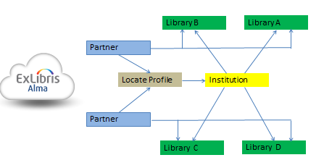
Holdings Attributes – Borrower
Libraries may also be grouped without a campus. In other words, a partner’s locate process may be targeted to succeed only if the requested resource is found to be held by specific libraries, even if they are not bound by a campus configuration

Slide 40
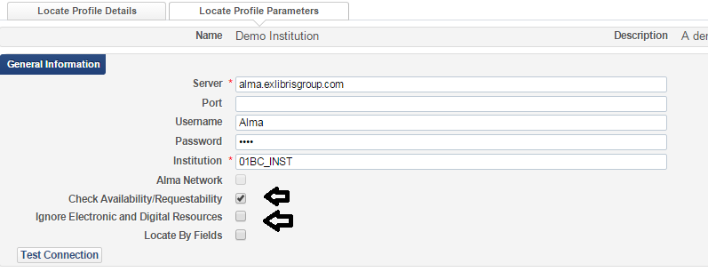
Holdings Attributes – Borrower
The locate profiles may be set up to test for Requestability and Availability if it is an Alma locate profile; i.e. if the peer target lender is an Alma lender.

Slide 41
Holdings Attributes – Borrower
The locate profiles may be set up ignore the existece of electronic resources at the lender side, if it is an Alma locate profile; i.e. if the peer target lender is an Alma lender.

Slide 42
THANK YOU

