Slide 1
Resource Sharing Request Renew
Moshe Shechter | Alma Product Manager

Slide 2
Renewal - Scenario
Patron requests renewal from Primo
Borrower staff approve request and send ISO messages or email to lender
Lender rejects/approves the request
Borrower updates status as renewed

Slide 3
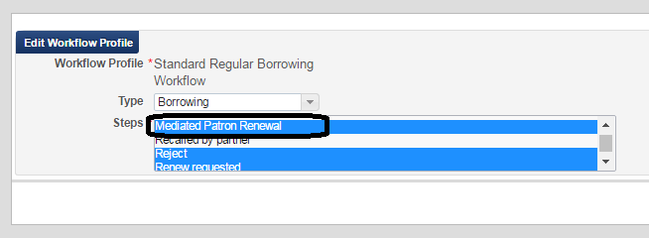
Renewal – Setup Comment
We will demonstrate the following setup :
Borrowing Workflow Profile set to Mediated Patron Renewal on borrower side
Borrowing Workflow Profile set to Manual Renew on lender side

Slide 4
Renewal – Setup Comment
This setup will have the following effect:
Patron will be able to request renewal from Primo
The patron renew request will not activate the renew action. Rather, it will change the borrower request status to Mediated Patron Renewal. Staff will then have to manually send the renew request to the lender.

Slide 5
(1) Patron Requests Renewal

Slide 6
(2) – Borrower Renew Request is Sent to Lender
Request status is changed to Mediated Patron Renewal
Staff can now request the renewal from the lender

Slide 7
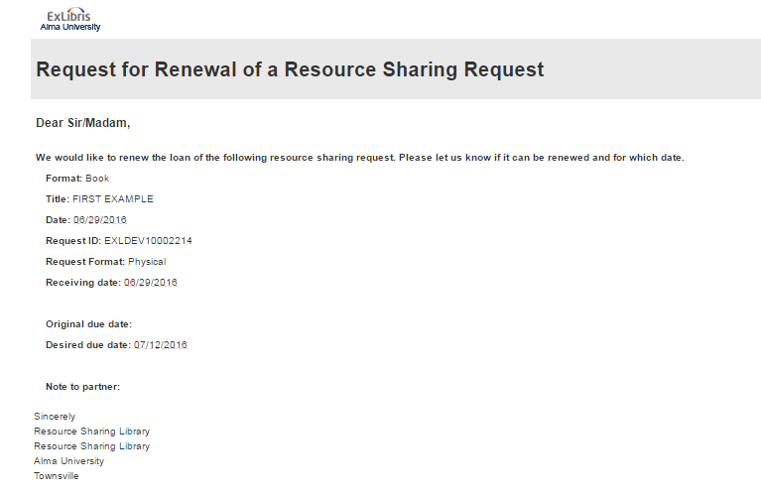
(2) – Borrower Renew Request is Sent to Lender
If the partner is an ISO partner then a renew message is sent.
If the partner is an email partner then a renew email is sent.

Slide 8
Renewal – Setup Comment
We can set the workflow profile so that patron renew request is directly sent to the lender. This is done by setting the lender workflow profile:
Patron Renewal – allows patrons to request from Primo
Staff Renewal – allows staff to request renewal from Alma

Slide 9
(3) – Lender Approves or Rejects the Renew Request
If the request is an ISO request then the lender side request automatically changes status to Renew Requested
Regardless of whether the request is ISO or not, the lender operator users a Renew option to manage the renew request
9
9

Slide 10
(3) – Lender Approves or Rejects the Renew Request
Lender can accept or reject the request
Accepting the renew request automatically updates the due date on the lender side.
If the request is ISO then a message is set to the borrower.

Slide 11
Renewal – Setup Comment
In case of ISO partner, the lender side may be configured to automatically accept all renew requests
There will be no need for lender to accept renew requests
This is done by configuring the borrowing workflow profile on the lender side for ‘Automatic Renew

Slide 12
(4) – Borrower Side Updates Renew Status
If the request is an email request, the borrower has to manually update the renew
If the request is ISO then update is automatic

Slide 13
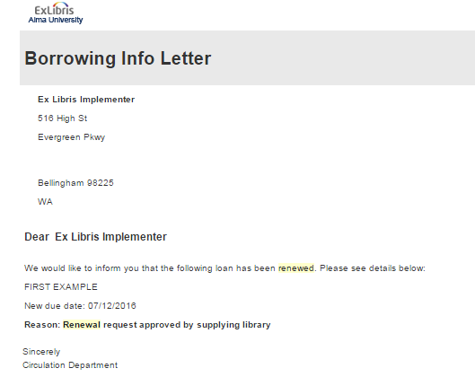
(4) – Borrower Side Updates Renew Status
In either case, the following happen automatically when the renew is updated on the borrower side:
Loan due date is updated
Borrower request due date is updated
Notification is sent to the lender

Slide 14
Thank You
Moshe.shechter@exlibrisgroup.com

