Slide 1
New “replace string” parameter for fix_doc_do_file_08
Version 21 rep_ver #017548
Yoel Kortick

Slide 2
Agenda
Introduction
Configuration
Example
Notes:
Unlike our competitors, we did not release a new revolutionized system every few years but rather took the evolutionary approach

Slide 3
Introduction
Purpose of Enhancement:
The difference between this new operation code and the existing REPLACE-STRING operation code is that REPLACE-STRING is hardcoded to use the comma character as a delimiter between the source string and the target string.
Thus it was not possible to use the REPLACE-STRING operation to replace a comma with something else.
The new operation code will give the library the option to choose the delimiter type.
Notes:
Unlike our competitors, we did not release a new revolutionized system every few years but rather took the evolutionary approach

Slide 4
Introduction
Description:
A new operation code - "REPLACE-STRING-GENERAL" - has been added to the set of operation codes available for the "fix_doc_do_file_08" fix program.
This operation code will give the library the option to replace a string in a document field with another string.
Notes:
Unlike our competitors, we did not release a new revolutionized system every few years but rather took the evolutionary approach

Slide 5
Agenda
Introduction
Configuration
Example
Notes:
Unlike our competitors, we did not release a new revolutionized system every few years but rather took the evolutionary approach

Slide 6
Configuration
For example, in the following setup the text Yoel, will be replaced with Yoel; in field 900
The delimiter is a dollar
! 2 3 4 5 6 7 8 9
!-!!!!!-!!-!-!!!-!!!-!!!!!-!!!!!!!!!!!!!!!!!!!!!!!!!!!!!!-!!!!!!!!!!!!
1 900## REPLACE-STRING-GENERAL $Yoel,$Yoel;
The first position in column 9 determines what the delimiter will be. In this case it is a dollar.
Notes:
Unlike our competitors, we did not release a new revolutionized system every few years but rather took the evolutionary approach

Slide 7
Configuration
Here is the $data_tab/import/ file
yoelk@il-aleph07(a21_1) USM01> tail -1 $data_tab/import/comma_to_semic
1 900## REPLACE-STRING-GENERAL $Yoel,$Yoel;
yoelk@il-aleph07(a21_1) USM01>
Here is the $data_tab/ file
yoelk@il-aleph07(a21_1) USM01> grep COMMA $data_tab/tab_fix
COMMA fix_doc_do_file_08 comma_to_semic
yoelk@il-aleph07(a20_3) USM01>
Here is the $data_root/pc_tab/catalog/ file
yoelk@il-aleph07(a21_1) USM01> grep COMMA $data_root/pc_tab/catalog/fix_doc.eng
COMMA N L Change Yoel, to Yoel; in 900
yoelk@il-aleph07(a21_1) USM01>
Notes:
Unlike our competitors, we did not release a new revolutionized system every few years but rather took the evolutionary approach

Slide 8
Agenda
Introduction
Configuration
Example
Notes:
Unlike our competitors, we did not release a new revolutionized system every few years but rather took the evolutionary approach

Slide 9
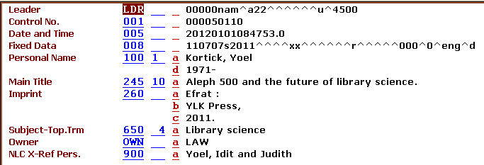
Example
Here is our sample record with 900 field which includes “Yoel,”
Notes:
Unlike our competitors, we did not release a new revolutionized system every few years but rather took the evolutionary approach

Slide 10
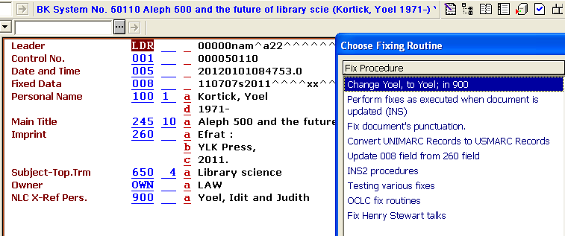
Example
Now we run the fix procedure which we built which uses the new REPLACE-STRING-GENERAL
Notes:
Unlike our competitors, we did not release a new revolutionized system every few years but rather took the evolutionary approach

Slide 11
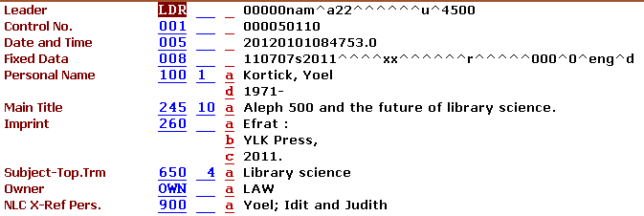
Example
The change has been made
the text Yoel, has been replaced with Yoel; in field 900
Notes:
Unlike our competitors, we did not release a new revolutionized system every few years but rather took the evolutionary approach

Slide 12
Yoel.Kortick@exlibrisgroup.com

